Slide 1
Unit 3
There is No Place Like Home
Writing
Mega Goal 2.2
Done by: Entisar Al-Obaidallah

Slide 2

Lesson Goals
01
AnalyzeD
02
Describe
the text to main elements.
Some unusual houses correctly
03
Complete
04
Write
Complete house parts description.
a descriptive essay about a house.

Slide 3
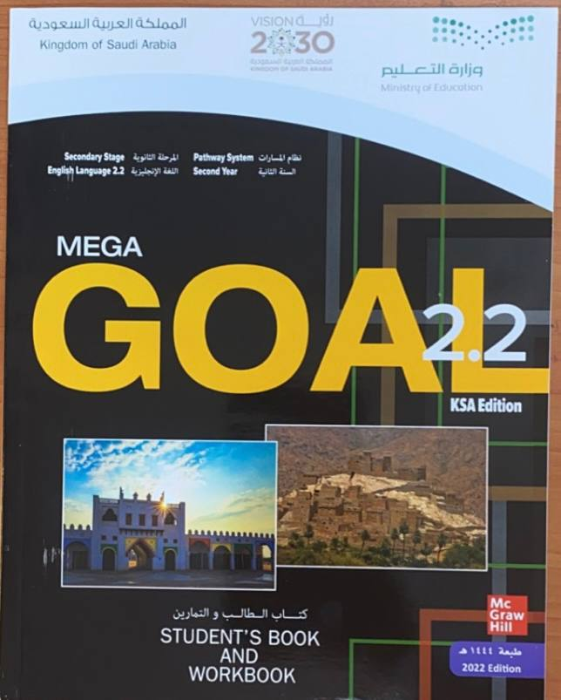
Book Open
Page ( 38 )

Slide 4
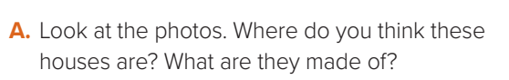
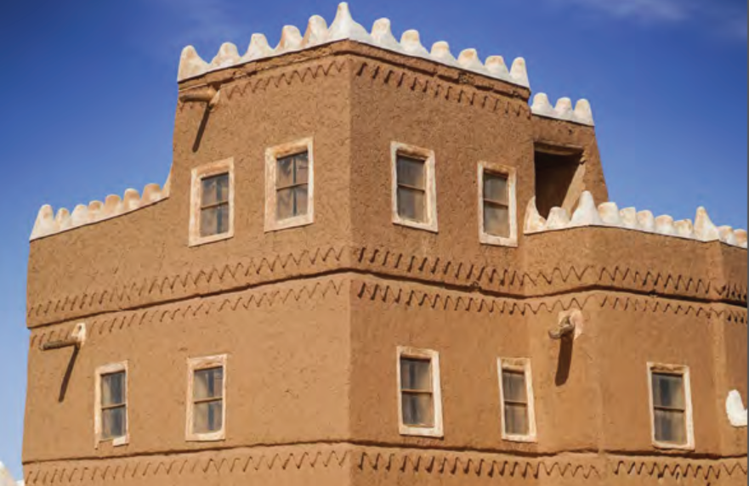
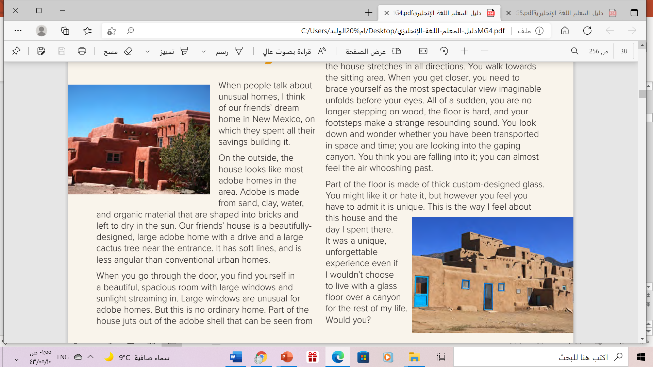

Slide 5
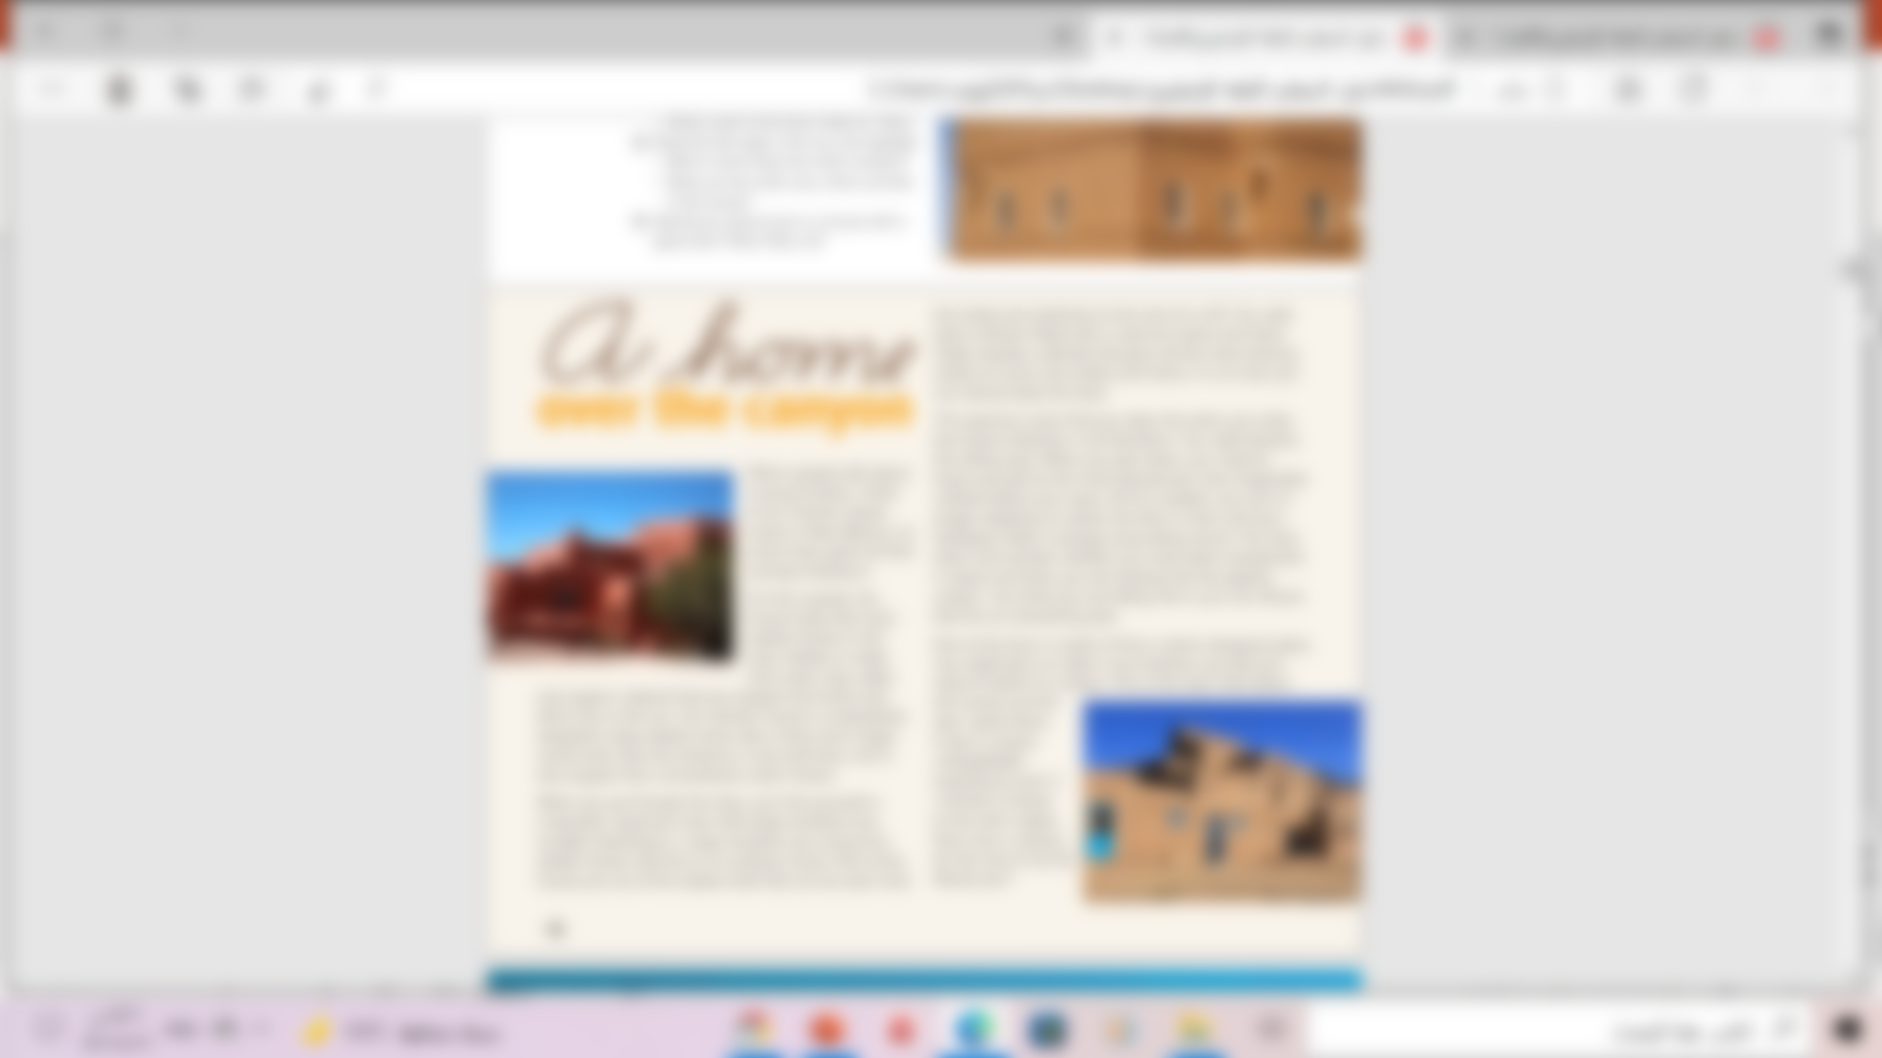

Read as long you listen

Slide 6

What is the title of the text?
How many paragraphs are there?
4
1
2
5
3

Slide 7
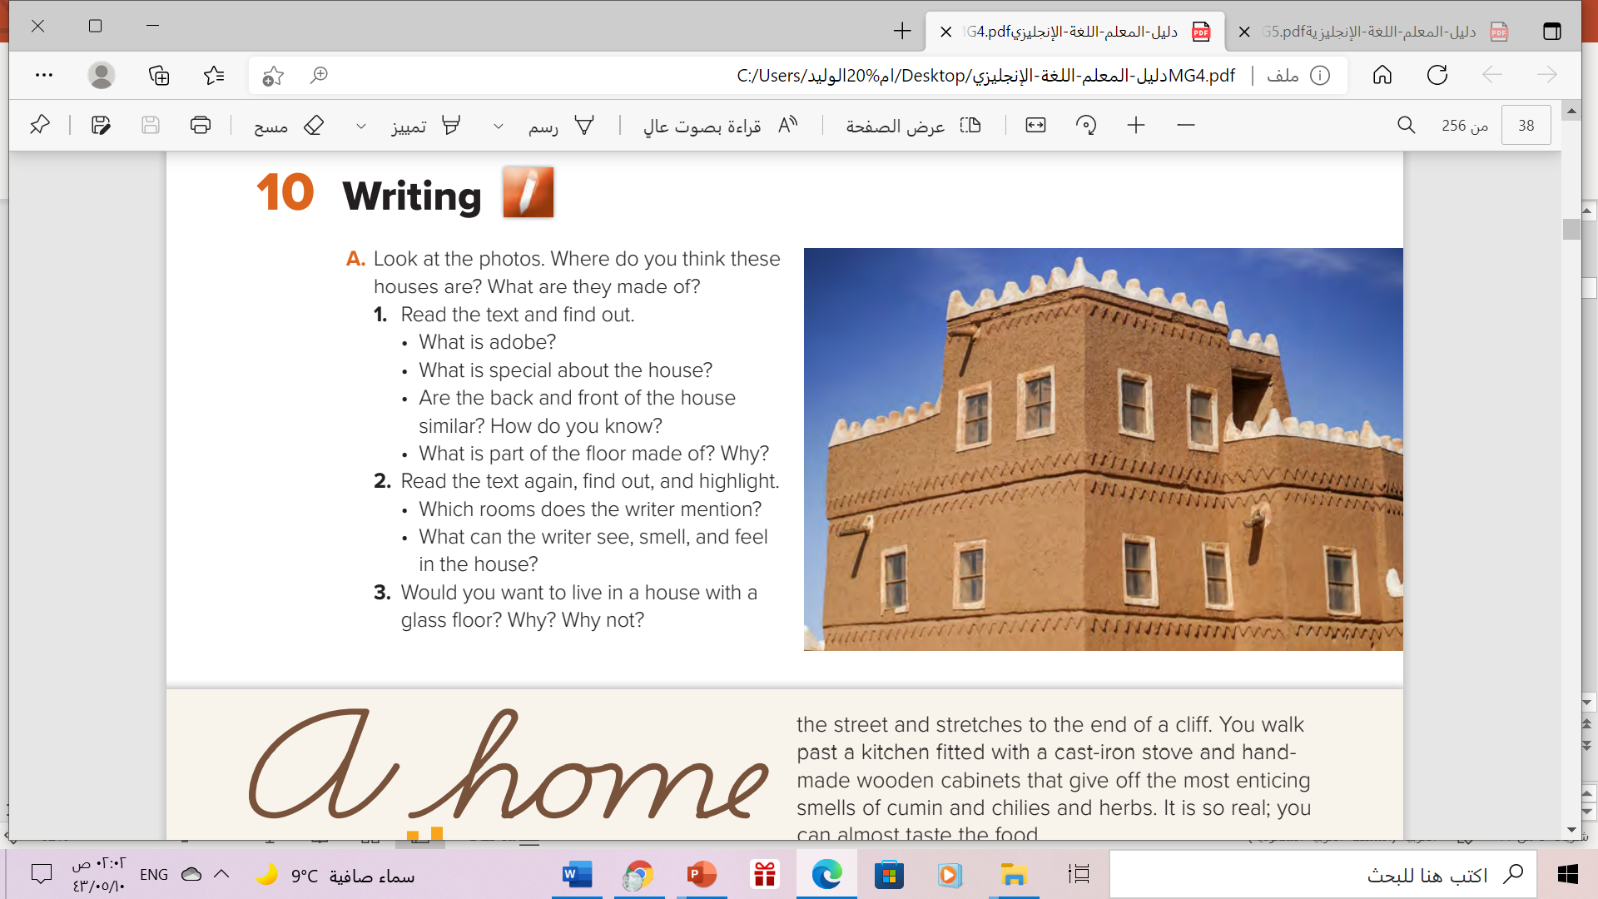
Adobe is building material that is made from sand, clay, water and organic material that is shaped into bricks and left to dry in the sun.
It’s a beautifully designed, large adobe home with soft lines./Part of the house juts out of the adobe shell and stretches to the end of a cliff.
No, they aren’t. The front of the house that can be seen from the street is that of a large adobe home with a drive and a cactus tree at the entrance.
The back of the house has large windows and stretches to the end of the cliff.( first 5
lines of paragraph 2)
Part of the floor is made of thick custom-designed glass to allow a unique view of the canyon below.

Slide 8
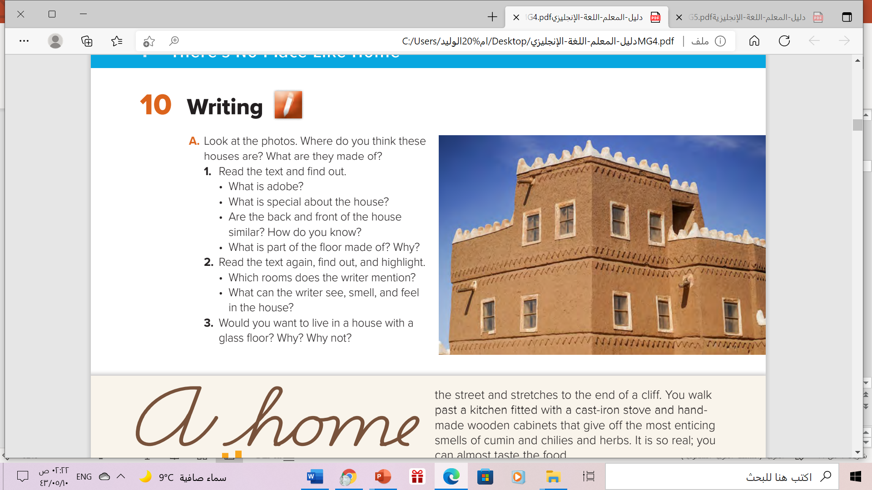
•A spacious room that stretches in all directions and the kitchen.
• He can see: the door, large windows, sunlight streaming in, the street, the cliff, the kitchen, the wooden cabinets, the sitting area, a spectacular view, the gaping canyon
He can smell: the most enticing smells of cumin , chilies and herbs.
He can feel: the hard floor, the air whooshing past (he imagines this)

Slide 9
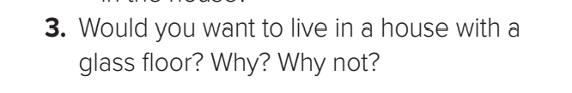
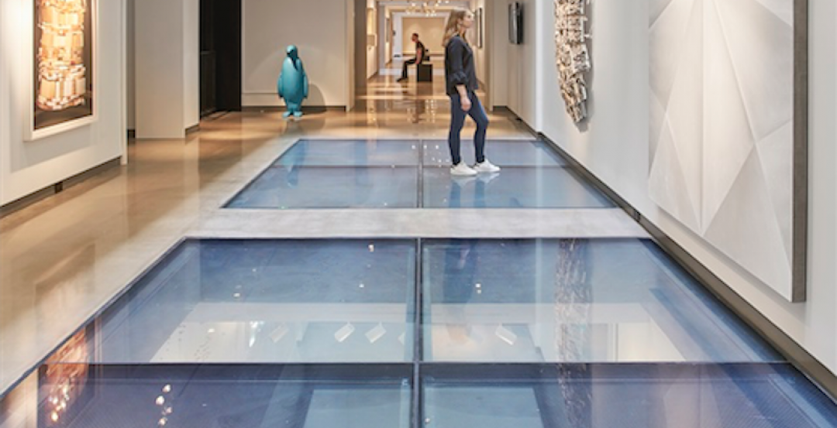

Slide 10
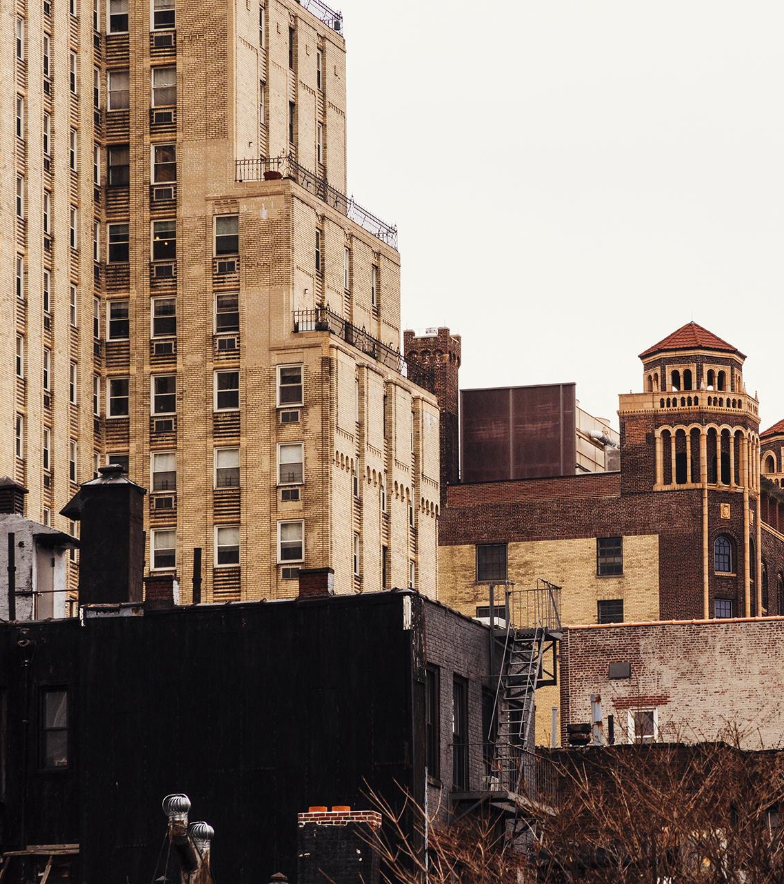
Book Open
Page ( 39 )

Slide 11
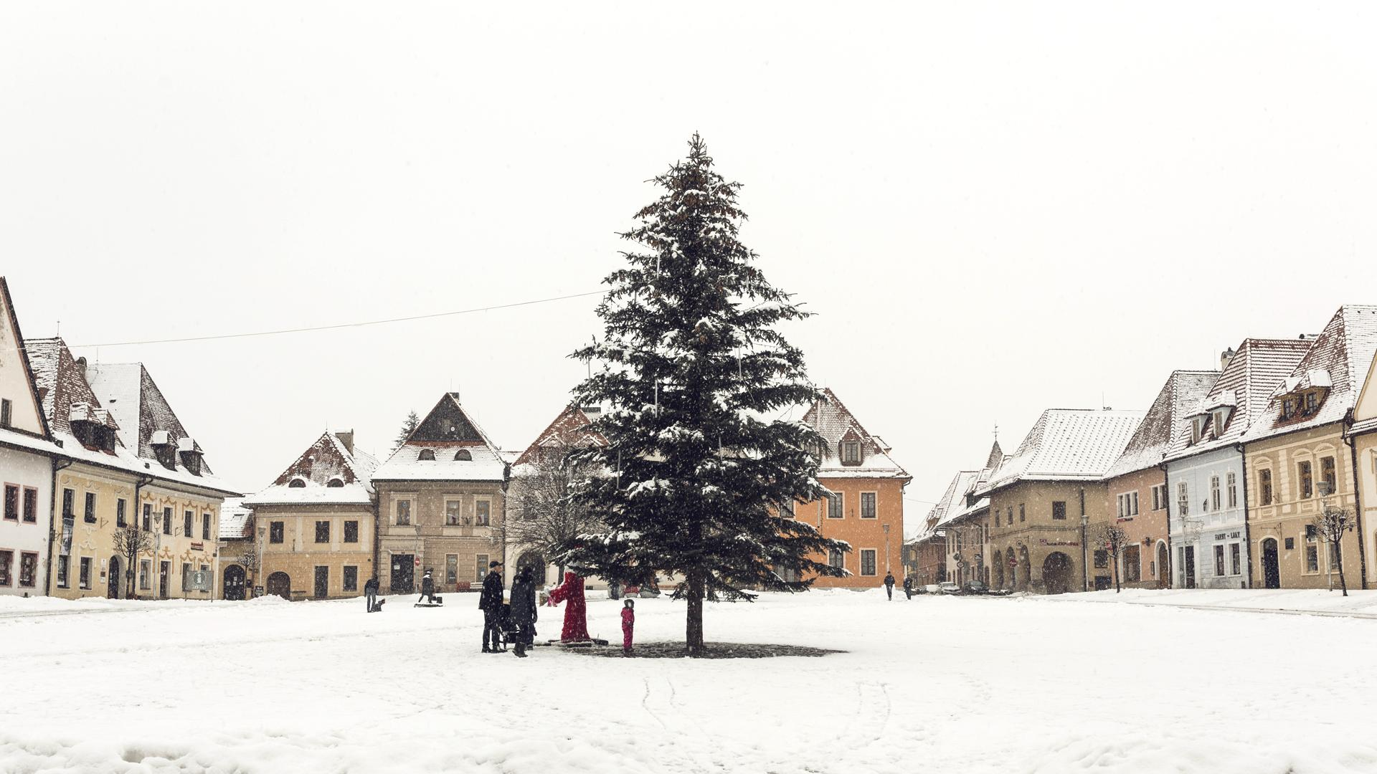
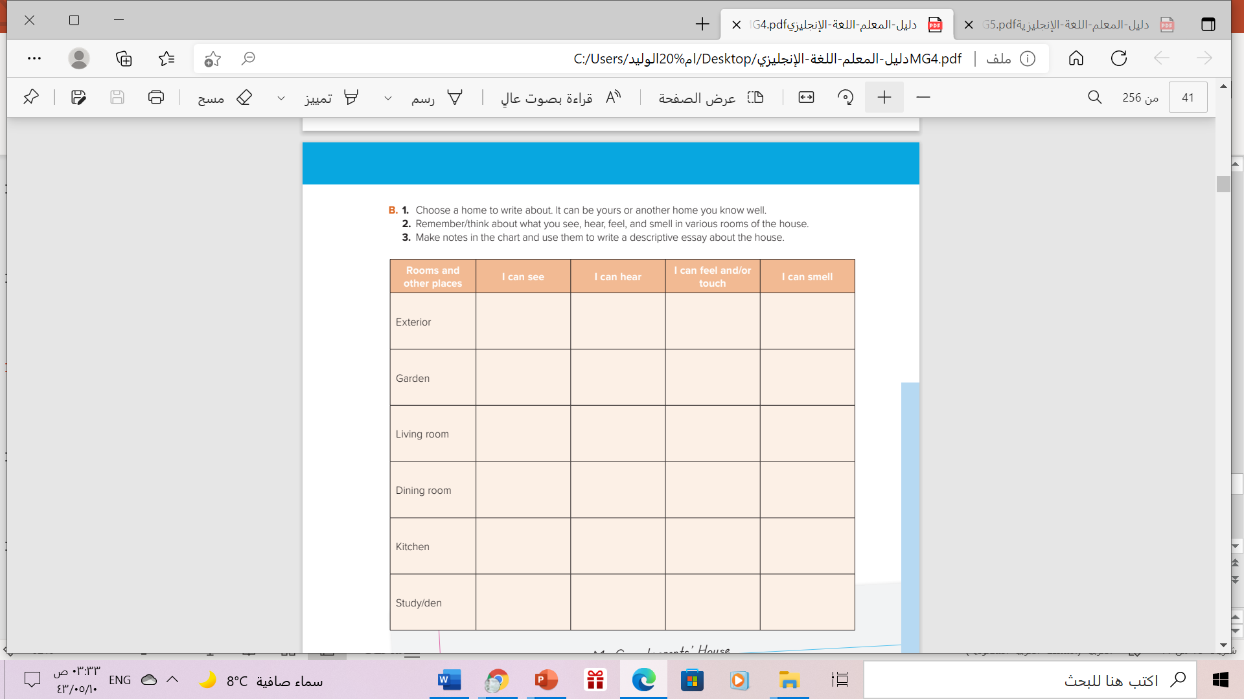

Slide 12
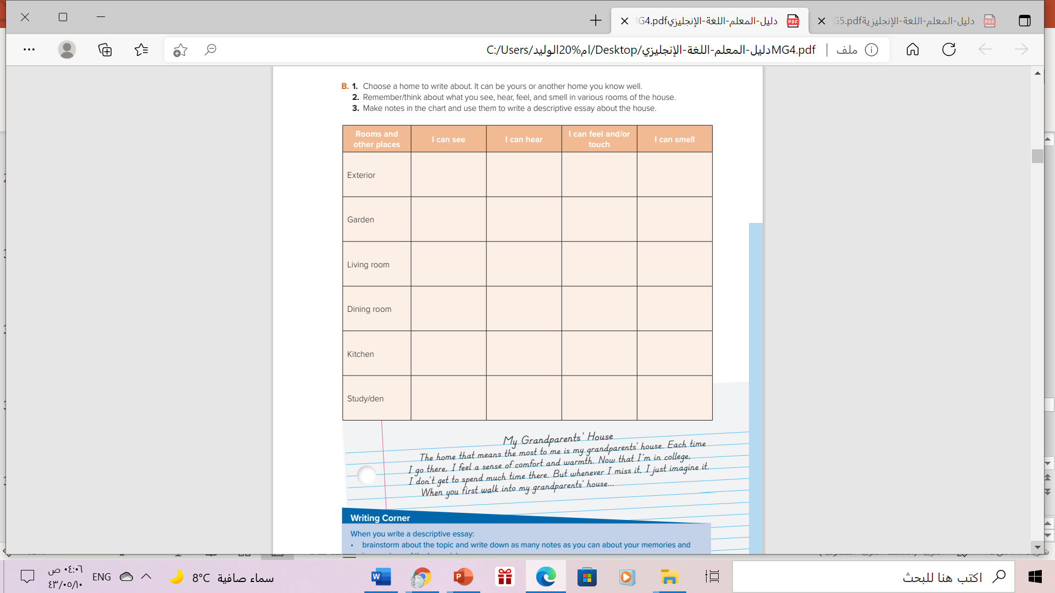

Use the notes in the chart to write a descriptive essay about the house

Slide 13

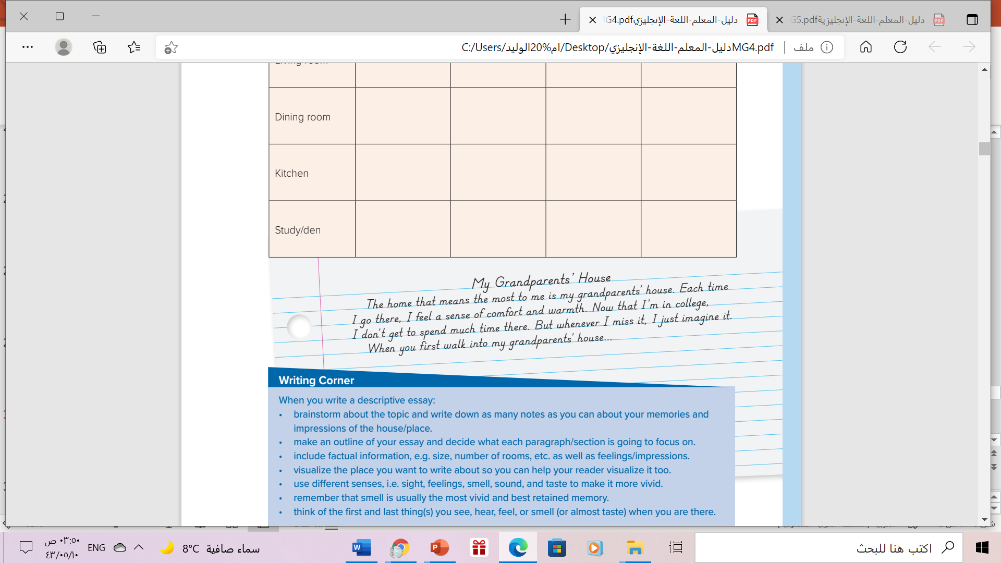
Example of descriptive essay

Slide 14
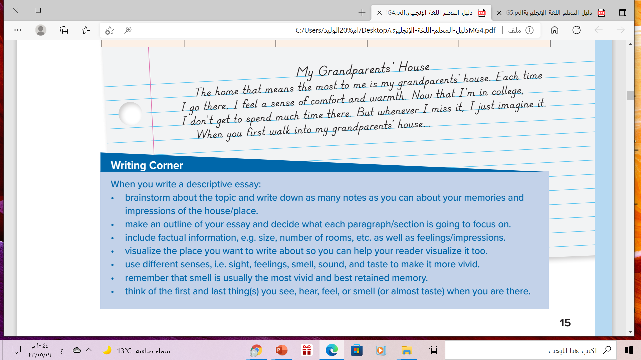
Follow these steps to write a descriptive essay

Slide 15
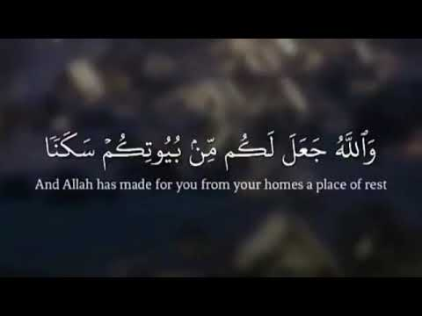

Remember

Slide 16
Home work
Workbook pahe ( 103 ), exercise ( L)

Slide 17

Thanks!

