Slide 1




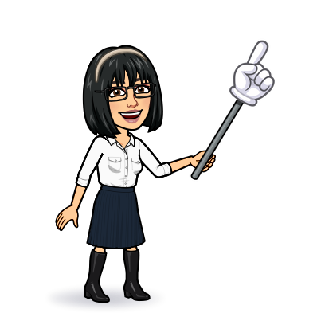

3 grammar
11form, meaning & function
Today:
Date:
- -
Page 90 - 95
By: Dalal Al-Juaid

Slide 2


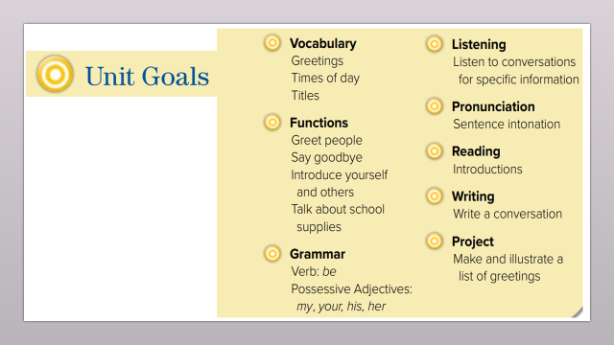
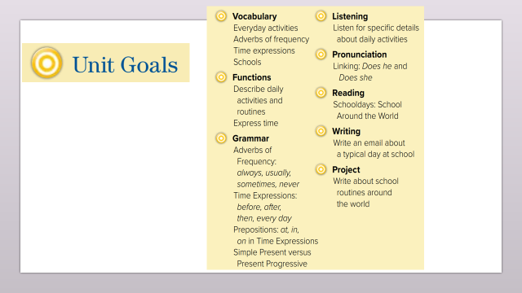
Use adverbs of frequency correctly in sentences
Apply time expressions
Warm up
Use prepositions (at-in-on) with time expressions
Use present simple Vs present progressive

Slide 3
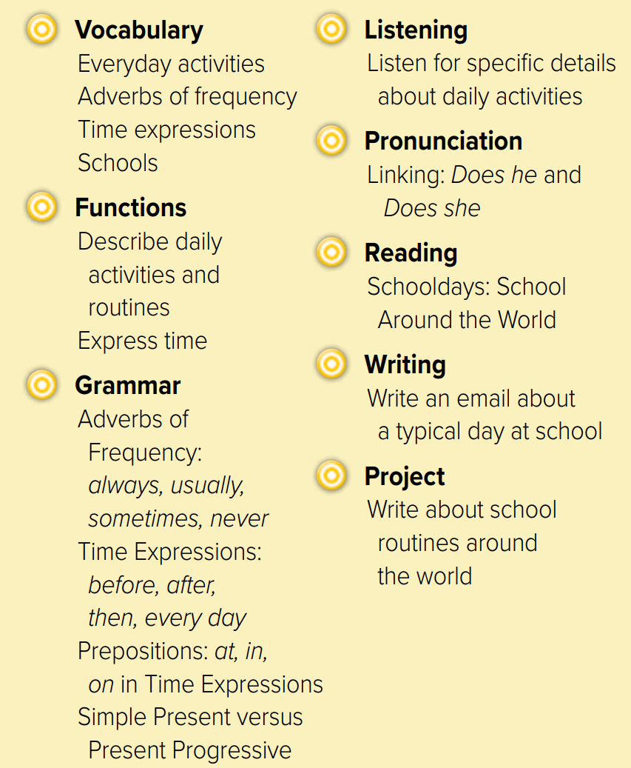
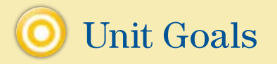

Slide 4


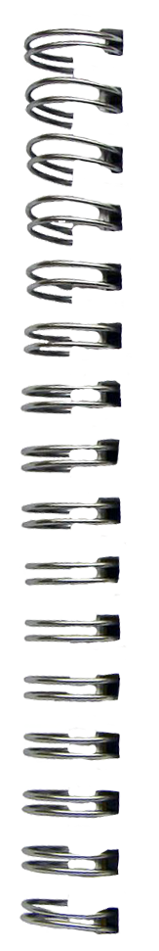

Revision
…..
…..
…..
….
100%
80%
50%
I go to school …………
….
#
late

Slide 5
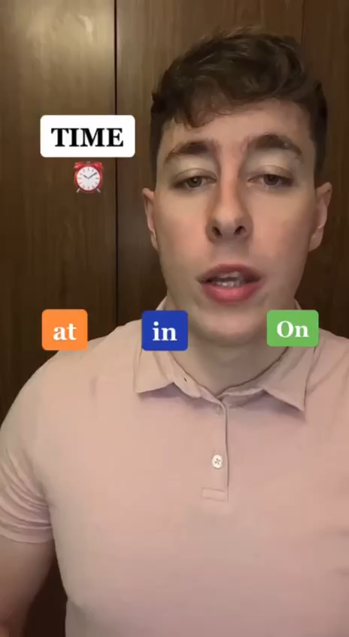
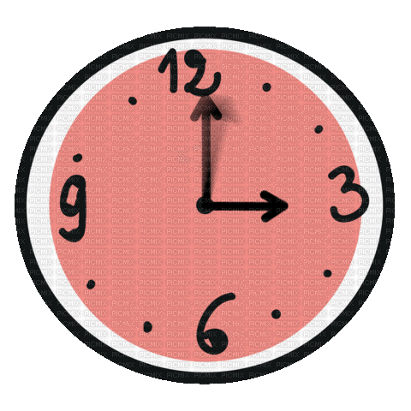



Warm up

Slide 6
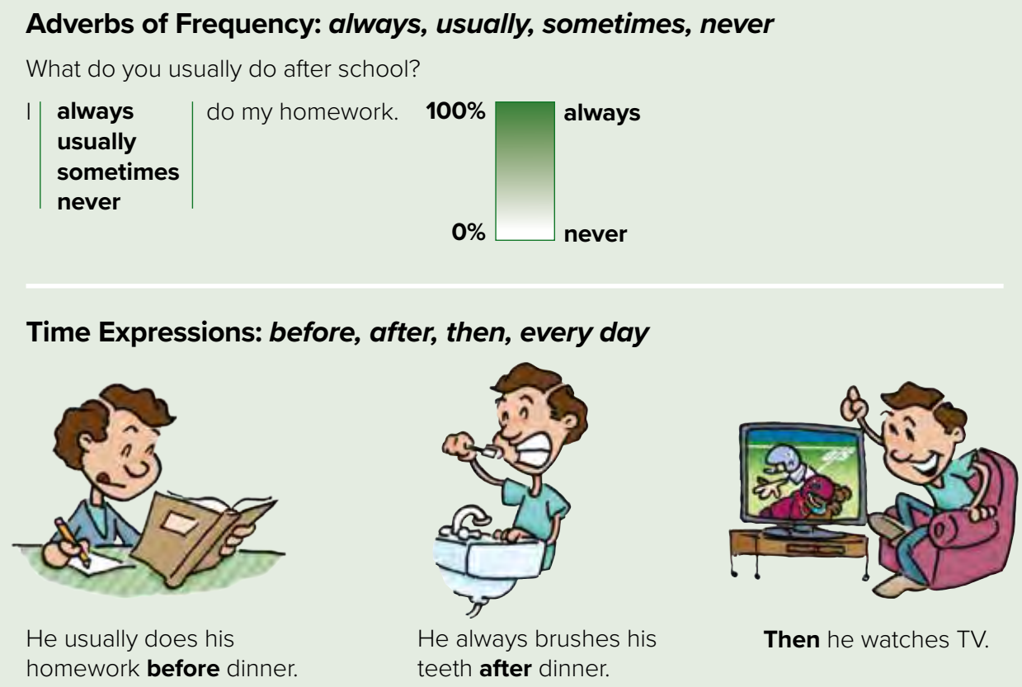

Page 90
Before V
What do you usually have before this class?
Warm up

Slide 7
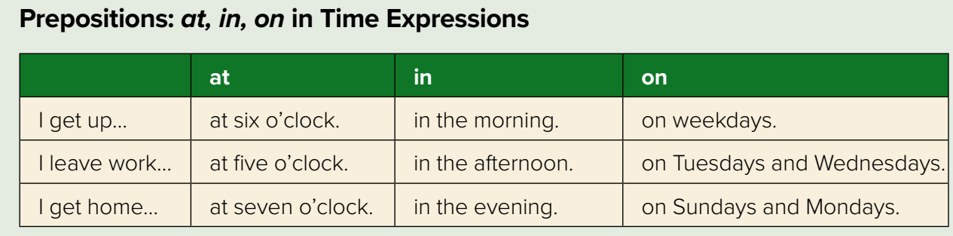

Page 90
Time (9:00)
Part of the day
days
Warm up
Months
Days
on
I go to the supermarket ______ Saturday,
School starts ______ September
in

Slide 8
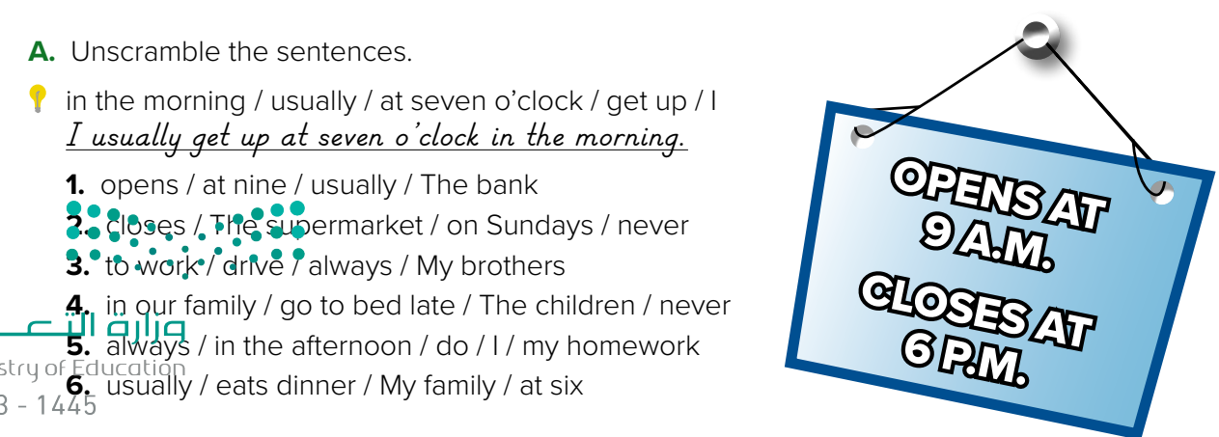

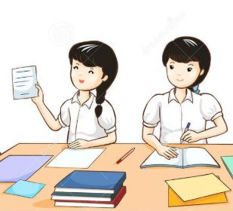

Page 90
Warm up
The bank usually opens at nine.
The supermarket never closes on Sundays.
My brothers always drive to work.
The children in our family never go to bed late.
I always do my homework in the afternoon.
My family usually eats dinner at six.
Think pair share

Slide 9
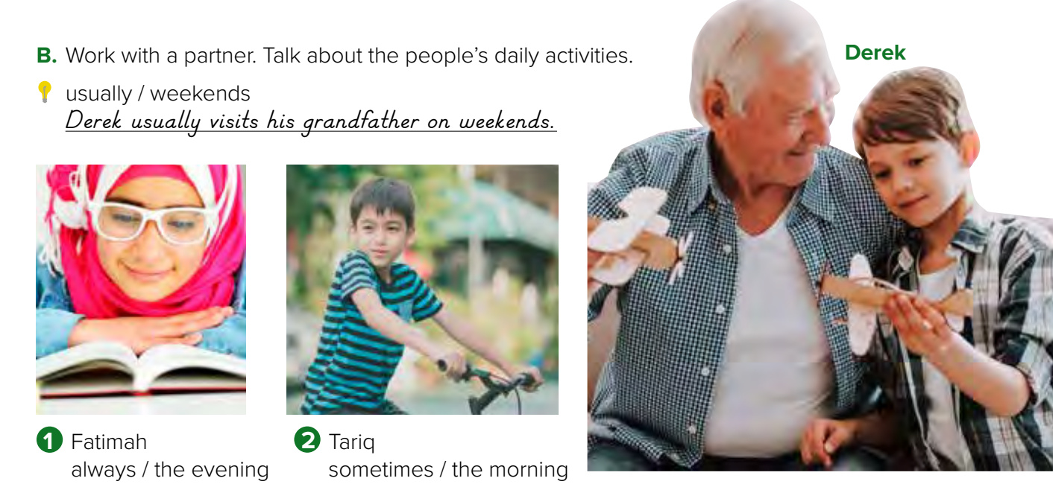
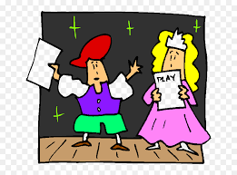
Page 91
Role paly
Warm up
1. Fatimah always studies (reads) in the evening.
2. Tariq sometimes cycles (rides his bike) in the morning

Slide 10
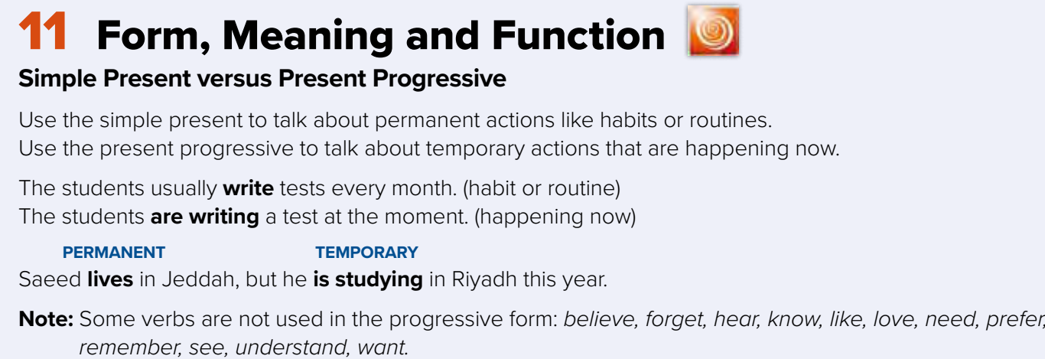

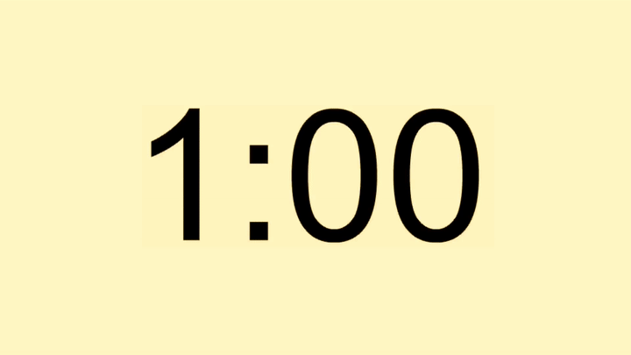
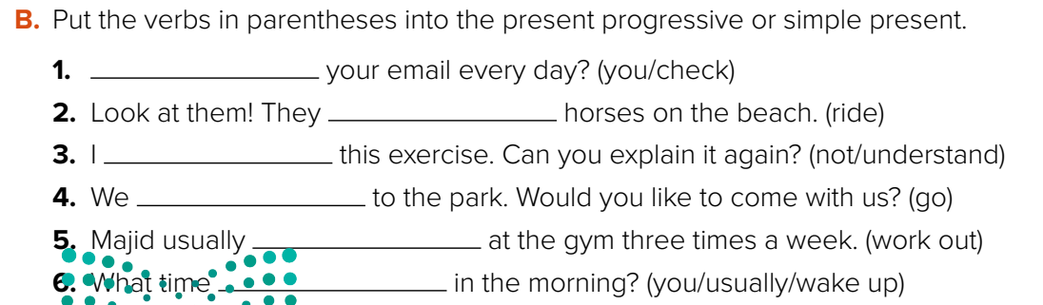
Page 95
Warm up
Do you check
are riding
don’t understand
are going
works out
do you usually wake up

Slide 11

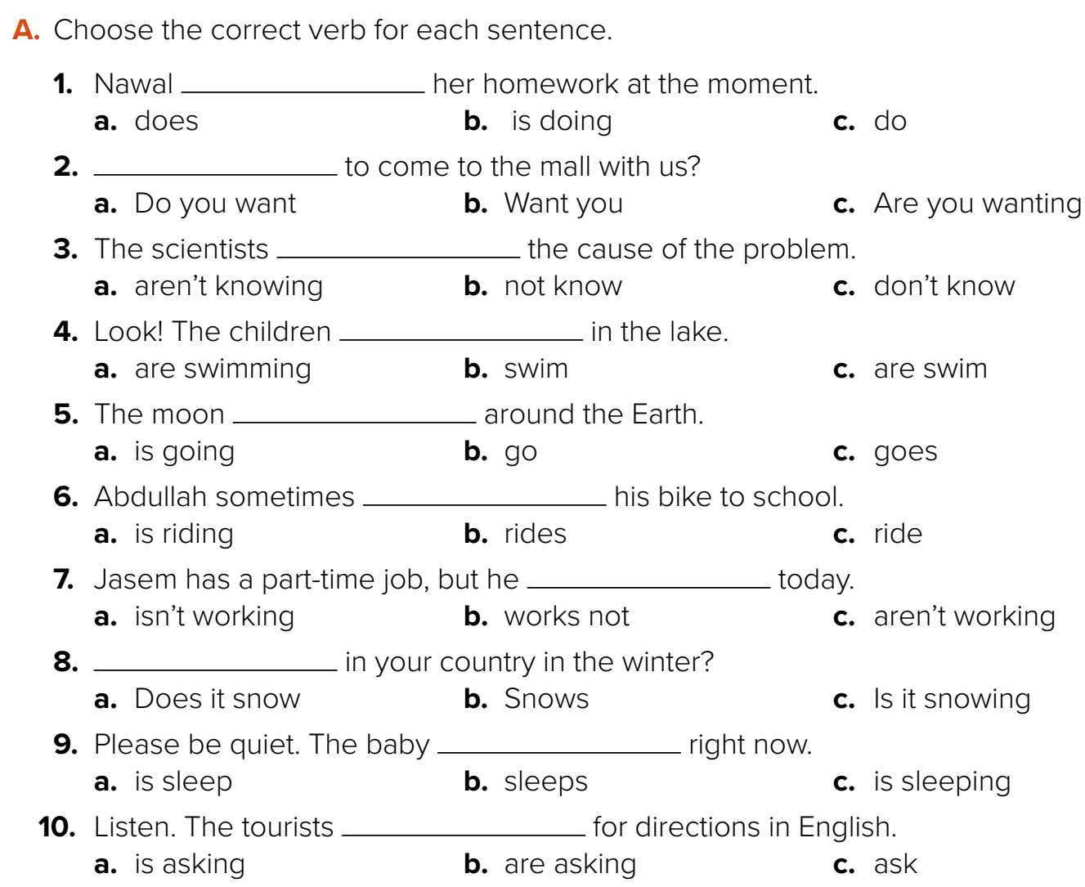










Talk about activities in Saudi Arabia ?
Warm up

Slide 12



Lets play

Slide 13





page 230 Ex(B-C-D)
for practice grammar
Warm up

Slide 14
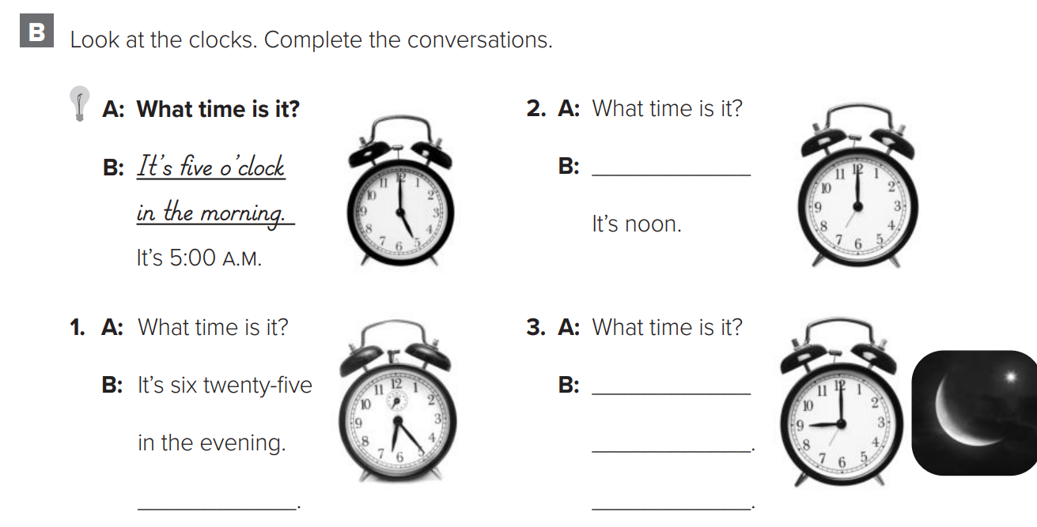
p.230
It’s twelve o’clock
It’s nine o’clock at night.
It’s 9:00 P.M.
Warm up
It’s 6:25 P.M.

Slide 15
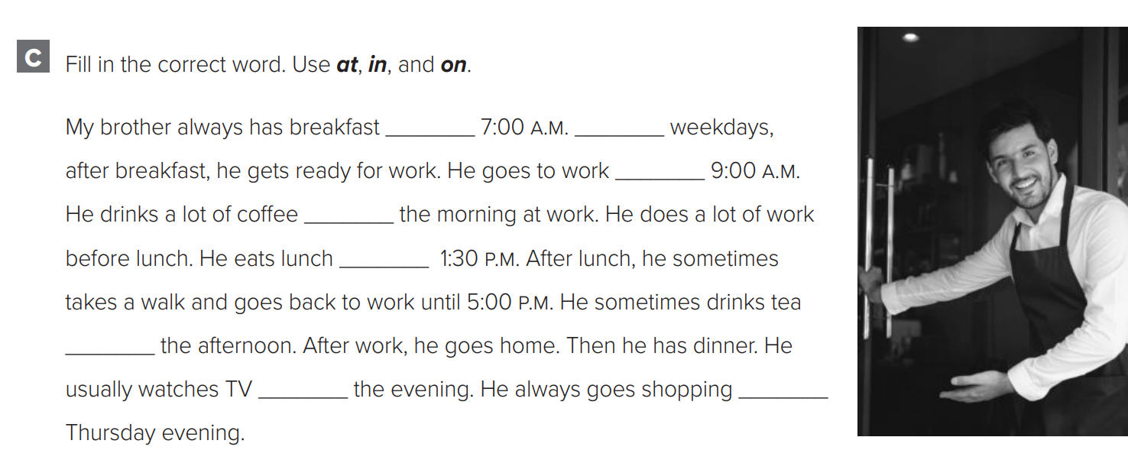
p.230
at
on
at
in
at
Warm up
in
in
on

Slide 16
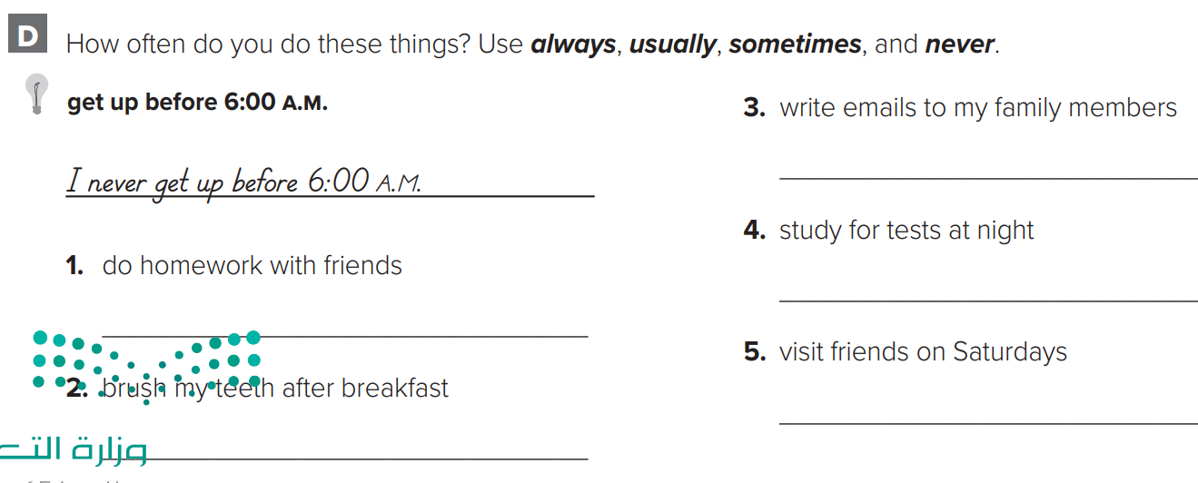
p.230
I sometimes write emails.
I always study for test at night
I never do homework with friends
Warm up
I usually visit friends on Saturdays
I always brush my teeth after breakfast

