Slide 1






9 writing
10 project
11 form, meaning & function
Today:
Date:
- -
Page 78
By: Dalal Al-Juaid

Slide 2


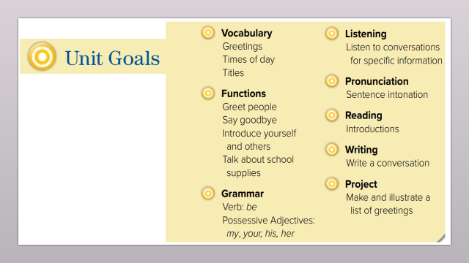
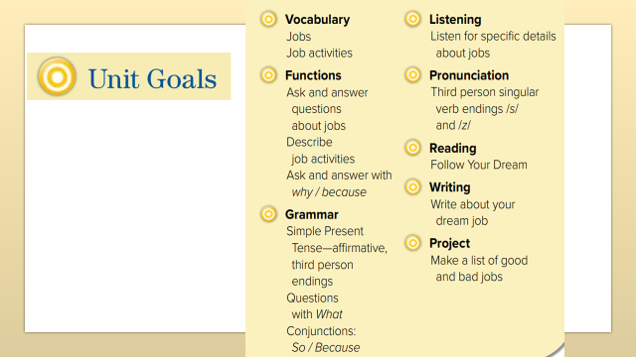
Use the question word (Why) to ask about reasons and explanations
complete sentences with so or because
Warm up
write about dream job

Slide 3
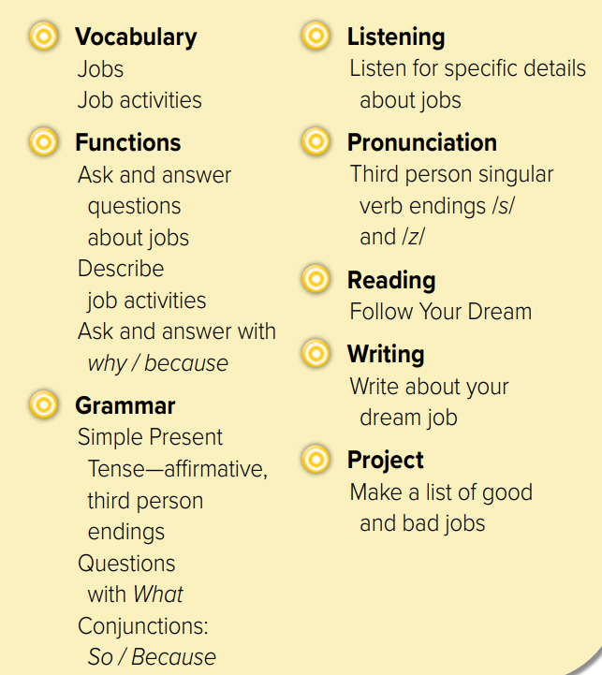
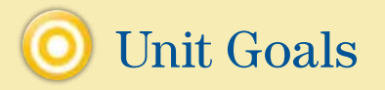

Slide 4
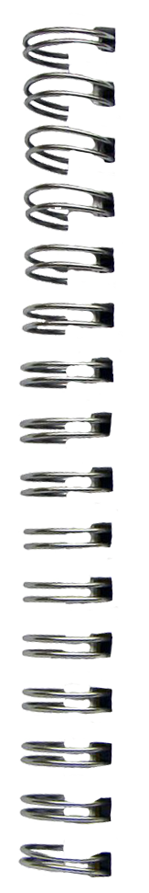

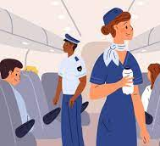




Revision
design clothes : ………
takes photo: ………
We read a book
She
reads a book
….
…..
….
……

Slide 5




Warm up

Slide 6
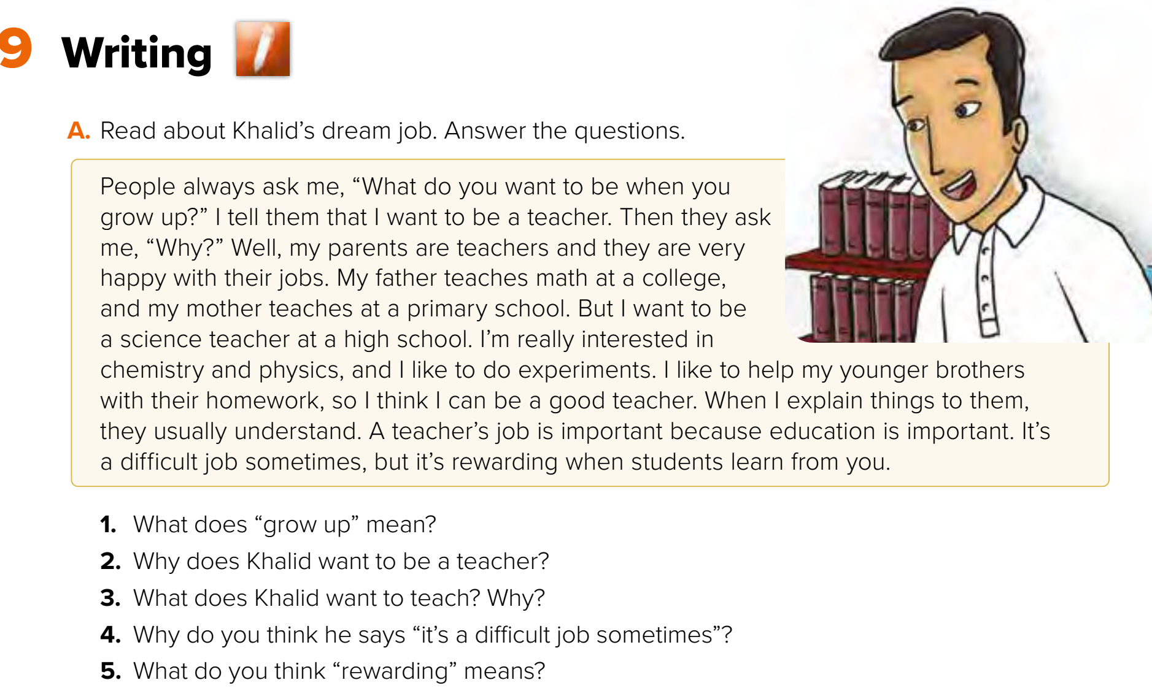



Page 78
What’s his dream job?
Think pair share
Warm up
become an adult
His parents are teachers
Science. Because he likes chemistry & physics
Satisfying - pleasing
H.W

Slide 7
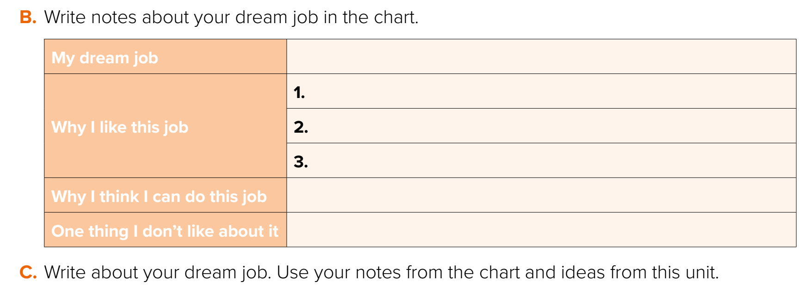

Page 78
doctor
Warm up
Talk in groups
H.W

Slide 8
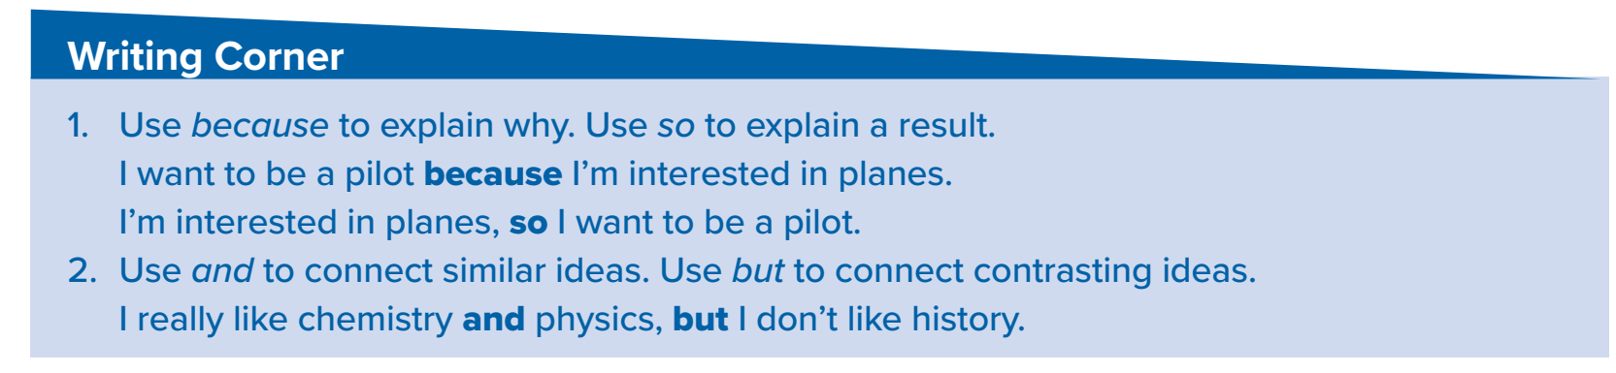
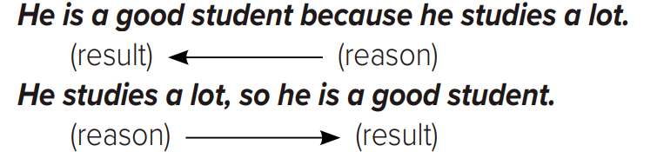











Warm up
H.W

Slide 9
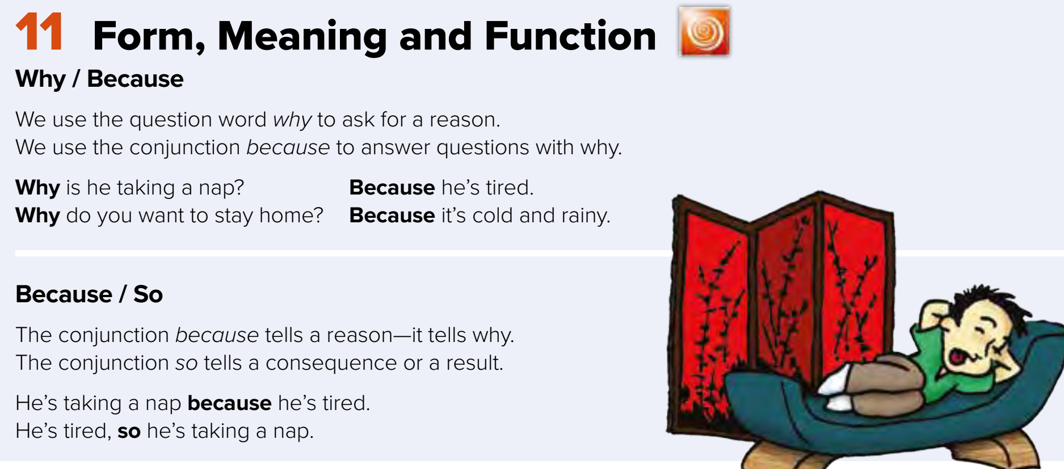
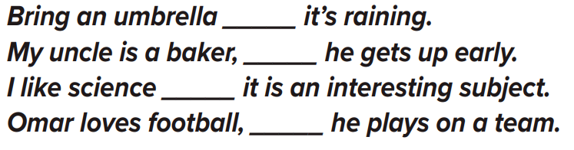















Page 79
Warm up
H.W

Slide 10

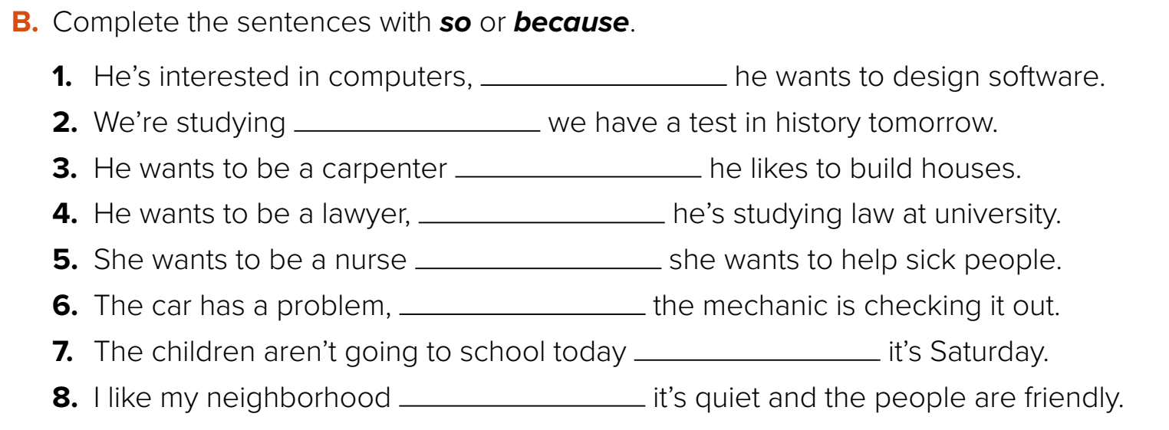
so
becuase
because
so
because
so
because
because
Warm up
Think pair share
H.W

Slide 11
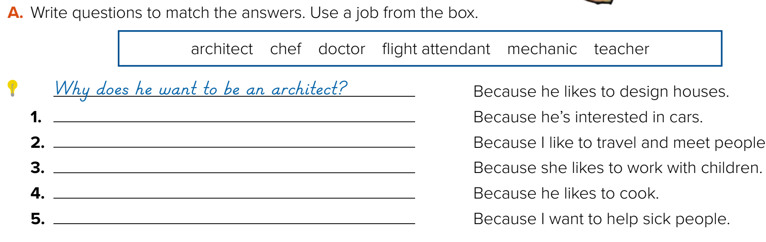

Why does he want to be a mechanic?
Why do you want to be a flight attendant?
Why does she want to be a teacher?
Why does he want to be a chef?
Why do you want to be a doctor?
Warm up
Why you have to keep your country from bad jobs?
H.W

Slide 12


Write in your notebook
Like final test أسئلة للاختبار النهائي
Choose:
Mmmmmmm ………. mmmmmmm
( ssss – ssss – sssss)
Make a question
Lets play

Slide 13





page 224 Ex(F)
for practice writing
Warm up
H.W

Slide 14
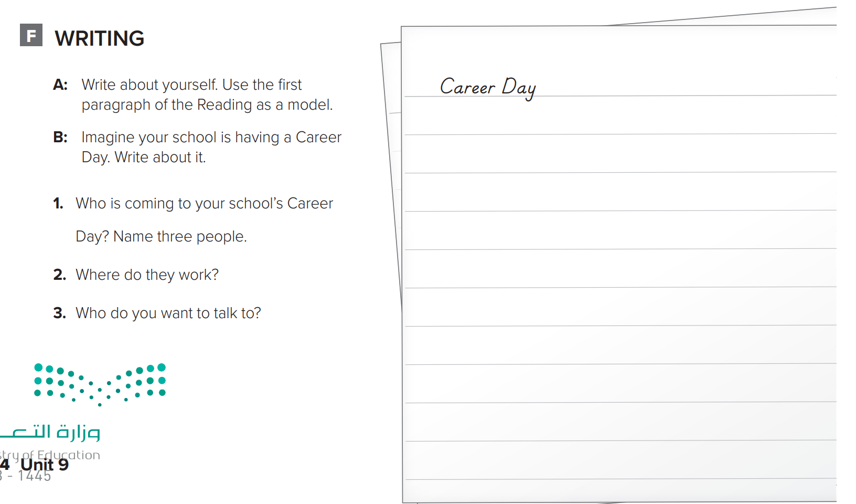
p.224
My school is having a Career Day. A lot of professionals are coming to school on that day. A chef is coming. A reporter and a designer are coming. The chef works at Roma’s Italian Restaurant. The reporter works at the TV station. The designer works for a computer company. I want to talk to the chef and the reporter.
Warm up
H.W

