Slide 1
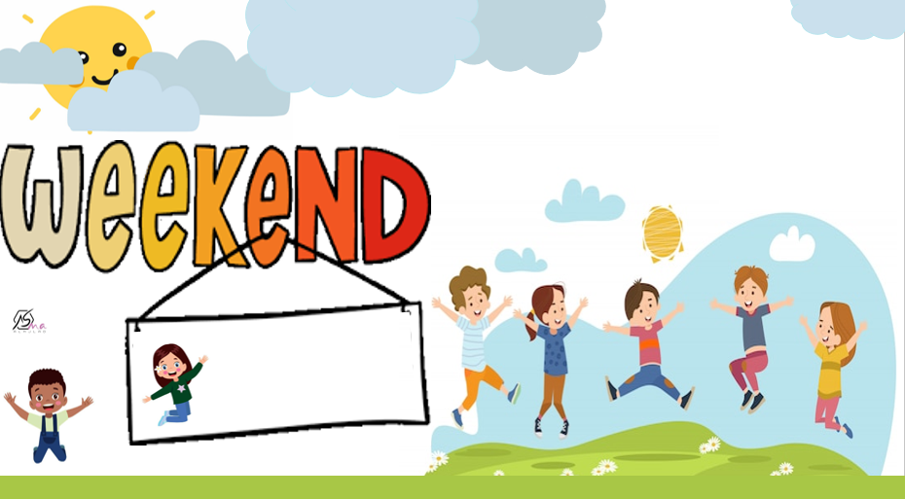

Reading and Writing
Fun on the

Slide 2
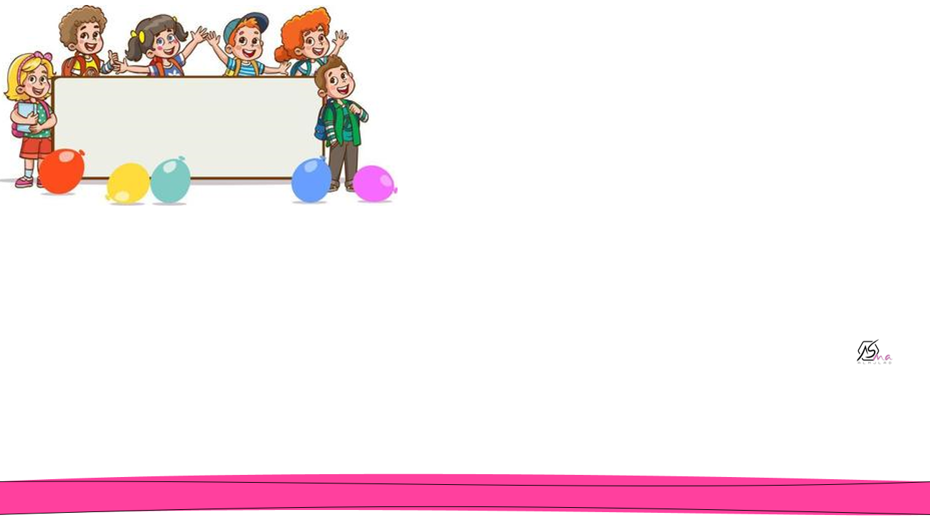

Objectives
Use How much and How many correctly.
Tell the main differences between countable and non-countable nouns.
Differentiate between the usage od “some” and “any”

Slide 3

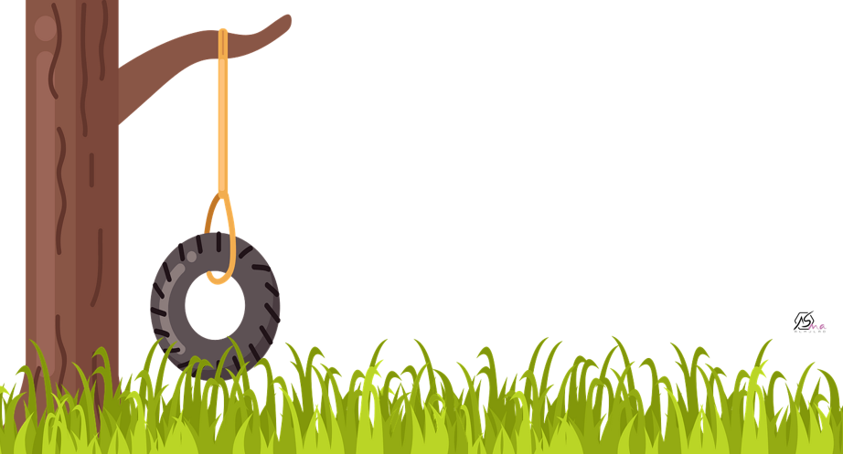
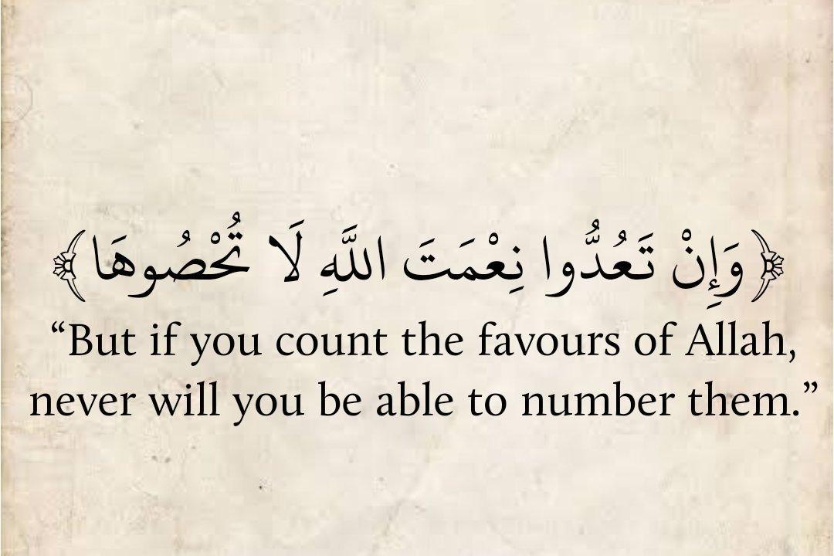

Slide 4
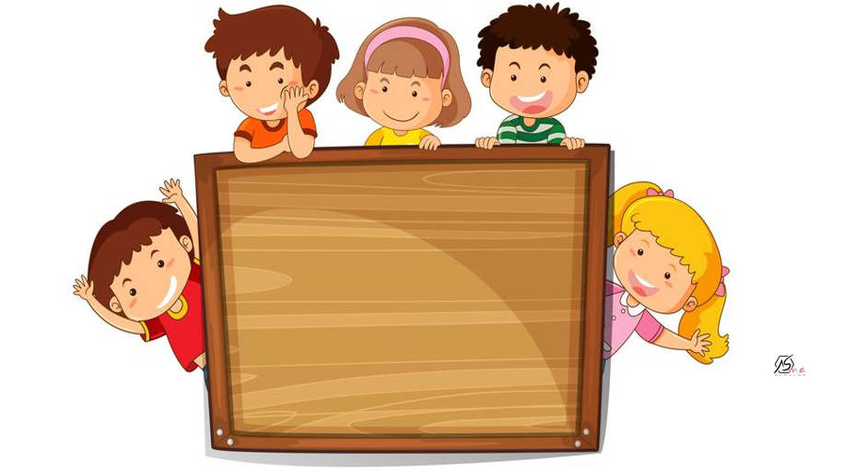


Slide 5
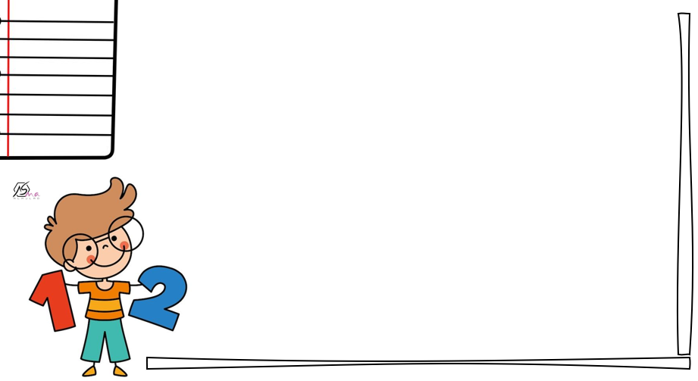
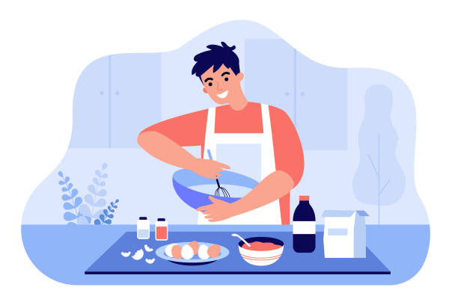
What can you see?
eggs
flour
What does he do?
oil

Slide 6

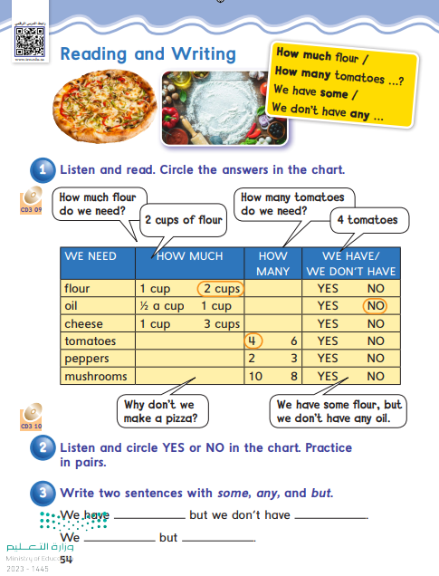
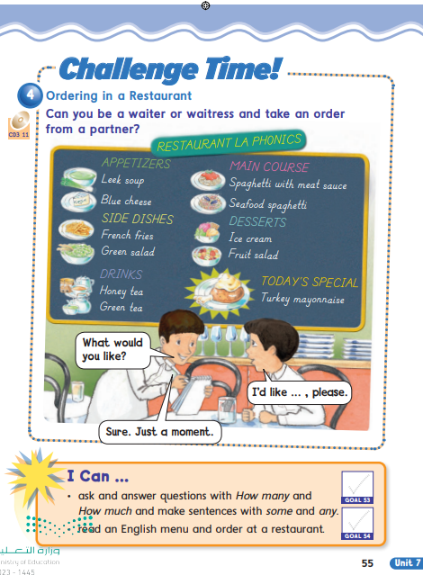

Slide 7
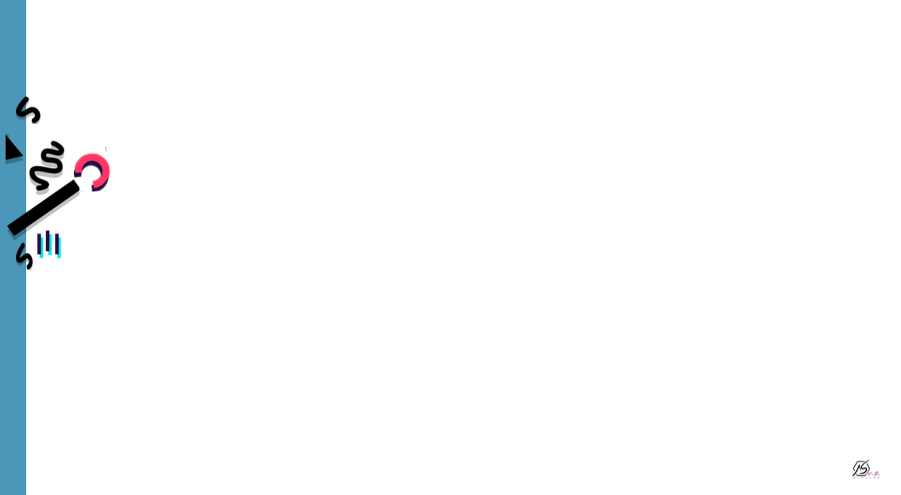


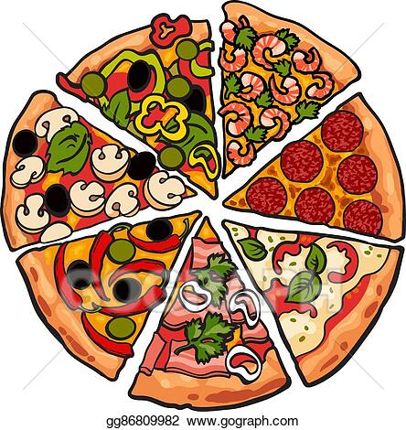
Italian dish
Round
Tomatoes
Cheese

Slide 8

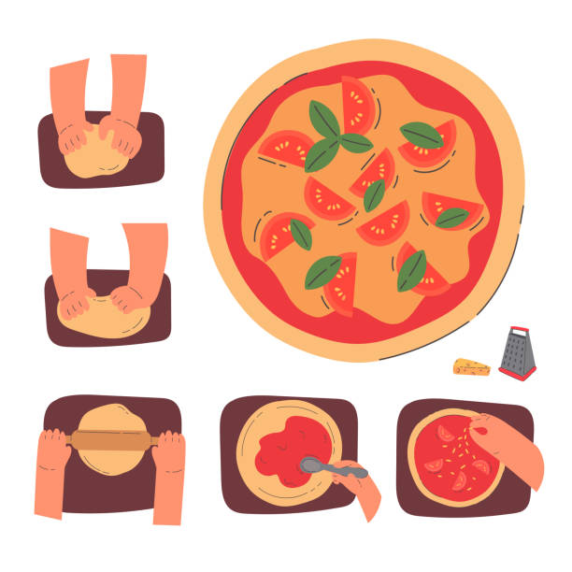
What is he making?
tomato
What can you see?
Tomato sauce
Cheese

Slide 9
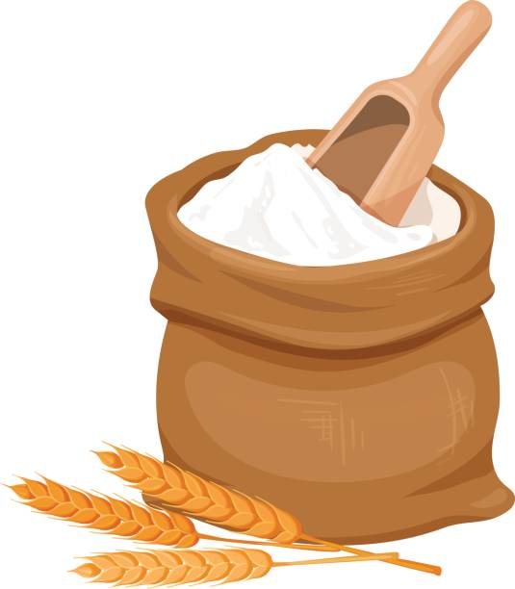
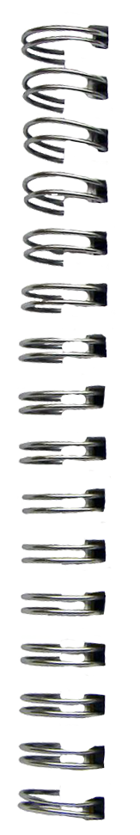
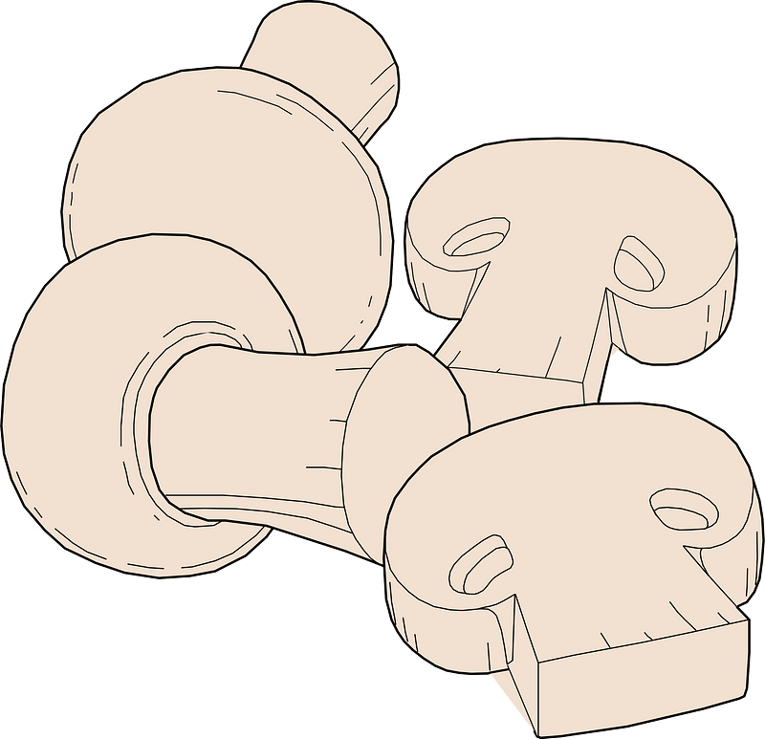
Flour
Mushrooms

Slide 10



peppers
Tomatoes

Slide 11


Cheese
Oil

Slide 12
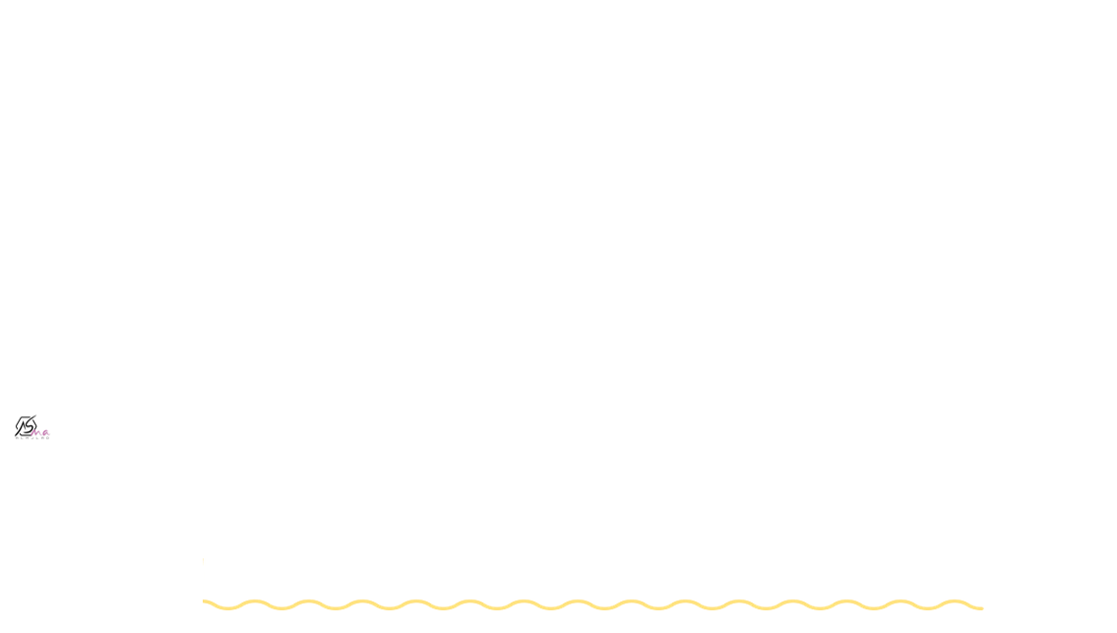
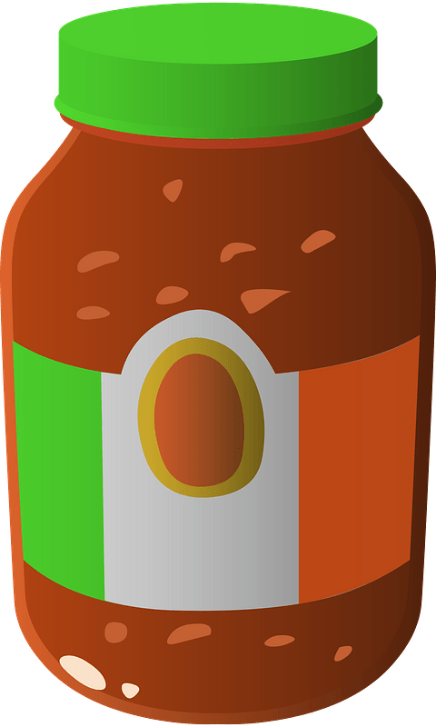


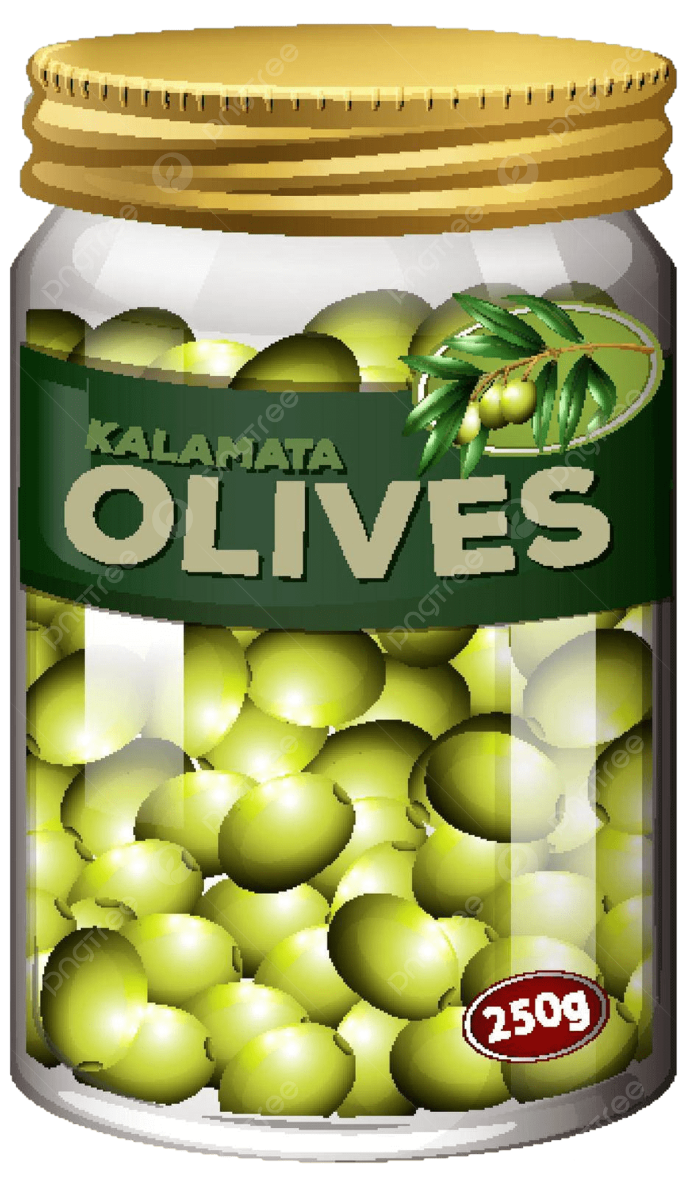
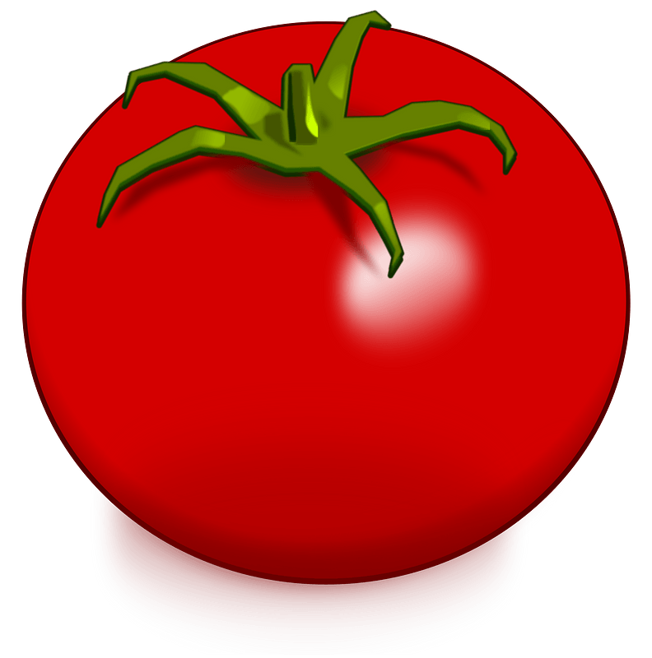
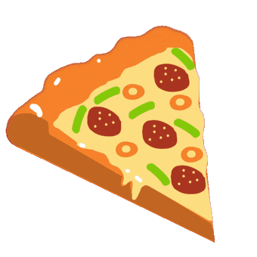
To make pizza , we need :

Slide 13

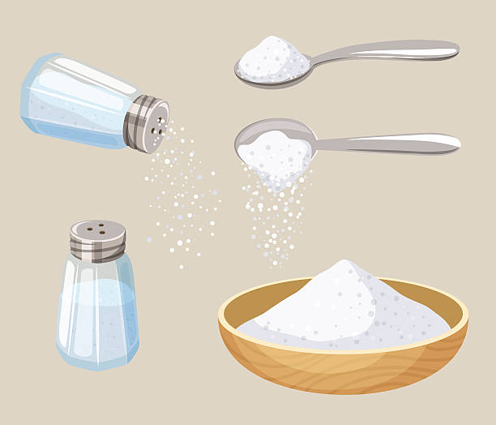


Is it easy to count it?
What about water?
can you count salt?
It’s liquid
Salt
uncountable nouns

Slide 14

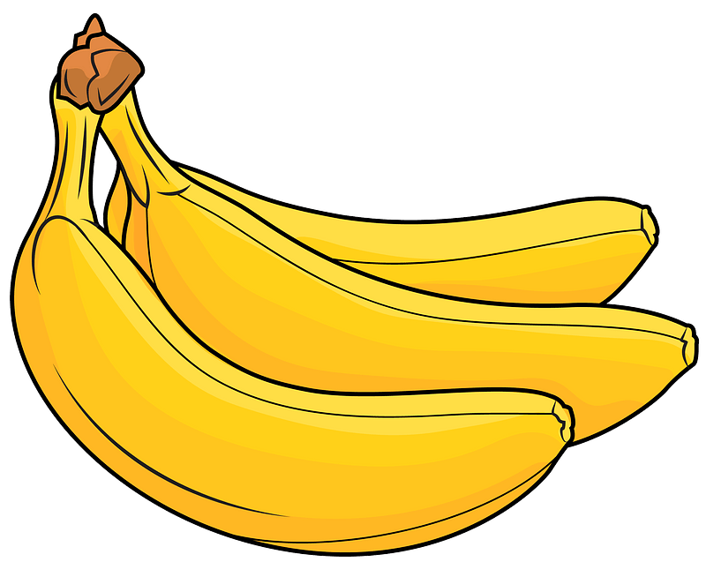

How many bananas do you have?
can you count bananas ?
What about tomatoes ?
Bananas
Countable nouns

Slide 15

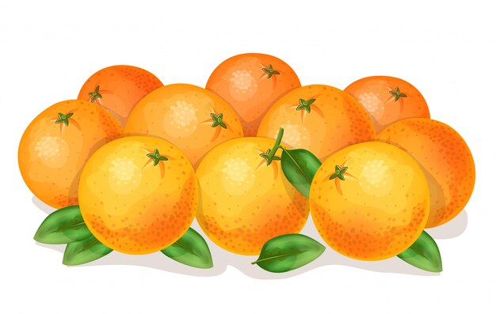
How many oranges do you have?

Slide 16
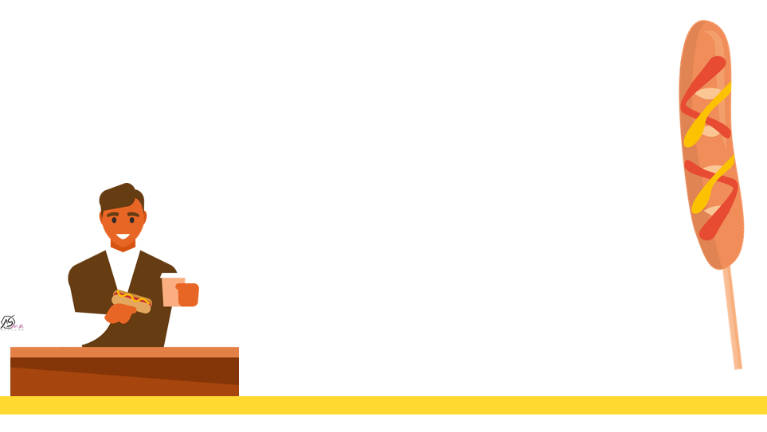
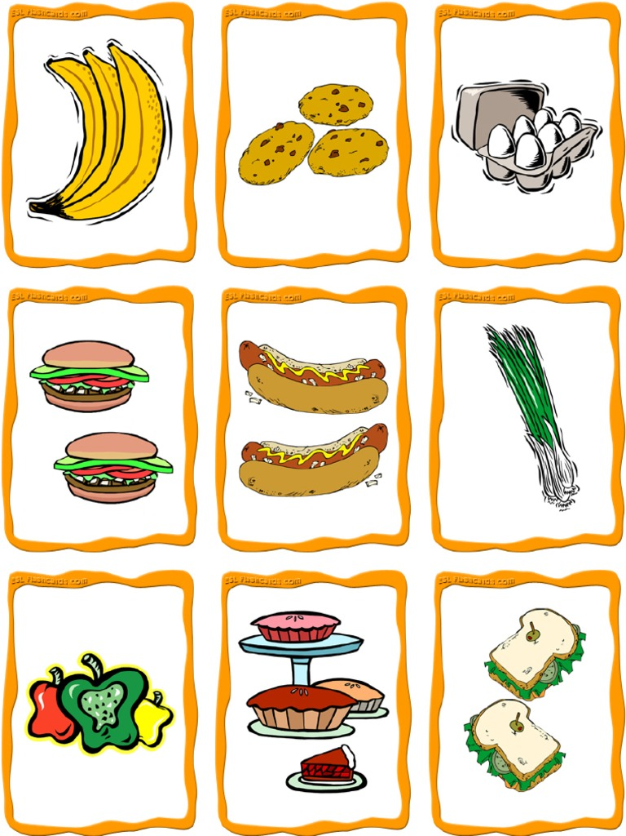
The plural…

Slide 17

How much flour do you have?

Slide 18
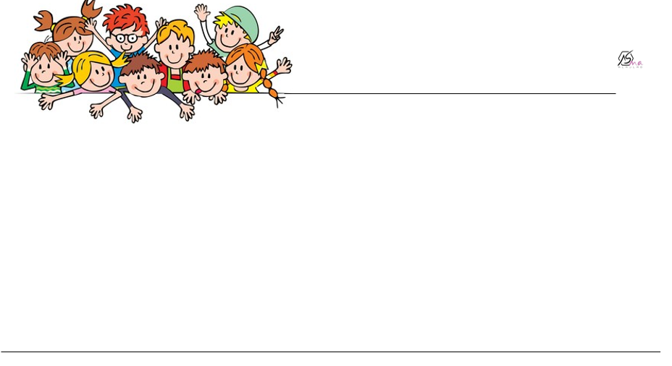
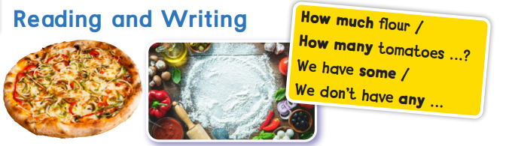

Slide 19
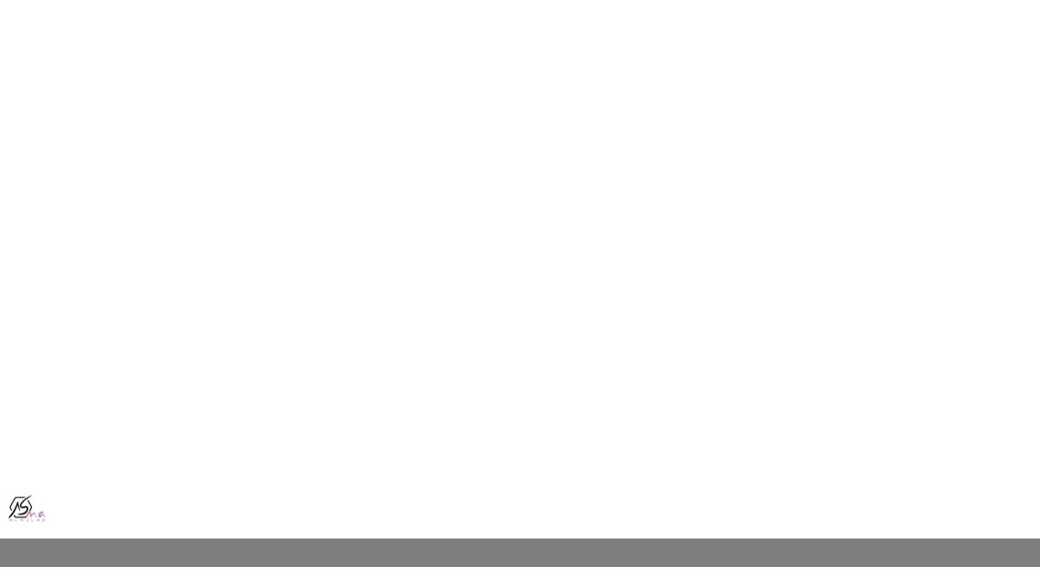
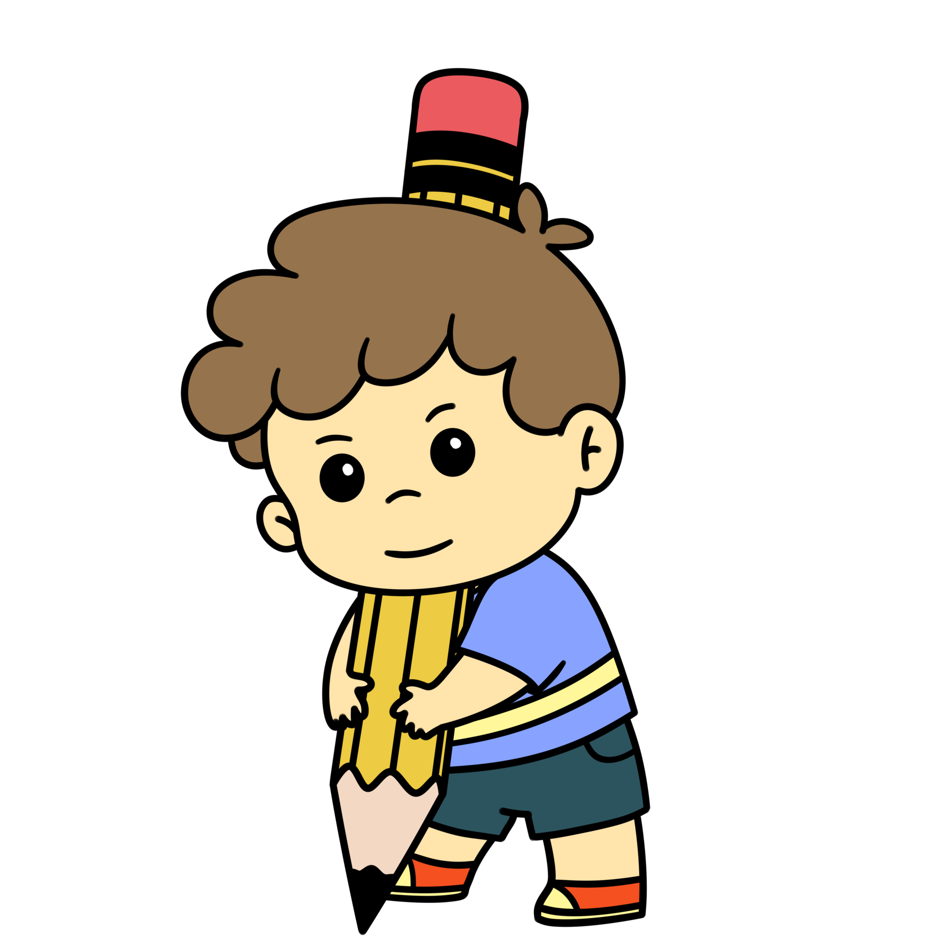
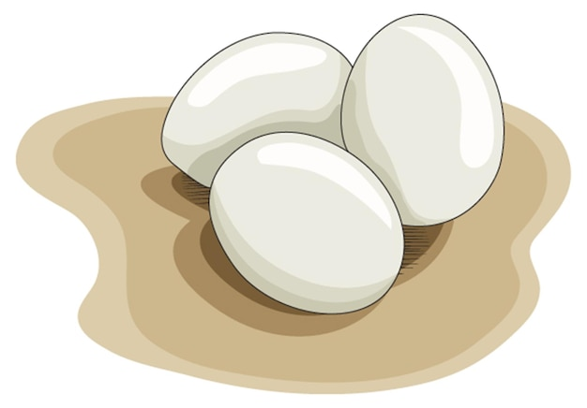
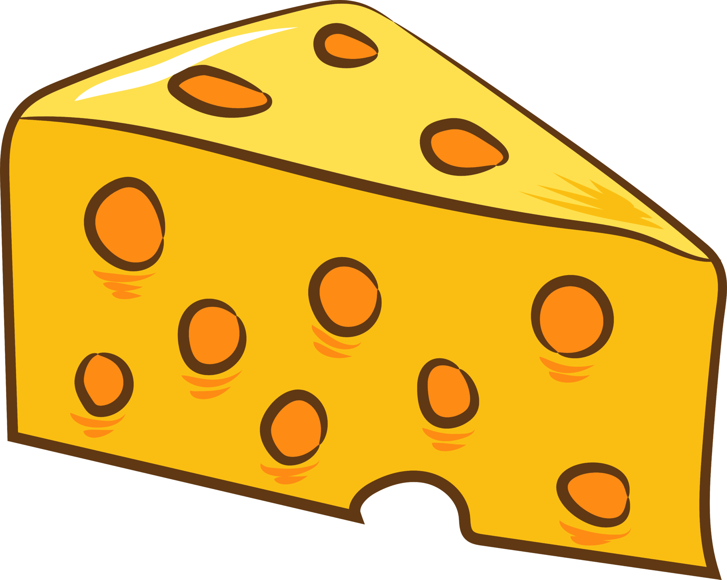
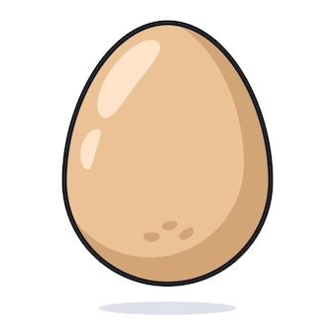
Countable nouns
Uncountable nouns
We add s at the end of countable nouns
When it is plural.
We don’t add s to uncountable nouns
When it is plural
an egg
eggs
Cheese

Slide 20
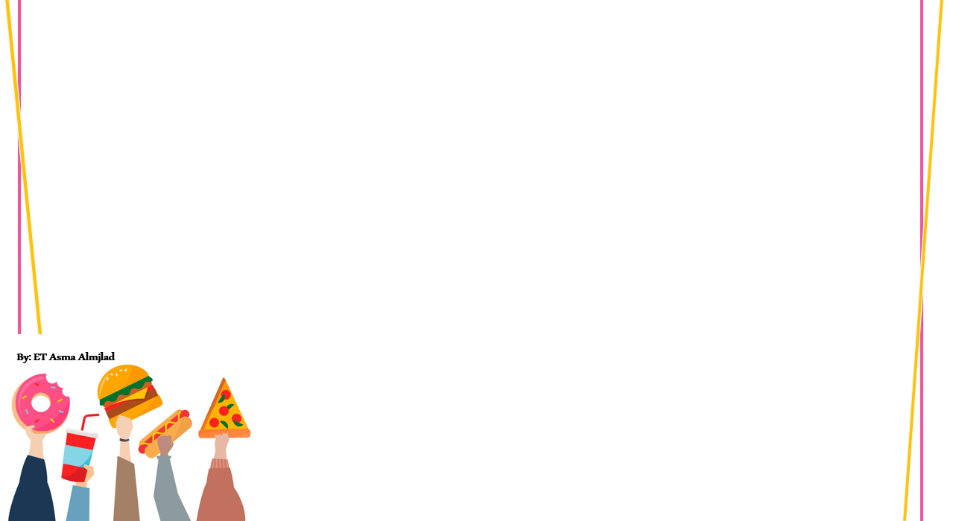
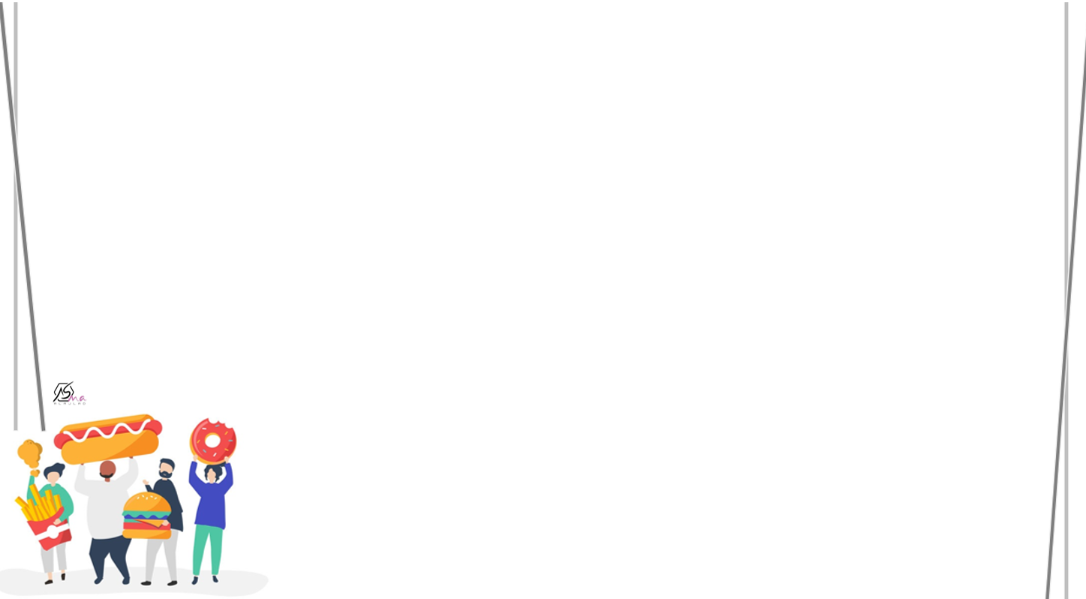

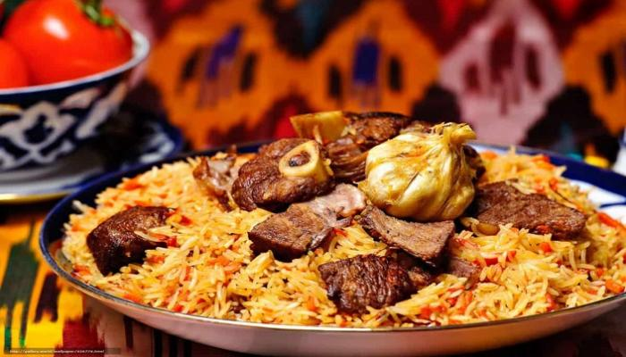

Saudi dish
Rice
Meat \chicken

Slide 21
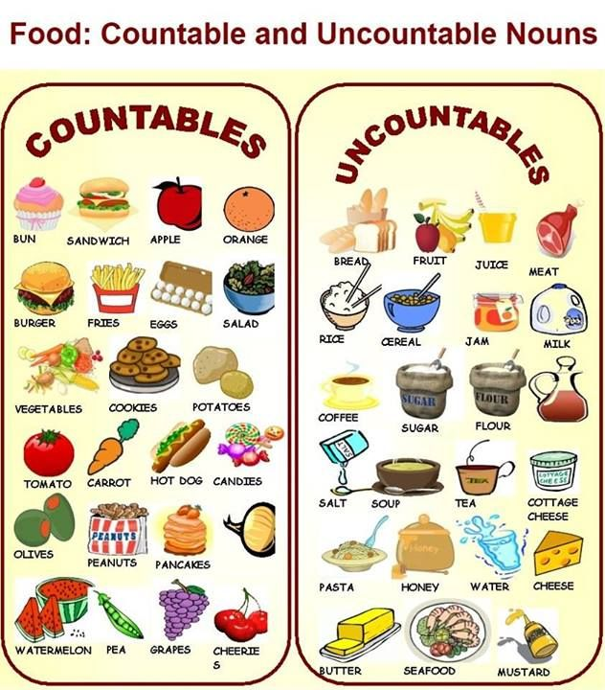
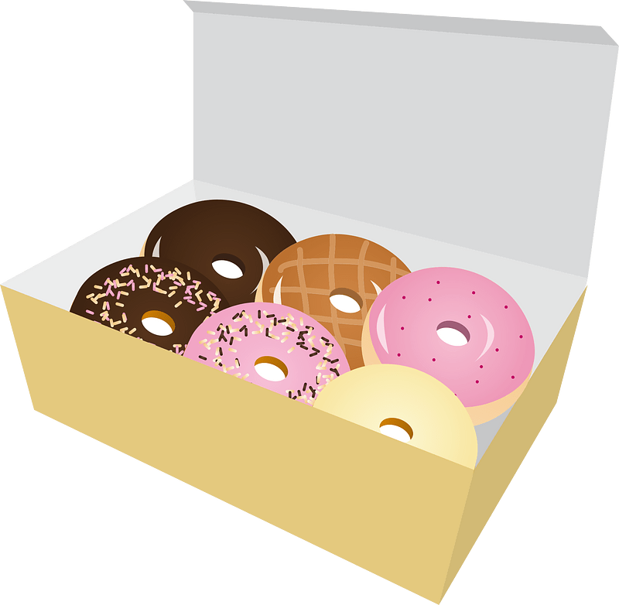

Slide 22
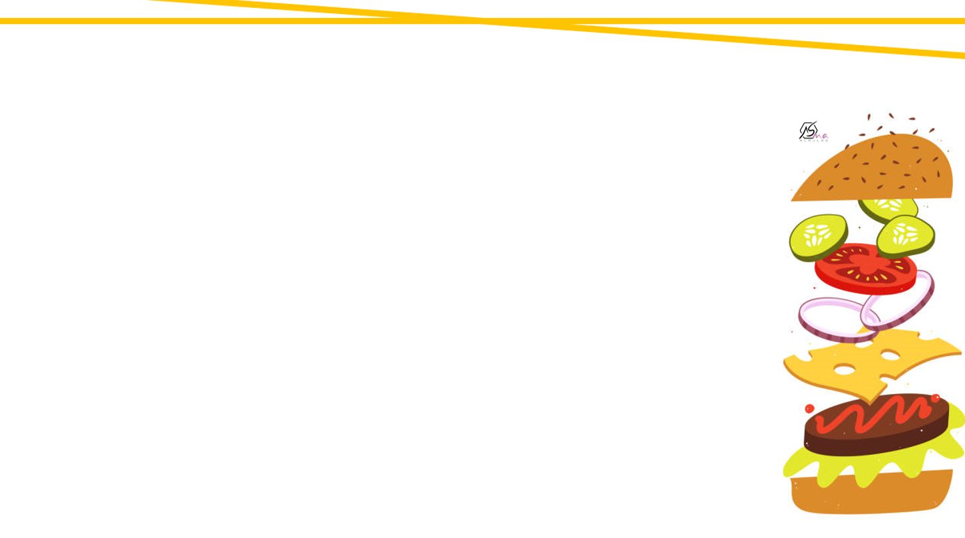

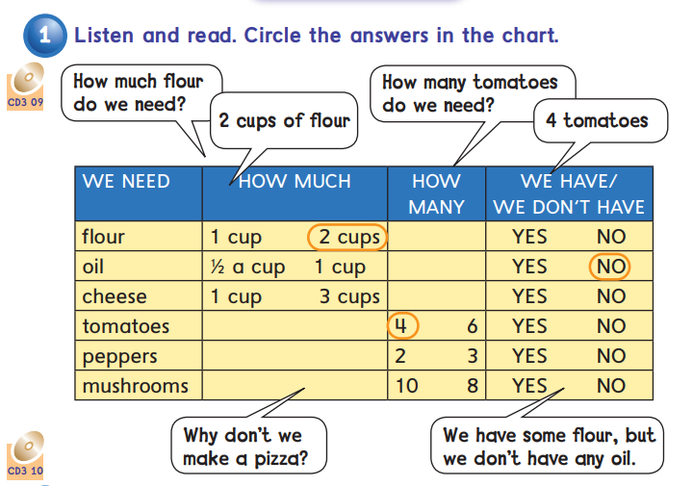


Slide 23
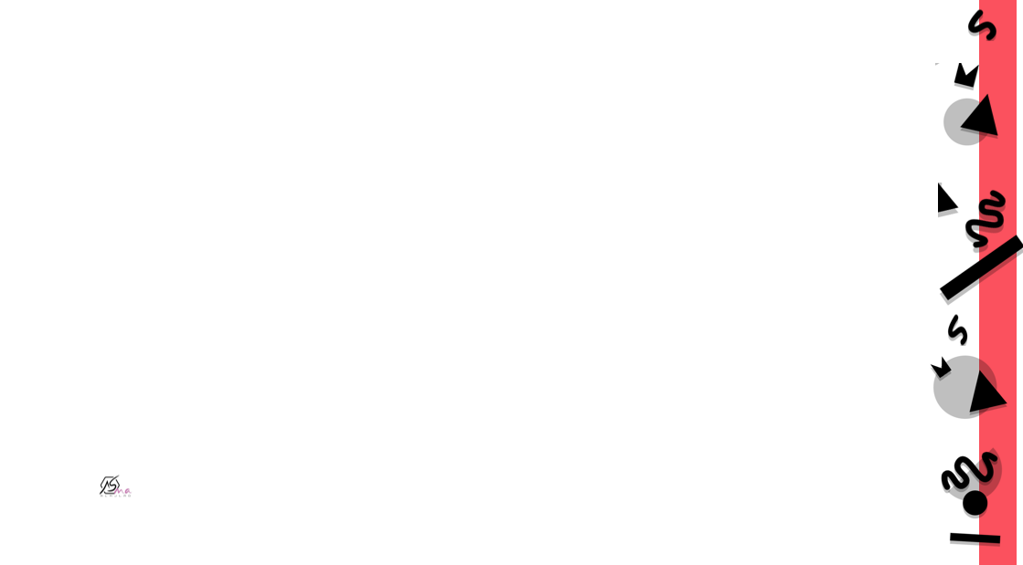
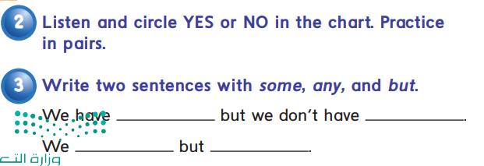
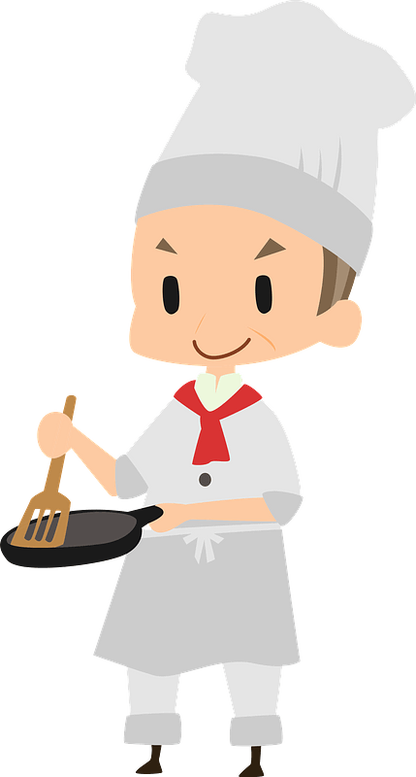

Slide 24
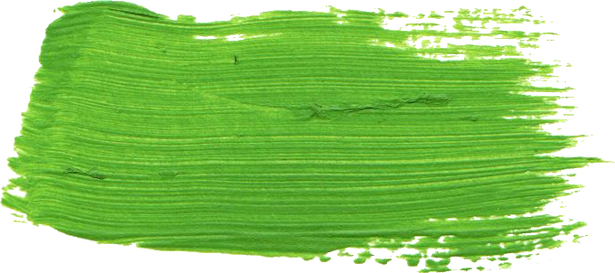
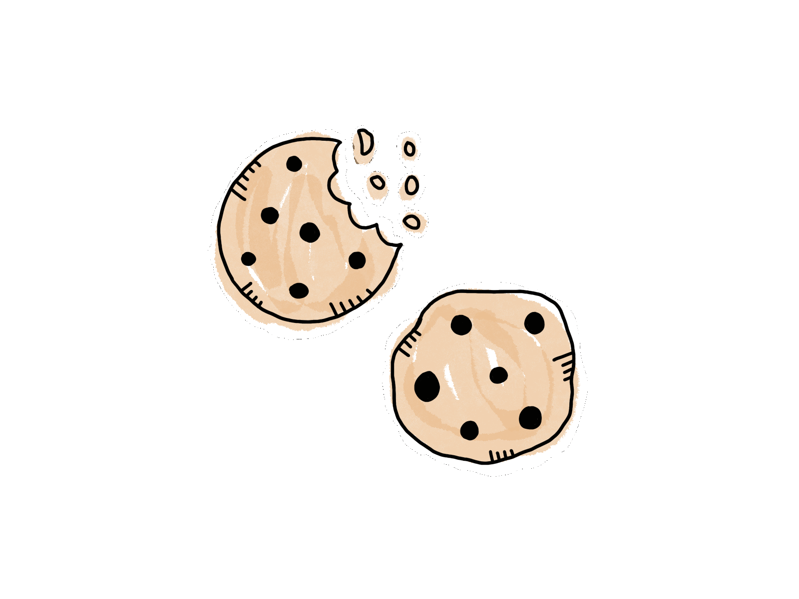
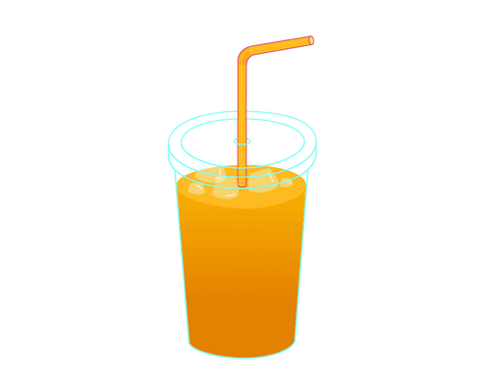
Some
Omar has some cookies
Affirmative sentences
( +)
There is some juice

Slide 25
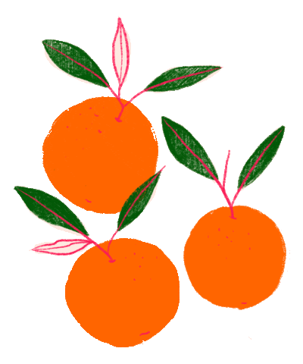
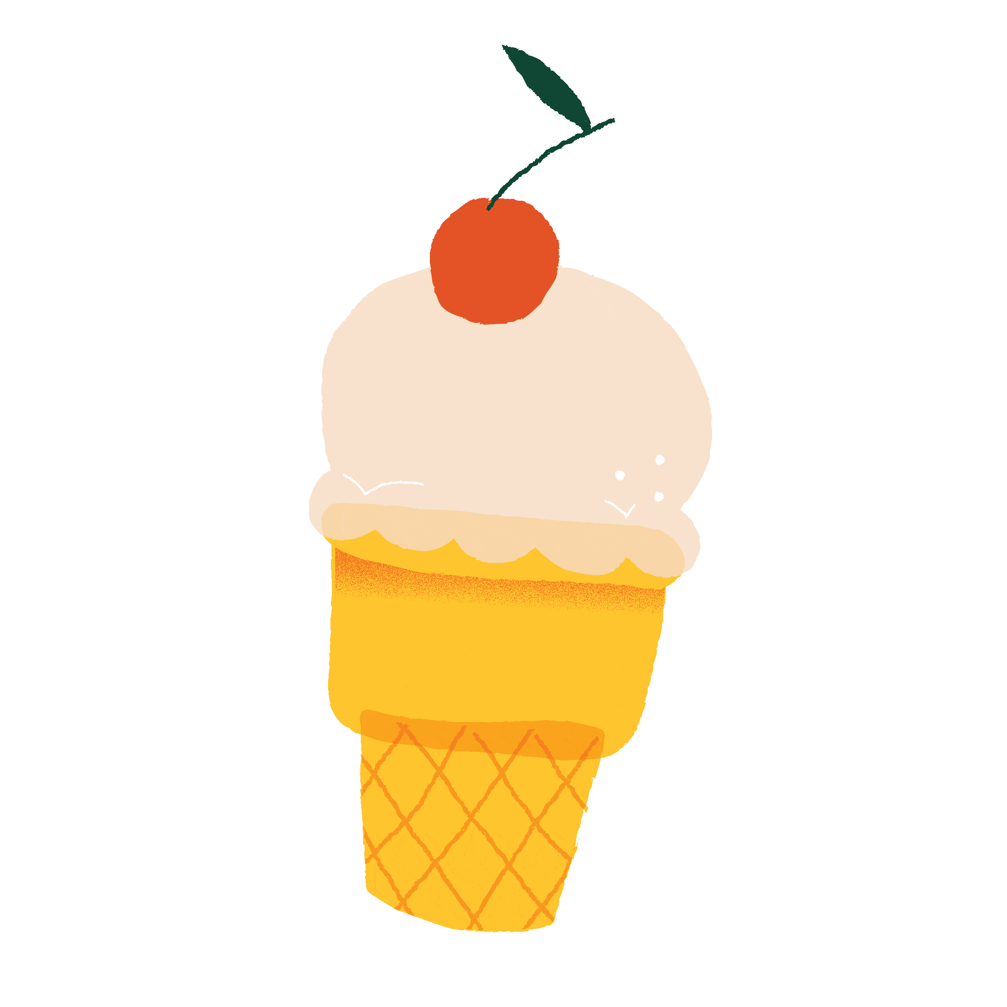
Any
There are n’t any oranges
Negative sentences
( - )
There is n’t any ice cream

Slide 26
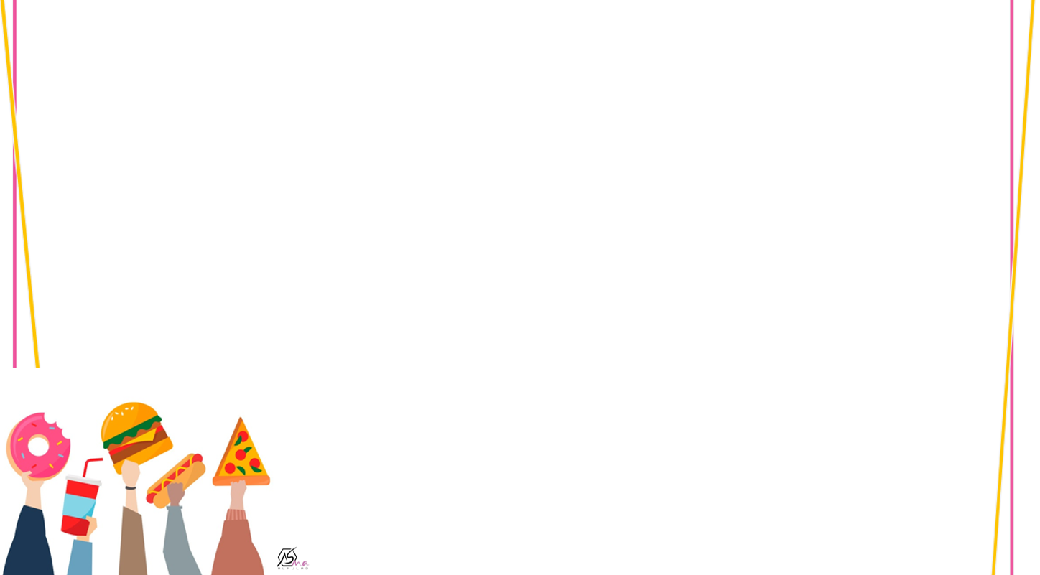
some
any
Affirmative sentences ( + )
Noncount nouns
Plural
Nouns
Negative sentences ( - )
Questions

Slide 27
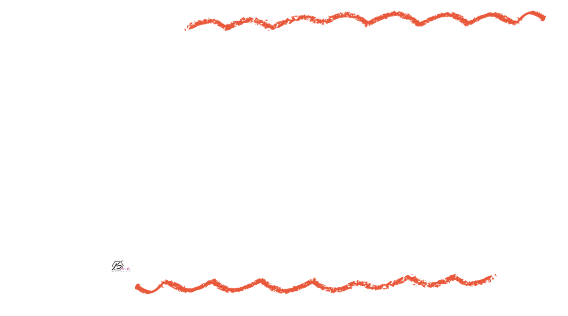

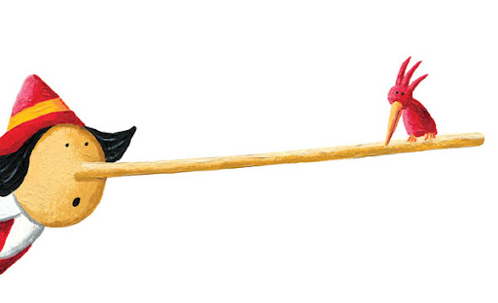

Find the fib
There are any fries.
some

Slide 28

Find the fib
We didn’t eat some cookies
any

Slide 29

Find the fib
We have any salt.
some

Slide 30

Find the fib
How many milk do you need to add?
much

Slide 31



We have some flour.
But we don’t have any oil.

Slide 32






Slide 33




Slide 34



Who are they?
Where are they?
What is she doing?
What can you see?
What is he doing?

Slide 35


Where are they?
What does he want to order?

Slide 36




Slide 37




What would you like?
I’d like ……………………….,please.
Sure, just a moment .

Slide 38

Get one
Give one
Appetizer
Drinks
Main course

Slide 39




Slide 40











List some
Traditional dishes
in your country

Slide 41














Choose the correct answer.
-flour
uncountable
countable

Slide 42
How……..does it cost?
many
much

Slide 43
How …….pens do you have?
much
many

Slide 44
This job is going to take ….time
some
any

Slide 45



Slide 46



Work
book

Slide 47



much
many
many
much
many

Slide 48


some
any
some
any
some
any
some

Slide 49

B
A\C
C\A

Slide 50


would
burger
fries
moment

Slide 51

B
C
A

Slide 52



Slide 53




