Slide 1

Good
Morning
اللَّهُمَّ انْفَعْنِي بما علمتني، وعلمني ما ينفعني، وَارْزُقْنِي علماً ينفعني

Slide 2
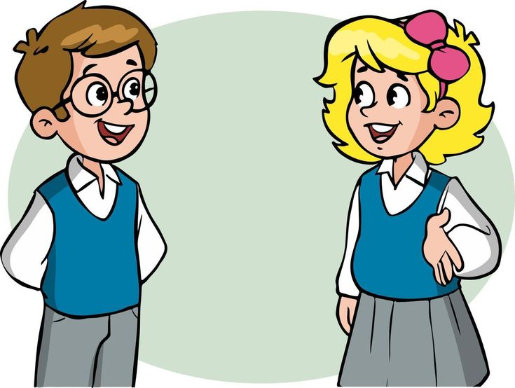
How are you today ?

Slide 3
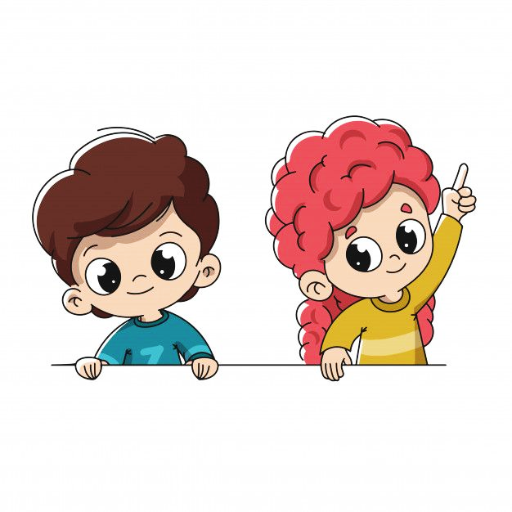
Revision
Writing – Form, Meaning and Function:
Writing: Compose sentences from scrambled words & create a report about a popular teen hangout.
Form\Meaning & Function : Use Would Like correctly in sentences.

Slide 4


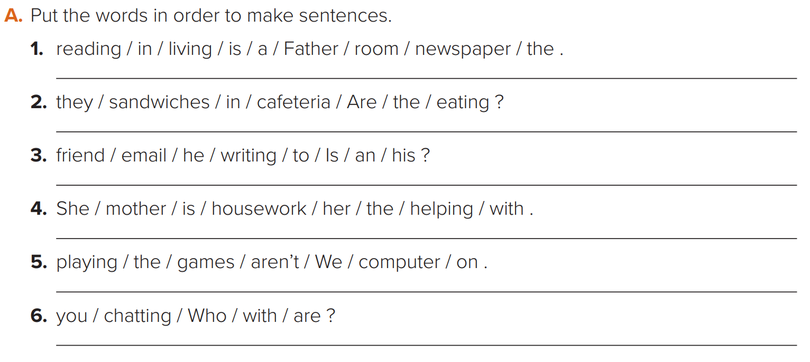

We started our previous lesson with this fun writing activity
Father is reading a newspaper in the living room.
Are they eating sandwiches in the cafeteria ?
Is he writing an email to his friend ?
She’s helping her mother with the housework.
We aren’t playing on the computer games.
Nice
Who are you chatting with?

Slide 5


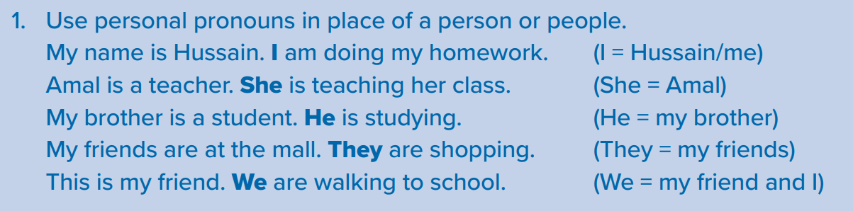
Then we learned how to use the Personal Pronouns

Slide 6
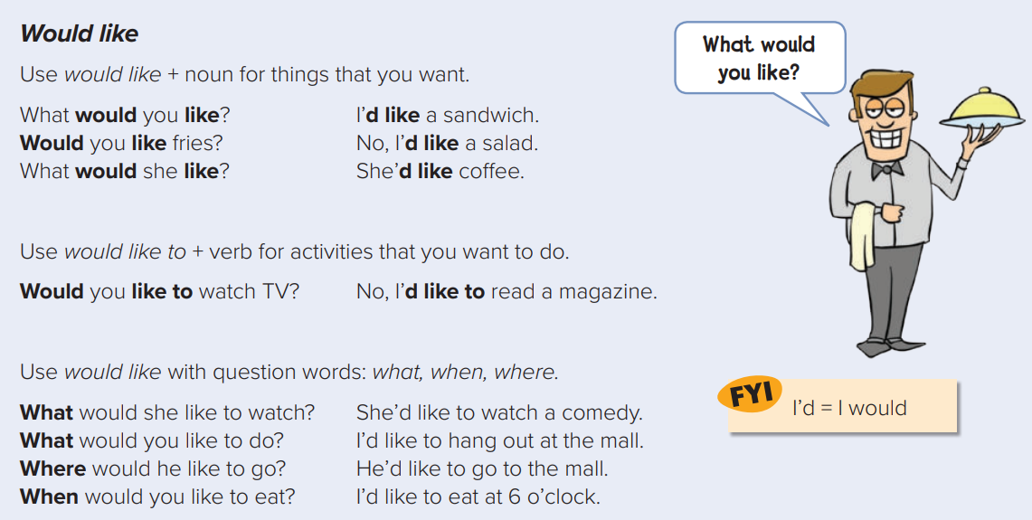
After that, we learned how to use Would like\ Would like to

Slide 7
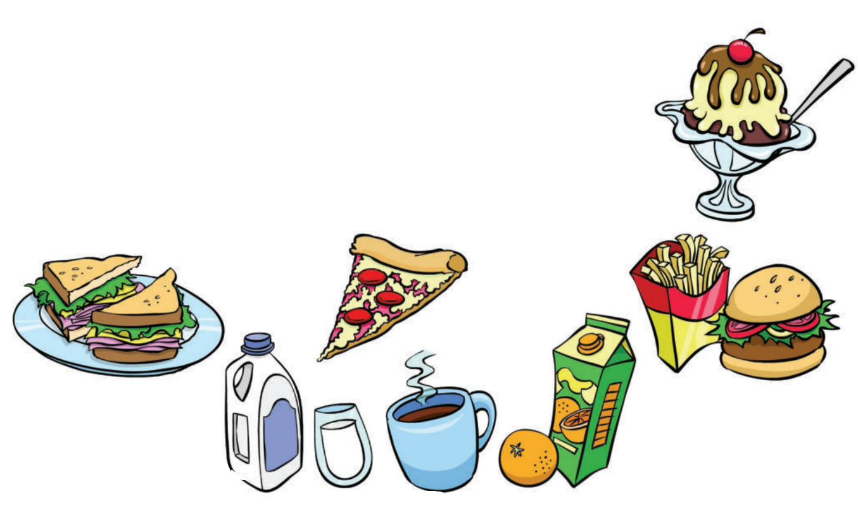
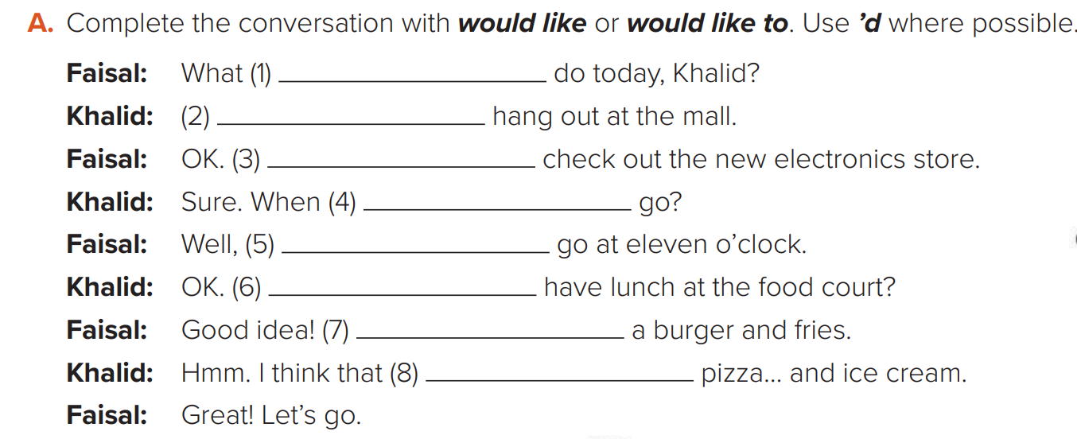
would you like to
I would like to
I’d like to
would you like to
I’d like to
would you like to
i’d like
i’d like
Finally, we evaluated our understanding by solving this fun activity

Slide 8
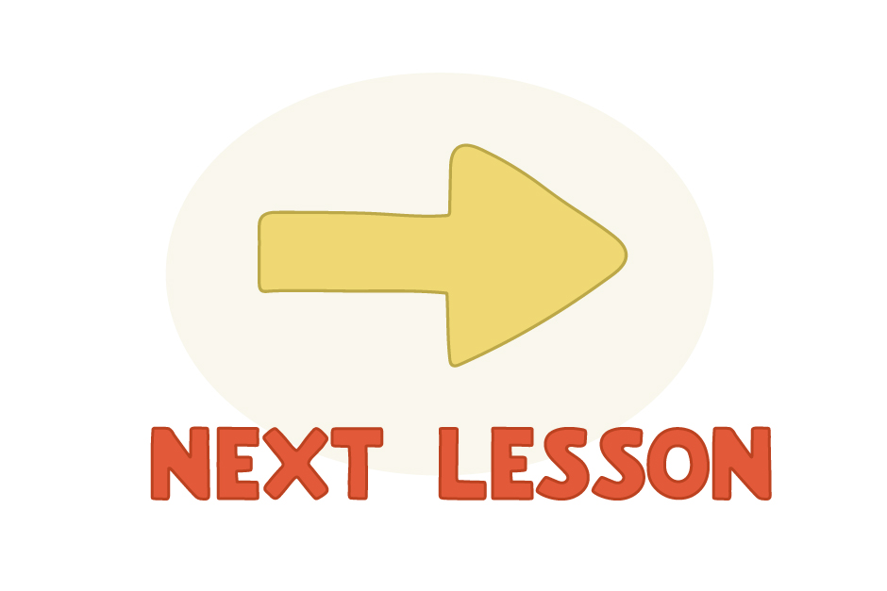

Slide 9


We have a new unit today

Slide 10


Objectives
We will learn about..
List a number of jobs.
Describe job activity.
Discuss future job using “Want”.

Slide 11


Slide 12


Slide 13
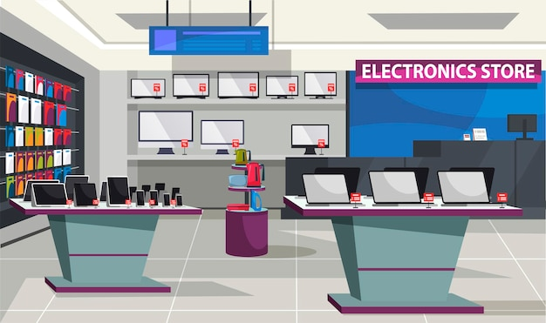

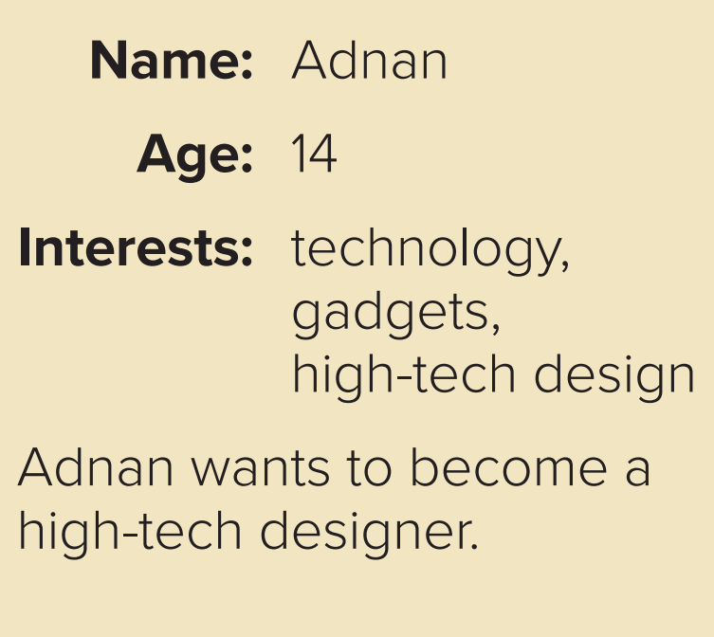
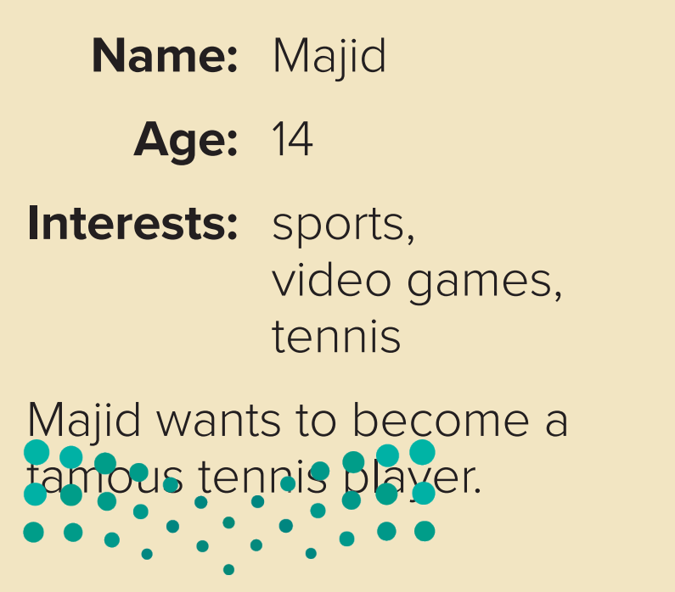
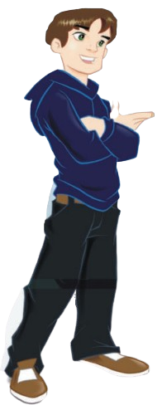
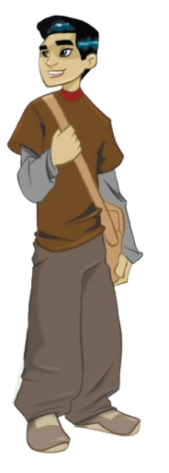

Majid wants to become a
Famous tennis player.

Slide 14
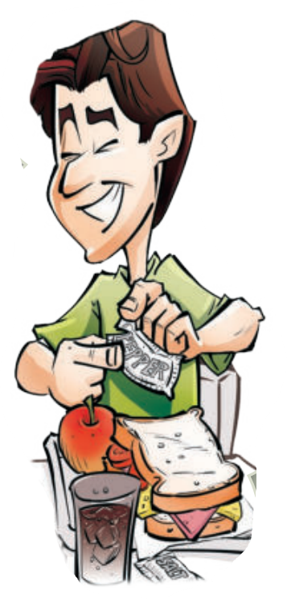
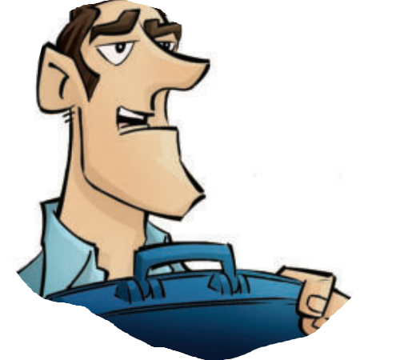
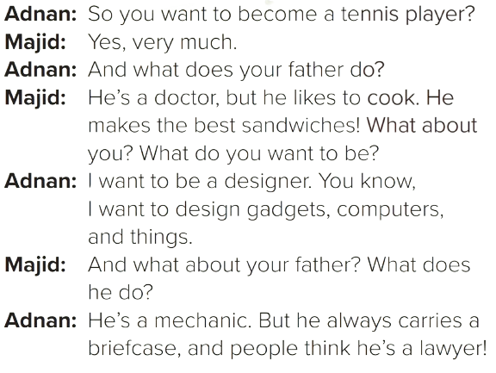
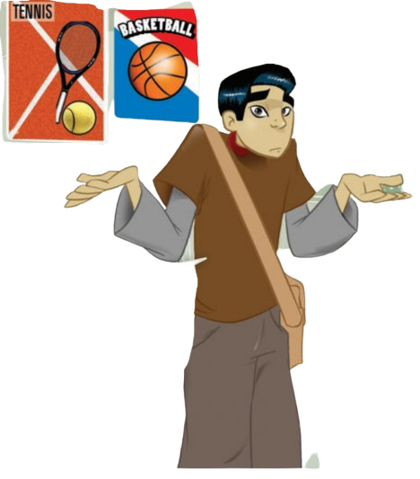
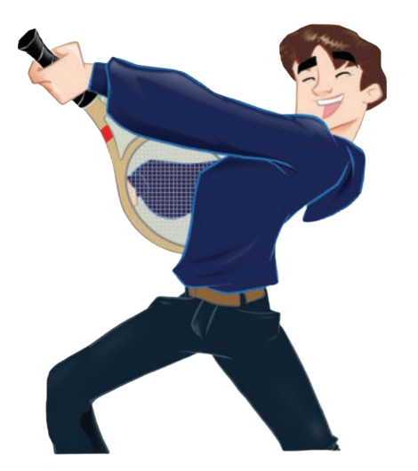

Slide 15
Look at the information about the boys. What do they want to be?
Majid wants to become a
Famous tennis player.

Slide 16

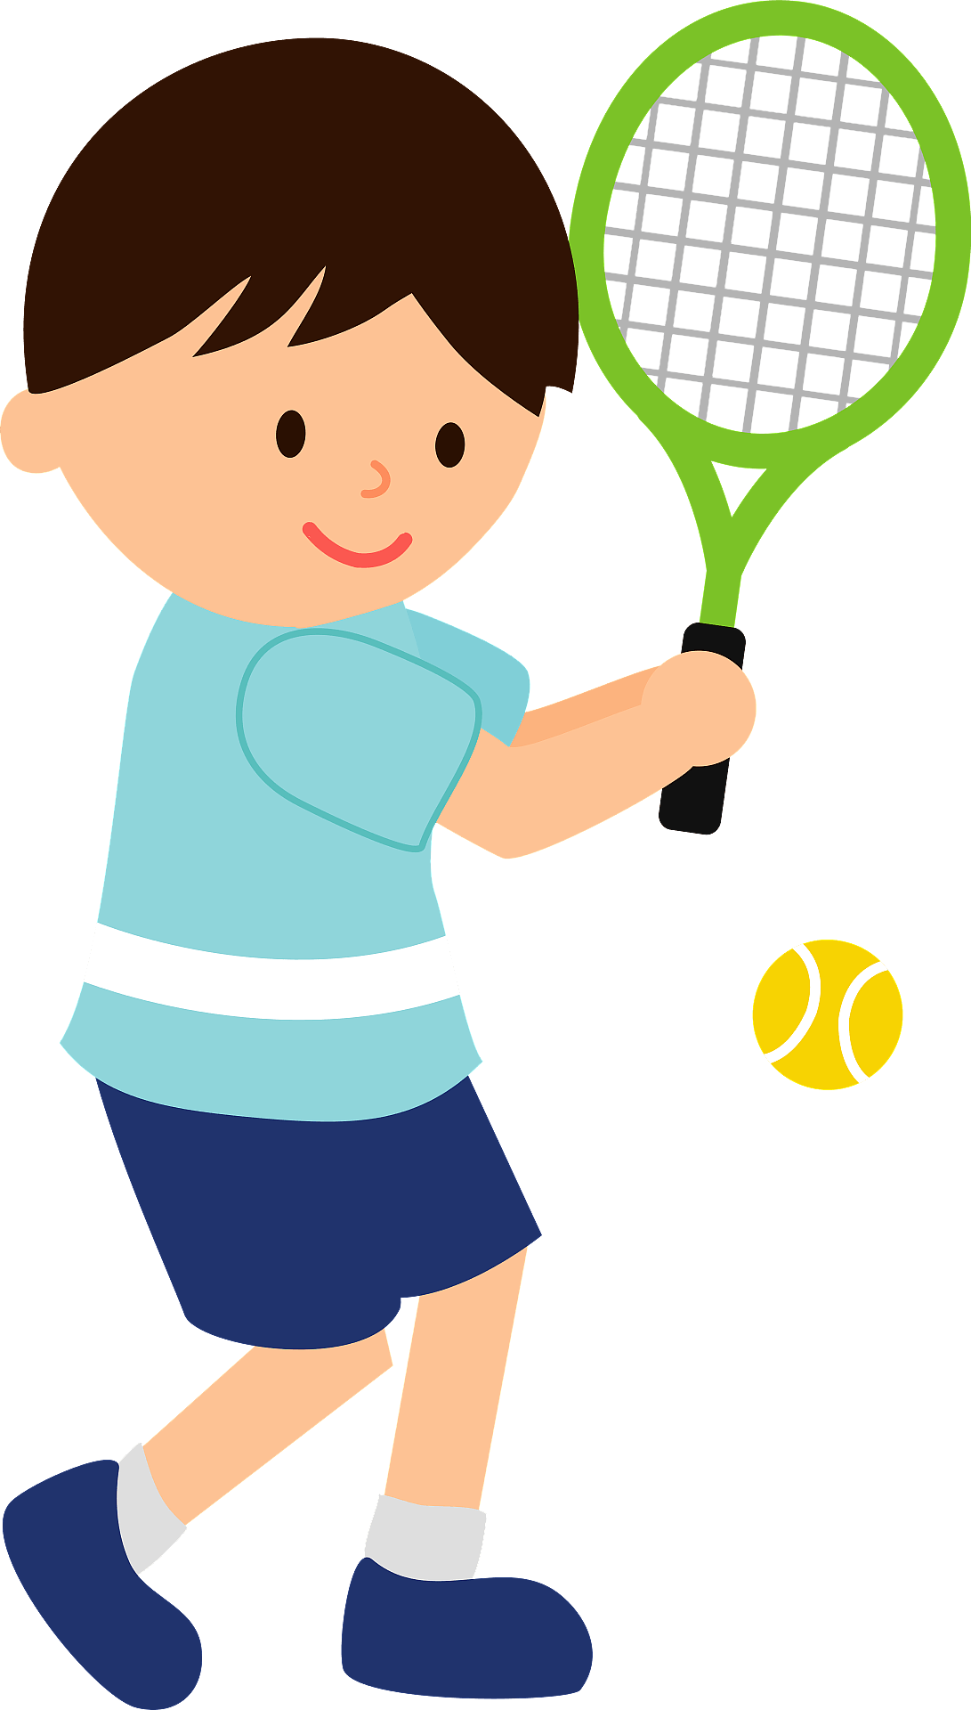

What are the names of the jobs?
Vocabulary
Doctor
Tennis Player
Plays tennis
Works in the hospital
Nice

Slide 17
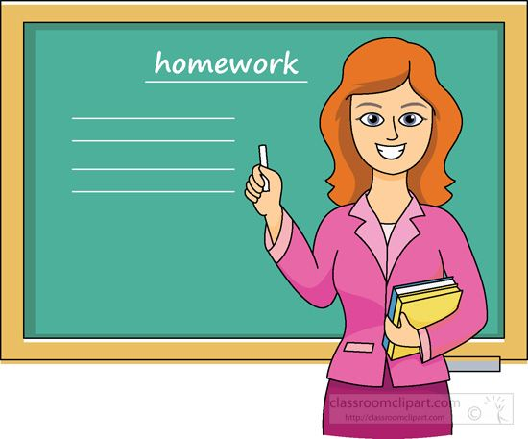

What are the names of the jobs?
Vocabulary
High-tech designer
Teacher
Nice
Teaches at school
Designs new gadgets

Slide 18
B. Comprehension. Answer yes or no.
Comprehension
___ Majid wants to be a teacher.
2. ___ Adnan wants to be a designer.
3. ___ Majid designs games.
4. ___ Adnan is interested in technology
No
Yes
No
Yes
Nice

Slide 19

Pair Work

Slide 20

A. Ask and answer about the people in the pictures.
Nice
What does Majid do?
He’s a student.
He goes to school.

Slide 21

B. Ask and answer with a partner.
Your Turn
What do you do?
I’m a ______. I ______.
Teacher
teach students.
Nice

Slide 22

START

Slide 23


Slide 24

Work Book
Open page 221
Practice the vocabulary
for jobs’ names and activities.
Notes:
الرجاء النقر على زر الأنشطة الكتابية المحددة للانتقال لها لتوضيح الحل.

Slide 25
Linking this lesson to my Country.
Vision 2030 : the Kingdom of Saudi Arabia
The “Kingdom’s Vision 2030” achieved several achievements in the field of jobs, including providing 101,000 jobs in the entertainment sector, and 422,000 jobs since the beginning of 2019, through nationalization agreements.
Jobs for the future were also created and innovation was supported by supporting small and medium enterprises, in addition to raising Saudi women’s participation in the workforce from 19,4% in 2017 to33,2% in 2020.

Slide 26
Linking this lesson to my Religion.
The importance of work
عَنْ عَائِشَةَ، قَالَتْ قَالَ رَسُولُ اللَّهِ صلى الله عليه وسلم ‏ "‏ إِنَّ أَطْيَبَ مَا أَكَلَ الرَّجُلُ مِنْ كَسْبِهِ وَإِنَّ وَلَدَ الرَّجُلِ مِنْ كَسْبِهِ ‏"‏ ‏.‏

Slide 27


Slide 28

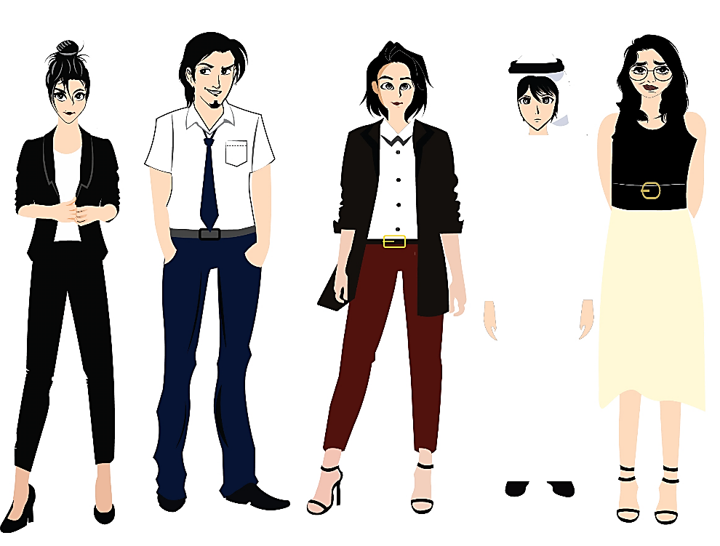


تم تصميم هذا العرض من قبل: فريق عمل البوابة الإنجليزية ، وهو مجاني لكي يستفيد منه معلمي اللغة الإنجليزية.
هذه الشريحة تعتبر كـ"حفظ حقوق" نتمنى عدم حذفها حال مشاركة العرض مع معلمين آخرين.
نسمح بحذف الحقوق في حالة واحدة فقط: اذا أراد معلم الإنجليزي إضافة هذا العرض كـ انتاج معرفي خاص فيه.

