Slide 1




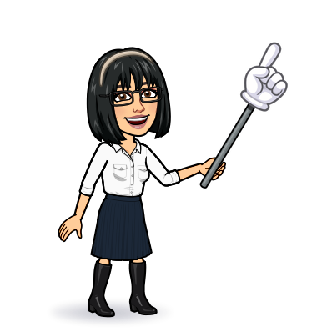

4 listening
5 pronunciation
6 conversation
7 about you
Today:
Date:
- -
Page 83
By: Dalal Al-Juaid

Slide 2


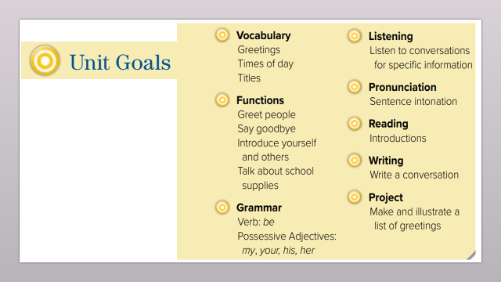
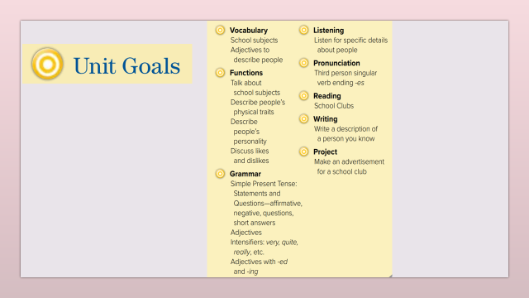
Answer yes or no to list of descriptions from a listening text
Practice the -es sound at the verb endings
Warm up
Use the "real talk " phrases in a conversation
Answer questions from a conversation
2-Pair work

Slide 3
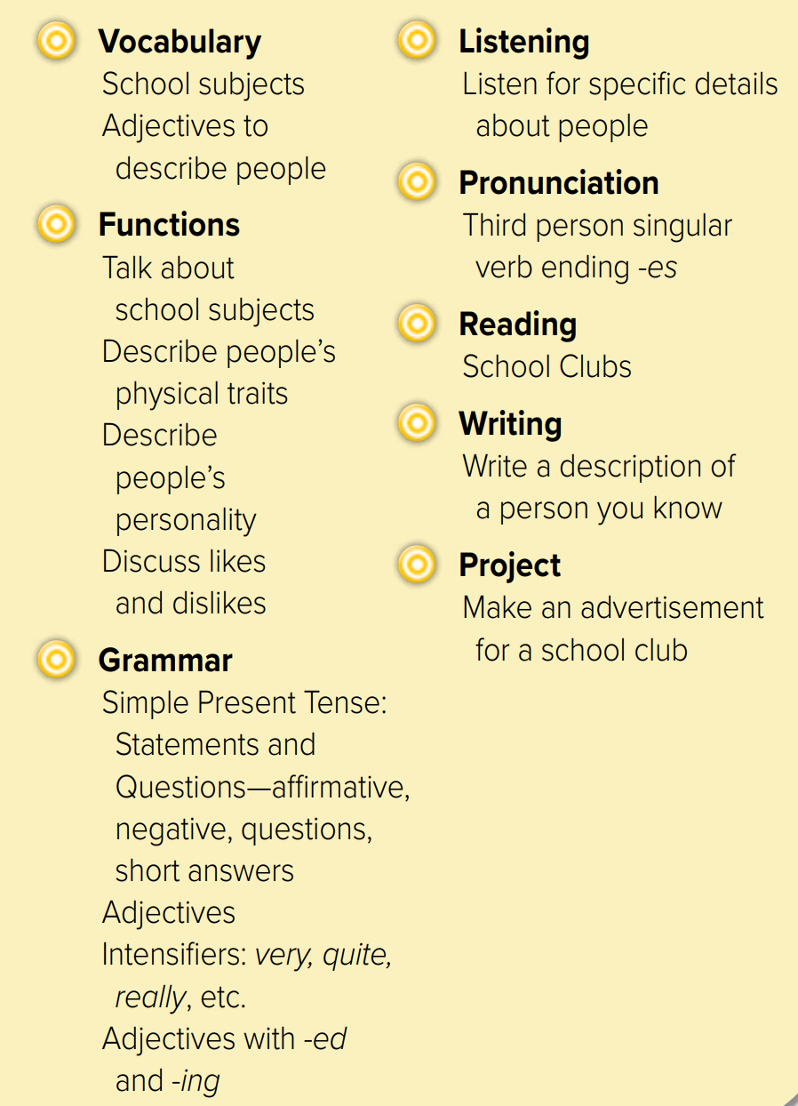
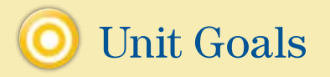

Slide 4

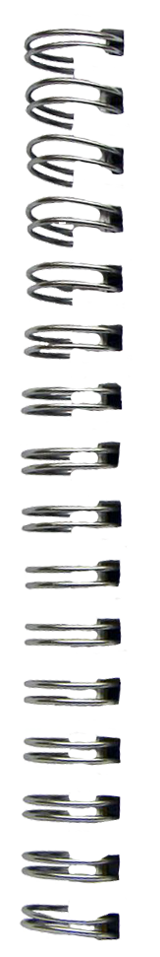

Revision
What does Dalal look like ?
subjects
Math – science – history
English – Art - Geography
Do you speak English?
Smart = ………
#
=
easy
……
……
#
=
……….
……
fun

Slide 5









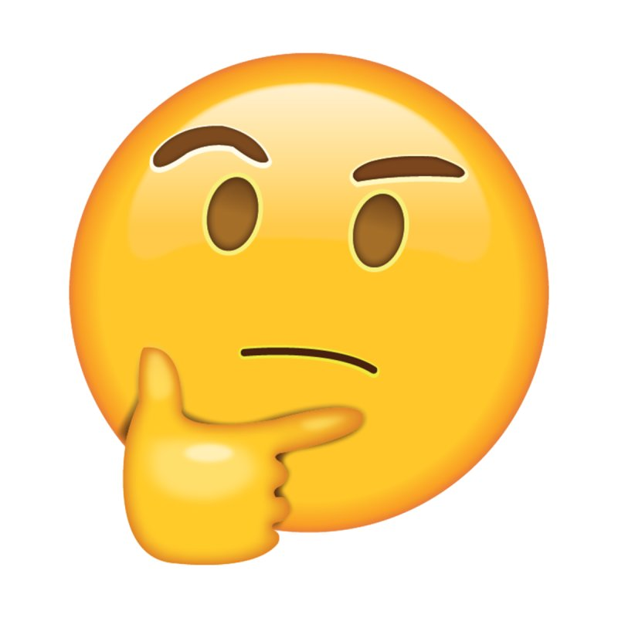
What’s your favorite subject?
why?
Answer with emoji
Warm up
smart
adjective
interesting
difficult
subject
2-Pair work

Slide 6
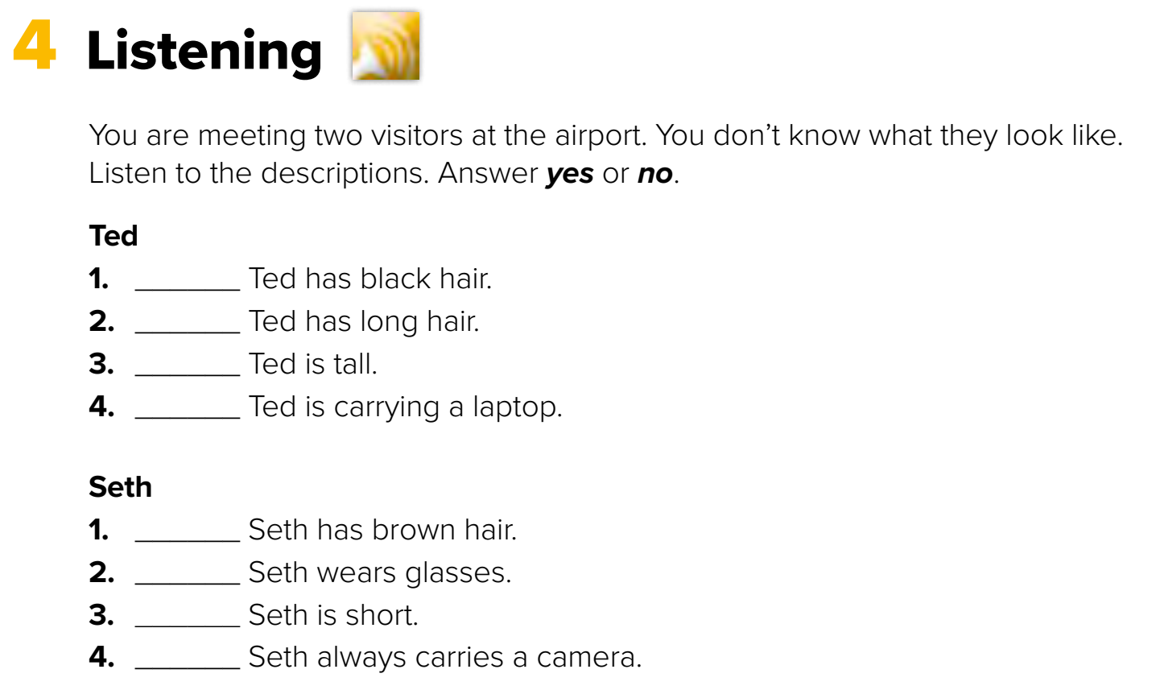

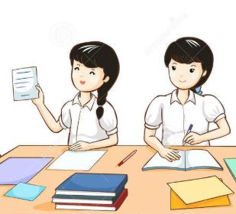
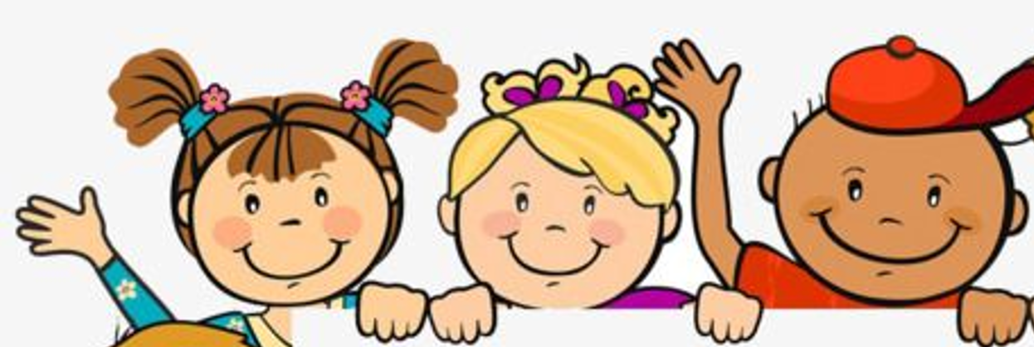

Page 83
no
no
Think pair share
yes
yes
Warm up
no
yes
no
yes
2-Pair work

Slide 7
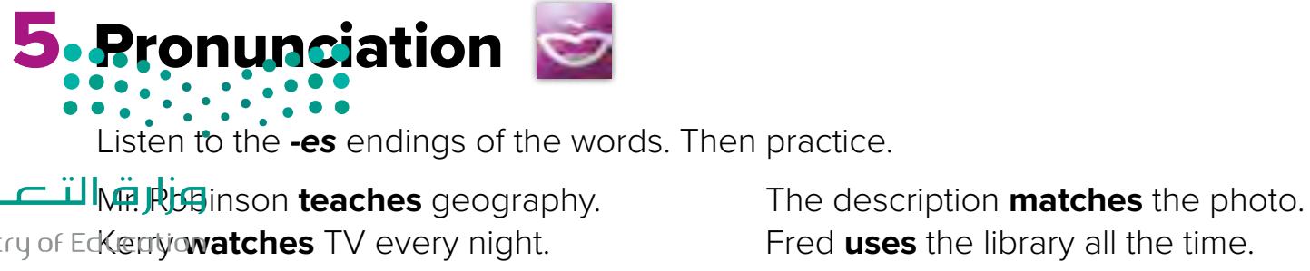

teach
Page 83
match
How many syllables?
Warm up
Listen
repeat
2-Pair work

Slide 8
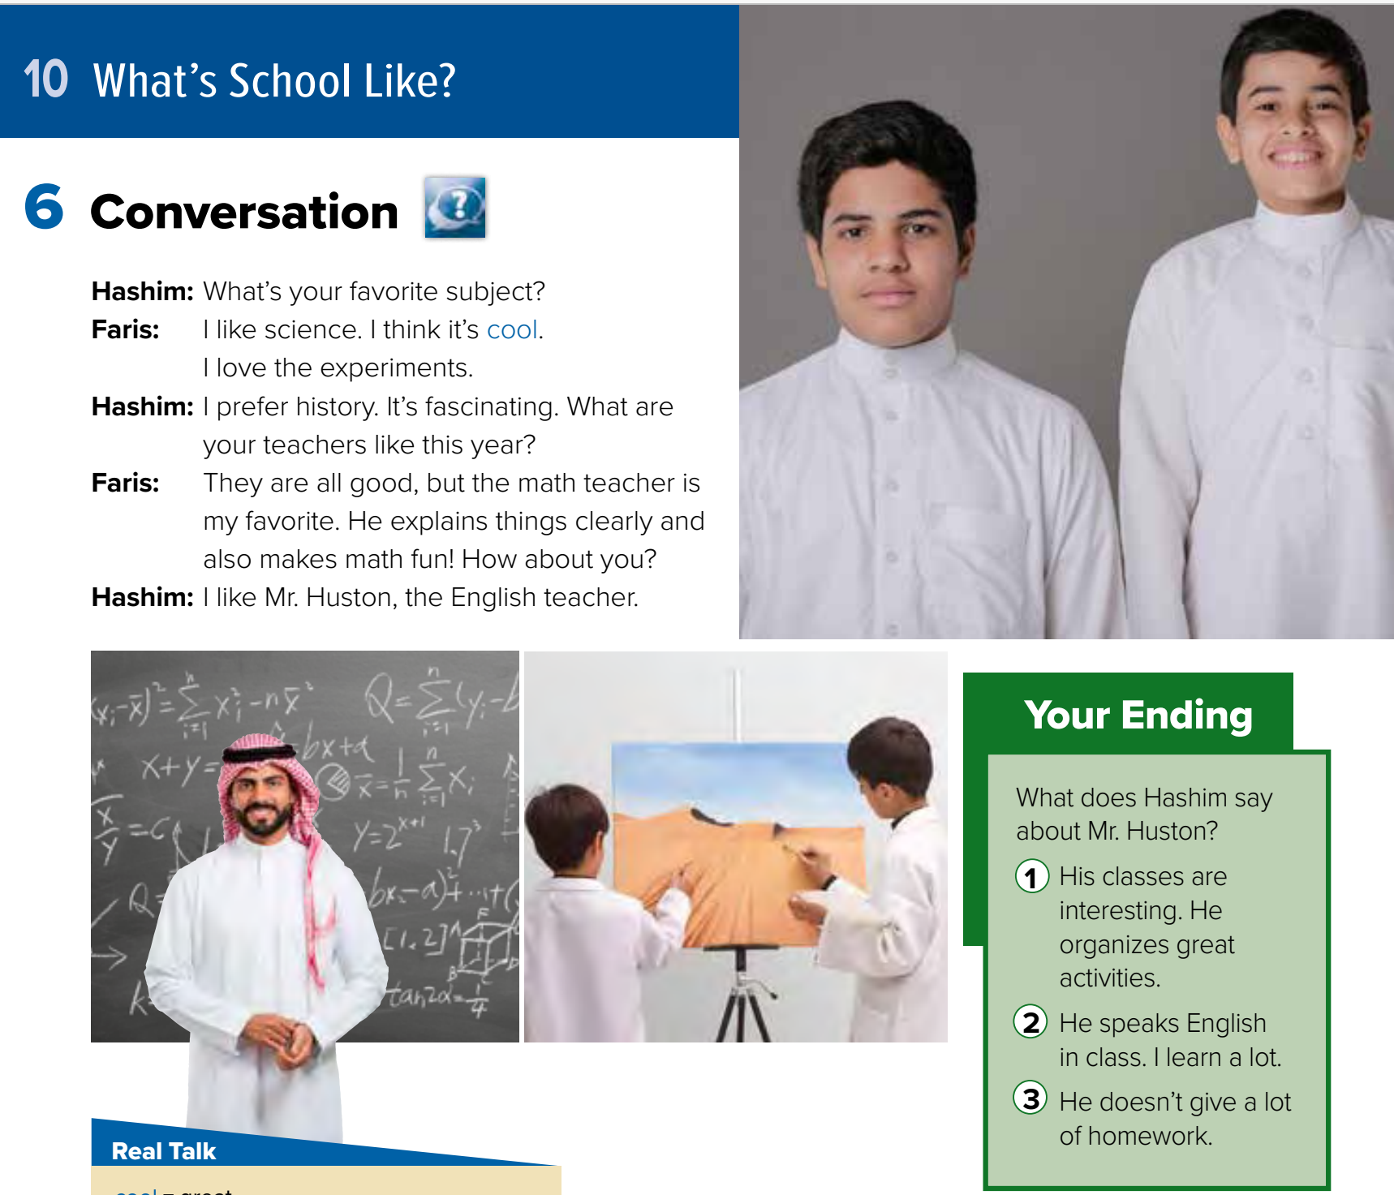
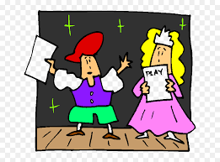






Page 84
What are the people in the picture doing?
Role paly
Warm up
Are any of your teachers strict? What does a strict teacher do?
2-Pair work

Slide 9
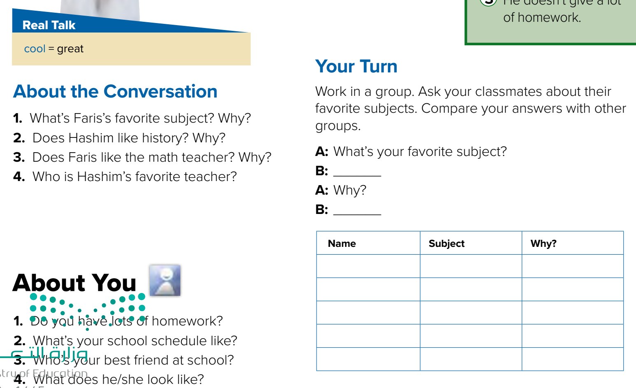

Page 84
=
……
Think pair share
Warm up
1- It’s science. He loves the experiments.
2- Yes, he does. He thinks it’s fascinating.
3- Yes, he does. He explains things clearly and makes math fun.
4- He’s Mr. Huston, the English teacher.
2-Pair work

Slide 10
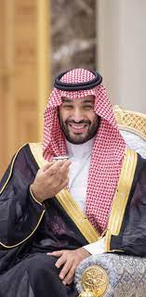

Page 84
Role paly
Warm up
Talk about MBS ?
2-Pair work

Slide 11
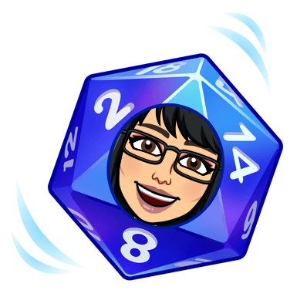
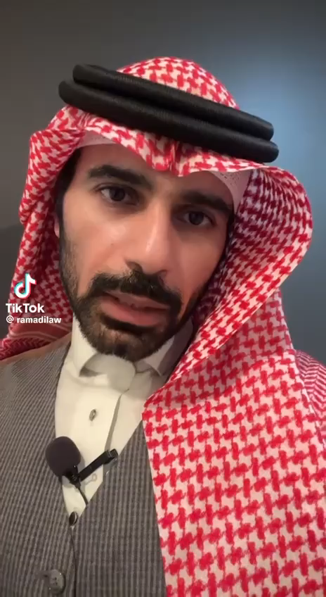
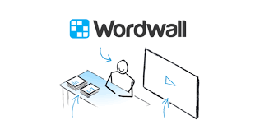
Lets play
Warm up
1-Listen
New words
Quick check
2-Pair work

Slide 12


New Words
cool
great
favorite
prefer
Like it more
fascinating
amazing
explain (v)
Make you understand
activities
Exercises

Slide 13
Write in your notebook
Like final test أسئلة للاختبار النهائي
Choose:
Mmmmmmm ………. mmmmmmm
( ssss – ssss – sssss)
Make a question

Slide 14





page 227 Ex(E-F)
for practice grammar
Warm up
2-Pair work

Slide 15
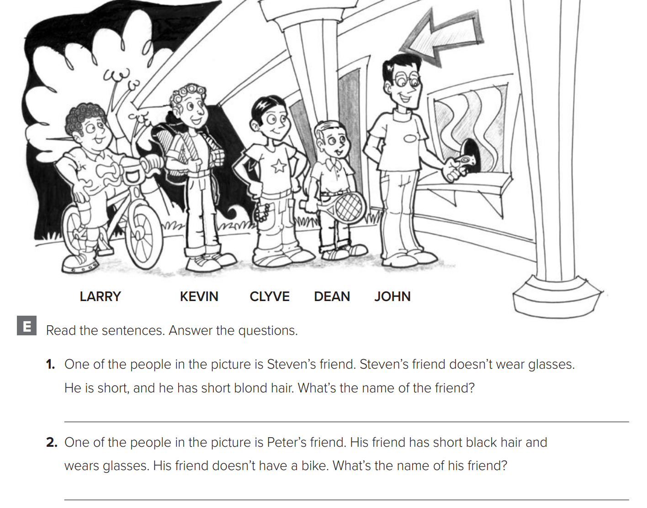
p.227
Warm up
Dean
John
2-Pair work

Slide 16
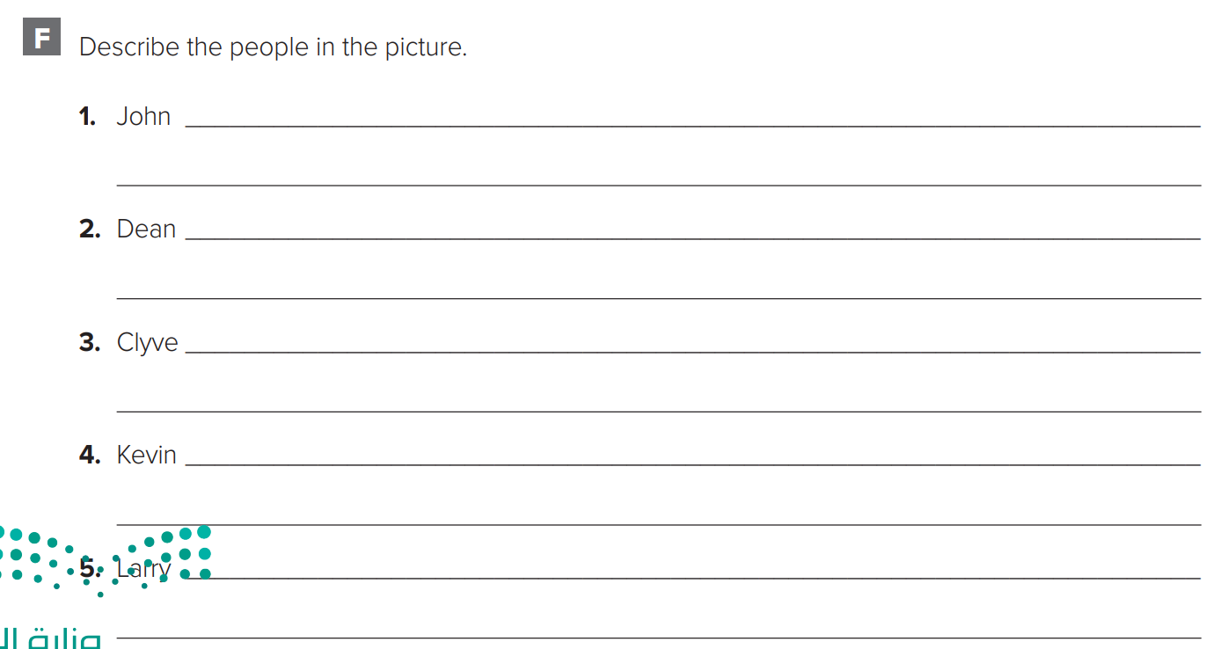
p.227
is tall. He wears glasses. He has short black hair.
is short. He has short blond hair. He plays tennis.
has short black hair. He isn’t very tall.
is tall. He has curly hair. He has a backpack.
has short curly hair. He has a bike.
Warm up
2-Pair work

