Slide 1



Slide 2
Mega goal.3.2
Against The Odd

Slide 3
Listening
Pronunciation
Vocabulary Building

Slide 4
Objectives:
Write twins resemblance according an audio
Practice dropped consonants
Match words with its meaning

Slide 5
Listening

Slide 6


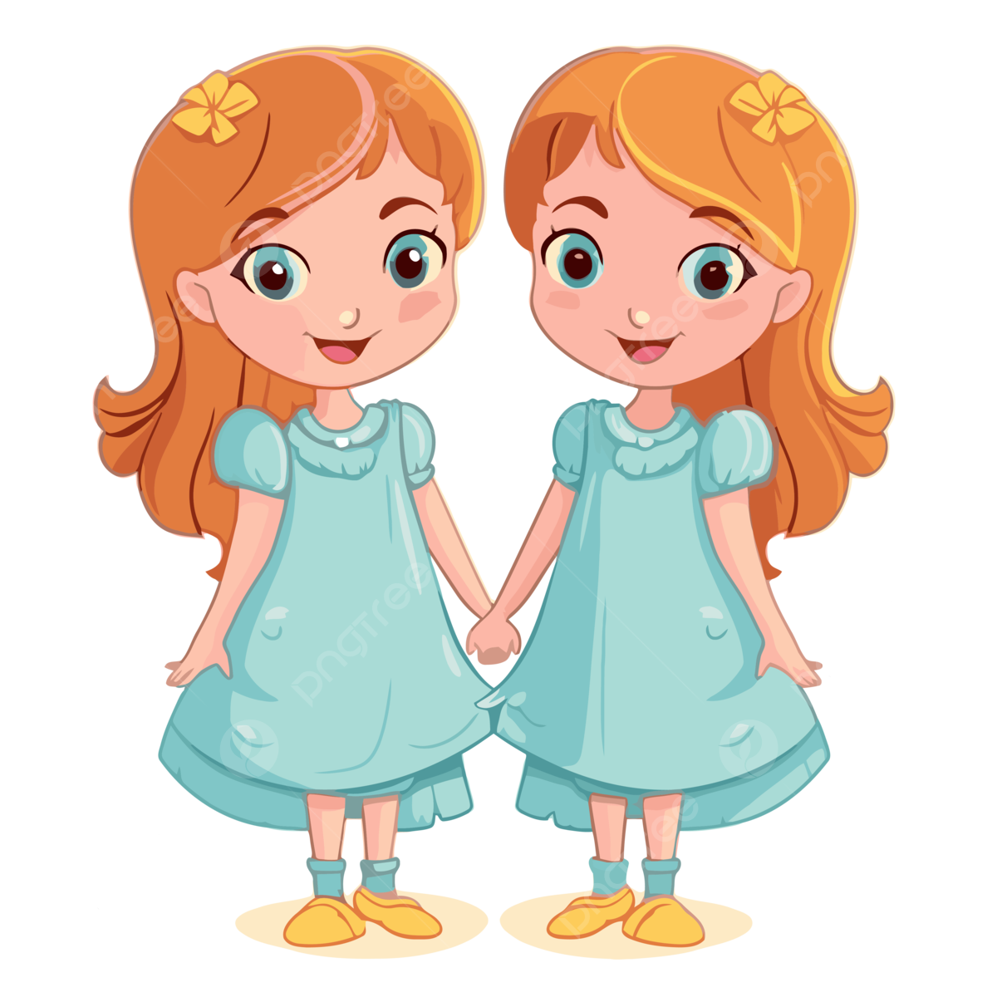

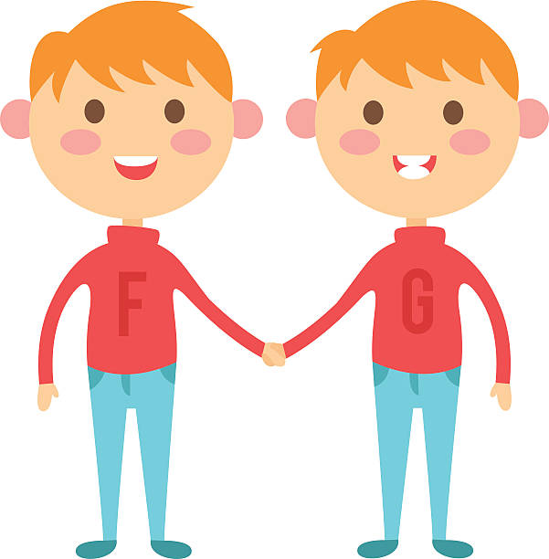
Listen to the story about identical twins who were separated at birth. Then list the similarities between the twins.

Slide 7
Listen to the story about identical twins who were separated at birth. Then list the similarities between the twins.
How are Alicia and Jenna alike?
Both of them: are studying psychology have similar accents and mannerisms have been painting since they were five liked horses planned to study teaching volunteered at the community support center have the same recurring dream

Slide 8
Pronunciation

Slide 9
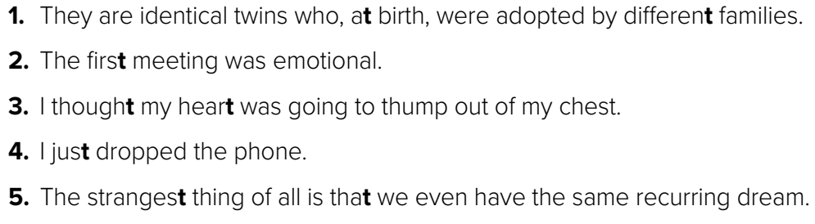
Sometimes consonant sounds are left out in casual speech. For example, when a word with a final t is followed by a word that begins with another consonant sound, the t is often left out. Listen and practice

Slide 10
Vocabulary Building

Slide 11
A. You will see the following words in the reading on pages 116 and 117. Match the words with their meanings.
______ detectable
2. ______ disoriented 3. ______ exhilarating
4. ______ haggard
5. ______ hallucinating
6. ______ intact
7. ______ reception
8. ______ startling
a. remaining whole and unharmed
b. imagining things that are not real
c. very thin and tired
d. able to be found
e. the quality of radio waves received by a device
f. very surprising
g. causing a strong feeling of excitement and happiness
h. confused
d
h
g
c
b
a
e
f

