Slide 1
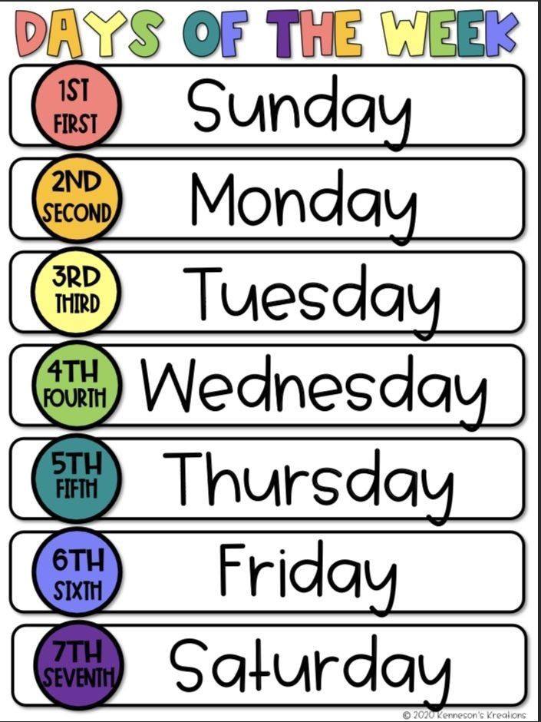



What’s the day today?
Notes:
ا

Slide 2
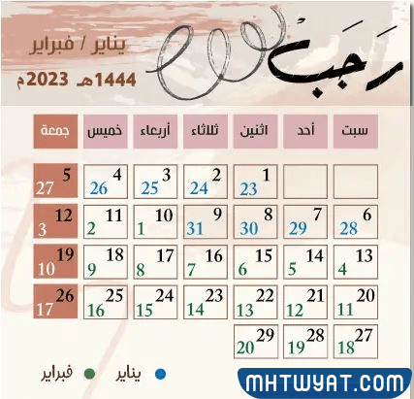
What’s the date today?

Slide 3
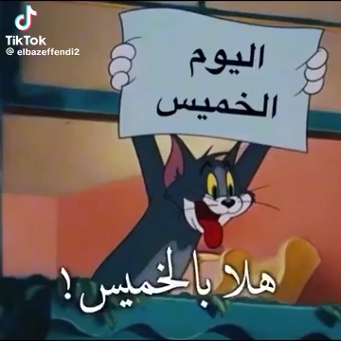

Slide 4
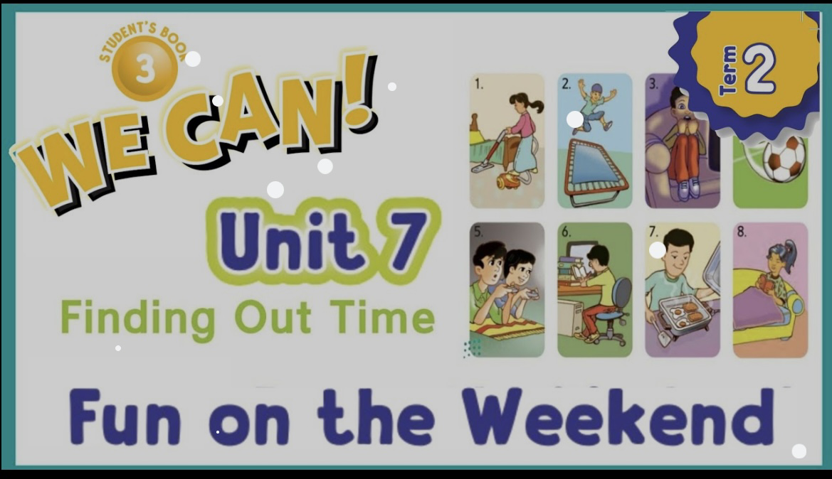

Slide 5

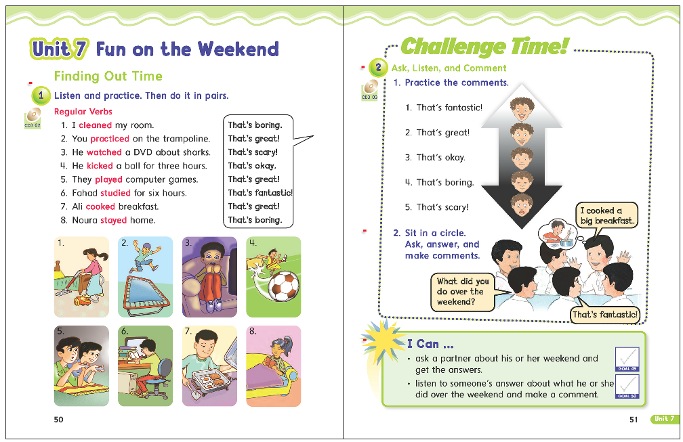
50

Slide 6
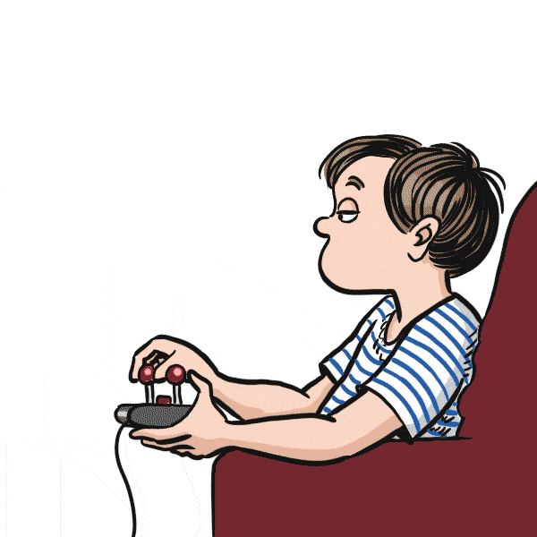

played

Slide 7
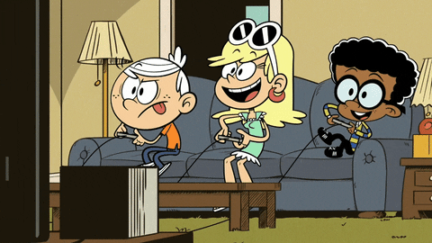

What did you do over the weekend ?
That’s fantastic.

Slide 8
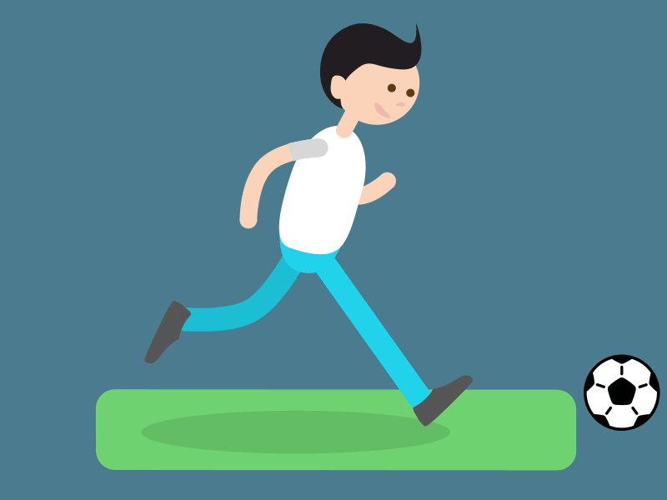
kicked

Slide 9
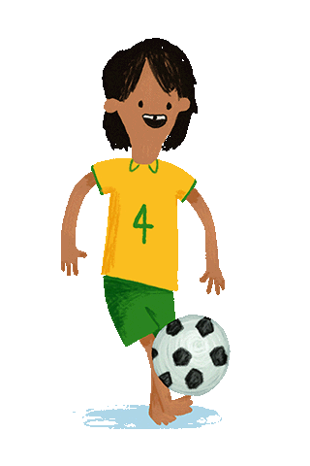

What did you do over the weekend ?
That’s great.

Slide 10
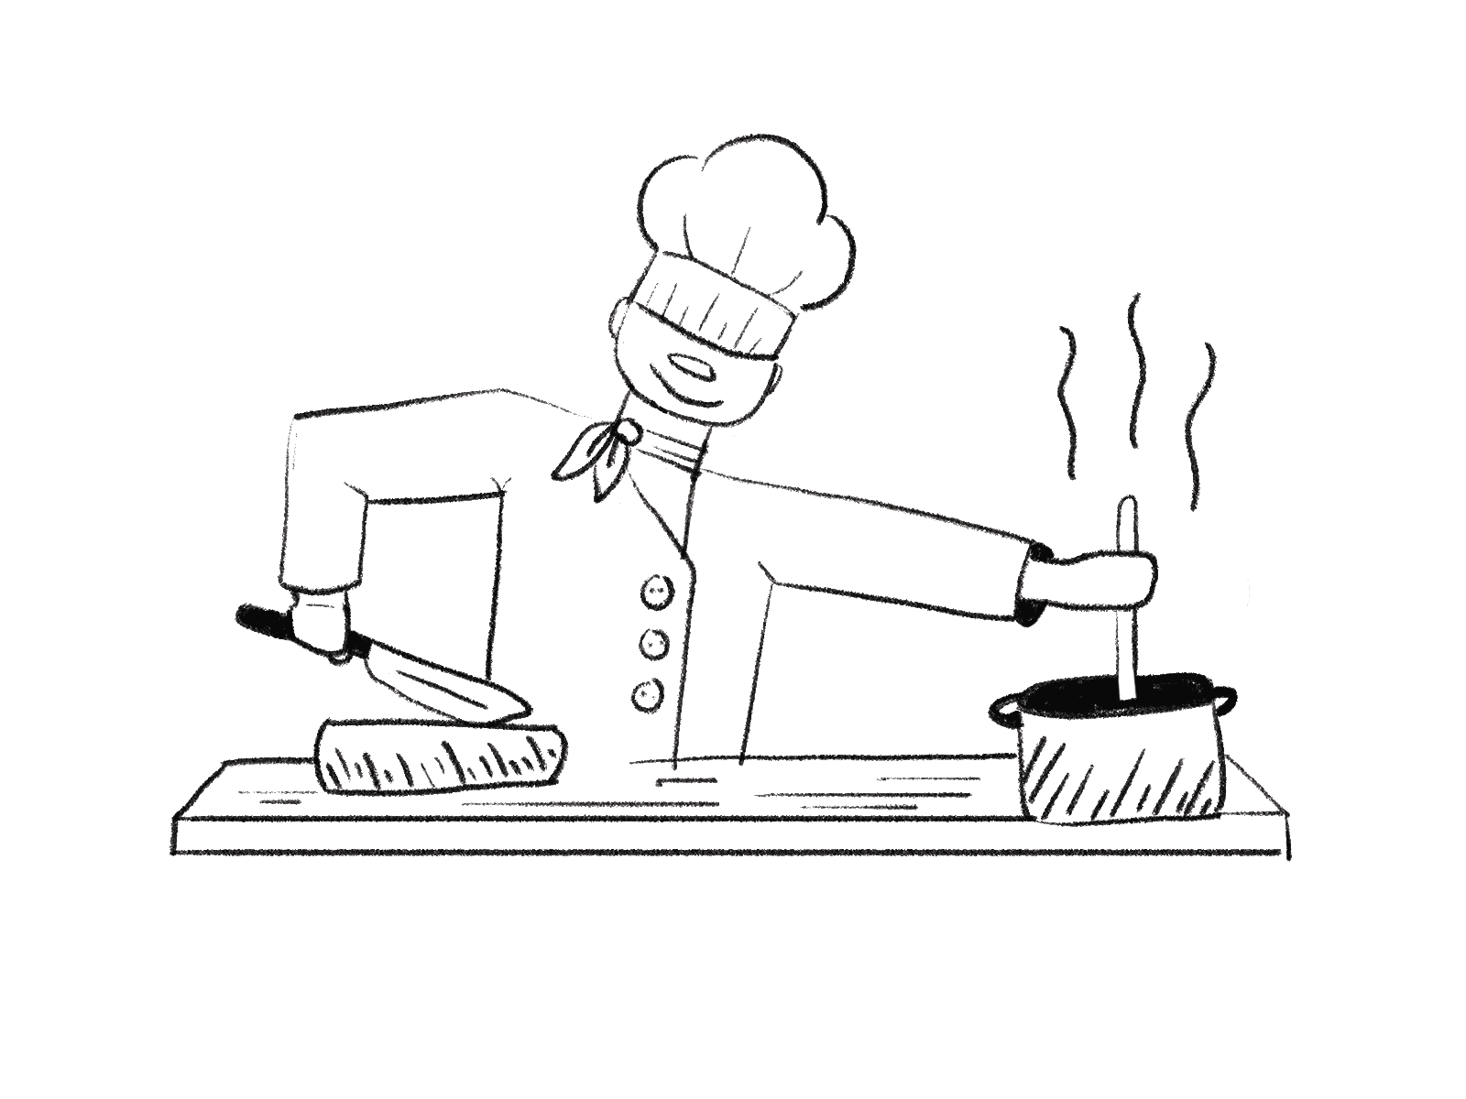
cooked

Slide 11
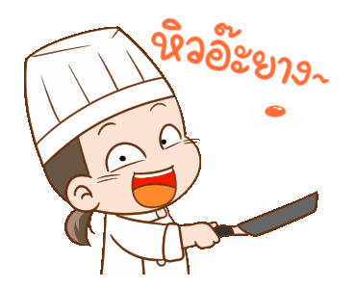

What did you do over the weekend ?
That’s okay.

Slide 12

watched

Slide 13
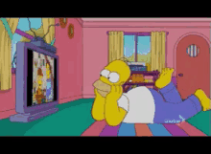
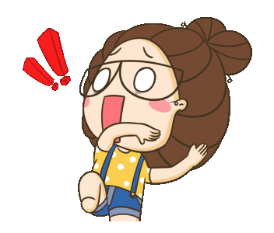
What did you do over the weekend ?
That’s scary .

Slide 14

cleaned

Slide 15
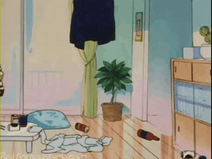
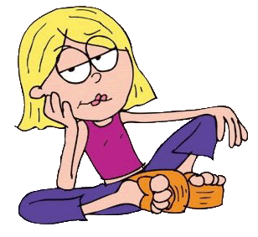
What did you do over the weekend ?
That’s boring.

Slide 16

studied

Slide 17

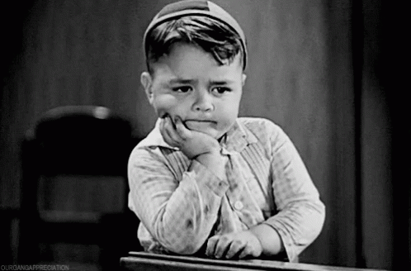
What did you do over the weekend ?
That’s boring.

Slide 18
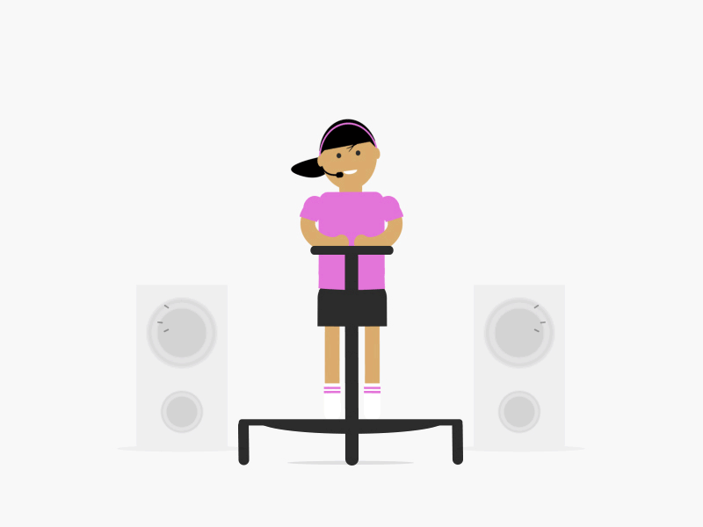
practiced

Slide 19
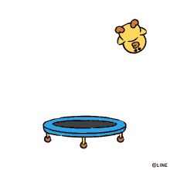
What did you do over the weekend ?
That’s great.

Slide 20

stayed

Slide 21

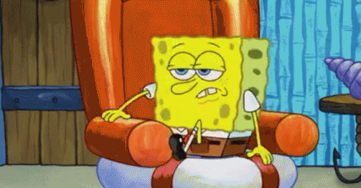
What did you do over the weekend ?
That’s boring.

Slide 22

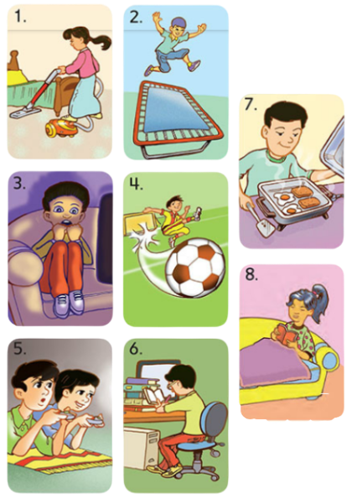
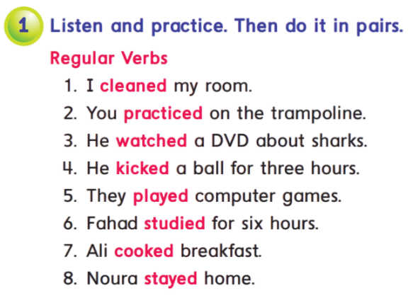
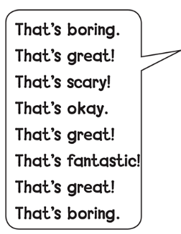

Slide 23


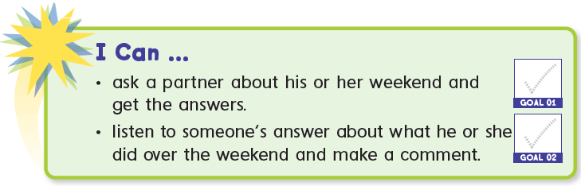

Slide 24


stayed
watched
kicked
played
cleaned
studied

Slide 25


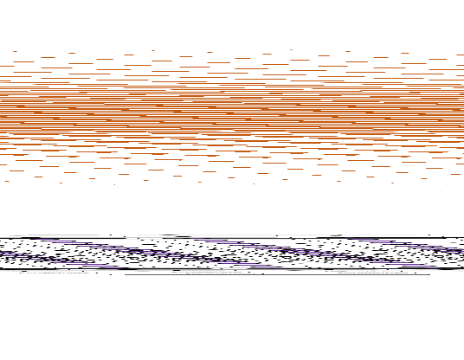


Regular Verbs
cleaned
clean

Slide 26
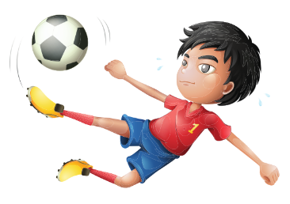
Regular Verbs
kicked
kick

Slide 27

Regular Verbs
watched
watch

Slide 28


Slide 29
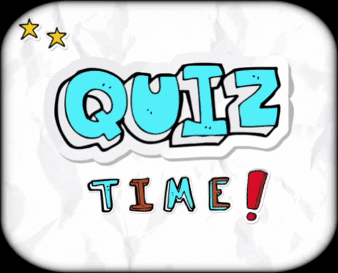

Slide 30





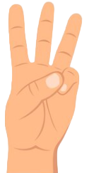
What did you do over the weekend?
01
I cleaned my room .
Objectives
02
I’m cleaning my room
Conclusions
Contact
03
I clean my room .

Slide 31

What did she do over the weekend?
01
She cook the dinner
Objectives
02
She cooked the dinner
Contact
03
She cooks the dinner

Slide 32
What did he do over the weekend?
01
I’m watching a movie .
Objectives
02
I watched a movie .
Contact
03
I watch a movie .

Slide 33
Write the past form of these verb
ask
asked
look
call
looked
called
help
helped
need
needed

Slide 34


Slide 35
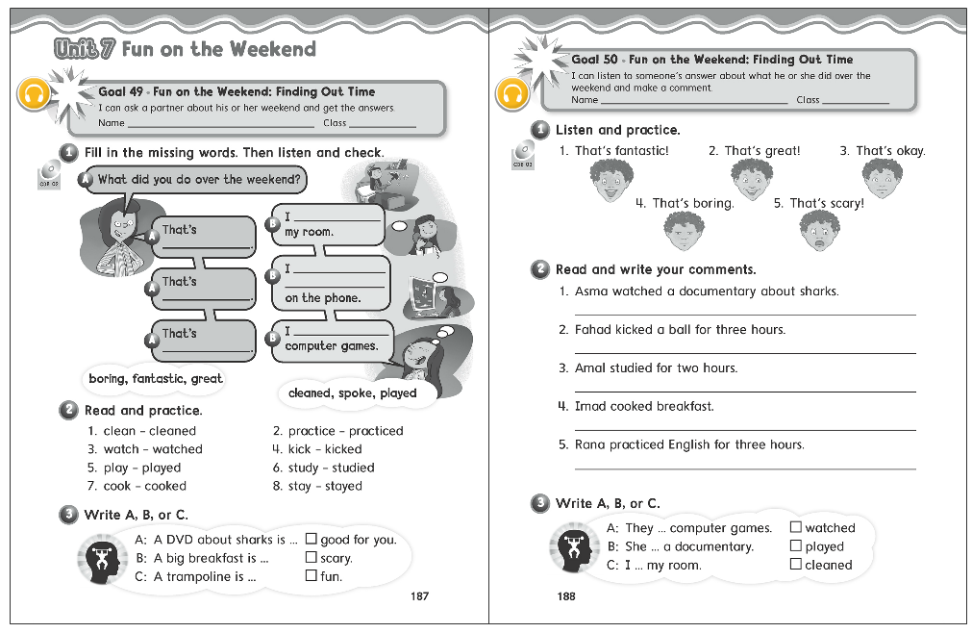
187
188

Slide 36
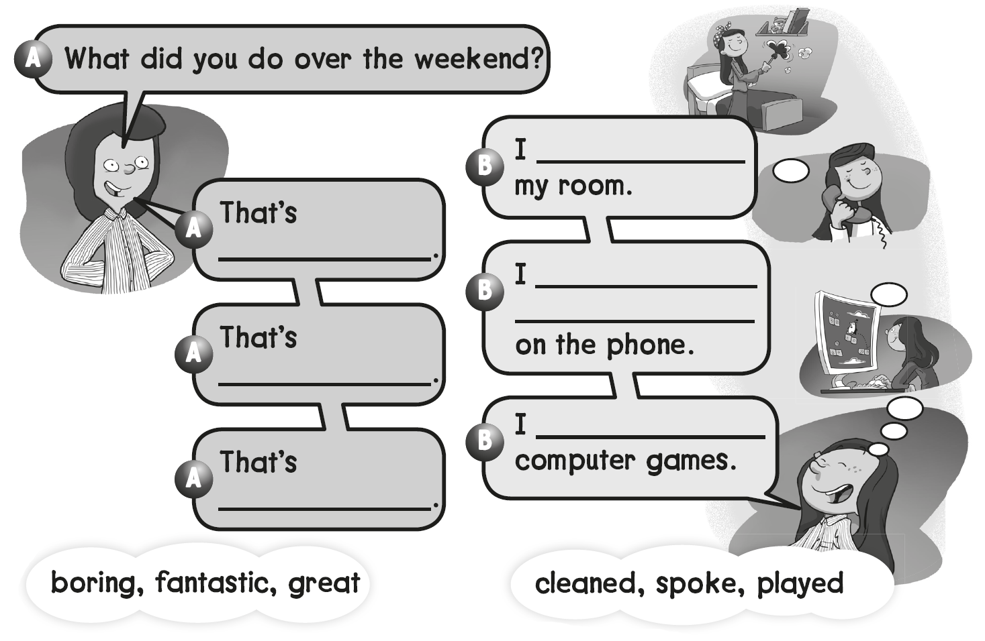
cleaned
boring
spoke with my friends
Fantastic
played
great

Slide 37
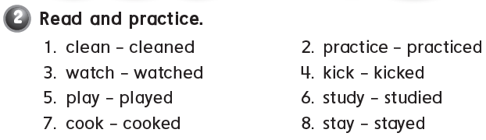
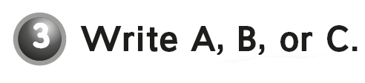
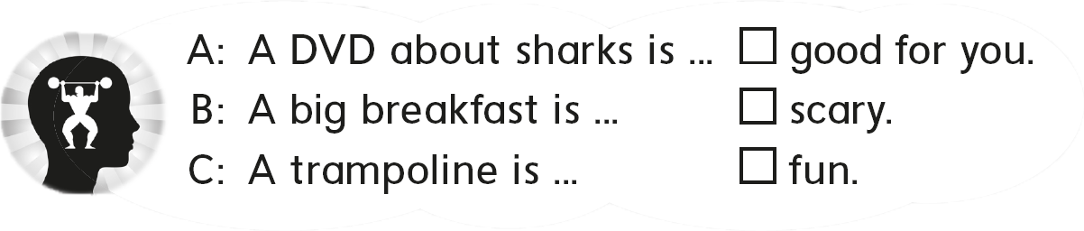
B
A
C

Slide 38

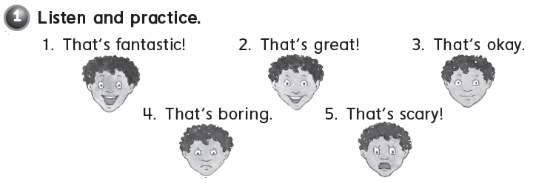

Slide 39
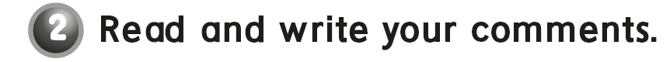
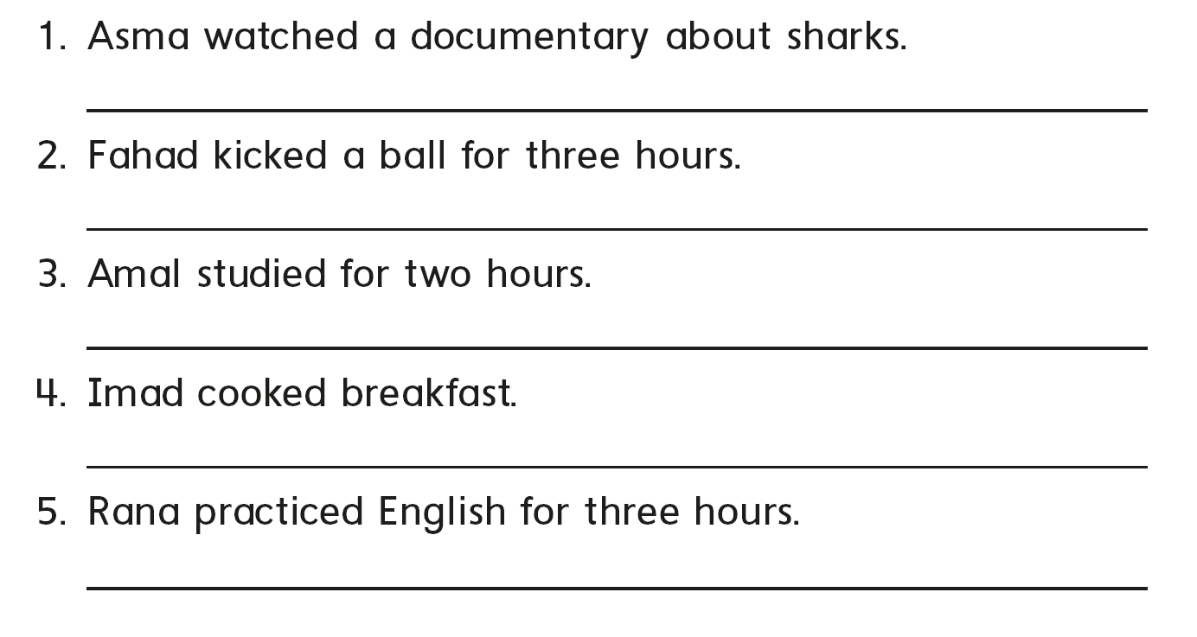
That’s scary
That’s boring
That’s okay
That’s good
That’s great

Slide 40

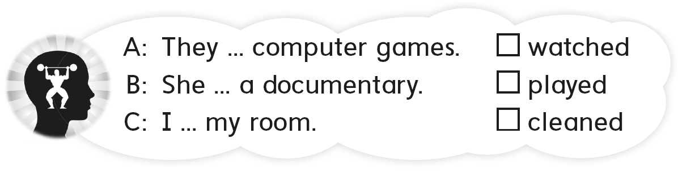
B
A
C

Slide 41


