Slide 1
Unit 7
Everyone Makes Mistakes
Mega Goal 3.2
Grammar
Done By: Entisar Al-Obaidallah

Slide 2
Lesson Objectives
01
02
03
04
Recognize
Change
the use of each modal in the past
The modals in the past into passive correctly
Practice
Apply
writing sentences using modals in the past
The rules to do the exercises correctly

Slide 3


Warm Up
Can you write as many as modal verbs you know..

Slide 4
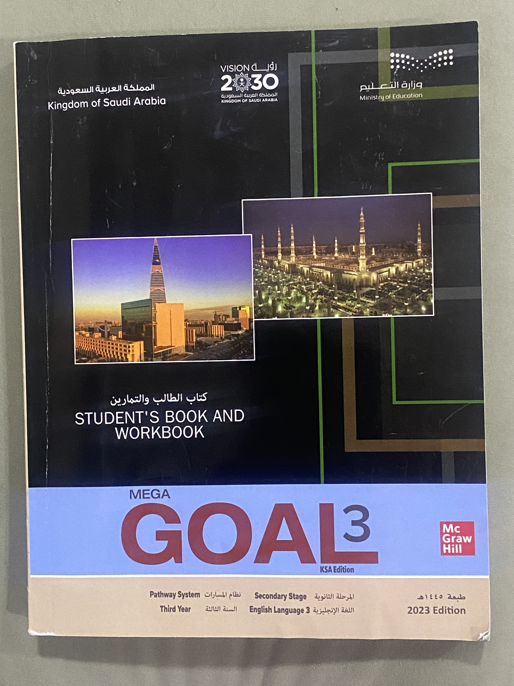
Open
Your student’s book
p. ( 98 )

Slide 5
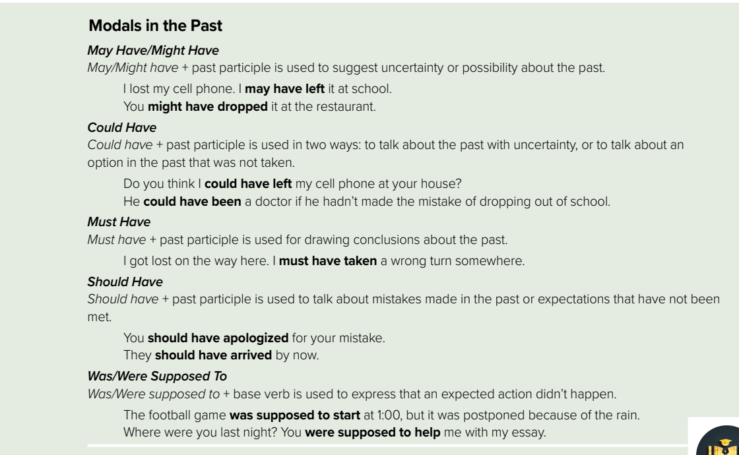



Slide 6
Past Modals
To create a sentence using past modal verbs, you add “have” and a past participle.
Must
May
Might
Could
90% of certain
50%
+ have + P.P.3
30%
10%

Slide 7

May have\might have
Use
We use it when some past event seems probable but we aren't sure. (to suggest uncertainty or possibility about the past) .
Form
might or may
have
Past participle
Example
It's ten o'clock. They might have arrived by now.
I think I might have left the AC on. Please can you check?
Police think the suspect may have left the country using a fake passport.
May have is more formal than might have but might have is more common.

Slide 8
Could have
Use
Something was possible in the past or there was a probability, but it didn't happen.
Form
could
have
Past participle
Example
I could have passed my math exam if I had studied harder..
I could have gone to the cinema, but I decided to stay home.
He could have slept till noon but the alarm clock woke him up.
He could have been injured. Fortunately, nothing happened.
We could have stayed longer but we decided to leave.

Slide 9
must have
Use
to show a high degree of certainty. We are almost 100% sure that something happened in the past. (certainty)
Form
could
have
Past participle
Example
He must have arrived early to secure a good seat..
He must have been exited about his new job.
She must have been tired after cleaning the house all day.
You must have studied hard to pass the exam .
They must have enjoyed their vacation in Riyadh.

Slide 10
Should have
Use
to talk about something that was a good idea in the past but which didn't happen. It can express regret ( Past Mistakes).
Form
should
have
Past participle
Example
You should have come to the party yesterday, it was fun.
I should have followed your advice, you were right.
I should have studied more for my test.

Slide 11
Was/Were Supposed To
Use
to express that an expected action didn’t happen.
Form
Was/Were supposed to
base verb
Example
I was supposed to post the letter, but I forget ..
They were supposed to bring their books..
You were supposed to pay for them before you left the shop..

Slide 12


Slide 13

Who broke the window?
Someone __________________the window.
may have broken
Might have broken
could have broken

Slide 14


Who broke the window?
must have broken
Ali was playing near the window
yesterday
Ali _________________the window.

Slide 15
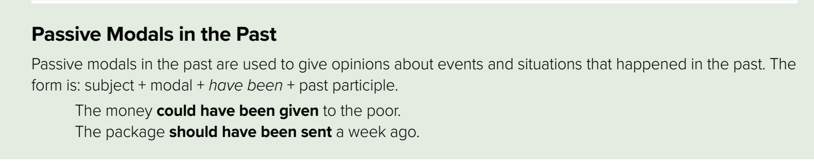
Form
subject
modal
Have been
P.P.3
Example
subject
modal
verb
object
A computer error may have caused the accident.
Start with the object
ends with the subject
The accident may have been caused by a computer error.
add been
add by

Slide 16
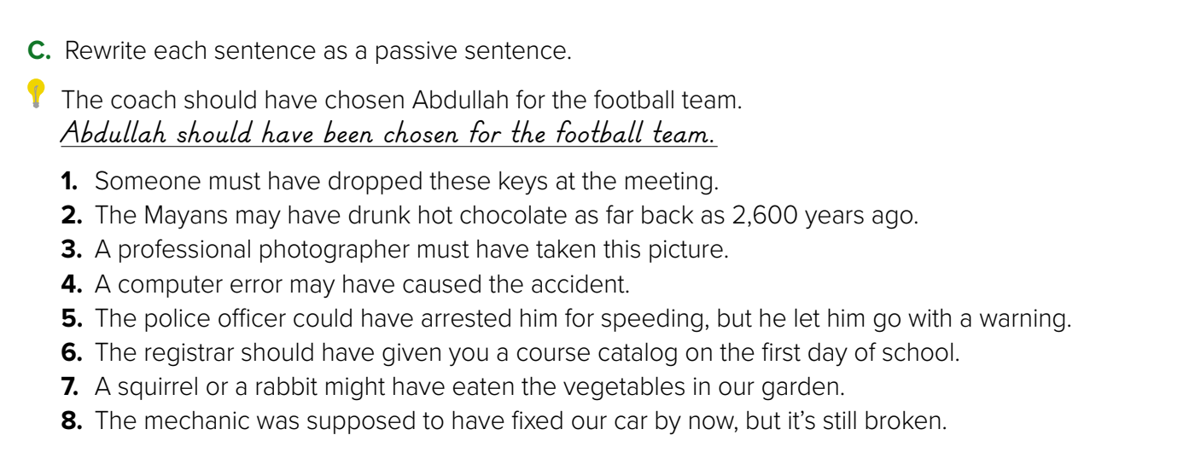
1. These keys must have been dropped at the meeting.
2. Hot chocolate may have been drunk by the Mayans as far back as 2,600 years ago.
3. This picture must have been taken by a professionalphotographer.
4. The accident may have been caused by a computer error.
5. He could have been arrested for speeding but was let go with a warning.
6. You should have been given a course catalog on the first day of school.
7. The vegetables in our garden might have been eaten by a squirrel or a rabbit.
8. Our car was supposed to have been fixed by now, but it’s still broken

Slide 18
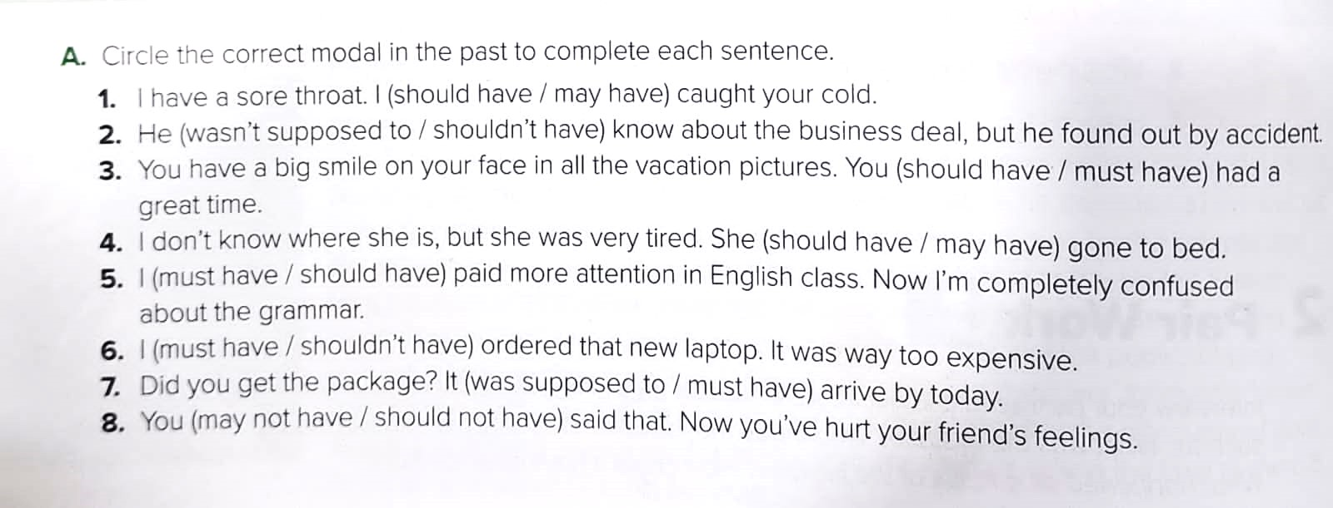

Slide 19
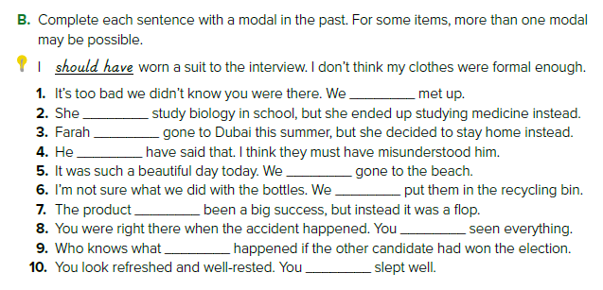
could have
might have
was supposed to
could have
Couldn’t have
could have
should have
might have
may have
should have
should have
must have
might have
could have
must have

Slide 20
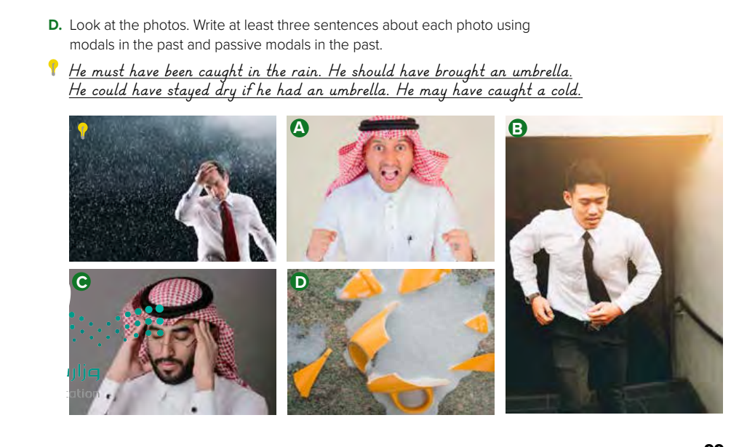

Slide 21
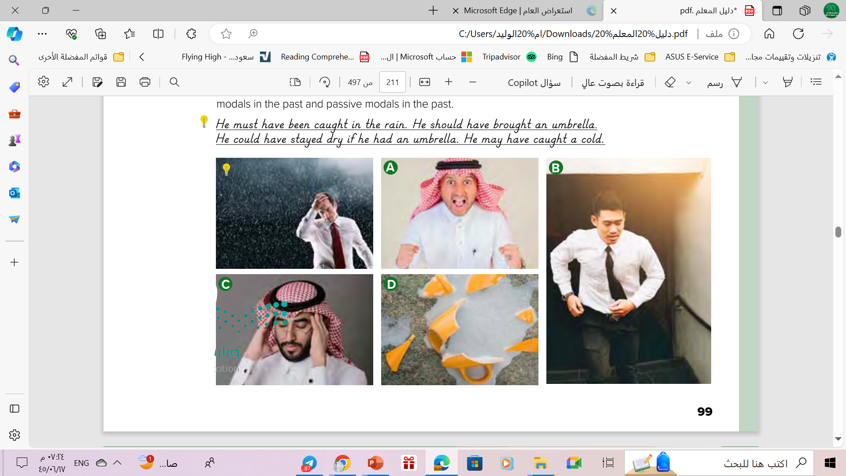

What is happening in this picture?
➔-He must not have been expecting the good news. ➔It might have been a surprise to him.
➔The good news may have been given to him by
his parents

Slide 22
What is happening in this picture?
➔He must have just missed his train..
➔He might have had a job interview
➔He should have gotten to the station earlier.

Slide 23
What is happening in this picture?
➔He might have forgotten something important.
➔Whatever he forgot must have been important. ➔He should have written it down.

Slide 24
What is happening in this picture?
➔The cup must have been made of ceramics.
➔Somebody might have dropped it accidentally. ➔It may have fallen out of a cabinet.

Slide 25
Homework
Workbook exercise ( E-F) ,
P.( 291)

Slide 26
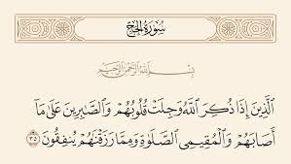
Passive in the Holy Quran

Slide 27

Thanks!

Slide 28
Alternative resources
Here’s an assortment of alternative resources whose style fits the one of this template
Vectors
Notebook paper quote templates
Hand drawn school template

