Slide 1
Unit 7 Everyone Makes Mistakes Listen & Discuss
Mega Goal 3.2
Done By: Entisar Al-Obaidallah

Slide 2
Lesson Objectives
01
02
03
04
Discuss
Listen
The topic of “ mistakes”
For specific information
Answer
Match
Some questions correctly
The words with their meanings correctly

Slide 3
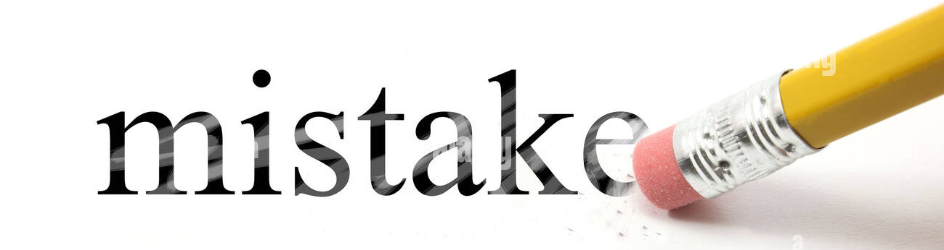
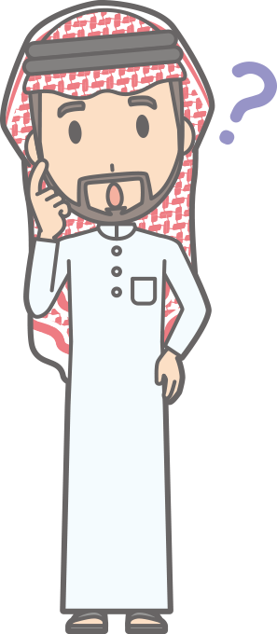

Warm Up
How would you define the word mistake?
A mistake is something that
you wish you hadn’t done.

Slide 4
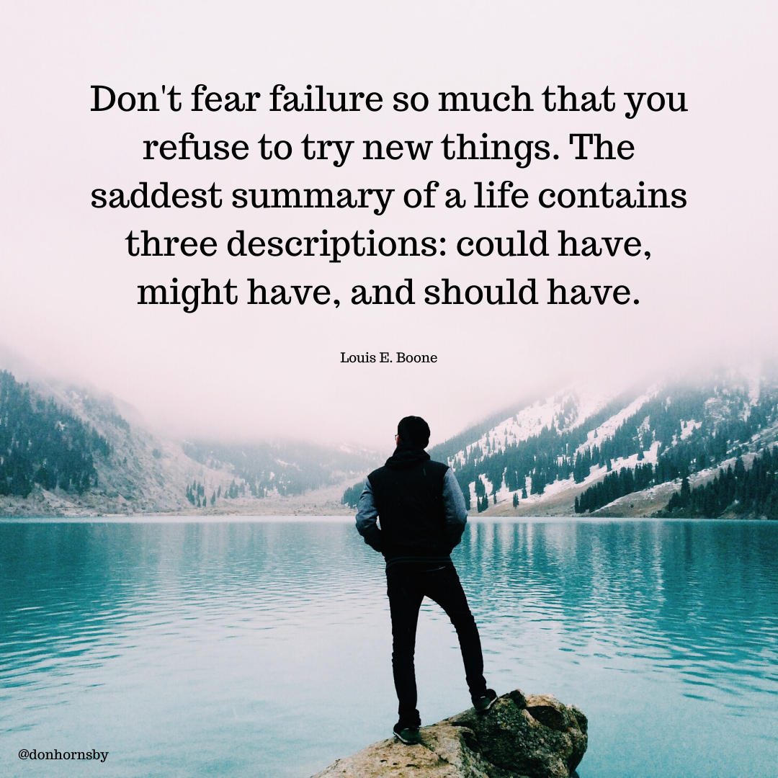
Read & Discuss
What does this quote mean?

Slide 5

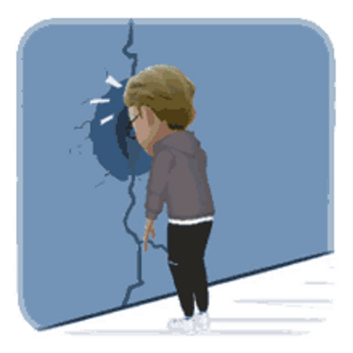


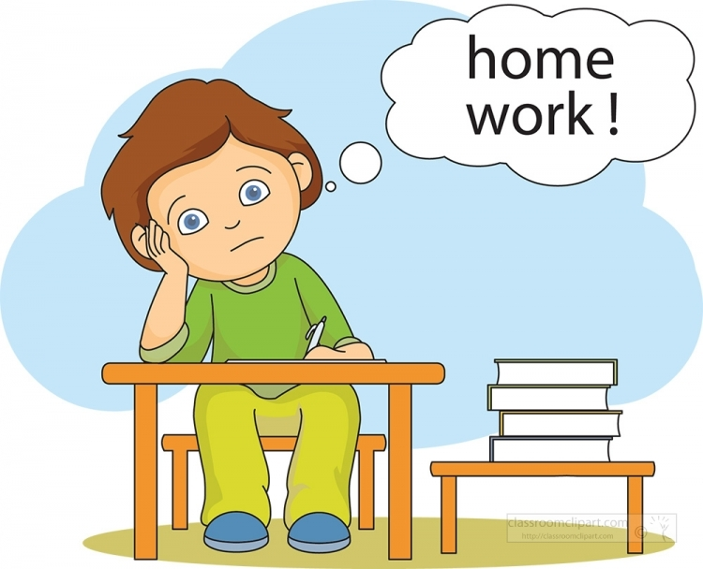

Brainstorming
regret
Give examples of things that people often
regret not doing or trying?

Slide 6

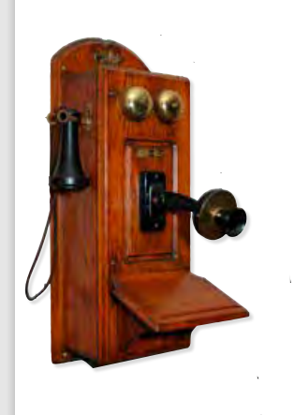
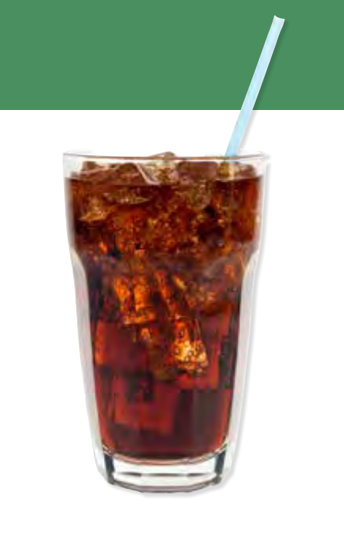
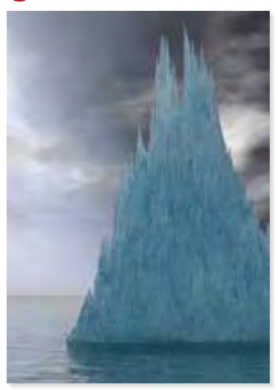
What does each picture show?
Coca-Cola
Telephone
icebergs
Alaska

Slide 7

Open
Your student’s book p. ( 96-97)

Slide 8
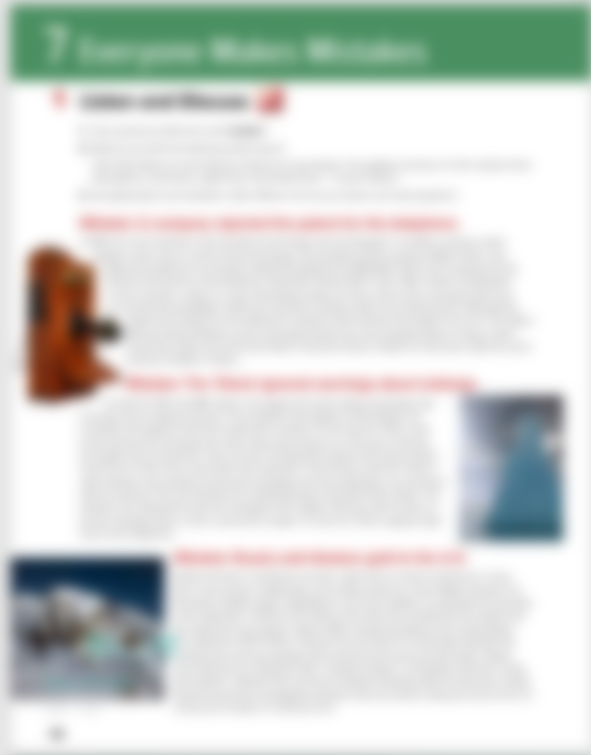
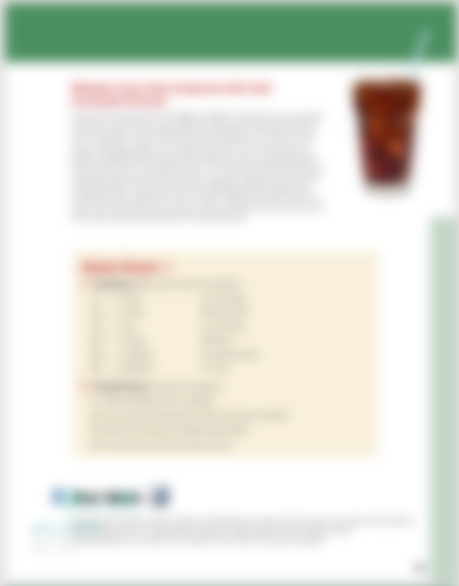

Read along as you listen

Slide 9
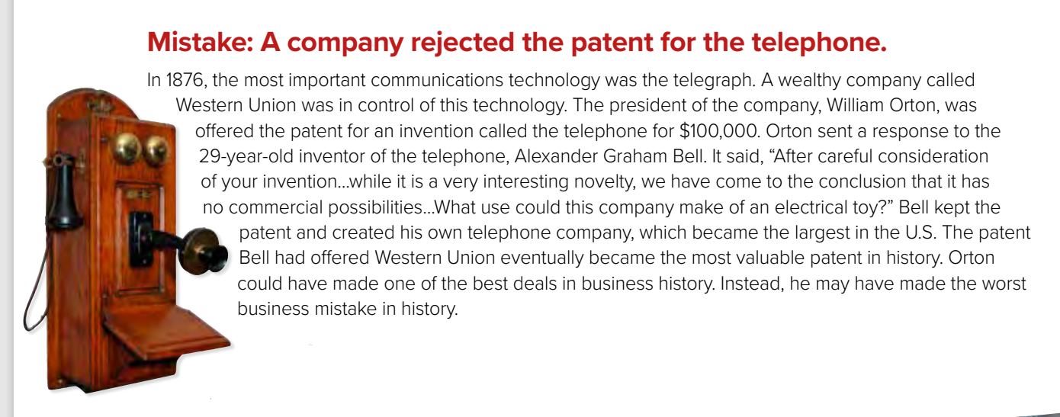


Why was this a mistake?
What was the mistake?
Western Union rejected the patent for the telephone
The company would have made a lot of money

Slide 10
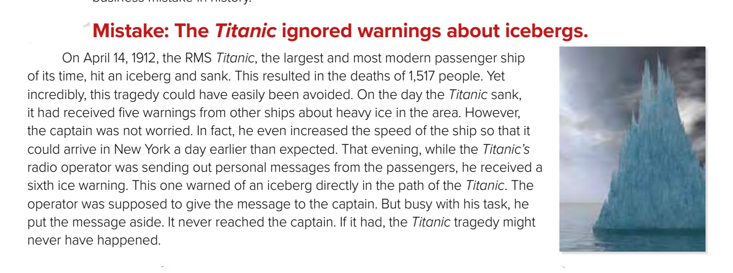
What was the mistake?
Why was this a mistake?
It resulted in the deaths of 1,517 people
The captain ignored five warnings about icebergs and the radio operator didn’t give the captain another warning

Slide 11
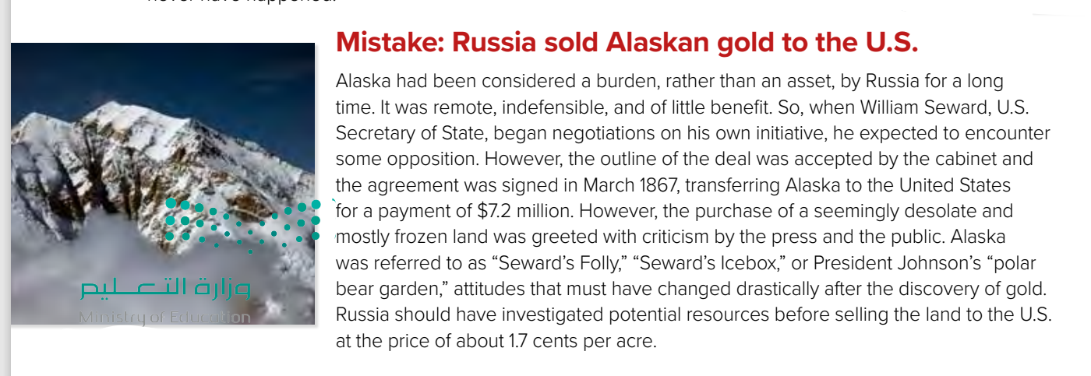
Why was this a mistake?
What was the mistake?
There was gold in Alaska
Russia sold Alaska to the United States for 1.7 cents per acre

Slide 12
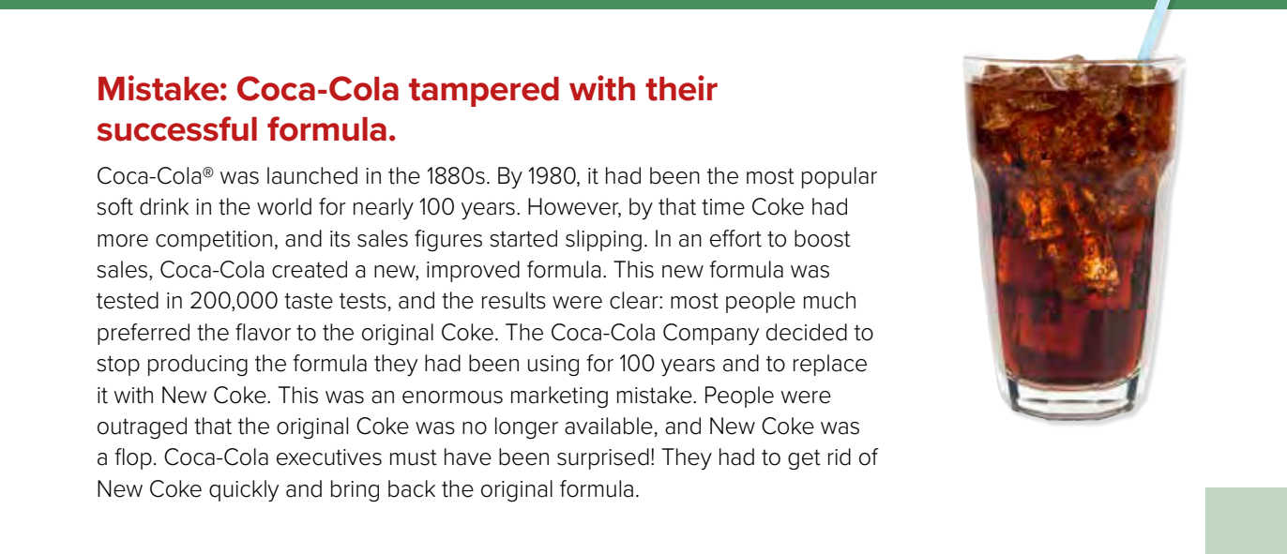
What was the mistake?
Why was this a mistake?
People were outraged that
the original Coke was not available
Coca-Cola changed their formula and taste

Slide 13
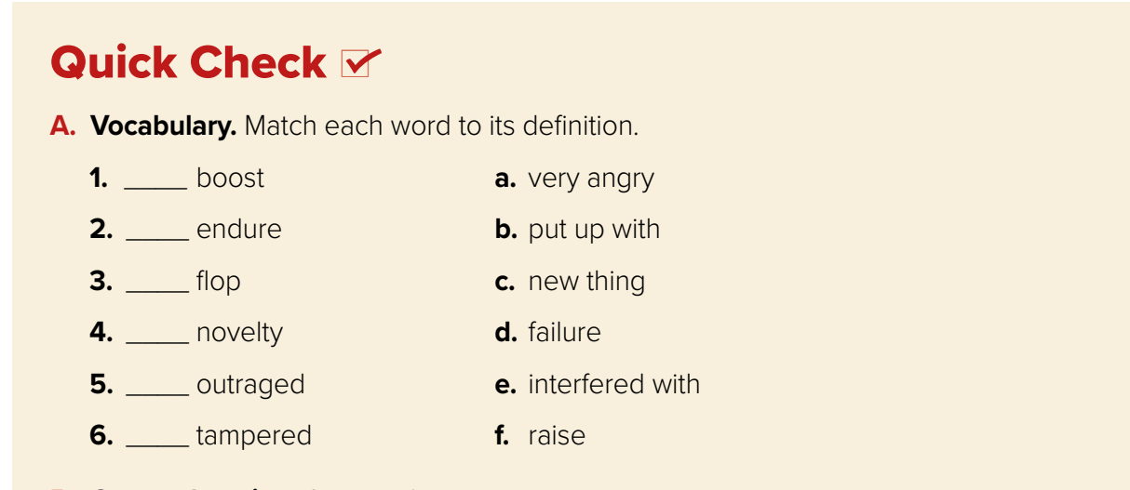

f
b
d
c
a
e

Slide 14
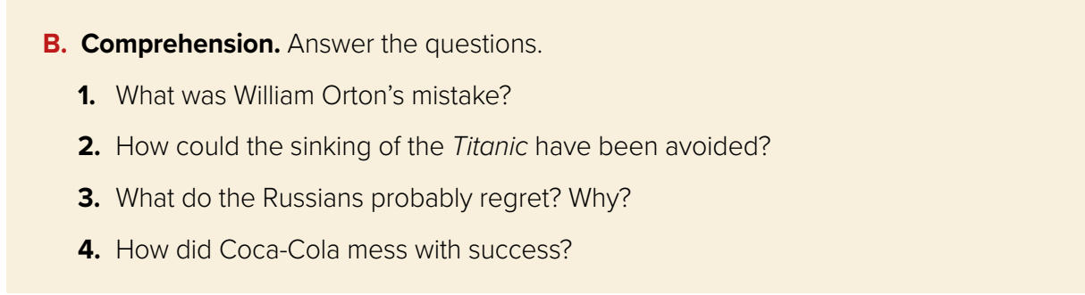

1. He did not realize that the telephone would become the most valuable patent in history.
2. If the radio operator had given the warning to the captain about the iceberg that was directly in the ship’s path, the Titanic might not have sunk.
3. Russia probably regretted selling Alaska to the United States since the Americans
discovered gold.
4. Coca-Cola tried to change the formula of the soft drink that had been the most popular in
the world for over 100 years.

Slide 15
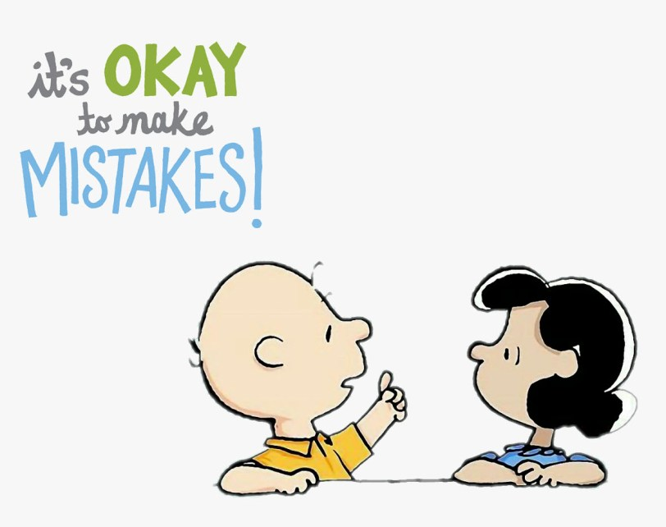
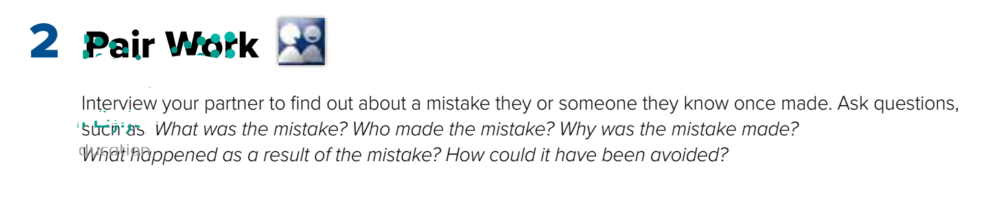
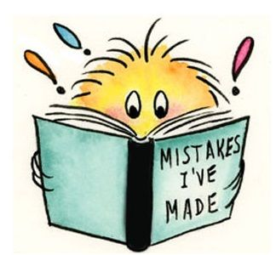
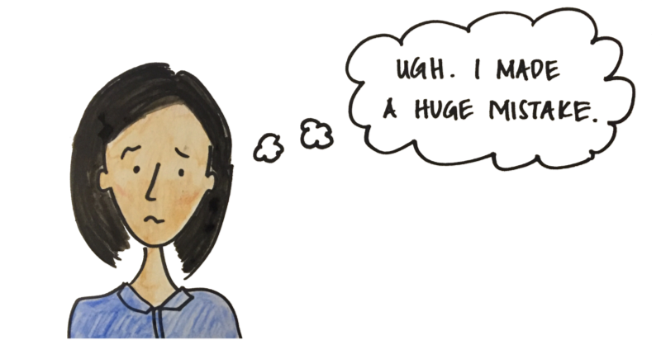
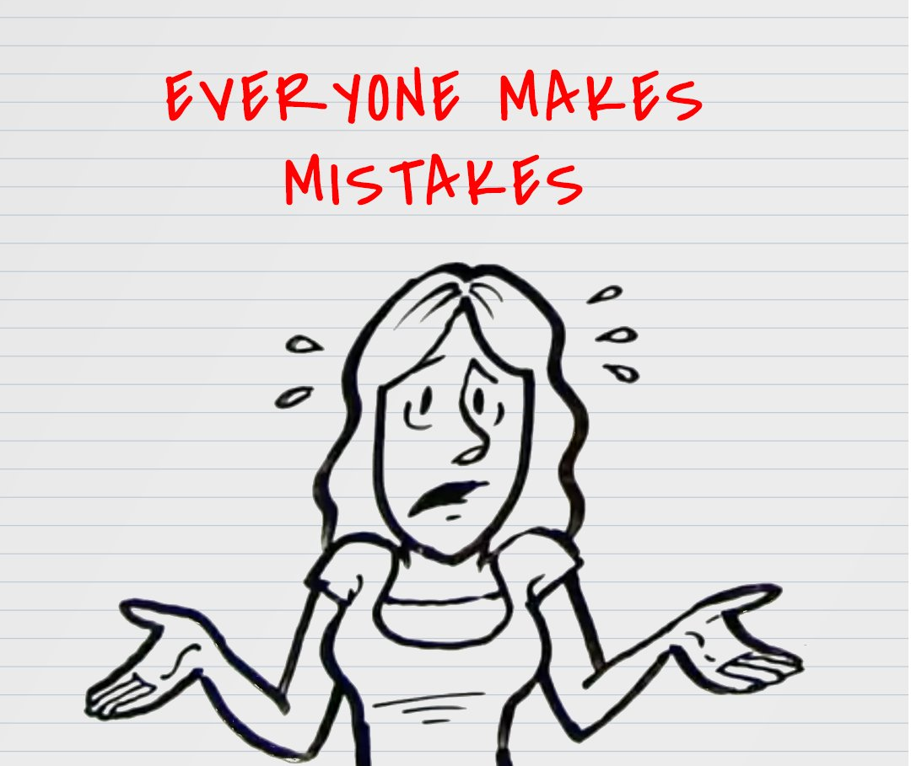

Slide 16
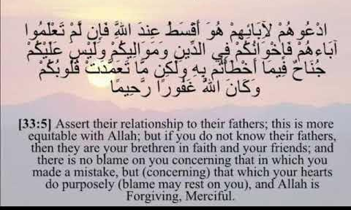
The word “ Mistake “ in the holy Quran

Slide 17

Homework
Workbook, exercise ( A-B ),
P.( 289)

Slide 18


THANKS!

