Slide 1
Unit 7
Everyone Makes Mistaes
Form,Meaning & Function
Mega Goal 3.2
Done by: Entisar Al-Obaidallah

Slide 2
Lesson Objectives
01
02
03
04
identify
Distinguish
Differntiate
Practice
The words connected with business
Between the articles correctly
Between count and non count nouns
Using expressions of Quantity

Slide 3
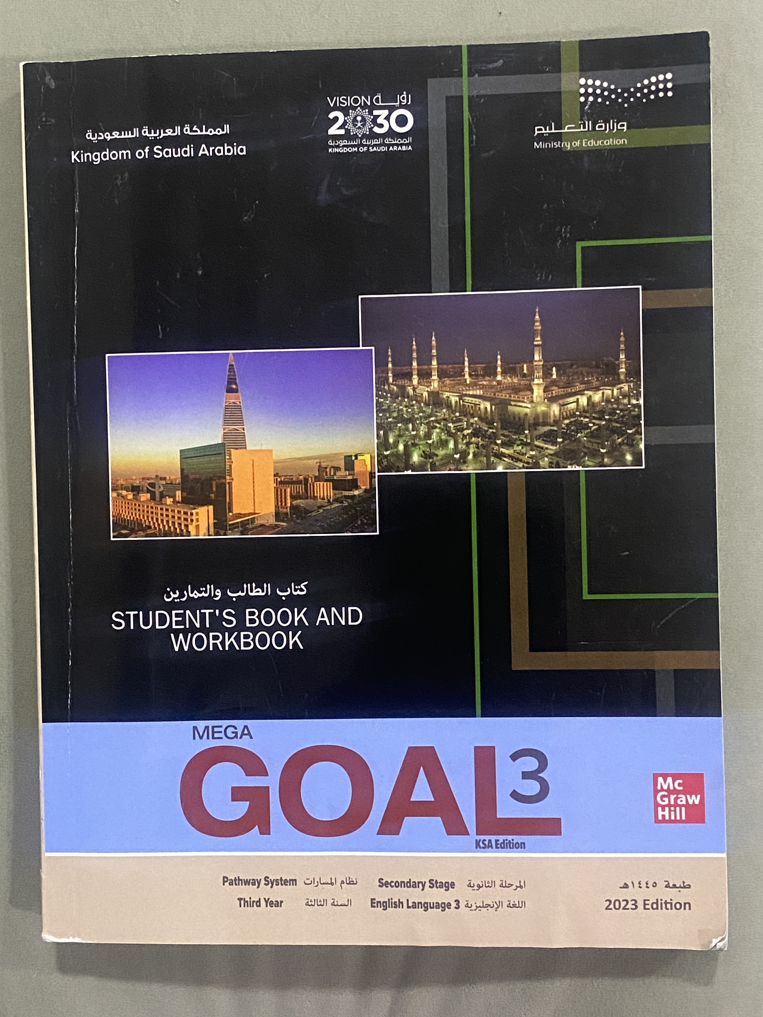
Open
Your student’s book ,
p.( 106)

Slide 4
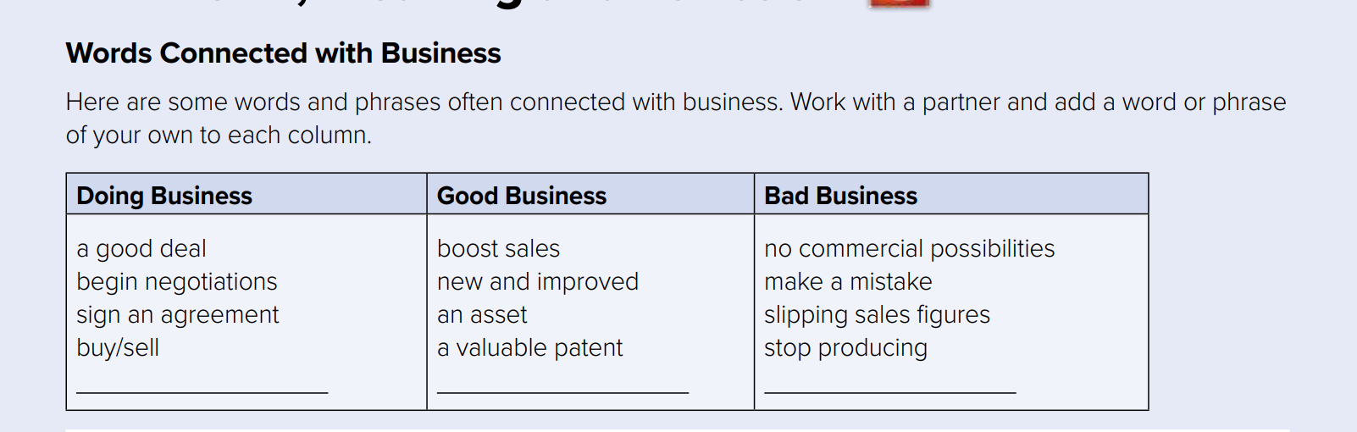

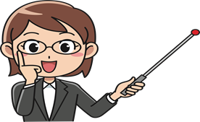
Read the words in the chart
Add a word or phrase of your own to each column in the vocabulary chart

Slide 5


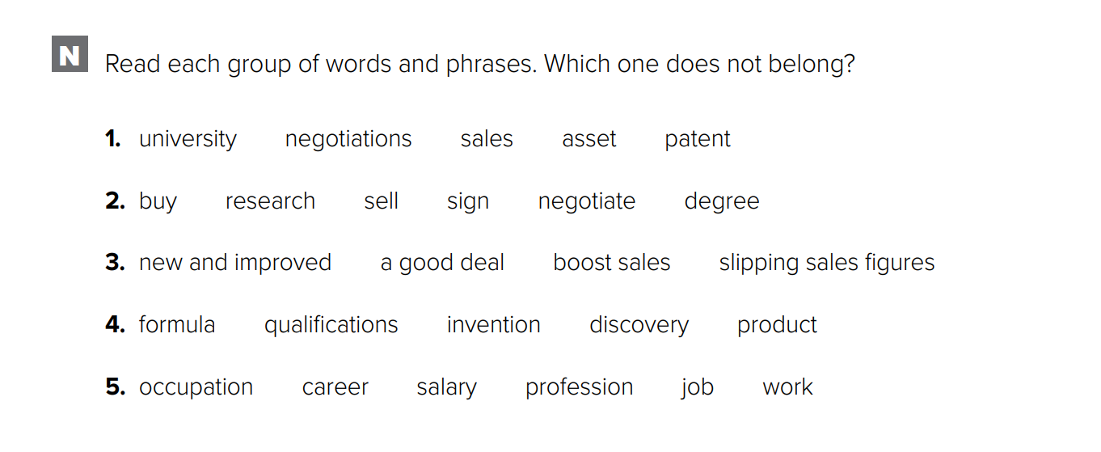
Workbook p.(297)

Slide 6
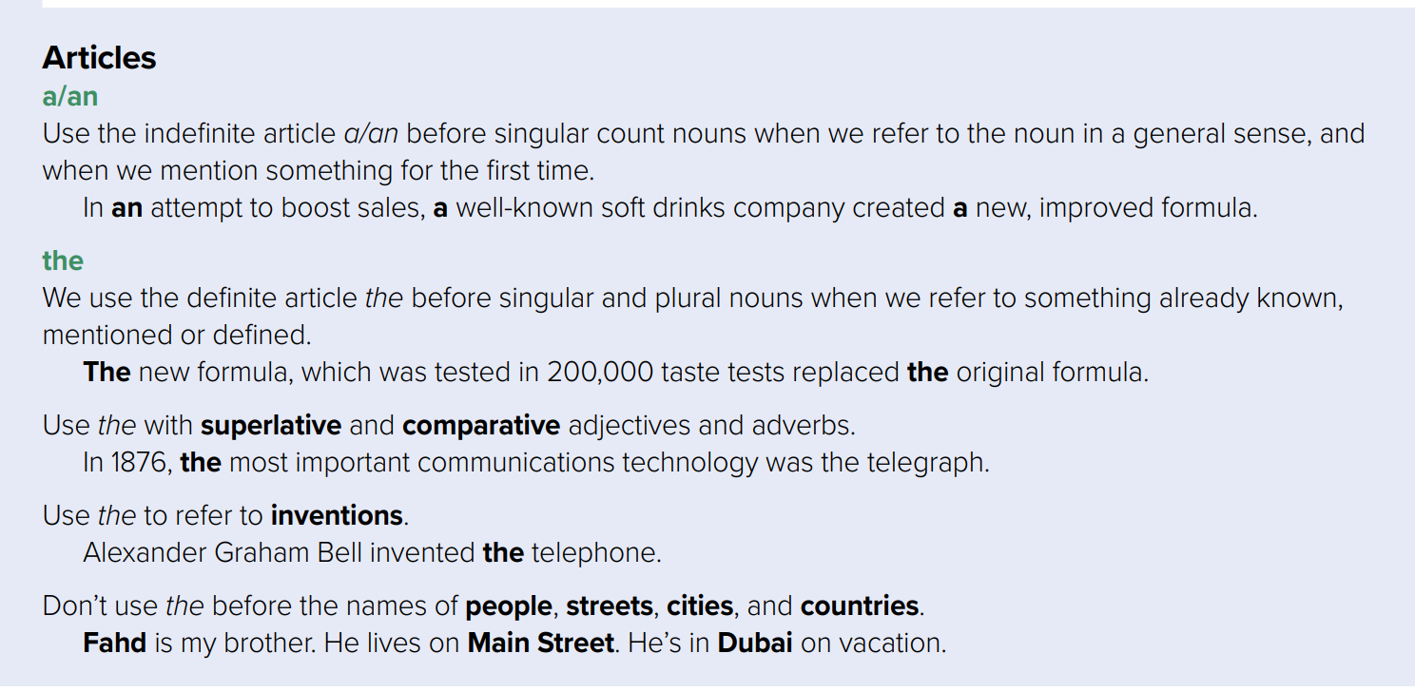

Slide 7
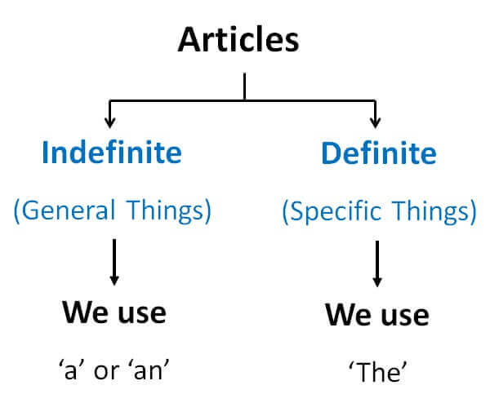
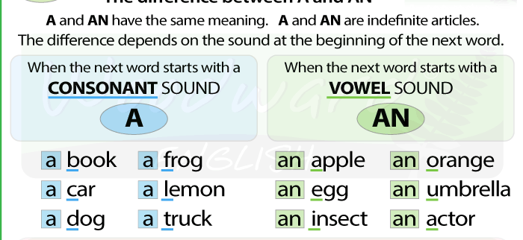
The difference between
A & AN
There are two kinds of Articles

Slide 8

A & An
A indefinite articles used before singular count nouns
1- when we refer to the noun in a general sense, not a specific object, one
of a number of the same objects) with consonants
Example
Singular , count noun
Singular , count noun
She has a cat.
He works in a factory.
Starts with consonants
2- when we when we mention something for the first time
First time
Repeated-2nd time
Example
I live in a house. The house is quite old .

Slide 9
A & An
An indefinite articles used before singular count nouns
1- Used when we refer to the noun in a general sense, not a specific object,
one of a number of the same objects) with vowels ( a ,e , I . o , u)
Singular , count noun
Singular , count noun
Example
She is an English teacher.
Can I have an apple?
Starts with vowel
2- Used when we when we mention something for the first time
Example
First time
Repeated-2nd time
I eat an apple. The apple is delicious.

Slide 10

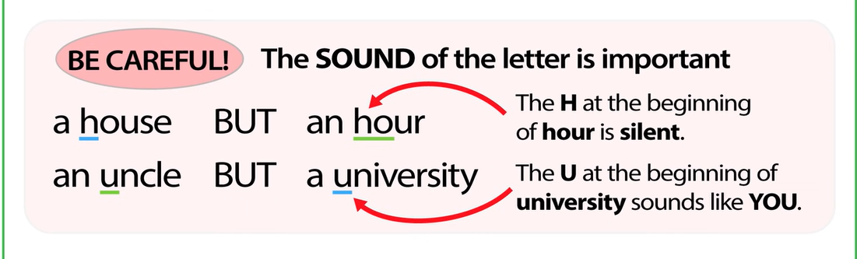

Slide 11
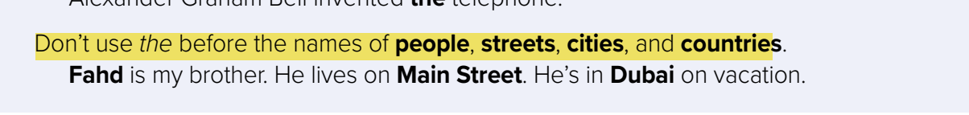
The
The definite article used before singular and plural nouns.
Used for specific nouns , like a particular person or particular thing.
Example
Where is the teacher ?
The moon looks beautiful tonight.
Use The with superlative and comparative adjectives and adverbs
Example
PEPSI is the most popular drink in the world
Use the to refer to inventions.
Example
Thomas Edison invented the light Bulb

Slide 12


Slide 13



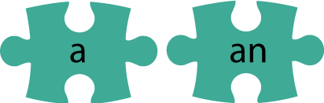

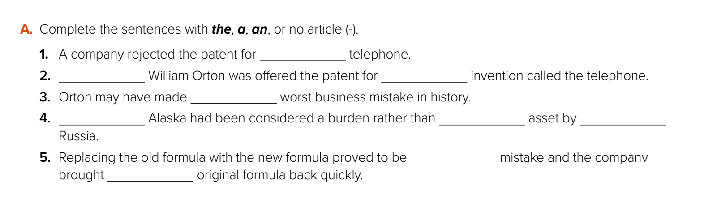
the
__
an
the
__
__
an
a
the

Slide 14
Open
Your student’s book ,
p.( 107)

Slide 15
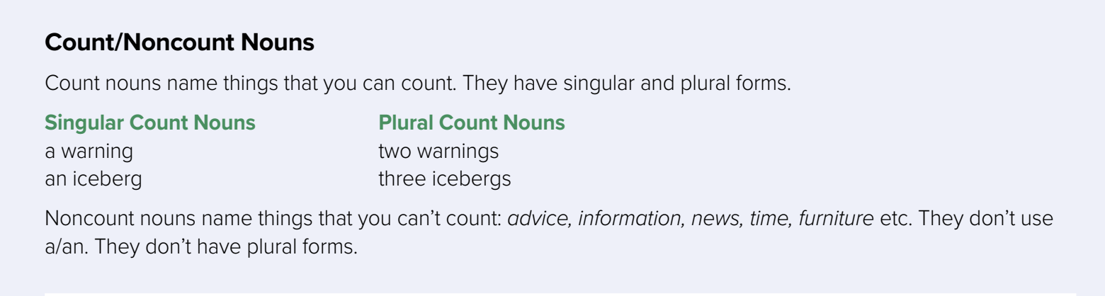
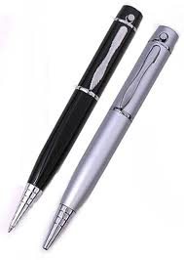
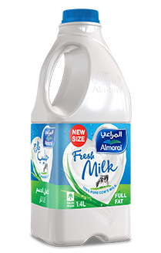
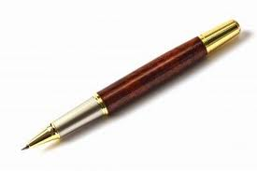
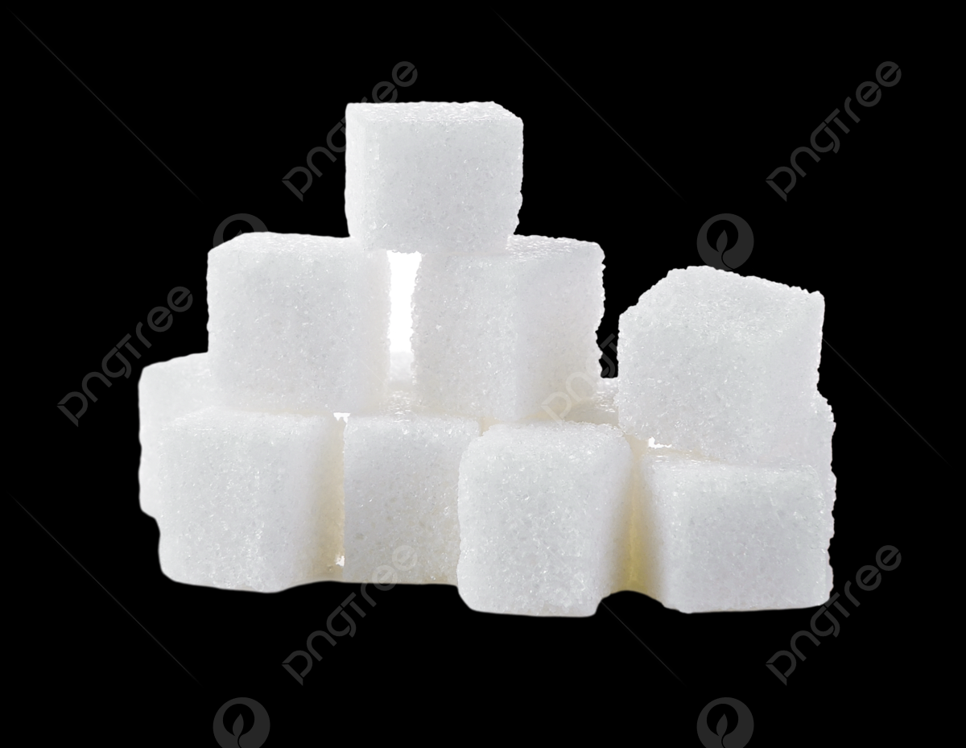
Example
uncountable
countable
noncount
One pen
Two pens
milk
sugar
singular
plural
singular
singular

Slide 16
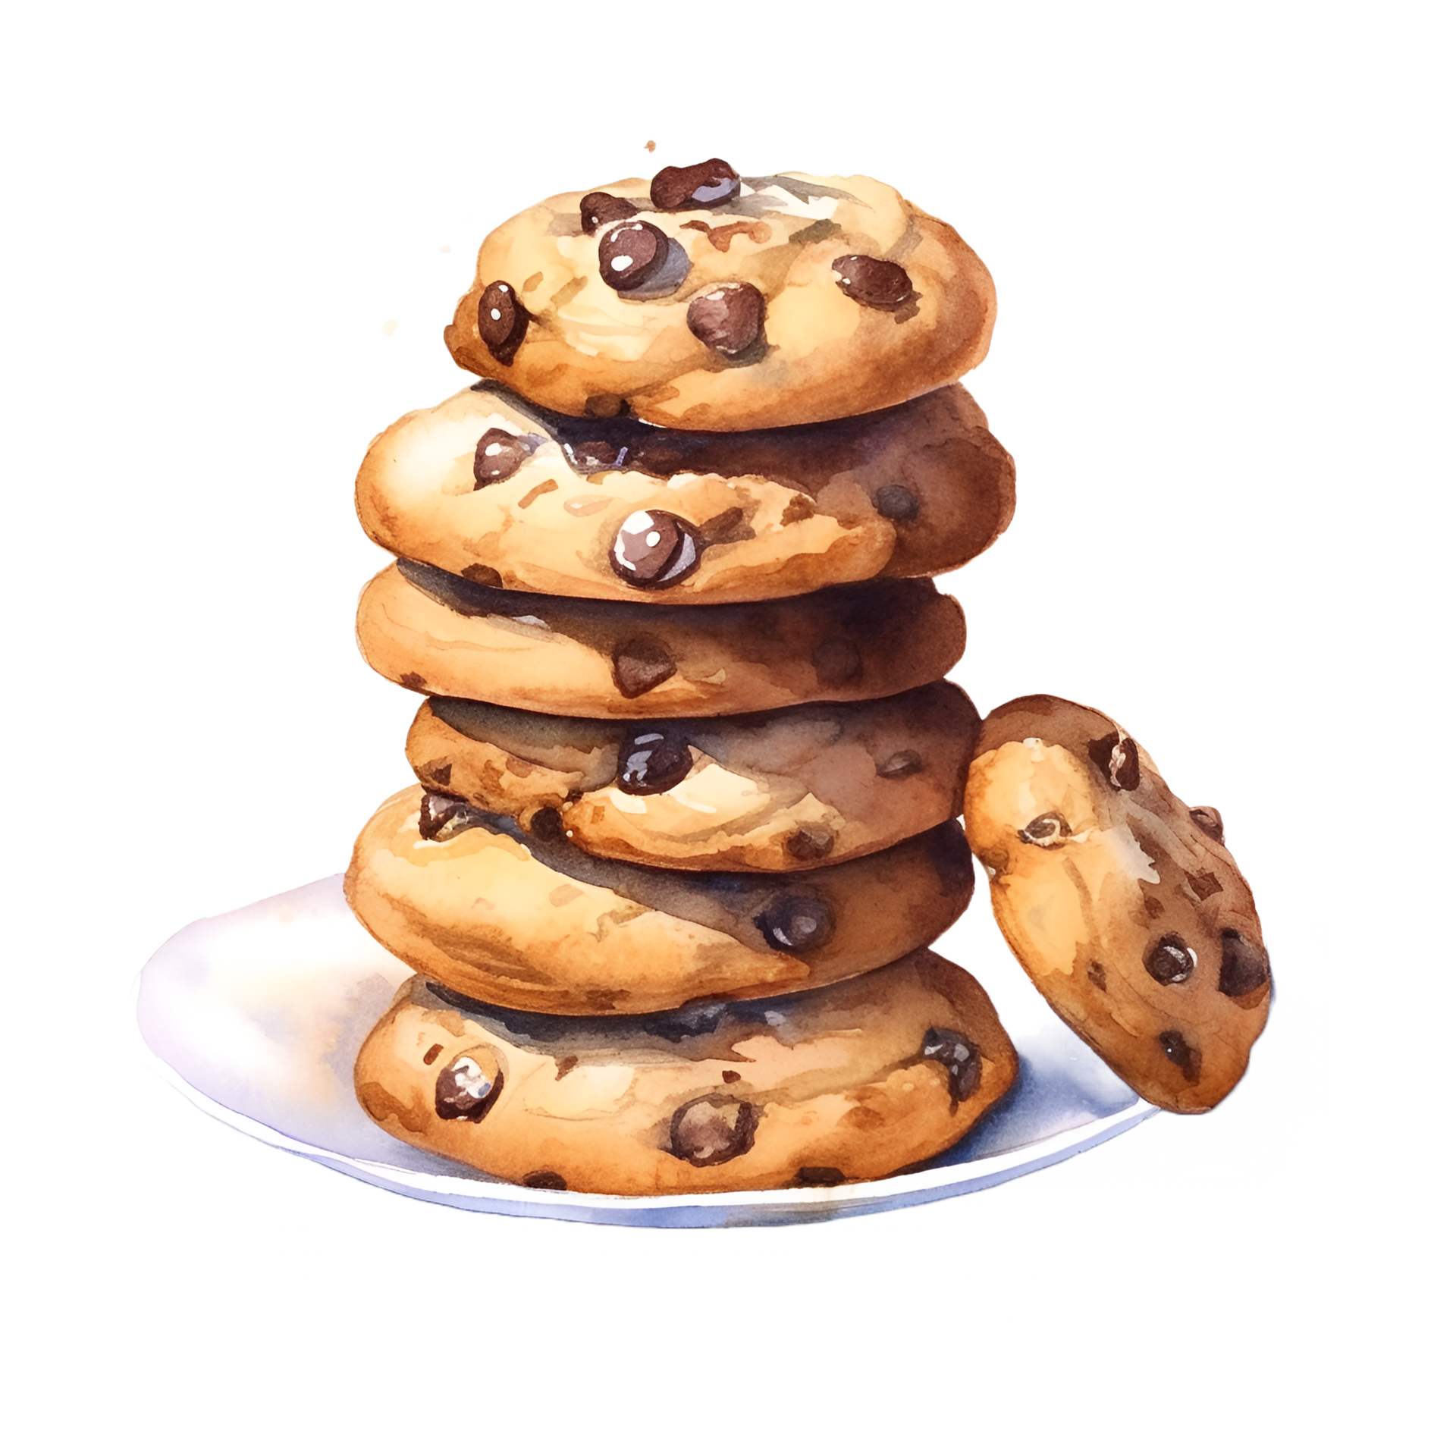
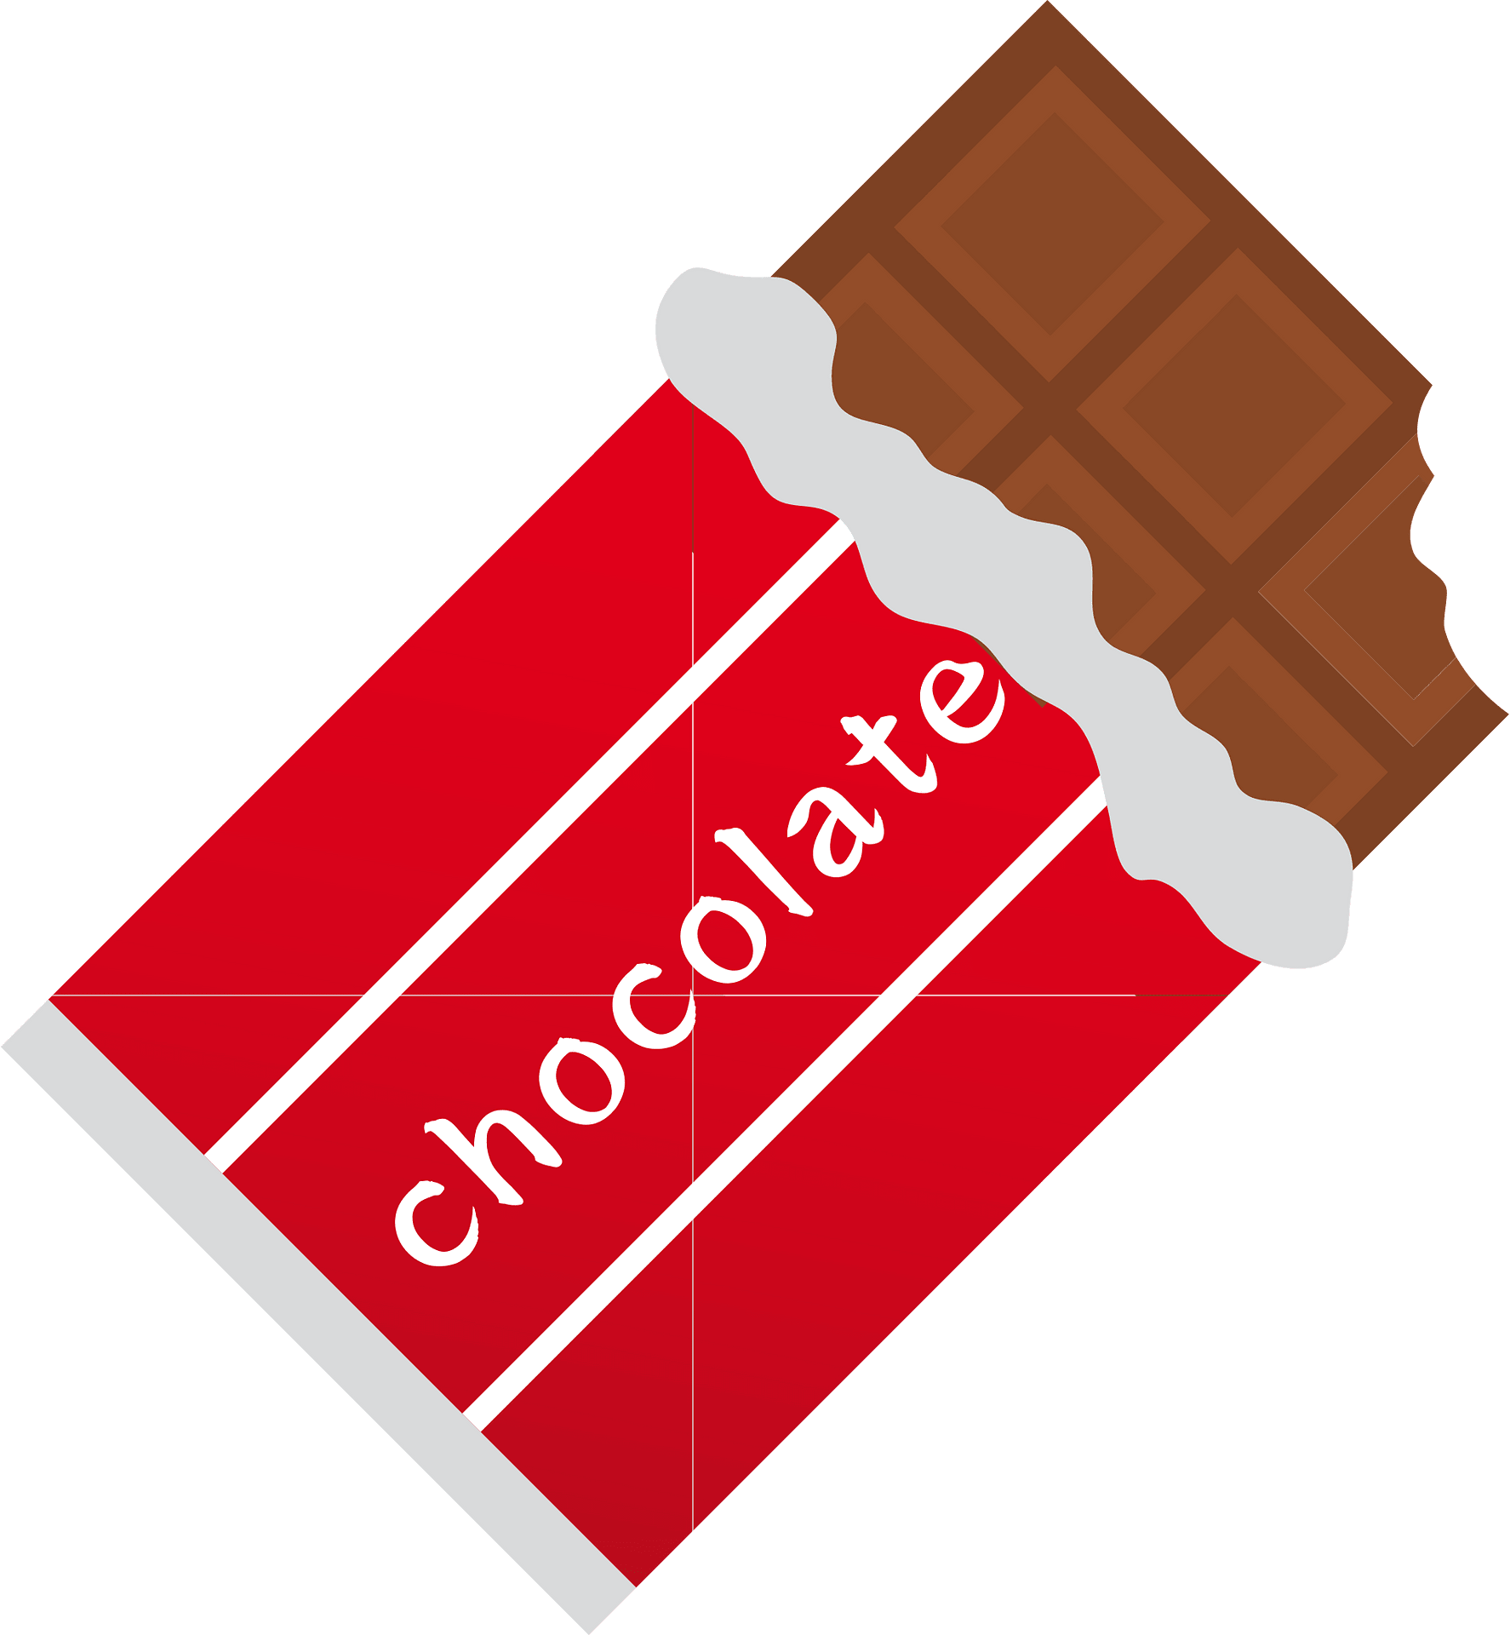
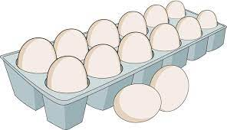
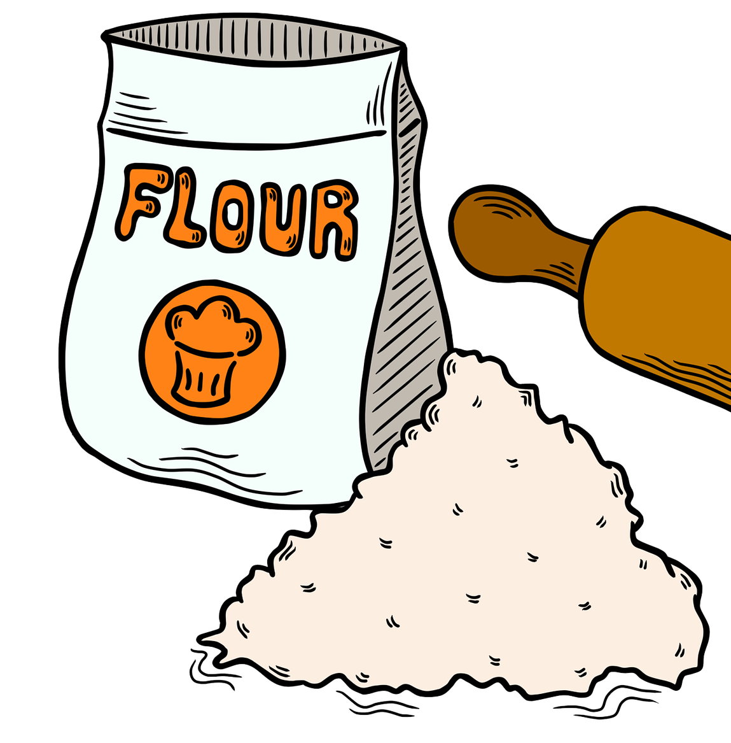
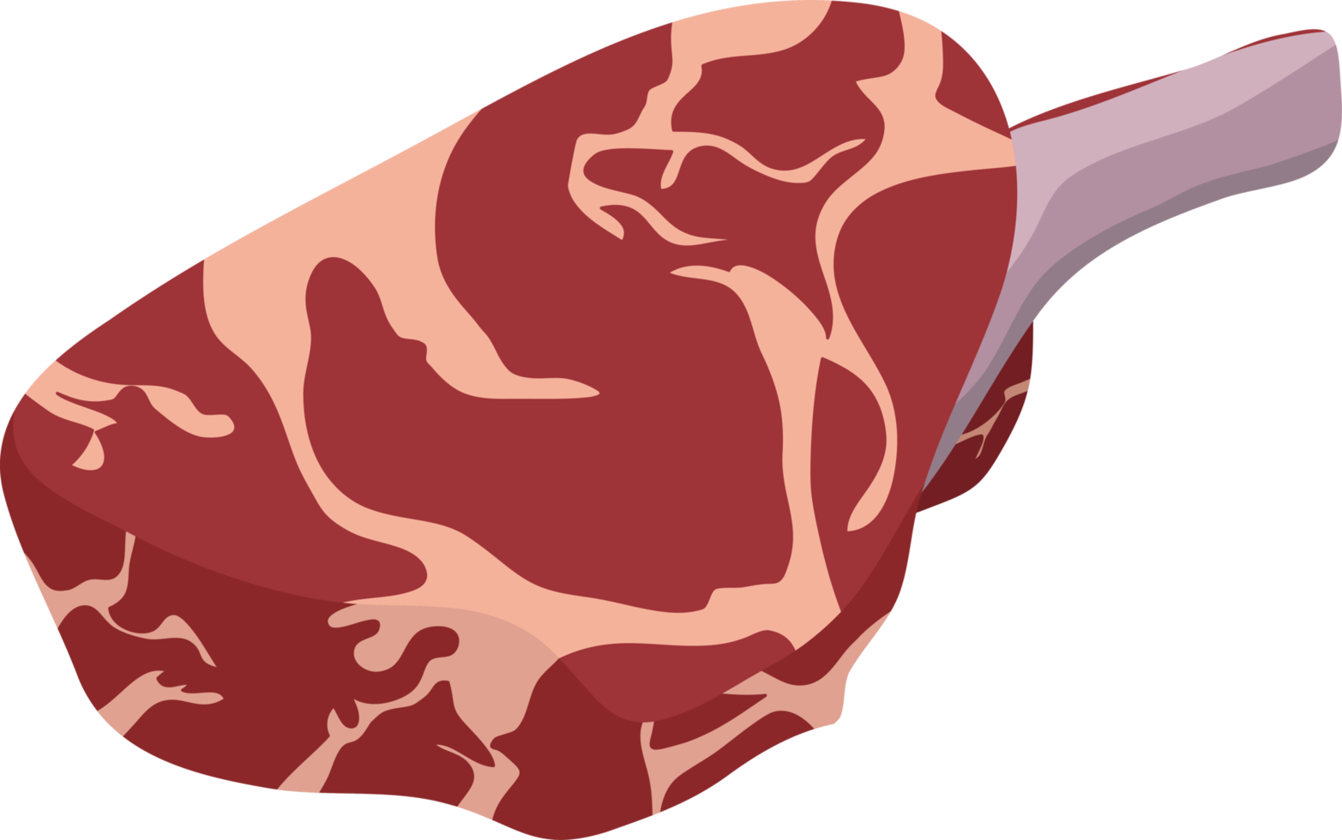


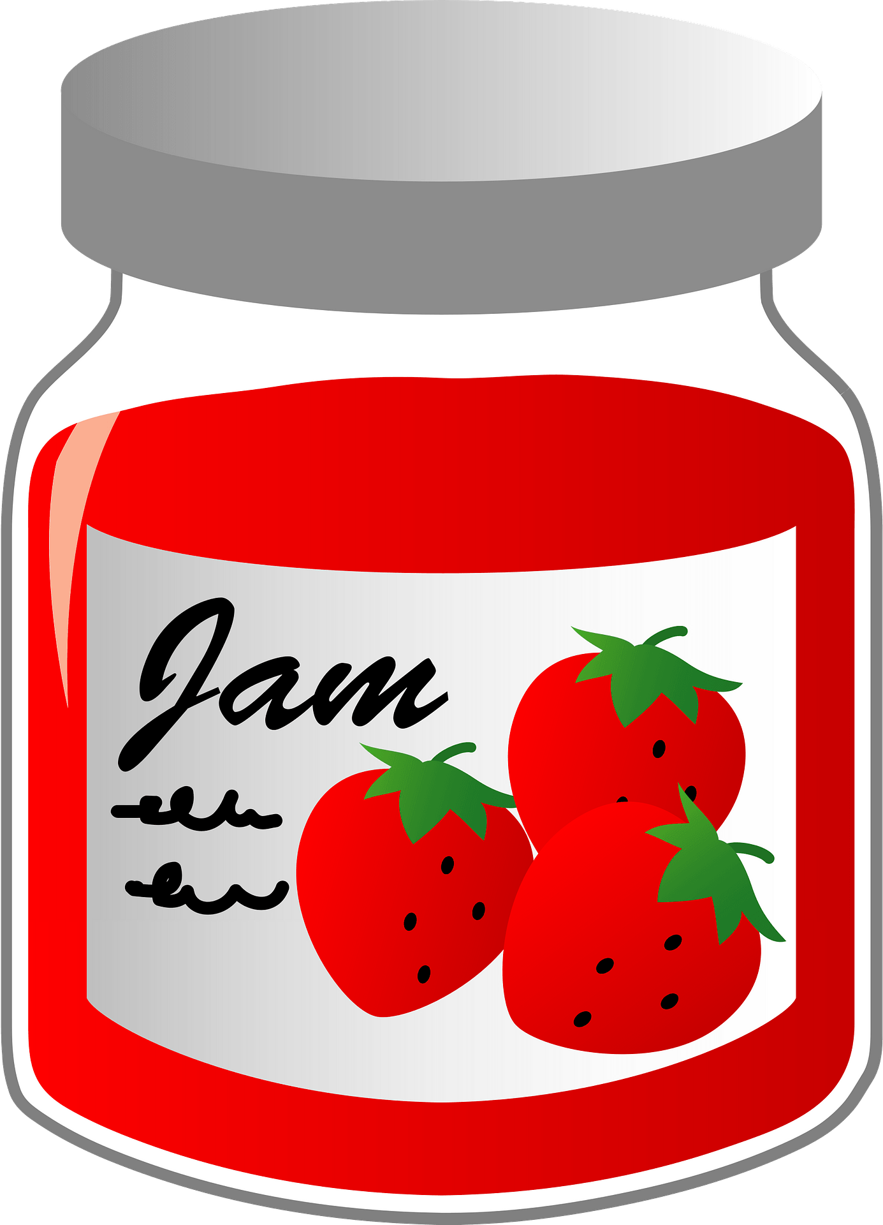

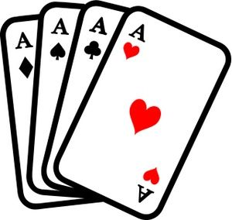
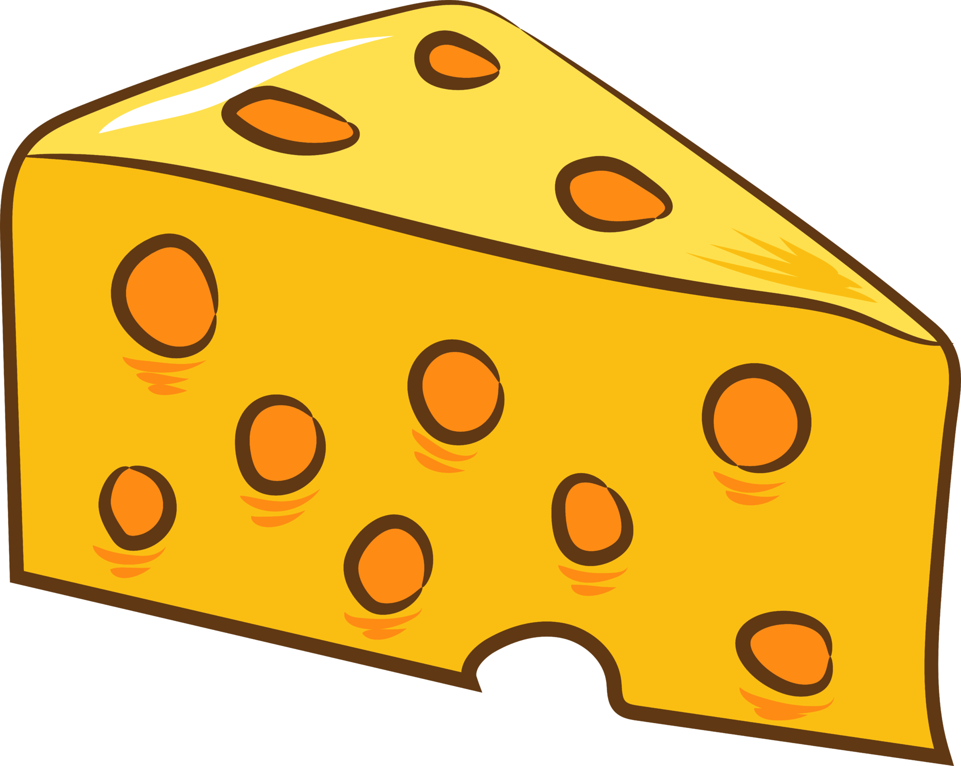
Countabe or uncountable
uncountable
countable
uncountable
uncountable
countable
countable
uncountable
countable
countable
uncountable
uncountable

Slide 17

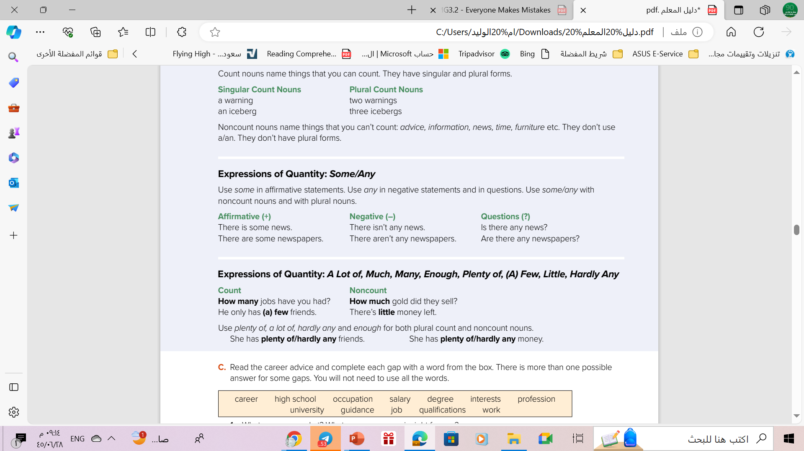


Slide 18

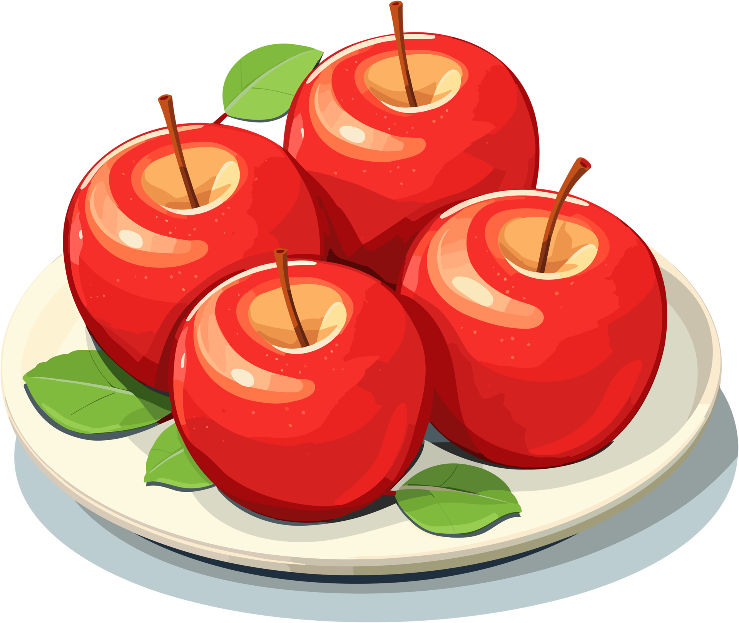

some
➔Used in affirmative statements.
➔Used with plural countable nouns and uncountable nouns.
Example
countable
There are some apples on the table .
uncountable
There is some water in the glass.

Slide 19

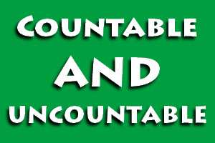
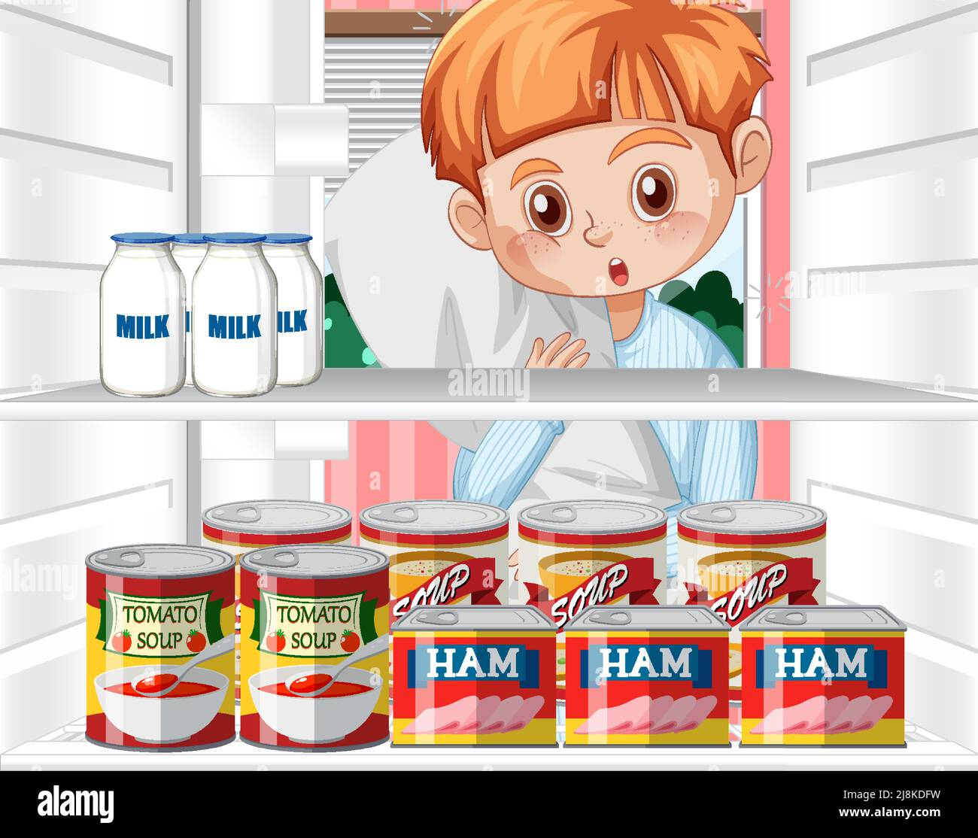
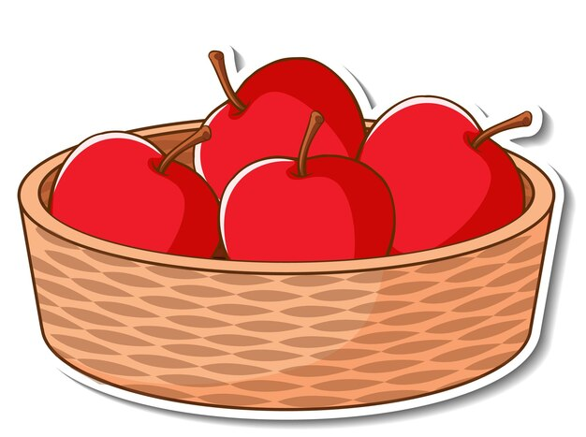
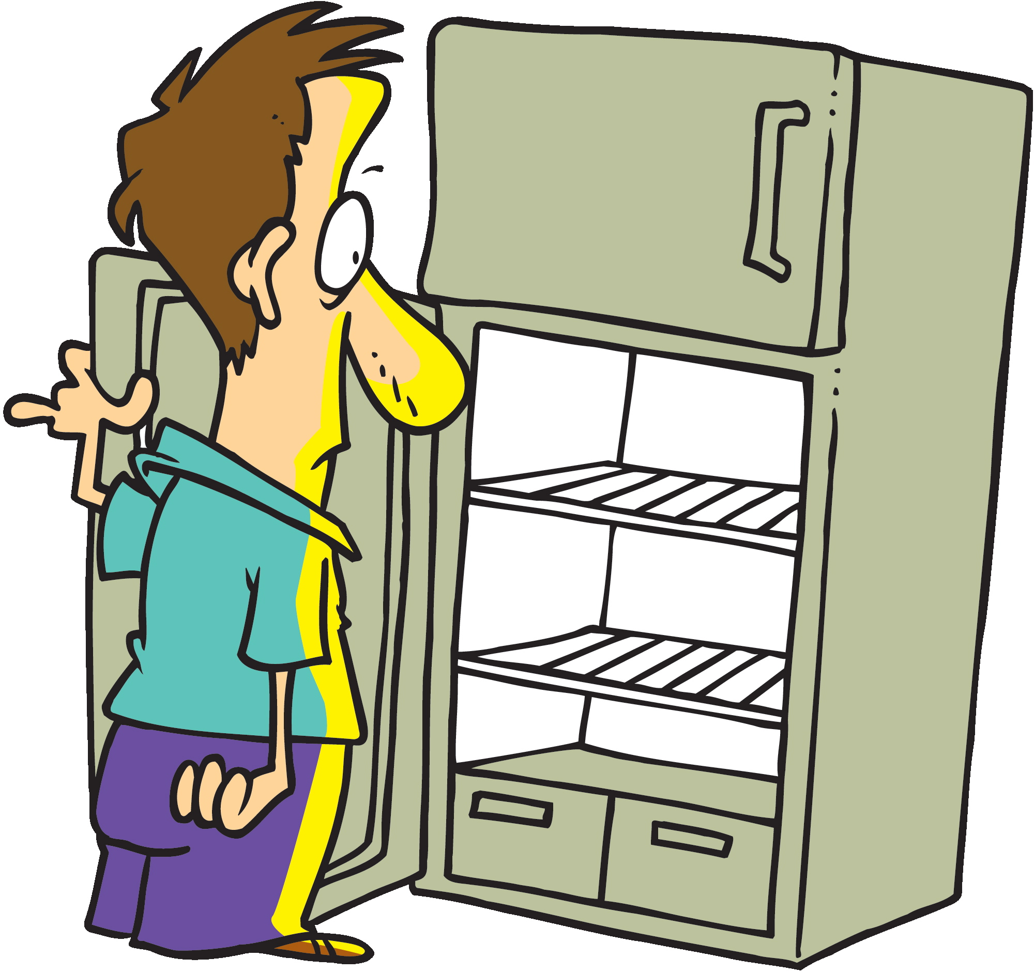
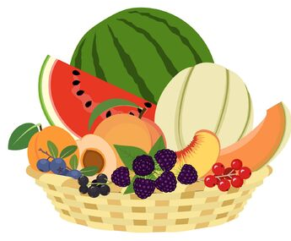
any
➔Used in negative statements and in questions .
Example
uncountable
Is there any milk in the fridge ?
A question
countable
Are there any apples in the basket ?
A question
uncountable
There isn’t any milk in the fridge.
negative
countable
There aren’t any apples in the basket.
negative

Slide 20
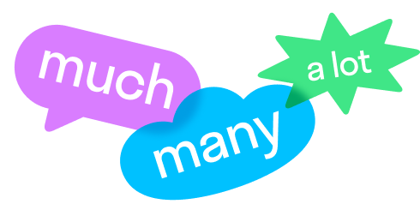
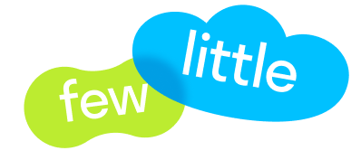

Slide 21
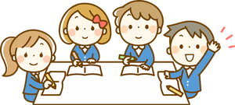
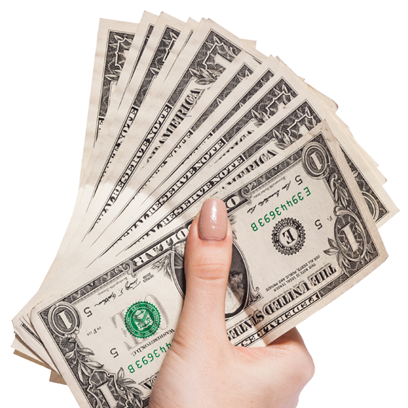


Many used with countable nouns.
Many vs Much
But
Much used with uncountable nouns.
Example
countable
There are many students in the class.
uncountable
I don’t have much money .
countable
How Many books are in the library ?
uncountable
How much water do you drink a day?

Slide 22
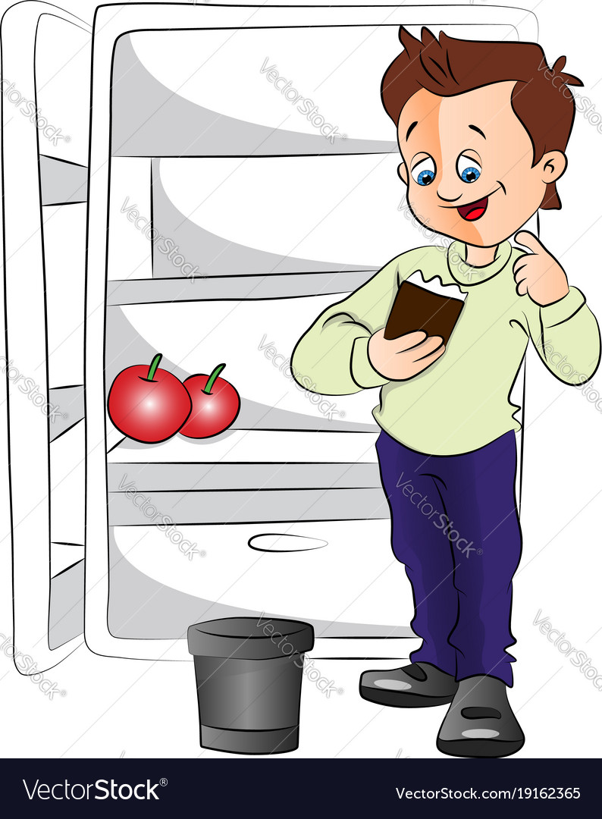
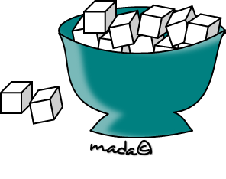
Few vs Little
A few with plural countable nouns.
Example
countable
There are a few apples in the fridge.
A little used with singular uncountable nouns.
Example
uncountable
I need a little sugar in my tea.

Slide 23
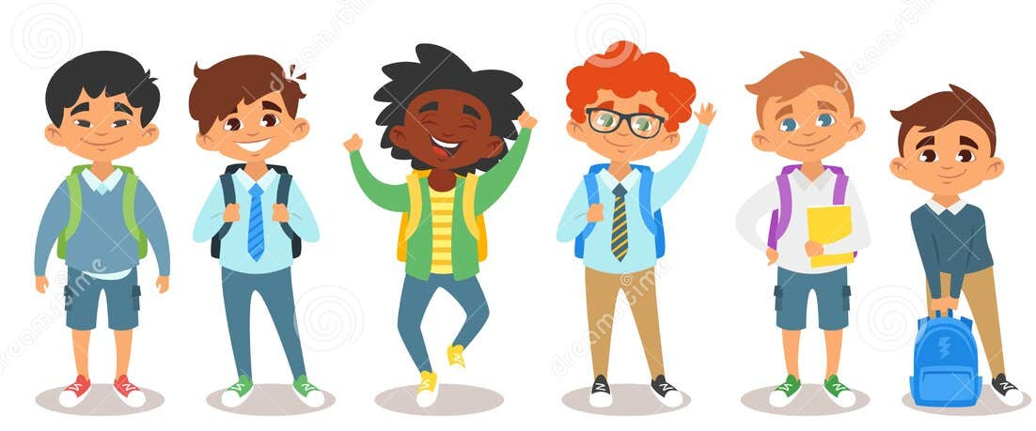
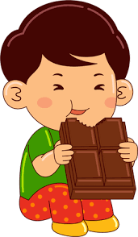
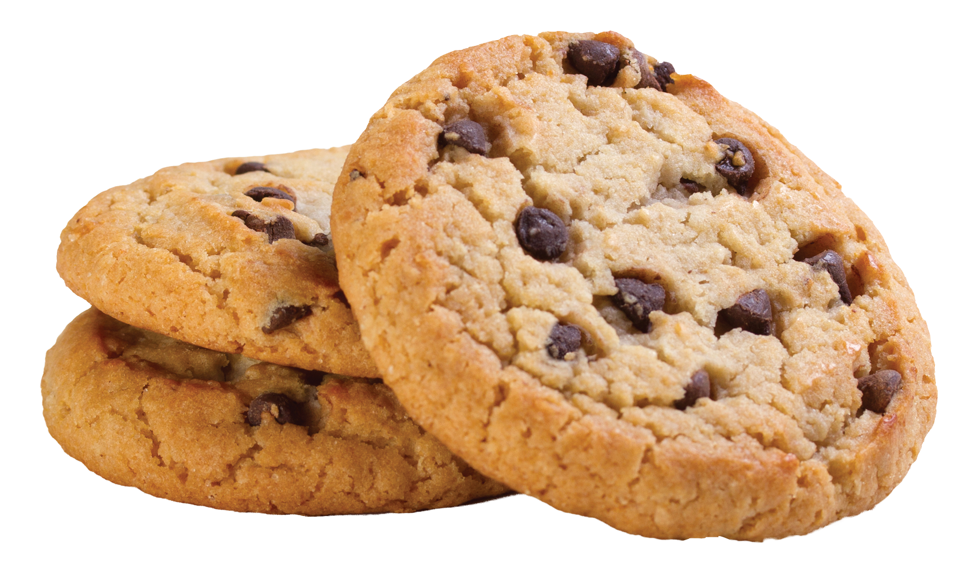
A lot of & Enough
➔a lot of used with countable and uncountable nouns
Example
countable
I have a lot of friends at school .
uncountable
He eats a lot of chocolate.
➔Enough used with countable and uncountable nouns
Example
countable
I eat enough cookies .
There isn't enough bread to make sandwiches.
uncountable

Slide 24
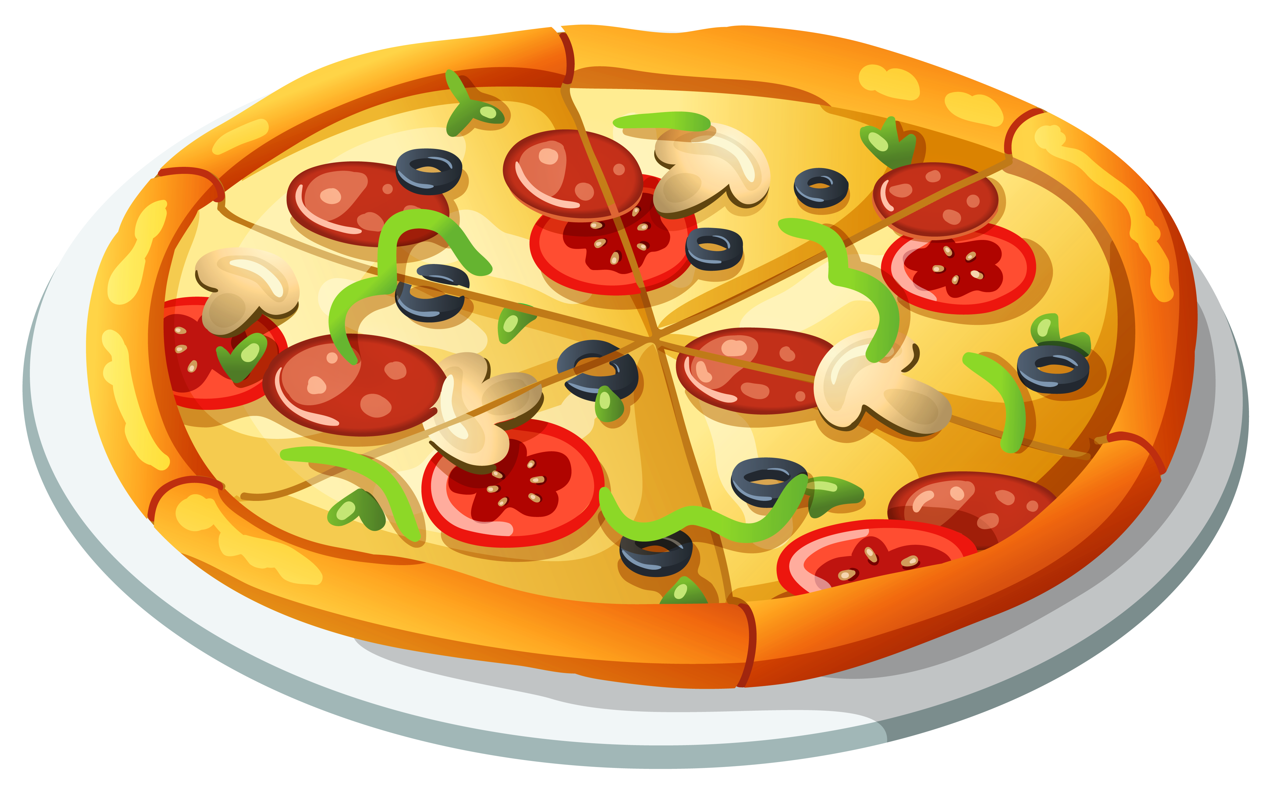
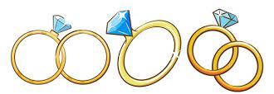
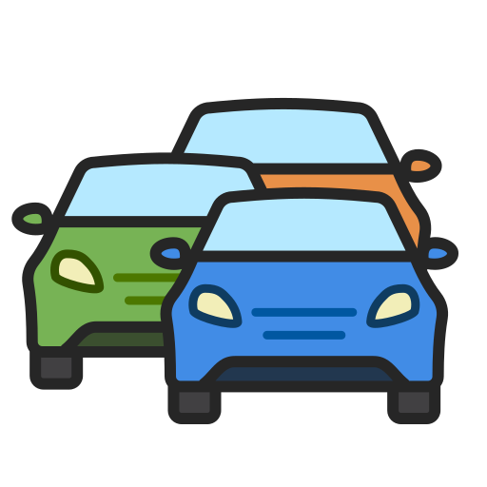
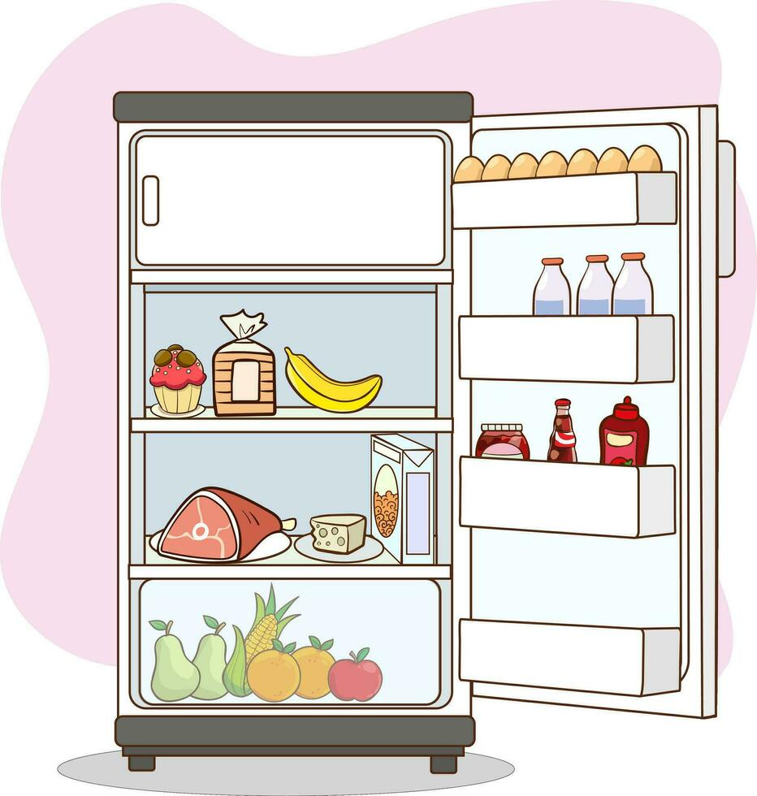
Plenty of & Hardly any
➔plenty of used with countable and uncountable nouns.
plenty of = lots of
Example
uncountable
There was plenty of pizza at the party.
countable
She has plenty of rings .
➔hardly any used with countable and uncountable nouns
hardly any = small amount or number of
Example
uncountable
There is hardly any traffic in this road.
countable
There were hardly any vegetables left in the fridge.

Slide 26
some or any
1- We need _______onions for his soup.
2- We’ve got________ popcorn In a bowl.
3- Have we got _______ cola?
4- Is there ________ water in that bottle?
5- I’m hungry. Let’s make _______ sandwiches.
6- We need _______ flour for the cake.
7- There aren’t _______ tomatoes in the fridge.
8- Have you got ________CDs?
some
some
any
any
some
some
any
any

Slide 27
Few or Little
1. There are ___________cars in the streets this morning.
2. Ali has got a _________friends here.
3. I’m not very hungry. I want only a _________food.
4. I take a _______ sugar with my coffee.
5. There are only a _________shops in our town.
6. Eggs taste better with a _________salt.
7. Let’s have a coffee. I’ve got a _______minutes.
few
few
little
little
few
little
few

Slide 28
Much or Many
1- There’s _________ juice in that carton.
2- We’ve got __________ money today.
3- There isn’t __________time left.
4- We have ________ problems but we will solve them all.
5- I’ve got ___________computer games.
6- How _________time did you stay in Paris last month ?
7- There aren’t ____________messages for you.
8- How _____________brothers and sisters have you got ?
much
much
much
many
many
much
many
many

Slide 29
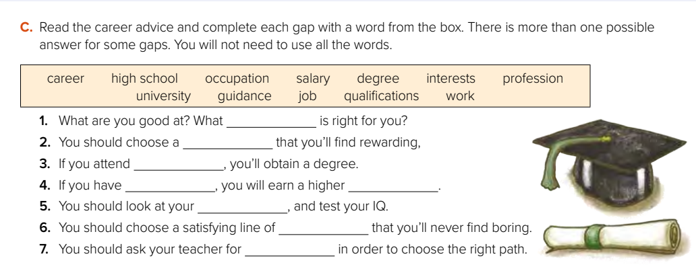
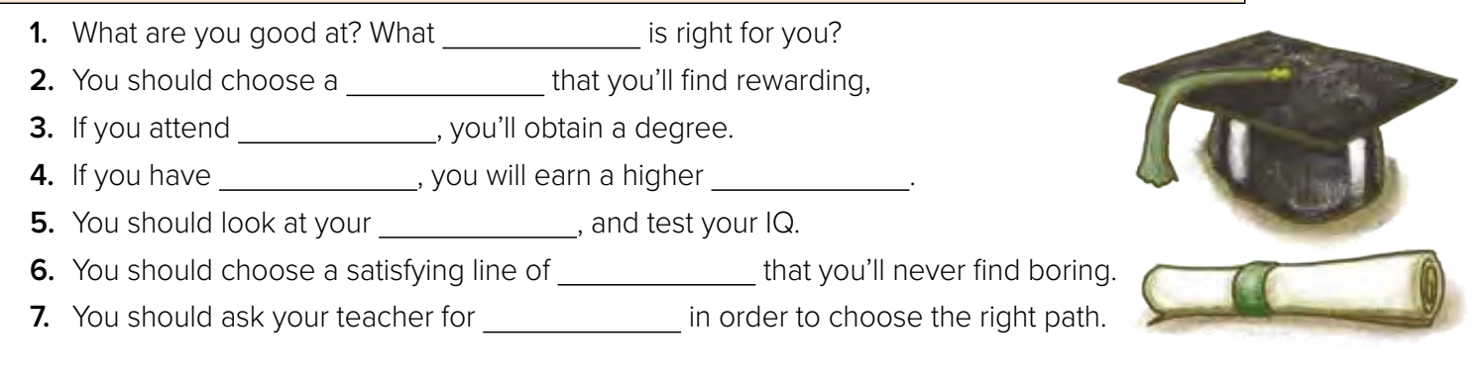
career
occupation
profession
job
job
career
occupation
profession
university
qualifications
salary
interests
work
guidance

Slide 30
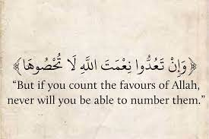
“Count “ in the
Holy Quran

Slide 31
Home work
On workbook p. ( 298 ) ,
exercise ( P )

Slide 32

Thanks!

