Slide 1









Unit 7
Everyone Makes Mistakes
Mega Goal 3.2
Writing
Done by: Entisar Al-Obaidallah

Slide 2



Lesson Objectives
01
02
03
04
Describe the picture using their own words
Discuss the topic of a mistake or an accident
Read the text for specific information
Write a descriptive and personal narrative

Slide 3
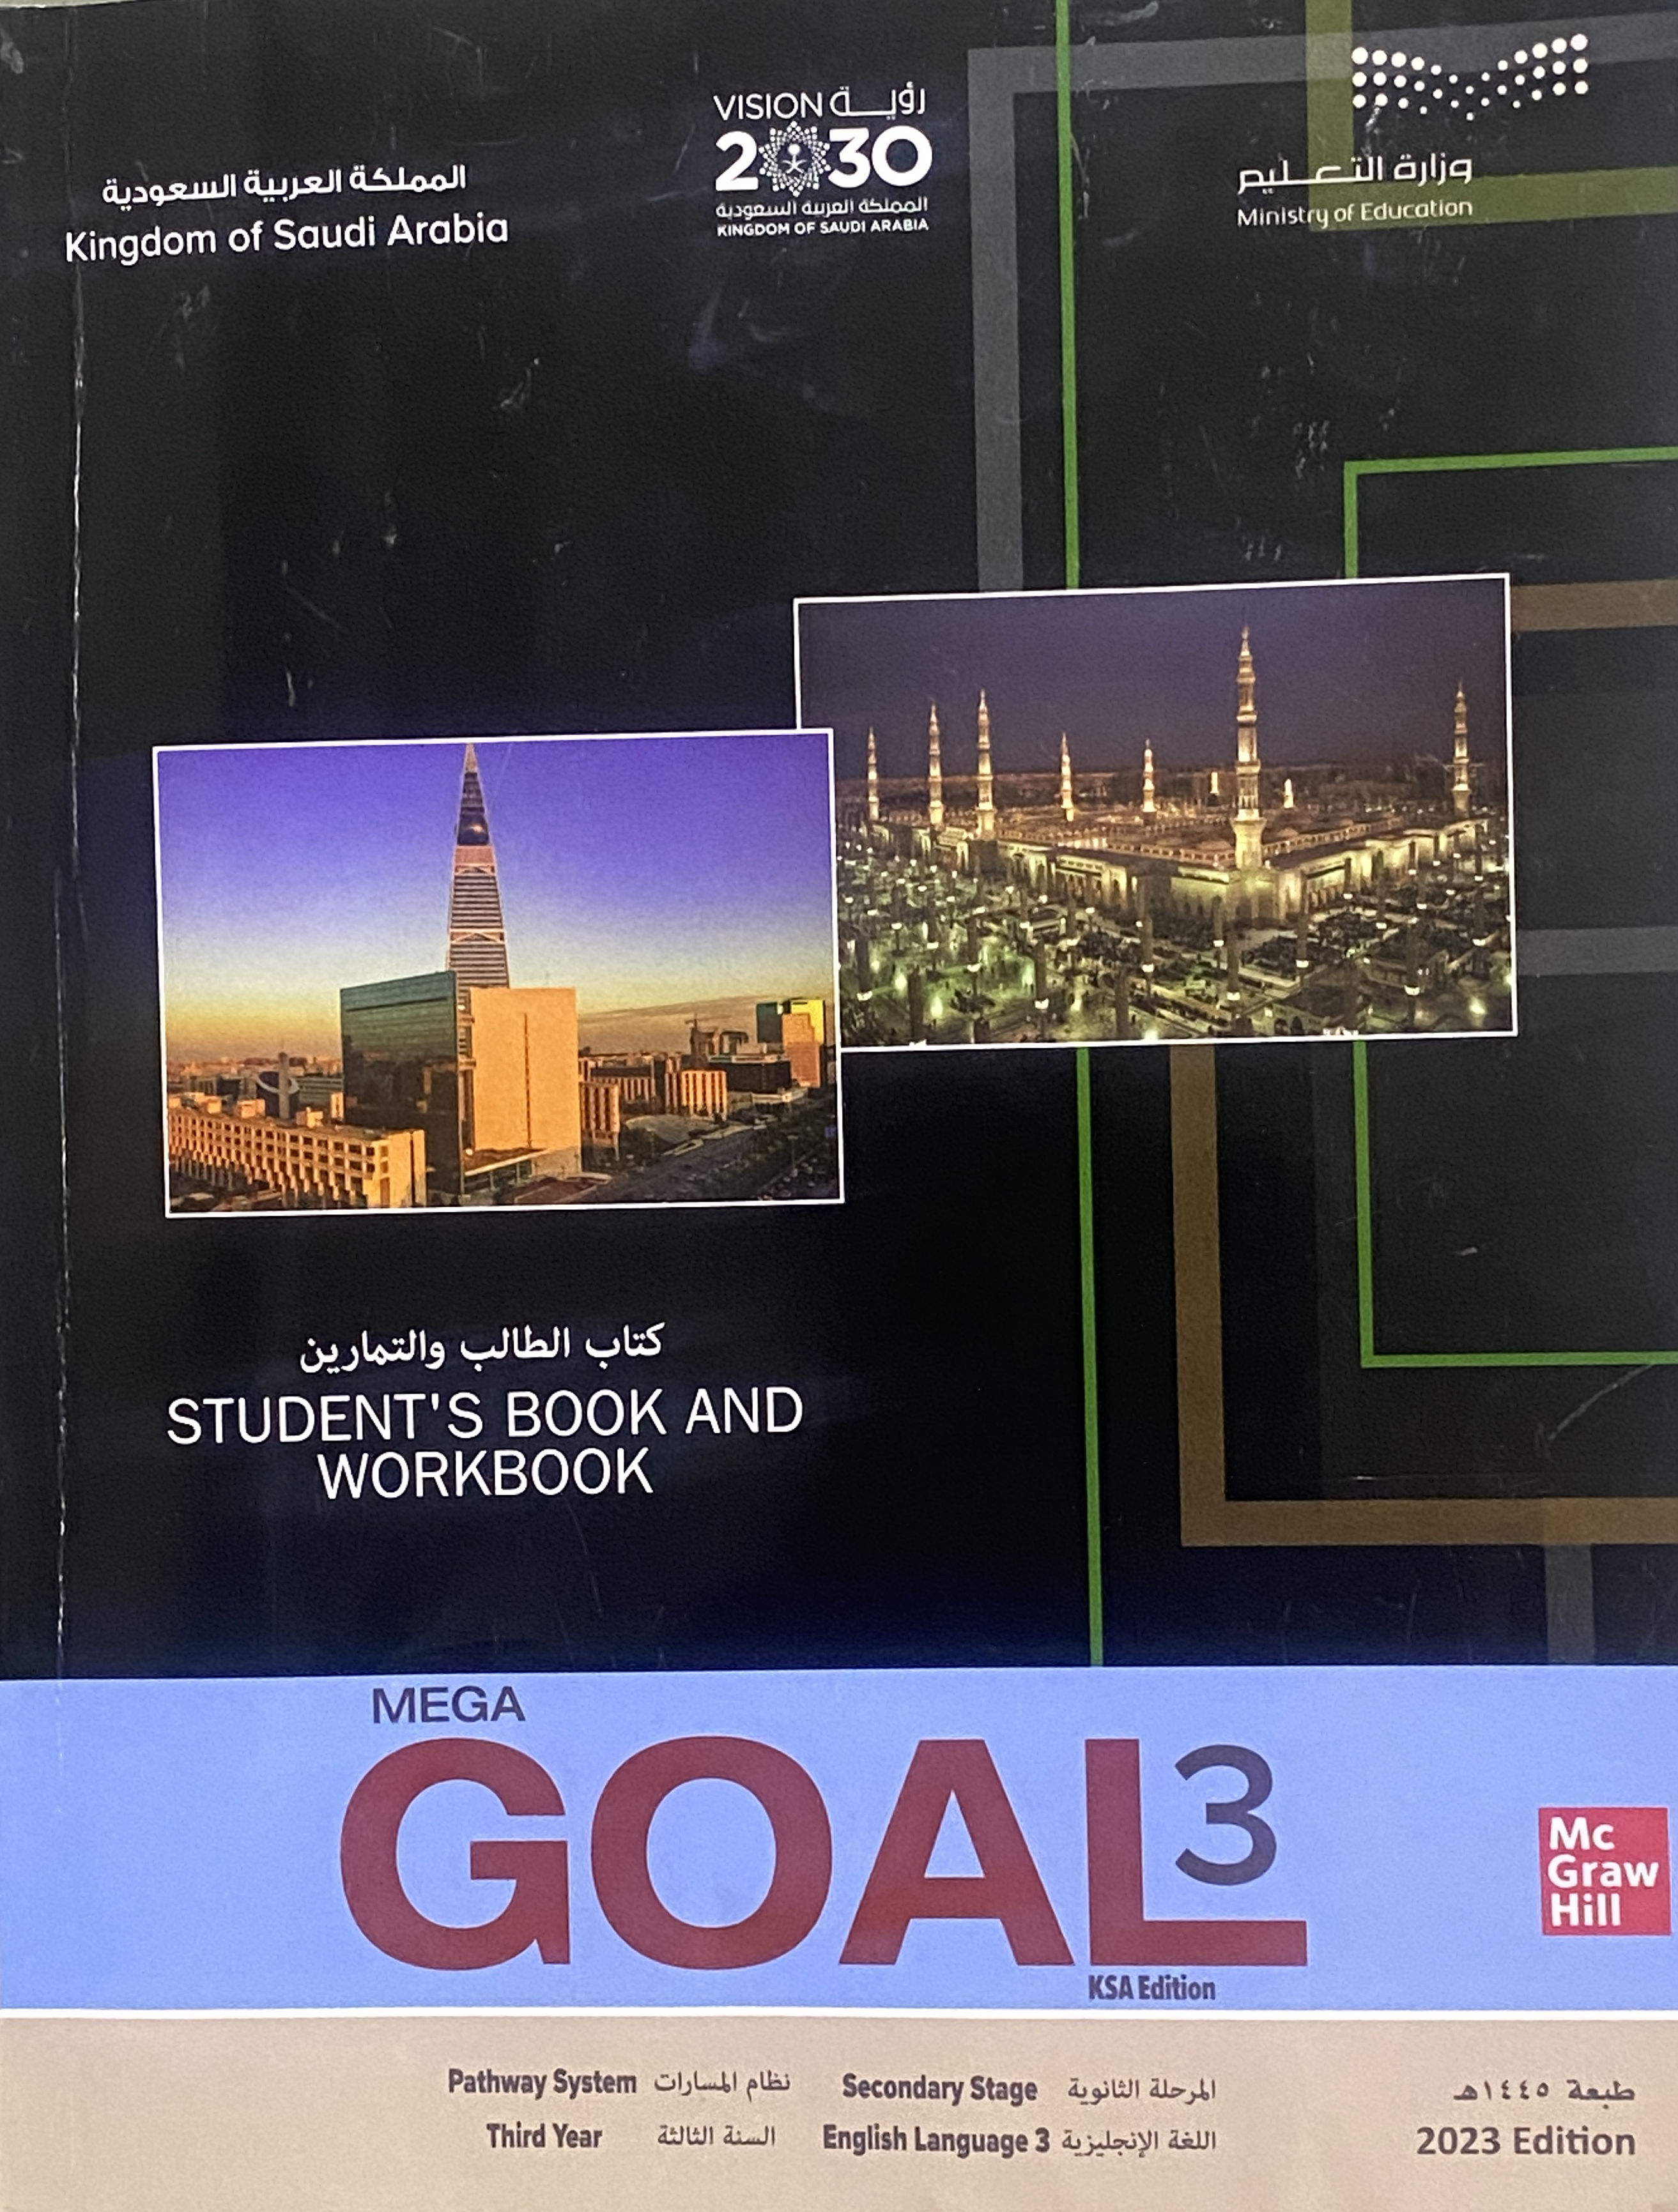
Open
your student’s book,
p. (104)

Slide 4



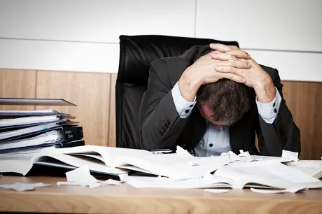
Warm up
Have you ever made a mistake that has
turned out for the best?
Who was involved?
When ? Where?

Slide 5
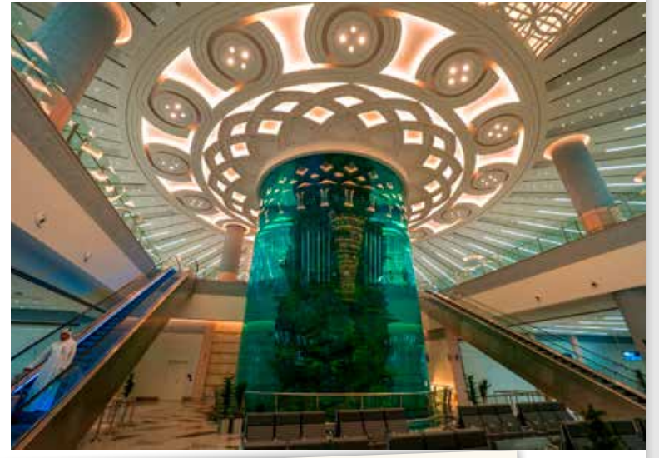

Where do you think the people are ?
What are mistakes that likely to happen in these places?
people might mix up their luggage, sit in the wrong seat, go to the wrong gate, miss the plane/ train, etc.
May be: an airport, airport terminal, mall, station.

Slide 6
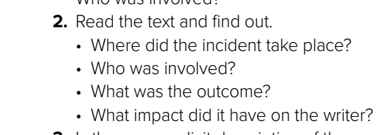
• At the airport terminal
• The writer and the person who looked like him and had the same family name.
• They got to know each other and found out that they were descendants of the same family.
• He gained a close friend and relative that he would never have met if he hadn’t mistakenly picked up the wrong coat.

Slide 7
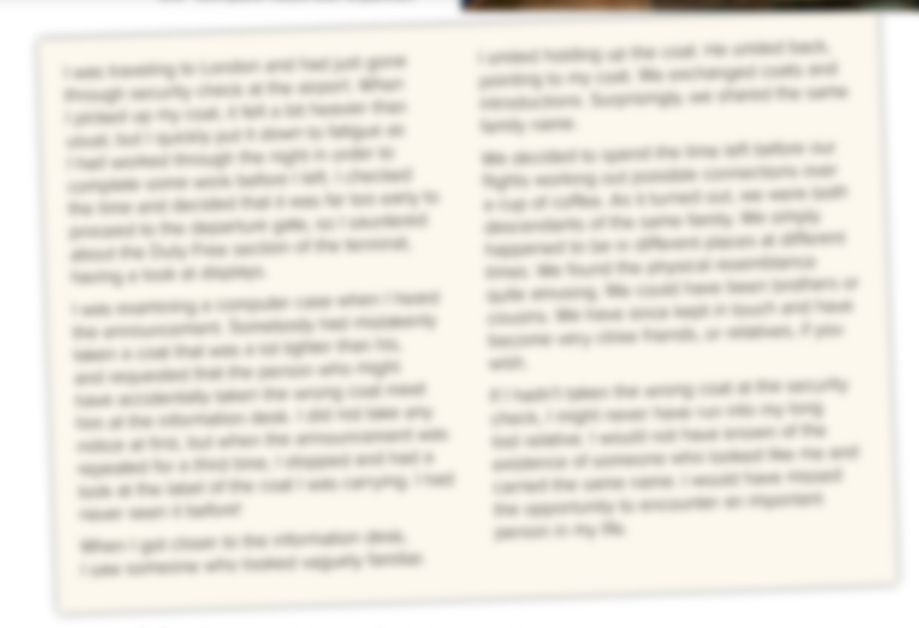



Listen & Read along

Slide 8
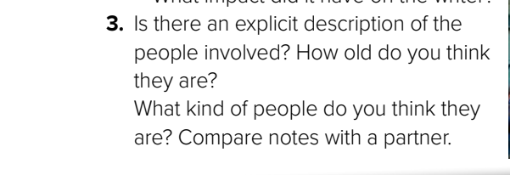
Listen & Answer
They are over 30 because it sounds as if they are both used to travelling. One was just looking around the Duty Free shops while the other one directed himself to the information desk as soon as he realized that he didn’t have the right coat. What they did indicates that they are seasoned travelers.

Slide 9
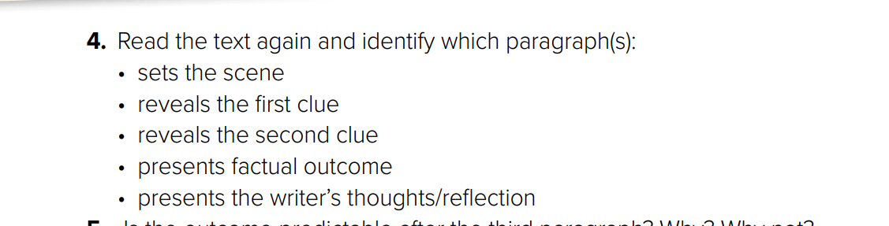
The second paragraph reveals the first clue, “Somebody had mistakenly taken a coat that was a lot lighter than his ... to meet him at the information desk. / I stopped … a look at the label … I had never seen it before!
• The first paragraph sets the scene
The final paragraph presents the writer’s thoughts and reflection
The third paragraph reveals the second clue, “… looked vaguely familiar ... shared the same family name.
The fourth paragraph presents factual outcome

Slide 10
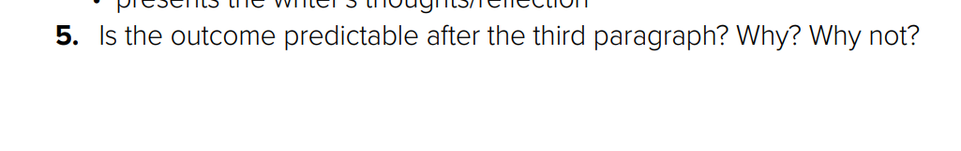
Yes, it is as there is mention of the fact that they looked alike and shared the same family name.

Slide 11
Open
your student’s book,
p. (105)

Slide 12
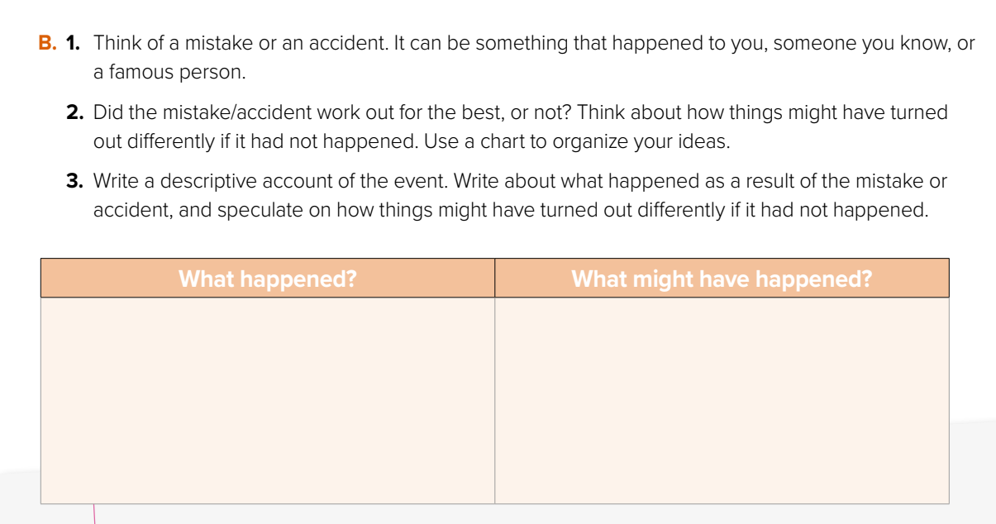

I didn’t study hard for the final exam . Instead , I went to play with my friends
I have failed in the exam for the first time in my life .

Slide 13
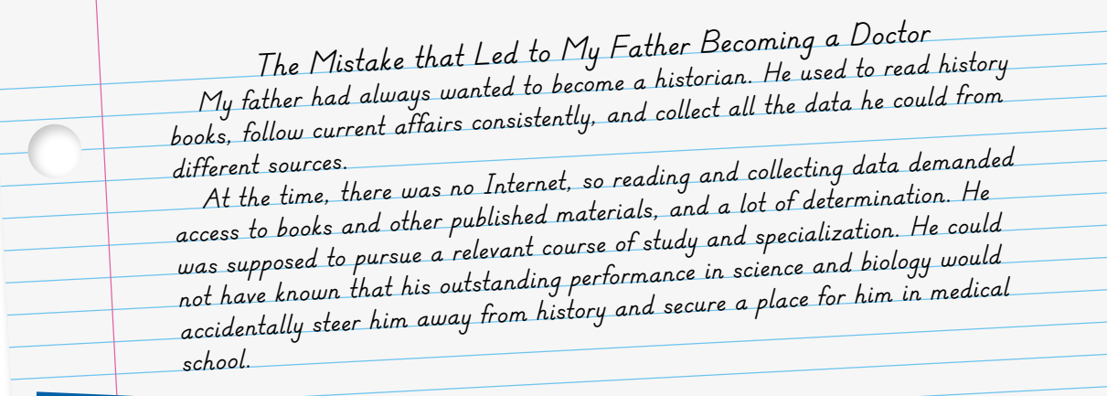
Write a descriptive
account of an event & speculate on how things could have turned out very differently
Example

Slide 14
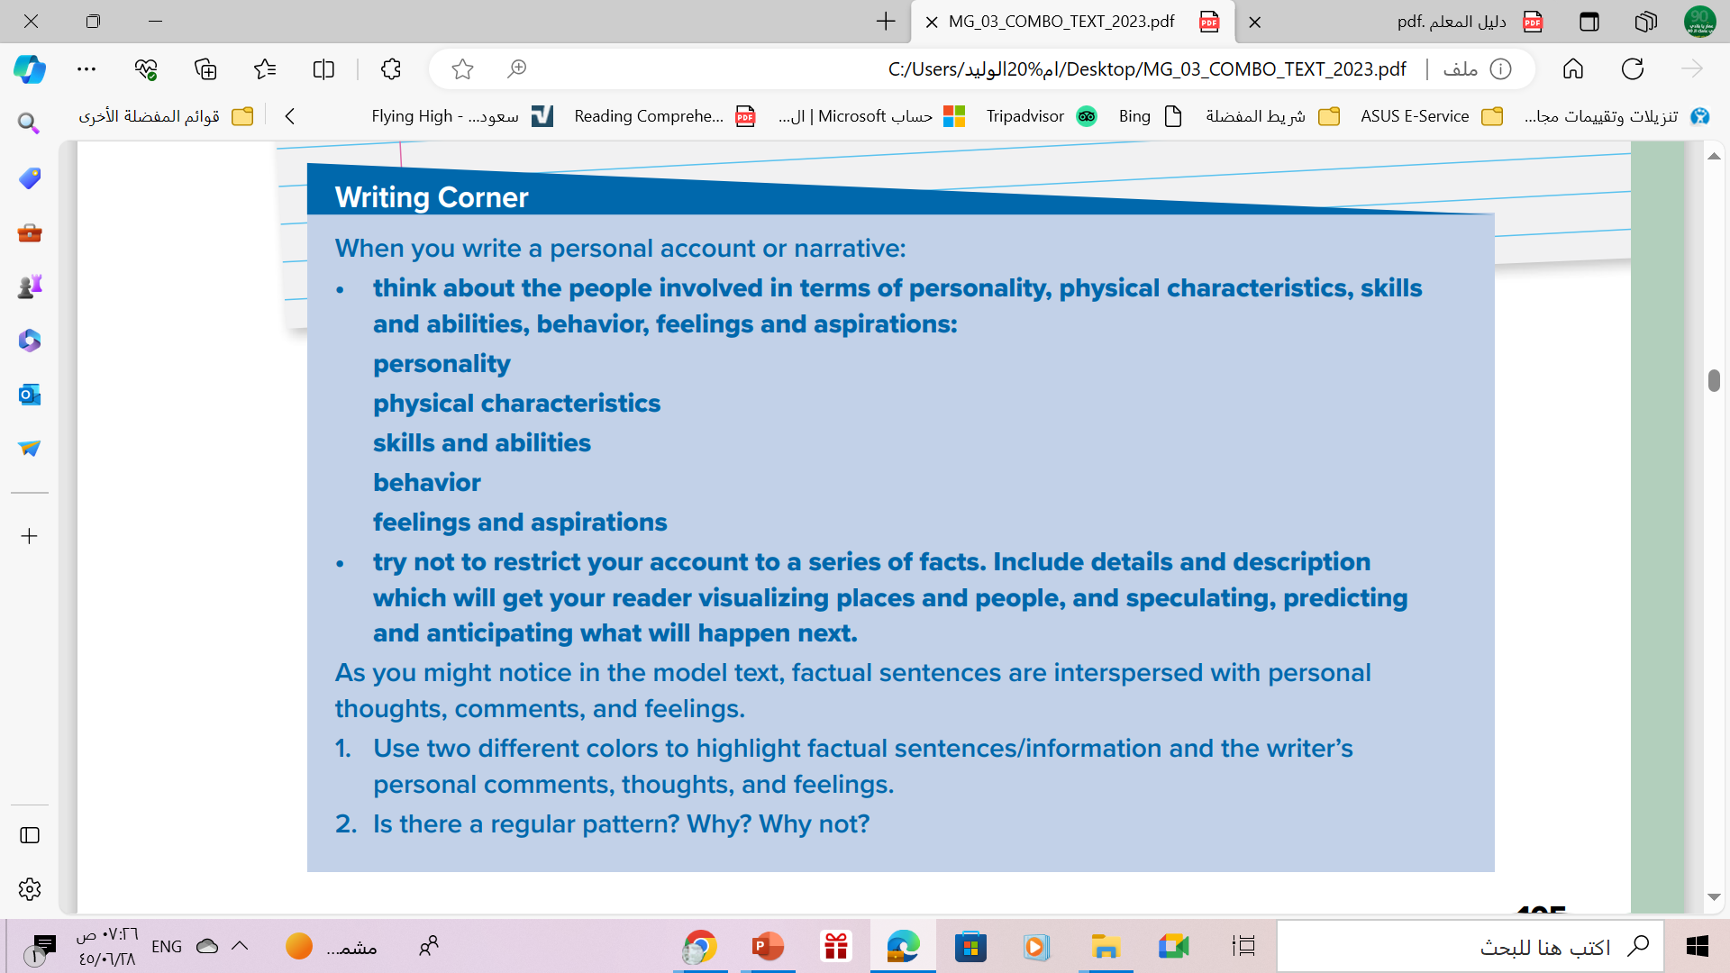
Follow these steps when you When you write a personal account or narrative:

Slide 15


They need to describe different aspects of a person and not restrict their description to physical appearance. Point out that a lot can be provided about a person’s attitude and feelings through behavior.
It is important to draw the reader’s attention and create some proximity through addressing him/her directly by asking questions, commenting, or allowing the reader access to narrator’s thoughts and images.
In personal narratives, factual information is combined with feelings, thoughts and attitude/comments.

Slide 16
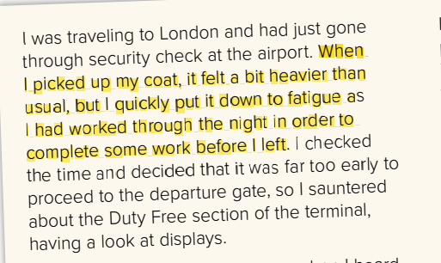
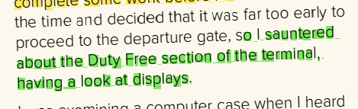
feeling, thought
Fact

Slide 17
No, there isn’t a regular pattern. Facts and feeling/thoughts are integrated as required

Slide 18
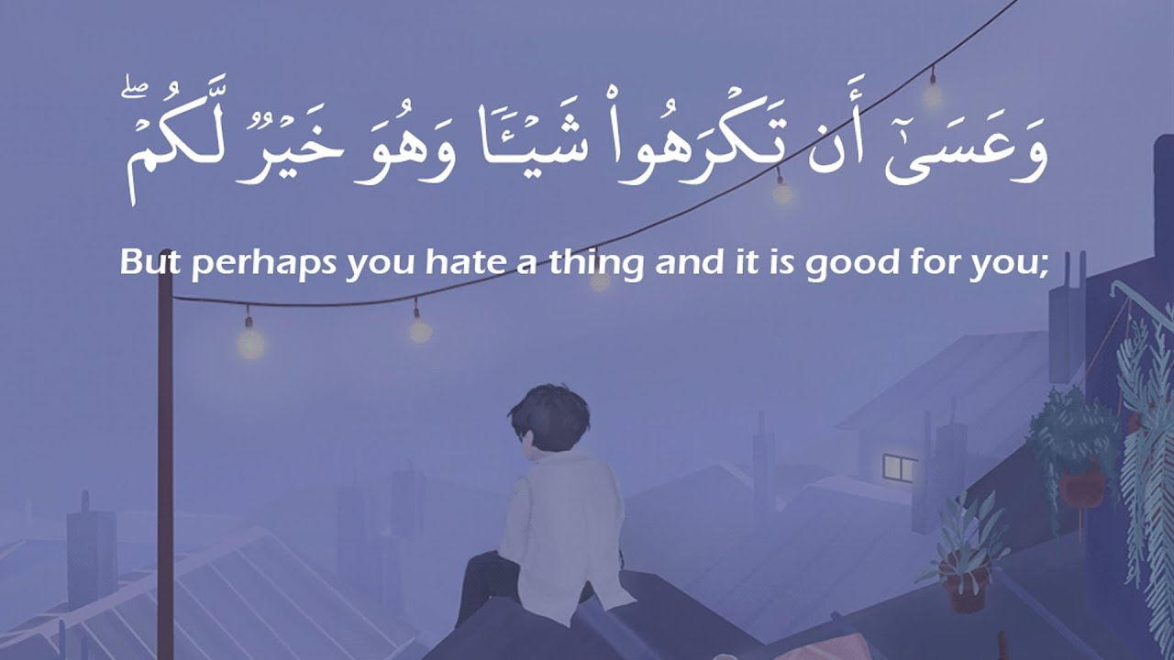
Always Remember..

Slide 19
Homework
On workbook , exercise (i) ,
p. (293)

Slide 20


THANKS

Slide 21



ALTERNATIVE RESOURCES
Here’s an assortment of alternative resources whose style fits that of this template:
VECTORS
Watercolor botanical garden background I
Watercolor botanical garden background II
Watercolor botanical garden background III
Watercolor botanical garden element collection

