Slide 1
Mega Goal 1.2
Unit 4 GAME
Wishful Thinking
By: Essa Al Hussaini

Slide 2
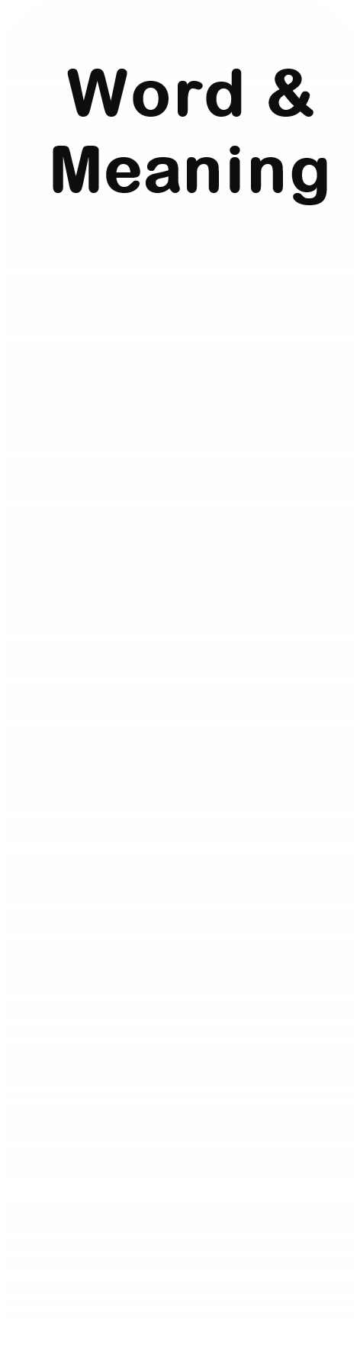



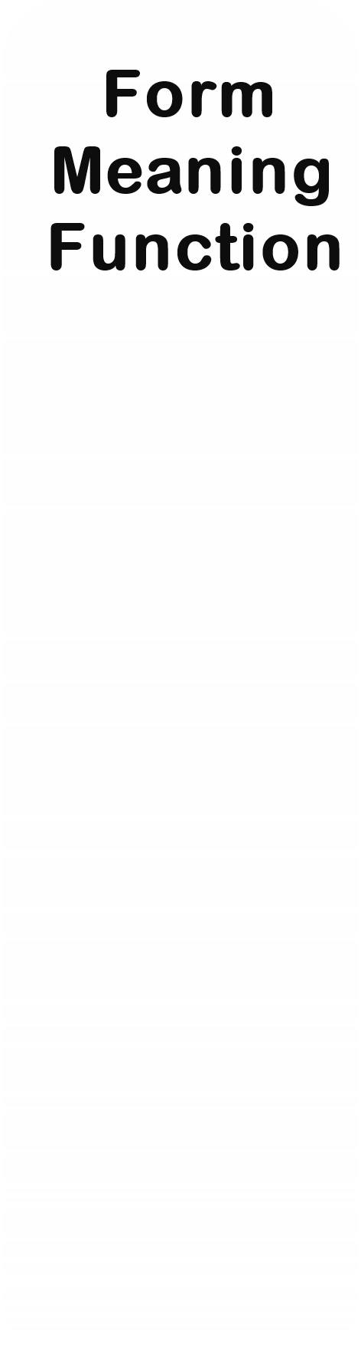
U4
Wishful Thinking
1
1
1
1
1
2
2
2
2
2
3
3
3
3
3
4
4
4
4
4
5
5
5
5
5

Slide 3
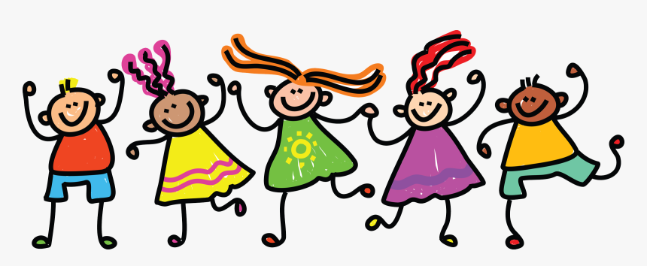



The party was fabulous.
We enjoyed and had a ball.
had a football
had a good time
had a balloon

Slide 4
He has been struggling against (poverty) in his country.
sadness
richness
poorness

Slide 5
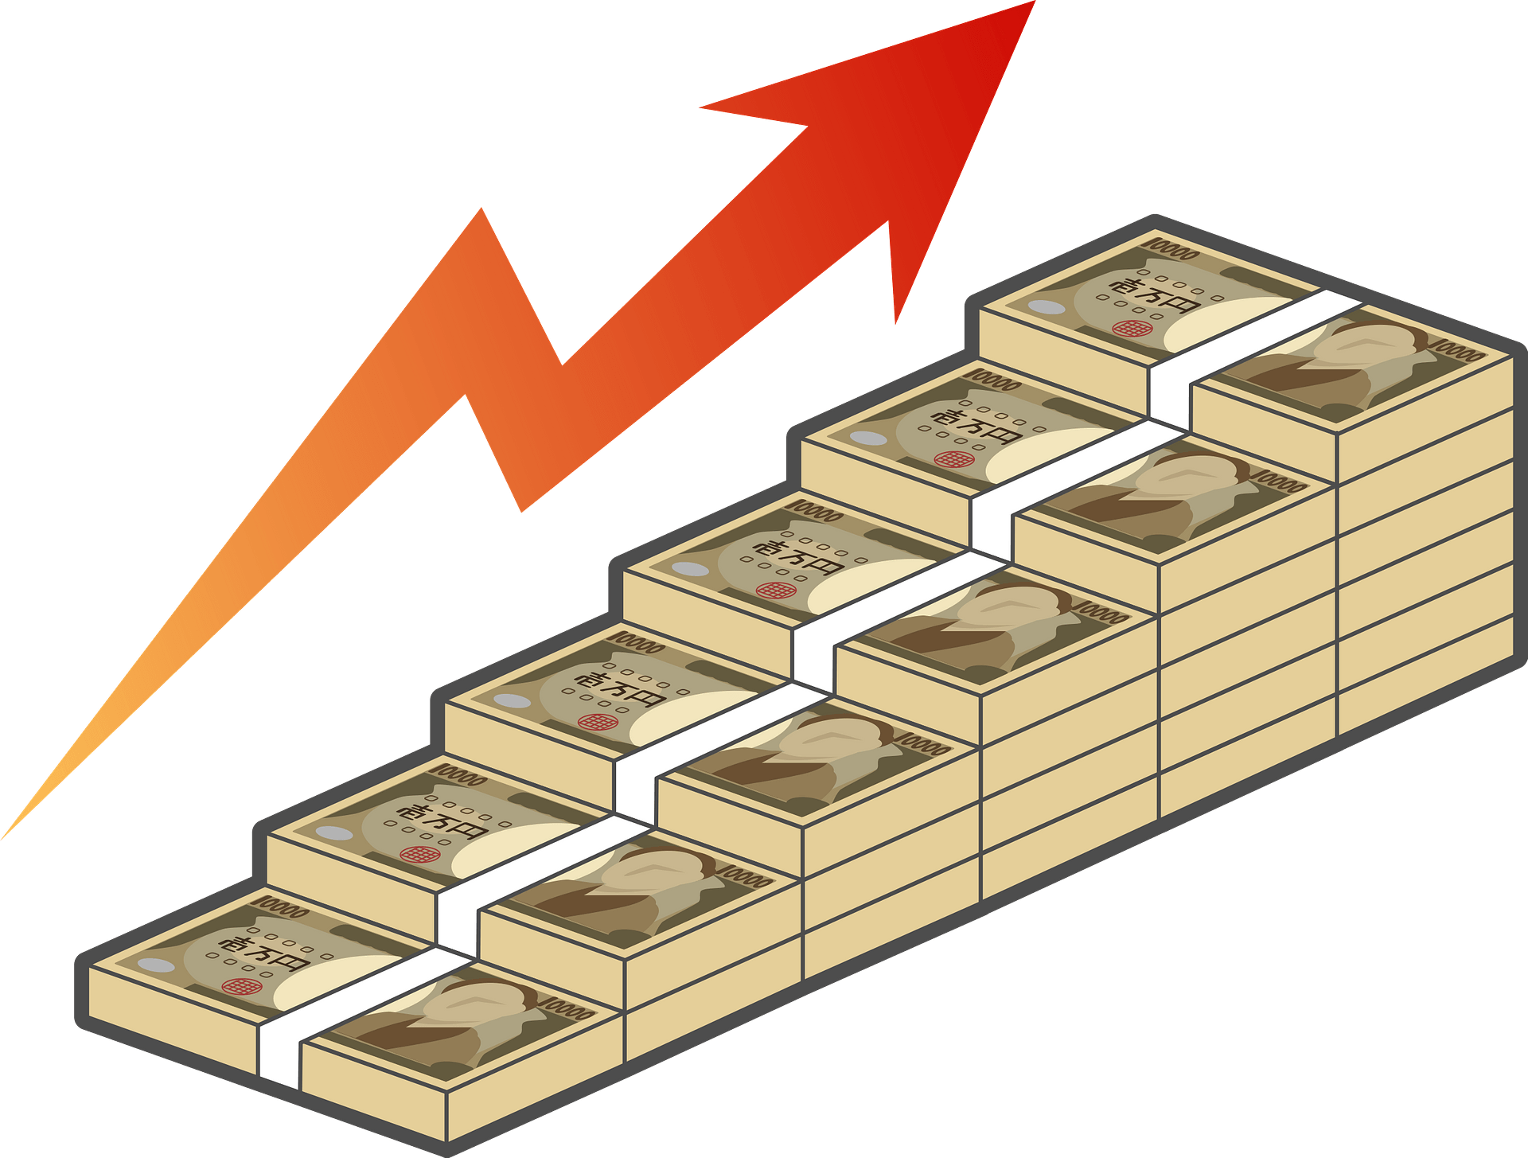
A word that is linked with “MONEY”
invest
empire
universe

Slide 6
Opposite of
" win"
pass
lose
succeed

Slide 7

The word “Leather” belongs to
price
size
material

Slide 8



If I found a million dollars, I would take it to the police.
true situation
real situation
imaginary situation

Slide 9

If Jinan had more experience, she ____ (apply) for the job.
would apply
would applied
applied

Slide 10

Express possibility
If they had extra money, they ______ (visit) France.
might visit
could visit
would visit

Slide 11

If I ____ (not have) a test tomorrow, I ____ (help) you
didn’t have // would help
wouldn't have // help
don’t have // would helped

Slide 12
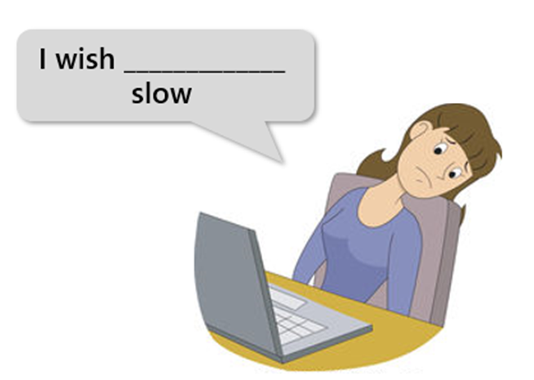
“My laptop is so slow.”
Complete the wish
I wish my laptop _____________.
was so slow
wasn’t so slow
isn’t so slow

Slide 13

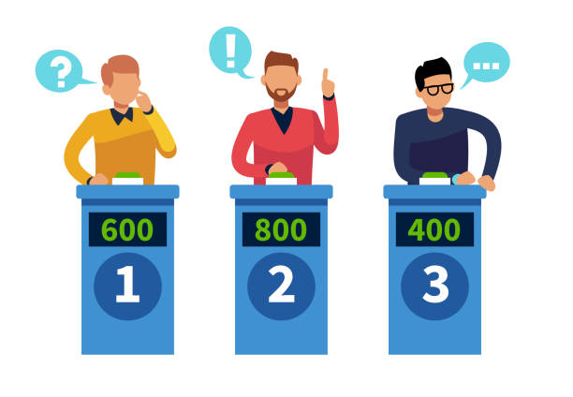
I’m only that ____ (person) who was on a quiz show.
family
guy
award

Slide 14
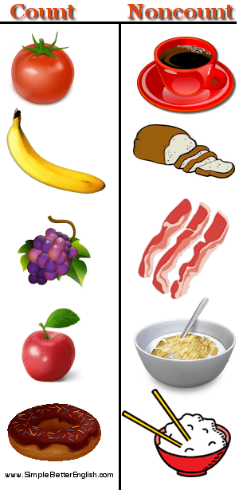
Nouns such as (money, news, rice, tea) are ______ .
They don't have plural forms.
quantifiers
count nouns
noncount nouns

Slide 15
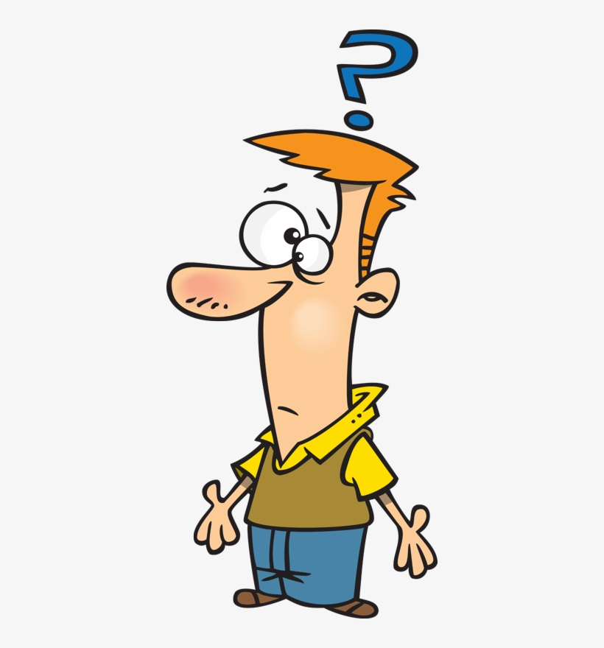
Identify the odd word
money
prize
tea
news

Slide 16
Identify the odd word
small
large
gold
medium

Slide 17


wool – cotton –
gold - silver
item
Oops!!
WRONG
thobe – dress -
bracelet - shows
material
small – medium –
large - xlarge

Slide 18


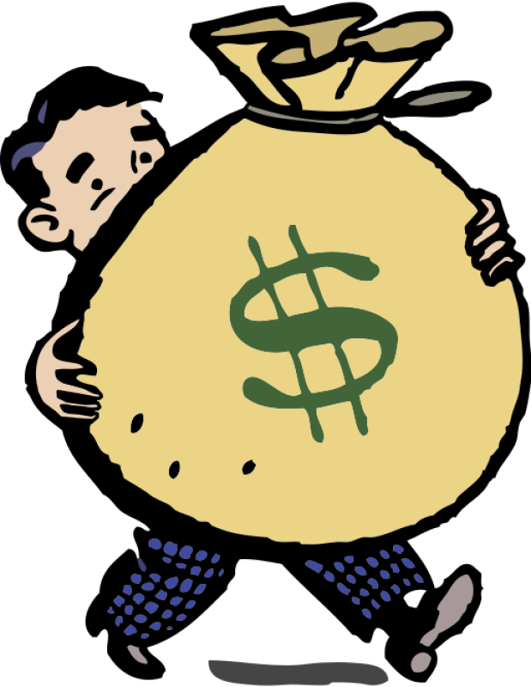
He ________ SAR million and the family farm when his father died.
bought
sent
inherited

Slide 19

People with a lot of money should donate to children's _______.
charities
technology
cash

Slide 20
Winning _______ as a prize could bring the winner problems.
leader
money
price

Slide 21
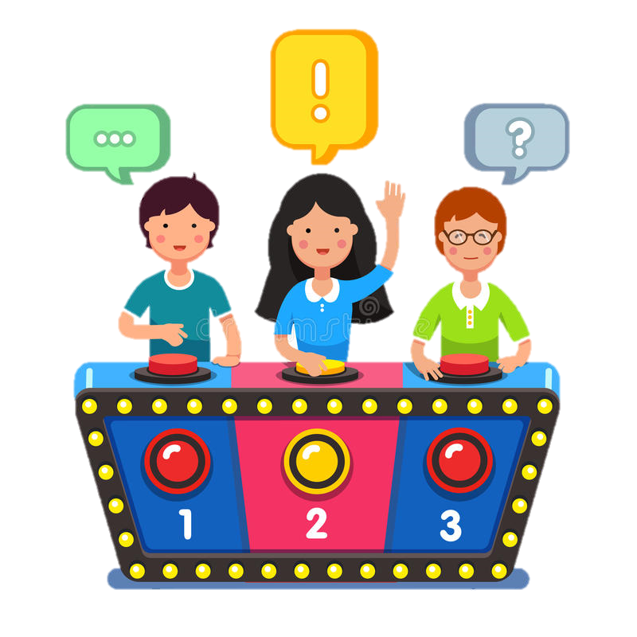
She won the big ________in a TV game show.
certificate
bankruptcy
prize

Slide 22

I _______ (gain) a gold medal in swimming.
wish
fail
win

Slide 23

I think we need ______ rice.
a
any
some

Slide 24

Do you have _____coffee left?
I need some please.
any
some
an

Slide 25
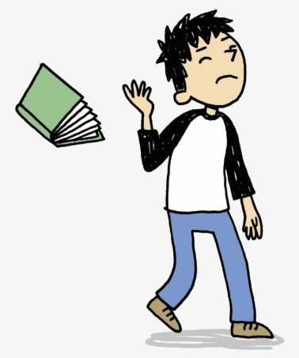
Nasser gave me some books and magazines but I didn't read ______ book.
no
any
some

Slide 26
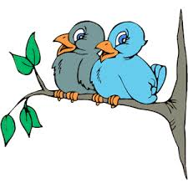
Hey Khaled, _________ birds in the tree?
there is
there are
are there

Slide 27

I guess, ______ a cat on the porch.
there are
there is
there some

