Slide 1





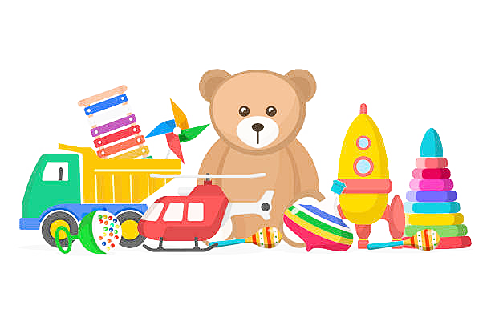


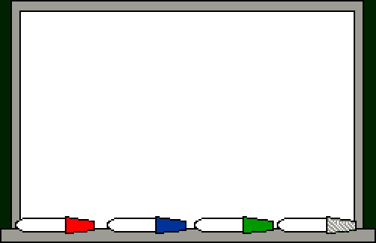
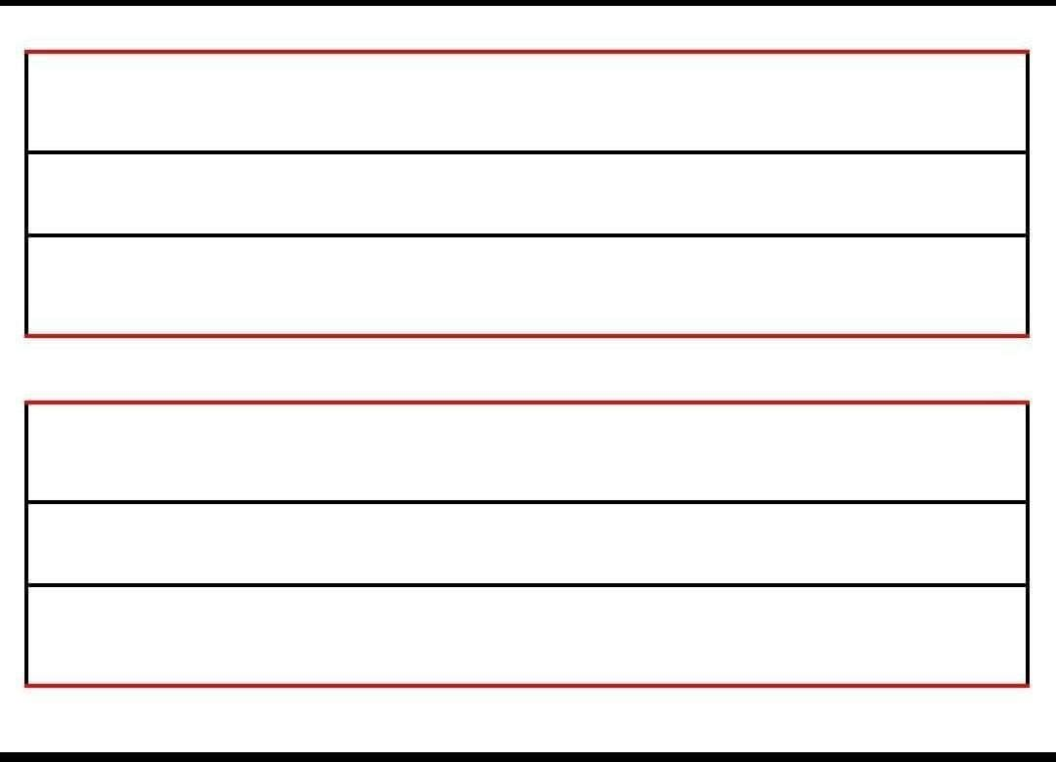

Slide 2

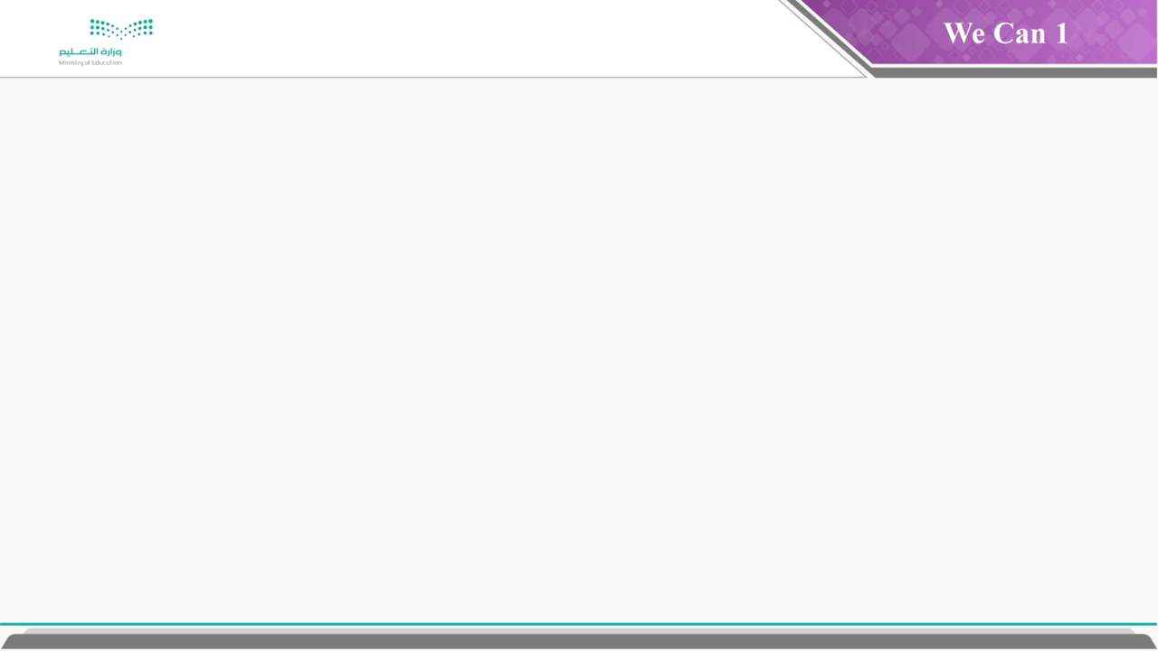

Slide 3












Slide 4


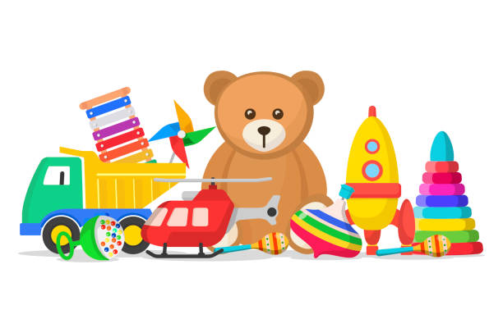


How many toys do you have?

Slide 5

Choose
1- Two robot
2- Two robots

Slide 6
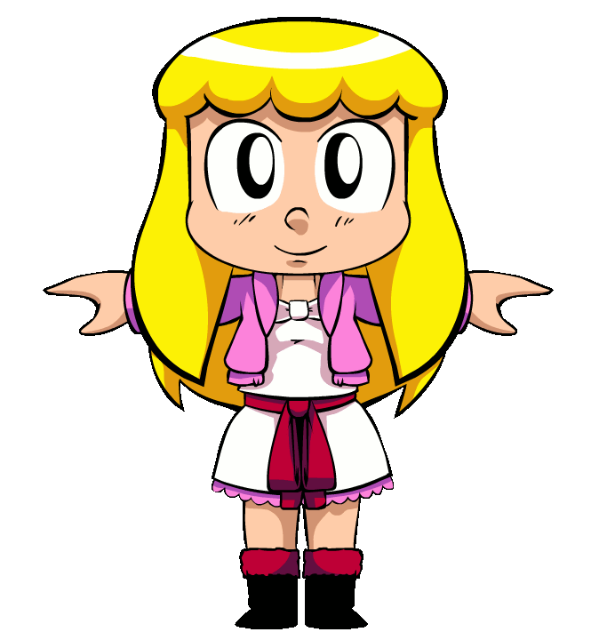
Guess the action

Slide 7
What letter is this? What sound does it make?
M

Slide 8

How many brothers
do you have?

Slide 9

What’s this?

Slide 10
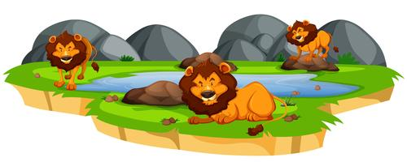
  How many lions?

Slide 11
Count from 1 to 10

Slide 12
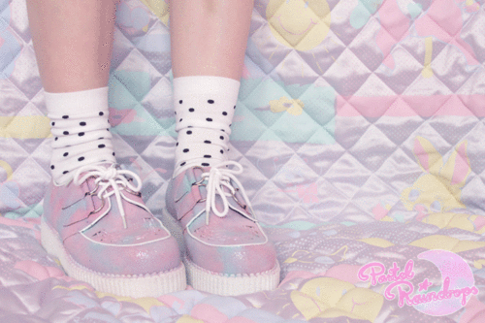
Guess the action

Slide 13
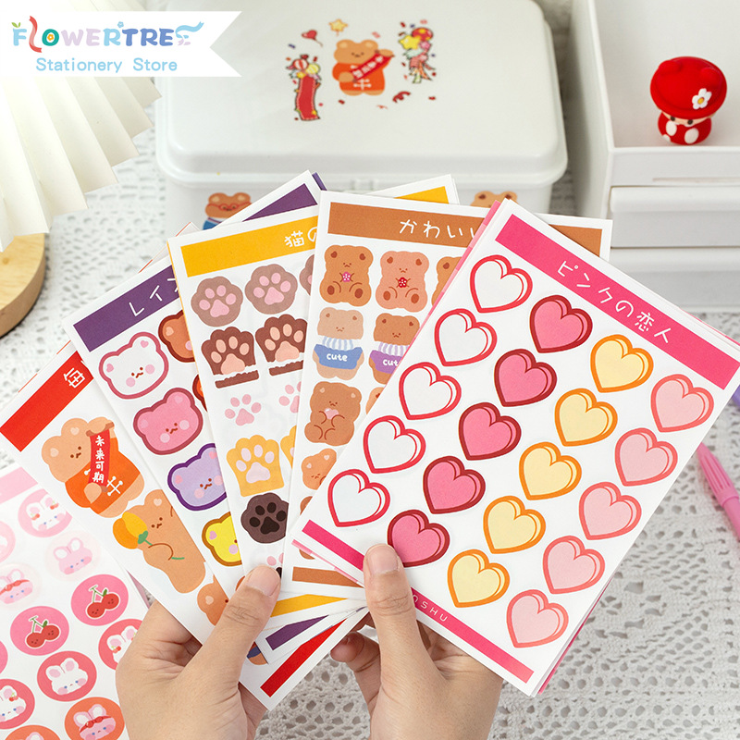
What’s this?

Slide 14
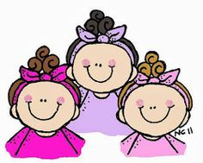
How many sisters
do you have?

Slide 15
What letter is this? What sound does it make?
K

Slide 16
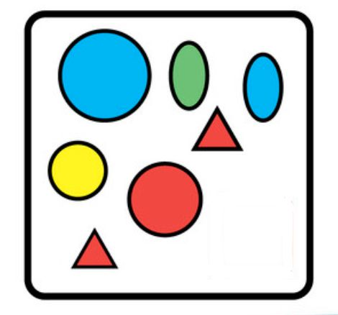
How many shapes?

Slide 17
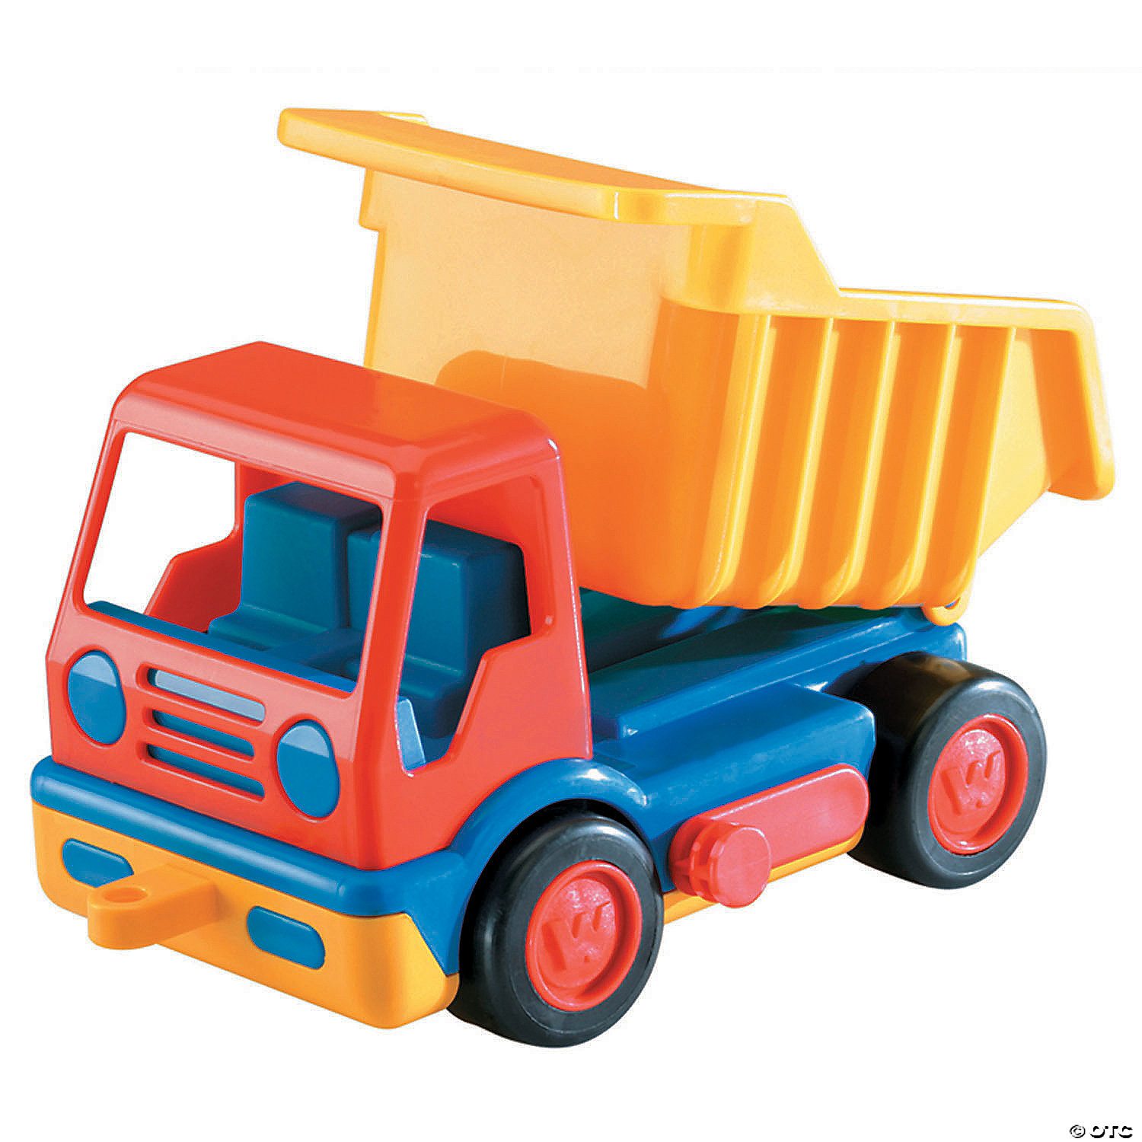
What’s this?

Slide 18

Choose
1- 3 star
2- 3 stars

Slide 19
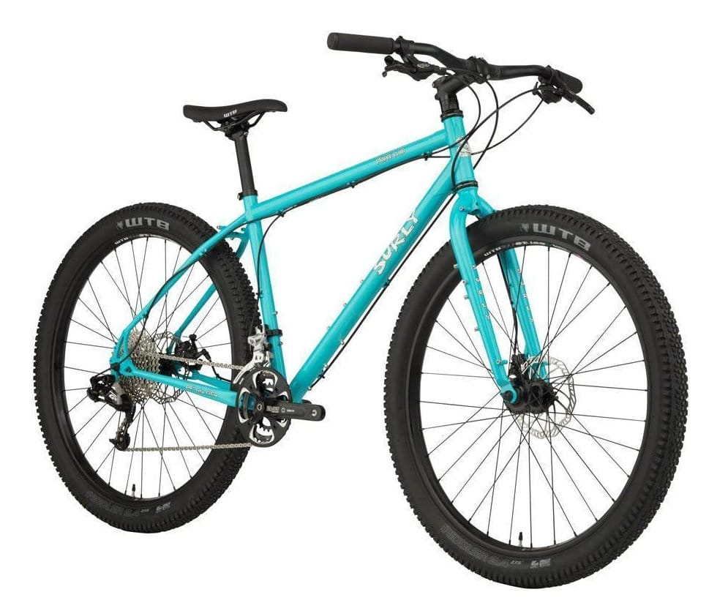
What’s this?

Slide 20

What’s this?

Slide 21
Name three toys you have?

Slide 22
What letter is this? What sound does it make?
N

Slide 23
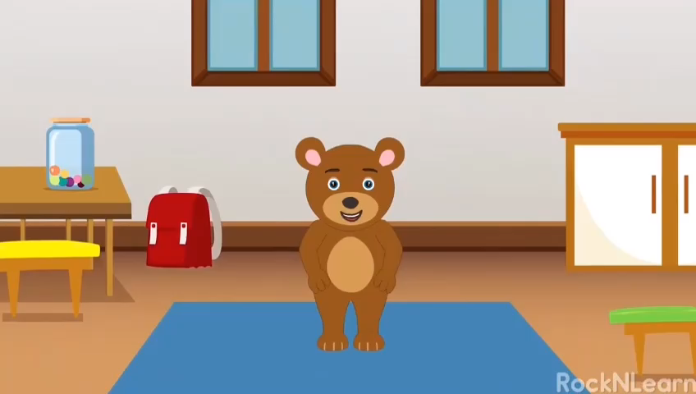
Guess the action

Slide 24
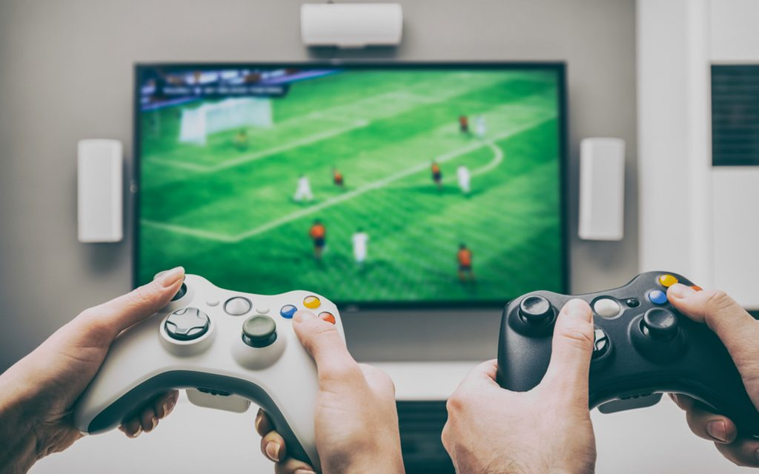

What’s this?

Slide 25
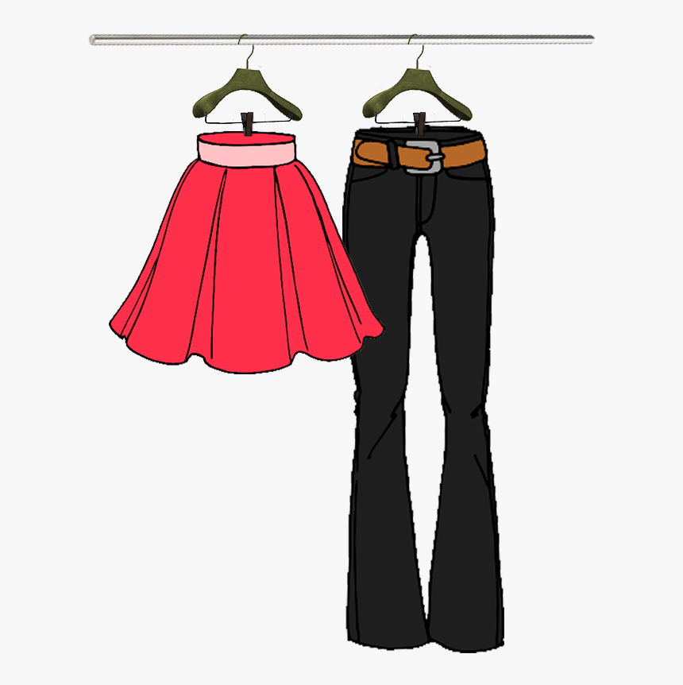
What are these?

Slide 26
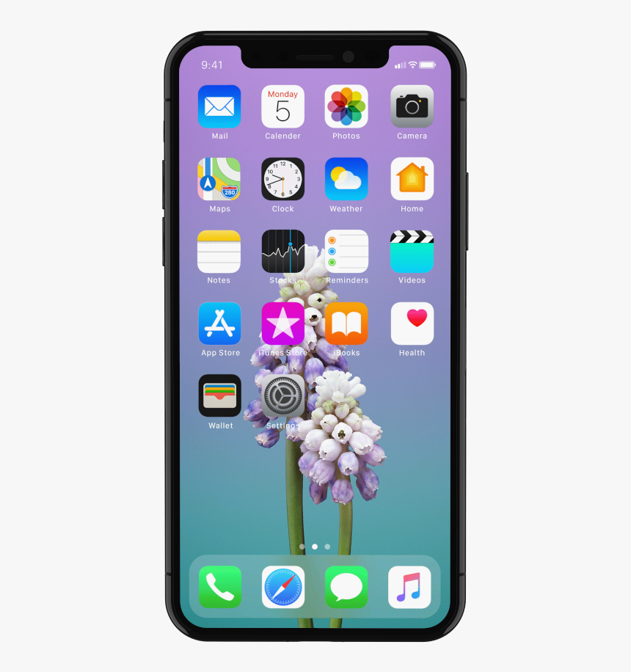
What’s this?

Slide 27
What letter is this? What sound does it make?
L

Slide 28



Slide 29



Slide 30
