Slide 1
7 Everyone Makes Mistakes
Listen & Discuss
P. 96 + 97

Slide 2




Our goals
1
2
3
4
Learn new vocabulary
Practice
pair work activity
Read and listen to four stories about big mistakes made in history.
Answer comprehension questions

Slide 3
Warm-up

Slide 4
How do you define the word mistake?

Slide 5
—Louis E. Boone
What do you think the following quote means?
“Don't fear failure so much that you refuse to try
new things. The saddest summary of a life contains
three descriptions: could have, might have, and
should have.”

Slide 6
Listen & Discuss

Slide 7
What are these?

Slide 8
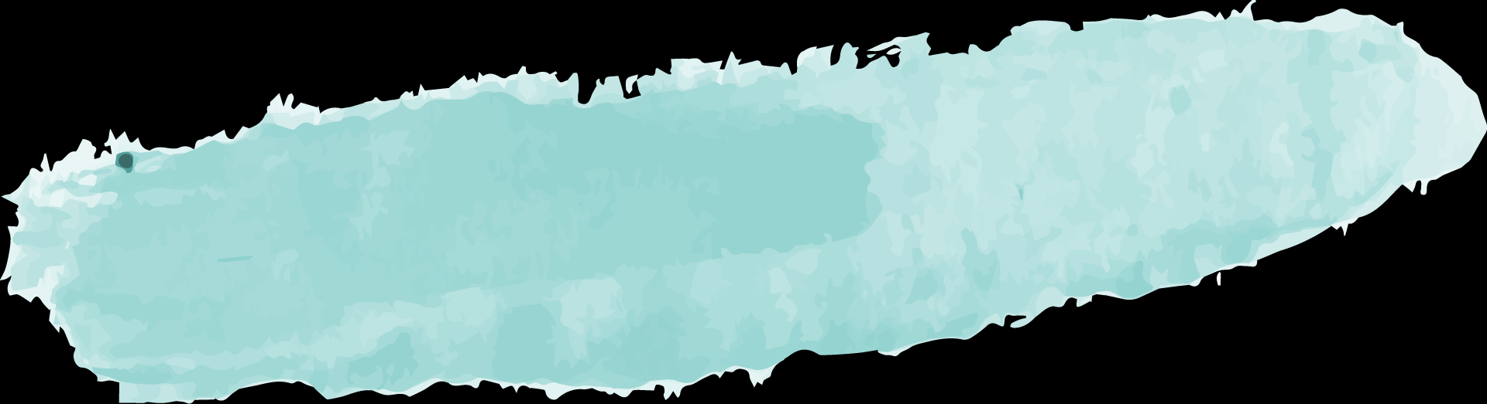
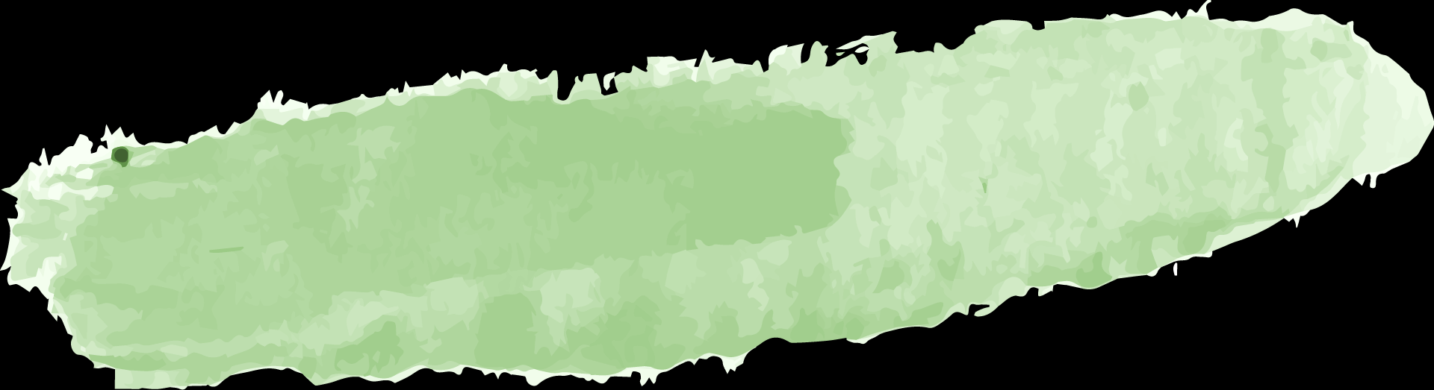
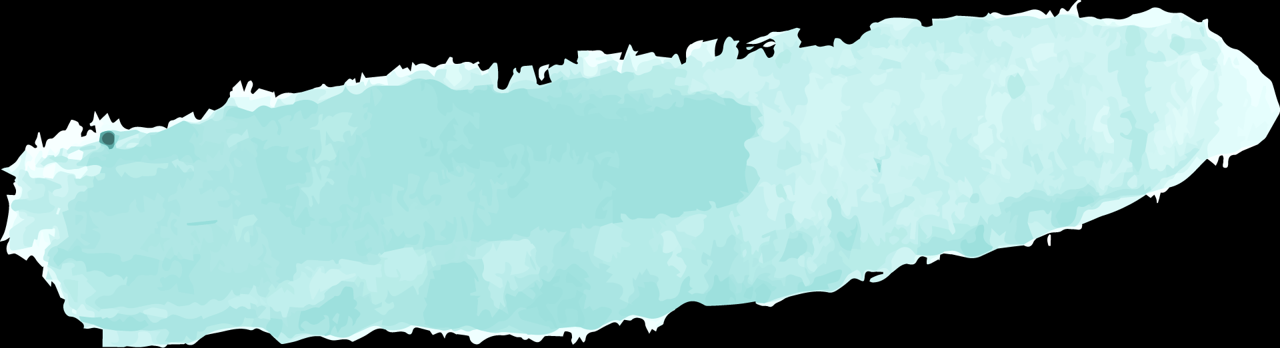
Story 1
Listen to the four MISTAKES stories then fill the chart
Story 2
Mistake: A company rejected the patent for the telephone.
Mistake: The Titanic ignored warnings about icebergs.
Story 3
Story 4
Mistake: Russia sold Alaskan gold to the U.S.
Mistake: Coca-Cola tampered with their
successful formula.

Slide 9

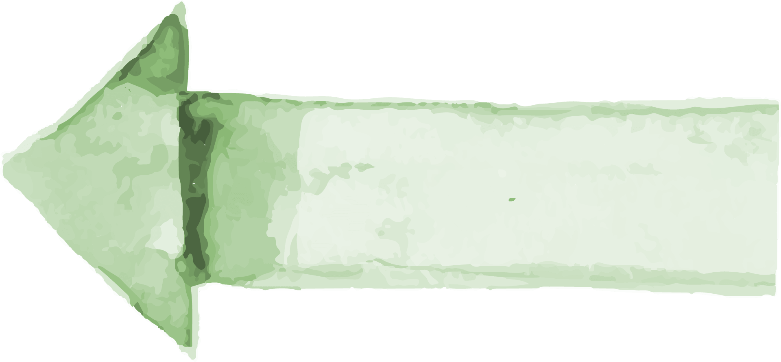
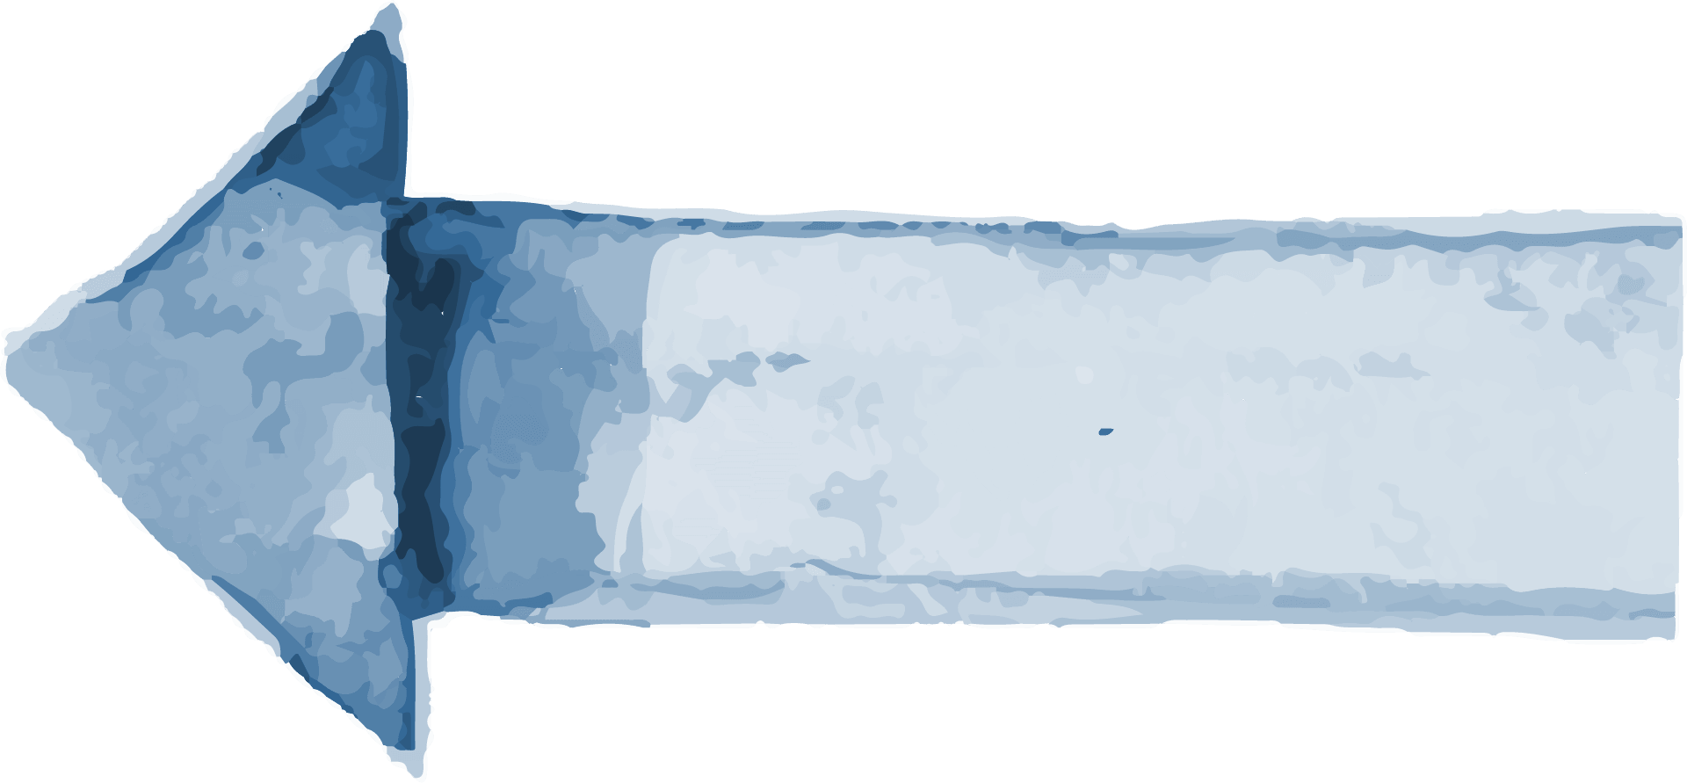
What was the mistake?
Who made the mistake?
Why was this a mistake?
1
2
3

Slide 10

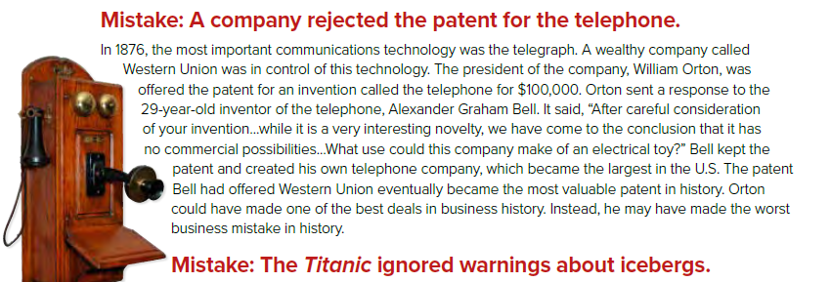

Slide 11
What was the mistake?
Who made the mistake?
Why was this a mistake?
Mistake: A company rejected the patent for the telephone.
Western Union rejected the patent for the telephone
The president of the company, William Orton.
The company would have made a lot of money.

Slide 12
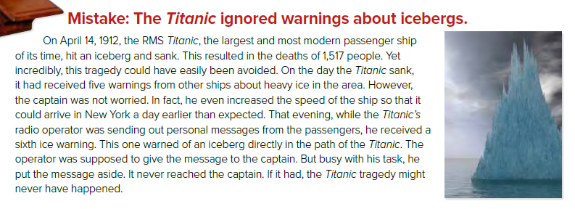

Slide 13
What was the mistake?
Who made the mistake?
Why was this a mistake?
Mistake: The Titanic ignored warnings about icebergs.
The captain ignored five warnings about the icebergs and the radio operator didn’t give the captain another warning.
The operator who was supposed to give the message to the captain
It resulted in the death of 1,517 people.

Slide 14
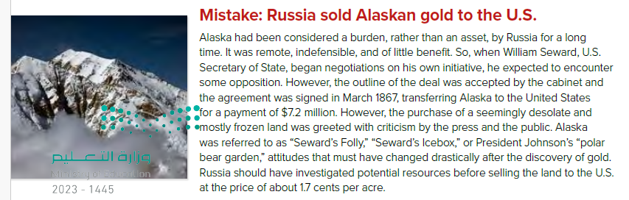

Slide 15
What was the mistake?
Who made the mistake?
Why was this a mistake?
Mistake: Russia sold Alaskan gold to the U.S.
Russia sold Alaska to the United States for 1.7 cents per acre.
Russian government.
There was gold in Alaska.

Slide 16
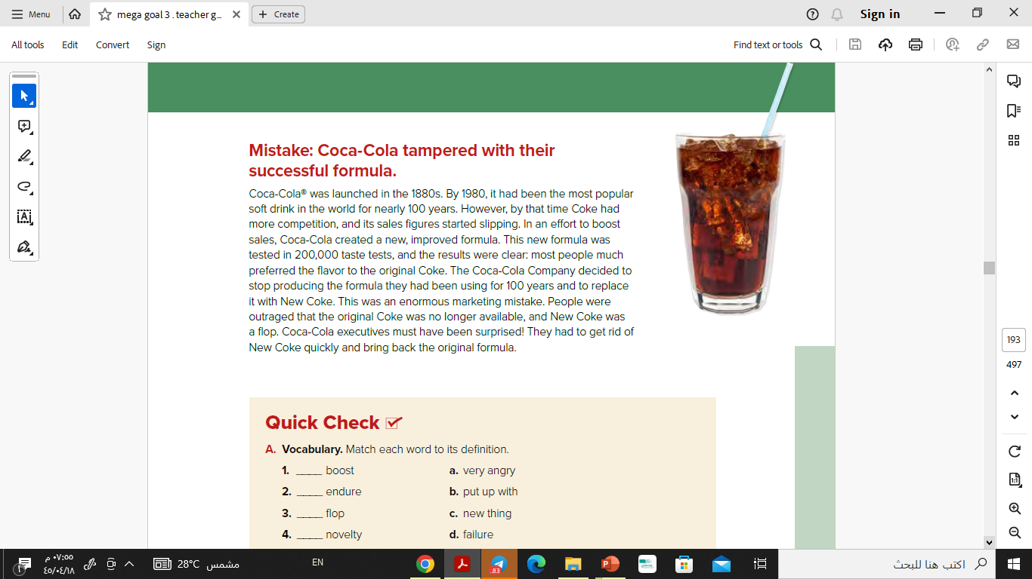

Slide 17
What was the mistake?
Who made the mistake?
Why was this a mistake?
Mistake: Coca-Cola tampered with their successful formula.
Coca-Cola changed their formula and taste.
Russian government.
People were outraged that the original Coke was not available

Slide 18
Vocabulary

Slide 19
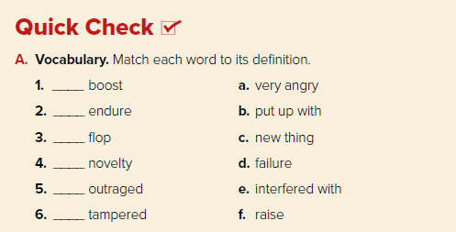
f
b
d
c
a
e

Slide 20
Pair Work

Slide 21
Interview your partner to find out about a mistake they or someone they know once made. Ask questions,
such as:
What was the mistake?
Who made the mistake?
Why was the mistake made?
What happened as a result of the mistake?
How could it have been avoided?

Slide 22
Example:
Student A: What was the mistake?
Student B: My father’s car was wrecked in an accident.
Student A: Who made the mistake?
Student B: My brother did.
Student A: Why was the mistake made?
Student B: He wasn’t paying attention while driving.

Slide 23
Thanks!

