Slide 1
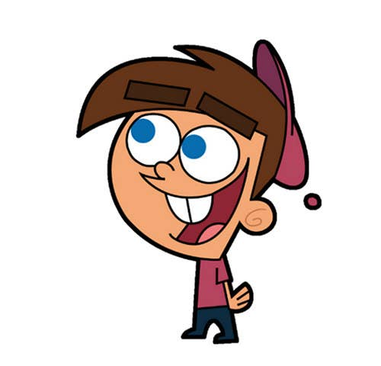


Welcome to class
T.
Mohamad
Zaid

Slide 2
Day
Sunday
Date
1st Jun 2022
Subject
We can 6
Unit
1 Fun on the Weekend
Lesson
1 Finding Out Time

Slide 3

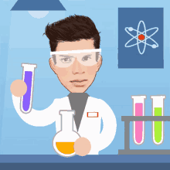

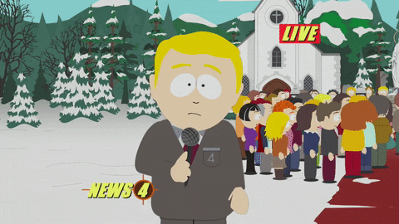
Revision for the previous UNIT :
What do you want to be when you grow up ?

Slide 4
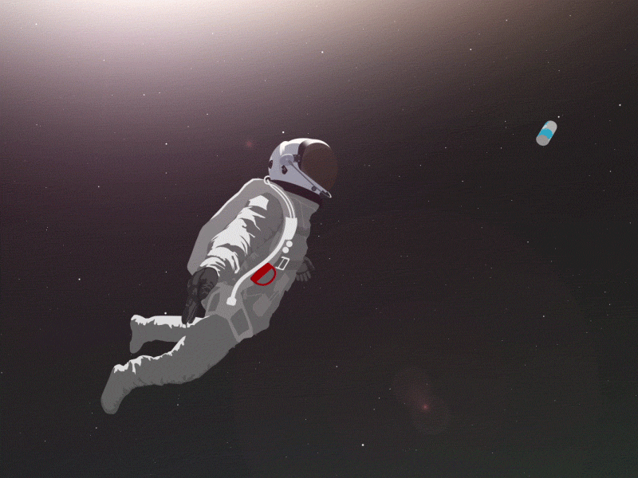
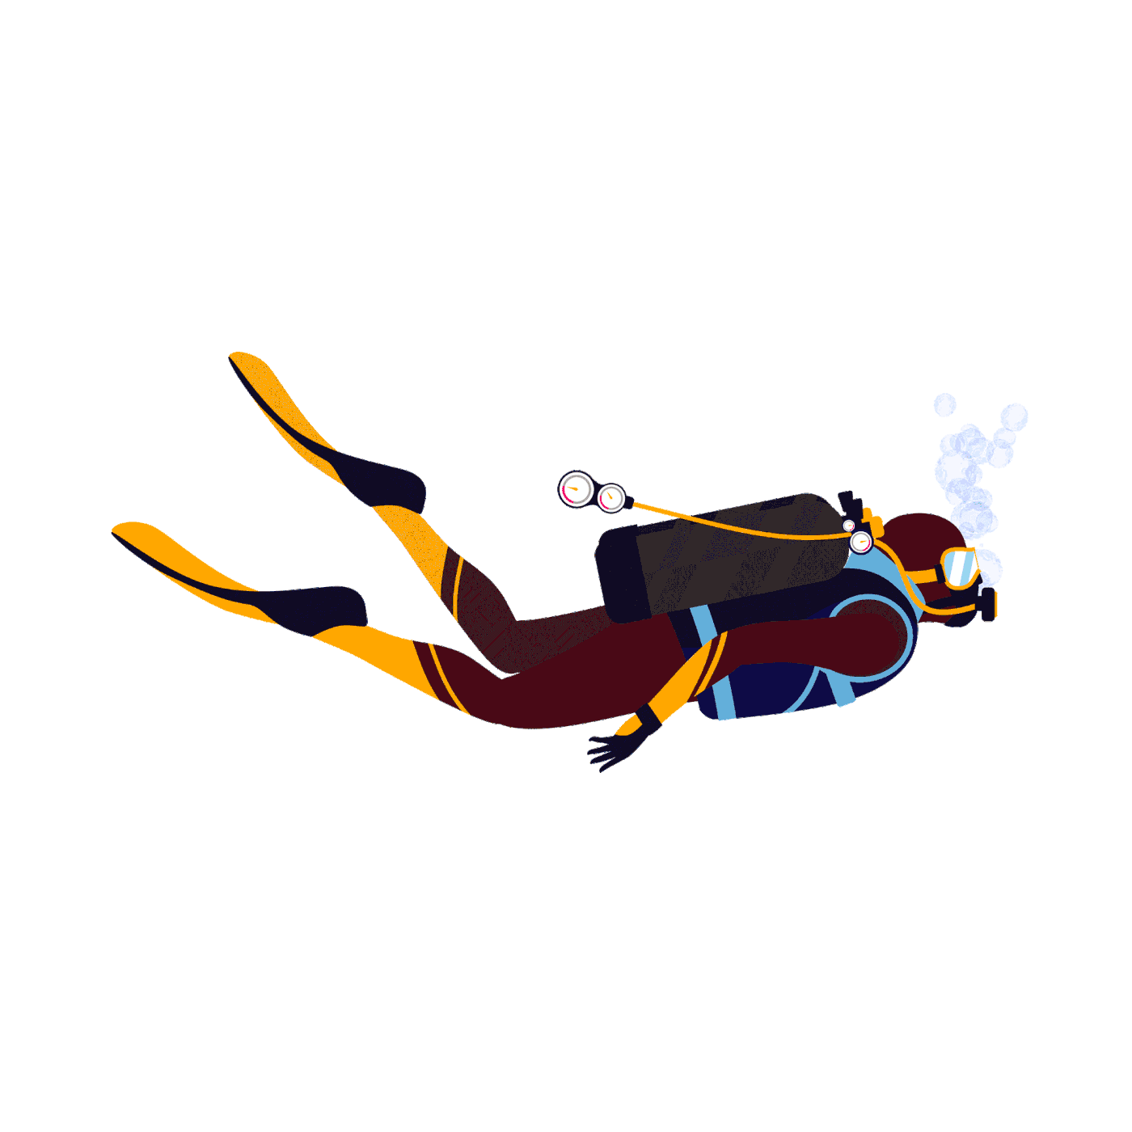
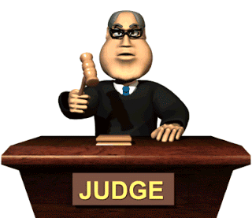
Revision for the previous UNIT :
1
2
3
astronaut
diver
lawyer

Slide 5
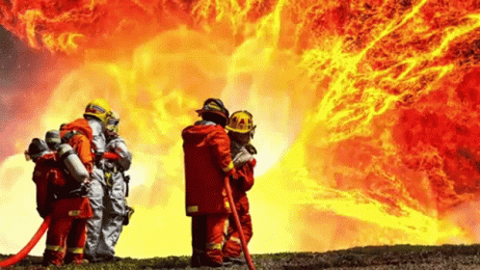
Revision for the previous UNIT :
Who are they?
Where do they work?
What do they do?
They are firefighters.
They put out fires.
In the fire station .

Slide 6
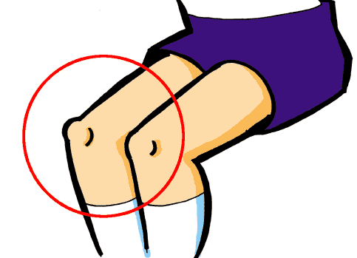

Revision for the previous UNIT :
Fill in the missing letters :
kn
gh
kn
gh
__ee
Ri__t

Slide 7




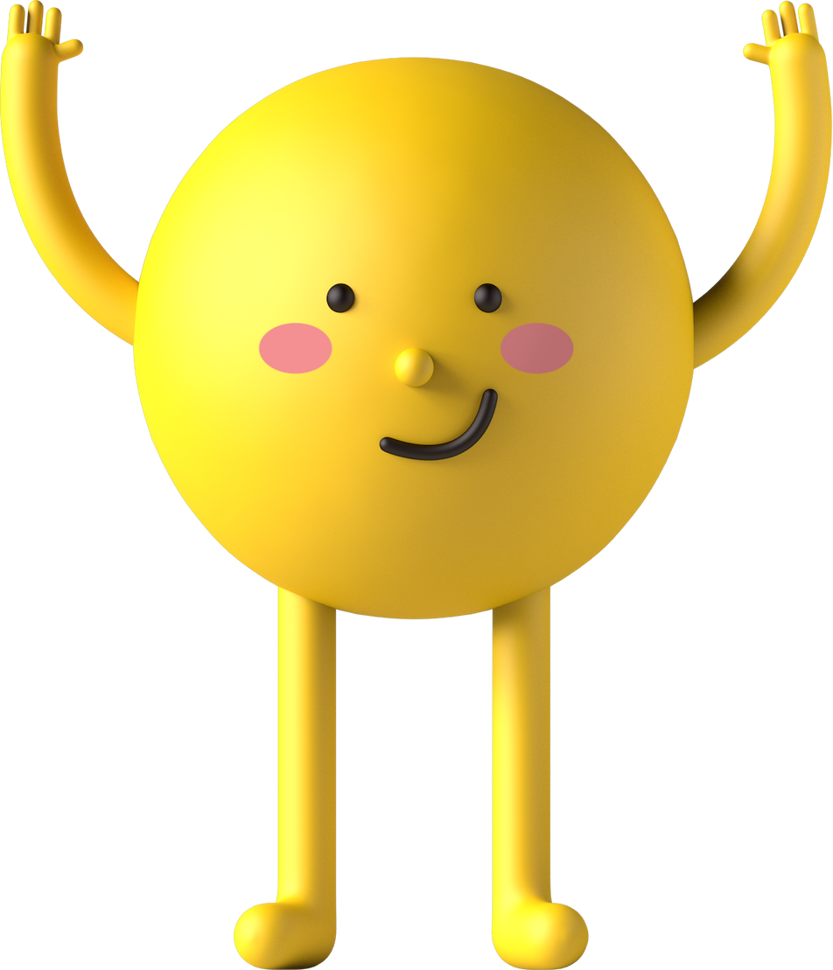
PAGEs 2 , 3

Slide 8
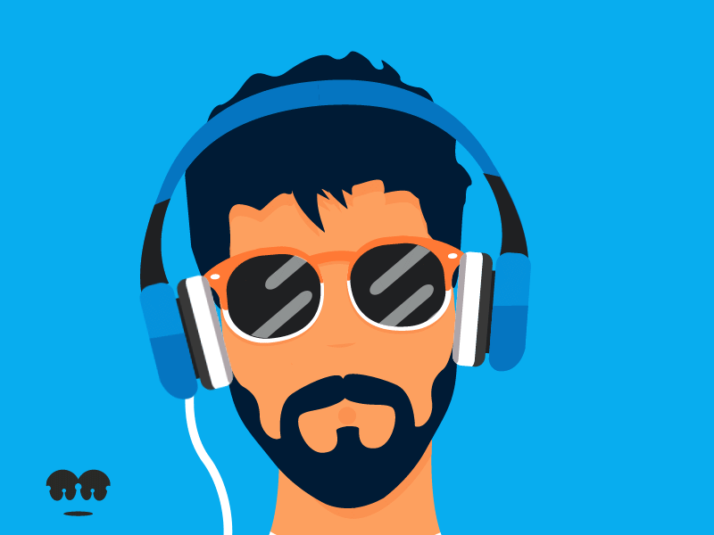
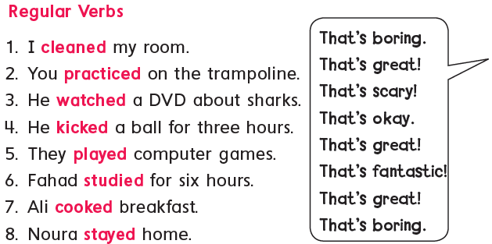
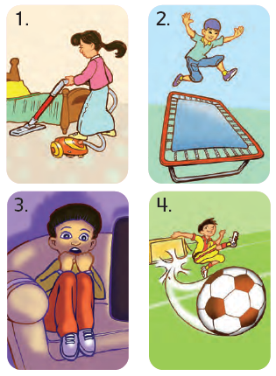

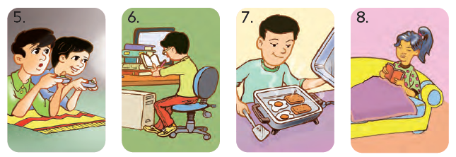
Listen and practice . Then do it in pairs .

Slide 9

English Verbs
Regular verbs
Irregular verbs
In the past tense
In the past tense
Verbs + ed
Have different forms
Play___
come
ed
came

Slide 10

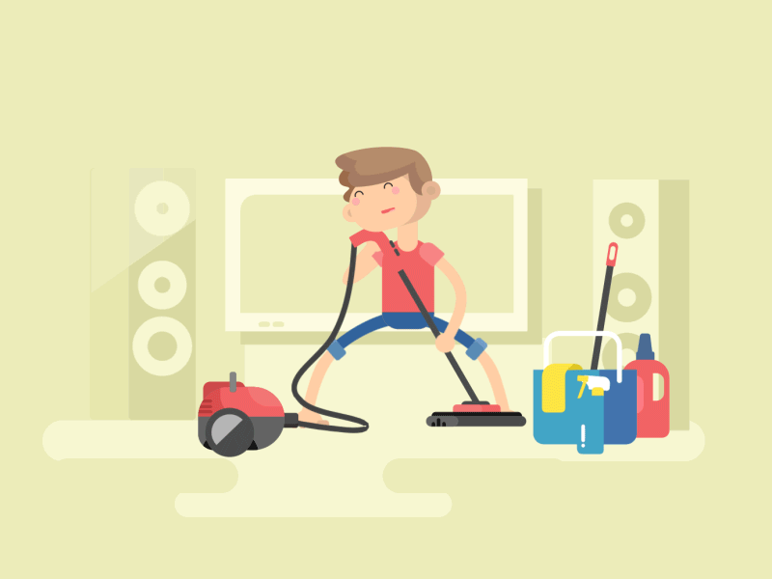
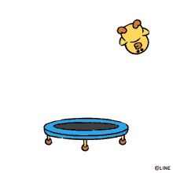
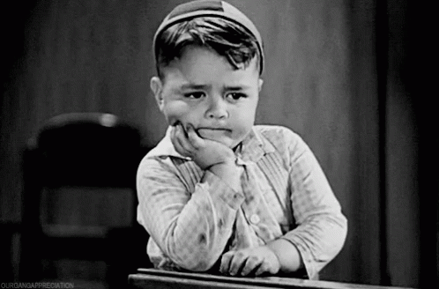

Regular verbs are the verbs that end with ed in the past tense
What did you, he, she or they do over the weekend ?
1. I clean___ my room
2. You practice _ on the trampoline
ed
d
That's boring
That’s great

Slide 11
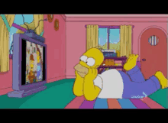
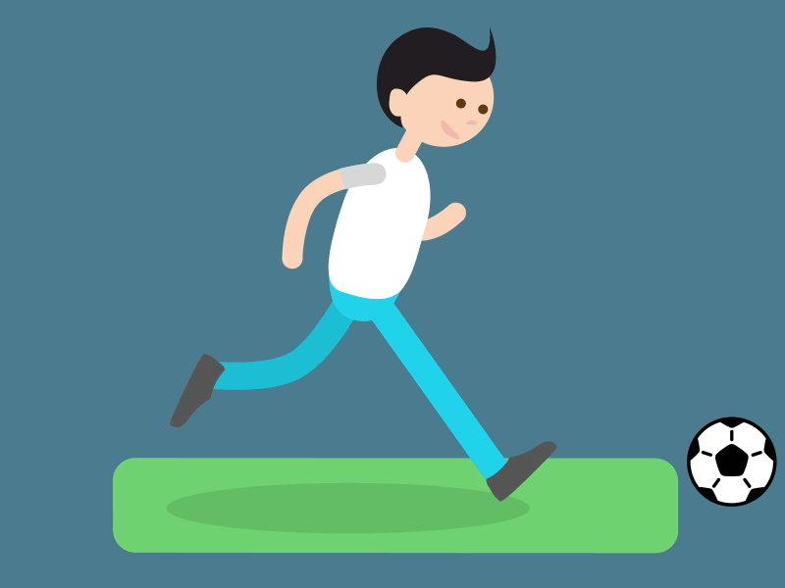
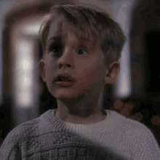

What did you, he, she or they do over the weekend ?
What did he do over the weekend ?
What did he do over the weekend ?
3. He watch___ a DVD about sharks
4. He kick __ a ball for 3 hours
ed
ed
That’s scary
That’s okay

Slide 12
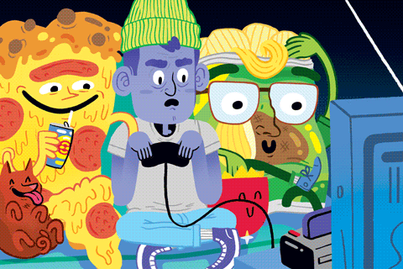
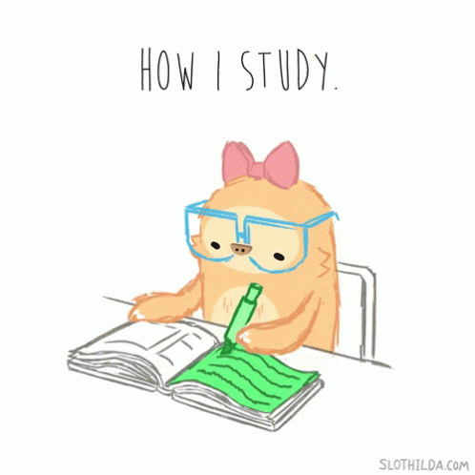

What did you, he, she or they do over the weekend ?
What did they do over the weekend ?
What did he do over the weekend ?
5. They play___ computer games
6. He study __ for 6 hours
ed
ied
That’s great
That’s fantastic

Slide 13
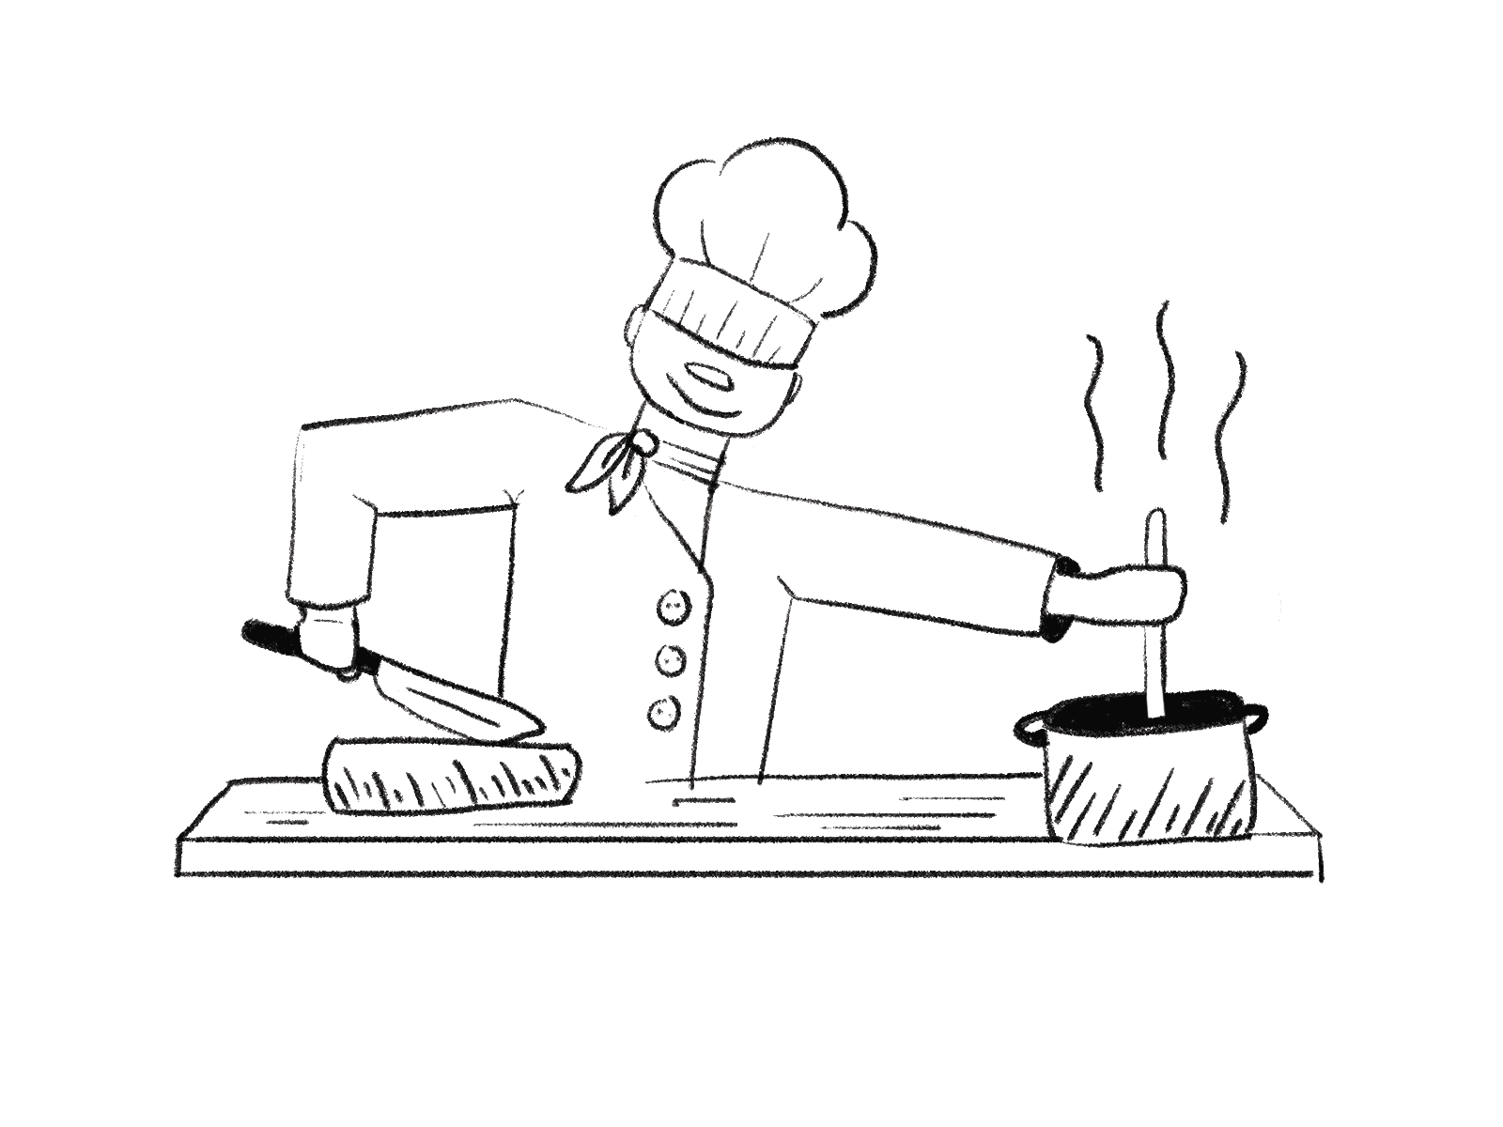

What did you, he, she or they do over the weekend ?
What did Ali do over the weekend ?
What did Nora do over the weekend ?
3. Ali cook___ breakfast
4. Nora stay __ home
ed
ed
That’s great
That's boring

Slide 14



https://www.liveworksheets.com/worksheets/en/English_as_a_Second_Language_(ESL)/Expressions/Unit_1fun_on_the_weekend_l1_eb1542214ie

Slide 15


Open your workbook
Pages 71 , 72

Slide 16
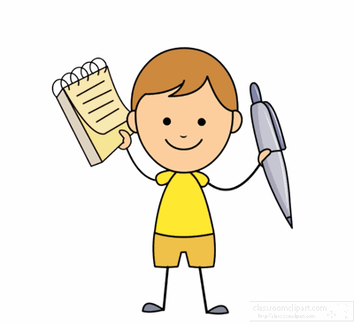

Home work at

Slide 17


