Slide 1



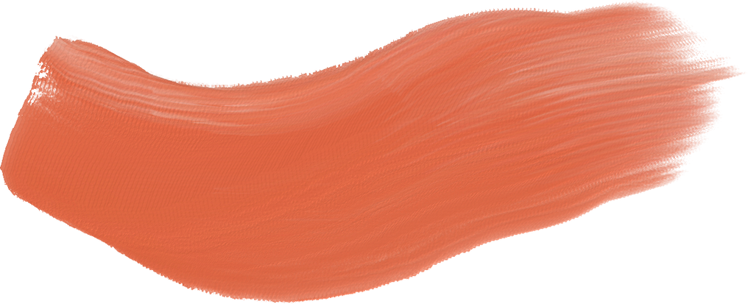










Slide 2
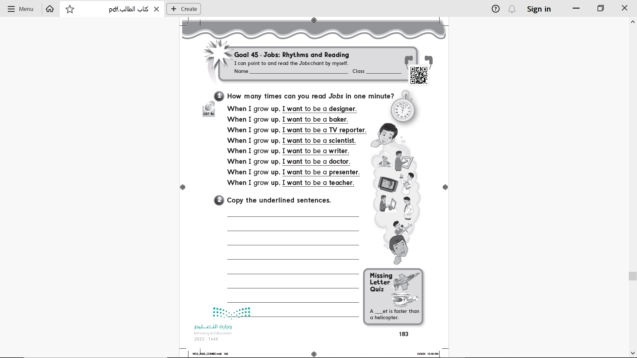

Page 183

Slide 3
I want to be a designer .
I want to be a baker .
I want to be a TV reporter.
I want to be a scientist.
I want to be a writer.
I want to be a doctor.
I want to be a presenter.
j
I want to be a teacher.
Page 183

Slide 4
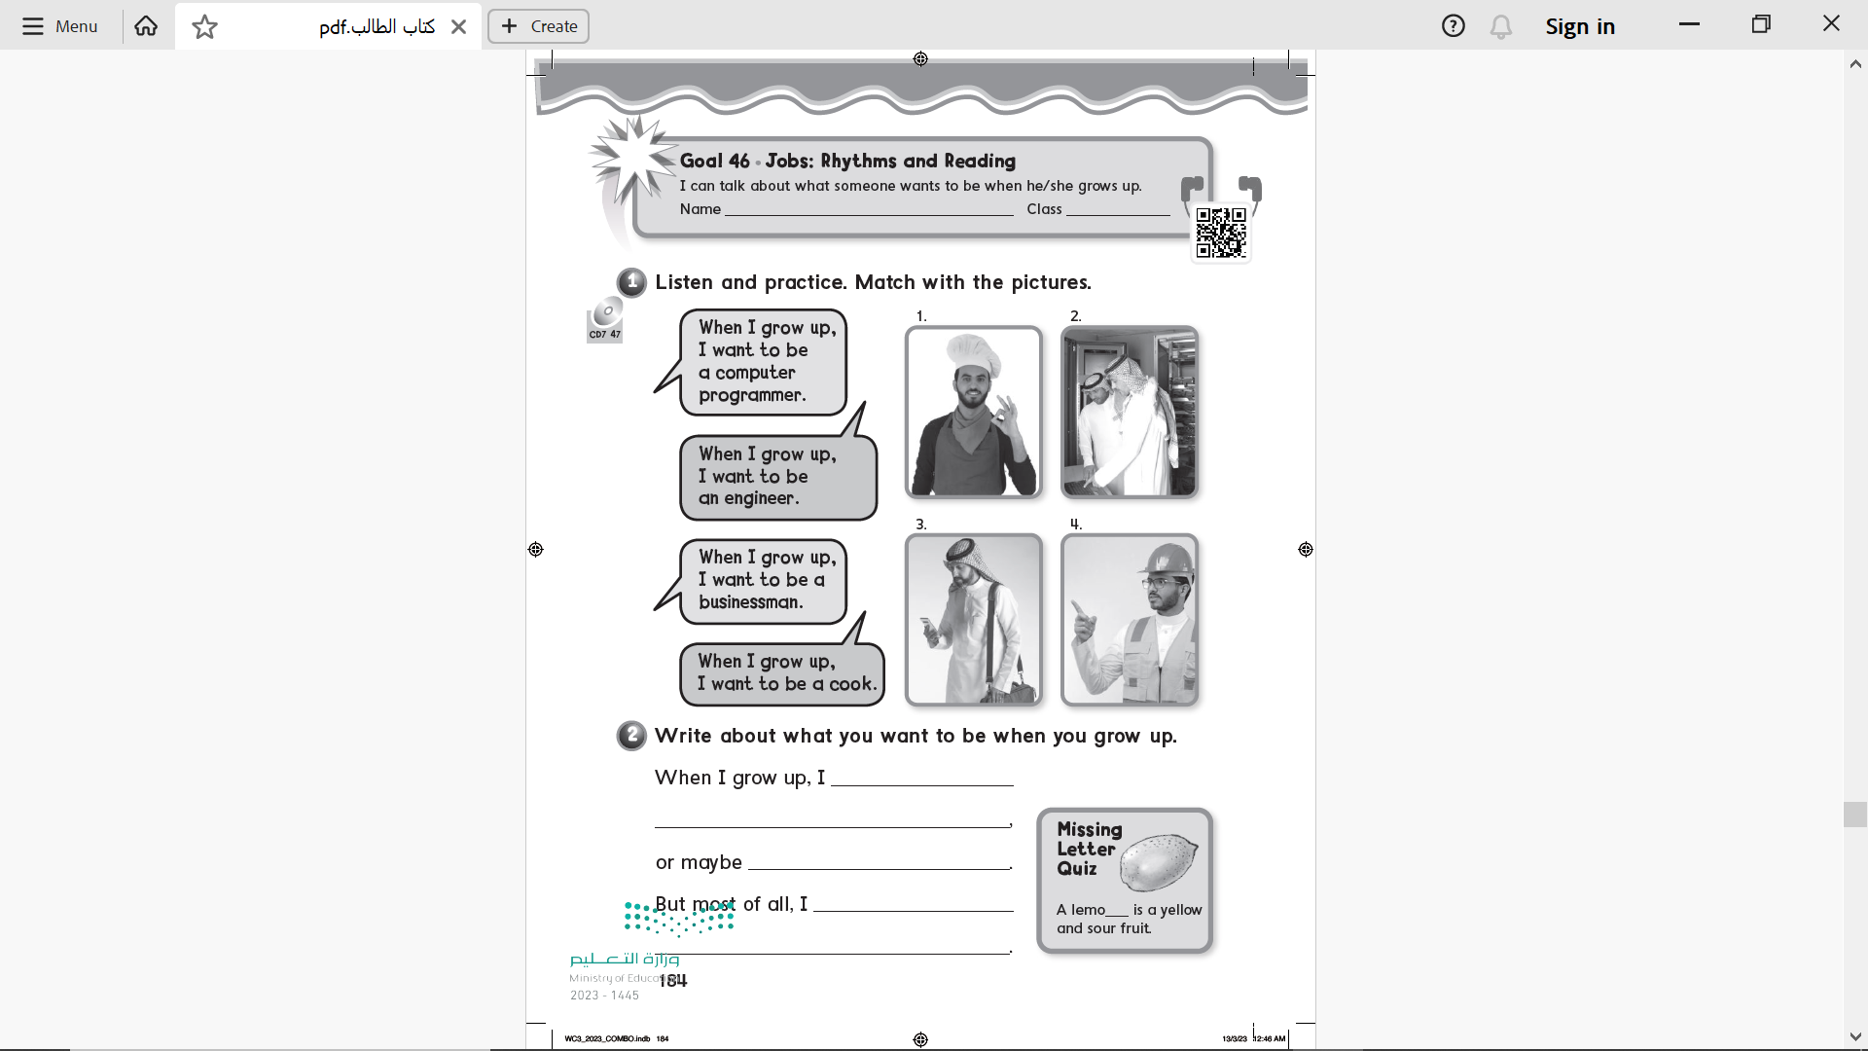
2
4
3
1
Page 184

Slide 5
want to be a designer .
I want to be a writer.
want to be a designer .
n
Page 184

Slide 6




Slide 7




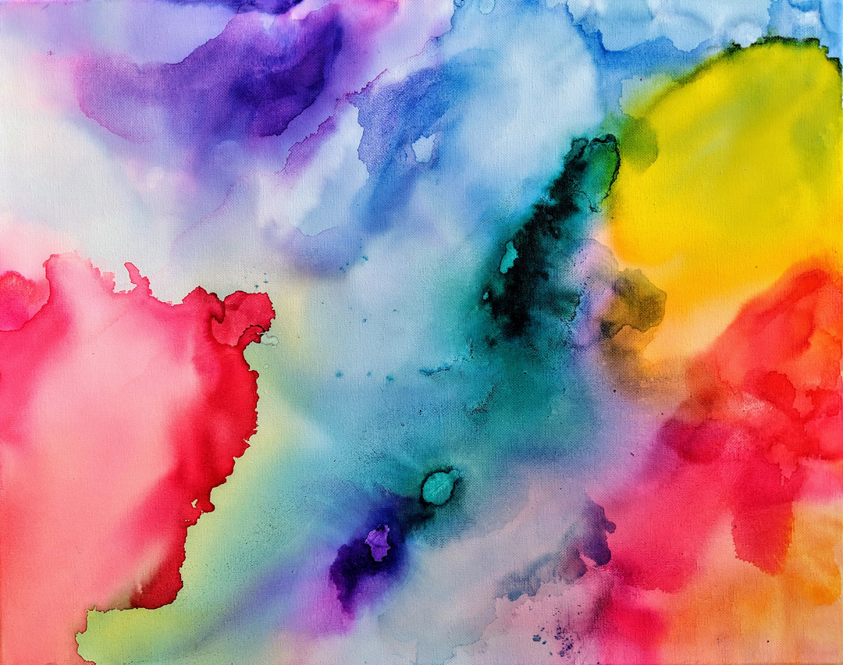
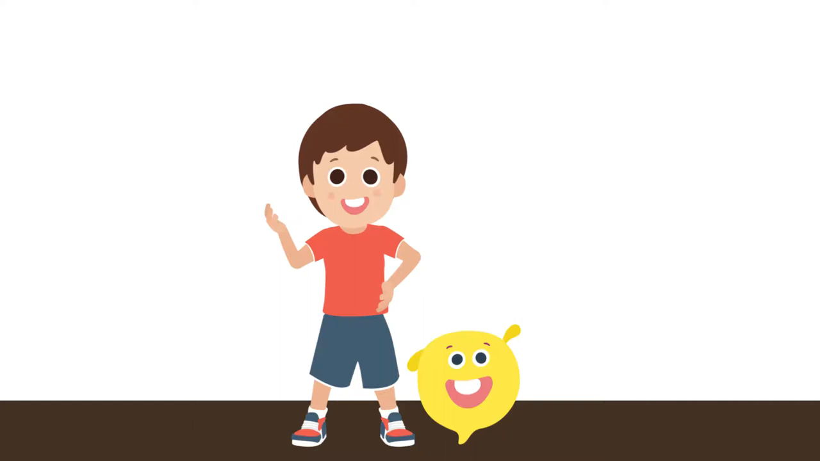


Slide 8
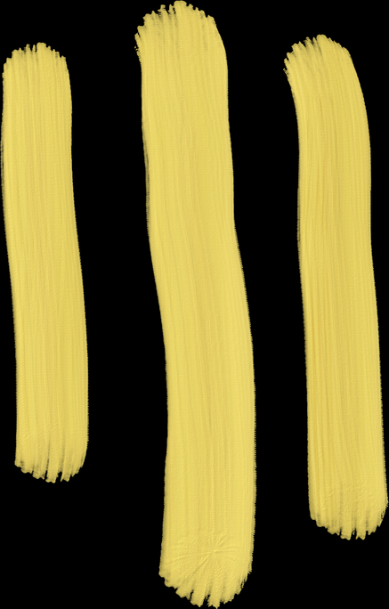
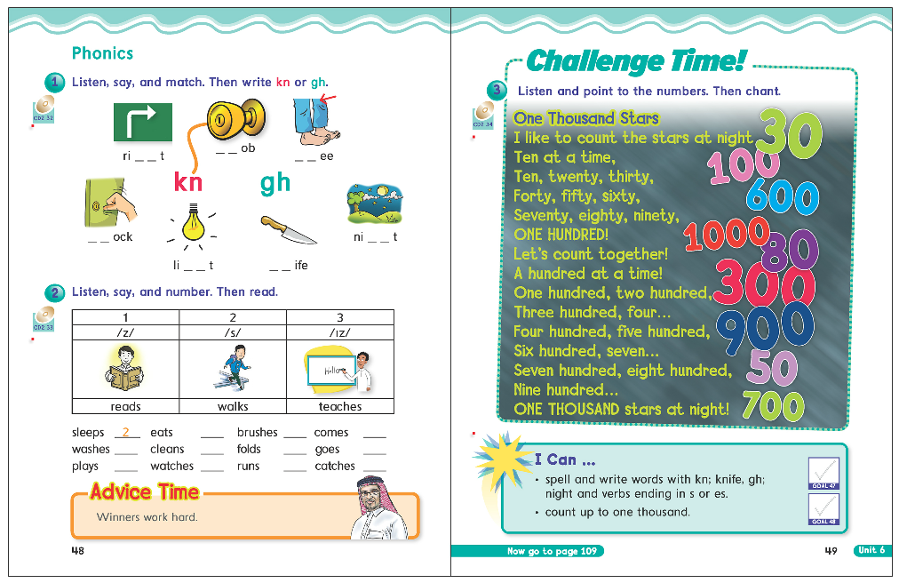

48
49

Slide 9
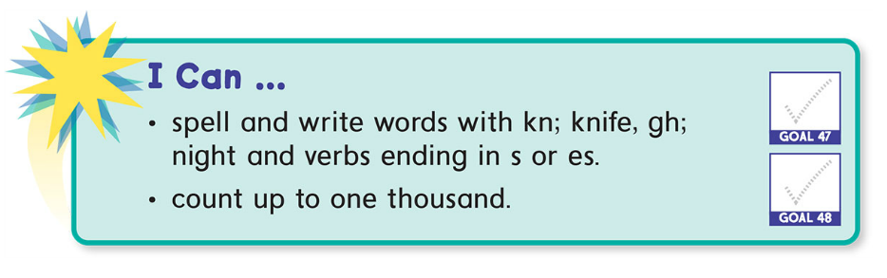

Slide 10

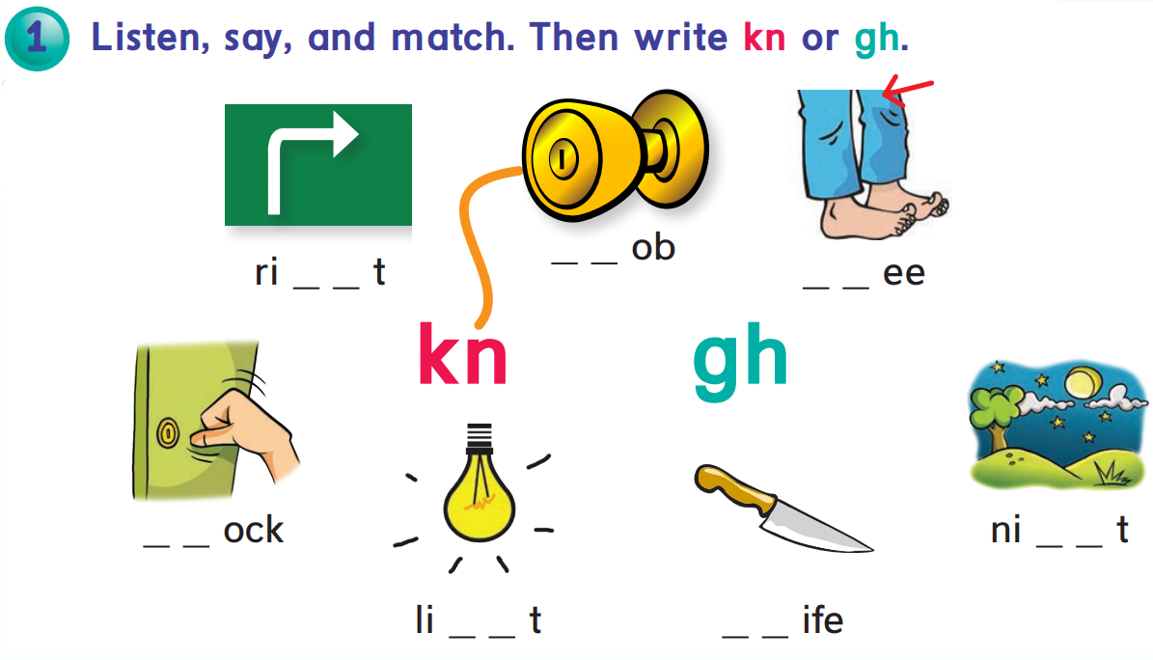



Slide 11

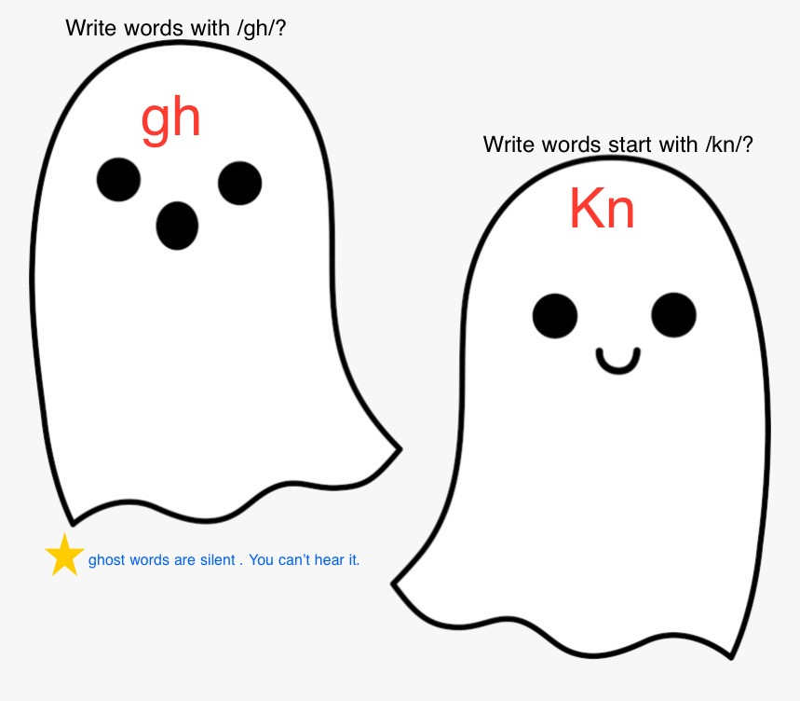

Slide 12
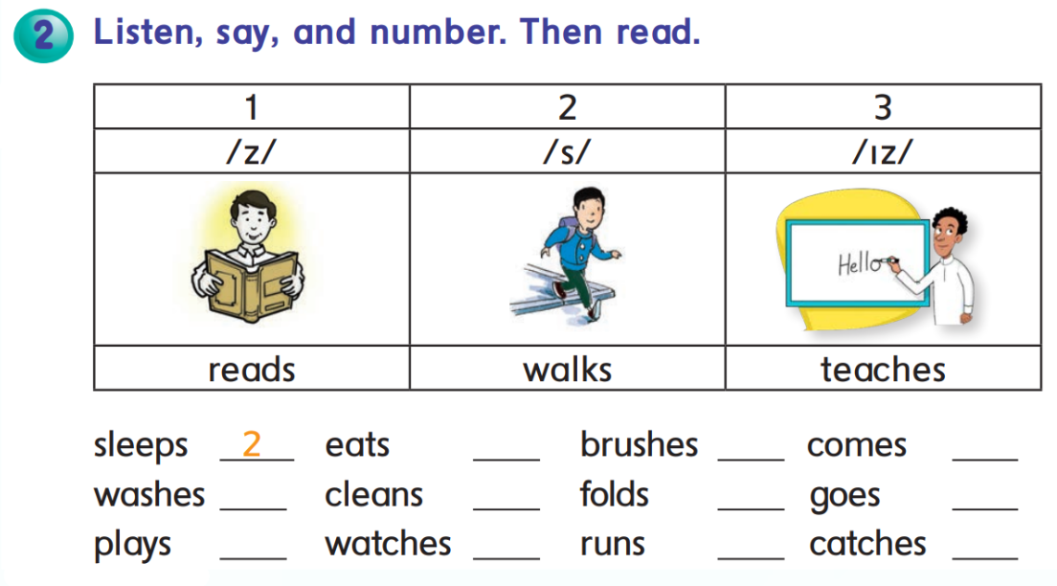




2
3
2
3
2
1
1
1
3
2
3

Slide 13
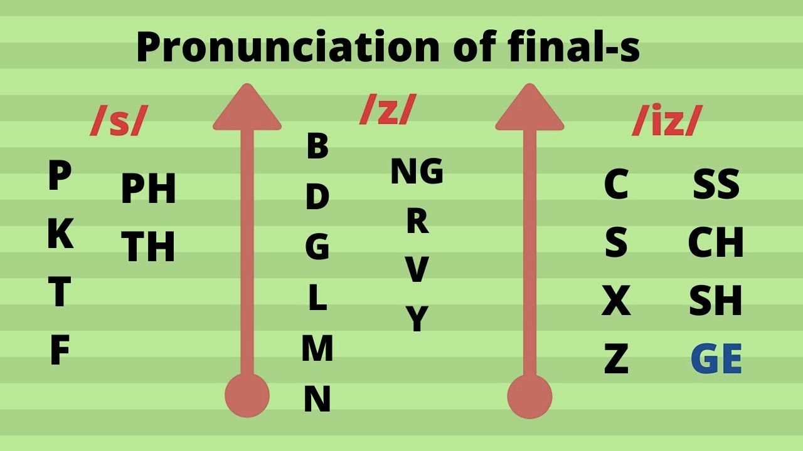

Slide 14


Slide 15

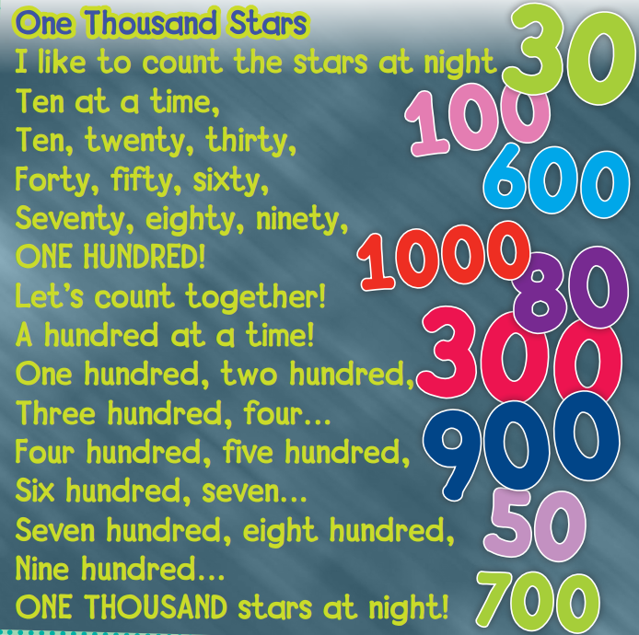


Slide 16



Slide 17


Slide 18
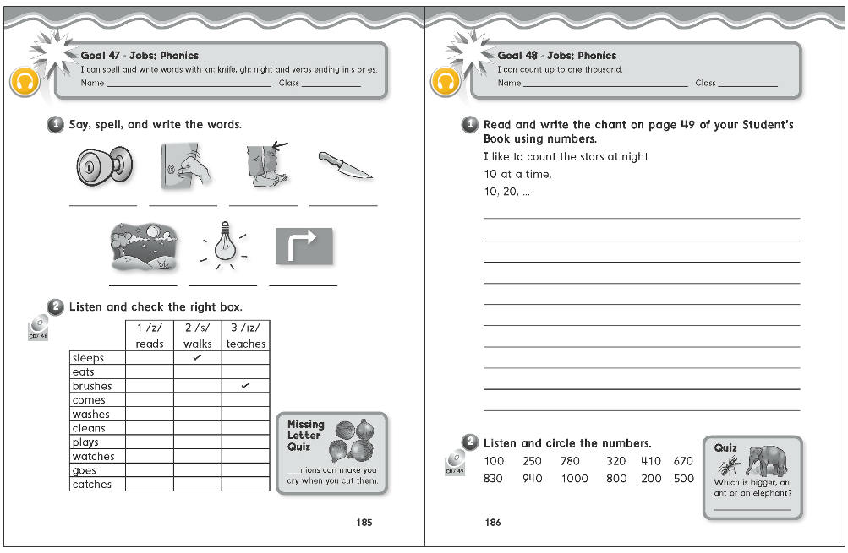
185
186

Slide 19
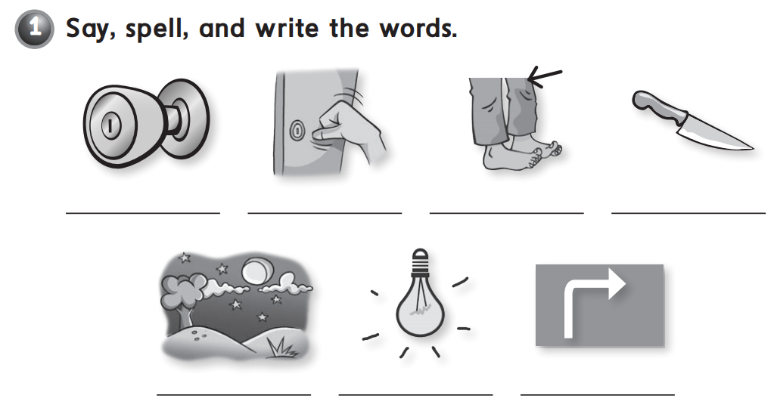

Slide 20
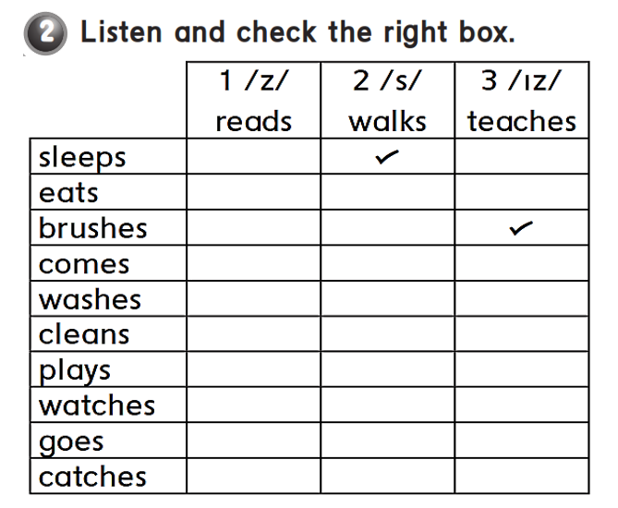



Slide 21

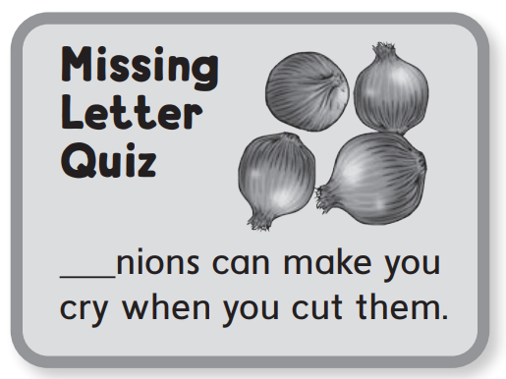

o

Slide 22
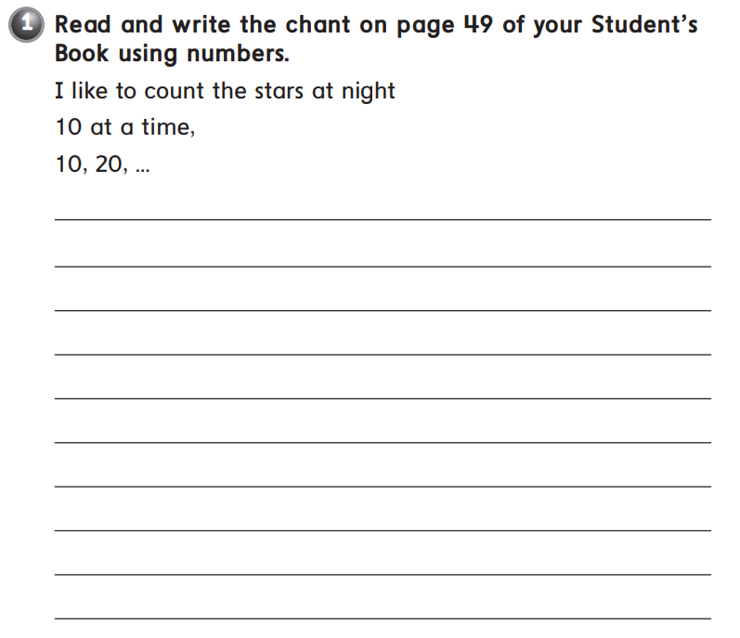
I like to count the stars at night .. 10 at a time,
10, 20, 30, 40, 50, 60, 70, 80, 90, 100!
Let’s count together! 100 at a time ..
100, 200, 300, 400, 500, 600,
700, 800, 900, 1000 stars at
night!

Slide 23
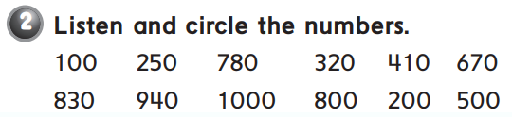

Slide 24
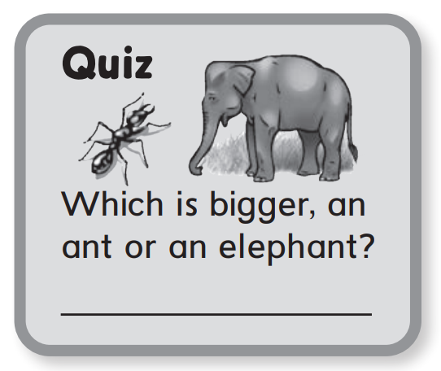
An elephant

Slide 25
Thank you!

