Slide 1

U 8 Grammar
Tr. Nora Khalid

Slide 2
Goals
USE should / shouldn't / when clause
Listen for specific information
Pronounce sounds
( /sn/, /st/, /sw/, and /sl/.

Slide 3


Should
Shouldn’t
I should study.
I shouldn’t eat fast food.

Slide 4
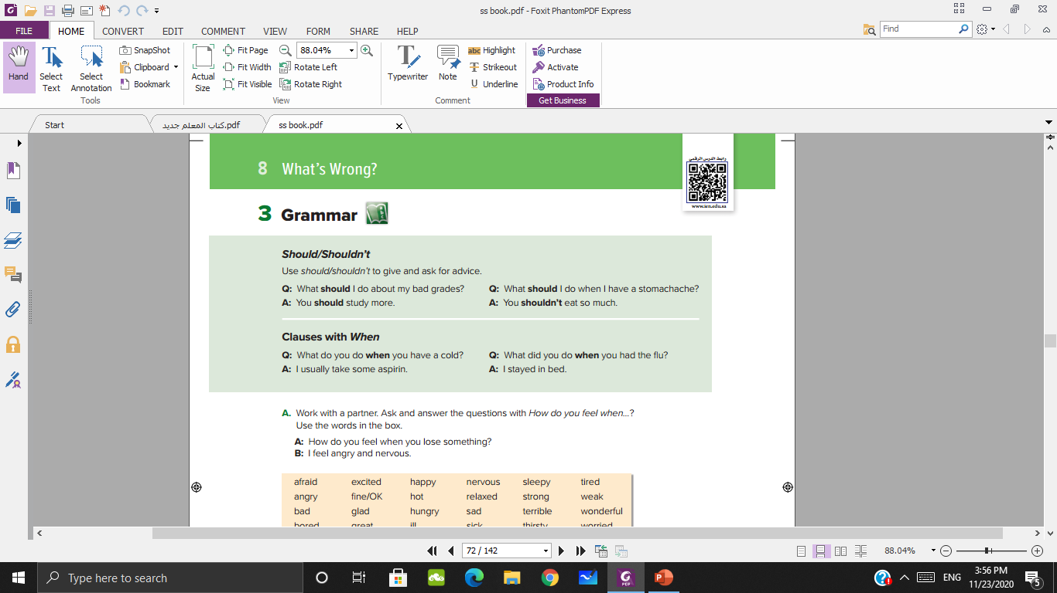

Slide 5
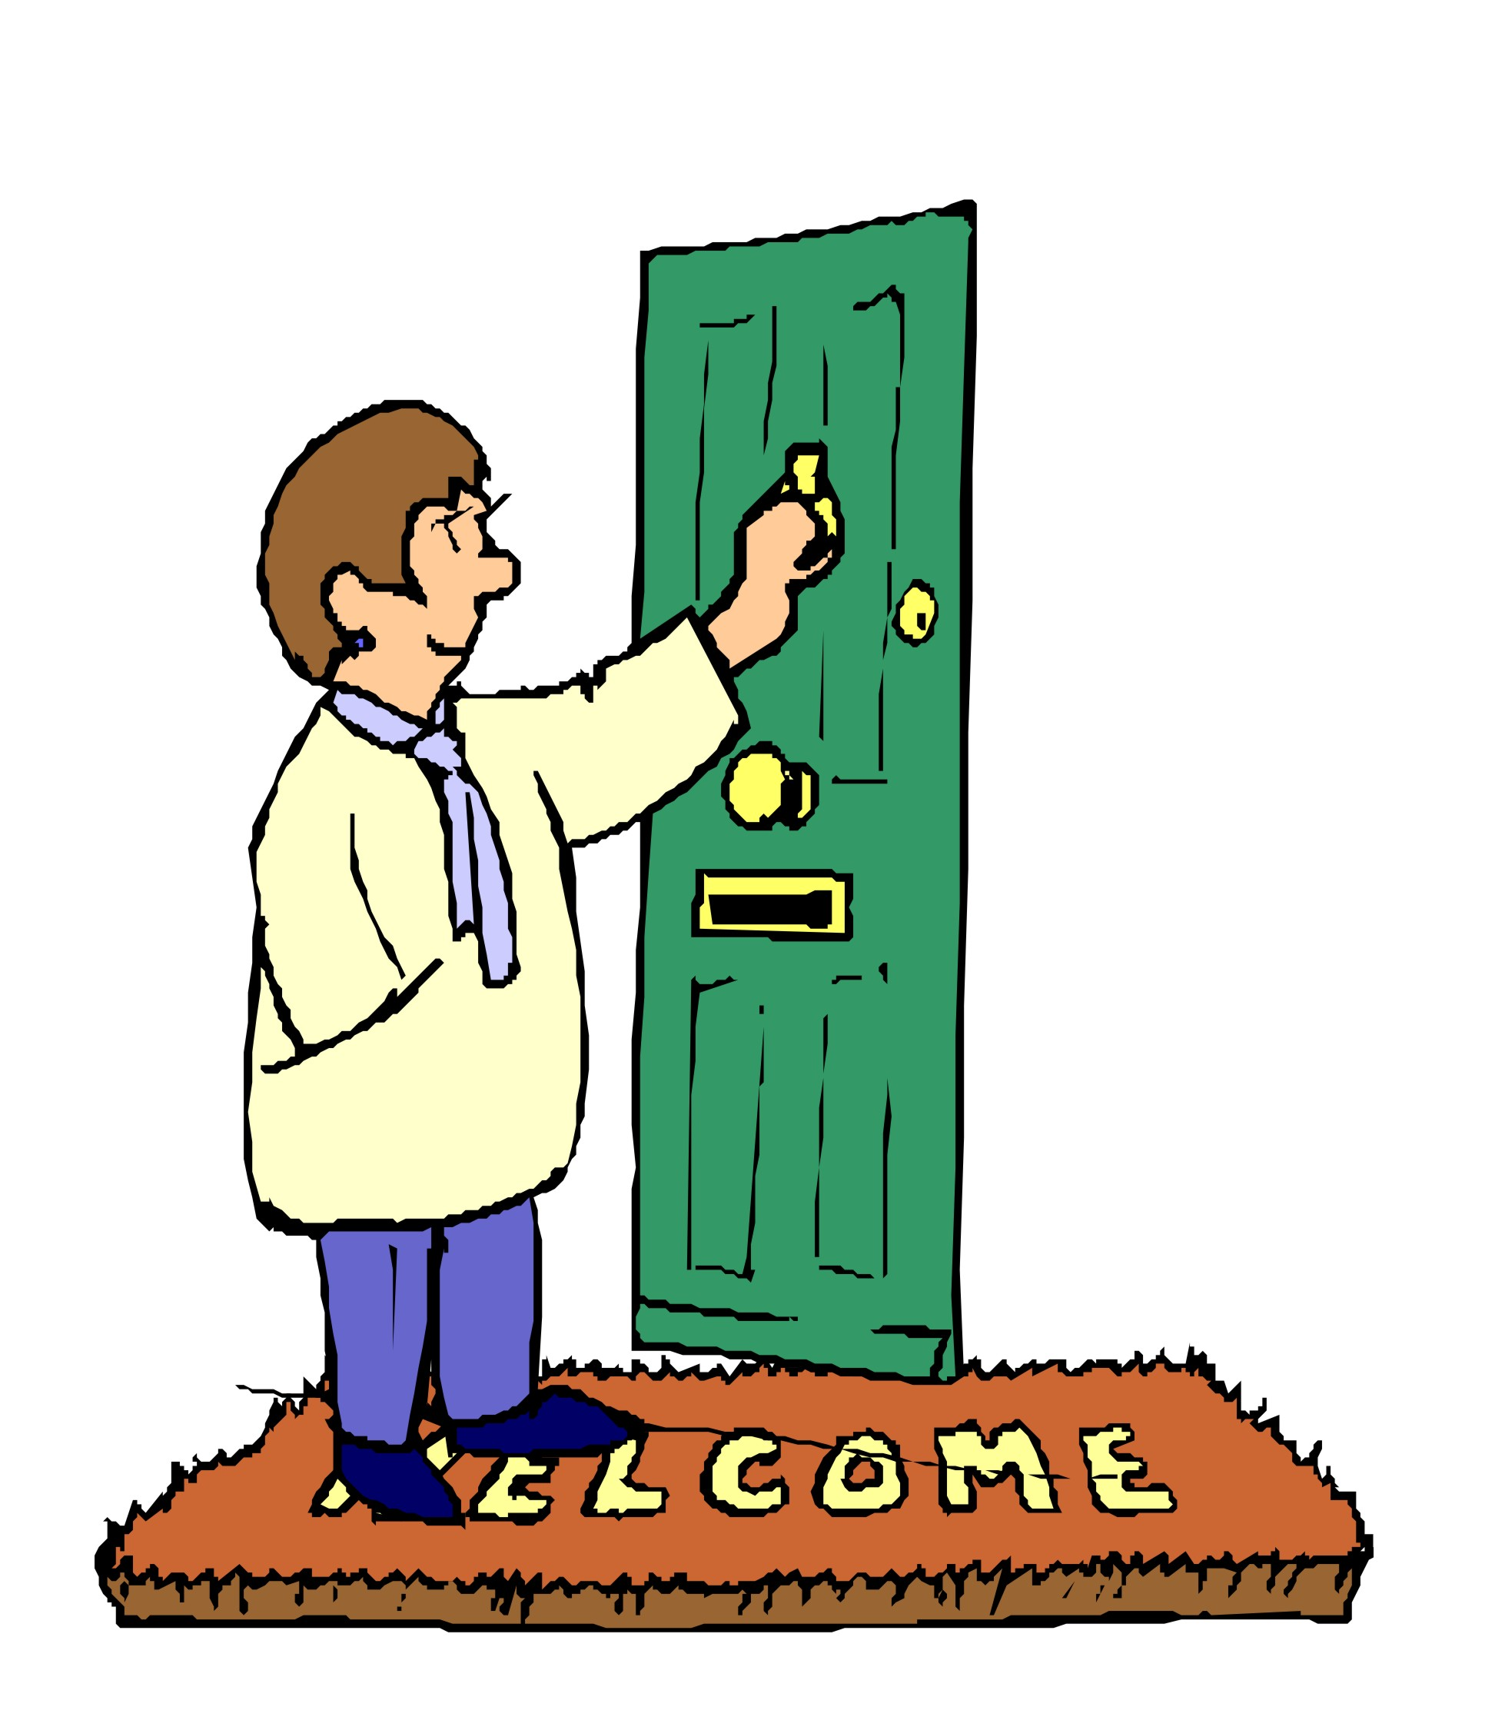
Visitors ………………… knock the door before they get in.
should

Slide 6

You ………………… carry very heavy things by yourself.
Shouldn’t

Slide 7
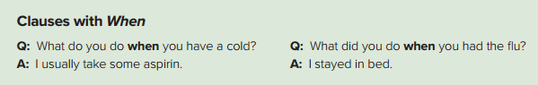
Read:
S + v after when.
Question or sentence?
In the past or the present?

Slide 8
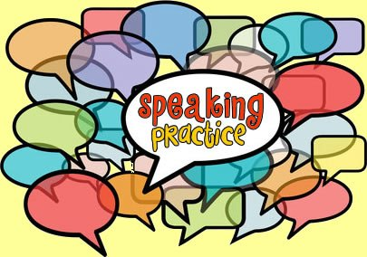

Slide 9
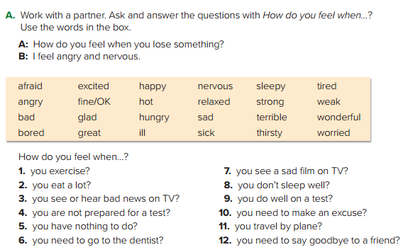

Slide 10
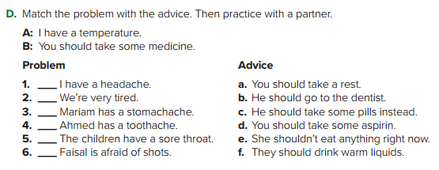
d
a
e
b
f
c

Slide 11
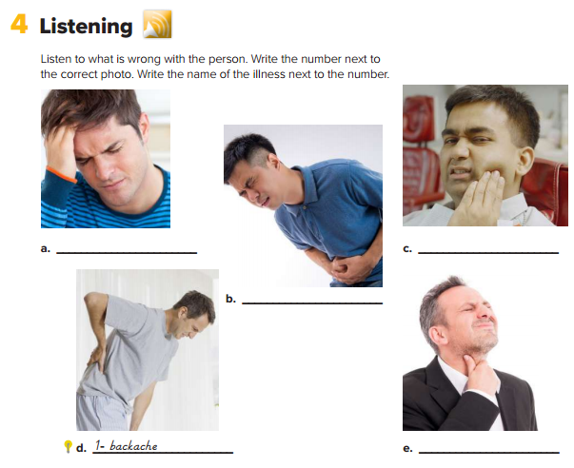
How many people are there?
Are they happy?
What’s wrong with each one?

Slide 12


Slide 13
cold
Toothache
Stomachache
Sore throat

Slide 14
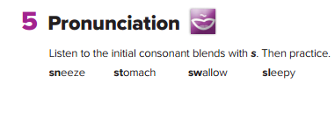

Slide 15

P 120 - 121

