Slide 1
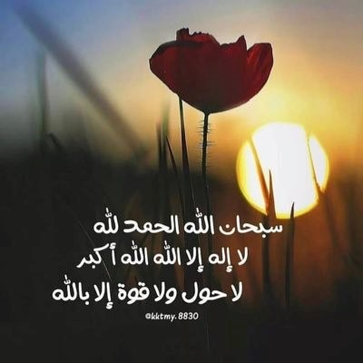

Slide 2
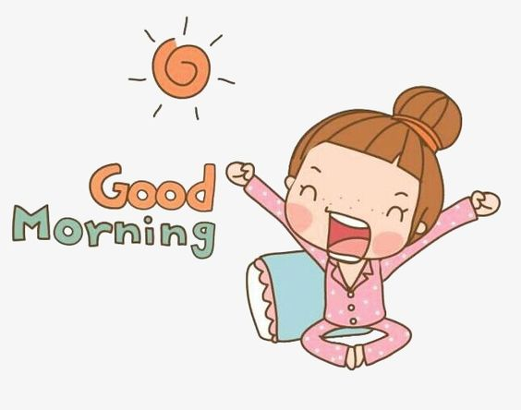

Slide 3
Unit 7
Where do you live ?

Slide 4

Today’s lesson :
1 .Listening & discuss
2 .Pair work .

Slide 5
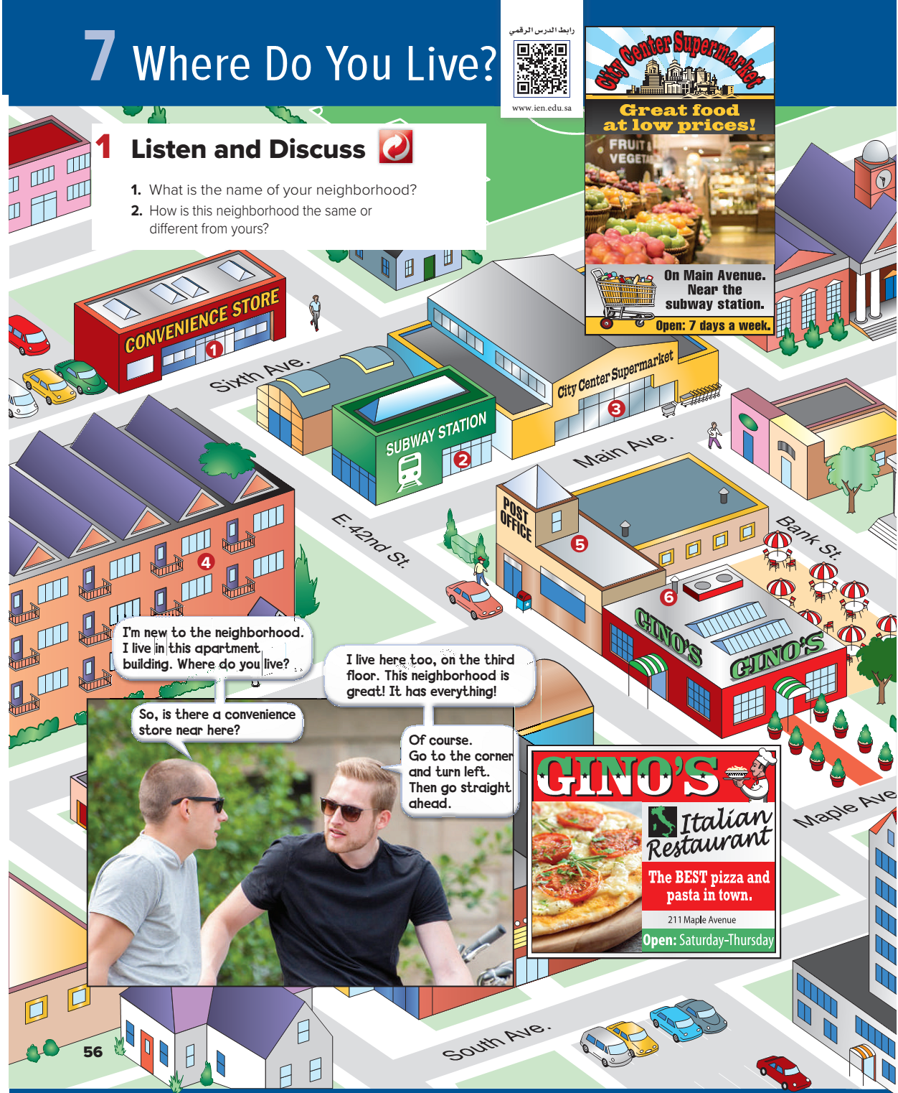
Page: 56

Slide 6
Page: 56

Slide 7

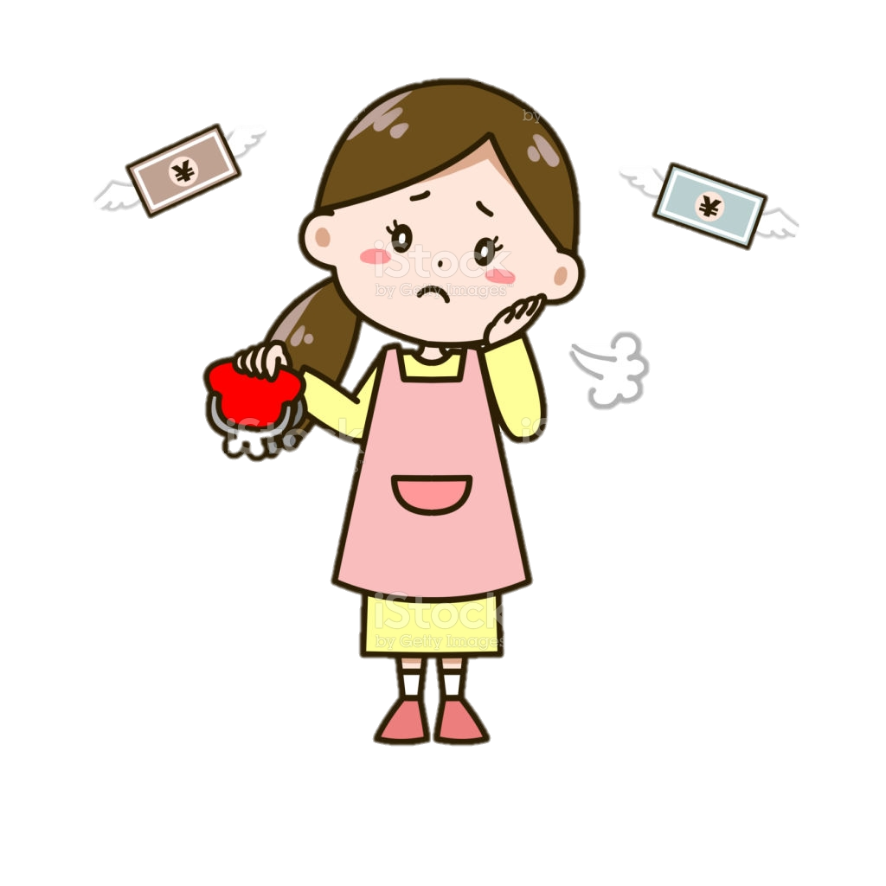

Slide 8
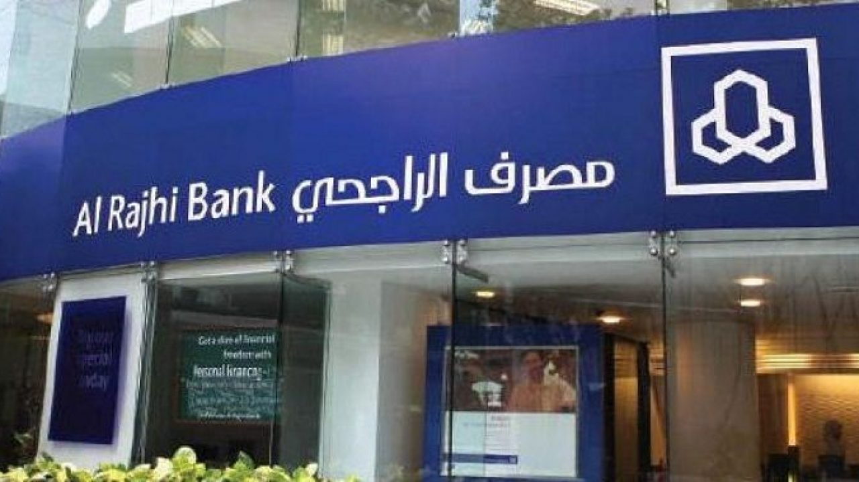
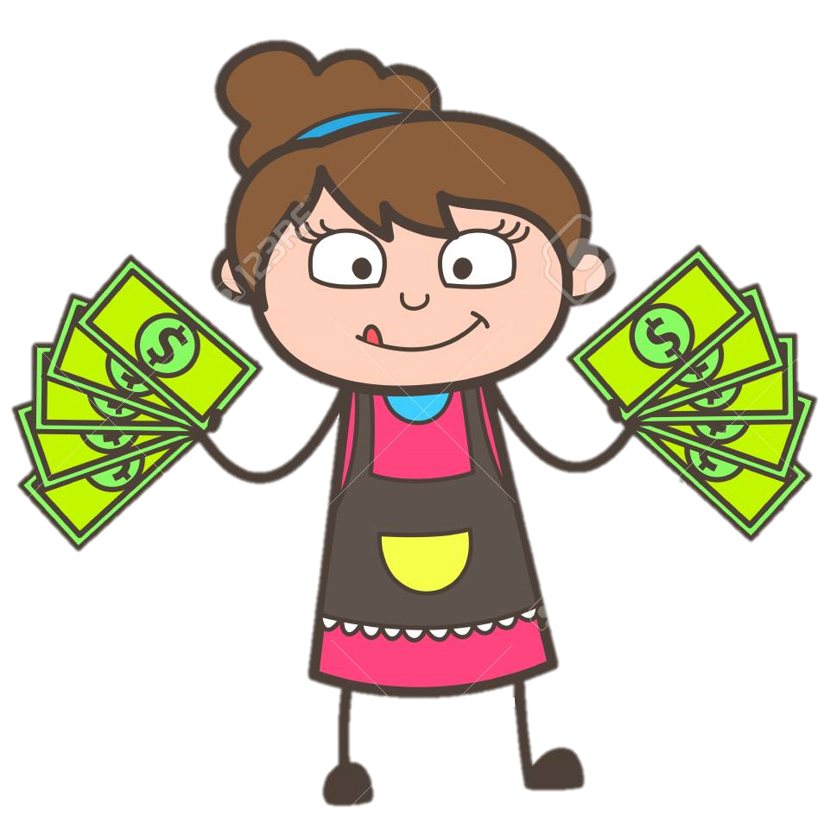
Bank

Slide 9
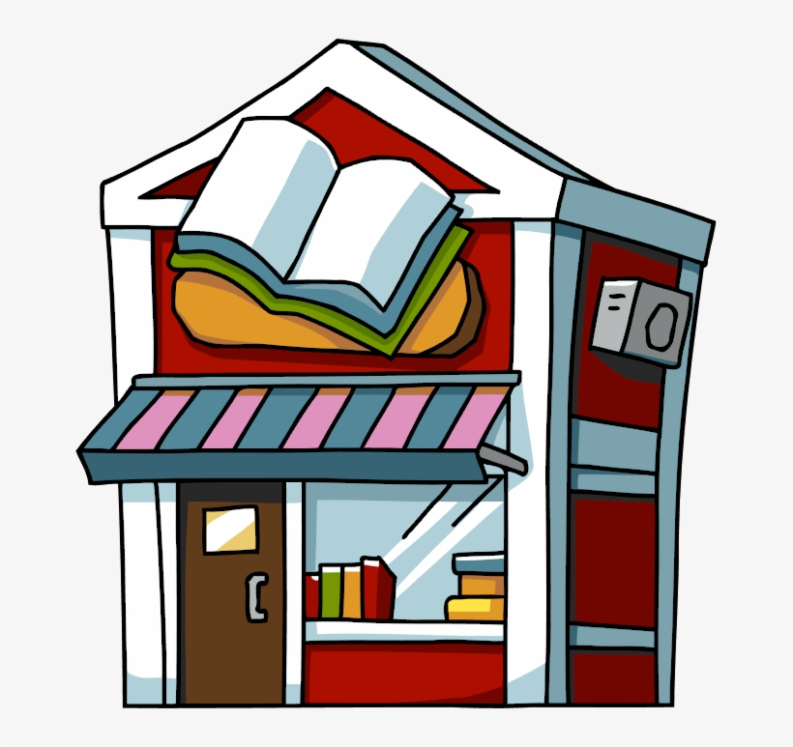
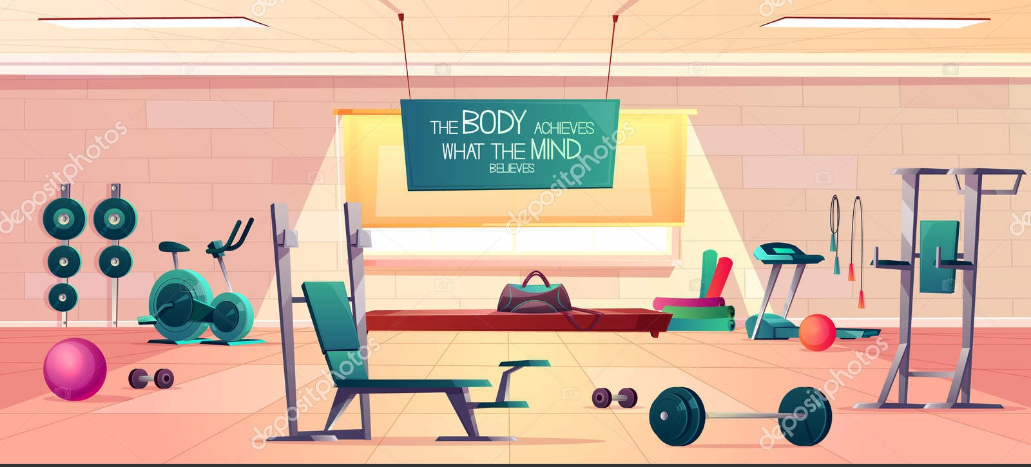
Bookstore.
Health club

Slide 10
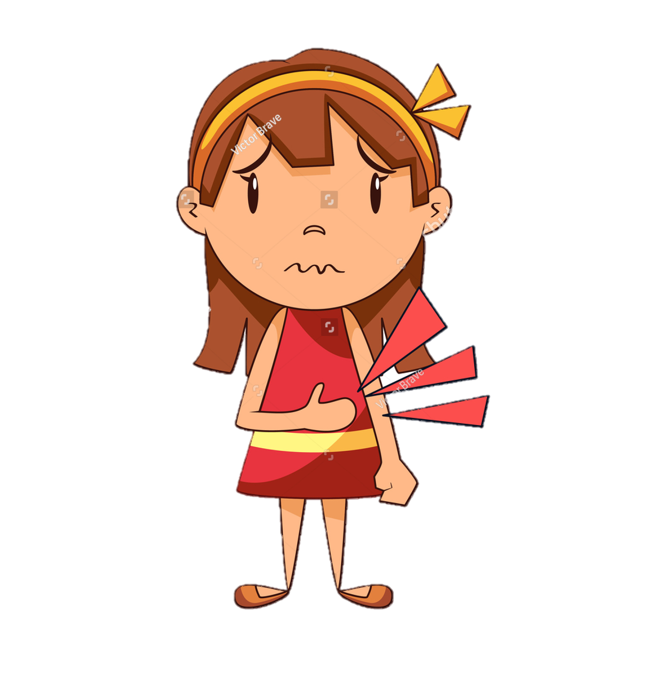
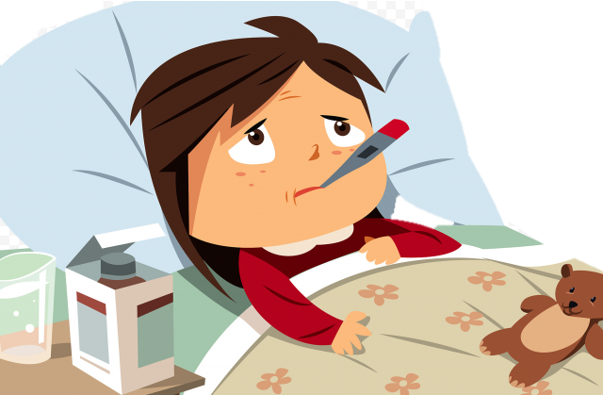

Slide 11
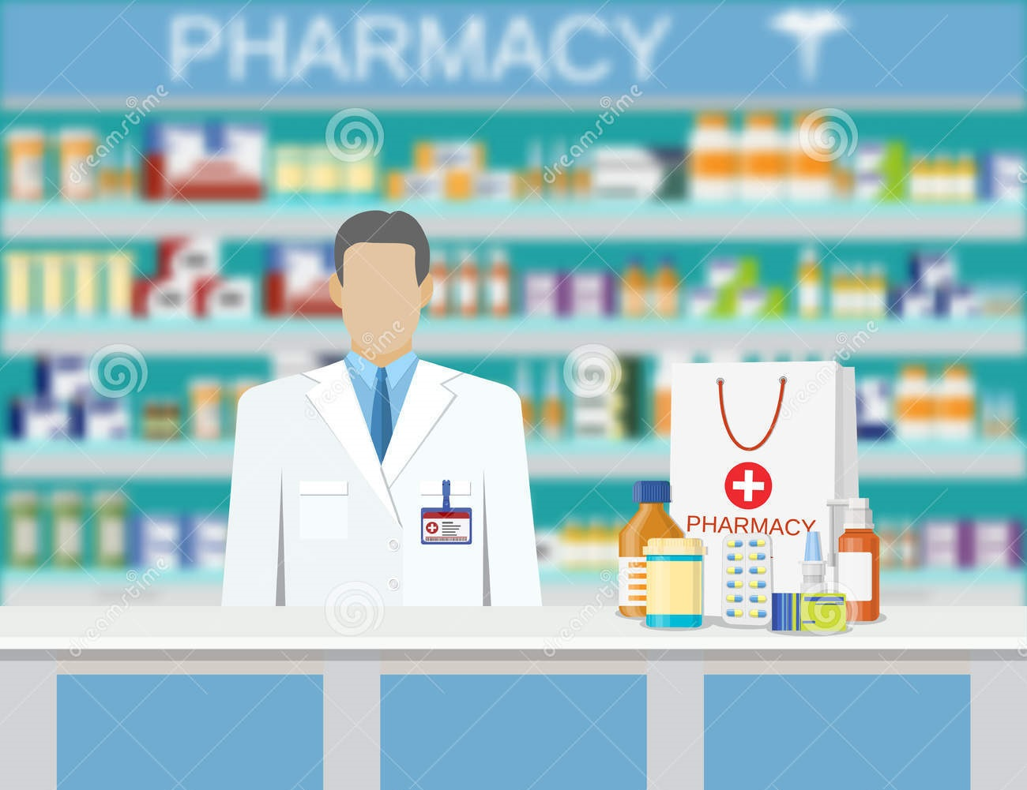
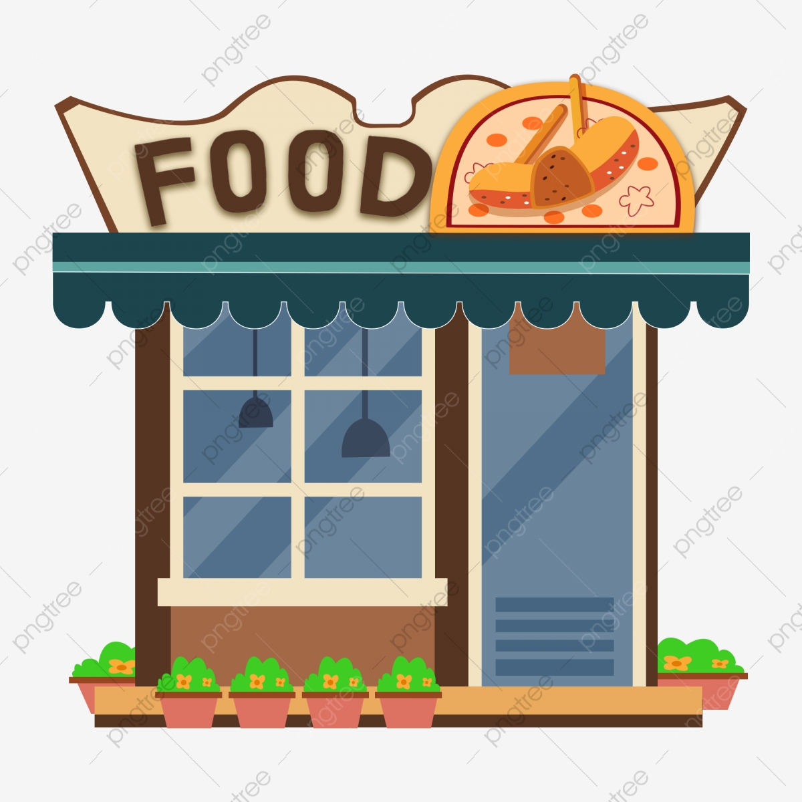
Pharmacy
Restaurant

Slide 12
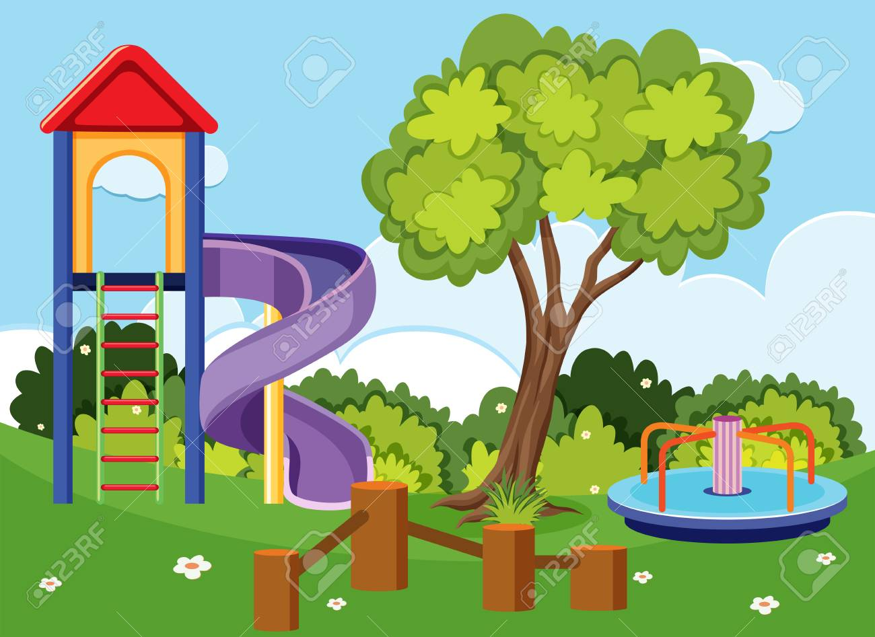
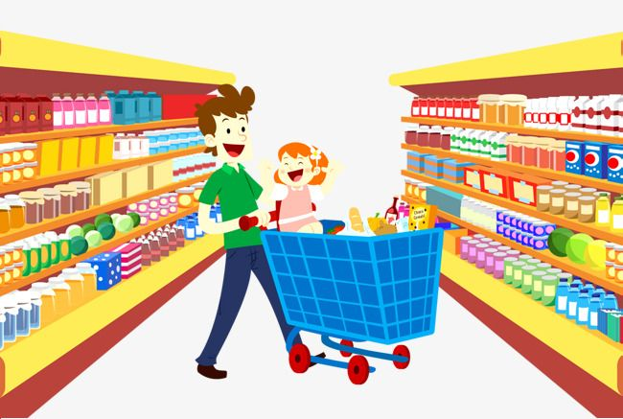
Park
Supermarket

Slide 13
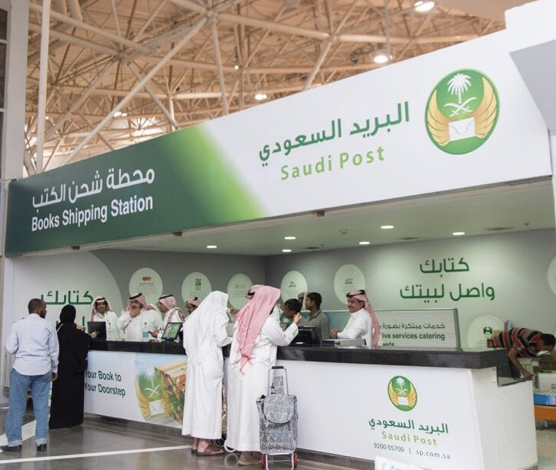
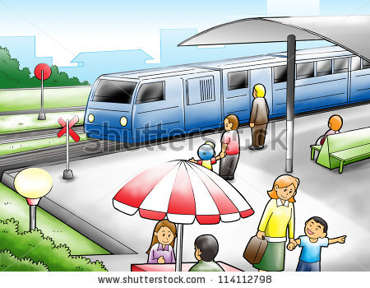
Post office .
Subway station

Slide 14
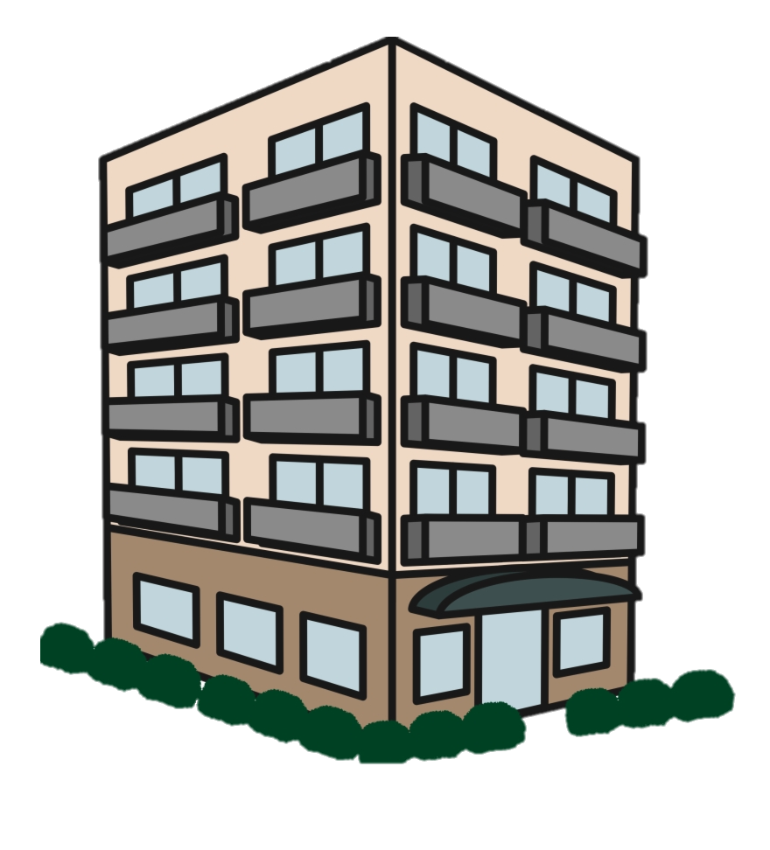
Apartment building

Slide 15
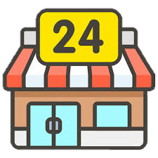
Convenience store .

Slide 16
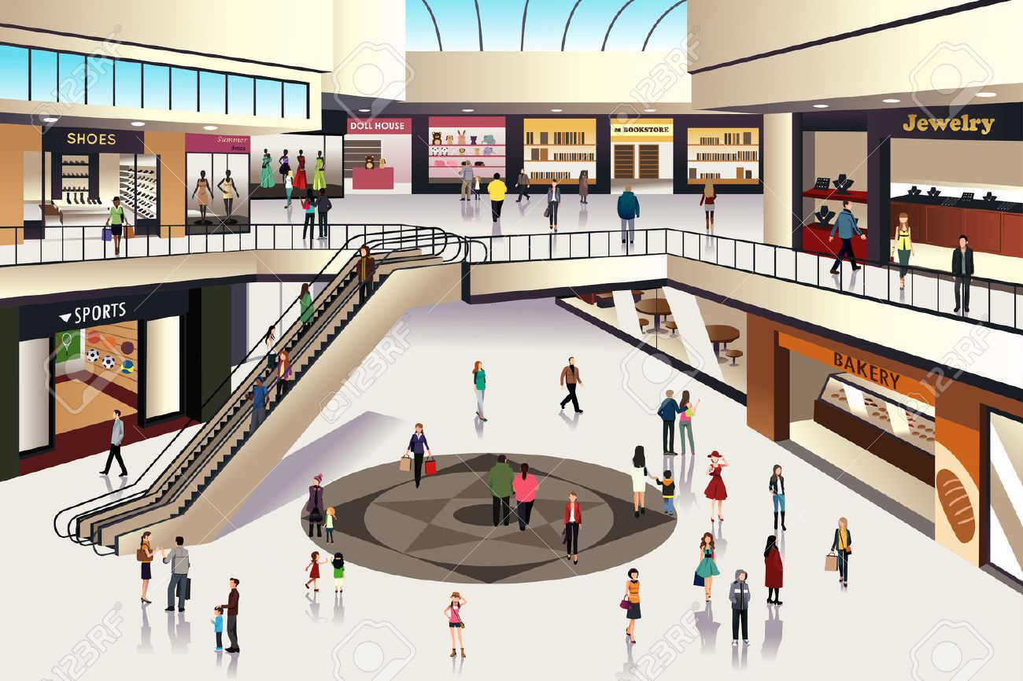
Mall

Slide 17

Page: 56

Slide 18
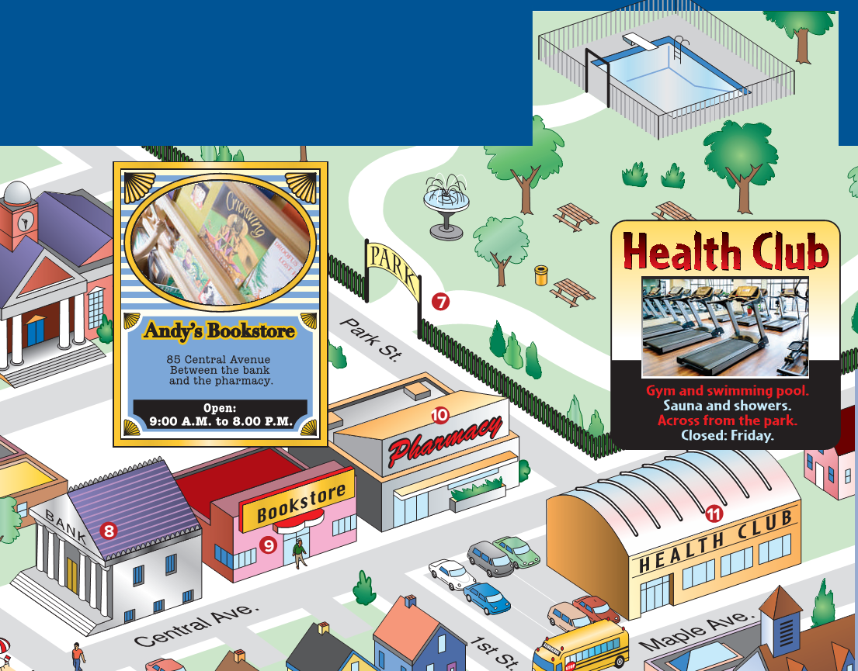
Page: 57

Slide 19
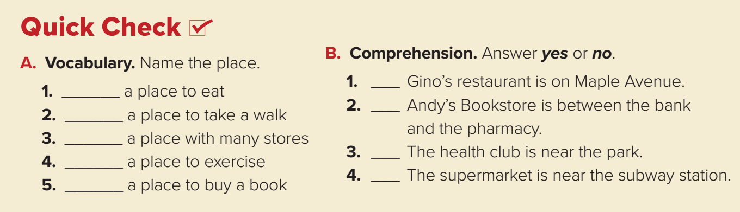
a restaurant
The park
The mall
The health club
The bookstore
Page: 57

Slide 20
No
Yes
Yes
Yes
Page: 57

Slide 21
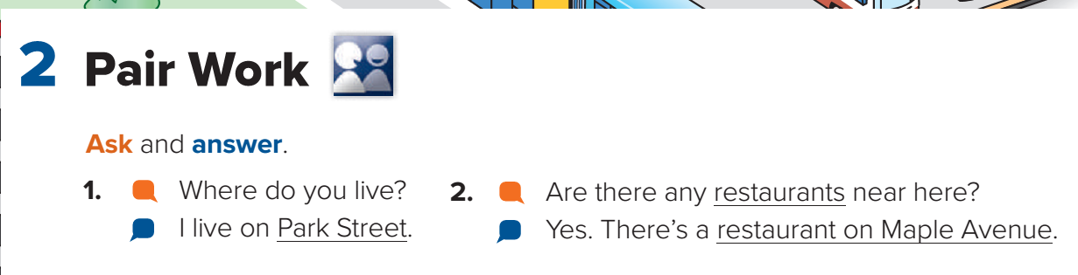
Page: 57

Slide 22
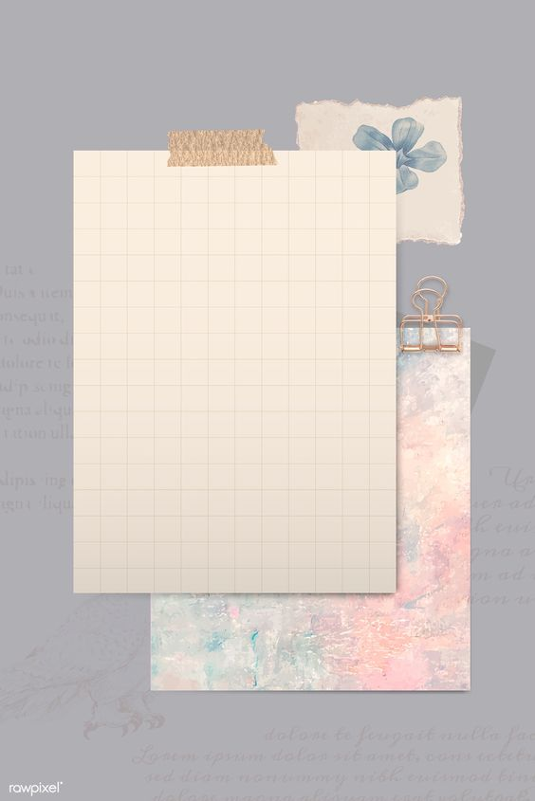
Homework
Workbook page : 115
( A , B )

Slide 23
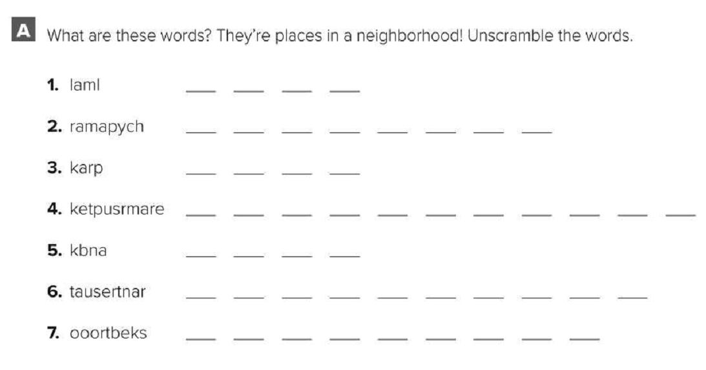
work book page: 115
mall
pharmacy
park
supermarket
bank
restaurant
bookstore

Slide 24
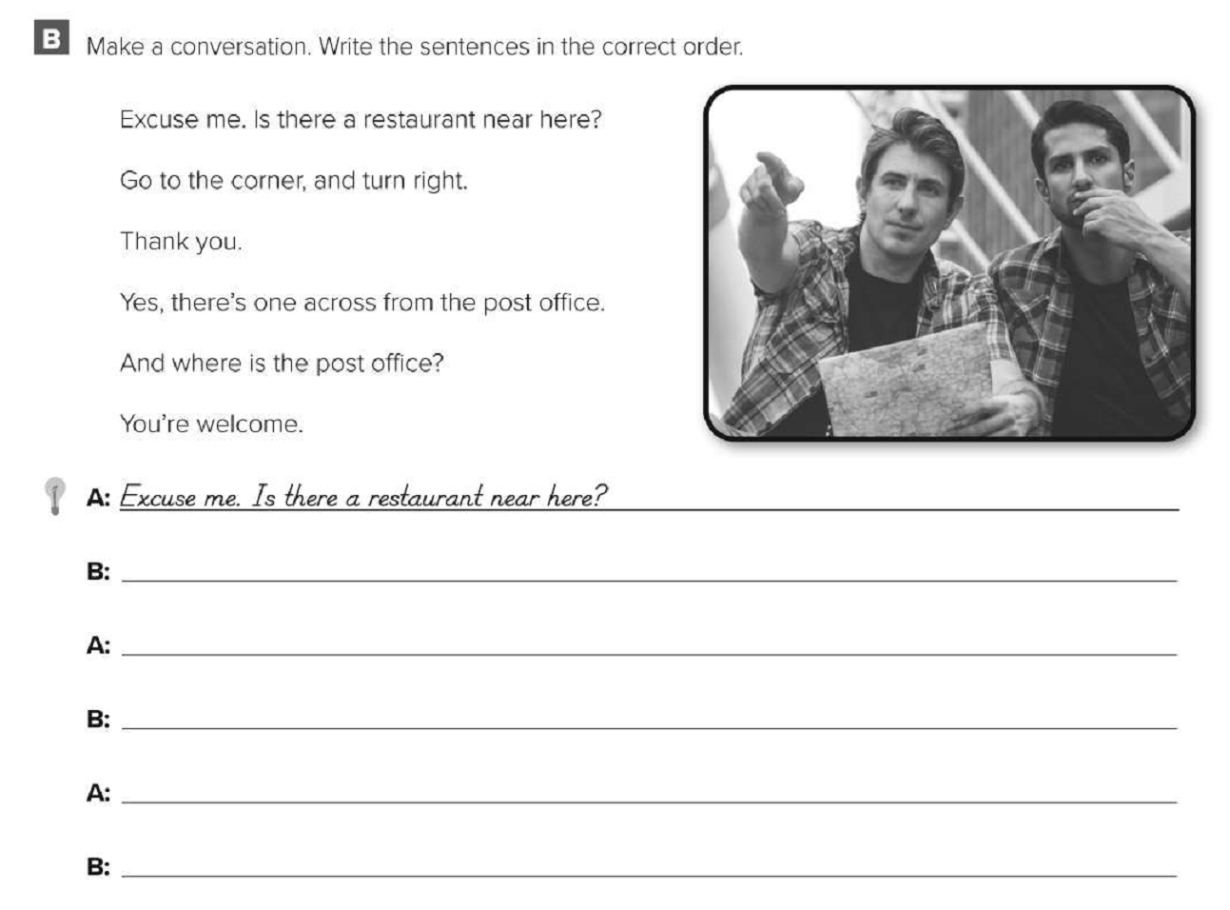
work book page: 115
Yes, there’s one across from the post office
And where is the post office?
Go to the corner, and turn right.
Thank you.
You’re welcome.

Slide 25
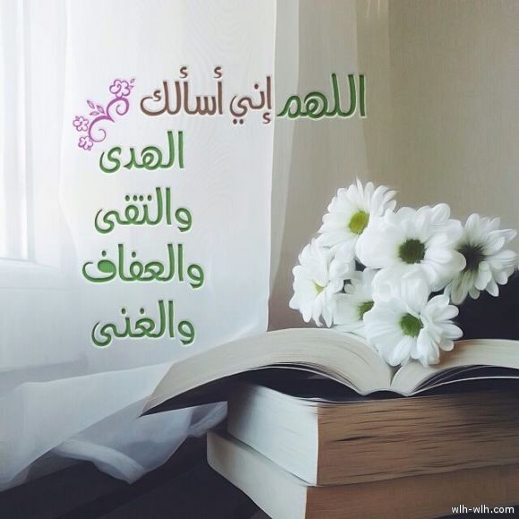

Slide 26
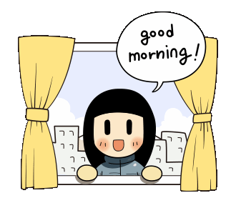

Slide 27
Today’s lesson :
3. Grammar .

Slide 28
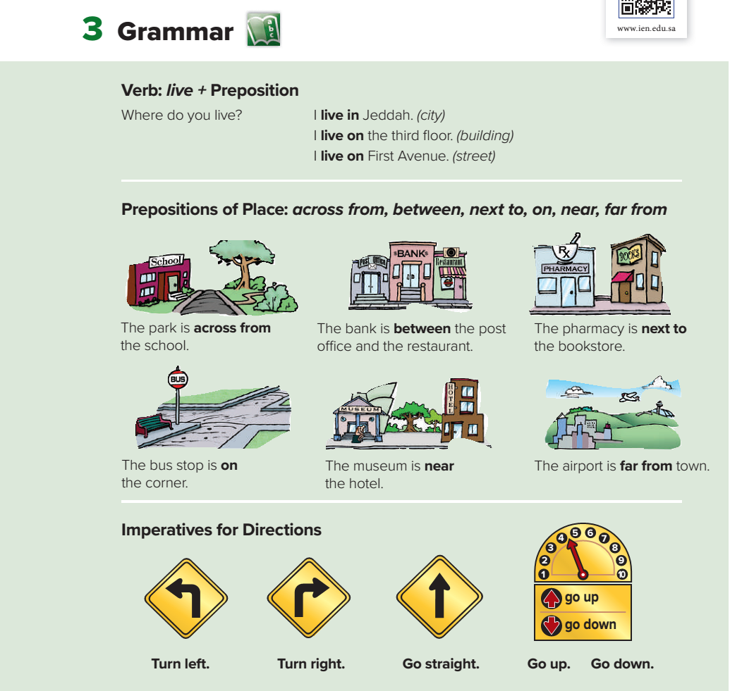
Page: 58

Slide 32
Page: 58

Slide 35
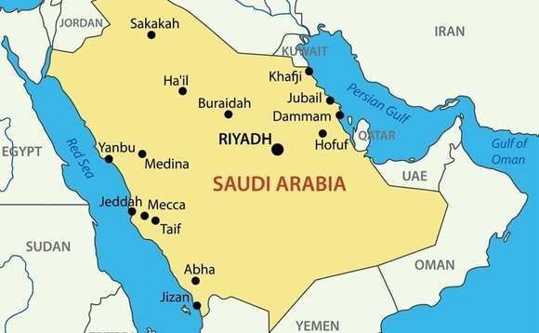
Where do you live ?
I live in Makkah .
CITY

Slide 36
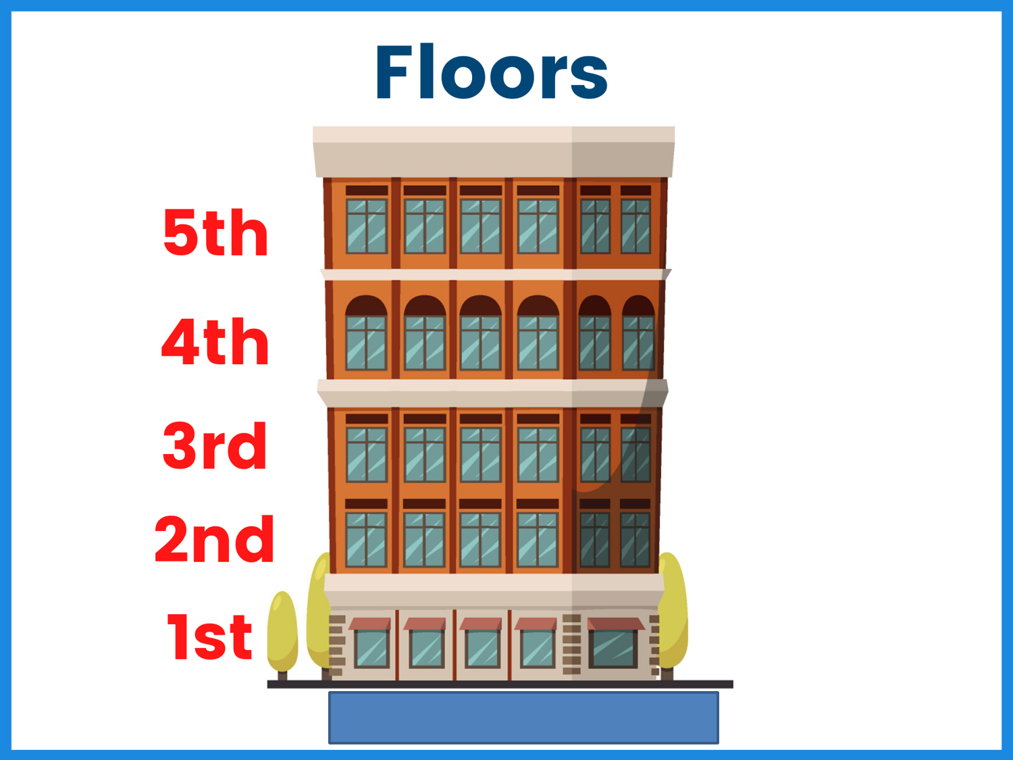
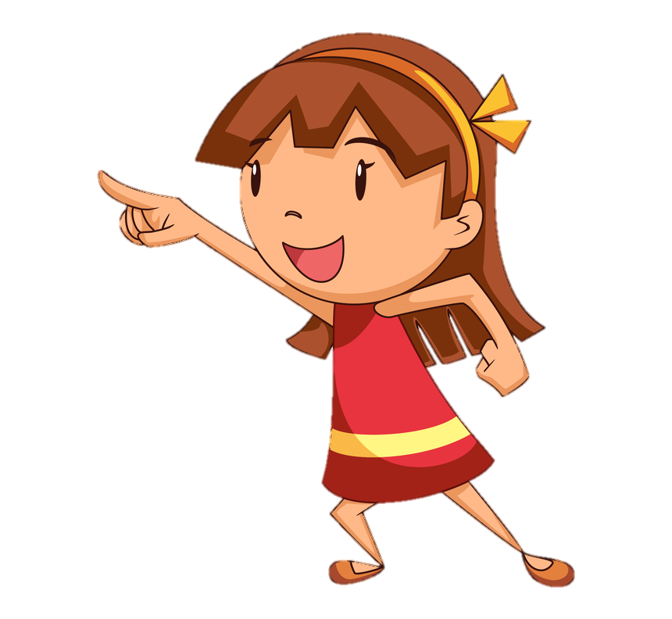
Where does she live ?
She lives on the third floor .
BUILDING

Slide 37
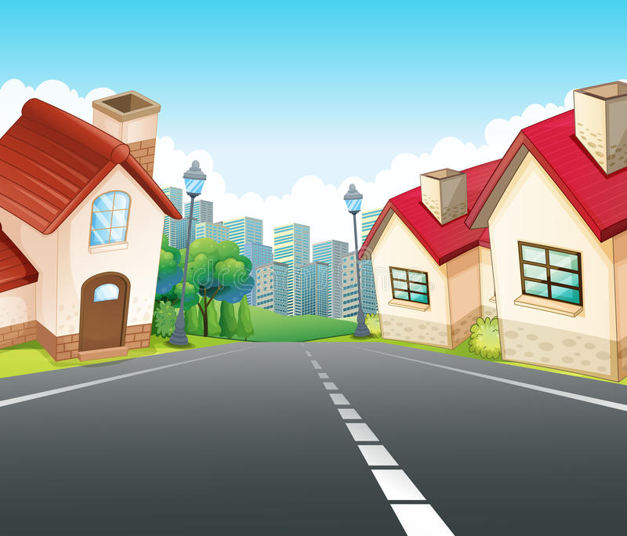
Where does she live ?
She lives on FIRST AVENU .
STREET

Slide 39
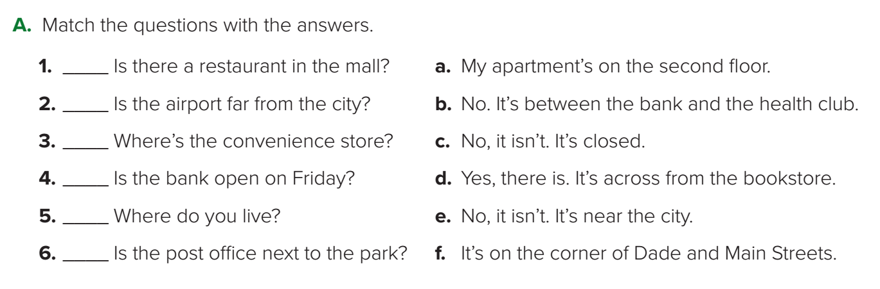
Page: 58
d
e
f
c
a
b

Slide 40
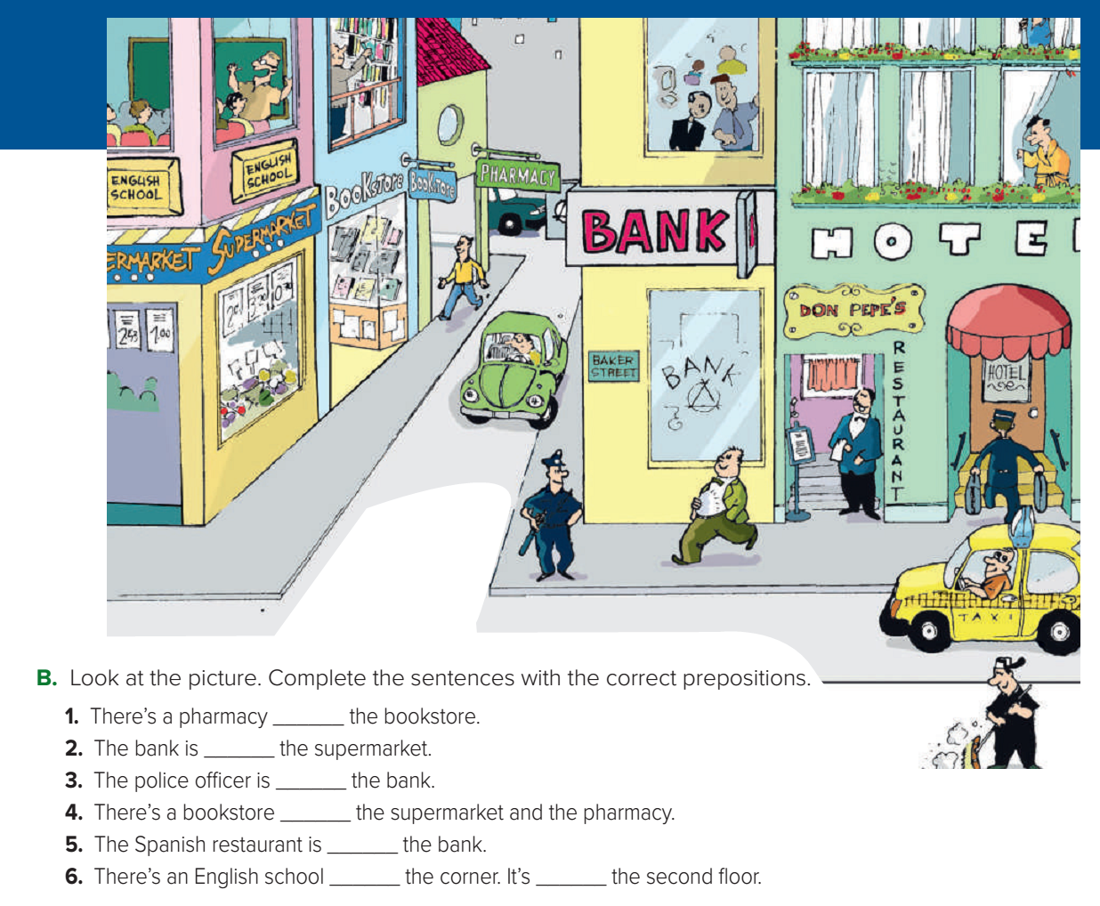
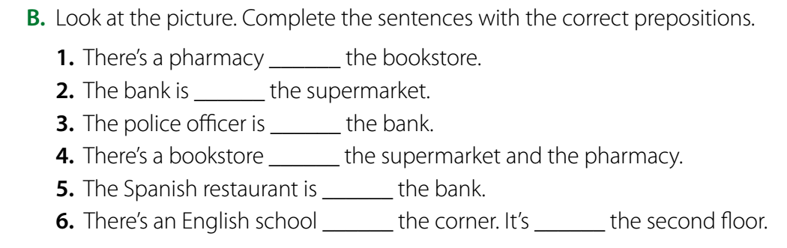
Page: 59
next to
across from
near
in front of
between
next to
on
on

Slide 41
Homework
Workbook pages : 116-117
( C , D, E, F)

Slide 42
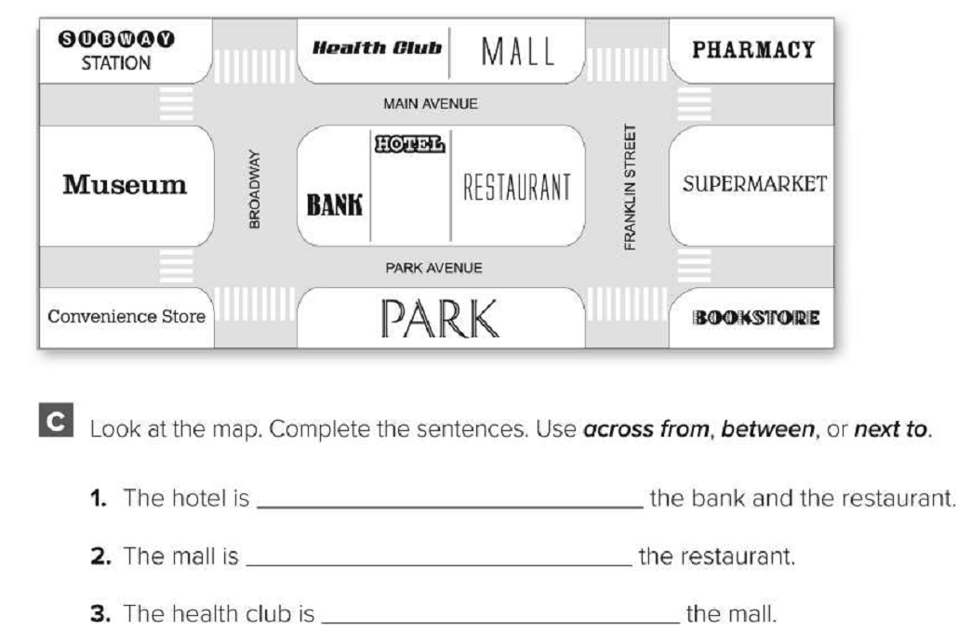
Work book page: 116
between
across from
next to

Slide 43
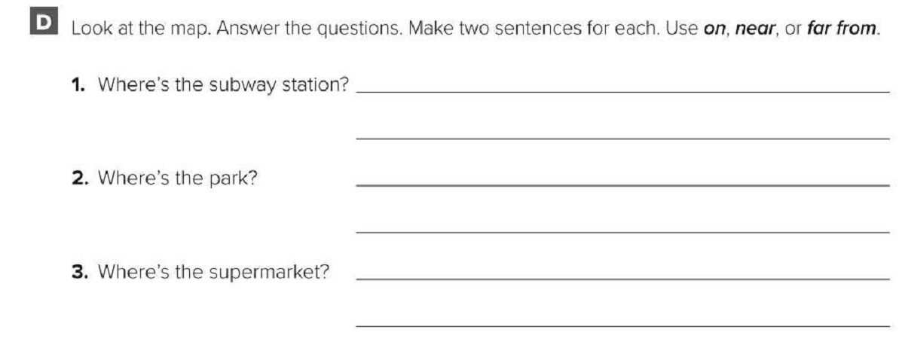
work book page: 116
The subway station is far from the bookstore.
The subway station is on Main Avenue.
The park is near the bank.
The park is on Park Avenue.
The supermarket is far from the convenience store.
The supermarket is near the bookstore.

Slide 44
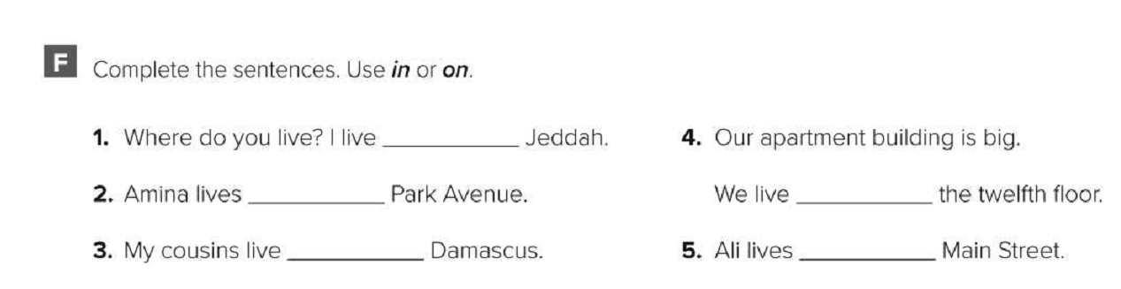
Work book page: 117
in
on
on
in
on

Slide 45
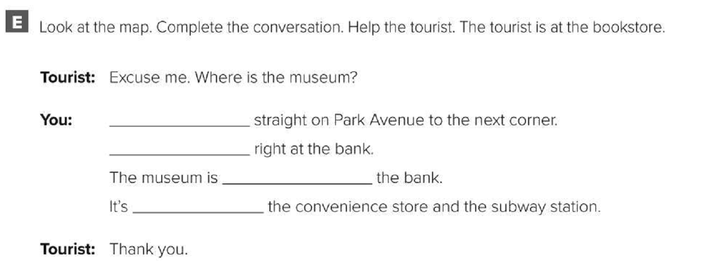
Work book page: 117
Go
turn
across from
between

Slide 46
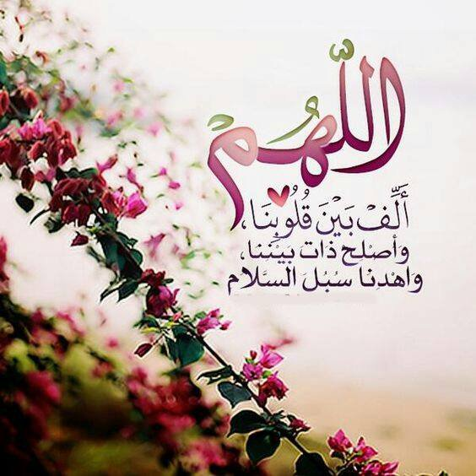

Slide 47
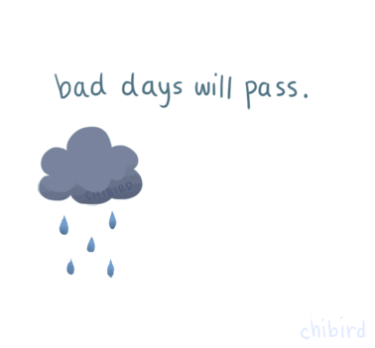

Slide 48
Today’s lesson :
4. Listening.
5. Pronunciation .
6- conversation .

Slide 49
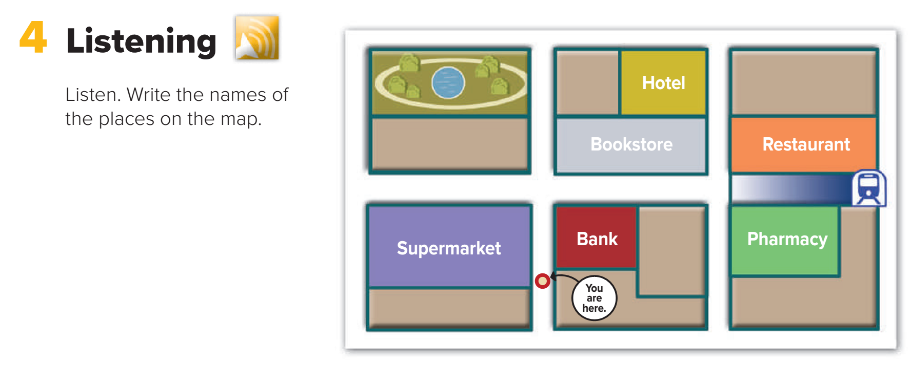
café
English school
subway
convenience store
Page: 59

Slide 50
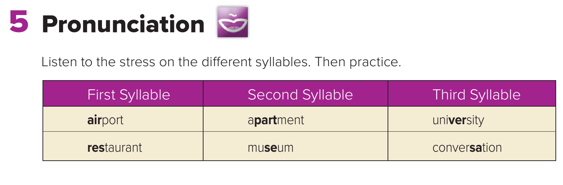
Page: 59

Slide 51
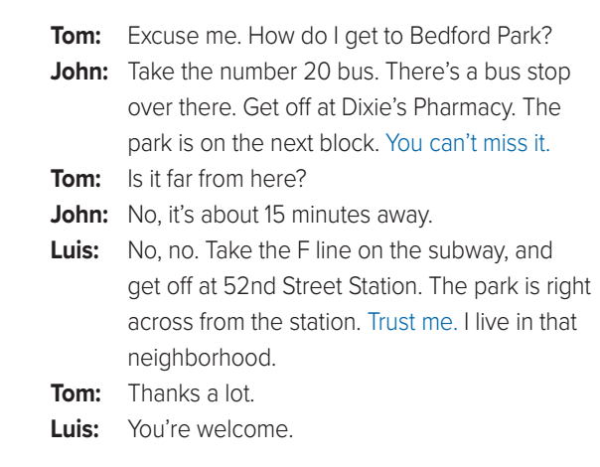
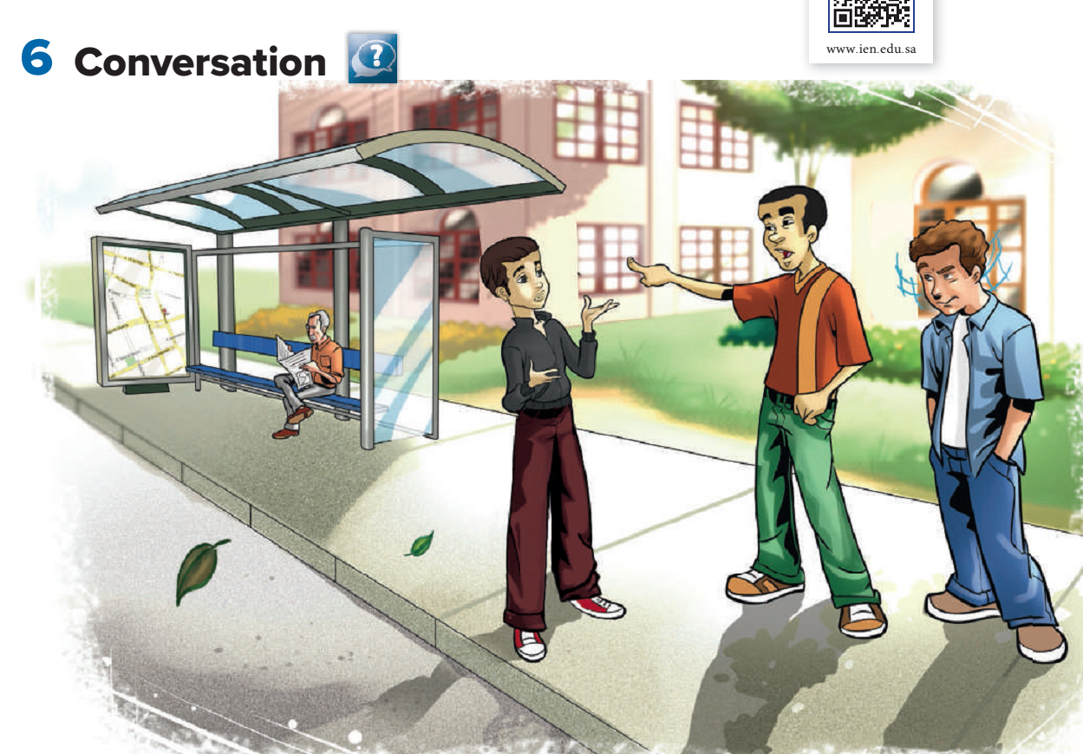
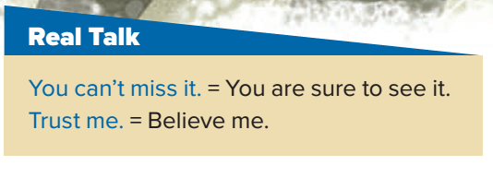
2
3
4
Page: 60

Slide 52
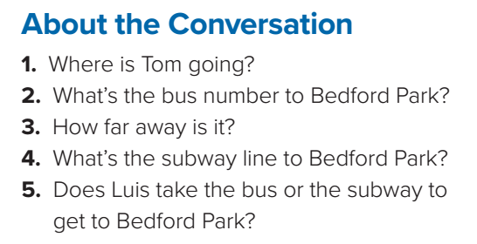
He’s going to Bedford Park.
It’s the number 20 bus.
It’s about 15 minutes away by bus.
The F line goes to Bedford Park.
Luis takes the subway.
Page: 60

Slide 53
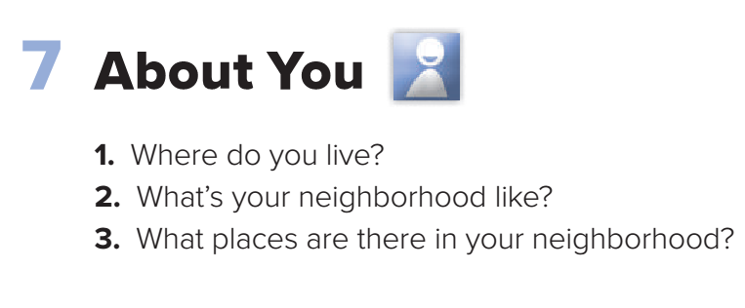
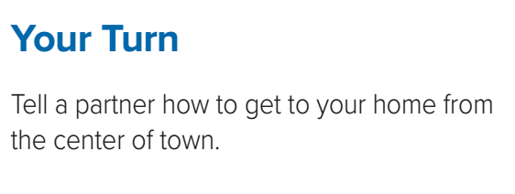
Page: 60

Slide 54
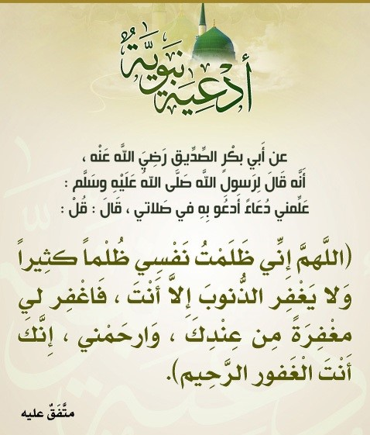

Slide 55


Slide 56
Today’s lesson :
8. Reading .

Slide 57

Page: 61

Slide 58

√
√
√
Page: 61

Slide 59


Slide 60


Slide 61
Today’s lesson :
9. Writing .

Slide 62

Page: 62

Slide 63

Page: 62

Slide 64
I live in a nice neighborhood.
Neighborhood has friendly people.
I live in a nice neighborhood.
It has friendly people.
personal pronoun.

Slide 65
The houses aren’t modern.
The houses are traditional.
The houses aren’t modern.
They are traditional.
personal pronoun.

Slide 66
My neighbors and I are friendly.
My neighbors and I always say “hello.”
My neighbors and I are friendly.
We always say “hello.”
personal pronoun.

Slide 67
neighborhood
Robert
buildings
my neighbors and I
palace
my neighbors and I
my neighborhood
Page: 62

Slide 68

Page: 62

Slide 69
Homework
Workbook pages : 117
( G )

Slide 70

Work book page: 117

Slide 71
Work book page: 117
Yes.
No
There are over 200 stores in Penang.
No
There are big hotels in the town.
No
KOMTAR is the name of a shopping mall
No
There are many beautiful parks in Penang.

Slide 73


Slide 74


Slide 75



Slide 76
Today’s lesson :
11. Form , Meaning, Function. .

Slide 77

Page: 63

Slide 78

Short
Mark is shorter than Jack.
Jack
Mark

Slide 79


Summer
Winter
Cold
Winter is colder than Summer .

Slide 80
Tall
Jack is taller than Mark .
Jack
Mark

Slide 81


What would happen if you were the tallest girl in the world ??

Slide 82


The Clock Tower is longer than The kingdom Tower .

Slide 83

1
2
Cow #1 is big.
Cow #2 is bigger than cow 1.

Slide 84

hot
The tea is hot.
The fire is hotter than the tea.

Slide 85

Nice
The red bag is nice .
The orange bag is nicer than red bag.

Slide 86

Funny
Mark is Funnier than Jack .
Jack
Mark
Daived

Slide 87


Difficult
Maths is moredifficult than English language .

Slide 88


Beautiful
Riyadh is more beautiful than Jeddah .

Slide 89


Slide 90



Slide 91

smaller than
bigger than
more dangerous than
less dangerous than

Slide 92

faster than
slower than

Slide 93

good
Red car is good .
Blue car is better than red car .

Slide 94


Bad
Arabic
Math
My mark in Math subject is worse than Arabic subject .

Slide 95
Comparative ( between 2 things )
Short (Adj + er) + than
Long (more/ less adj ) than
Irregular ( adj + than )
Short adjectives
Irregular adjectives
long adjectives
long
Good
longer than
better than
Beautiful
More/ less beautiful than
Nice
Nicer than
Bad
worse than
Colorful
More/ less colorful than
Happy
happier than
Big
bigger than

Slide 96

1- taller than
2- more beautiful than .
3- fatter than
4- hotter than
5- higher than
6- noisier than
7- more boring than
8- more comfortable than
9- heavier than
10- deeper than
11- more intelligent than
12- better
13- more popular than
14- colder than
15- worse than

Slide 97



Slide 98


Slide 99


Saturday
Sunday
Monday
It is cold today .
Saturday is colder than Sunday.
Monday is the coldest .

Slide 100
3
2
1
Cow 1 is big.
Cow 2 is bigger than cow 1.
Cow 3 is the biggest .

Slide 101
hot
The tea is hot.
The fire is hotter than the tea.
The sun is the hottest .

Slide 102
Nice
The red bag is nice .
The orange bag is nicer than red bag.
The blue bag is the nicest .

Slide 103
Davied is the Funniest boy.
Jack
Mark
Daived

Slide 104

Davied is the strongest boy.
Jack
Mark
Dived

Slide 105

The women is the oldest person.

Slide 106

Difficult
Science is the most/least difficult subject.

Slide 107
good
Red car is good .
Blue car is better than red car .
White car is the best .

Slide 108
Bad
Arabic
English
Math
My mark in Math subject is the worst .

Slide 109


Slide 110
Superlative ( more than 2 things )
Short ( the + Adj + est)
Long (the most / least + adj )
Irregular ( the + adj )
Short adjectives
Irregular adjectives
long adjectives
long
Good
the longest
the best
Beautiful
the most/ leastbeautiful
Nice
the nicest
Bad
the worst
Colorful
the most/ leastcolorful
Happy
the happiest
Big
the biggest

Slide 111

the lightest
the biggest
the tallest
the most beautiful
the best
the hottest
the happiest
the most expensive

Slide 112

the shortest
the heaviest
the most interesting

Slide 113



Slide 114

the best
better
more popular
the hottest
the driest
the worst
the quietest
bigger
more beautiful
Page: 63

Slide 115

Page: 63
No, it isn’t. It’s shorter.
No, it isn’t. It’s smaller.
No, they aren’t. They’re slower.
No, it isn’t. It’s worse.
No, it isn’t. It’s noisier.
No, they aren’t. They’re dirtier.

Slide 116

Work book page: 118

Slide 117

Work book page: 118

