Slide 1
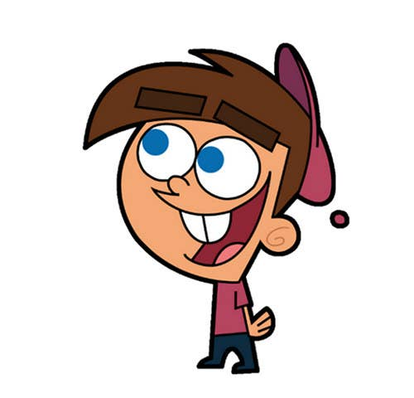


Welcome to class
T.
Mohamad
Zaid

Slide 2
Day
Tuesday
Date
20th Dec 2022
Subject
We can 3
Unit
6 jobs
Lesson
4 Phonics

Slide 3

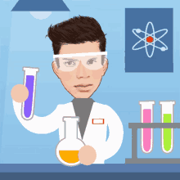

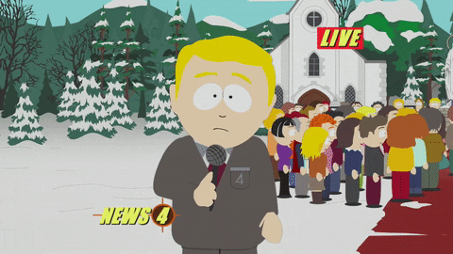
Revision for the previous lesson :
What do you want to be when you grow up ?

Slide 4





PAGEs 48 , 49

Slide 5

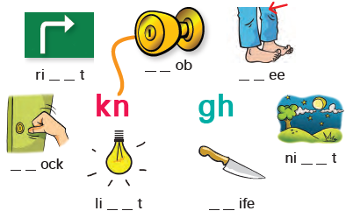

Listen and say
PAGE 48

Slide 6


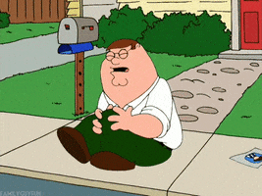
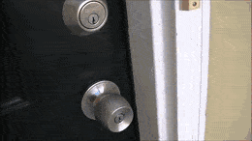


Silent letters
kn
___ock
kn
___ee
kn
___ob
kn
___ife
kn

Slide 7


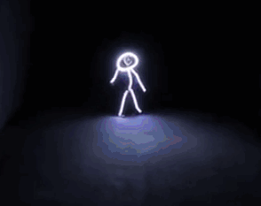
Silent letters
gh
ri___t
gh
ni___t
gh
li___t
gh

Slide 8

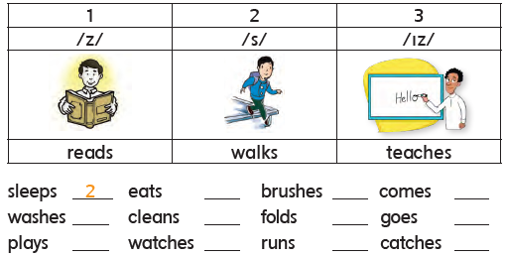

1
2
3
2
3
2
1
1
3
1
3
2

Slide 9

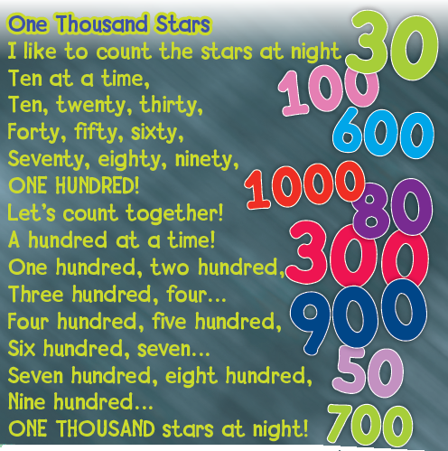

Listen and point to the numbers

Slide 10



Say the numbers
100
200
300
400
500
600
700
800
900
1000

Slide 11



https://www.liveworksheets.com/worksheets/en/English_as_a_Second_Language_(ESL)/Jobs_and_occupations/We_can_5_unit_6_bc1453680vk

Slide 12


Open your workbook
Pages 117 , 118

Slide 13
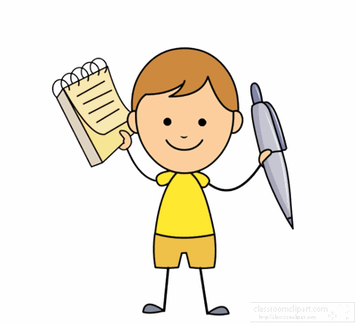

Home work at

Slide 14


Slide 15
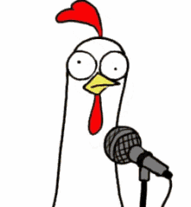

Slide 16


