Slide 1

Unit 5
Since When?
Reading
Page 54, 55

Slide 2
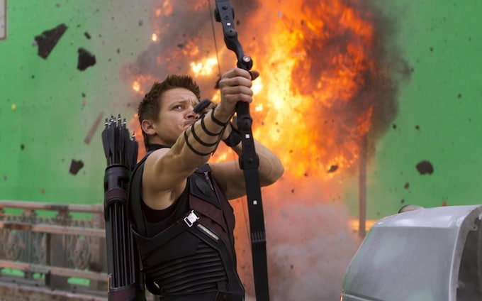
A History of Special Effects

Slide 3
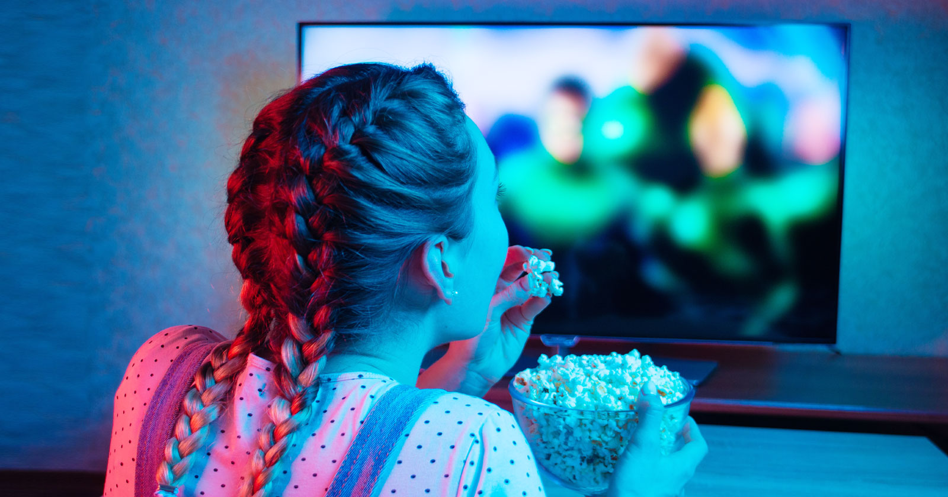
Do you watch movies?
film
filmmakers
audiences
special effects
characters

Slide 4

Scan the text to give a title for each paragraph
Answer some questions by reading
Match the words with their meanings

Slide 5



Slide 6
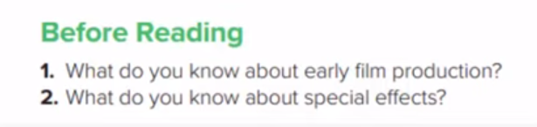
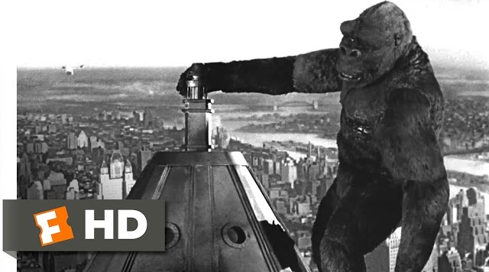
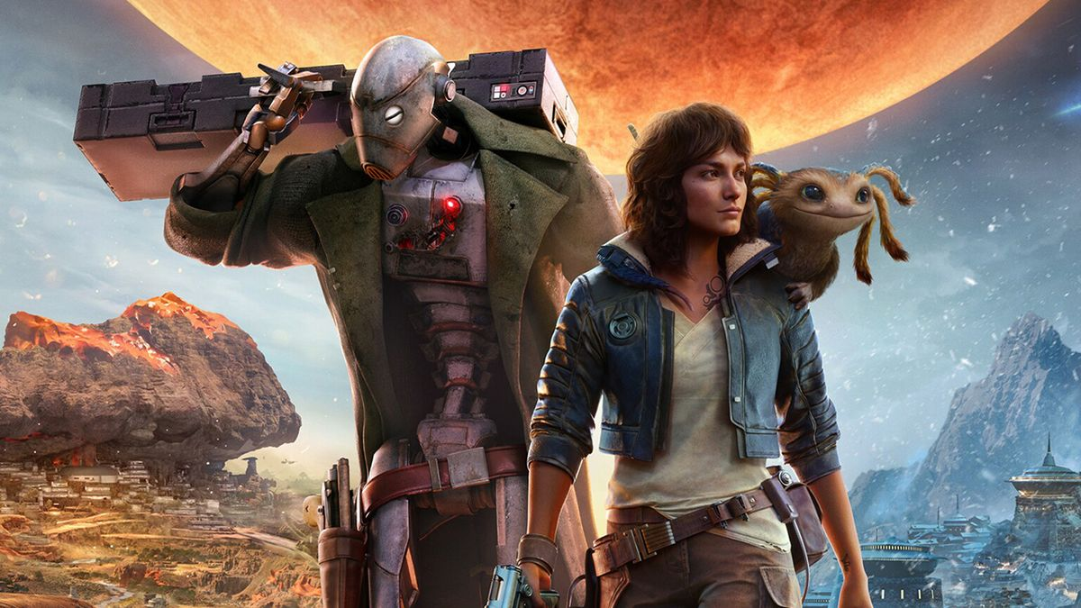
King Kong
Star Wars

Slide 7
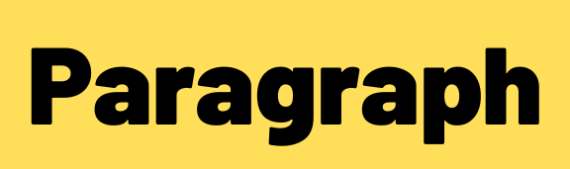






The Start
By accident
“King Kong” Film
“Star Wars” Film
Digital Technology

Slide 8
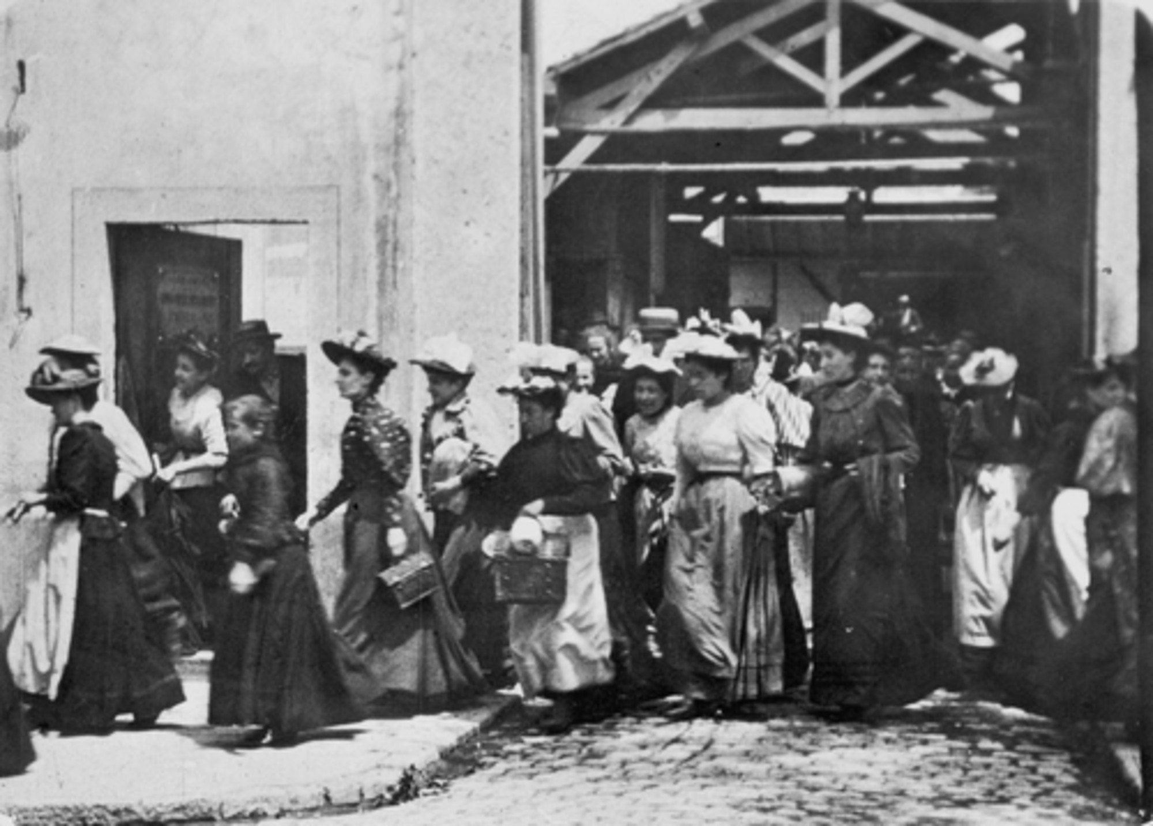
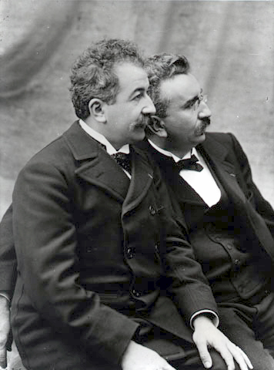
The Start
audiences
film viewers
techniques
a way of doing things
1- How long have audiences watched films?
Since December 28. 1895
2- Why have filmmakers used different techniques?
To amaze viewers.

Slide 9
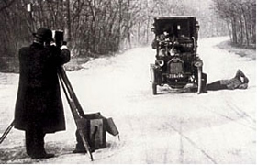
By accident
sequence
actions in special order
interrupt
stop in the middle
1- How was the “stop trick” discovered ?
When George camera stopped and started again
2- Why did the picture seem to change before his eyes?
Because the film sequence had been interrupted

Slide 10
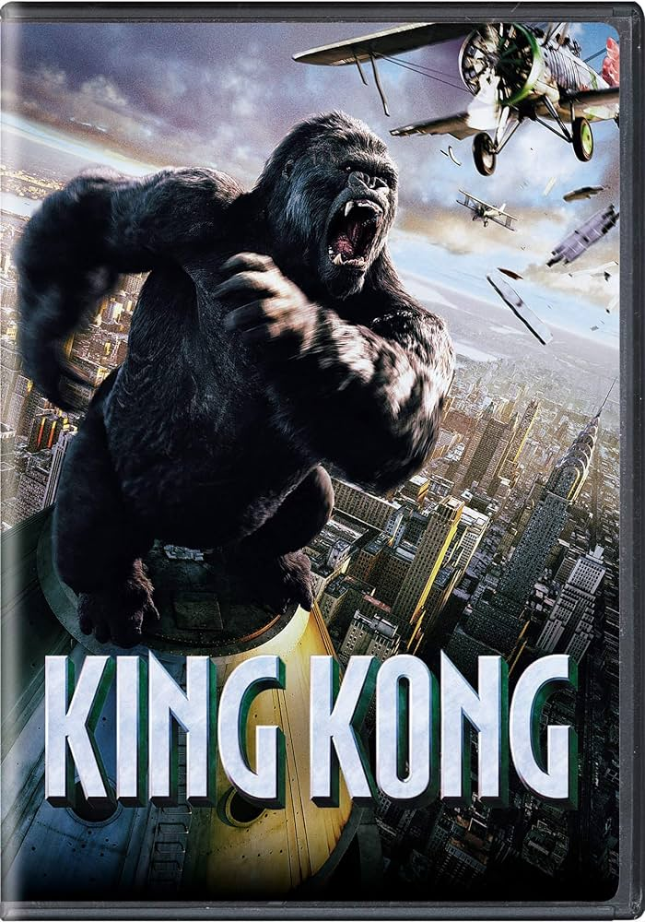
“King Kong” Film
miniature
a small model
innovation
a new way
1- What special effect was used in “King Kong”?
Miniature , animation of small-scale models
2-The film contained many technical ……………… for its time
innovations

Slide 11
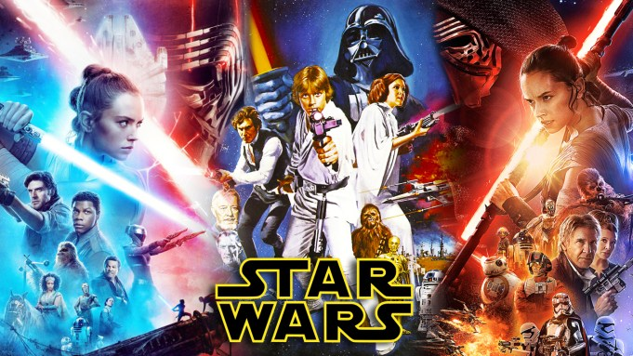
“Star Wars” Film
accomplish
succeed in doing something
1- How did the special effects crew of “Star Wars” creat realistic motions ?
They had to invent new techniques to accomplish them

Slide 12
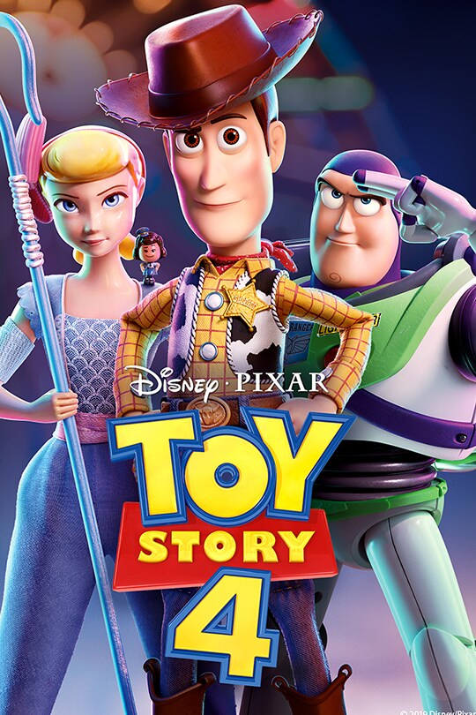
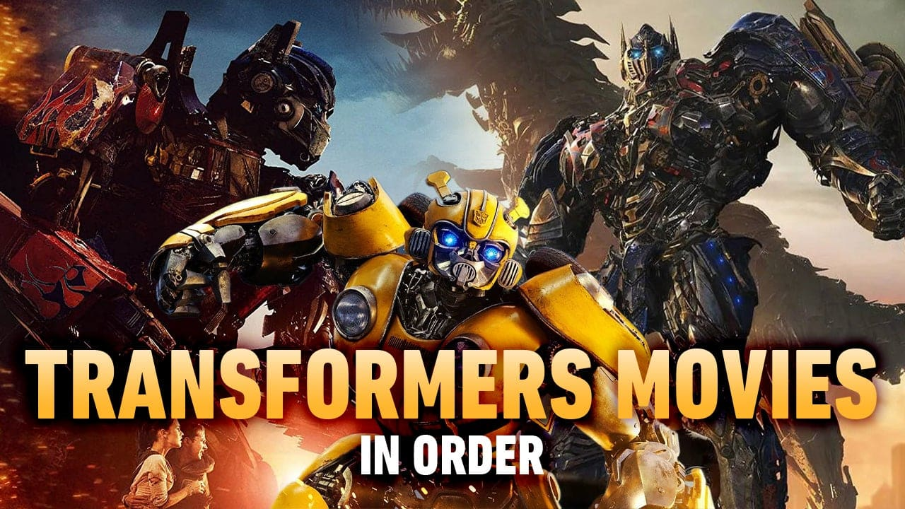
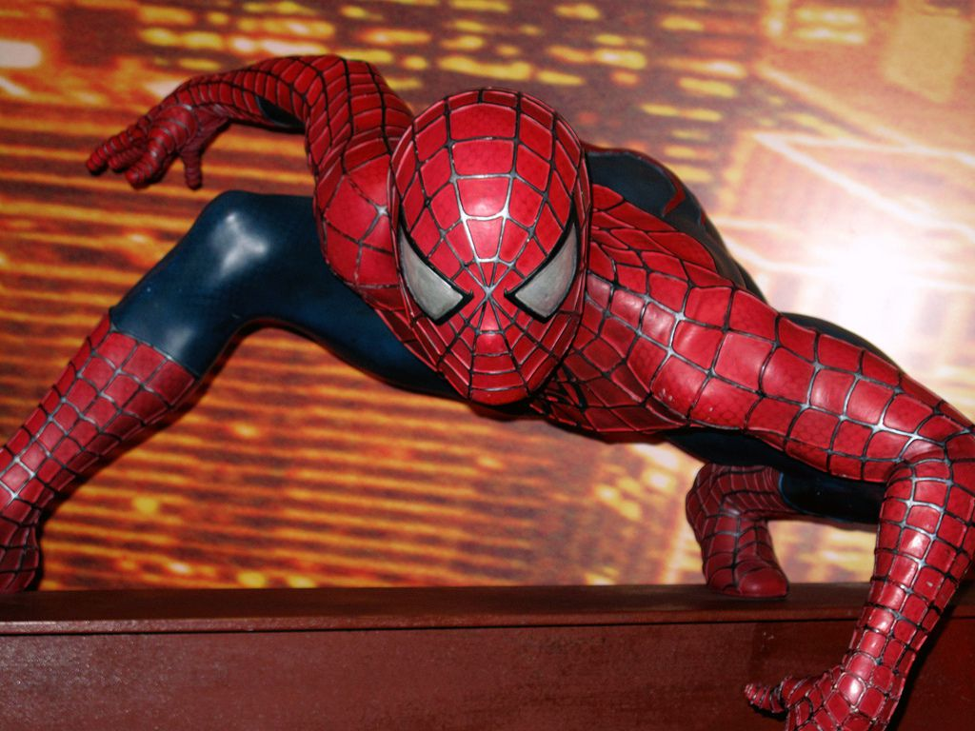
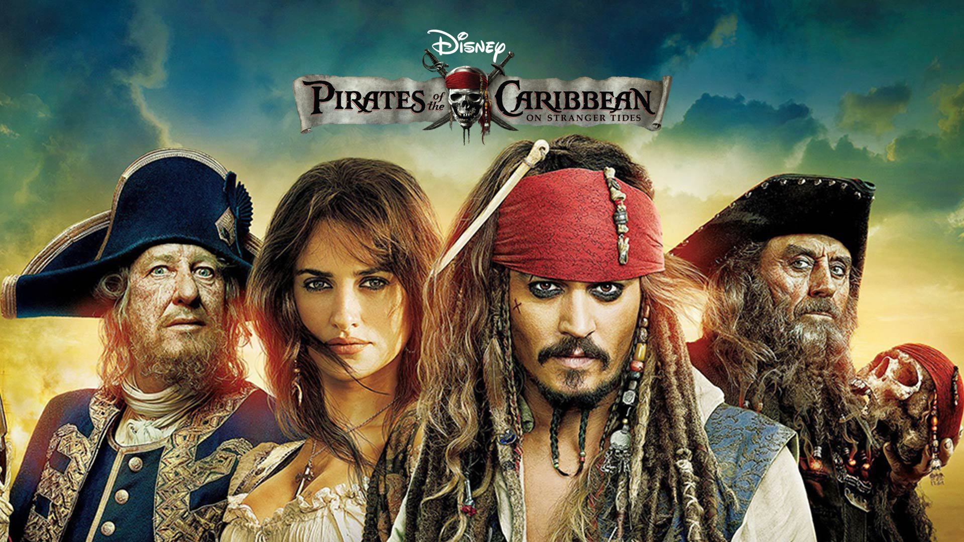
Digital Technology
imaginary
not real
1-What films have become references in the art of visual effects?
“Jurassic Park” .. “Toy Story” .. “Transformers”

Slide 13
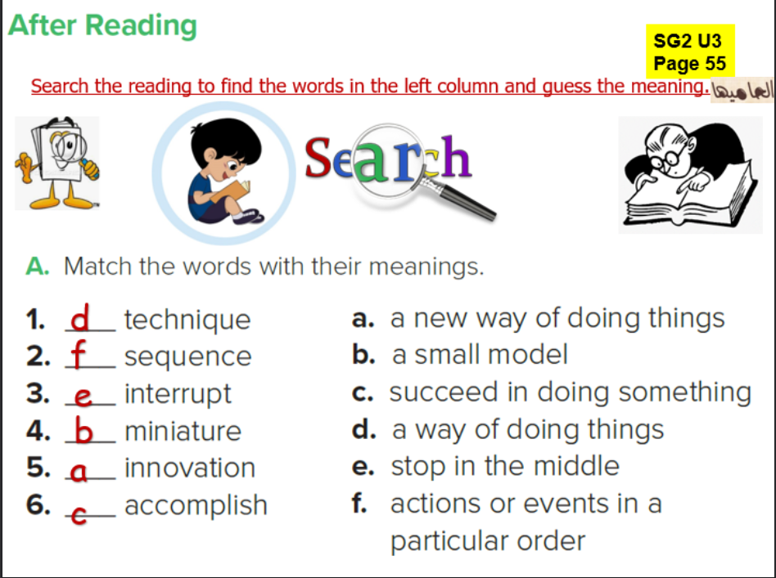
d
f
e
b
a
c

Slide 14

Work Book page 201
Tr.Kholud

Slide 15
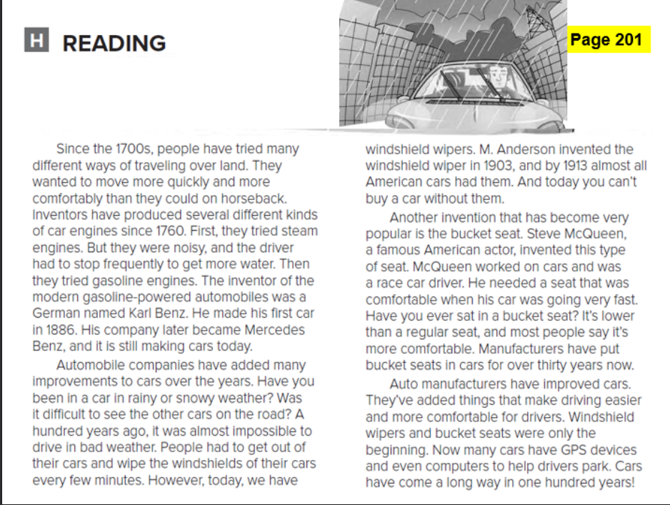

Slide 16
