Slide 1
. Choose the correct answer :
. The food was ( such - so ) spicy that it burned my mouth .
. The ( early - earlier ) the class , the more tired I am .
. He took ( so – such ) a long time to reach his destination .
. No way ! The story about the green aliens ( must - can't ) be true .
- I wish the children would ( stops-stop- stopped- stopping) interrupting.
- I wish he ( will- would ) not use his cell phone in the class.
- He is late . He ( must – may – might – can't ) have missed his plane.
- The fans look happy. Their team ( must – may – might – can't ) have won the game.
- Scary films are ( interested – interesting – interest – interests ).
-Emma is( such- so ) a popular name that there are four girls in the class with that name.

Slide 2
Fill in the space
. Someone who can speak both Arabic and English is bilingual.
. Someone who is amazed at something is astonishes.
. Something that is incredible can also be called remarkable .
. Someone who is confused by something is puzzled.
. Someone who is annoyed at something is irritated.
. Someone who is very interested in something is fascinated

Slide 3
Mach with meaning
Amazing | Astounding
Make you feel happier | Cheer you up
Really impress me | Blow me away
Involving the heart and blood vessels | Cardiovascular
equal | equivalent
Strong with feeling | Hearty
Substance produced by the body to fight germs and infection | Antibodies
Related to the medical care of children | Pediatric
to increase energy or activity | Stimulate
To improve | Enhance
to cause someone to do something | Prompt
Real not false | Genuine
To tell you exactly how I feel | to tell you the truth
great, amazing | killer
annoying or bothering | getting to

Slide 4
Do as shown between brackets .
1. I didn't see the football match . _____________ the football match . ➔ ( Make a wish ).
2. My mother gets ( worry ) if I'm not home by 10:00 . ➔ ( Correct it ).
3. question / is / embarrassing / This / an /. ➔ ( Rearrange ).
4. The more sleep I get, the ( good ) I feel . ➔ ( Correct ).
5- The ( funny ) the joke , the harder the audience laughs. ➔ ( correct )
I didn't see the football match I wish I had seen the football match .
My mother gets worried if I’m not home by 10:00
This is an embarrassing question
The more sleep I get, the better I feel.
The funnier the joke , the harder the audience laughs

Slide 5
Which is correct
1 . Many people find winter to be a depressed season .
2 . Many people find winter to be a depressing season .
➔

Slide 6
Choose the correct answer
She is really ----------- about the news.
Depressed Ο
Depressing O
Depress Ο
Depression Ο
The ---you study for these exams, the --- you will become
Hard - better Ο
Harder –more successful O
Much – better Ο
The sport of climbing is -----------
Challenging Ο
Challenged O
Challenge Ο
Challenger Ο

Slide 7
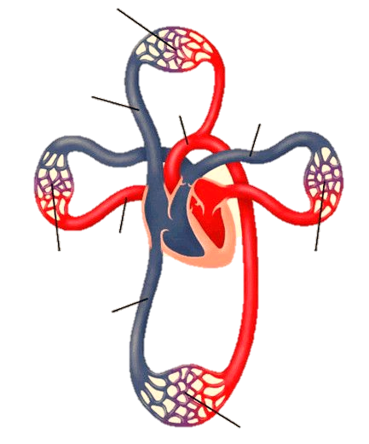
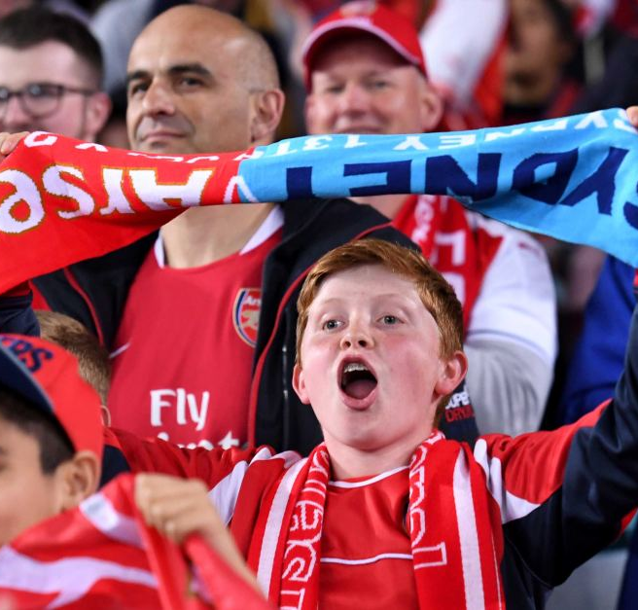
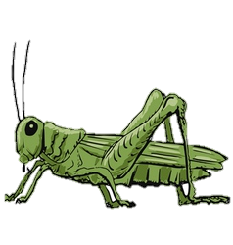
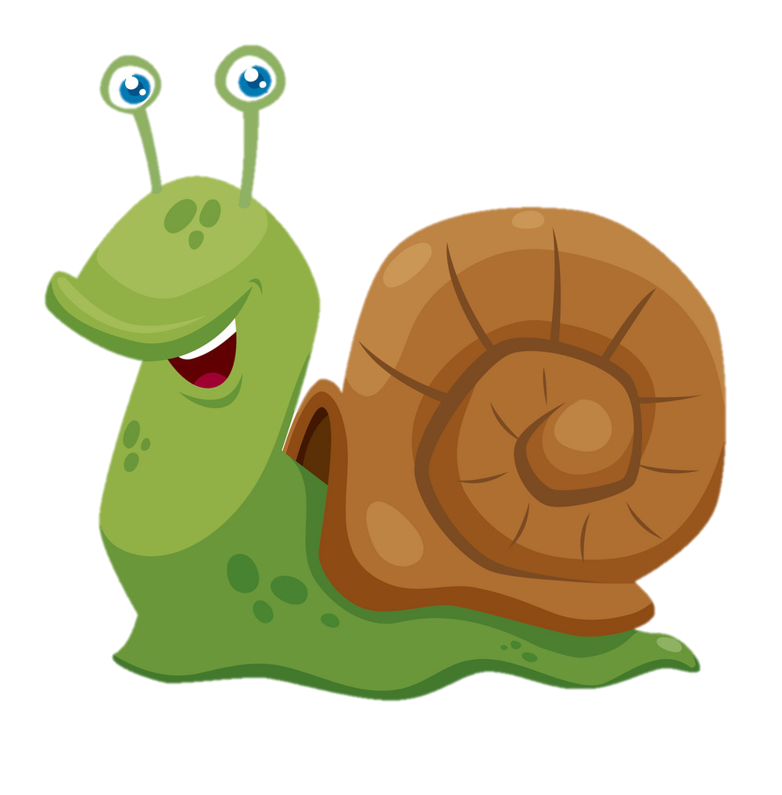

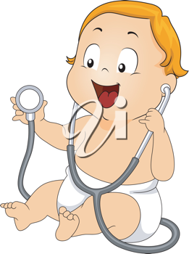
Cardiovascular
Spectator
snail
grasshopper
Pediatric
Antibodies

