Slide 1
Unit 1
Laugh Out Loud
Grammar
Mega Goal 2.3
Done by : Entisar Al-Obaidallah

Slide 2
Lesson Goals
01
03
02
04
Use
Complete
the past and present
participle forms as
adjectives.
using ( The … , the comparative … )
Use
Point out
Get + Adjective;
Get + Past participle to suggest that something is starting to happen
a participial adjective in a sentence

Slide 3

Book Open
Page ( 8 )

Slide 4
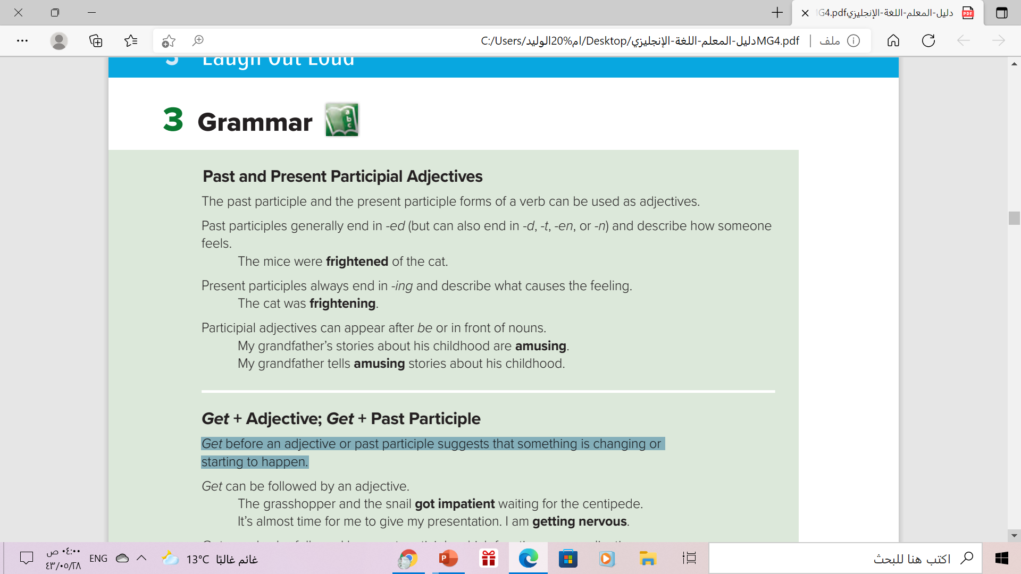

Slide 5
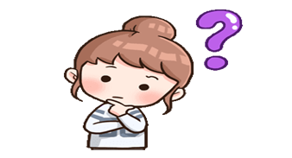
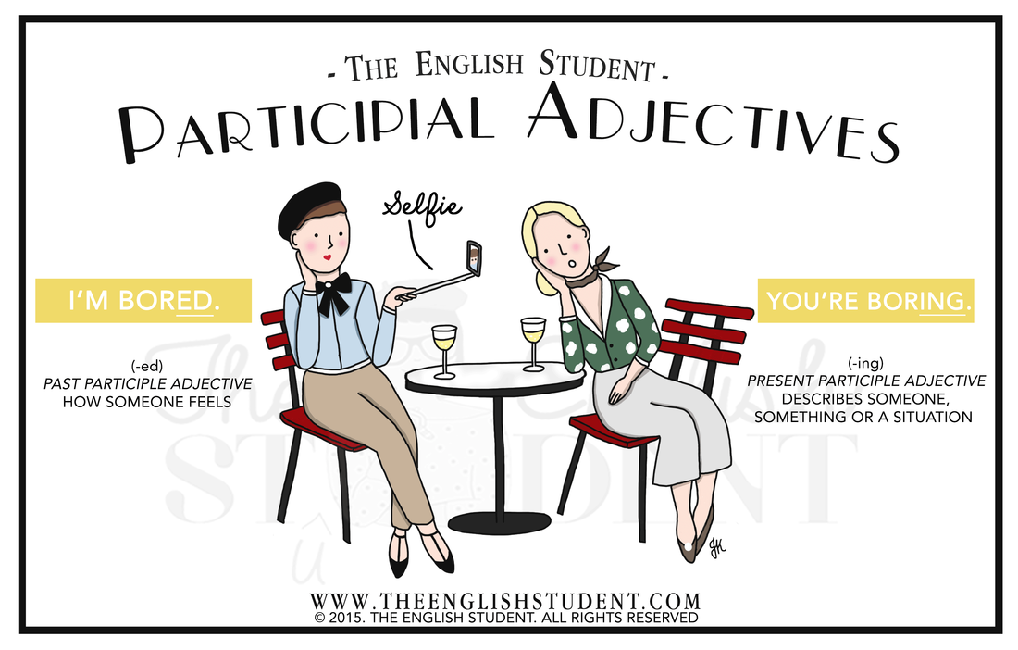
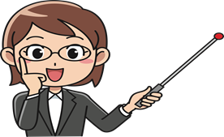
In this picture you can tell these friends are not having a great lunch together.
The woman on the left is feeling bored.
The woman on the right thinks her friend is a boring person
The words "bored" and "boring" are known as participial adjectives.

Slide 6

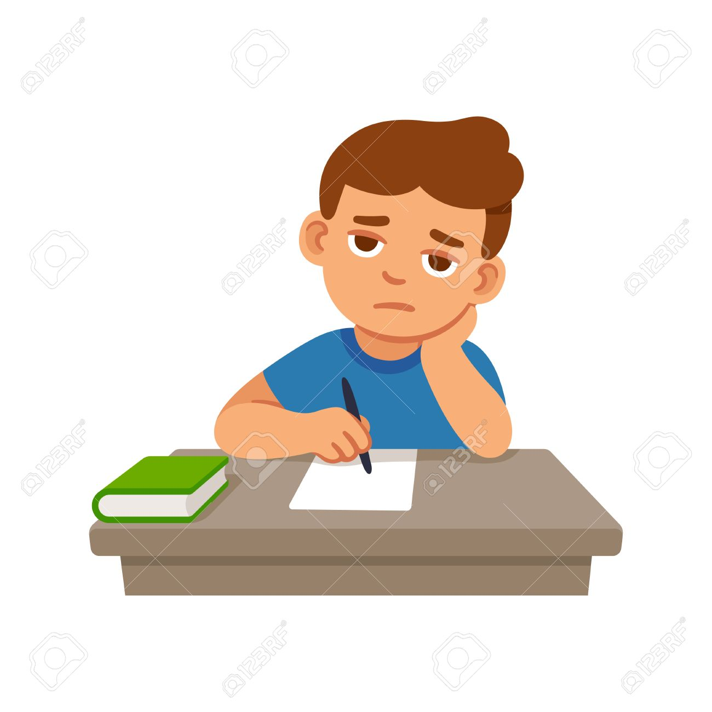

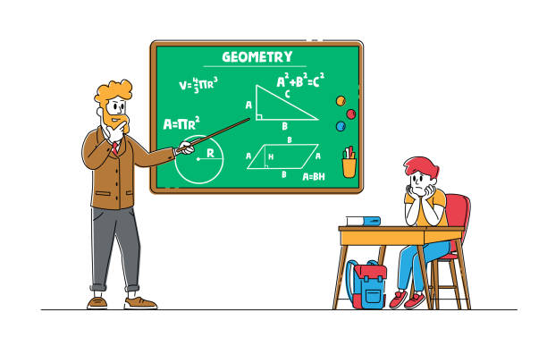

-ed vs -ing
What is the difference?
-ed Use to describe how people feel
-ed
bored interested exited confused surprised
Example :
He is bored . ( How feels)
-ing Use to describe something or situation causes a feeling or an emotion .
-ing
boring interesting exiting confusing surprising
Example :
The lesson is boring. (the \ that makes us feel)

Slide 7
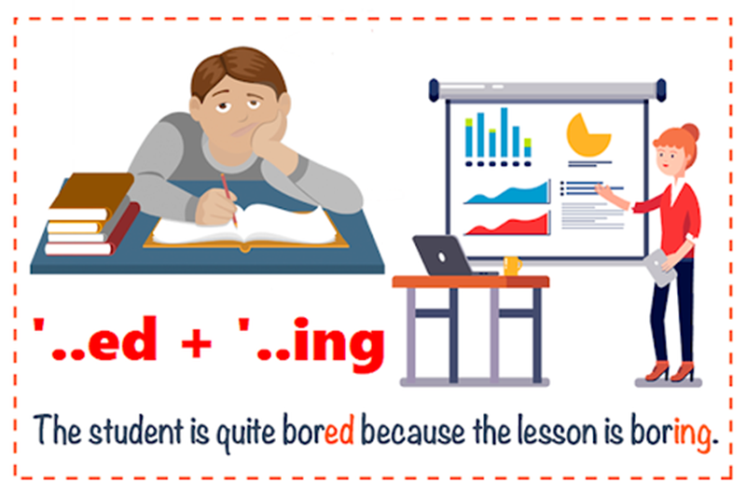
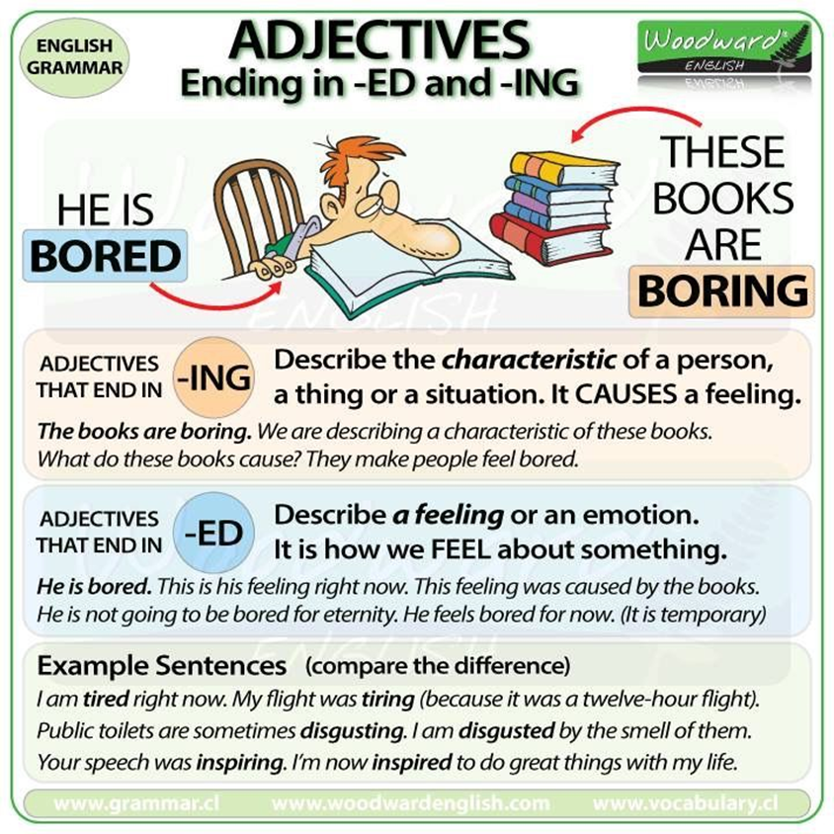
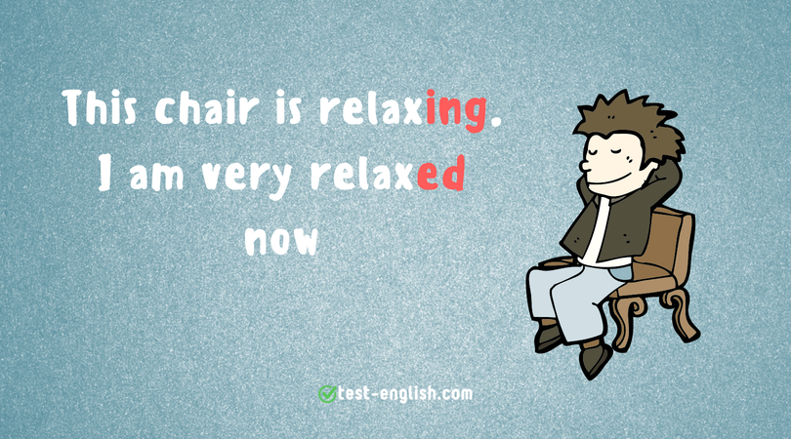
More Examples

Slide 8
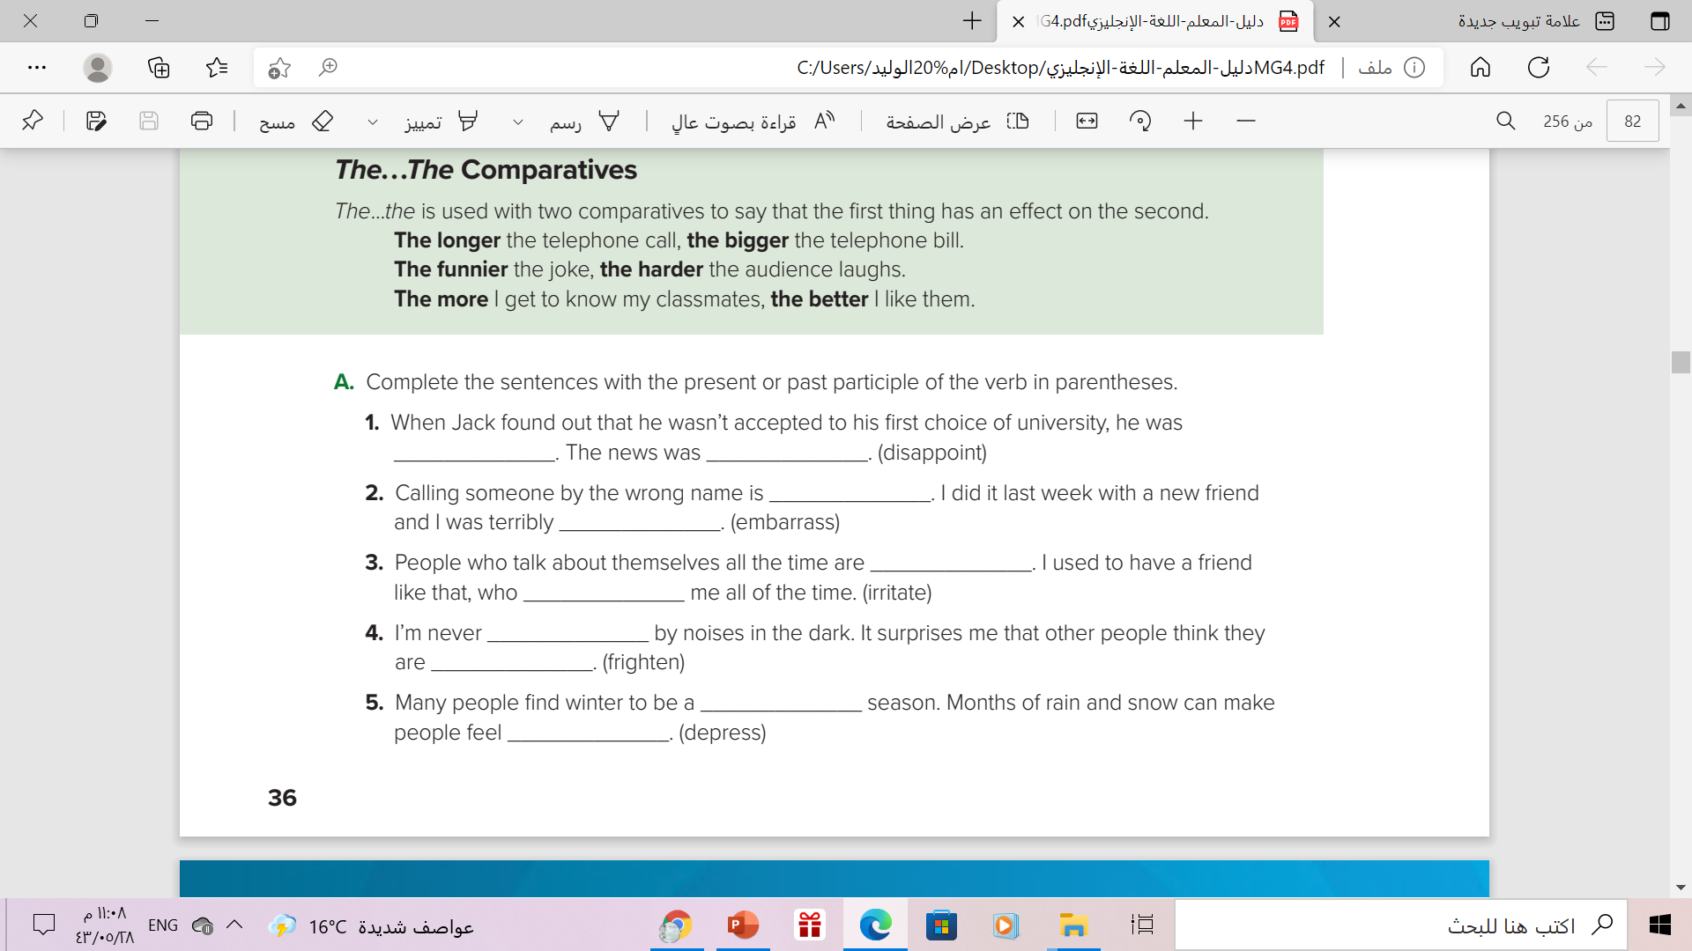
disappointed,
disappointing
embarrassing
embarrassed
irritating,
irritated
frightened
, frightening
depressing
depressed

Slide 9
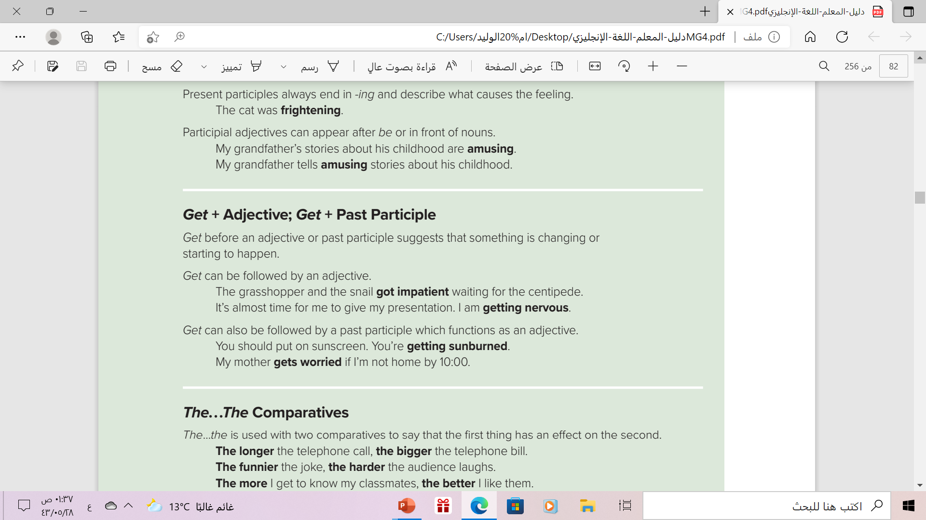

Slide 10

Get + adjective
Get can be followed by an adjective .Get gives the idea of change - the idea of becoming , beginning to be , growing to be.
Example :
subject
verb
adjective
Ahmad got hungry after test
“ hungry” an adjective describe the subject “ Ahmad”
It also gives the idea that someone becoming “ hungry”

Slide 11
Get + past participle
Get also is followed by past participle .The past participle after Get is like an adjective. It describes the subject and gives the idea of change & becoming
Example :
subject
Past participle
verb
Ahmad is getting exited about the game
“ exited” the past participle form of the verb describes the subject
“ Ahmad”
It also gives the idea of change and becoming

Slide 12
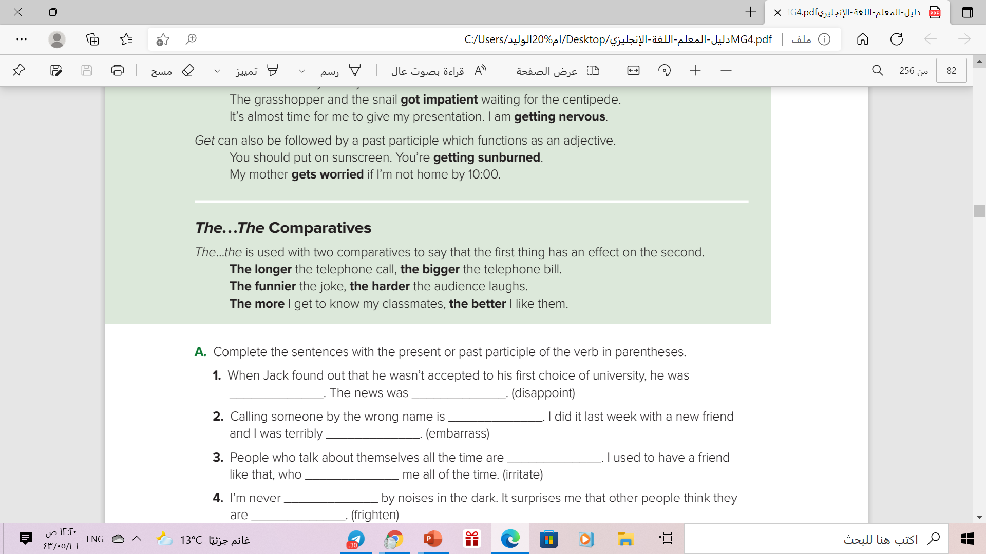

A double comparative has two parts :both parts begin with the . The second part of the comparison is the result of the first one .
Examples
The older we grow, the wiser we become.
The higher you climb, the colder it gets..
The earlier you leave, the better it is.
Short adjective
The more you study, the more you learn.
The more money he makes, the more things he buys.
The more we work, the more we earn.
More +(noun OR s+v)

Slide 13
If You Study More, do you learn more?
You could answer this questions in two different ways
1
Yes, If I study more , I learn more
2
Yes, The more I study , the more I learn
The meaning is the same
=
One thing depends on another

Slide 14

But.. We change the sentence structure
Let’s have a look together :
Take ‘ if ’ away
If I study more , I learn more
Add “The” at the beginning of both parts of the sentence
The I study more , The I learn more
Rearrange the order of the words
The more I study , The more I learn

Slide 15
Book Open
Page ( 9 )

Slide 16
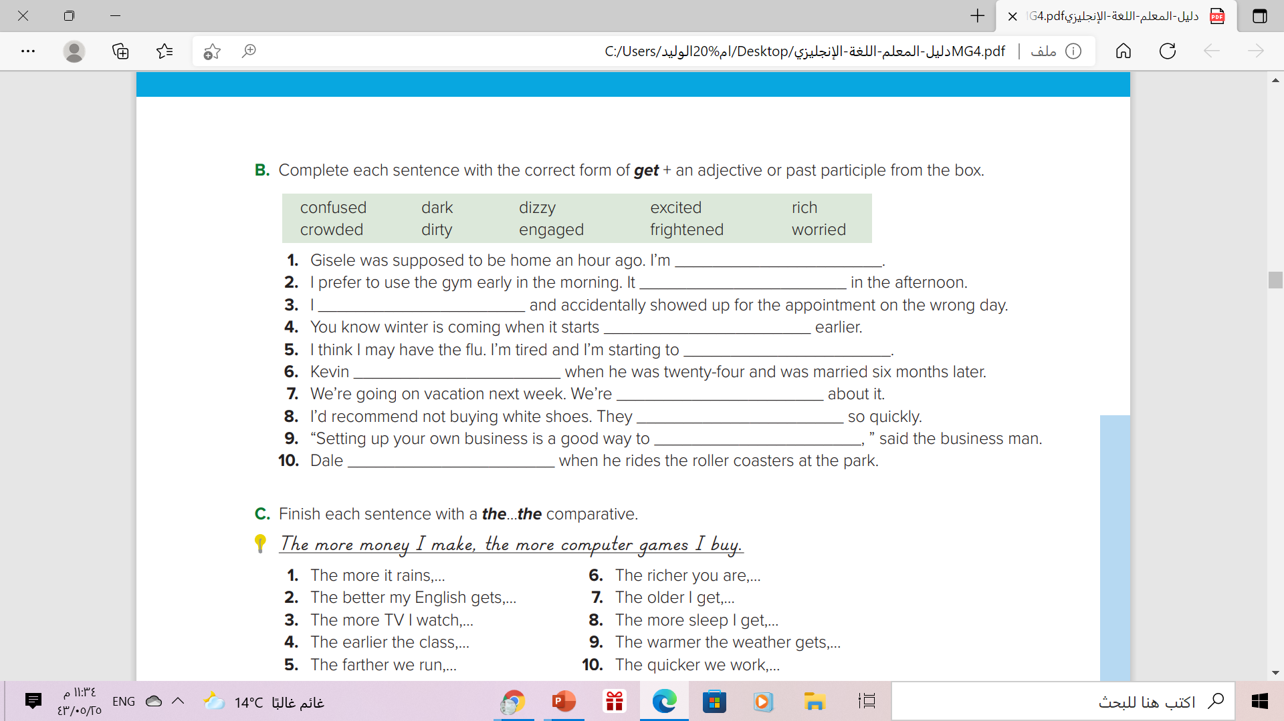
getting worried
gets crowded
got confused
getting dark
get dizzy
got engaged
getting excited
get dirty
get rich
gets frightened

Slide 17
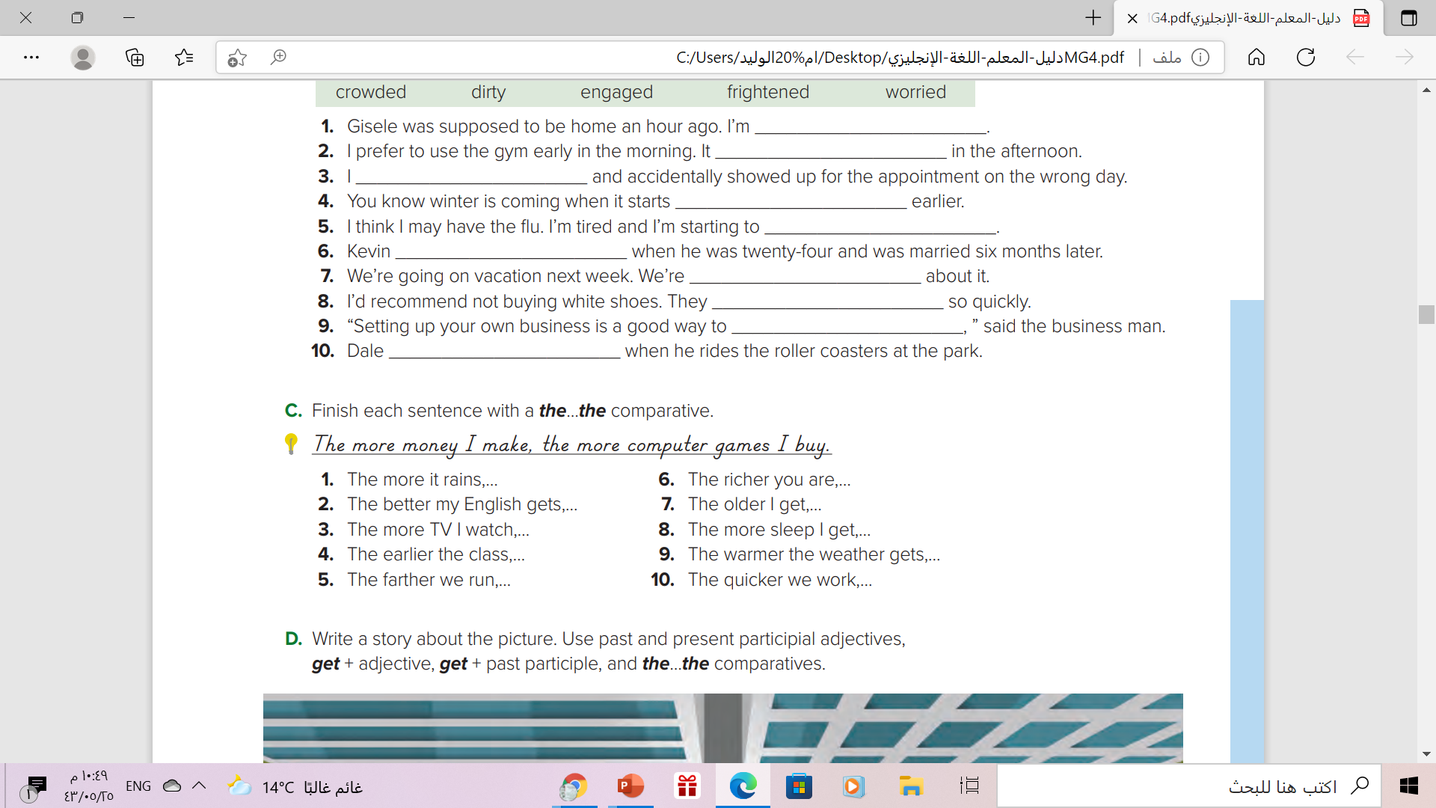
1-The more it rains, the higher the water level gets in the river.
2.The better my English gets, the easier it is to understand English TV shows.
3. The more TV I watch, the less I like it.
4. The earlier the class, the more tired I am.
5. The farther we run, the longer it will take us to get back.

Slide 18

6. The richer you are, the more stuff you can buy.
7. The older I get, the less I care what others think.
8. The more sleep I get, the better I feel.
9. The warmer the weather gets, the nicer it is for swimming.
10. The quicker we work, the more we’ll finish today

Slide 19

Remember..

Slide 20
Work Book
Workbook page ( 82 ) ,
exercise ( C )

Slide 21
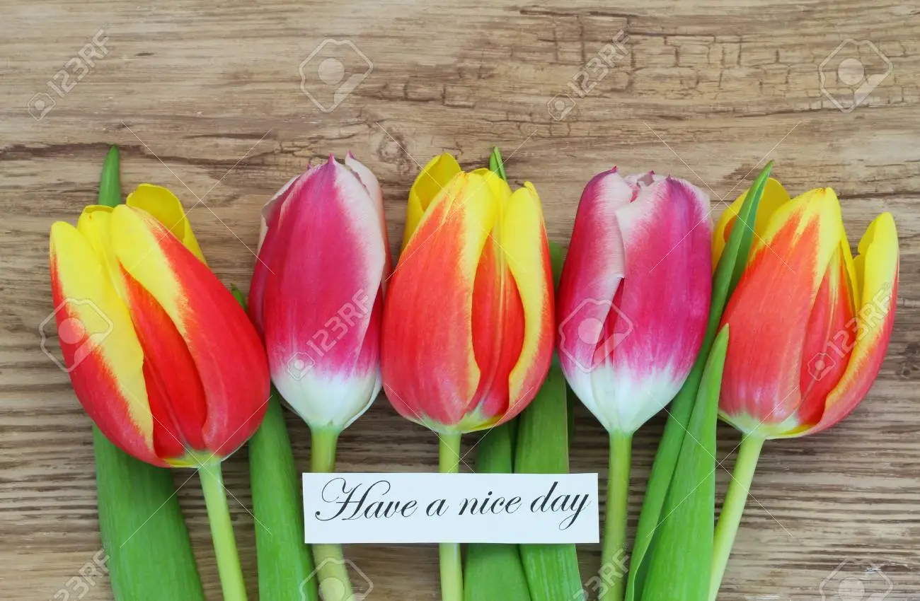
Thanks

