Slide 1
Unit 2
Sporting Life
Listen & Discuss
Mega Goal 4
Done by: Entisar Al-Obaidallah

Slide 2
Lesson Goals
01
02
03
Listen
Match
Show interest
for specific information
the words with their meanings
In designing their won flags

Slide 3
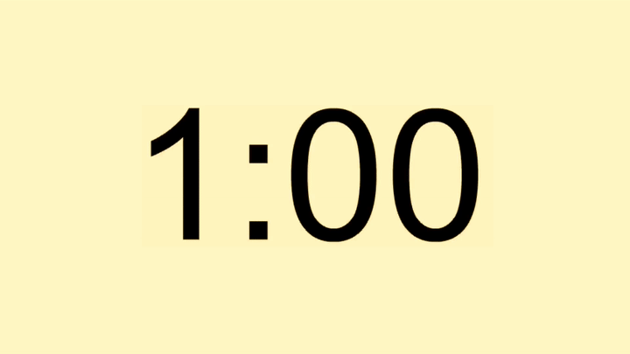
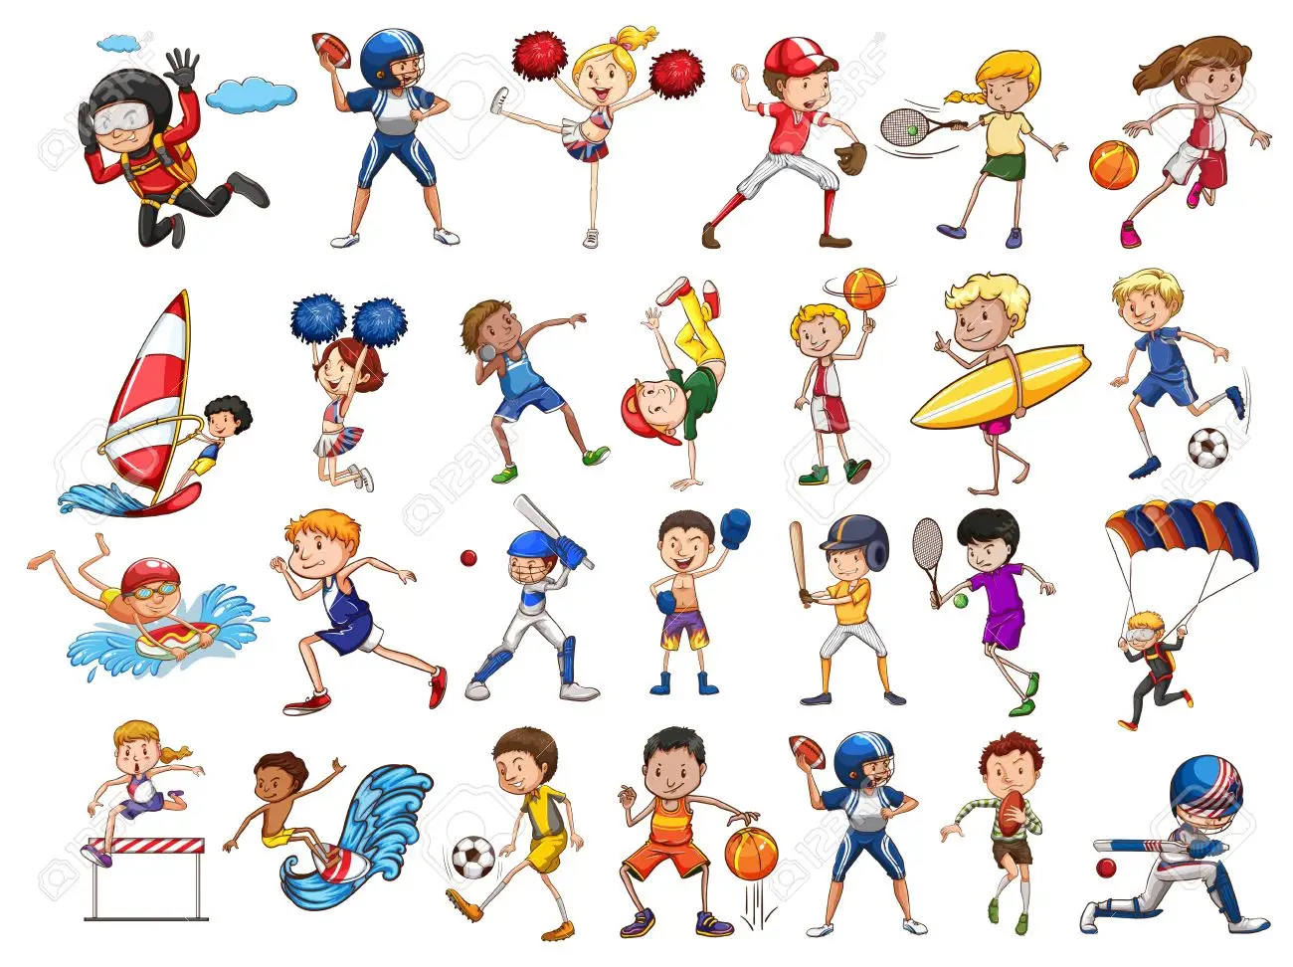

Warm Up
One minute strategy
How many SPORTS can you get from the picture?

Slide 4
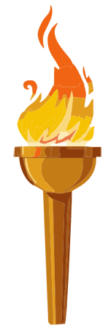
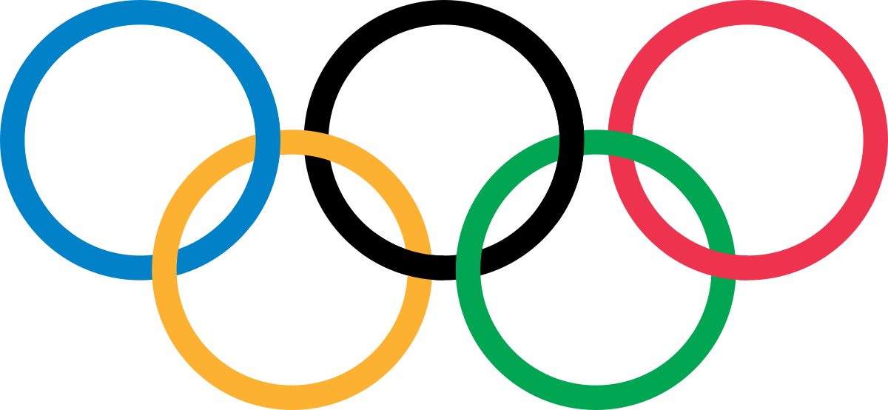
Warm Up
Which competition is that logo?
the Olympic Games

Slide 5
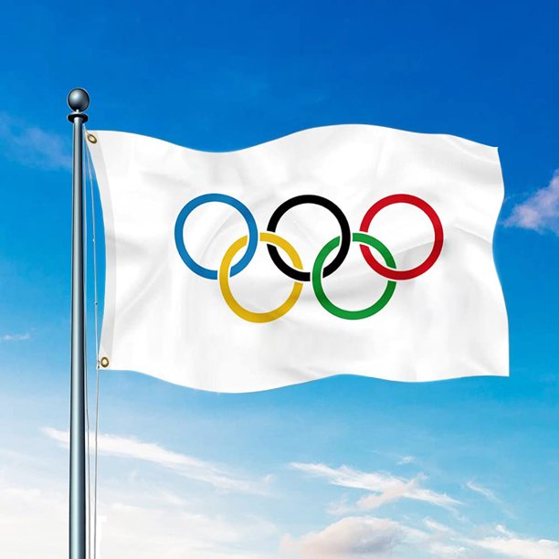
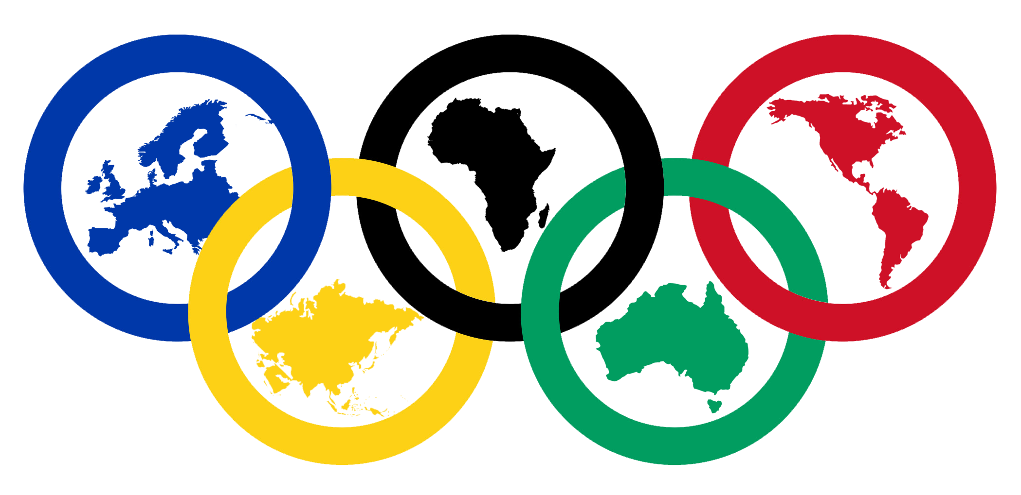
Warm Up
How many rings does the Olympic flag have?
5 rings
What does the 5 rings symbolize?
5 continents linked together in friendship
What does the 6 colors represent?
6 colors are those that appear in all the national flags of the world

Slide 6

Book Open!
Pages ( 20 -21)

Slide 7
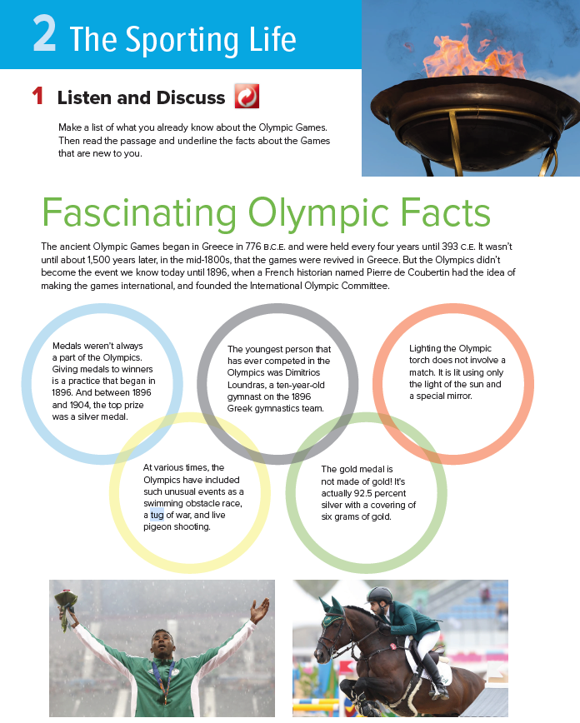
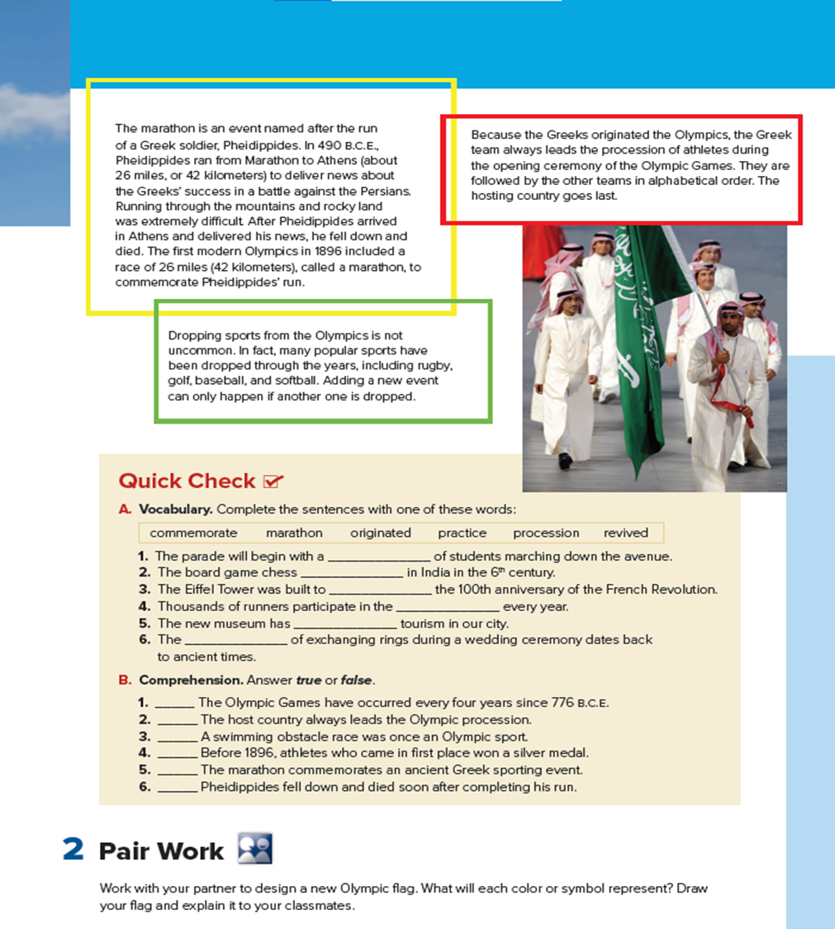


Read along as you listen

Slide 8
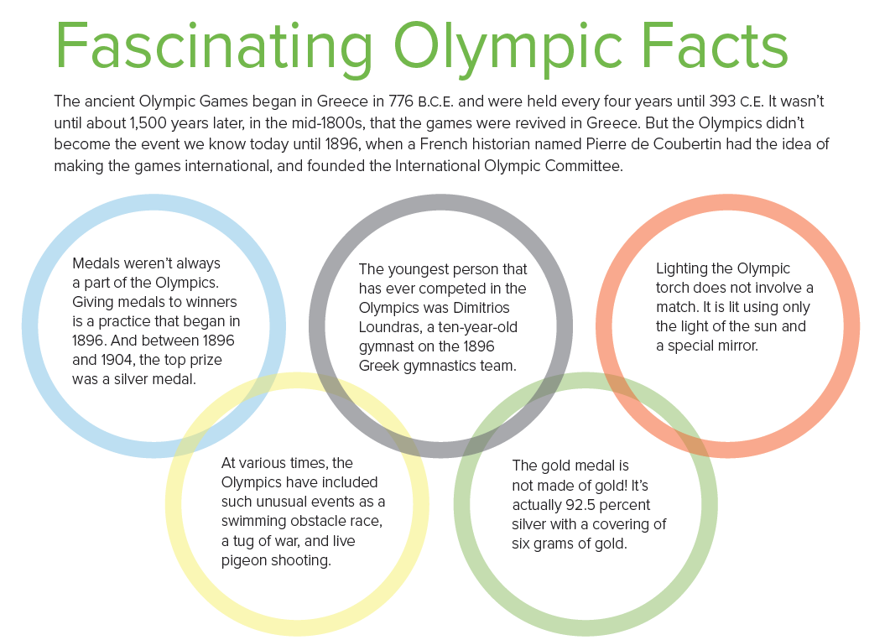
When did the ancient Olympic Games begin?
When did the Olympics become an international event?
Who founded the Olympic Committee?
What was the top prize in the Olympics in 1896
How old was the youngest person in the Olympics?
How much gold is there in a gold medal?

Slide 9
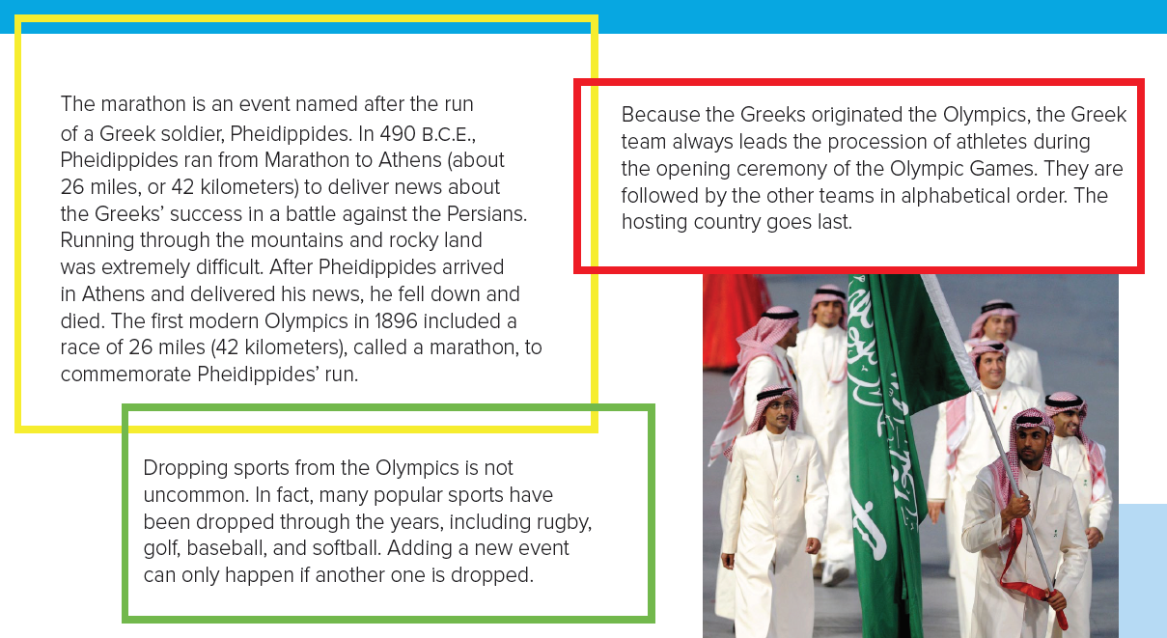
When did the first “ marathon” start?
Which team goes first in the opening procession?
What is a “ marathon”?
Give some examples of sports that have been dropped?

Slide 10
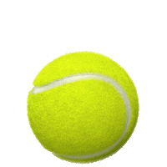
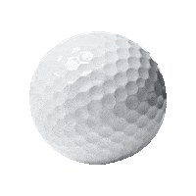


Slide 11

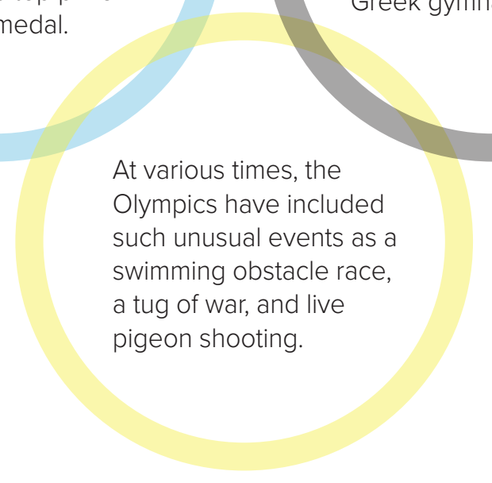
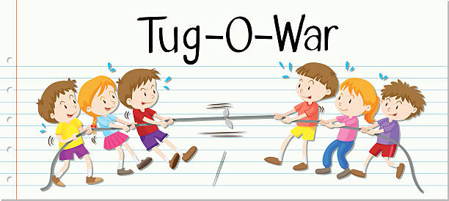
A word means
a game in which two teams pull on a rope

Slide 12
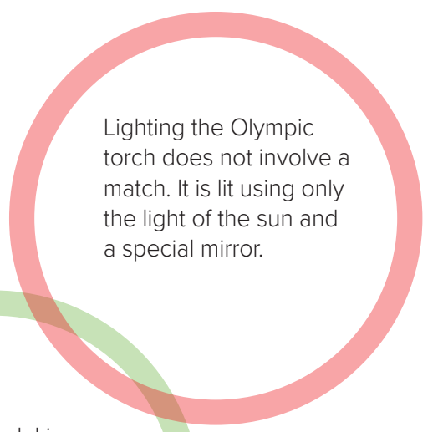

A word means
something used to start a fire

Slide 13
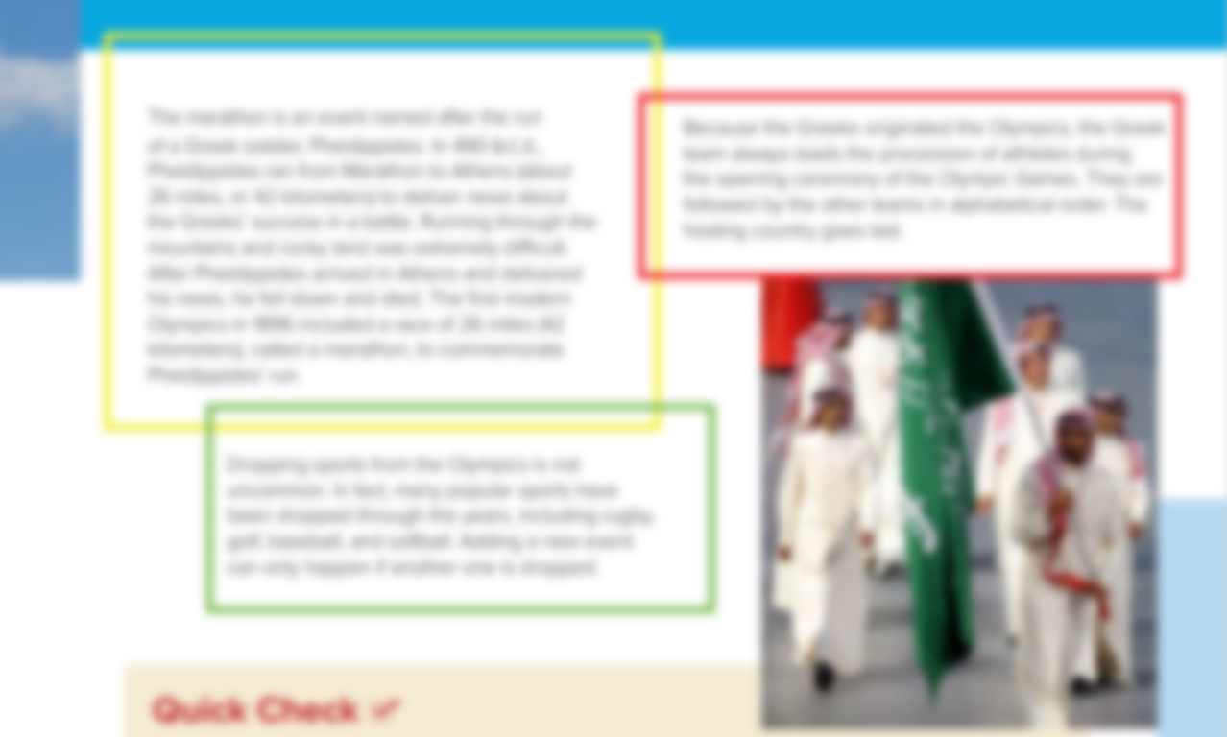
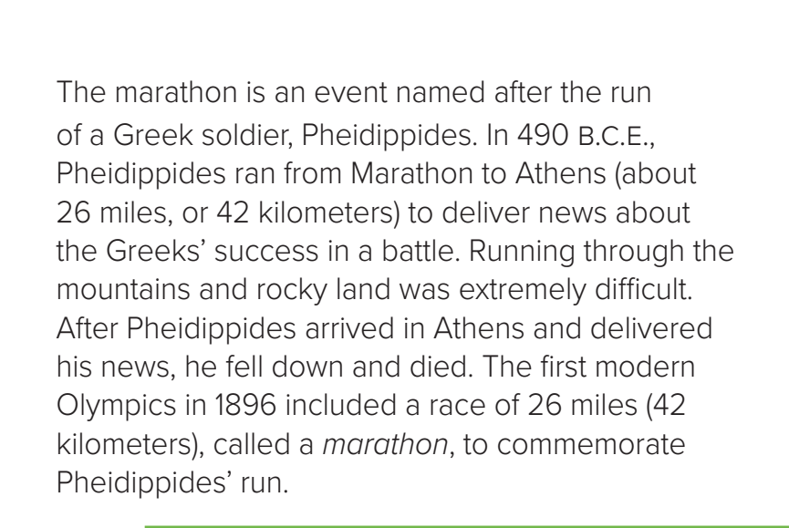
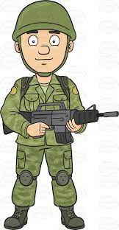
A word means
a member of the military

Slide 14
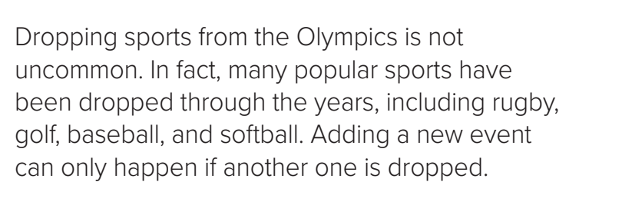
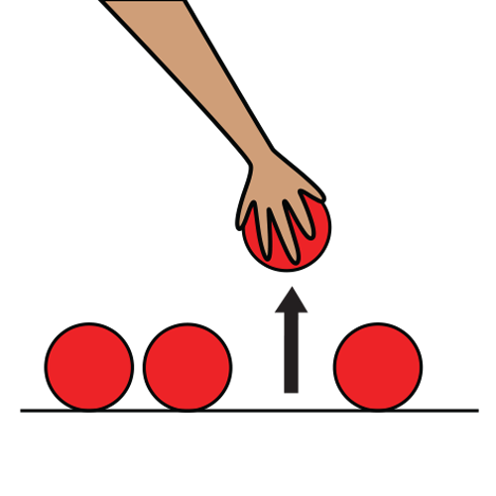
A word means
excluded or removed from a group

Slide 15
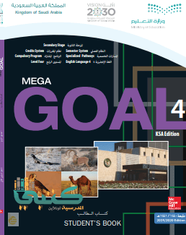
Book Open pages ( 21 )

Slide 16
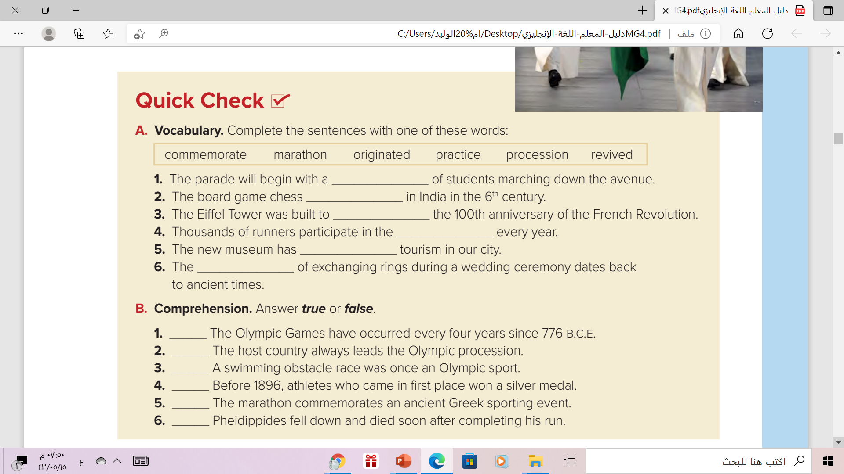

procession
originated
commemorate
marathon
revived
practice

Slide 17

False
False
True
False
False
True

Slide 18
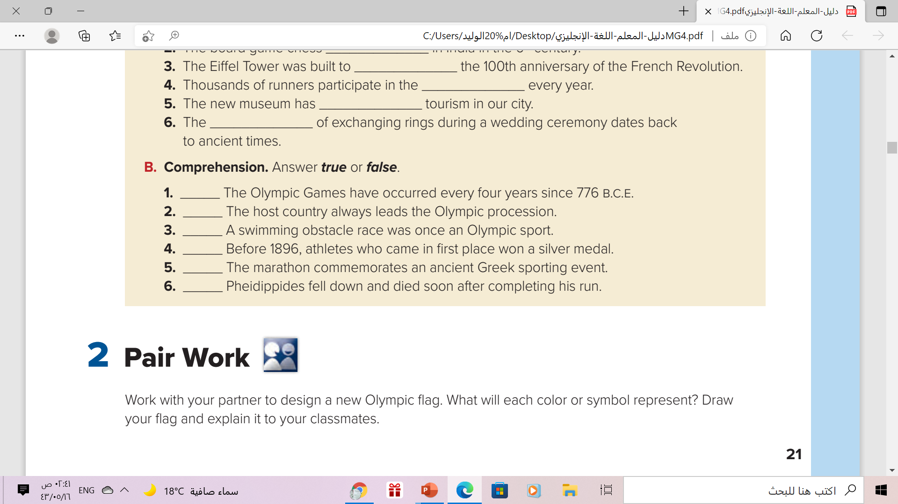
Pair Work

Slide 19
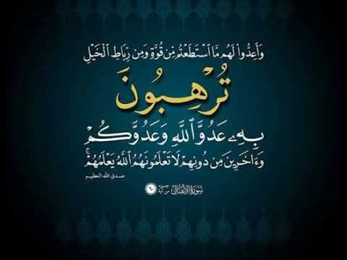
Remember..

Slide 20
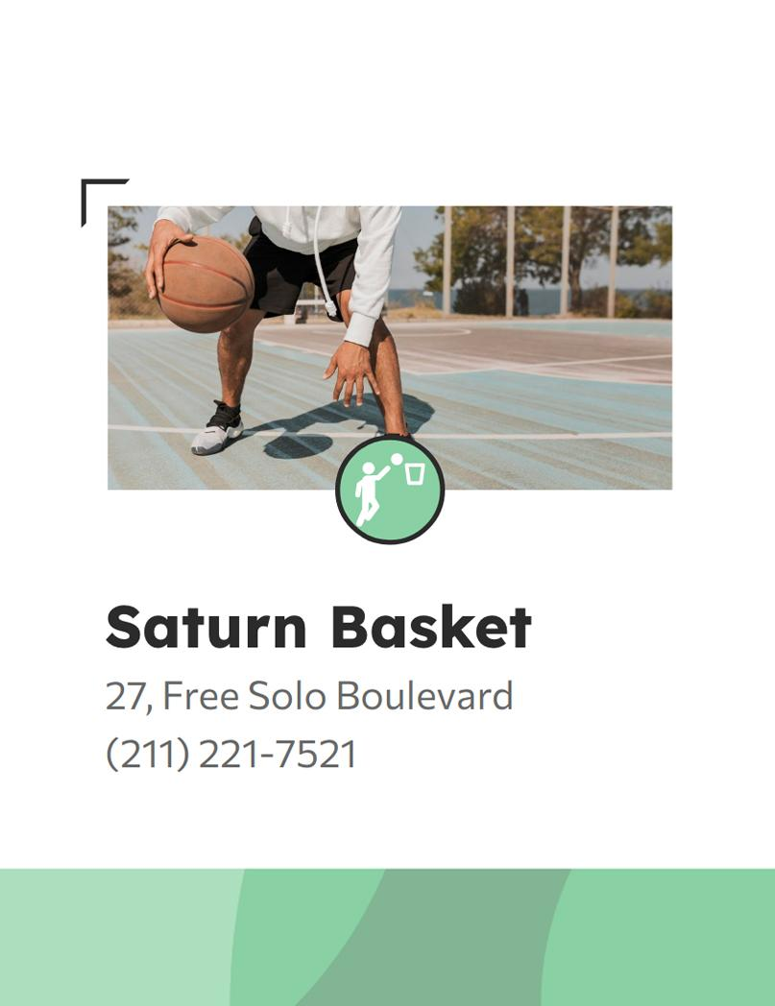
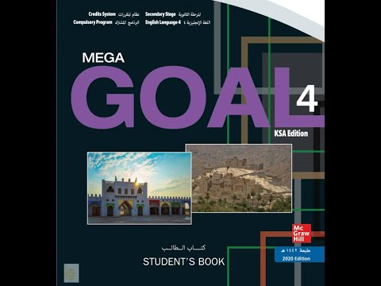
Homework
Workbook page ( 11 ), exercise ( a )

Slide 21

Thanks!

