Slide 1
Unit 3
You’ve Got Mail
Mega Goal 1.2
Language in Context + Conversation
Done by : Entisar AL-Obaidallah

Slide 2
01
02
Lesson Objectives
04
05
Form sentences with “ used to”
Listen for specific information
03
Recognize the rule of Short vowels /ɛ/, /æ/, /ɪ/
Answer some questions about the conversation
Use real talk phrases to Accept & refuse invitations

Slide 3

01
Language in Context
Open your student’s book p.36

Slide 4
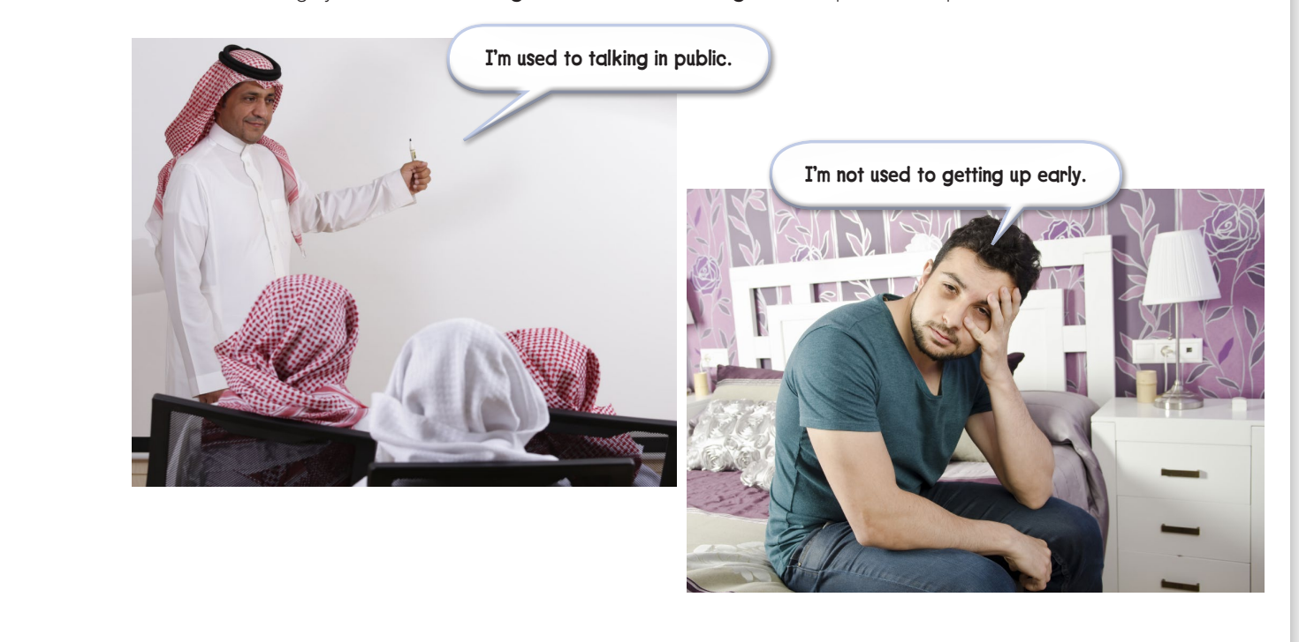
Look at the photos and read the speech bubbles :

Slide 5
Remember
What does “ used to “ mean ??
“used to” means accustomed to, or in the habit of..

Slide 6
Compare these two sentences
I am used to waking up early.
I used to wake up early.
In this sentence – “used” is an adjective and it means “accustomed "or familiar & no longer strange .After the adjective
is a preposition and then we have
a gerund.
So this sentence means “I wake up early now and it feels normal for me or I’m accustomed to it.”
You can replace the image on the screen
In this sentence “ used” is a verb. and it means that it happened regularly in the past but we don’t do it any more.
So this sentence means: In the past I woke up early but now I don’t.

Slide 7
Make a list of things you’re used to doing & not used to doing
Used to + doing
Not used to + doing
1
I’m used to eating fast food
1
I’m not used to exercising everyday
2
I’m used to drinking tea with milk
2
I’m not used to getting up early
3
I’m used to working hard
3
I’m not used to eating healthy food
4
I’m used to speaking English
4
I’m not used to speaking in public

Slide 8
02
Listening

Slide 9

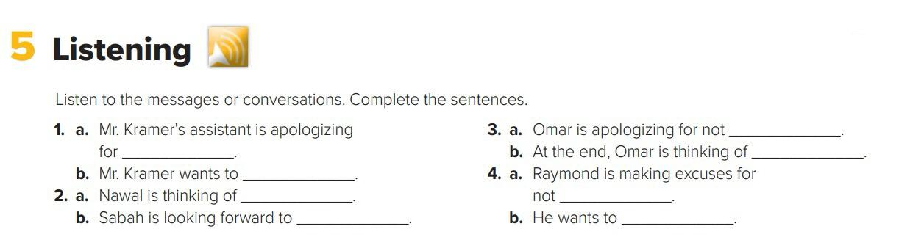
Listen to the conversation and complete the sentences:
1. a changing the time of an appointment.
1. b changing the meeting to Monday at the same time.
2. a visiting New York .
2. b seeing Brenda .
3. a coming to Ron’s house .
3. b bringing his cousin to Ron’s house .
4. a handing in his history project .
4. b hand the project in a couple of days late .

Slide 10
03
Pronounciation

Slide 11
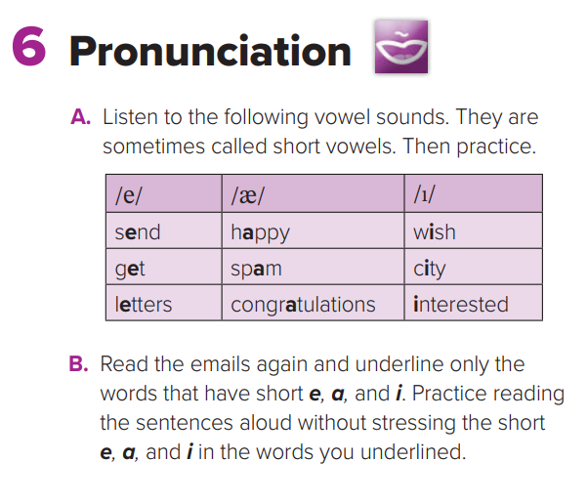
Listen to the following vowels sounds . They are called short vowels .Then practice
Short Vowel Rule: When there is one vowel in a word, either at the beginning or between two consonants, it usually has the short vowel sound

Slide 12
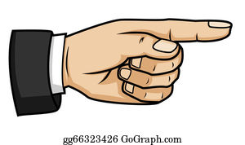
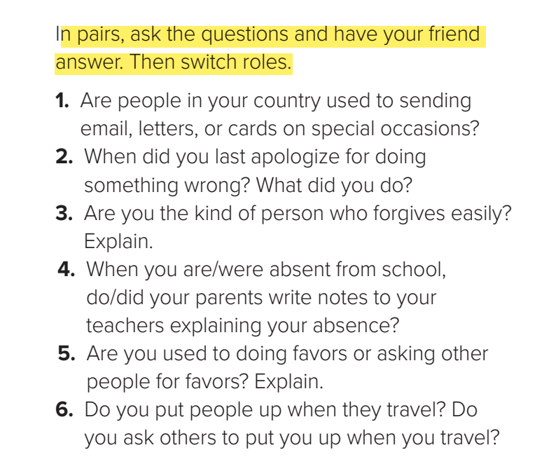
Now, Your Turn

Slide 13
04
Conversation
Open your student’s book p.37

Slide 14
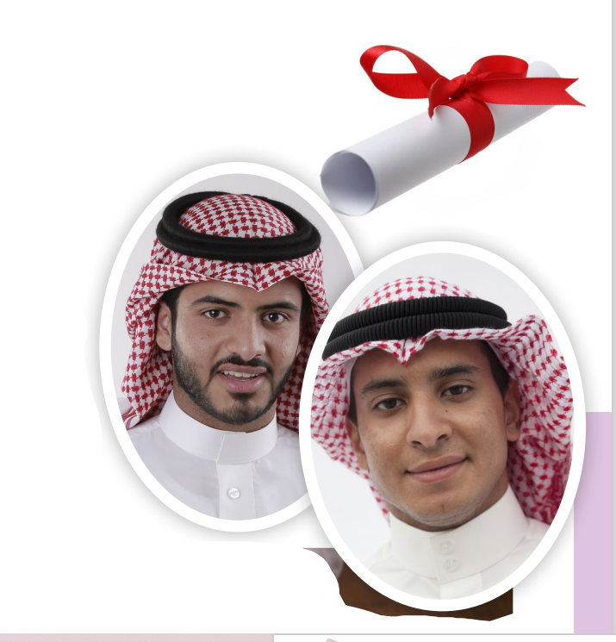
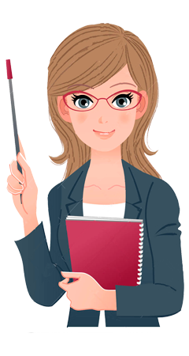
Student’s book p.(37)
Can you predict what the phone conversation is about ?
What Can You see in the picture?

Slide 15
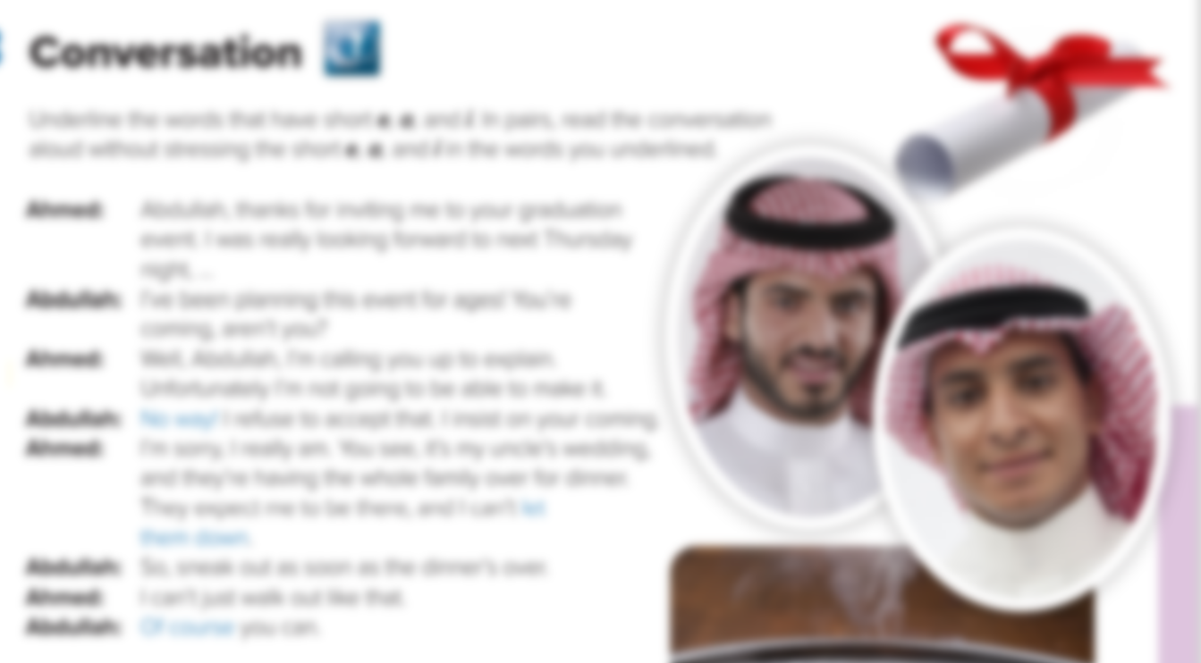
Listen and Read along
What is the phone Conversation about ?
an invention to graduation event
Whose graduation party is it ?
Abdullah
Why can’t Ahmed accept the conversation?
Because of his uncle’s wedding

Slide 16


Slide 17

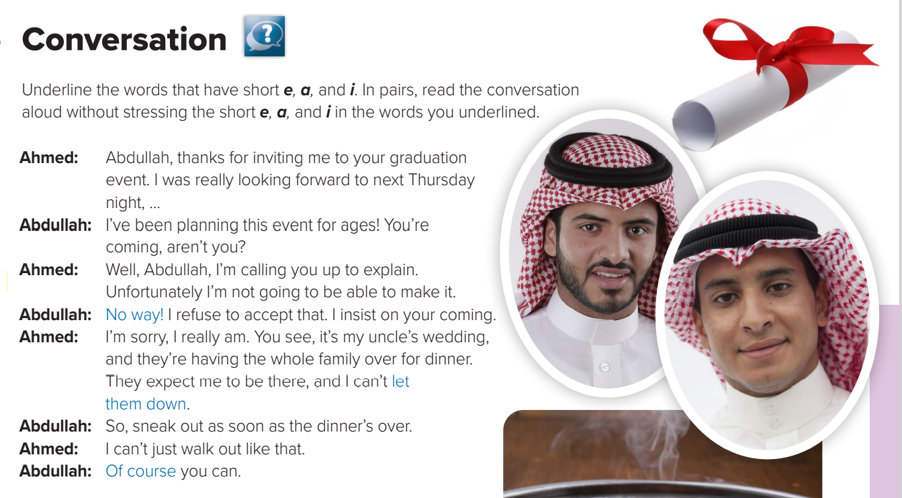
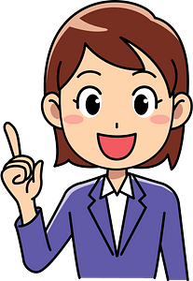
Find word that means …….
achieve a specific goal
make it

Slide 18
Find word that means …….
disappoint
Let down

Slide 19
Find word that means …….
excited about
Looking forward to

Slide 20
Find word that means …….
demand
Looking forward to

Slide 21
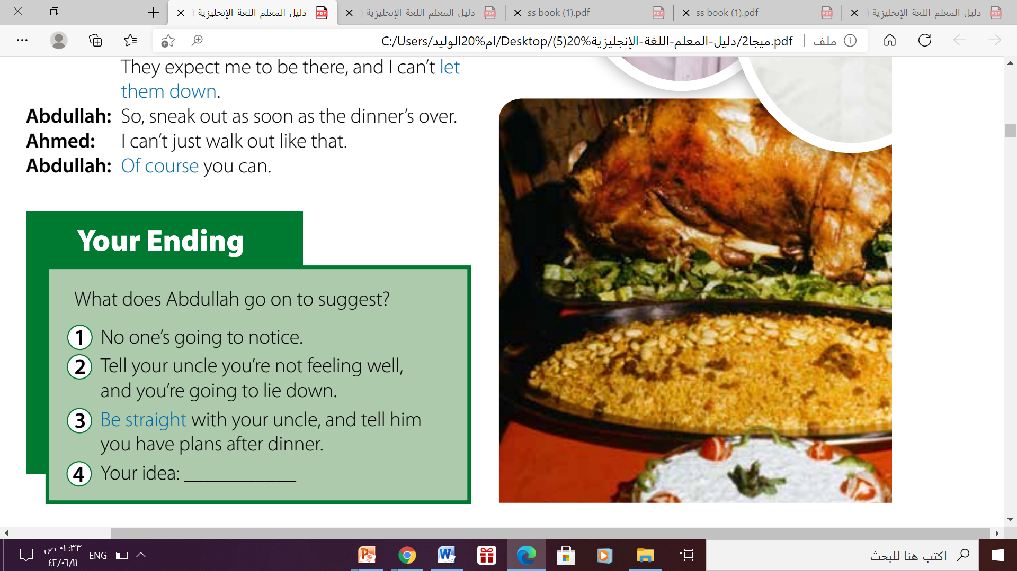
Your Ending p.(37)
Write Your Ending here
which ending do you think is the most likely?

Slide 22
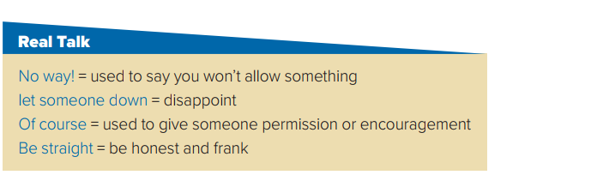
Read the words and their meanings:

Slide 23
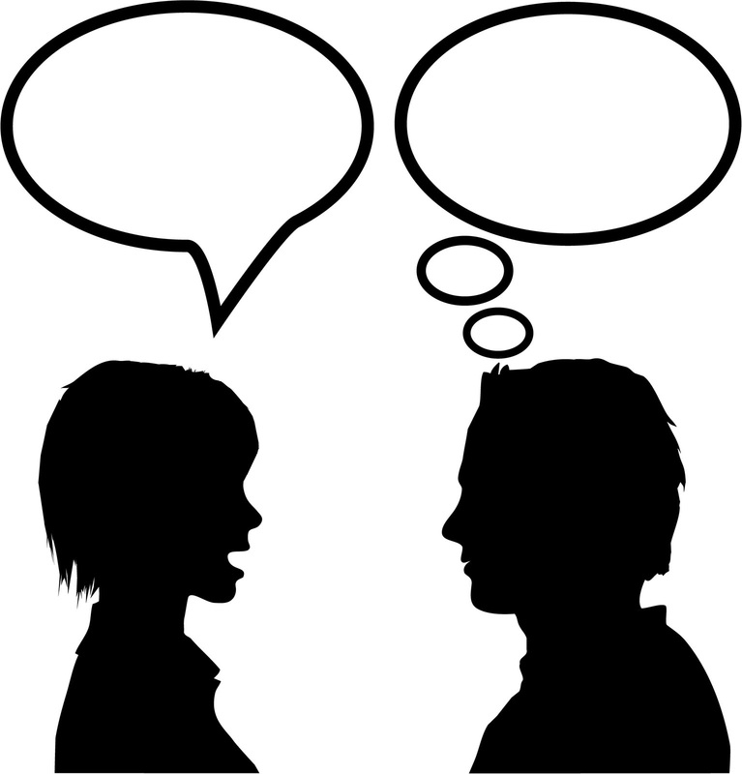
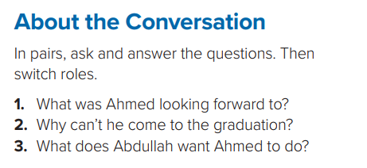
About the Conversation
Question1
Question2
Question 3
Ahmed was looking forward to going to Abdullah’s graduation event.
Ahmed has to go to a family dinner for his parents’ wedding anniversary.
He wants Ahmed to leave the dinner early.

Slide 24
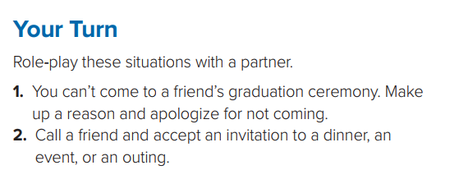
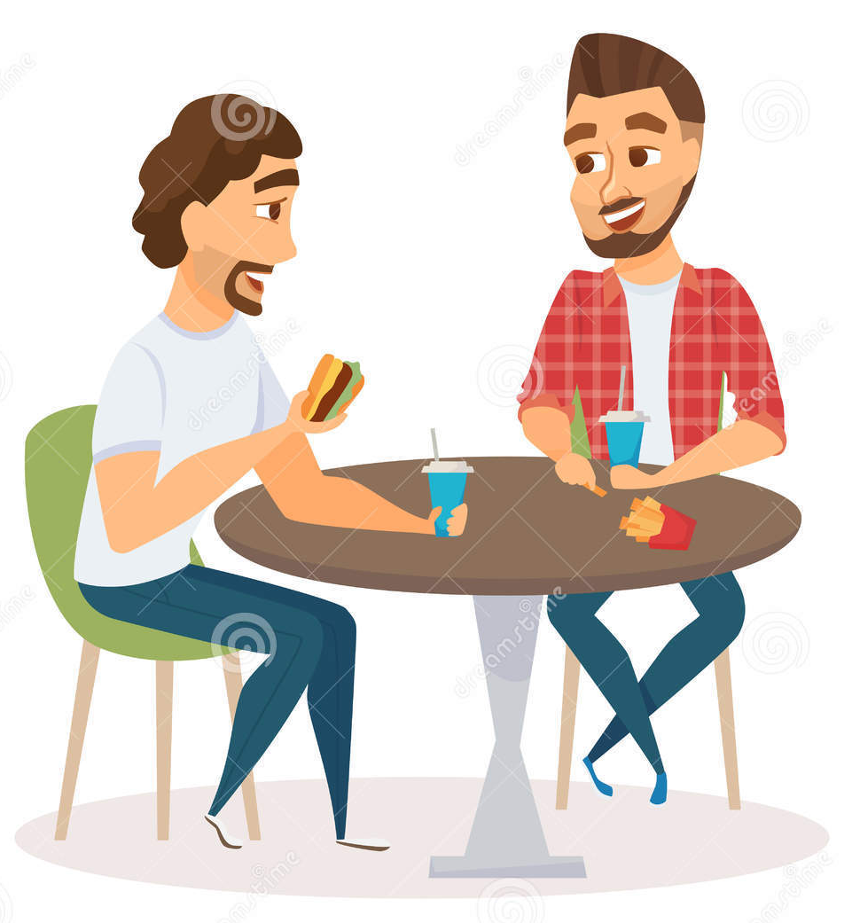

Now, Your Turn

Slide 25
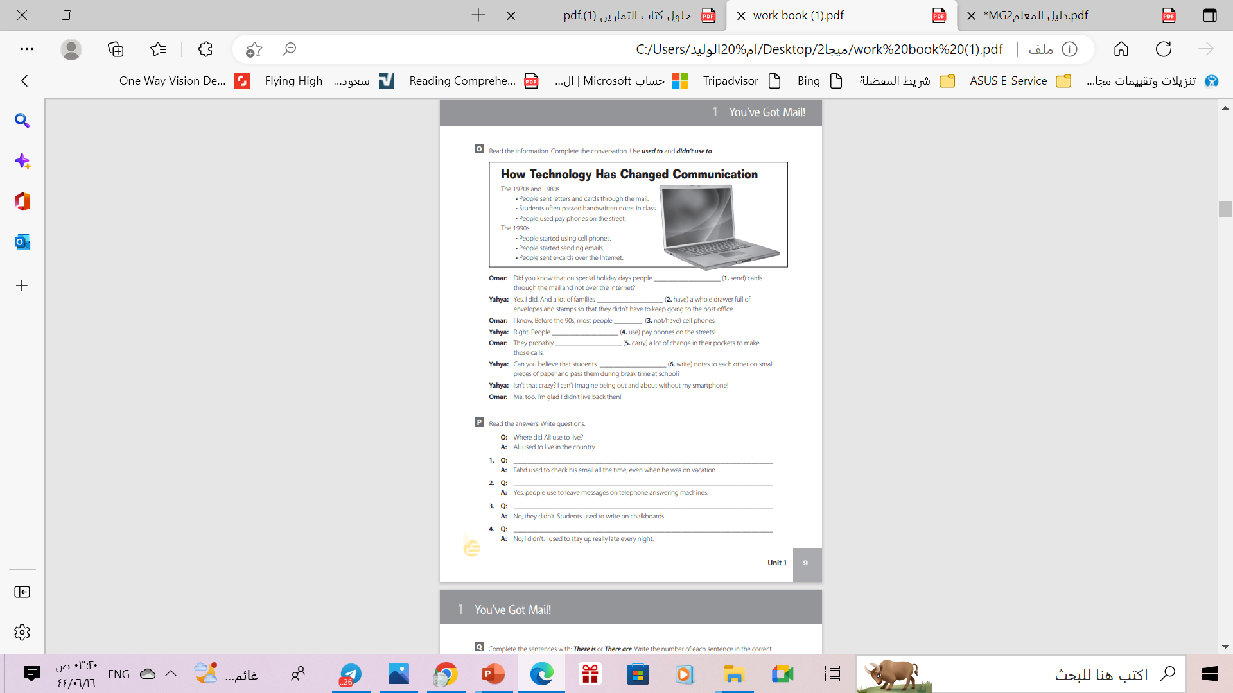
Homework
Workbook , p. ( 105) , exercise ( O)

Slide 26
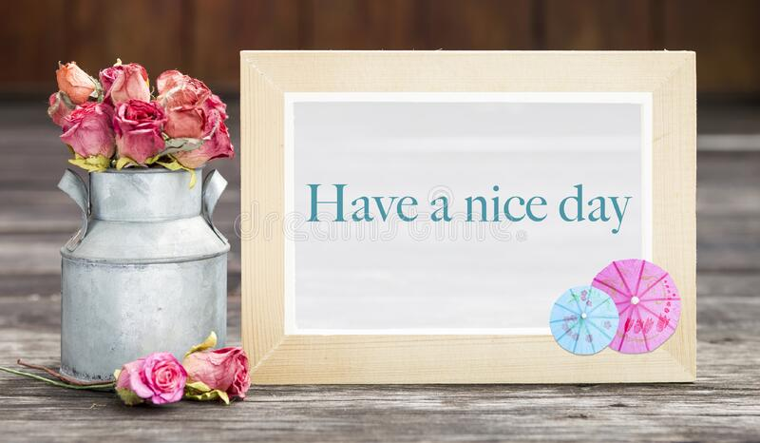
THANKS

