Slide 1
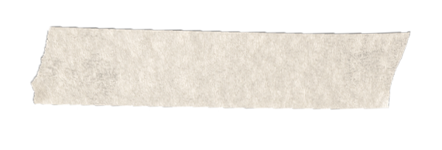
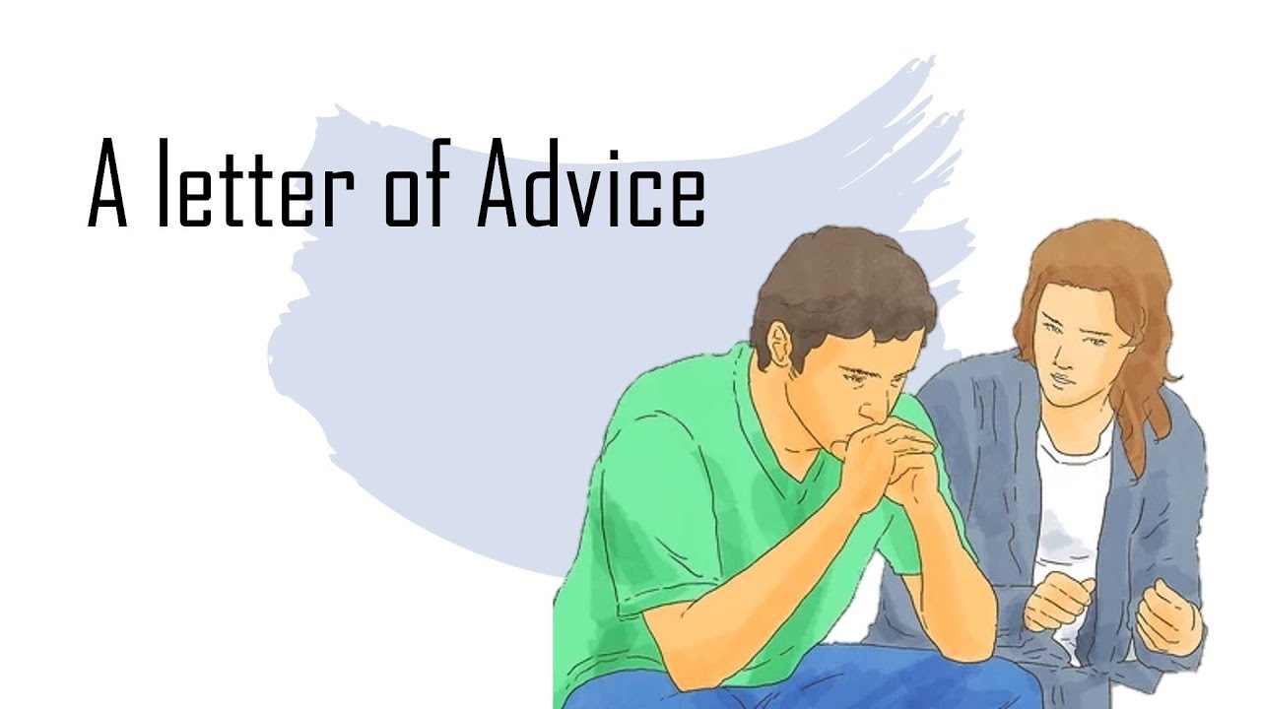
Unit1 Take My Advice Writing
Done by: Entisar Al-Obaidallah

Slide 2
Lesson Objectives
01
02
03
04
Ask
write
friends about their problems.
notes about a letter correctly
Find
Find
a problem in a text.
advice and solution in a text.

Slide 3
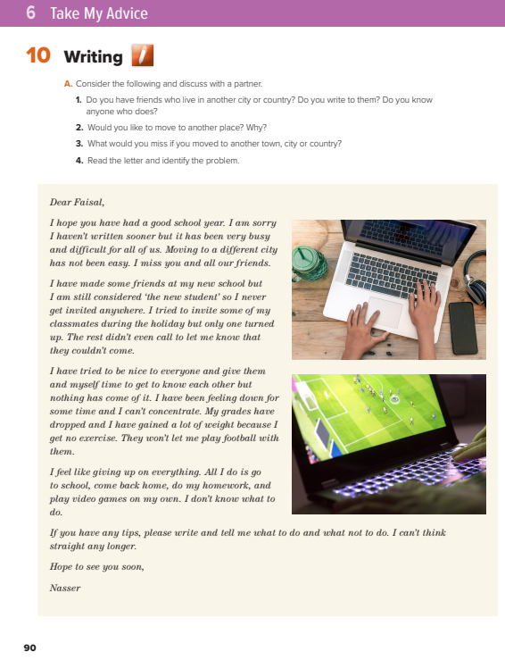
Open
Stude nt’s book p. ( 26-27 )

Slide 4
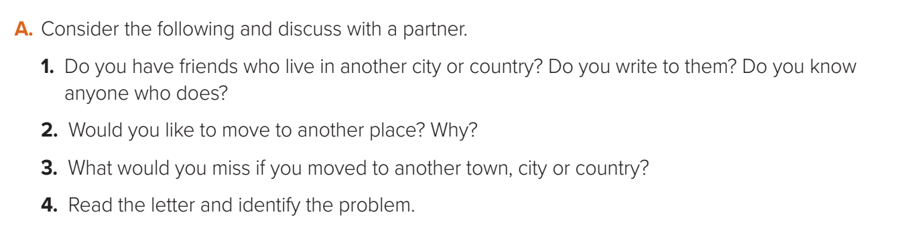
Discuss the following questions

Slide 5
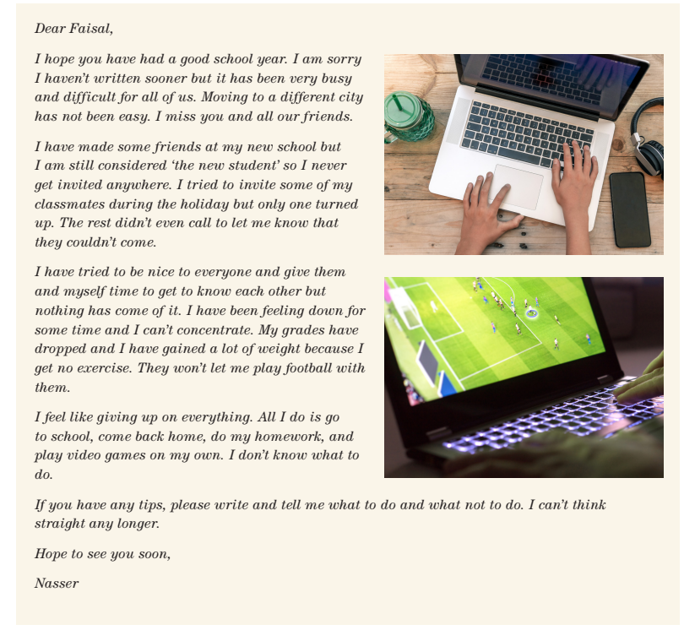

Listen and Discuss

Slide 6
Who wrote the letter?
To whom Nasser wrote the letter ?
Did he move to another city?
What was his problem?
Why did he gain a lot of weight?

Slide 7
Could you summarize
the problem ?
He feels isolated.
He is very unhappy and bored.
He can’t concentrate not think straight.
He can’t function well at school.

Slide 8
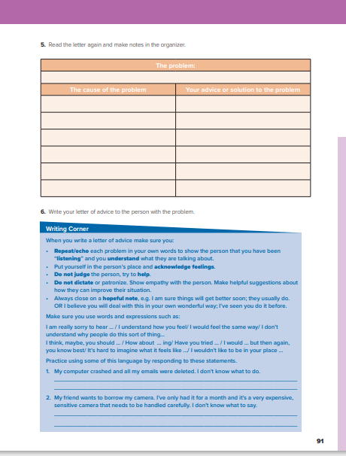
Open
Stude nt’s book p. (27 )

Slide 9
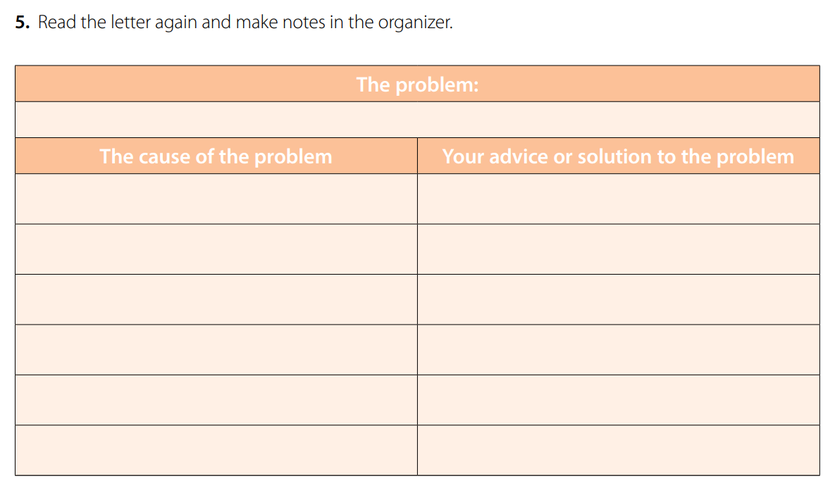
He is very unhappy and bored . He misses his friends . He can’t adjust to his new school .
He has not accepted by his classmates in his new school
He should join study groups to make new friends
He is the “ new student “
He should have a calm relaxed manner
He is not invited anywhere
He should go out with his family .
He is not allowed to participate in the football
team / or / play football at school
He should show them his skills in football .
He is ignored and rejected by his classmates
He should deal with them in a good way .
Only one person turned up when he invited them
He should make friends then invite them

Slide 10
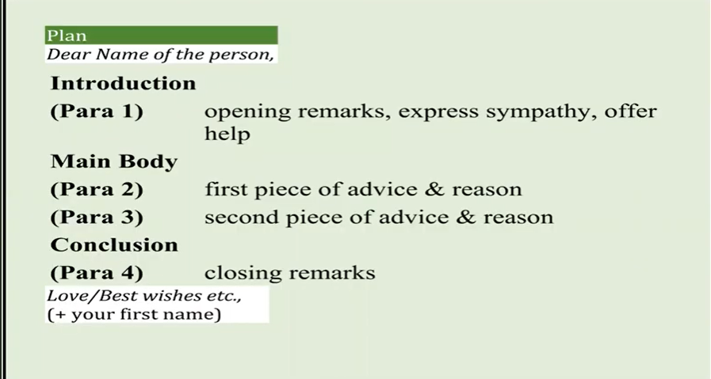
How to write a an advice letter:

Slide 11
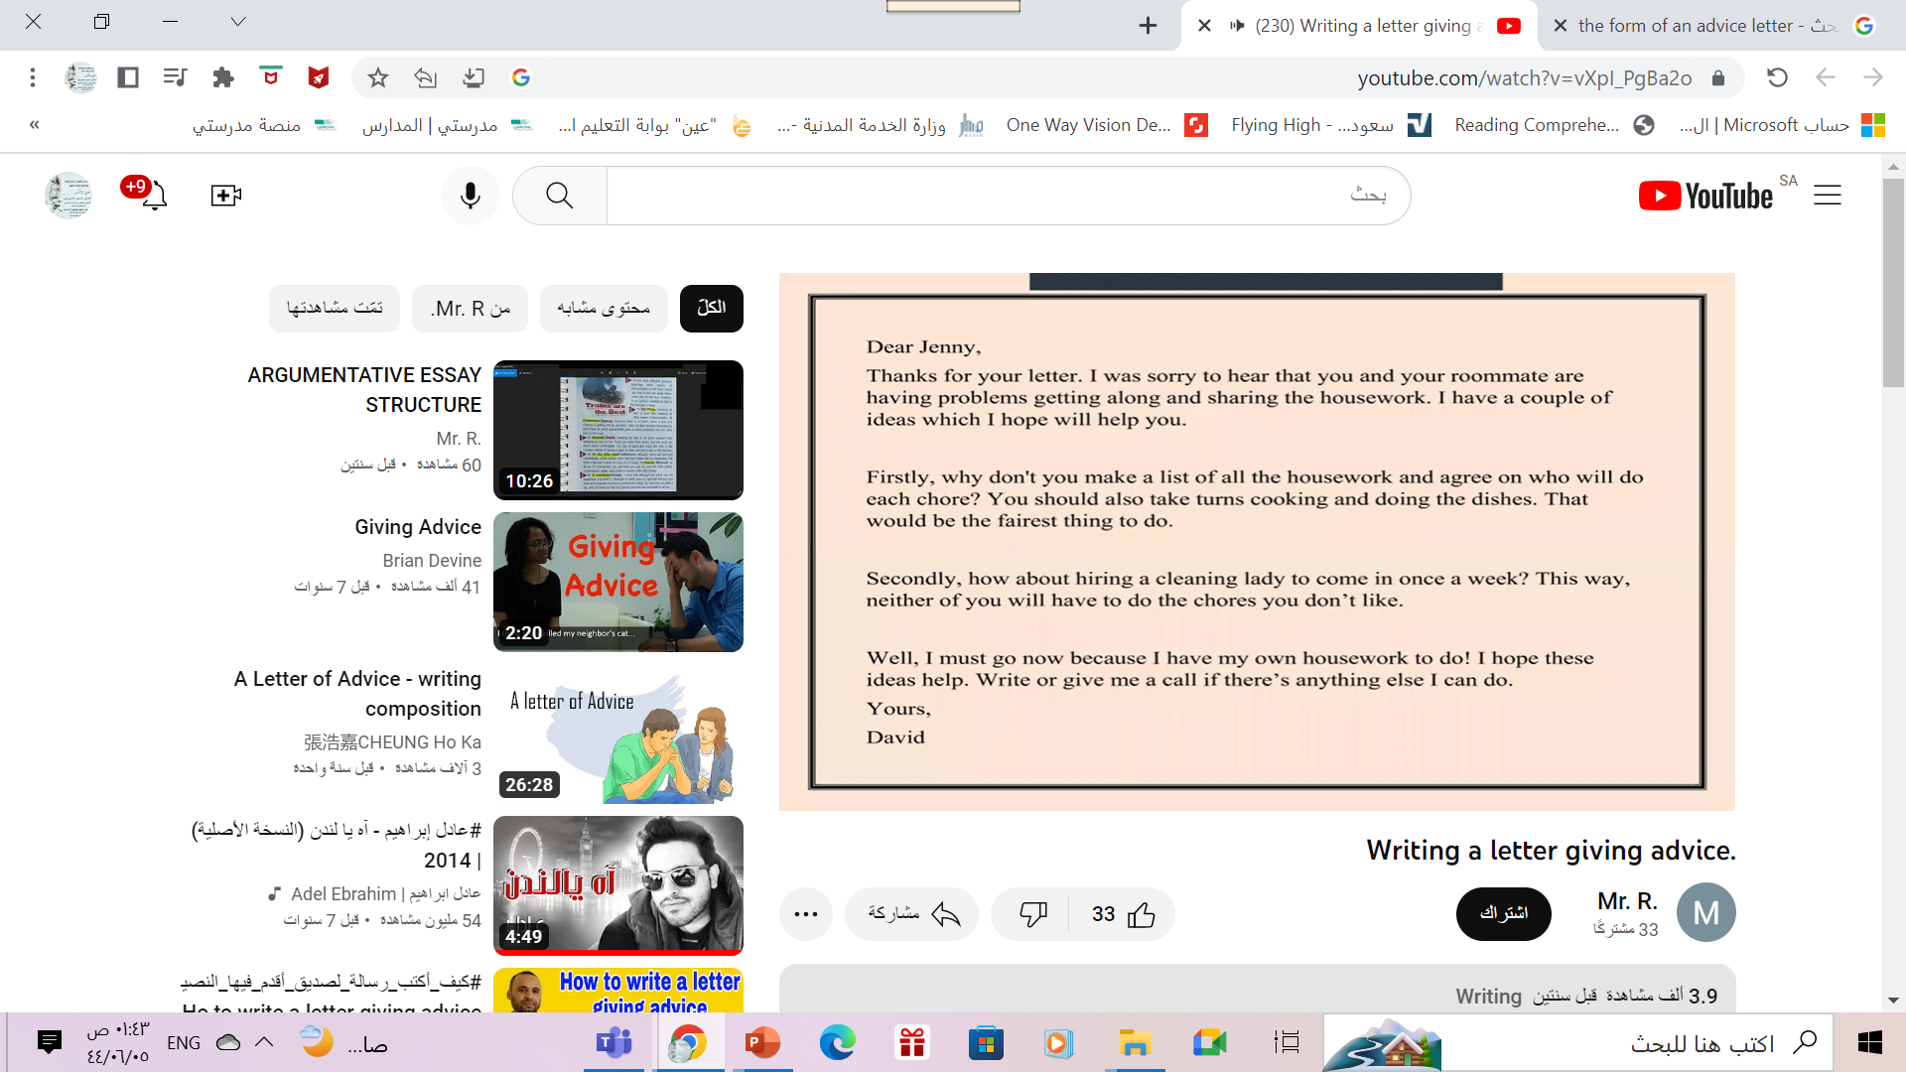
Dear
Introduction
Main Body1
Main Body2
Conclusion

Slide 12
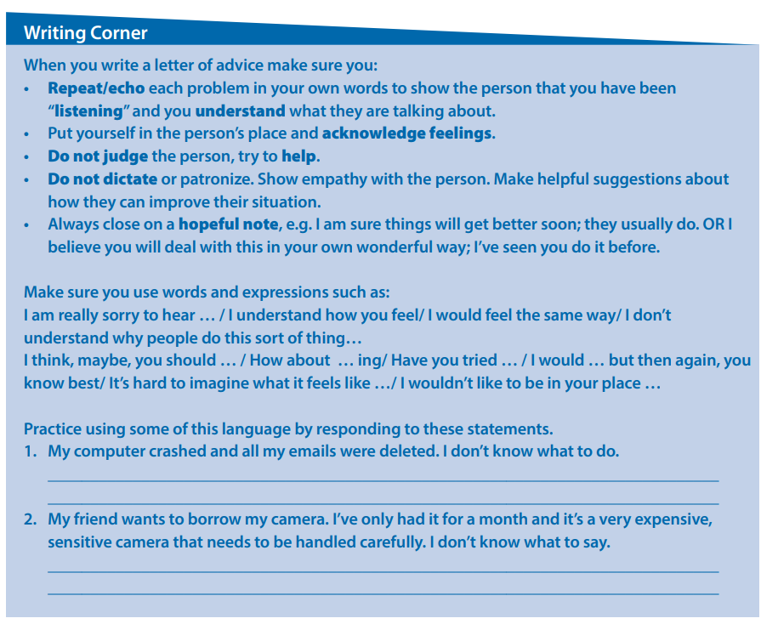
Remember: Follow these steps when you write a letter of advice

Slide 13

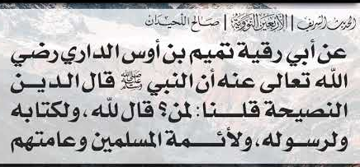
Remember

Slide 14
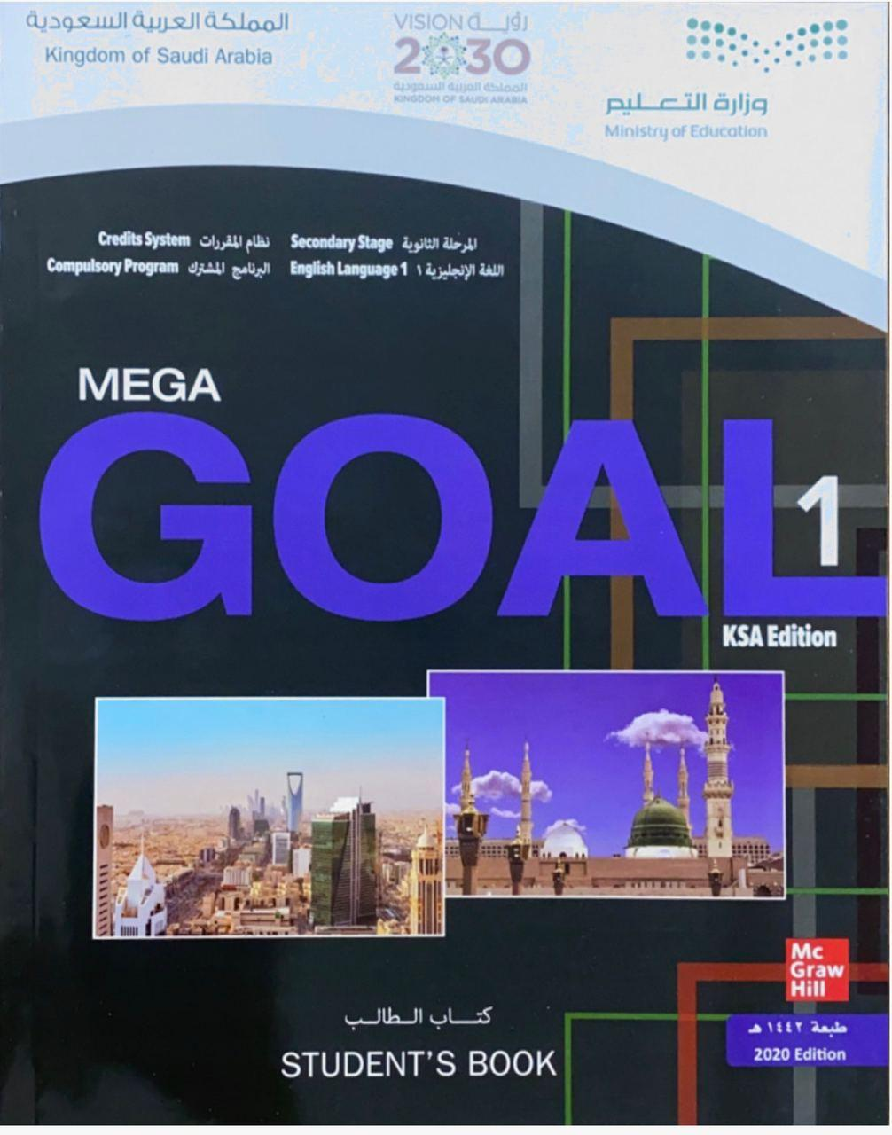
Homework
Workbook p.( ) , exercise ( )

Slide 15


Thanks!

