Slide 1

Mega goal 1.2

Slide 2
Unit 1

Slide 3
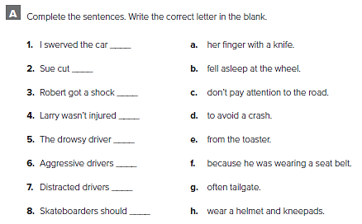
d
a
e
f
b
g
c
h

Slide 4
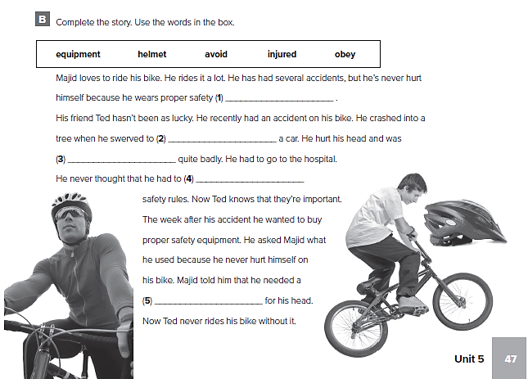
equipment
avoid
injured
obey
helmet

Slide 5
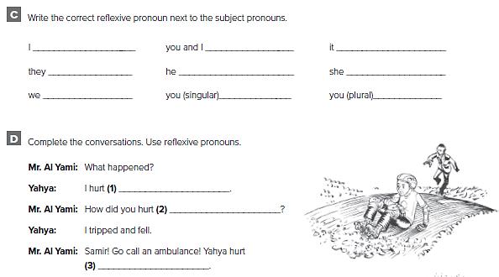
myself
ourselves
itself
themselves
himself
herself
ourselves
yourself
yourselves
myself
yourself
himself

Slide 6
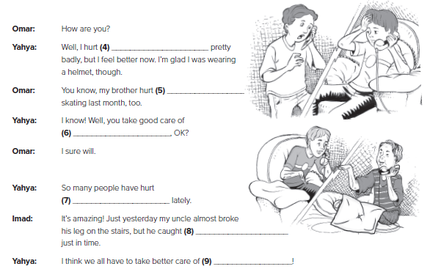
myself
himself
yourself
themselves
himself
ourselves

Slide 7
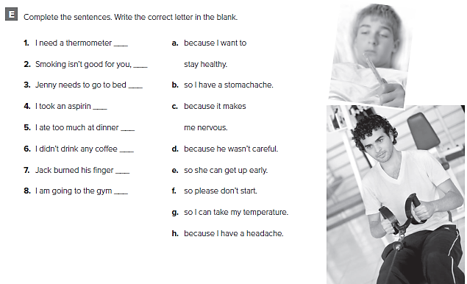
g
f
e
h
b
c
d
a

Slide 8
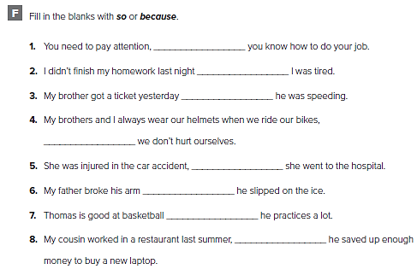
so
because
because
so
so
because
because
so

Slide 9
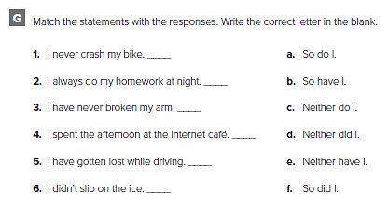
c
a
e
f
b
d

Slide 10
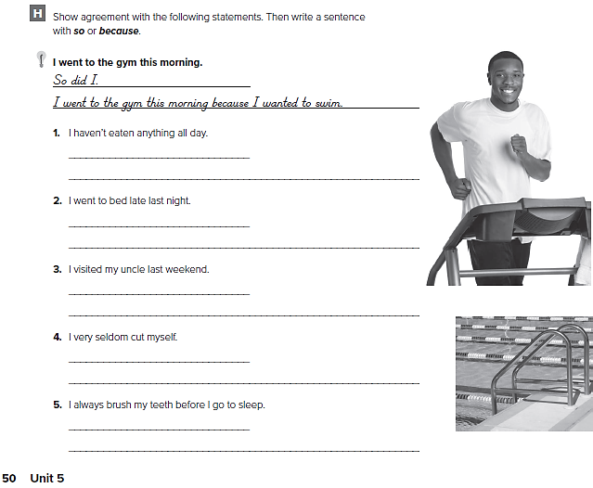
من الممكن أن تختلف الإجابات
Neither have I.
I haven’t eaten anything all day, so I can eat a lot at the restaurant tonight.
So did I.
I went to bed late last night because I watched a movie on TV.
So did I.
I visited my uncle last weekend because I wanted to give him a present
Neither do I.
I very seldom cut myself because I’m careful.
So do I.
I always brush my teeth, so I don’t have to go to the dentist.

Slide 11
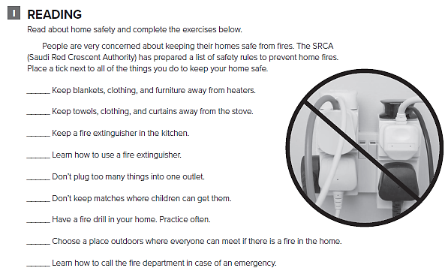
حدد أدوات الأمن والسلامة الموجودة في منزلك

Slide 12
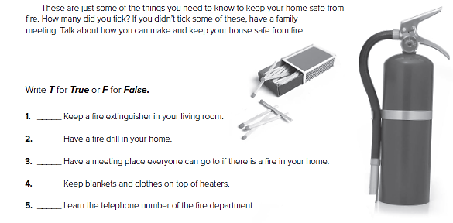
F
T
T
F
T

Slide 13
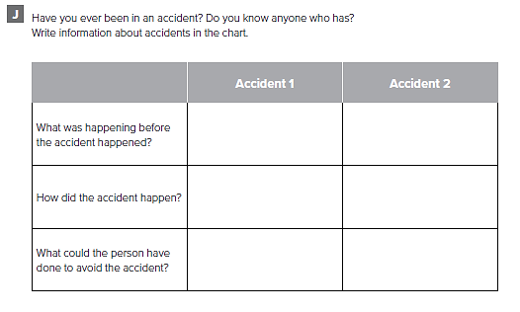
أكمل الجدول عن حادث شاهدته

Slide 14
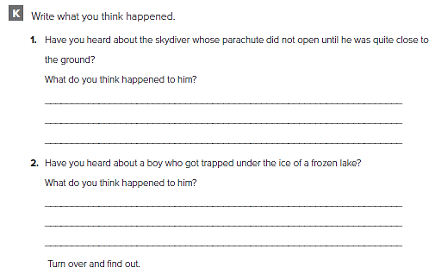
من الممكن أن تختلف الإجابات
I think he probably hurt himself
He probably suffocated

Slide 15
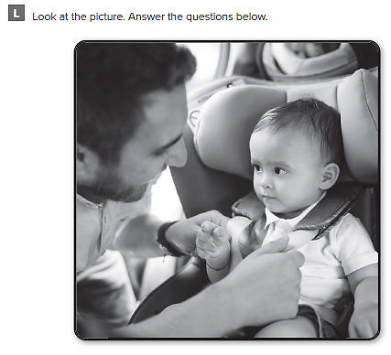

Slide 16
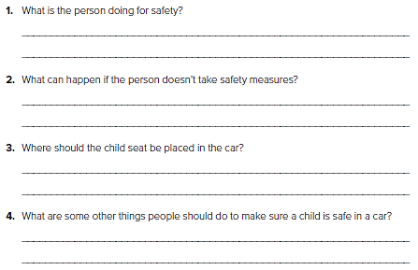
من الممكن أن تختلف الإجابات
He is fastening the baby in the child seat
The baby might get hurt.
It should be placed on the back seat of the car
They should ensure the child locks are activated

Slide 17
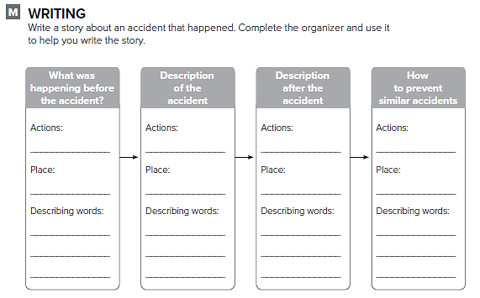
اكتب قصة عن حادث شاهدته

Slide 18
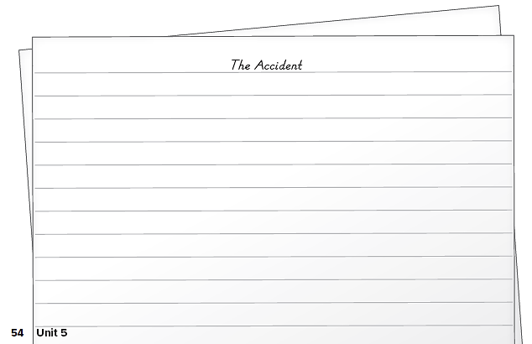
اكتب قصة عن حادث شاهدته

Slide 19
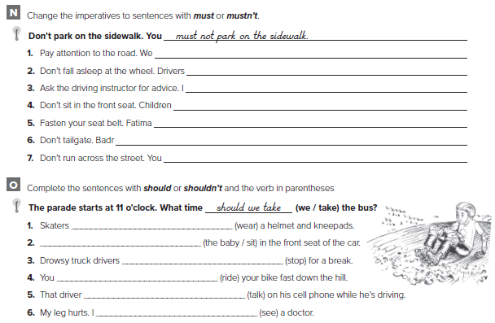
must pay attention to the road
mustn’t fall asleep at the wheel
must ask the driving instructor for advice
mustn’t sit in the front seat
must fasten her seat belt
mustn’t tailgate
mustn’t run across the street
should wear
The baby shouldn’t sit
should stop
shouldn’t ride
shouldn’t talk
should

Slide 20
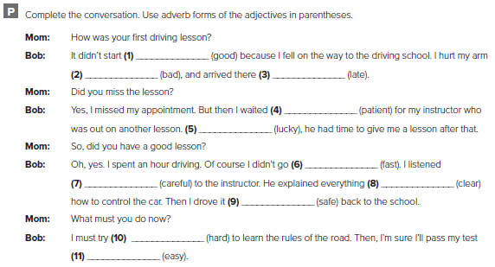
well
badly
late
patiently
luckily
fast
carefully
clearly
safely
hard
easily

Slide 21
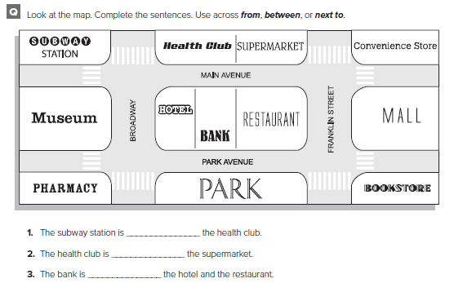
across from
next to
between

Slide 22
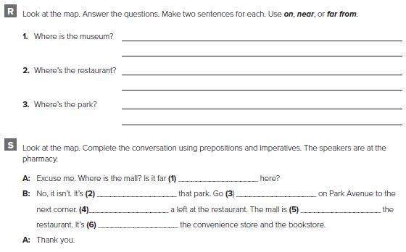
It’s across from the bank hotel.
It’s between the subway station and the pharmacy
It’s between the pharmacy and the bookstore.
It’s across from the bank
far from
near
straight
Take
across from
between

Slide 23
Unit 2

Slide 24
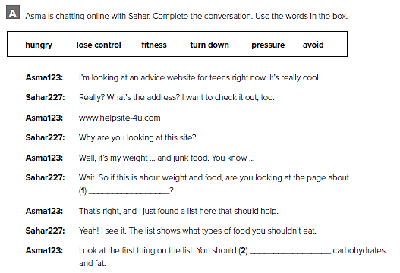
fitness
avoid

Slide 25
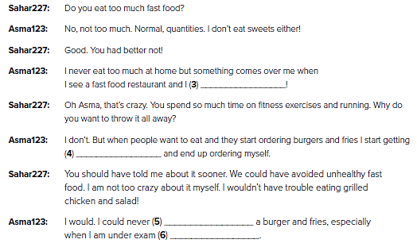
lose control
hungry
turn down
pressure

Slide 26
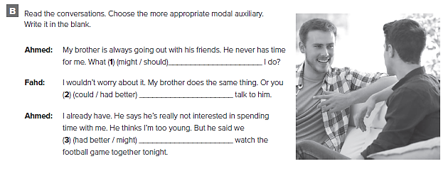
should
could
might

Slide 27
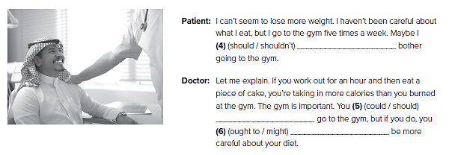
shouldn’t
should
ought to

Slide 28
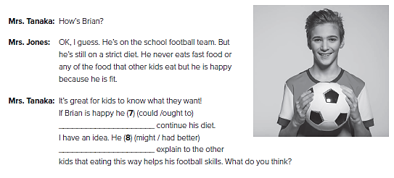
ought to
might

Slide 29
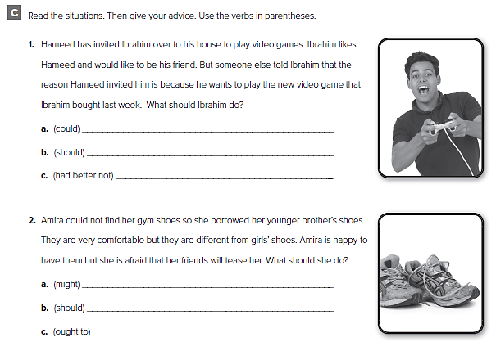
أكمل النصائح باستعمال عباراتك الخاصة

Slide 30
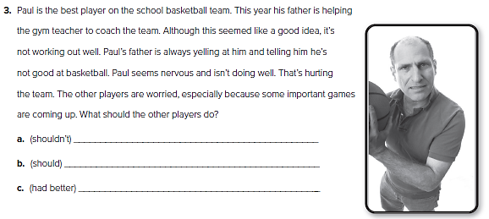
أكمل النصائح باستعمال عباراتك الخاصة

Slide 31
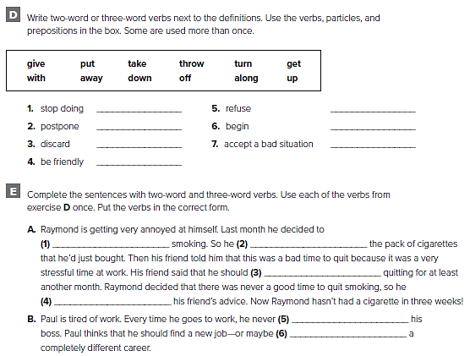
give up
turn down
put off
take up
throw away
put up with
get along
give up
threw away
put off
turned down
gets along with
take up

Slide 32
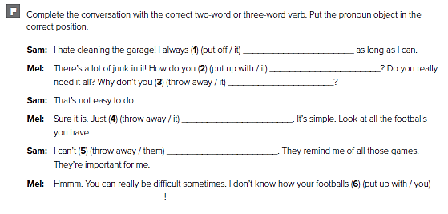
put it off
put up with it
throw it away
throw it away
throw them away
put up with you

Slide 33
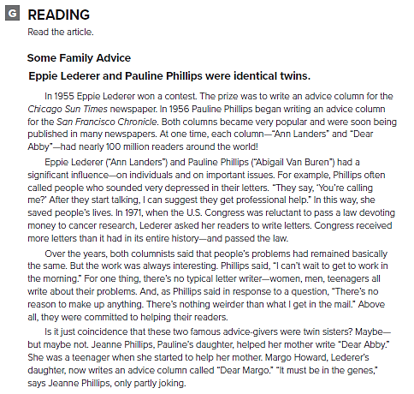

Slide 34
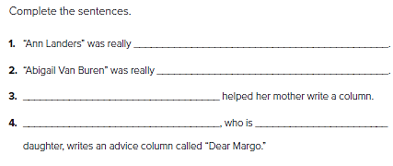
Eppie Lederer
Pauline Phillips
Jeanne Phillips
Margo Howard Eppie Lederer’s

Slide 35
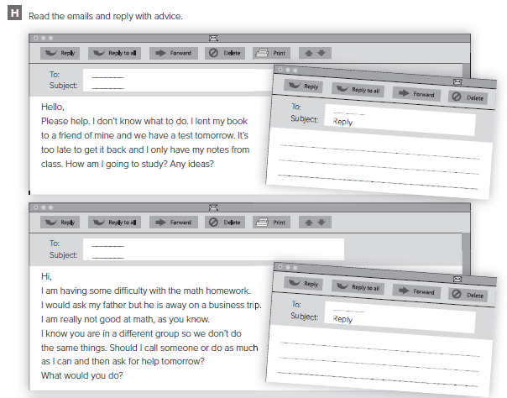
من الممكن أن تختلف الإجابات
Hello,
Please don’t worry. Email your friend and ask him/her to scan the pages you need and send them to you.
Hi,
Why don’t you tell me what you are having difficulty with. And I will call you as soon as I check on it

Slide 36
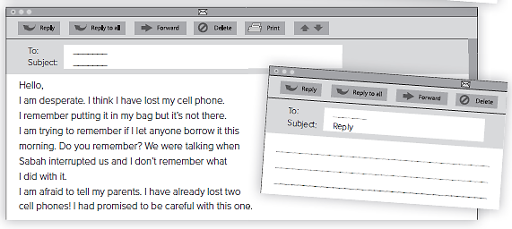
Hello,
No need to be desperate. You left it on the shelf with the science books when Sabah turned up

Slide 37
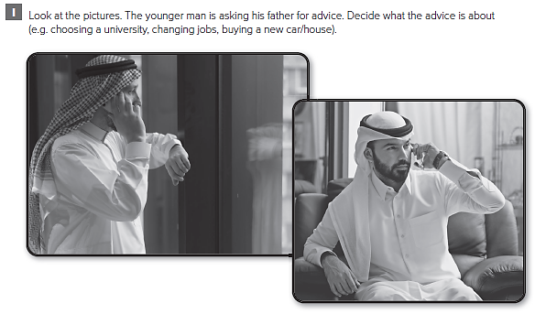

Slide 38
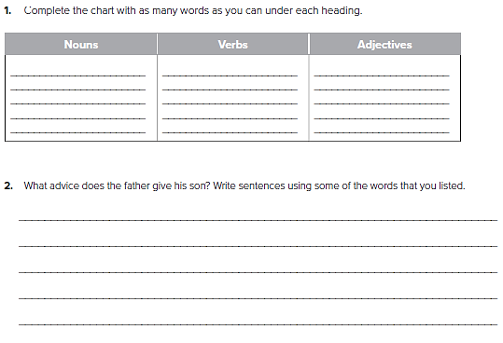
Father
Son
University
Course
Decision
Consider
Think
Change
Make
Choice
Careful
The best
Suitable
Fast
Large
من الممكن أن تختلف الإجابات
You’d better think carefully about what you want to do.
Why don’t you decide according to your skills, background and preferences?

Slide 39
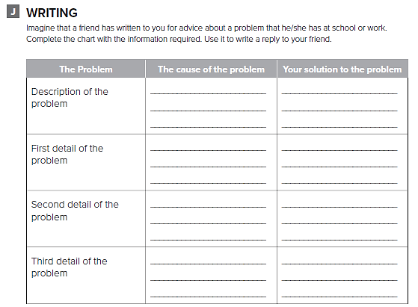
قم بتصور مشكلة لدى صديقك
ثم قم بكتابة بعض النصائح له

Slide 40
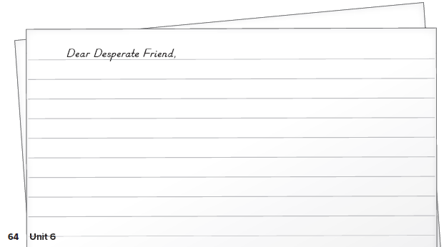
قم بكتابة بعض النصائح لصديقك

Slide 41
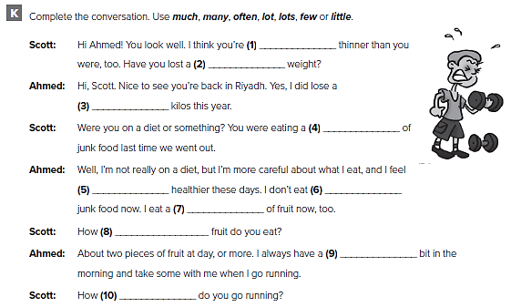
much
little
few
lot
much
much
lot
much
little
often

Slide 42
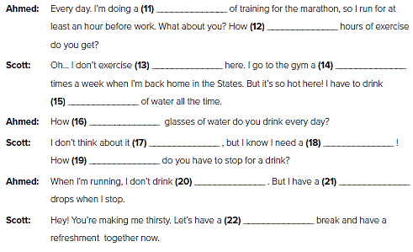
lot
many
much
often
lot
many
often
lot
often
much
few
little

Slide 43
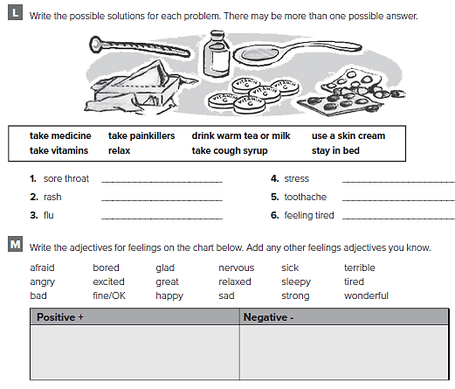
Take cough syrup
Drink some tea
Use a skin cream
Take painkillers
Stay in bed
Relax
excited, fine/OK, glad, great, happy, relaxed, strong, wonderful
afraid, angry, bad, bored, nervous, sad, sick, sleepy, terrible, tired

Slide 44
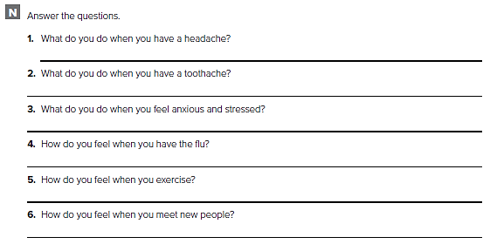
كل طالب/ة يجيب عن نفسه

Slide 45
Unit 3

Slide 46
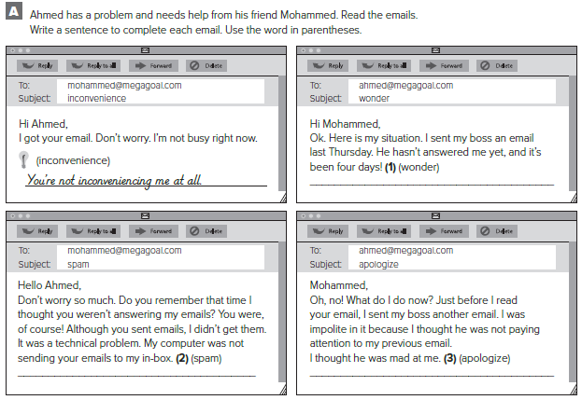
I wonder if he is mad at me.
It thought they were spam!
I need to call him and apologize for my last email.

Slide 47
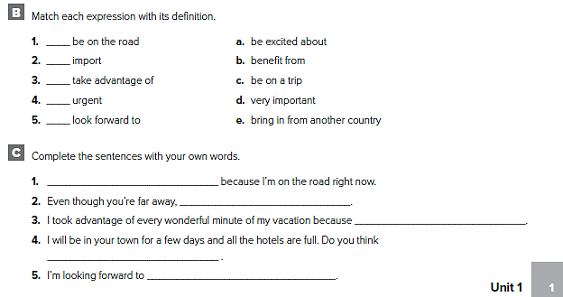
c
e
b
d
a
I don’t have access to my email
I think about you all the time
I really needed to relax
you could put me up?
my vacation in New York City

Slide 48
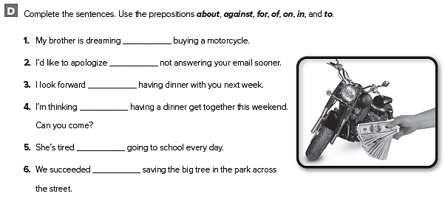
of
for
to
of
of
in

Slide 49
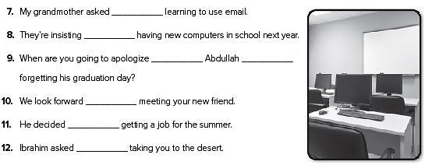
about
on
to
for
to
against
about

Slide 50
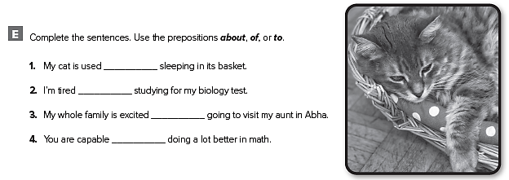
to
of
about
of

Slide 51
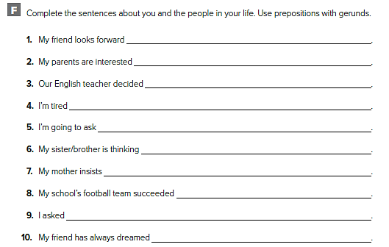
to sleeping late on the weekend
in starting our vacation early
against giving a test tomorrow
of going to the gym every day
about going to the dinner on Saturday
of getting a new computer
on cooking dinner for us
in winning the championship this year
about driving my brother’s car to school
of riding his bike across the country

Slide 52
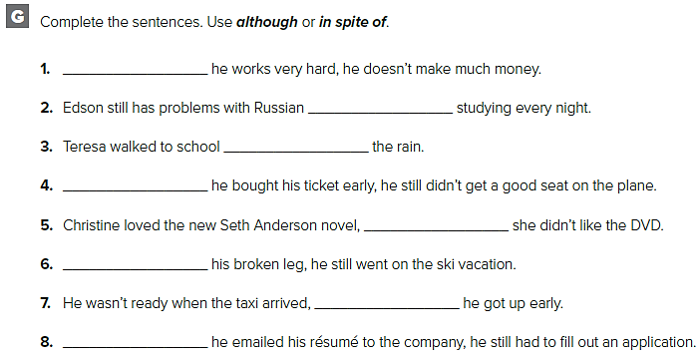
Although
in spite of
in spite of
Although
although
in spite of
although
Although

Slide 53
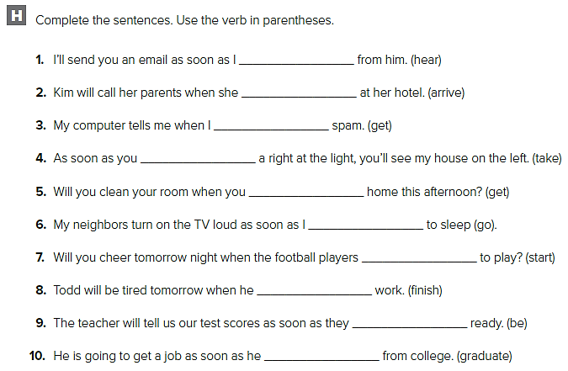
hear
arrives
get
take
get
go
start
finishes
are
graduates

Slide 54
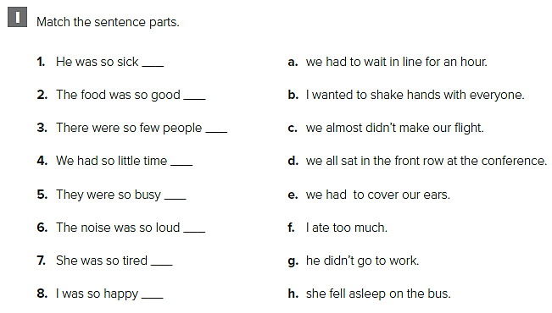
g
f
d
c
a
e
h
b

Slide 55


Slide 56

F
T
F
F
T
T

Slide 57

قد تختلف الإجابات
My favorite form of communication is emailing because it is reliable and fast.
Yes, I do. I have to communicate fast for professional reasons.
I write letters once or twice a month to people who don’t have email.
I usually call family members or arrange to see them.
I call, text message, email or communicate Face-to-face

Slide 58

قد تختلف الإجابات
I would call and if he didn’t answer I would text him.
He could text message or email.
I would send a telegram
I would prefer to talk to him Face-to-face

Slide 59

قد تختلف الإجابات
monitor
Watch
Call
Notify
Warn
Alert
Protect

Slide 60

Weather changes are monitored closely so that damage by storms can be prevented
The controller watches the screen very carefully so that accidents can be avoided
Large screens are used so that conditions can be shown clearly over a broad area

Slide 61

أكمل الجدول حول الأشخاص الذين تتواصل معهم

Slide 62


Slide 63


Slide 64

used to send
used to have
didn’t use to have
used to use
used to carry
used to write

Slide 65

Did Fahd use to check his email all the time?
Did people use to leave messages on telephone answering machines?
Did students use to write on paper/in books/on tablets?
Did you use to go to bed early?

Slide 66

There are
There is
There is
There is
There is
There are
There is
There is

Slide 67

The
_
the
_
_
_
the
the
a

Slide 68
Unit 4

Slide 69

leader
technology
empire
prize
desert island

Slide 70

قد تختلف الإجابات
Scientists use technology like satellites to study the universe
He wishes that he was on a desert island. He wouldn’t be lonely there
The man participated in a game show on television, and he won a very large prize
King Abdul Aziz Al Saud was a historical leader. He was responsible for the unification of Saudi Arabia

Slide 71

weren’t
would be
asked
wouldn’t answer
didn’t have
would help
would believe
didn’t say

Slide 72

If I had the cash right now, I would buy a cell phone.
If Larry wanted a summer job, he would apply for the job at the library.
If Ahmed didn’t have an English test next Sunday, they’d go on vacation with us.
If my shirt had holes in it, I’d buy a new one.
If I liked baseball, I’d go to the game with you.

Slide 73

If I could be the leader of my country, I’d work to improve the environment.
If I won a large cash prize on TV, I could travel to every country in the world.
If I lived on a desert island, I could surf and swim all the time.
If I met an extraterrestrial, I might ask about life on other planets.
If I had more time, I could watch more TV.
If I worked for a charity, I might build houses for homeless people.
If I found 5,000 riyals on the street, I might try to find who lost it.
If I lived in a foreign country, I could teach English.

Slide 74

Tommy wishes that he didn’t have to pay the municipal fees on his house.
Charles wishes that he was good enough to play professional basketball.
Kevin wishes that his friend would listen to him.
David wishes that he didn’t have to do homework every night.
Joanna wishes that she could see her parents this year.
Maria wishes that there wasn’t so much traffic in the city.

Slide 75

قد تختلف الإجابات
the traffic wasn’t so bad
it wasn’t so noisy at the restaurant
he didn’t have a lot of homework
he was 18

Slide 76

قد تختلف الإجابات
her computer wasn’t so slow
it wasn’t so hot today
there was something good on TV tonight
she didn’t have a fever

Slide 77


Slide 78


Slide 79

كل طالب يجيب عن قصته

Slide 80

If she didn’t have a toothache she wouldn’t need to see the dentist.
Asma wouldn’t do so well at school if she missed classes.
Adel would go to a picnic with his friends if he hadn’t to study over the weekend for his test.
They would go to their house in the country more often if they didn’t need to work so hard.
If there wasn’t such a huge range of models I would know which laptop to choose.

Slide 81


Slide 82

قد تختلف الإجابات
had some time off I’d go on a trip.
had enough money I’d invite my friend to come along.
I had the time and the money to do it.
my friend could accompany me

Slide 83

اكتب قصة عن أمنية تحققت لصاحبها

Slide 84


Slide 85

C
C
C
C
N
N
C
C
N
N

Slide 86

some
any
a
many

Slide 87

shop online
make payments
buy
expensive
spend
money

Slide 88

كل طالب يجيب عن نفسه

Slide 89

Prepared by
Teacher :
Badr Sayid Al-Shehri

