Slide 1
Unit 4 Wishful Thinking Listen and Discuss
Mega Goal 1.2
Done by : Entisar Al-Obaidallah

Slide 2
Lesson Objectives
1
3
2
4
Talk
Ask and Answer
about imaginary situations
Some questions for some wishes
Listen
Make
for specific information
a list of some wishes.

Slide 3

Warm Up
Have you ever wanted to have more money ?Why?

Slide 4
Wish
What is the difference between “Wish” and “ hope”?
Hope
Wish often refers to something that is Not expected to happen
Example :
I wish I had a better job.
Hope indicates that the event might happen.
Example :
I hope I get the job I applied for last week.

Slide 5
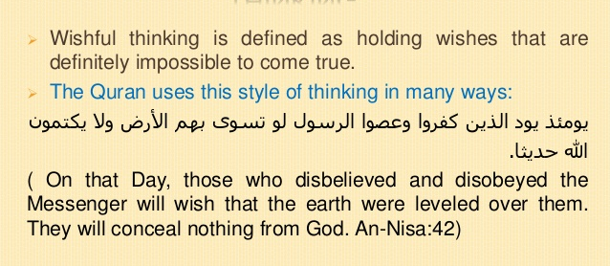
What is the meaning of “Wishful Thinking” ?

Slide 6
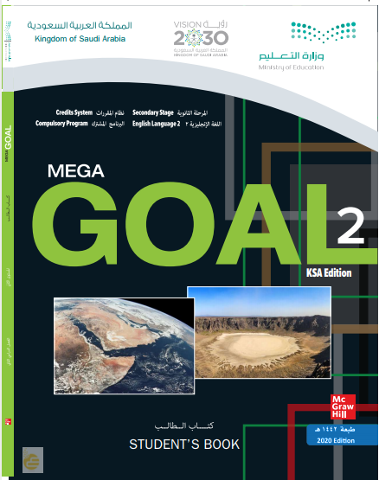
Open
Student’s book ,
pages (46 - 47)

Slide 7

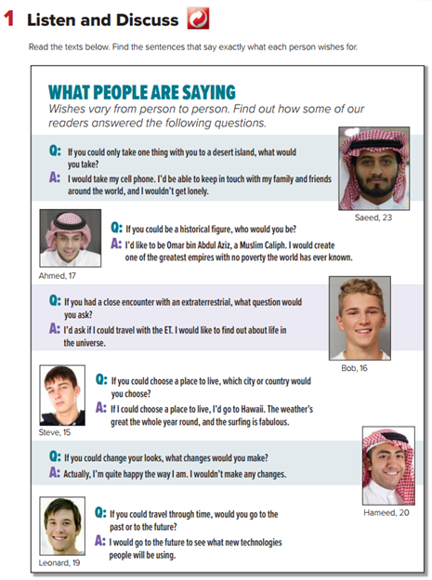
Listen and Discuss
How many persons are there ?
Do all responses seem to be reasonable?

Slide 8
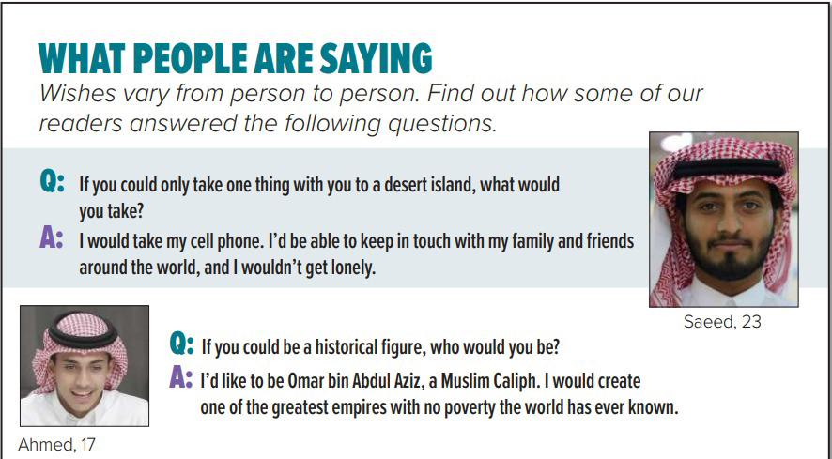
How old is Saeed?
He is 23
What would he take with him to a desert island?
A cell phone
Why did he choose to take his cell phone?
To keep in touch with his family and friends , and he wouldn’t get early

Slide 9
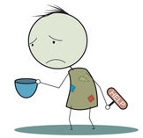
How old is Ahmed?
He is 17
Who would he be if he could be a historical figure?
Omar bin Abdul Aziz
Why did he choose to be Omar bin Abdul Aziz?
No poverty= no poor
To create one of the greatest empires with no poverty

Slide 10
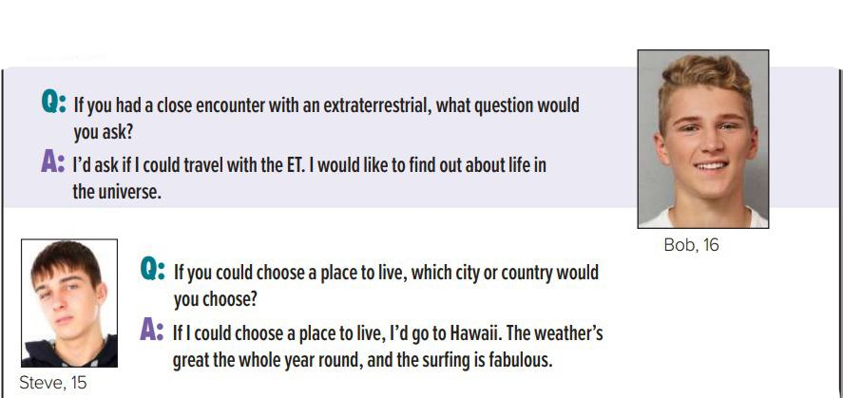
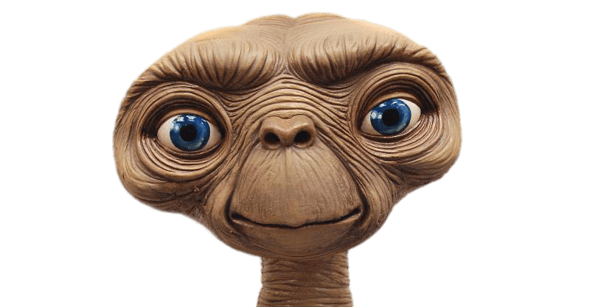
How old is Bob?
He is 16
What question would he ask if he had a close encounter with an extraterrestrial?
If he could travel with the ET
ET = An extraterrestrial
Why would he like to travel with the ET ?
To find out about life in the universe

Slide 11
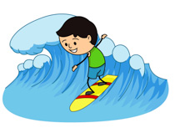
How old is Steve?
He is 15
Which city or country would he choose if he could choose a place?
he’d go to Hawaii
Why would he like to go to Hawaii ?
surfing
The weather is great the whole year round and the surfing is fabulous

Slide 12
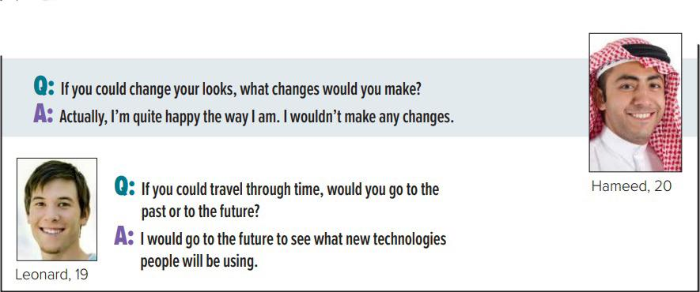
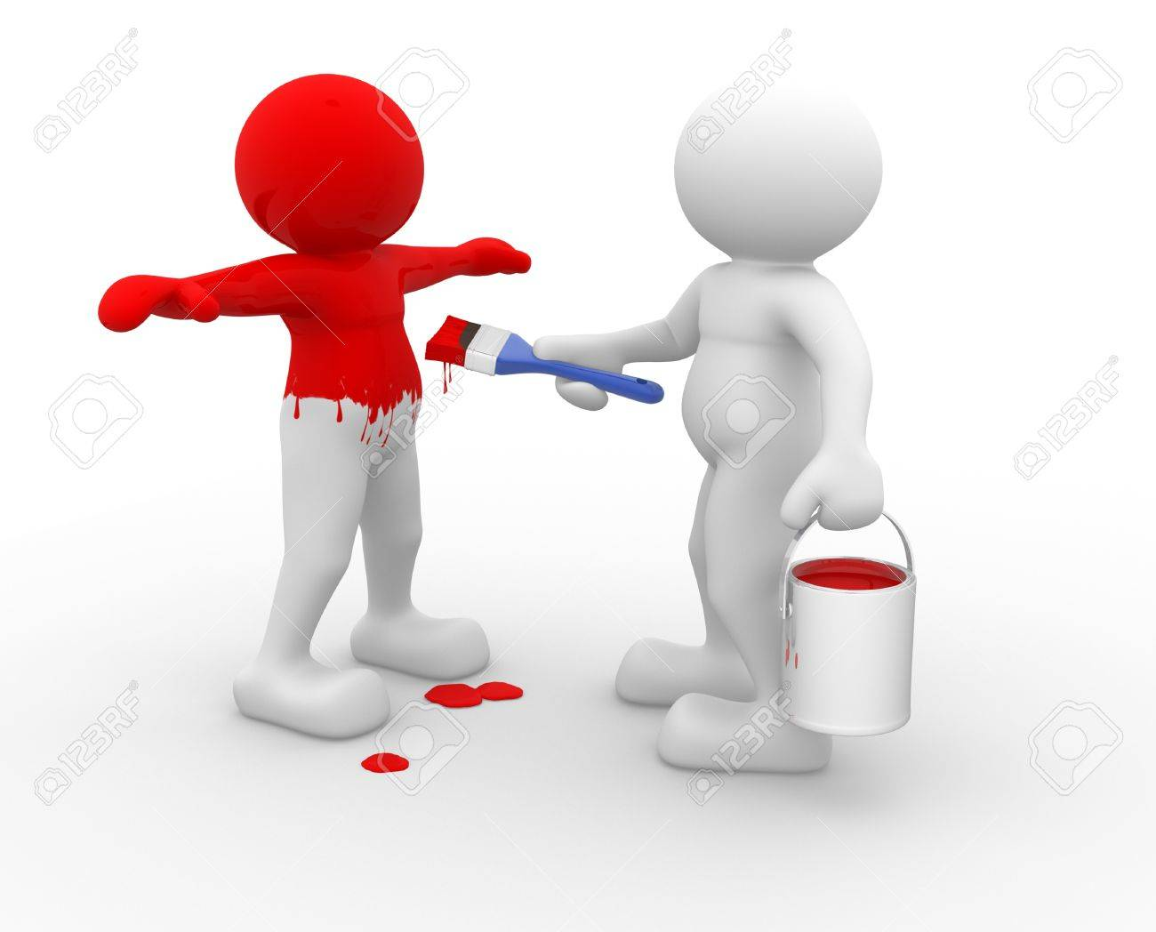
How old is Hameed?
He is 20
What changes would he make if he could change his look?
Nothing . He wouldn’t make any changes
Change your look

Slide 13

How old is Leonard?
He is 19
Would he like to go to the past or future?
To the future
Why did he choose the future?
Travel through Time
To see what new technologies people will be using

Slide 14
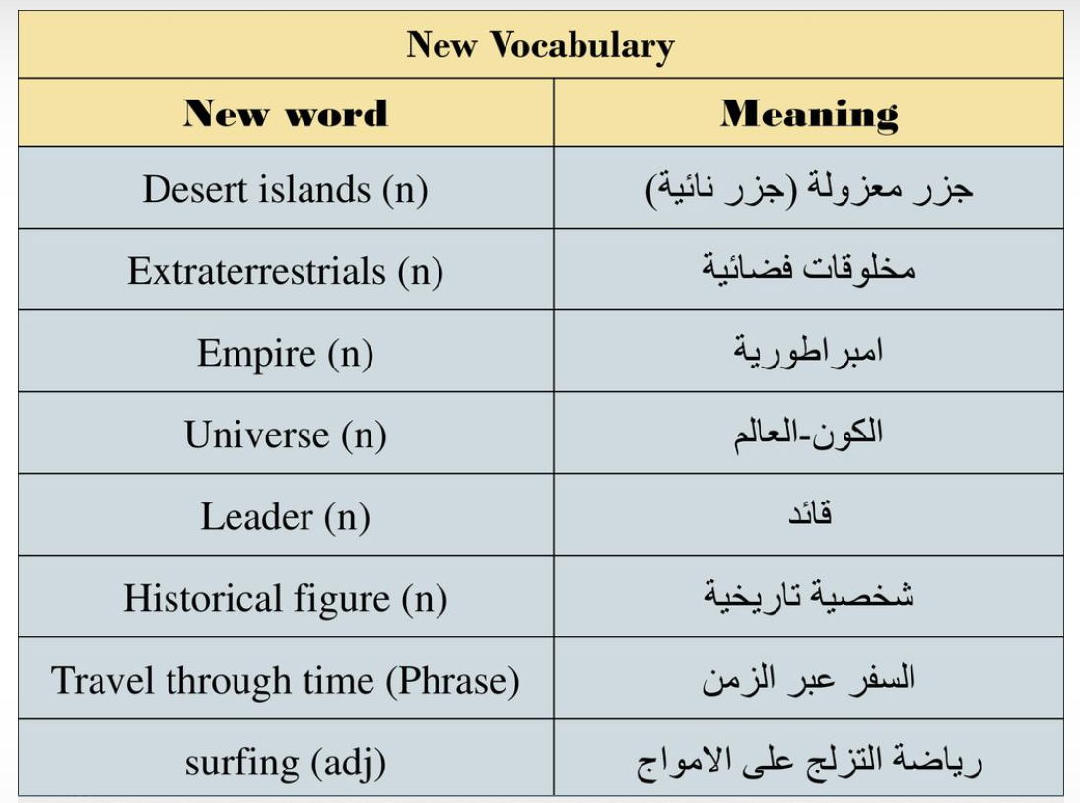
New Vocabulary

Slide 15
Open
Student’s book ,
pages (47)

Slide 16
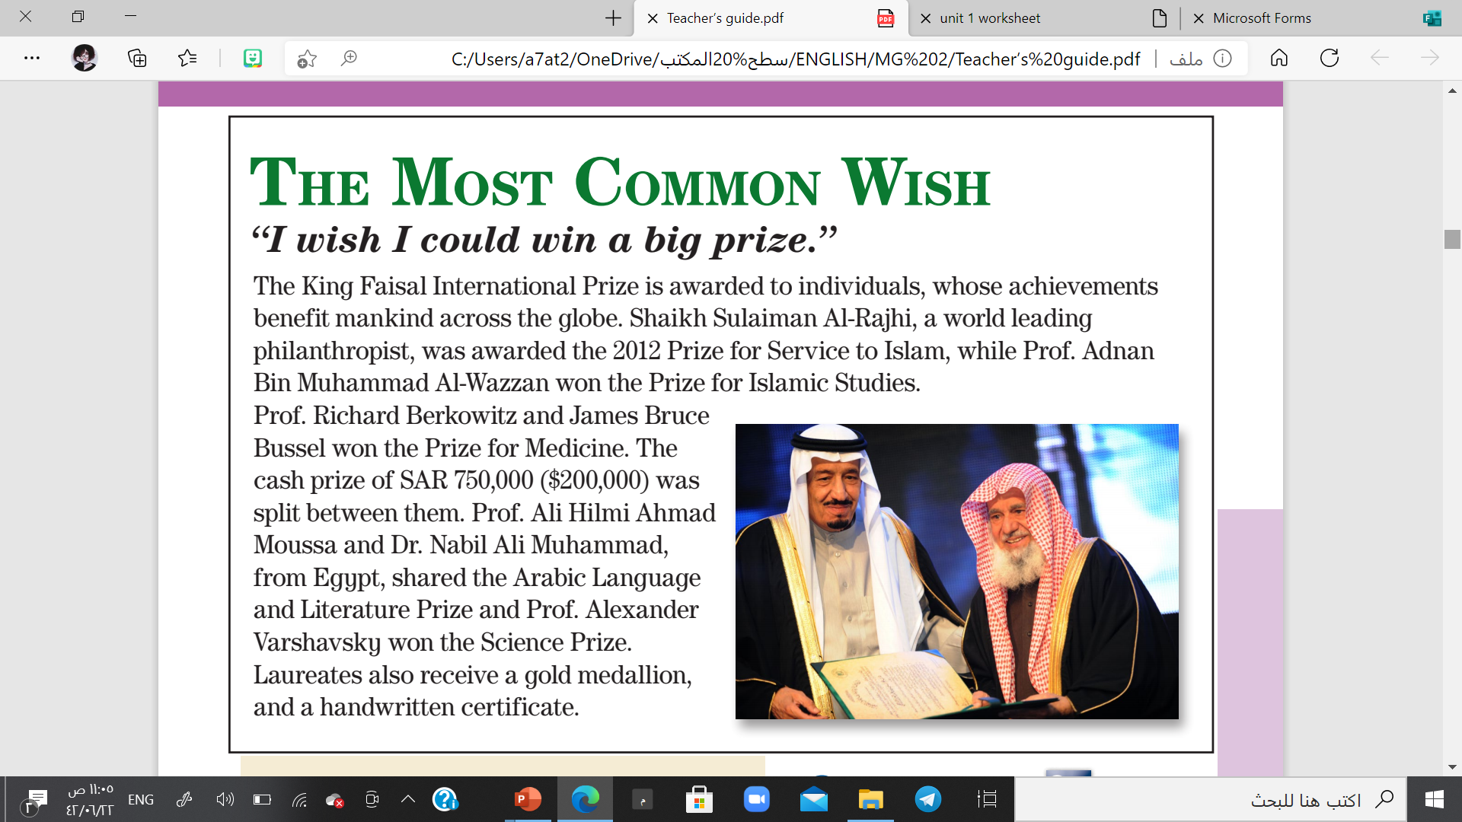
Which prize did Shaikh Sulaiman Al-Rajhi win?
The 2012 Prize for Service to Islam
Who won the Arabic Language and Literature Prize?
Prof. Ali Hilmi Ahmad Moussa and Dr. Nabil Ali Muhammad
Which prize did Prof. Alexander Varshavsky win?
The Science Prize)
What kind of achievements are required for one to qualify?
achievements that benefit mankind across the globe

Slide 17
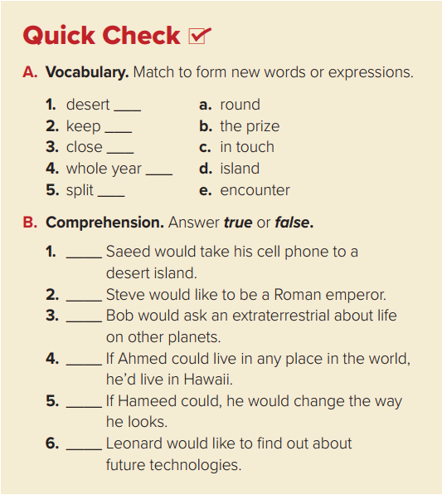
d
c
e
a
b

Slide 18
True
False
True
True
False
True

Slide 19
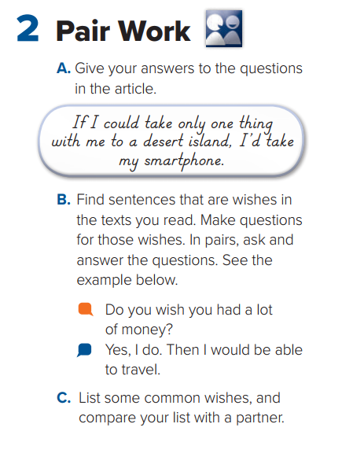

Slide 20

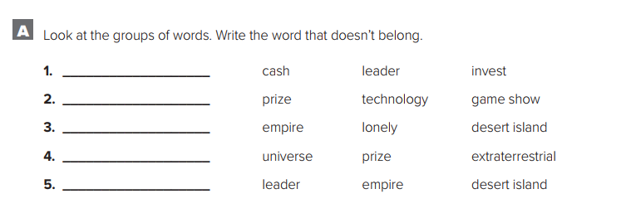
Home work
p.11- Exercise A
leader
technology
empire
prize
desert island

Slide 21

THANKS

