Slide 1
Unit 3 You’ve Got Mail Writing
Mega Goal 1.2
Done by : Entisar Al-Obaidallah

Slide 2
Lesson Objectives
01
03
05
Analyze email format and details
Read the email for specific information .
Write an email to a friend correctly .
02
04
Answer some questions about the email .
Complete the chart using their notes

Slide 3

Open your student's book p.40

Slide 4
Jonathan Maynard , Import Manager
Melanie
Mr. Silva
Olivia
Dear Mr. Silva
Hi Olivia
I want to apologize for not answering
your email sooner.
How’s work, and how’s Paris?
pending visit/ stay with friend/
weather in Paris
new suppliers/ new business
Best regards.
I’m really looking forward to
seeing you again.
J. Maynard
Melanie
To reply to a business proposition
To inform and ask for information

Slide 5
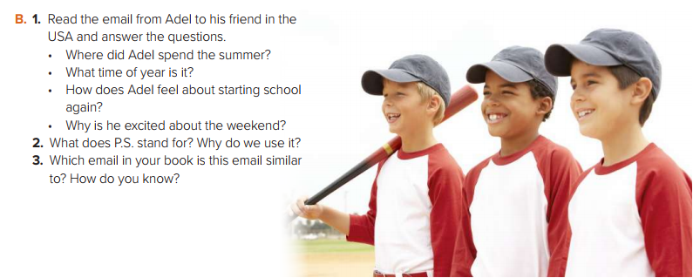
Look at exercise ( B)

Slide 6
Open your student's book p.41

Slide 7
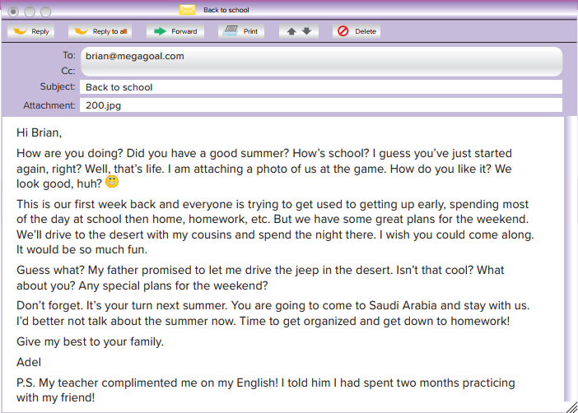

Read & Listen

Slide 8
Read the email from Adel to his friend in the USA and answer the questions
1.
2.
3.
4.
Adel spent the summer in the USA.
It’s early Summer.
He doesn’t feel very happy because he has to get up early, spend the whole day at school and do homework.
Because his father has promised to let him drive the jeep in the desert
2- PS stands for: postscript. Postscript is writing added after the main letter.
3- This email is similar to the email on page 7, from Melanie to Olivia
The greeting is: Hi Brian Opening line: How are you doing? |Did you have a good summer? The content has to do with what the two friends share and what is special in their lives. Closing: Give my best to your family
Signed: Adel (first name)

Slide 9
Which email is similar to? How do you know?
Greeting
Opening line
content
Closing
Signed

Slide 10
How to write an email to a friend

Slide 11
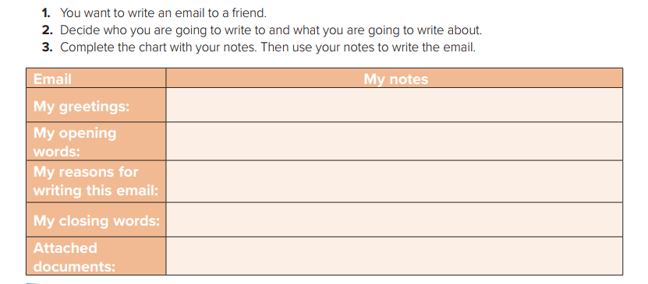
Writing
Email | My Notes
My greetings
My opinion words
My reasons for writng this email
My closing words
Attached documents
Hi Sara
How are you doing ?
I’m writing to remind you of my brother’s wedding party next week .
looking forward to seeing you .. Regards
Electronic invitation card

Slide 12
Example :
Write your own Email to a friend . Use the words in the chart.
Hi Sara
How are you doing ? I miss you too much and wish to see you .
I’m writing to remind you of my brother’s wedding party next week
In this delightful day , we invite you to come and be a part of our happiness . We are waiting for your arrival .
I’m looking forward to seeing you ..
Regards
Nada

Slide 13
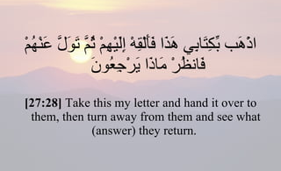
Remember

Slide 14
Homework
Workbook P. ( 104 ) , Exercise (N)

Slide 15

Thanks!

