Slide 1

Mega Goal 1.2
U: 3
You’ve Got Mail
Writing
By: Yousef Hilal Alyazedi

Slide 2
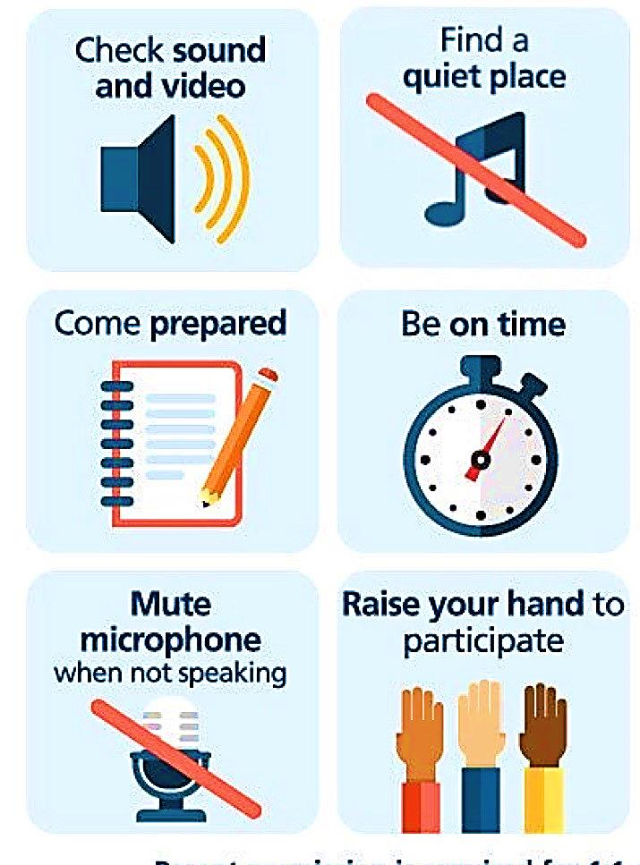
Online Classroom Rules

Slide 3
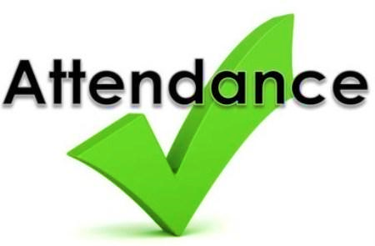
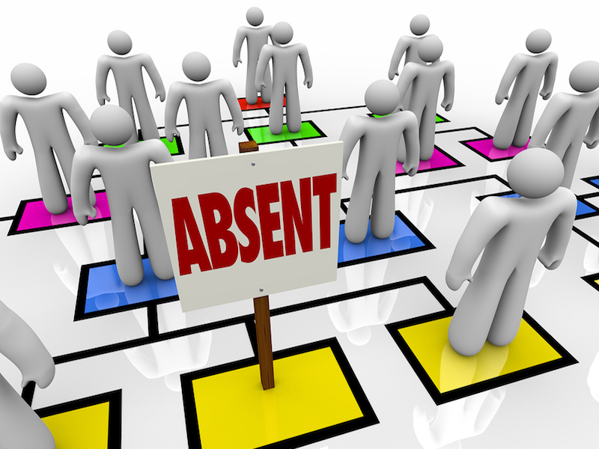

Slide 4
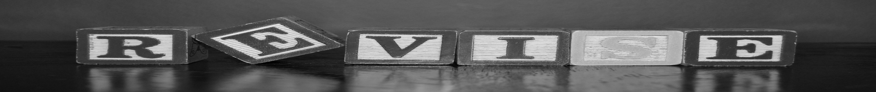
Revising the previous lessons
Tomlinson
1971
Central Africa
Ancient Greeks
1 – A kind of drum was used in today .
Central Africa
2 – The first email message was in .
1971
3 – invent the ( @ ) sign .
Tomlinson
4 – The established lines of signal towers on mountaintops .
Ancient Greeks

Slide 5


Lesson Objectives
analyze email format and details .
find information about an email .
write a correct email .
list correct greetings for an email .
write a correct sign for an email .
use formal and informal style to address a letter

Slide 6
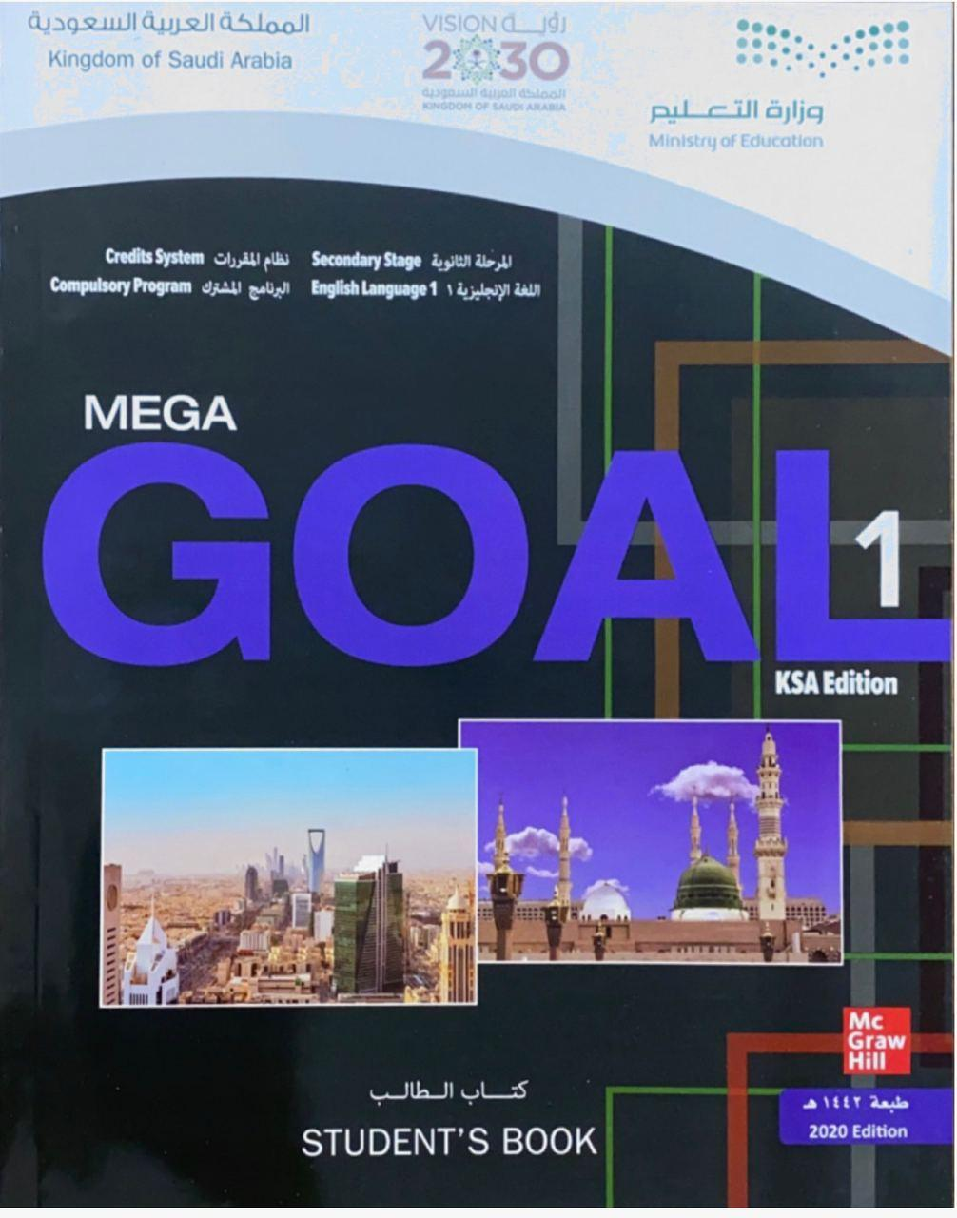

Open your Student’s book at page: 40

Slide 7
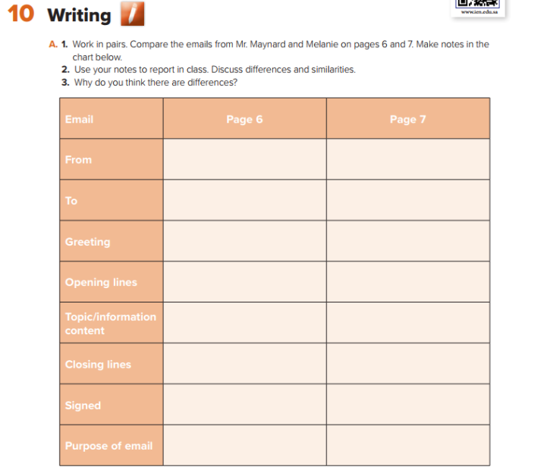
Jonathan Maynard
Melanie
Mr. Silva
Olivia
Dear Mr. Silva
Hi Olivia ,
want to apologize for not
answering your email sooner
How’s work , and how’s Paris?
new suppliers
Stay with friend/weather
Best Regards
I’m really looking……
J . Maynard
Melanie
To reply to a business proposition
To inform and ask for information

Slide 8
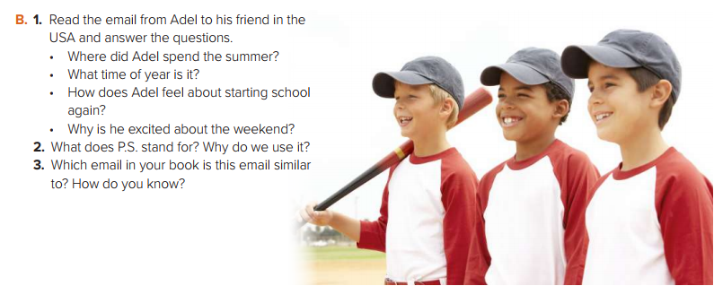

Slide 9
Open your Student’s book at page: 41

Slide 10
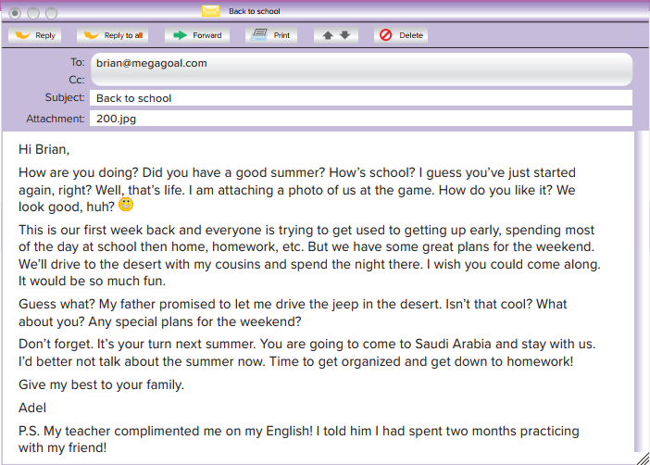


Read and Listen

Slide 11
Adel spent summer in the USA .
It’s really autumn .
He doesn’t feel very happy because he has to get up early , spend the whole day at school and do homework .
Because his father has promised to let him drive the jeep in the desert .
2- PS stands for : postscript . It is writing added after the main letter .
3- This email is similar to the email on page 7 , from Melanie to Olivia .

Slide 12
Greeting
Closing
signed

Slide 13
How to write an email to a friend
Greeting
opening words / lines
Reasons for writing the email
closing words/lines
signed

Slide 14
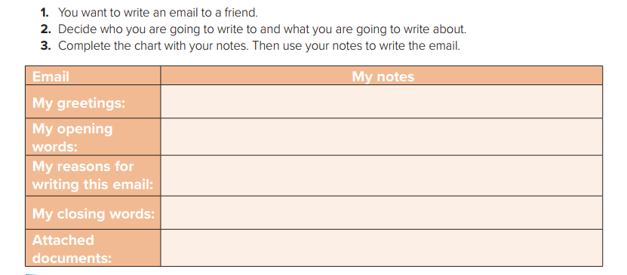
Hi Mohamad,
How are you ? I miss you .
I’m writing to remind you of my graduation party next week .
See you soon
Yousef
Invitation card

Slide 15
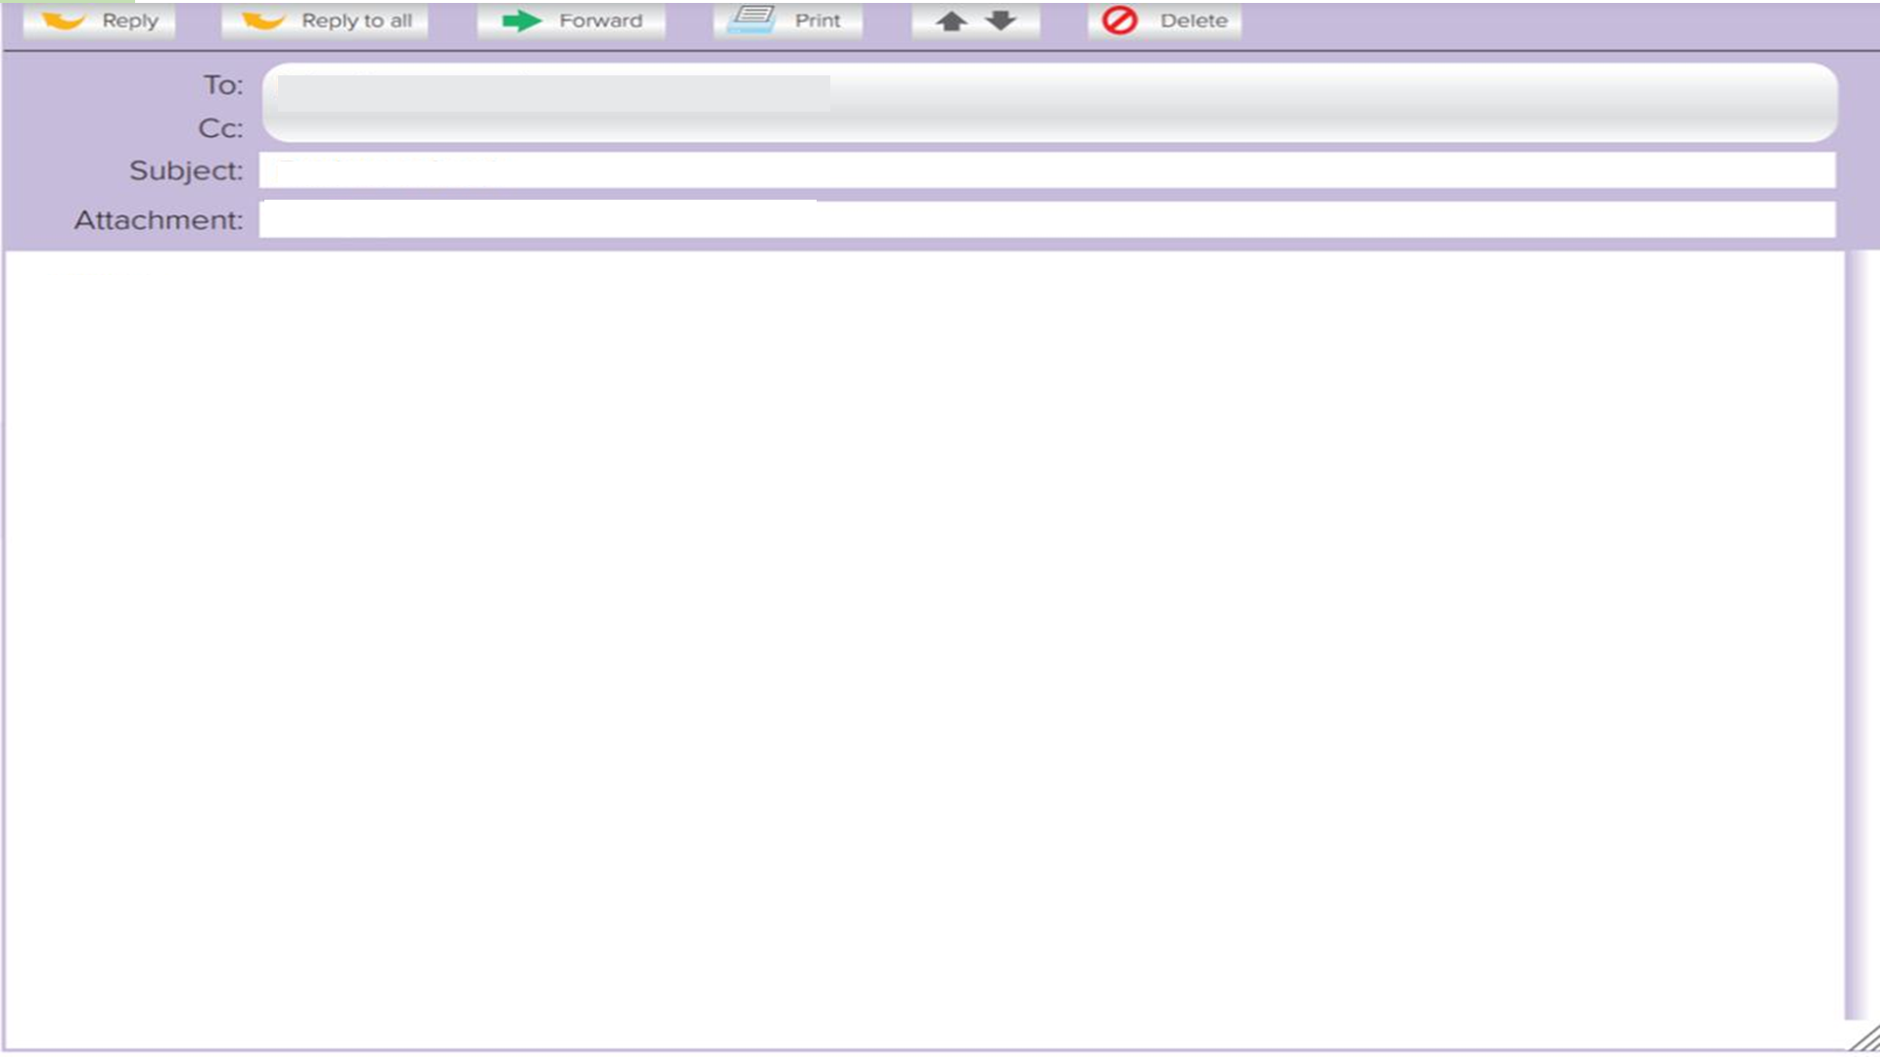
Hi Mohamad,
How’re you? I miss you .
I’m writing to remind you of my graduation
party next week .
We’re waiting your coming .
It will be lots of fun !
There will be lots of people there .
I’m sure you’ll enjoy there .
See you soon
Yousef

Slide 16
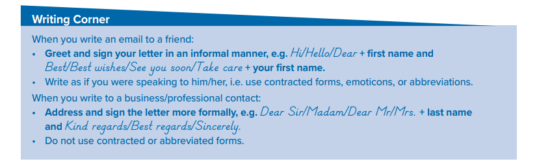

Slide 17

Quick Check
https://wordwall.net/play/9948/841/982

Slide 18

Workbook P. 1.3
Exercise M

Slide 19
