Slide 1
Unit 2
Take My Advice
Mega Goal 1.2
Reading
By : Entisar Al-Obaidallah

Slide 2
Lesson Objectives
List junk food attractive ingredients.
List factors that lead to addiction to junk food.
Find signs of junk food addiction .
Answer some questions .
Discuss reasons to change eating habits.
Discuss ways to stick to decision

Slide 3
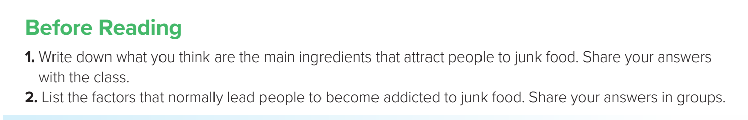
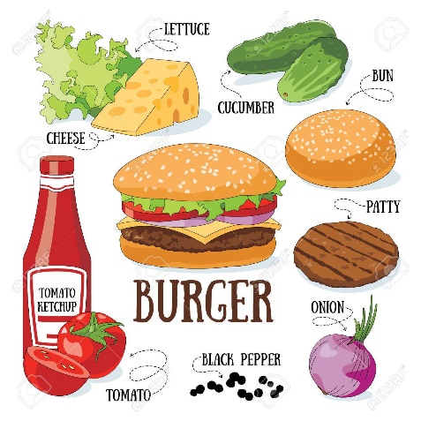
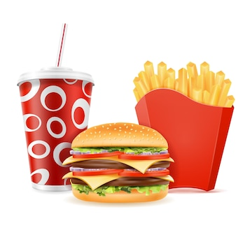
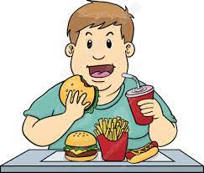
Warm up

Slide 4

Book Open
Page ( 24 )

Slide 5
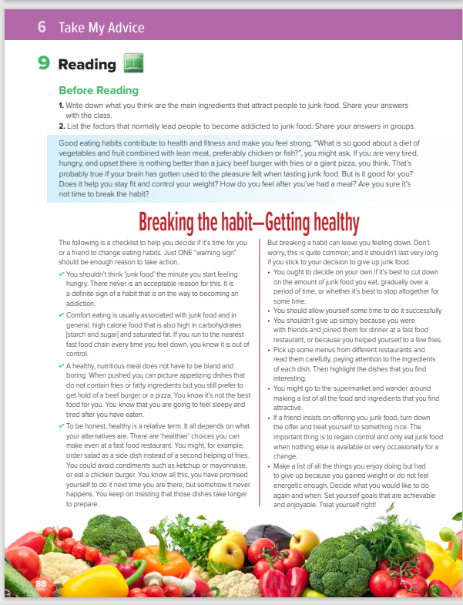
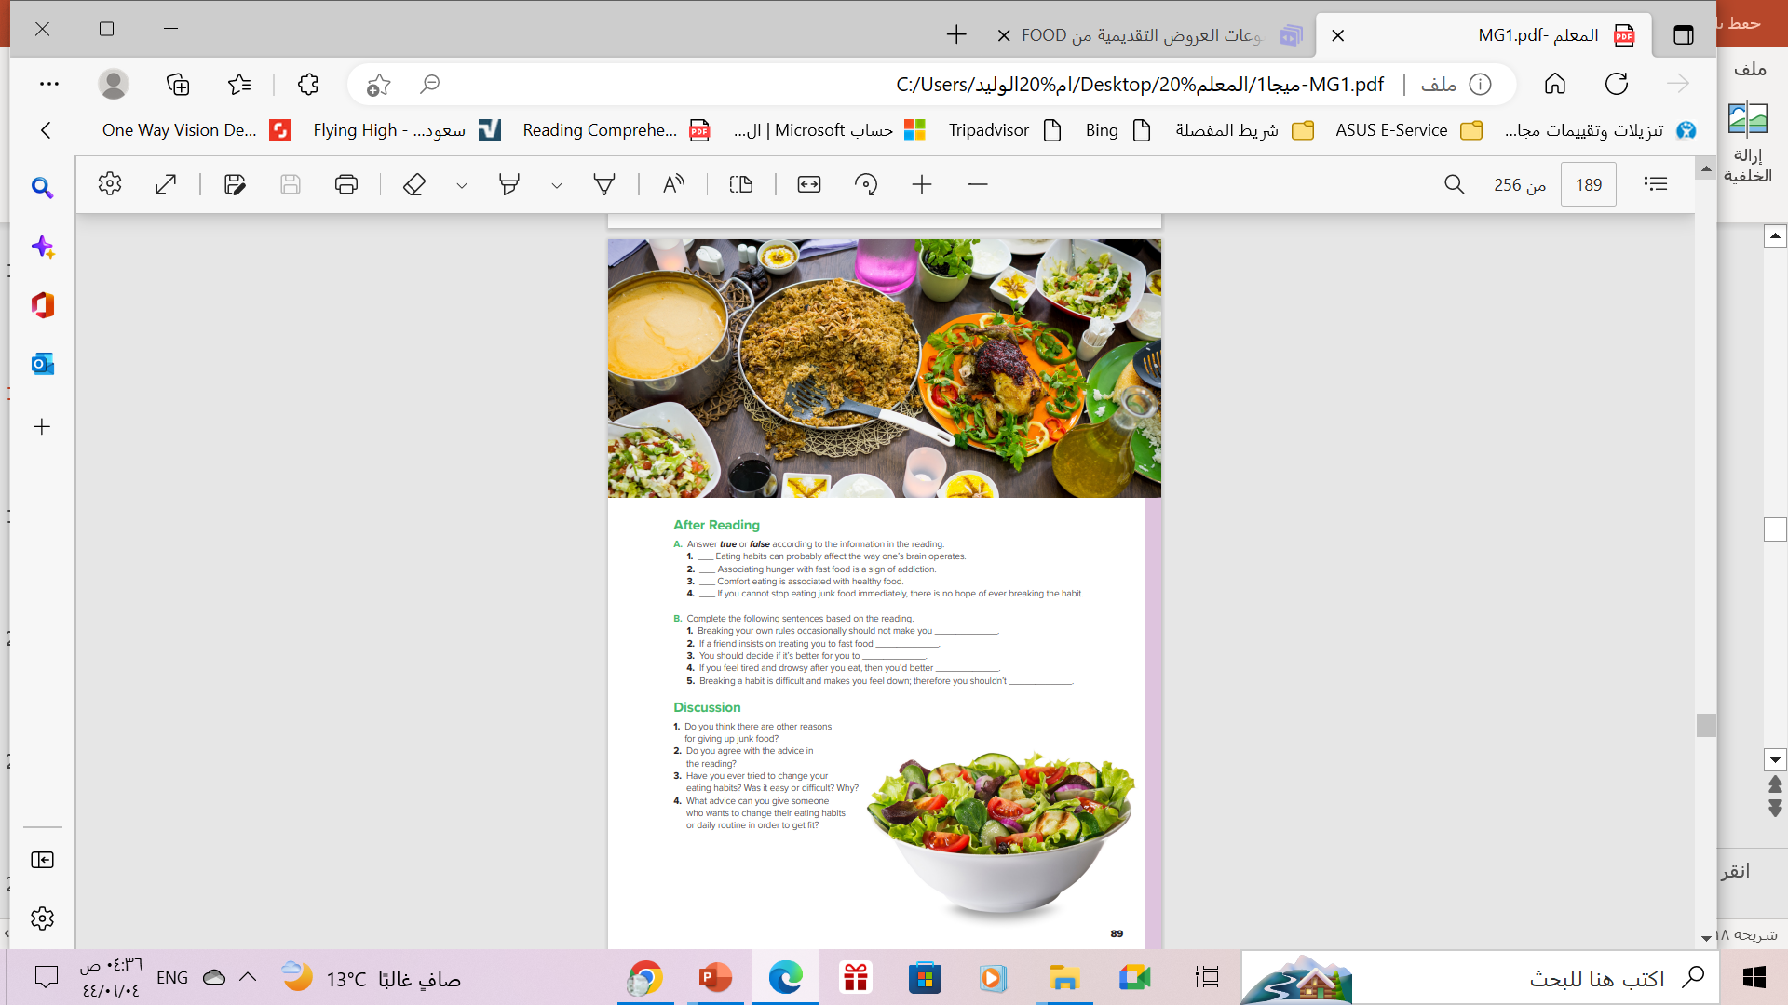


1
2
What’s the title?
How many sections are there ?
What does the pictures show?
3
Breaking the habit—Getting healthy
Three sections
Vegetables & fruits , salad, soup and rice .

Slide 6

What does the title mean?
stop eating junk food in order to become healthy .

Slide 7

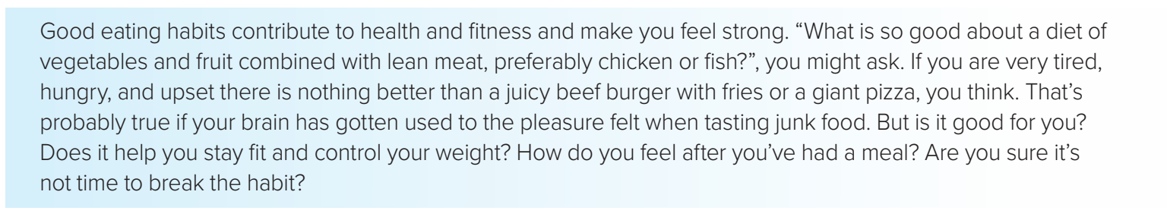
1
What is the main idea of this section?
What is so good about a diet of vegetables and fruit combined with lean meat?
What is so good about a diet of vegetables and fruit combined with lean meat?
Good eating habits
make you feel strong
make you feel strong

Slide 8

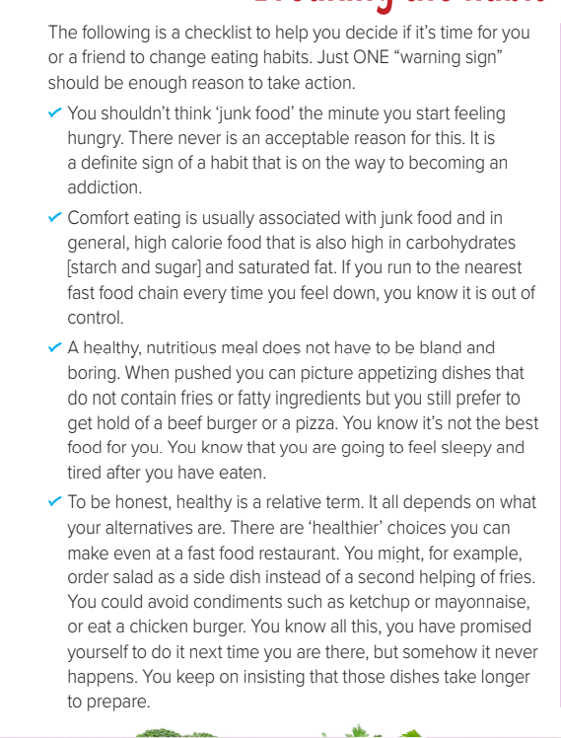
2
What is
this section about?
Is Associating hunger with fast food a sign of addiction ?
Is comfort eating is associated with healthy food?
Give examples of condiments ?
Reasons to change eating habits
Yes . It is a definite sign of a habit that is on the way to becoming an
addiction
No . Comfort eating is usually associated with junk food .
such as ketchup or mayonnaise

Slide 9
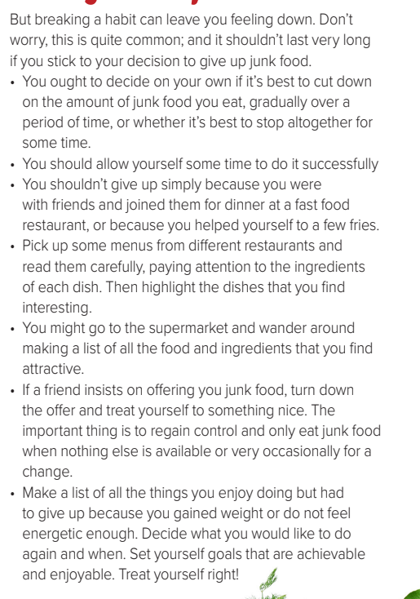
3
turn down = refuse
What is
this section about?
What do you do if a friend insist on offering
You junk food ?
ways to stick to your decision
turn down the offer and treat yourself to something nice

Slide 10


Slide 11

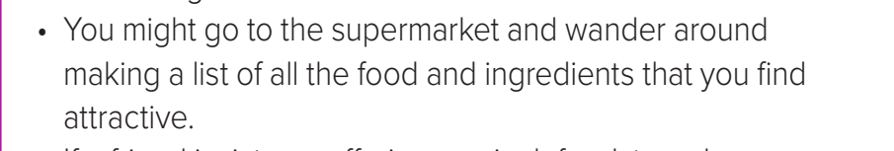
Find a word means …
the things that are used to make a particular food
ingredients

Slide 12
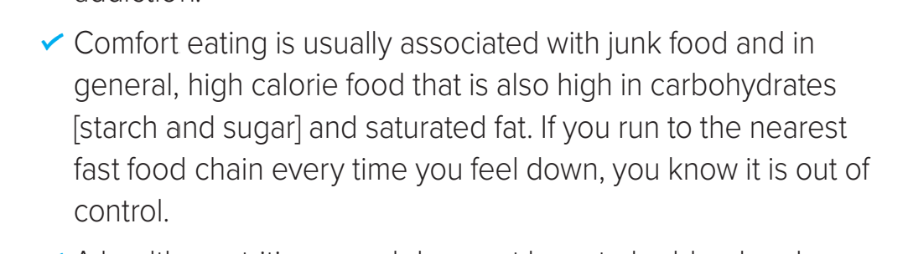
Find a word means …
having unhealthy food often when we feel stressed, bored, or lonely
comfort eating

Slide 13
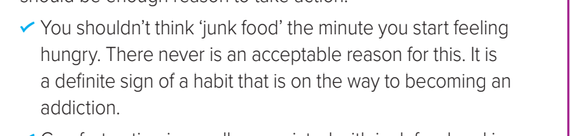
Find a word means …
liking to do something so much you don’t want to stop it
addiction

Slide 14
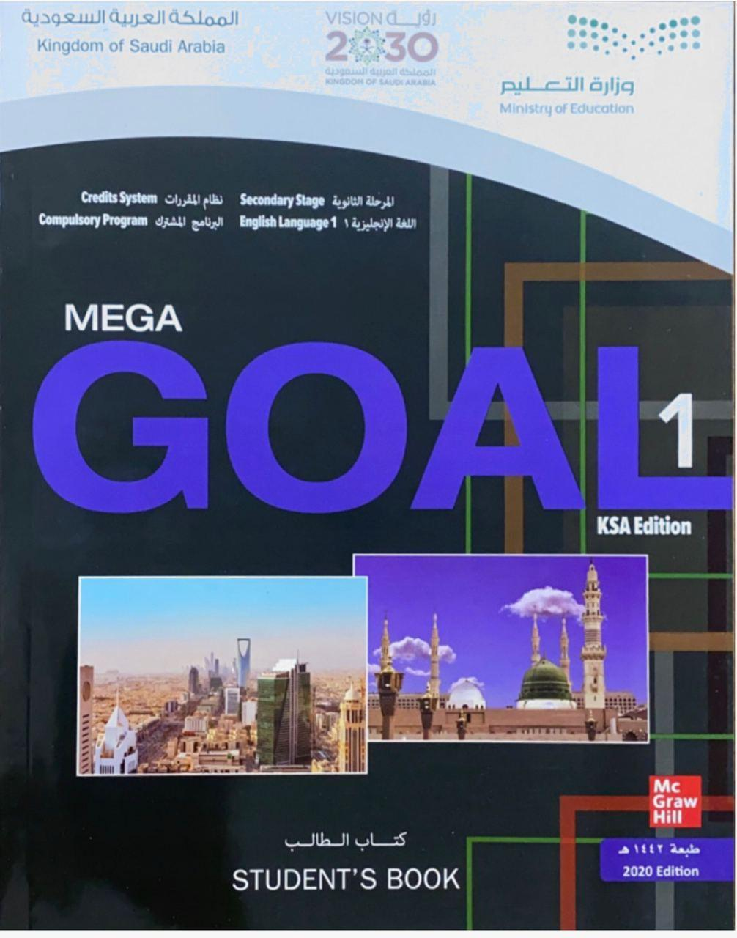
Book Open
Page ( 25 )

Slide 15
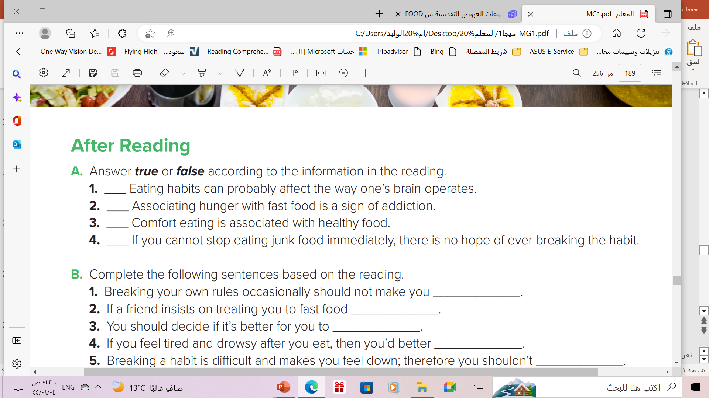
After Reading
T
T
F
F

Slide 16
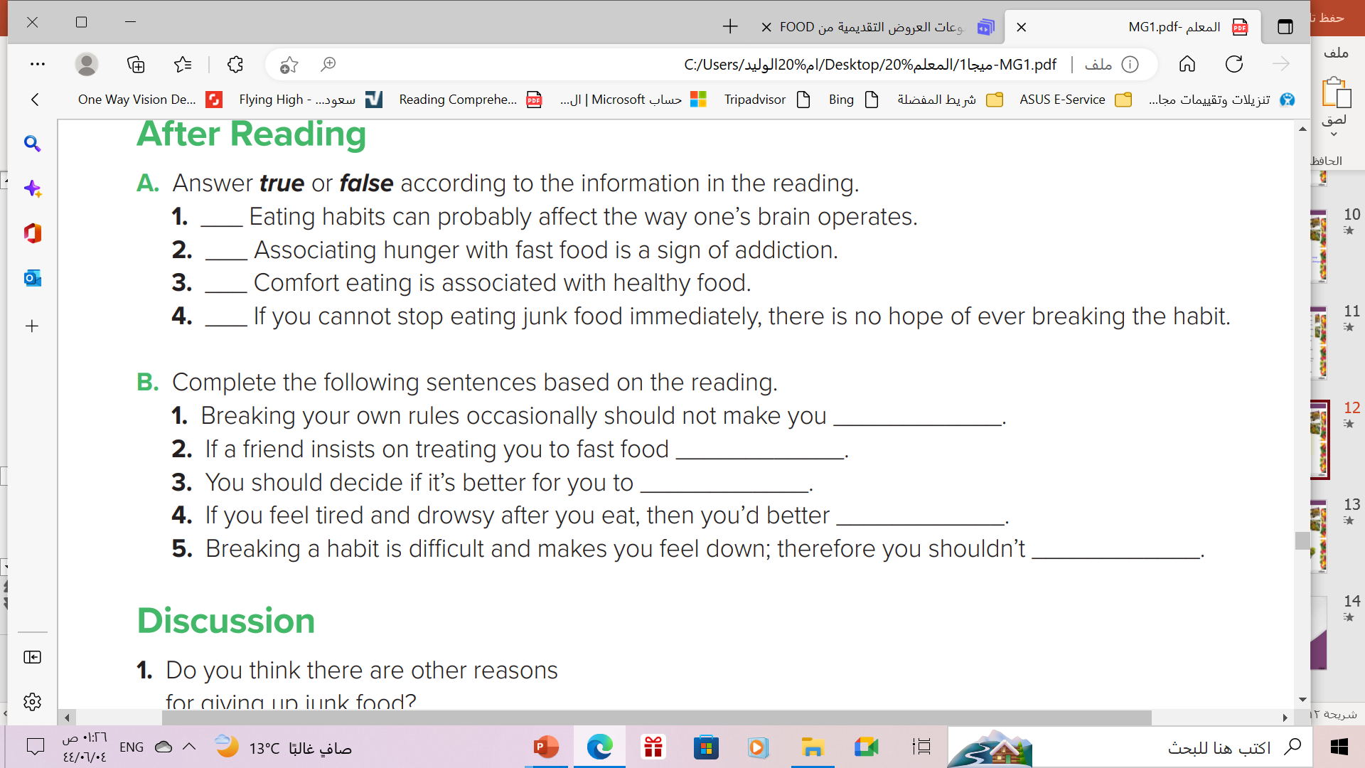
After Reading
worry
turn it down
cut down food gradually or altogether.
change your eating habits
give up

Slide 17
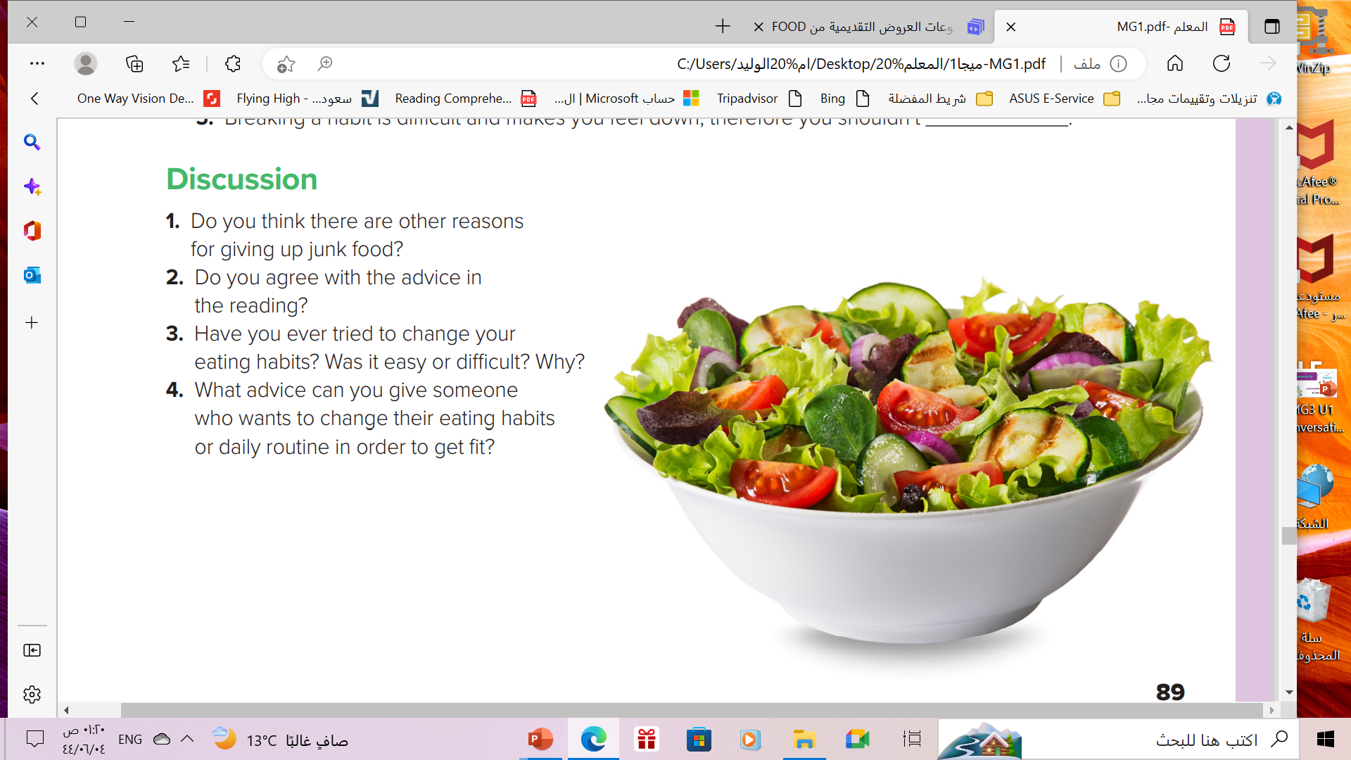

Slide 18

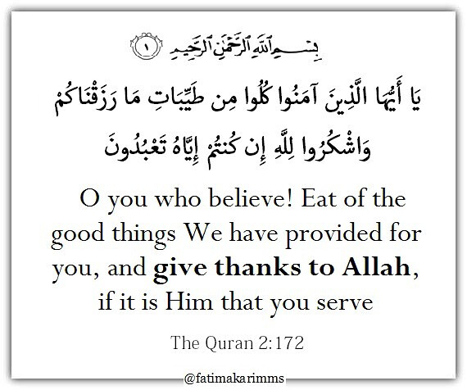
Homework

Slide 19
Homework
Page ( 61 ) , exercise ( F )

Slide 20

Thanks!
Unit

