Slide 1
Unit 2 Take My Advice
Mega Goal 1.2
Grammar
Done by: Entisar Al-Obaidallah

Slide 2
Lesson Objectives
Use
Form
01
03
Use
Use
02
04
“should, ought to, might, and could” to give advice.
correct two-and three-word verb correctly
“had better” to give
a firmer advice.
two-and three-word verb with pronoun objects correctly.

Slide 3
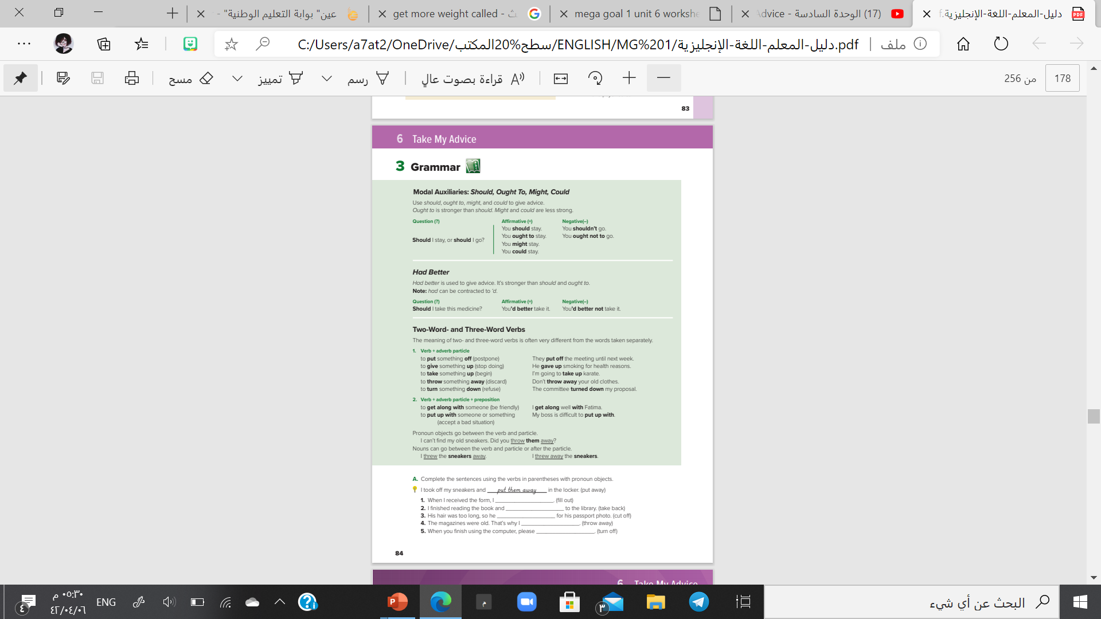

Open
Book p.( 20)

Slide 4
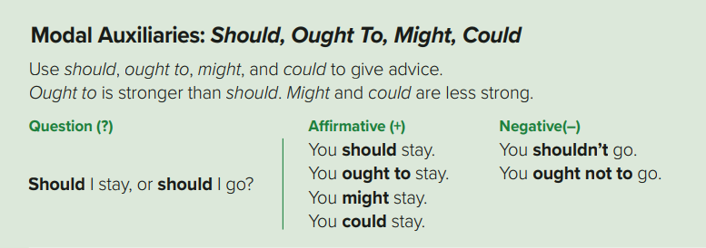

Slide 5


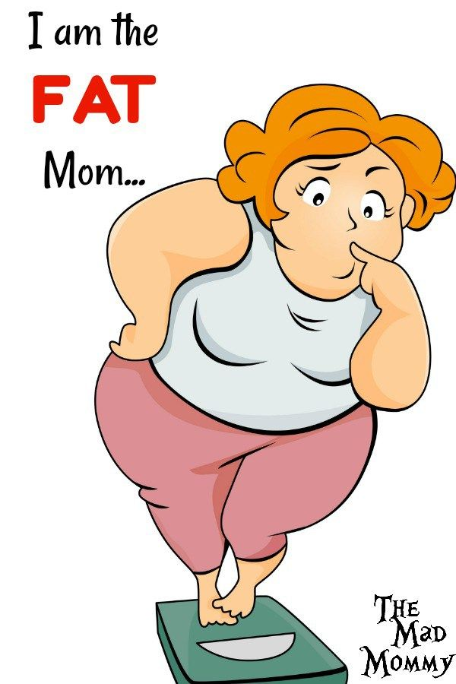
Modal auxiliaries
( should , ought to , might , & could )
Used to give advice
are followed by infinitive
Ought to is stronger than should
What should I do ?
You ought to eat healthy food
You should exercise regularly .
You might join a gym.
You could cut down sugar.
“might” & “could” usually used to express ideas rather than give advice .

Slide 6

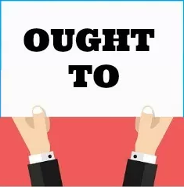
Modal auxiliaries
Used to give advice
(should , ought to, might, & could)
are followed by infinitive
SHOULD
Use: to give an advice or an opinion
Form : should/shouldn’t + simple verb
Examples: Your grades aren’t very good. You should study harder. (+)
You shouldn’t talk so much during the classes. (-)
OUGHT TO
Use: use (ought to) to give an advice or an opinion.
Form : ought to/ought not to + simple verb
Examples: You ought to study harder. (+)
You ought not to talk so much. (-)

Slide 7


Slide 8


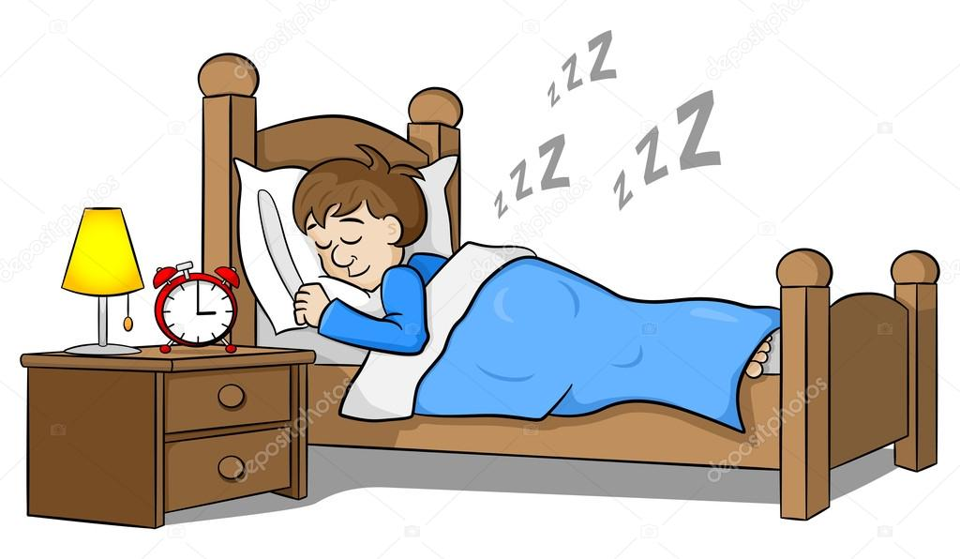

Give an advice
sleep
watch
walk
You should sleep
Early.
You shouldn’t watch
So much TV.
You should walk
an hour a day.

Slide 9
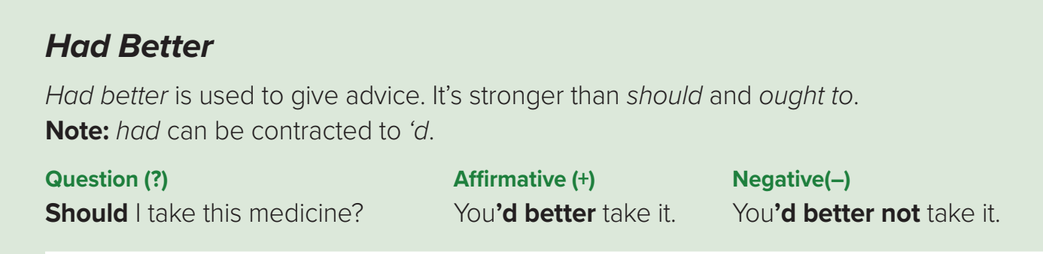





used to give advice. It’s stronger than should and ought to.
You had better prepare for the exam
He had better complete his work.
They had better sleep early ..
Examples
Negative (-)
had better + not + base form(V)
She had better not apply for the job
She had better not to apply for the job

Slide 10

SHOULD and OUGHT TO = it’s just a good idea to do something.
HAD BETTER = there is a problem or danger if you don’t follow the advice.
Question (?)
Should I take this medicine?
‘d better
=
had better
Affirmative (+)
You’d better take it.
Negative(–)
You’d better not take it

Slide 11
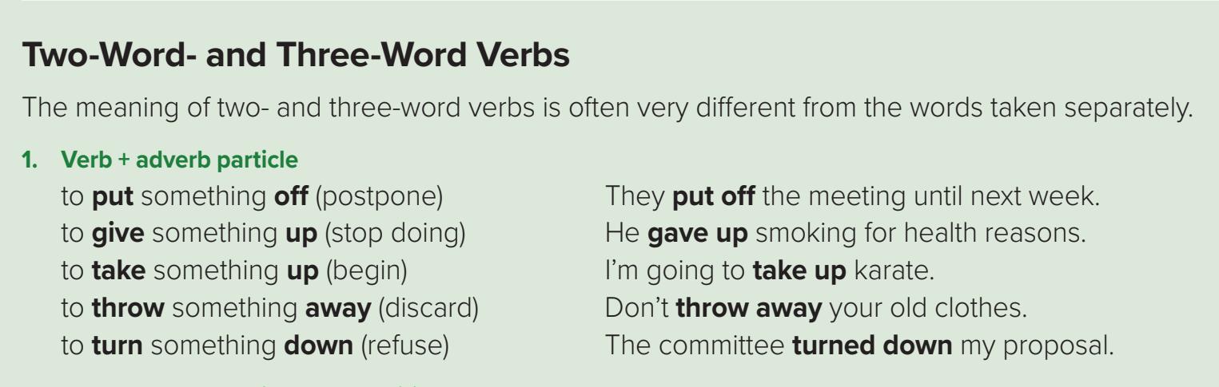
Some verbs are two-part verbs . They consist of a verb + a particle.
All of the two-word verbs are separable .
With separable two-word verbs we can replace the noun object with a pronoun .
threw
away
He threw the shirt away.
He threw away the shirt .
He threw it away.

Slide 12
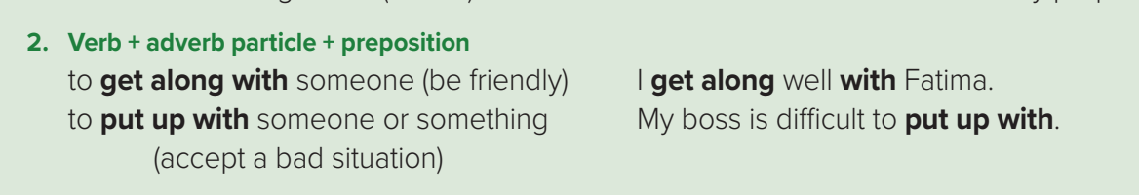
Some verbs are three-word verbs . They consist of a verb and adverb particle and a preposition.
put
up
with
Means “ accept bad situation”
I couldn't put up with the noise any longer
get
along
with
Means “ have a good relationship with someone”
He had an ability to get along with all kinds of people.

Slide 13

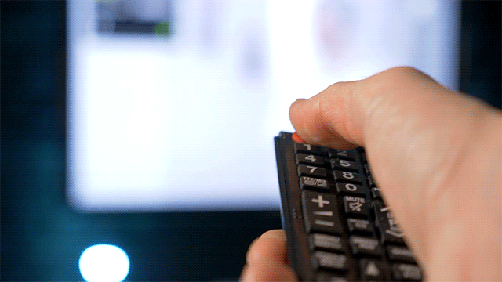
Phrasal Verbs
Nouns can go between the verb and particle or after the particle.
Pronoun objects go between the verb & particle.
me – him – her – them – us -it
Turn + off
Turn + off
Turn off the TV
Turn it off
noun
Pronoun objects
Turn the TV off
Turn off it

Slide 15
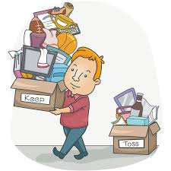
Substitute with two or three-word verb
We are cleaning the room, and we plan to (discard) ______________ anything we don't need.
throw away

Slide 16

Substitute with two or three-word verb
Can we (postpone) ______________ the meeting until Sunday , please?
put off

Slide 17

Substitute with two or three-word verb
Your singing is beautiful , don’t ( stop) ____________ it______ .
give
up

Slide 18
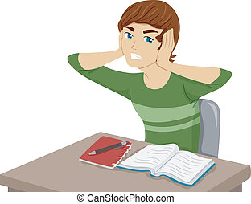
Substitute with two or three-word verb
I can’t ( tolerate) ________________ the noise in my street . I’ll have to move .
put up with

Slide 19
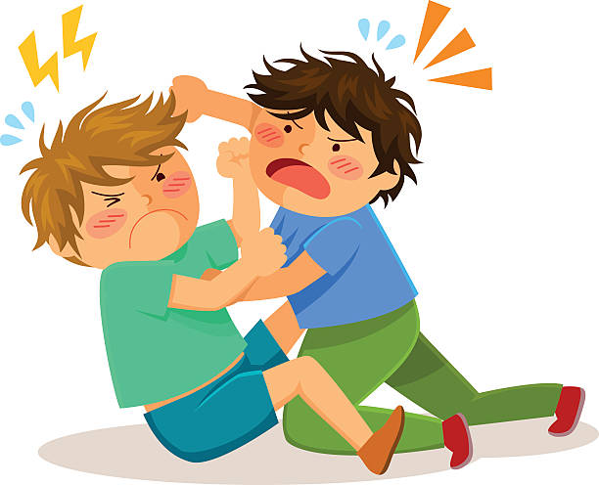
Substitute with two or three-word verb
I have never ( have good relationship) ____________ with my brother . We are always fighting.
get along

Slide 20

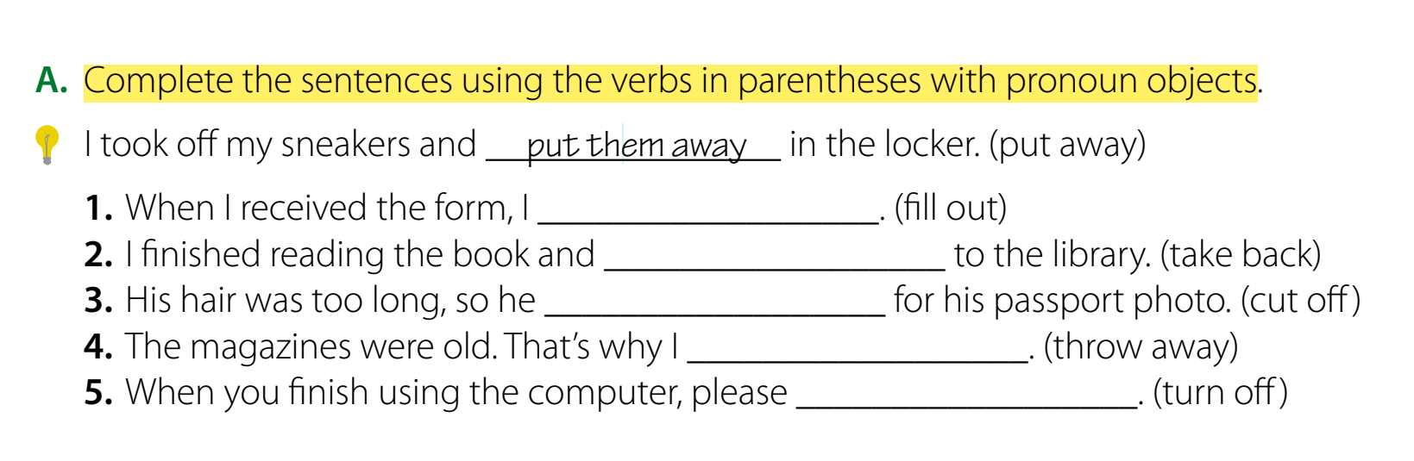
Student’s book p.(20)
filled it out
took it back
cut it off
threw them away
turn it off

Slide 21
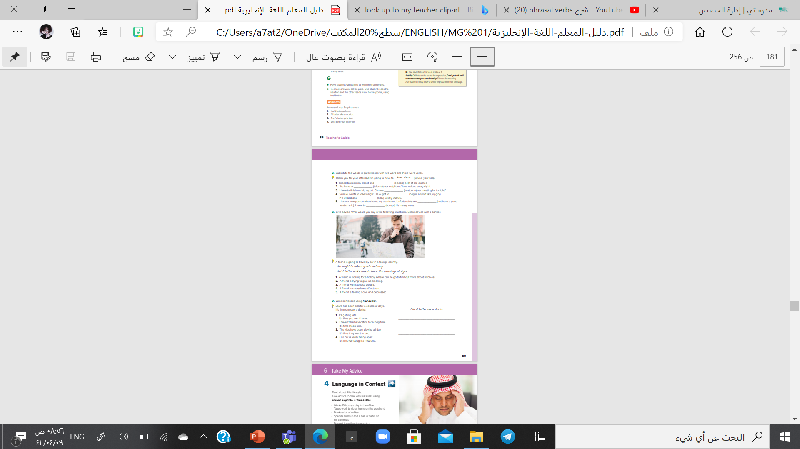
Open
Book p.( 21)

Slide 22
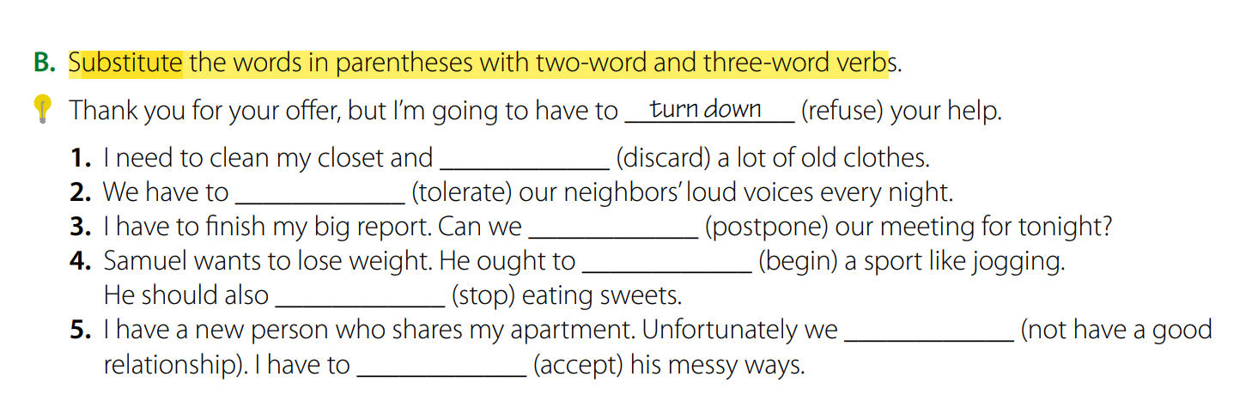
Student’s book p.(21)
throw away
put up with
Put off
take up
give up
don’t get
along with
Put up with

Slide 23
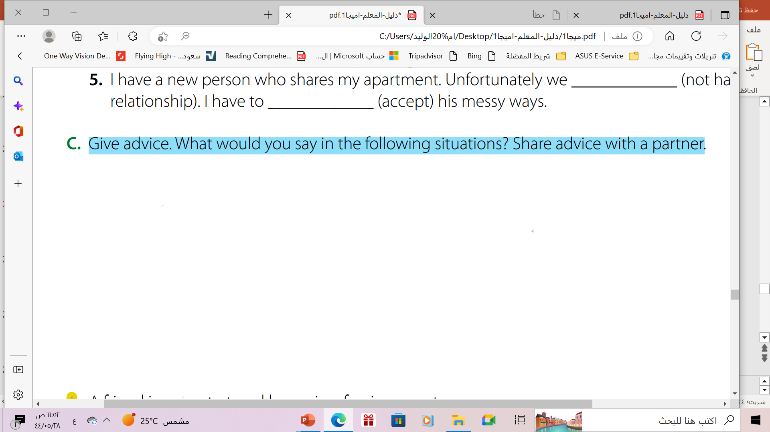
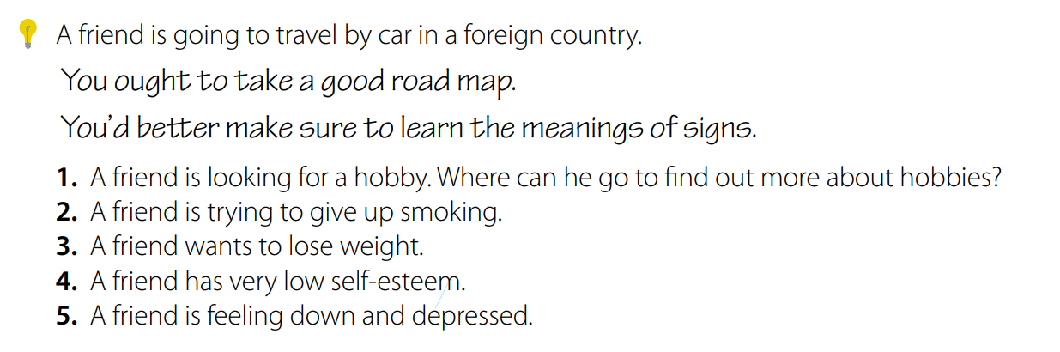
1. You could go to a sport’s club.
2. You ought to get a nicotine patch.
3. You’d better give up sweets. You ought to eat more vegetables.
4. You should have more confidence in yourself.
5. You should go out and have fun. You might volunteer to help others.

Slide 24
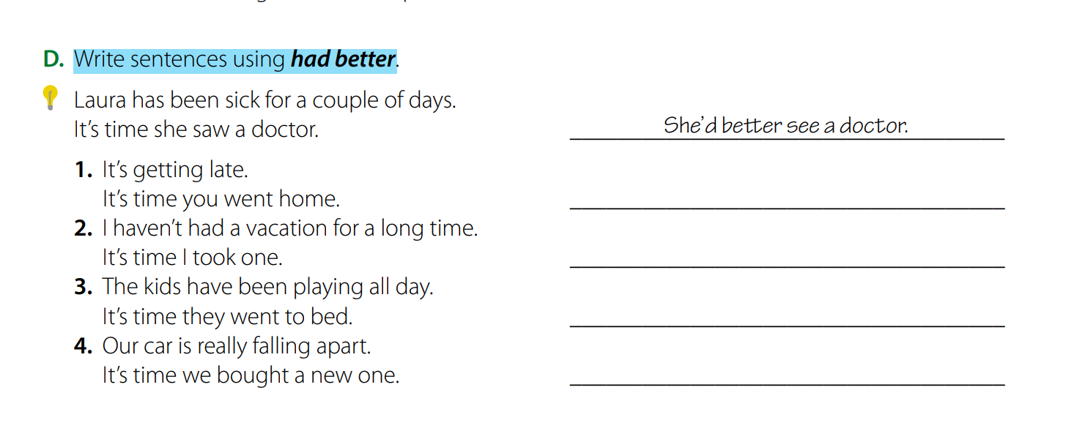
You’d better go home.
I’d better take a vacation.
They’d better go to bed.
We’d better buy a new car.

Slide 25

Extra Activities
https://www.liveworksheets.com/ya3129128pr
https://www.liveworksheets.com/yb1183453hb
https://wordwall.net/ar/resource/28789787

Slide 26

Remember

Slide 27

Homewok
Workbook P.( 58)

Slide 28

THANKS!

Slide 29





ALTERNATIVE RESOURCES
Here’s an assortment of alternative resources whose style fits the one of this template:
VECTOR
Ink brush stroke collection

