Slide 1


Slide 2

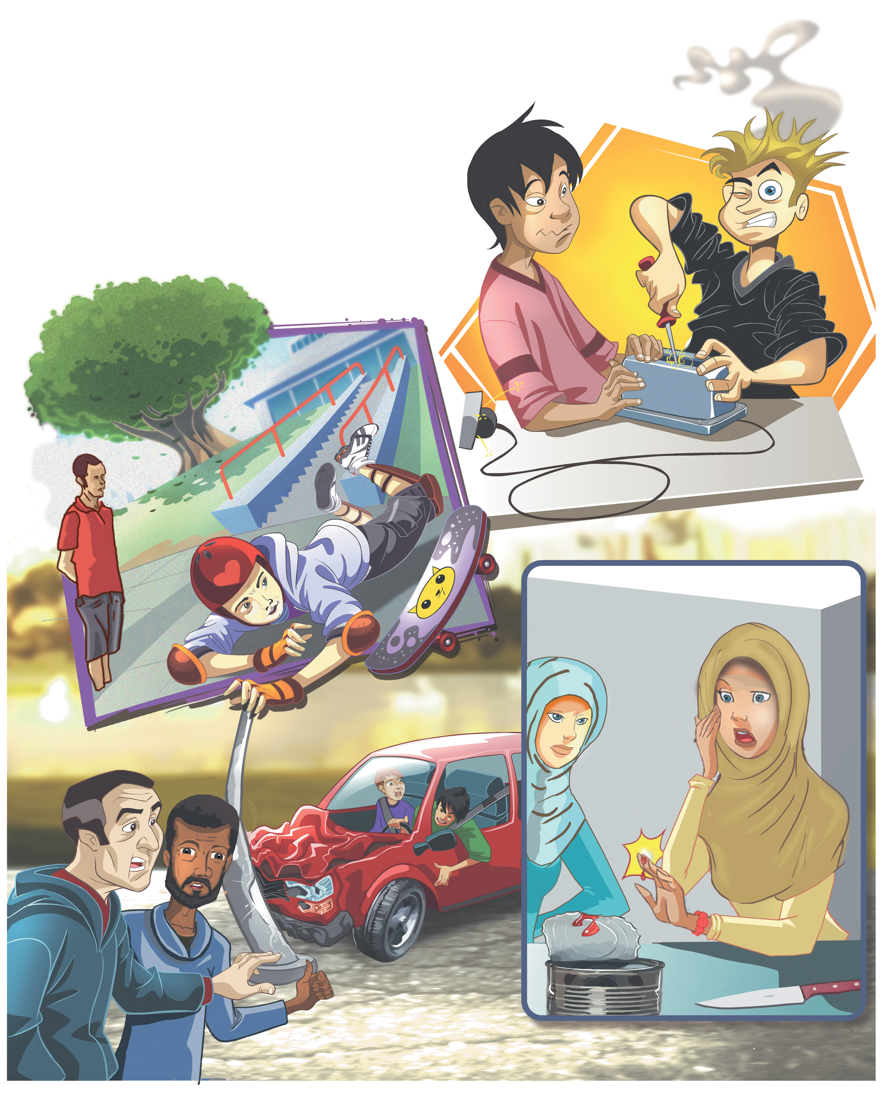
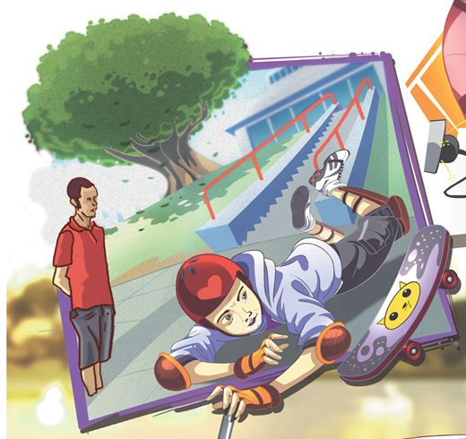

Slide 3

Unit-1-
Did You Hurt Yourself
1 Listen and Discuss
2 Pair Work

Slide 4
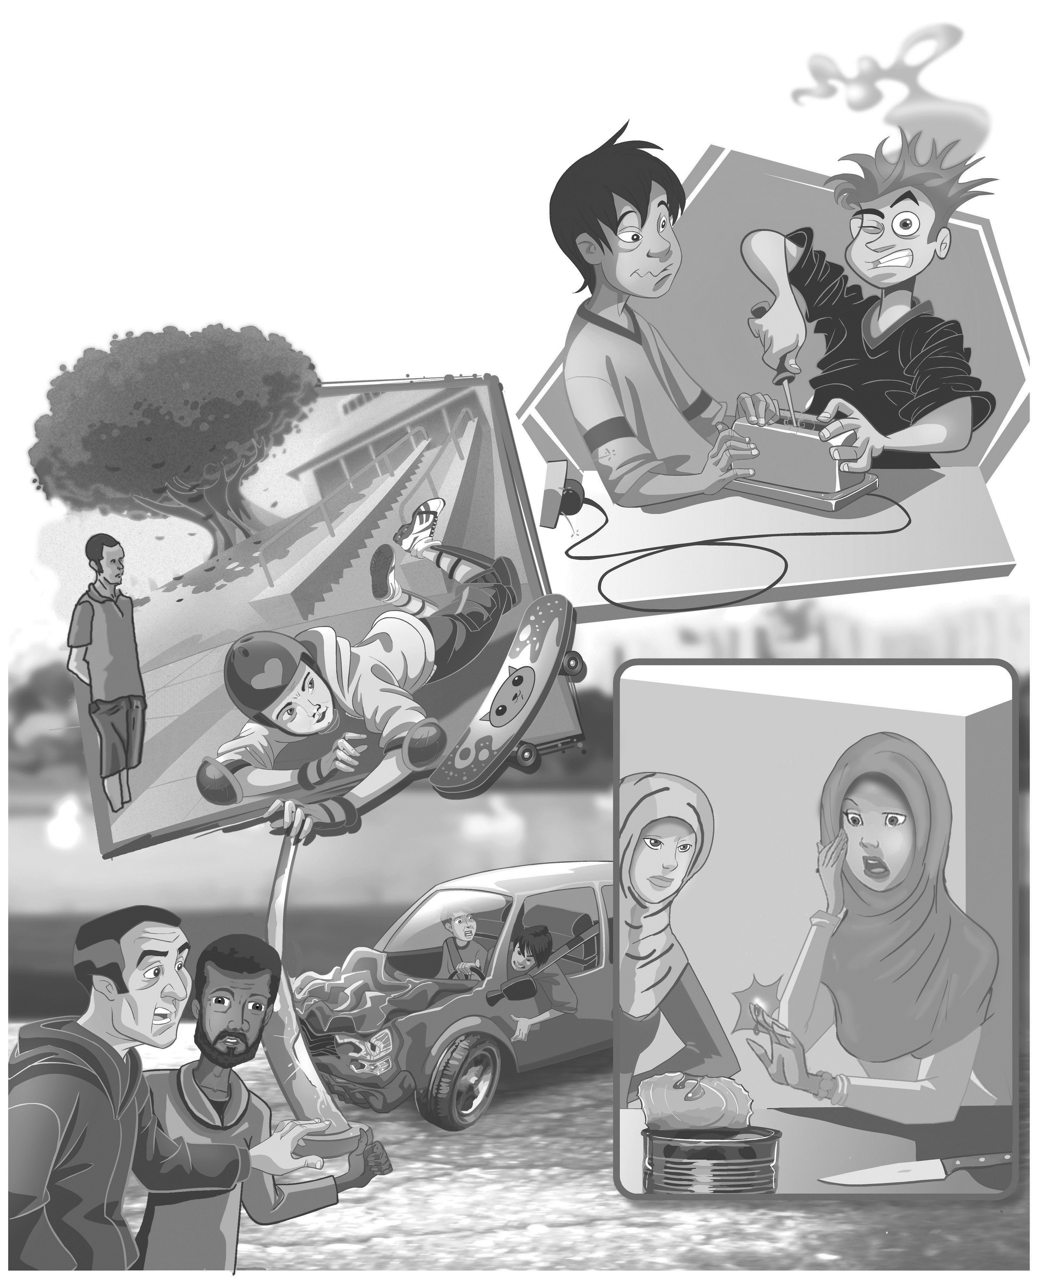
1-Listen & Discuss

Slide 5
Objectives
1
Listen to the audio
2
Discuss the pictures
3
Answer the questions
4
Practice cause & effect sentences
Say verse of aya or hadith about not hurting peoples lives
5
Differentiate between the most causes of automobile crashes
6
7
Share positively in pair work

Slide 6

Warm Up
My
Him
Her
Your
Our
Their
self

Slide 7
Skimming
What is the topic of the lesson?
Which accidents do you think are the most happen?

Slide 8
Common Accidents
Ouch! I got a shock
Did you hurt yourself?
So did I.
No, I’m OK.
They didn’t turn off the electricity, so they got a shock.
How did you cut yourself?
Because he was wearing a helmet and knee pads, he didn’t hurt himself.
The driver wasn’t injured
I tried to open the can with a knife
Neither was his friend.
They didn’t hurt themselves because they were wearing seat belts.
If you use the wrong equipment, you might hurt yourself.
Notes:
Language Builder
To express cause and effect, a speaker can choose to say either the cause first, or the effect first, depending on what he or she wants to emphasize. For example, write on the board: He didn’t get hurt because he wore a helmet. Because he wore a helmet, he didn’t get hurt. The first sentence emphasizes not getting hurt. The second sentence emphasizes that she wore a helmet.

Slide 9
Common Accidents
Ouch! I got a shock
Did you hurt yourself?
So did I.
No, I’m OK.
They didn’t turn off the electricity, so they got a shock.
How did you cut yourself?
Because he was wearing a helmet and knee pads, he didn’t hurt himself.
The driver wasn’t injured
I tried to open the can with a knife
Neither was his friend.
They didn’t hurt themselves because they were wearing seat belts.
If you use the wrong equipment, you might hurt yourself.
Notes:
Language Builder
To express cause and effect, a speaker can choose to say either the cause first, or the effect first, depending on what he or she wants to emphasize. For example, write on the board: He didn’t get hurt because he wore a helmet. Because he wore a helmet, he didn’t get hurt. The first sentence emphasizes not getting hurt. The second sentence emphasizes that she wore a helmet.

Slide 10
Common Accidents
Ouch! I got a shock
Did you hurt yourself?
So did I.
No, I’m OK.
They didn’t turn off the electricity, so they got a shock.
How did you cut yourself?
The driver wasn’t injured
I tried to open the can with a knife
Neither was his friend.
They didn’t hurt themselves because they were wearing seat belts.
If you use the wrong equipment, you might hurt yourself.
Notes:
Language Builder
To express cause and effect, a speaker can choose to say either the cause first, or the effect first, depending on what he or she wants to emphasize. For example, write on the board: He didn’t get hurt because he wore a helmet. Because he wore a helmet, he didn’t get hurt. The first sentence emphasizes not getting hurt. The second sentence emphasizes that she wore a helmet.

Slide 11
Common Accidents
Ouch! I got a shock
Did you hurt yourself?
So did I.
No, I’m OK.
How did you cut yourself?
Because he was wearing a helmet and knee pads, he didn’t hurt himself.
The driver wasn’t injured
I tried to open the can with a knife
Neither was his friend.
If you use the wrong equipment, you might hurt yourself.
Notes:
Language Builder
To express cause and effect, a speaker can choose to say either the cause first, or the effect first, depending on what he or she wants to emphasize. For example, write on the board: He didn’t get hurt because he wore a helmet. Because he wore a helmet, he didn’t get hurt. The first sentence emphasizes not getting hurt. The second sentence emphasizes that she wore a helmet.

Slide 12
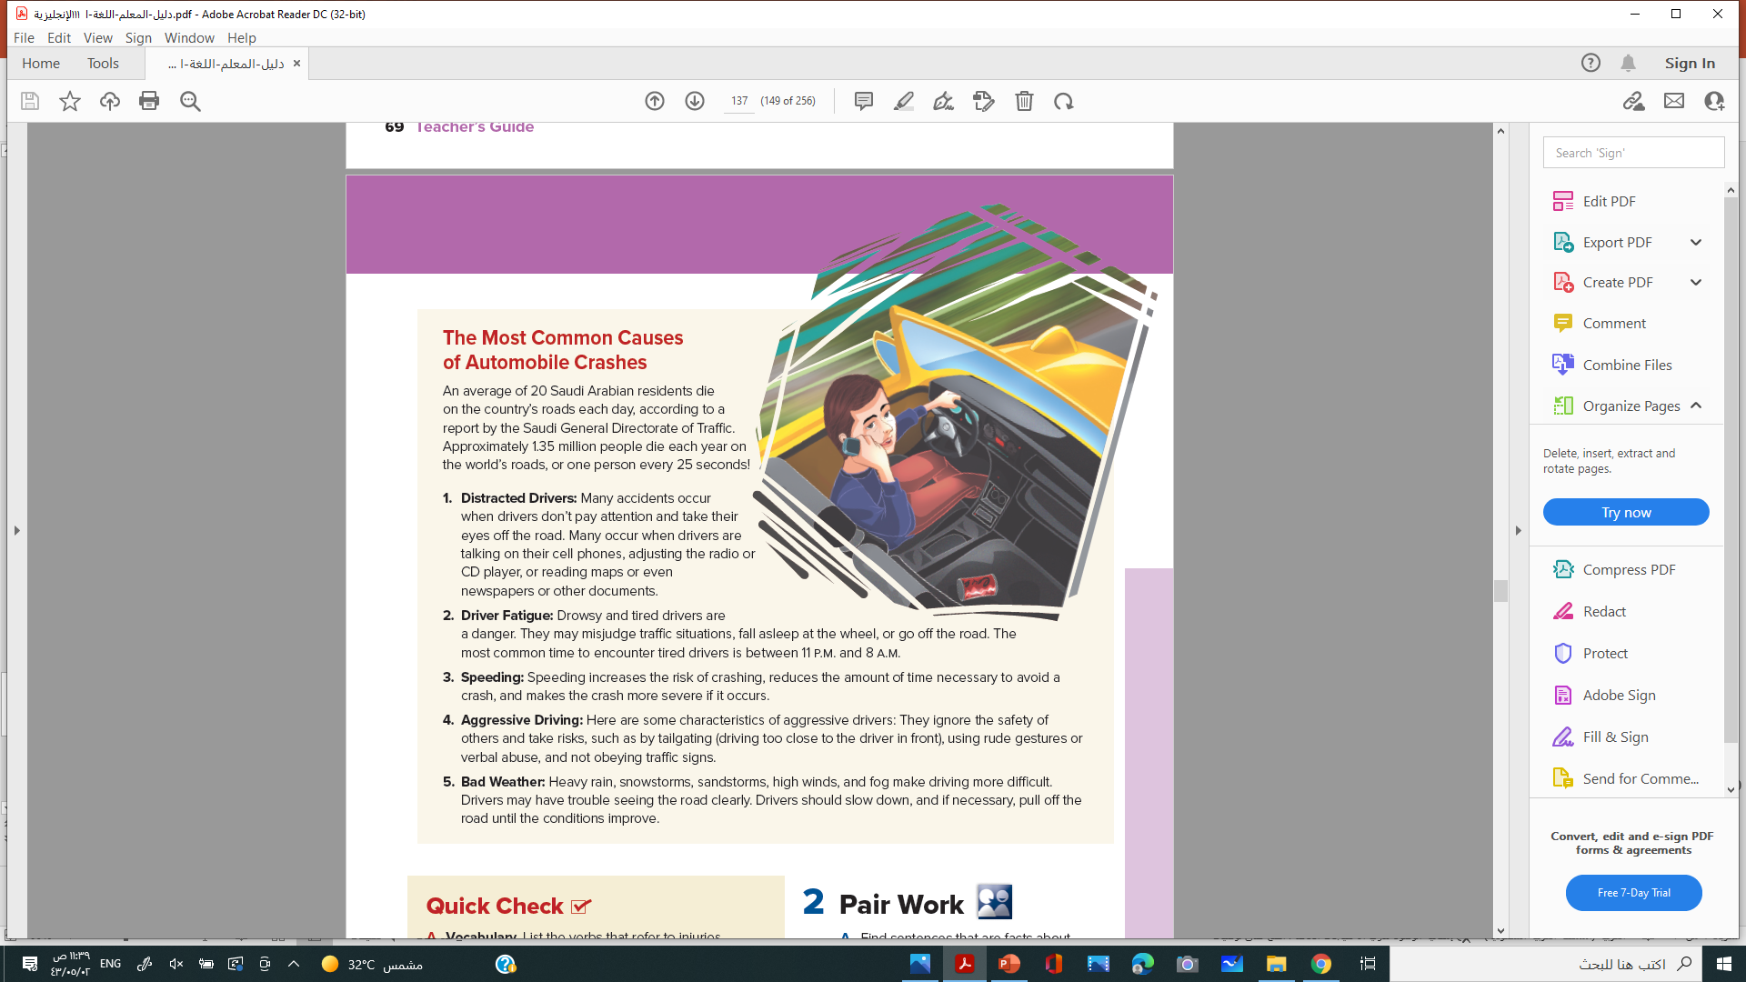
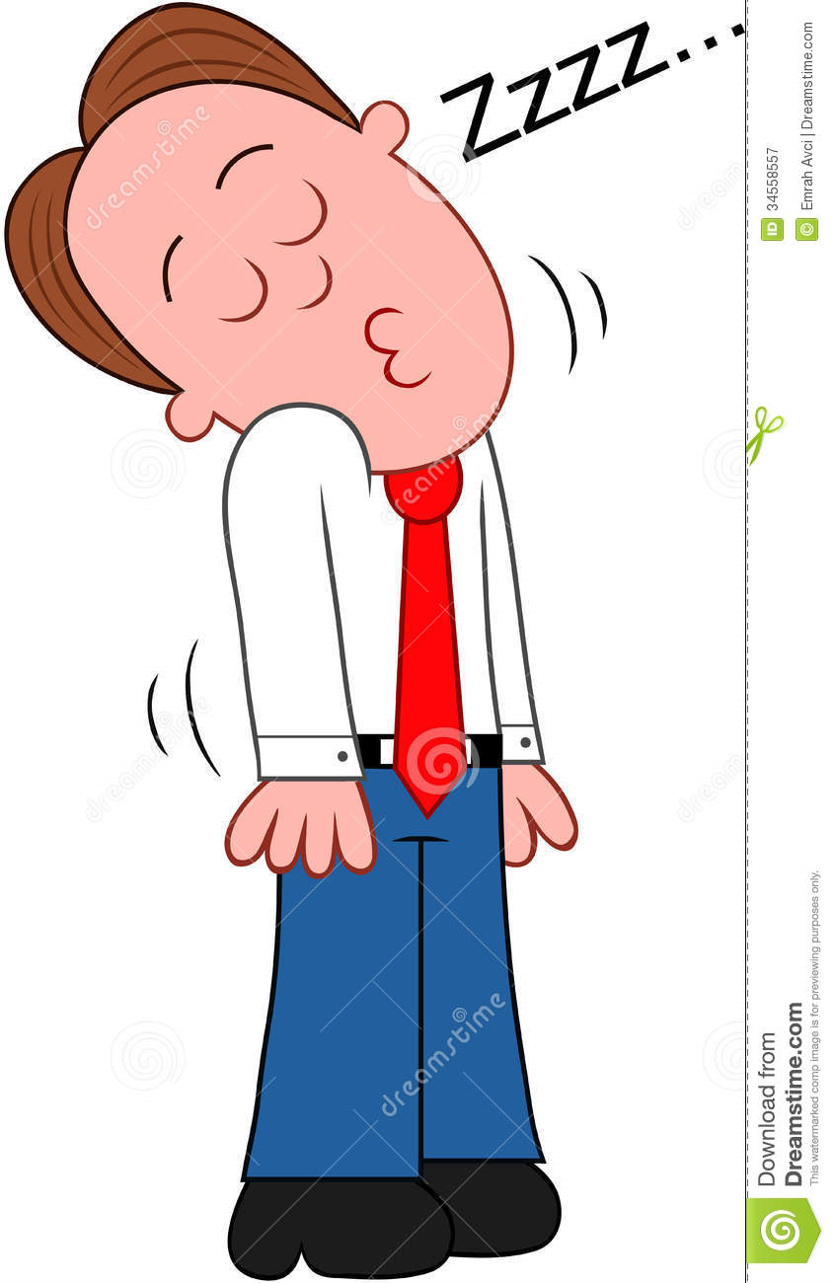
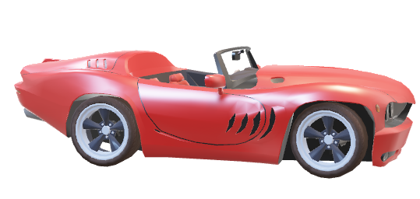
The Most Common Causes
of Automobile Crashes
An average of 20 Saudi Arabian residents die on the country’s roads each day, according to a report by the Saudi General Directorate of Traffic. Approximately 1.35 million people die each year on the world’s roads, or one person every 25 seconds
1. Distracted Drivers: Many accidents occur when drivers don’t pay attention and take their eyes off the road. Many occur when drivers are talking on their cell phones, adjusting the radio or CD player, or reading maps or even newspapers or other documents
2. Driver Fatigue: Drowsy and tired drivers are a danger. They may misjudge traffic situations, fall asleep at the wheel, or go off the road. The most common time to encounter tired drivers is between 11 p.m. and 8 a.m.
Notes:
Seatbelts save lives. They use the basic principle from physics, inertia, which states that something moving in a straight line will continue to move in that straight line unless something blocks its path. Sir Isaac Newton came up with this concept long ago. Seatbelts stop people from continuing to move when their car is in an accident. Basic physics!

Slide 13
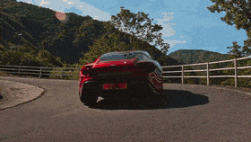
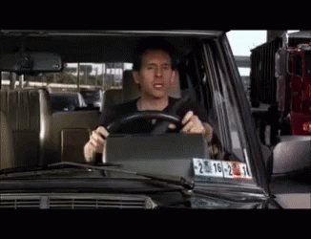
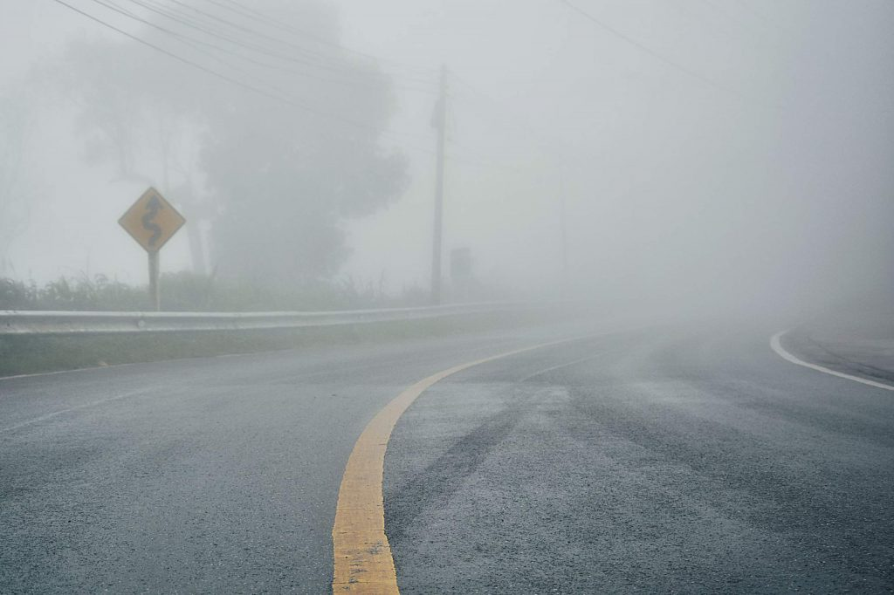
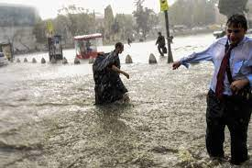
3. Speeding: Speeding increases the risk of crashing, reduces the amount of time necessary to avoid a crash, and makes the crash more severe if it occurs.
4. Aggressive Driving: Here are some characteristics of aggressive drivers: They ignore the safety of others and take risks, such as by tailgating (driving too close to the driver in front), using rude gestures or verbal abuse, and not obeying traffic signs.
5. Bad Weather: Heavy rain, snowstorms, sandstorms, high winds, and fog make driving more difficult. Drivers may have trouble seeing the road clearly. Drivers should slow down, and if necessary, pull off the road until the conditions improve.
.

Slide 14



Quick Check
A. Vocabulary.
List the verbs that refer to injuries.
hurt
crash
cut
got a shock
injured
B. Comprehension.
Answer true or false.
1-____ The skateboarder didn’t hurt himself because he had knee pads
2. ____ Neither of the people who were working on the electronic device got a shock.
3. ____ The people in the car were hurt.
4. ____ The woman cut herself trying to open a can
5. ____ Most road accidents are caused by the drivers themselves.
true. false. false. true
true

Slide 15
2-Pair Work

Slide 16

Find sentences that are facts about the accidents you read about. Make questions for those facts.
In pairs, ask and answer the questions. See the example below.
How did the young man hurt himself?
He fell off his skateboard.
B-Share experiences about accidents.
I once slipped on a wet floor and broke my arm.
So did I.

Slide 17

Which story of your friends do you prefer most ?
Why?

Slide 18


Slide 19


Slide 20


