Slide 1

Mega Goal 1.2
U: 2
Grammar
By: Yousef Hilal Alyazedi

Slide 2
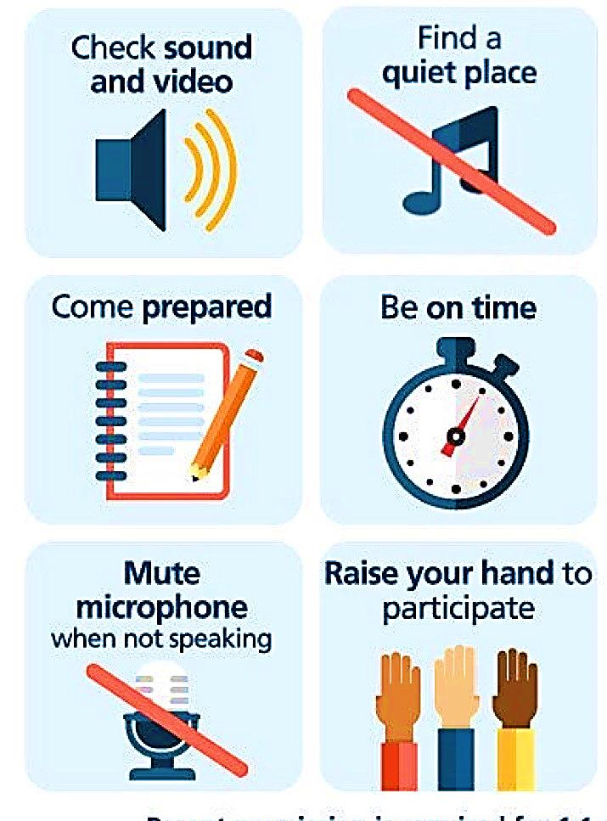
Online Classroom Rules

Slide 3

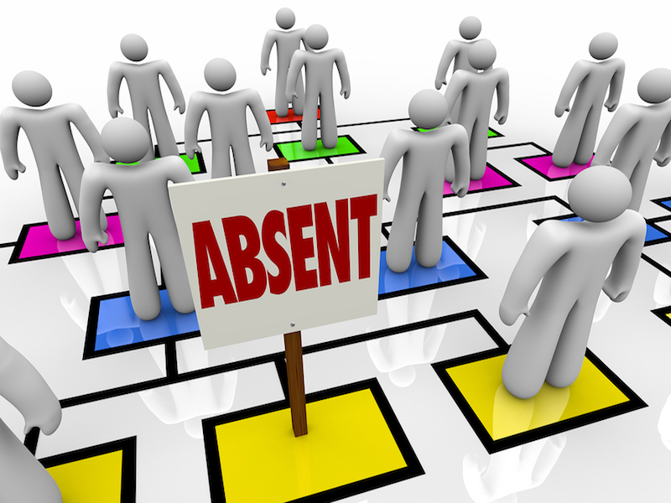

Slide 4


Lesson Goals
1 – Use ( should , ought to , might , could ) to give advice .
2 – use “ had better “ to make very strong advice .
3 – Build a correct two- and three-word verb .

Slide 5


Open your Student’s book at page: 20

Slide 6
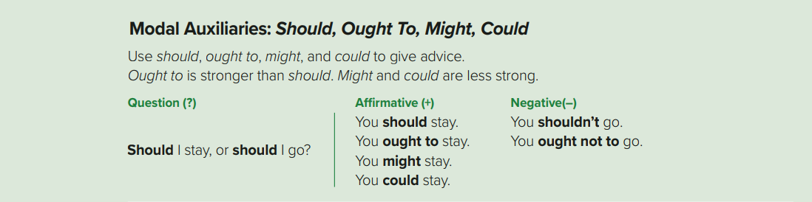
It is a great film . You ought to go and see it .
It is a great film . You should go and see it .
It is a great film . You might go and see it .
It is a great film . You could go and see it .
Should I ask about the salary at the interview ?
You ought not to ask about the salary at the interview .

Slide 7



Modal Auxiliaries
Advice
Should
Ought to
might
Could
are followed by infinitive
We use should and ought to for general advice .
Ought to is stronger than should .
We use should in questions .
Ought not to is formal and is usually only used in formal speech and writing .
Might and could are used to express suggestions or possibilities .

Slide 8

Negative
You should use your mobile while driving
You shouldn’t use your mobile while driving .
to / take / ought / He / medicine / his
Rearrange
He ought to take his medicine .

Slide 9
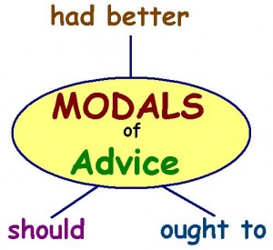

Slide 10
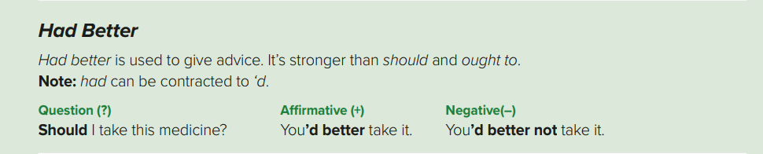
We had better stop for petrol soon . The tank is almost empty .
It might rain . You’d better take an umbrella .
He had better not park his car illegally .

Slide 11
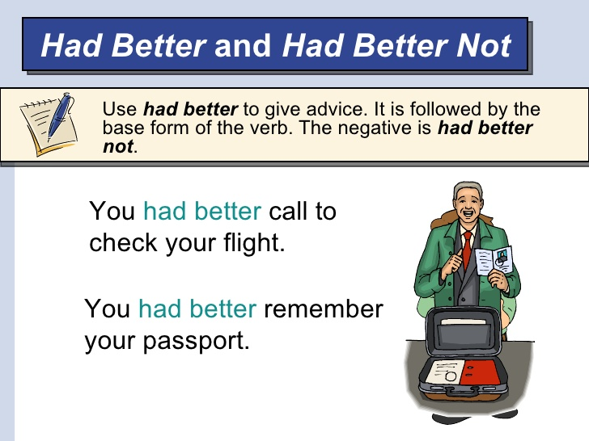
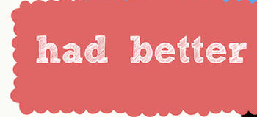
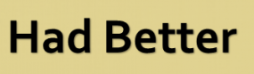
is stronger than should & ought to in giving advice .
There is always a danger or a problem if you don’t follow the advice.
You should finish this project .
but no problem if you don’t
You had better finish this project, or you might lose your job .

Slide 12
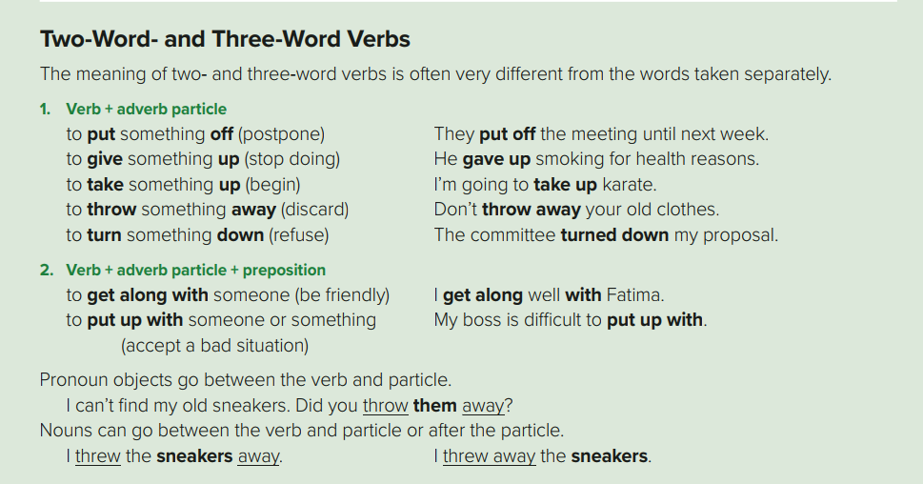
Please turn off the TV .
Please turn the TV off
She threw away the old pizza .
She threw the old pizza away .

Slide 13


Some verbs are two-part verbs . They consist of a verb and a particle .
All of the two-word verbs are separable .
With separable two-word verbs we can replace the noun object with a pronoun .
give
back
He gave back the money .
He gave the money back .
Put
off
I need to put off the meeting until next Sunday .
I need to put it off until next Sunday .

Slide 14
I get on with my brother .
Many young students look up to their teachers .
I get along with Ali really well . He’s one of my best friends .
That man has to put up with this kind of behavior every day .

Slide 15

Some verbs are three-word verbs . They consist of a verb and adverb particle and a preposition.
put
up
with
She can’t put up with this violence any longer .
get
along
with
He had an ability to get along with all kinds of people .
Pronoun objects go between the verb and particle .
I can’t find my keys . Did you throw them away ?

Slide 16
Substitute with two-word verb
Can we ( postpone ) our meeting for tonight ?
Can we put off our meeting for tonight ?
Substitute with three-word verb
He should ( accept ) his bad attitude .
He should put up with his bad attitude .

Slide 17
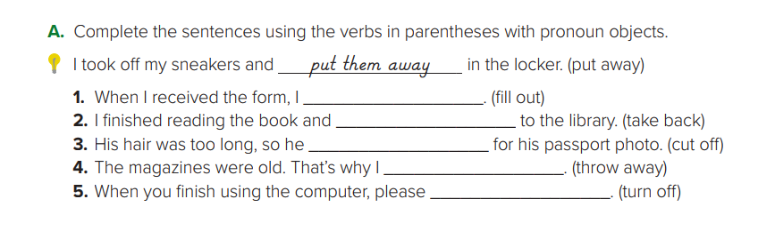
filled it out
took it back
cut it off
threw them away
turn it off

Slide 18
Open your Student’s book at page: 21

Slide 19
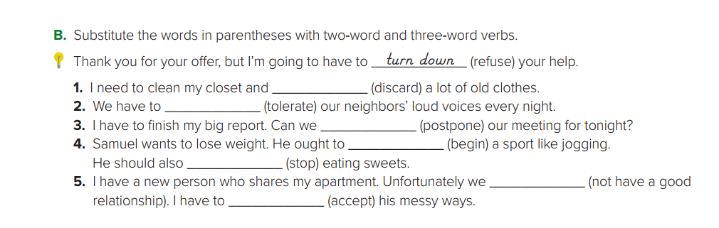
throw away
put up with
Put off
take up
give up
don’t get along
Put up with

Slide 20
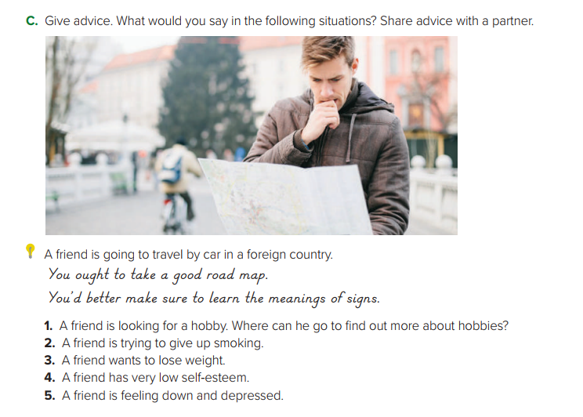
1 - You could go to a sport’s club.
2- You ought to get a nicotine patch.
3- You’d better give up sweets. You ought to eat more vegetables.
4- You should have more confidence in yourself.
5- You should go out and have fun. You might volunteer
to help others.

Slide 21
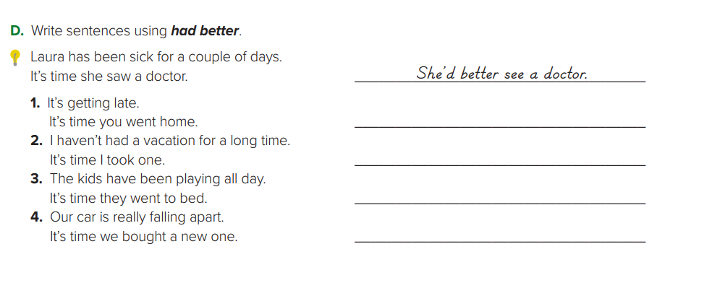
You’d better go home .
I’d better take a vacation .
They’d better go to bed .
We’d better buy a new car .

Slide 22
