Slide 1
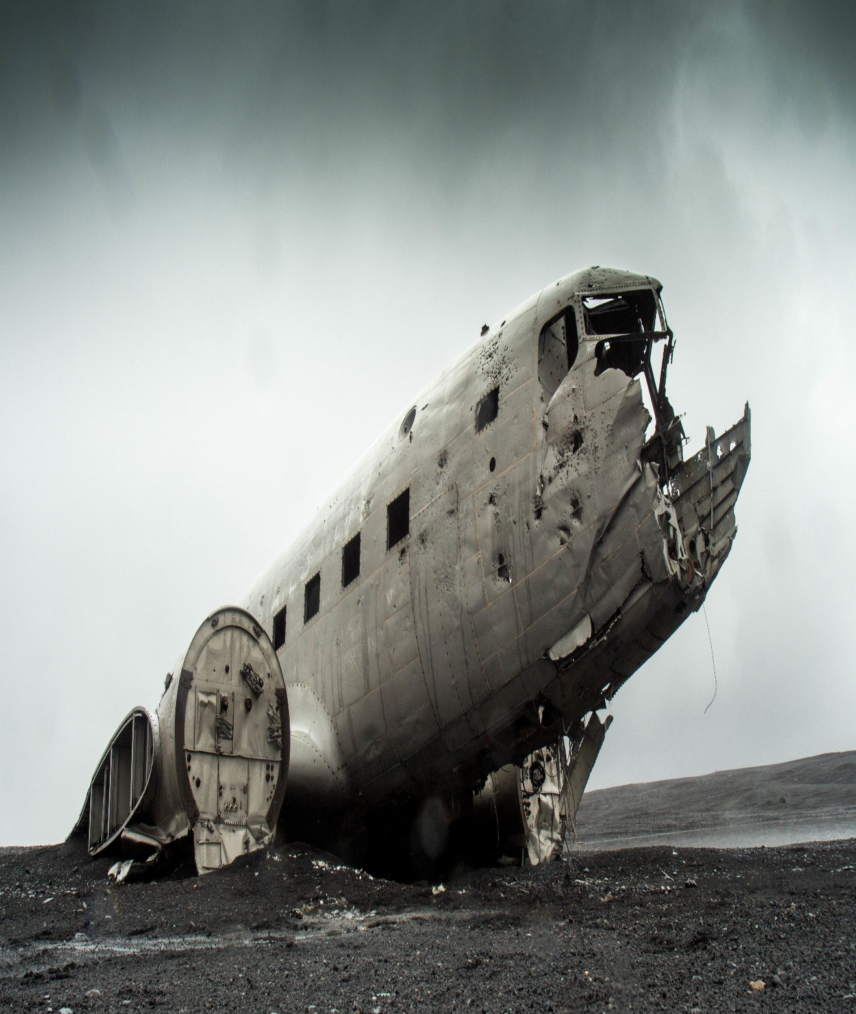
Mega Goal 1.2
U: 1
Did You Hurt Yourself ?
Reading
By: Yousef Hilal Alyazedi

Slide 2
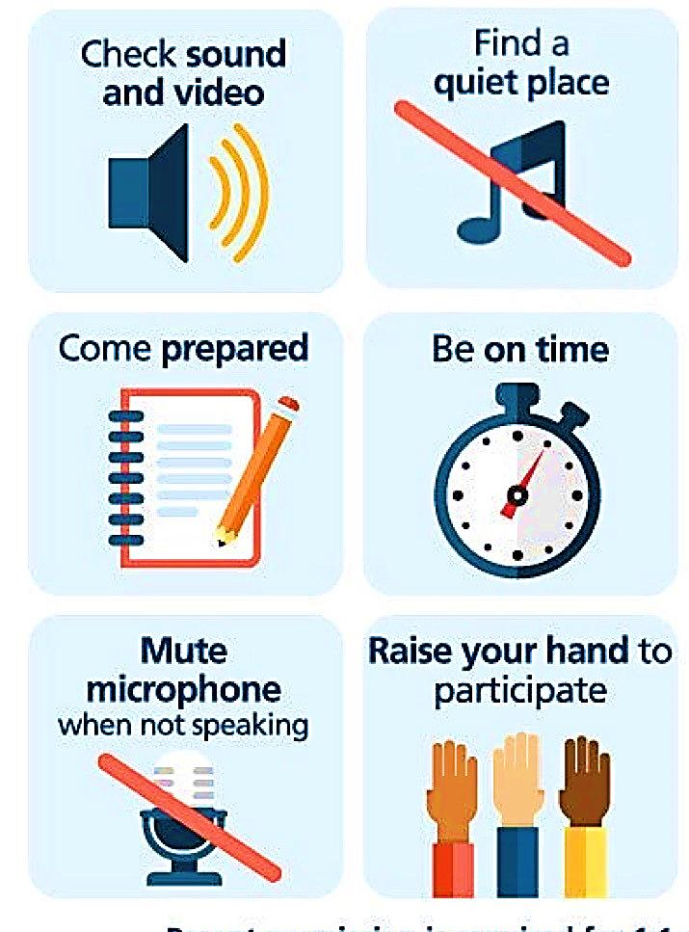
Online Classroom Rules

Slide 3
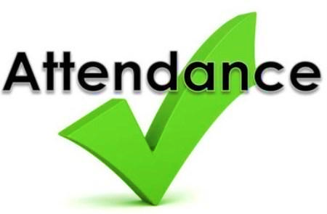
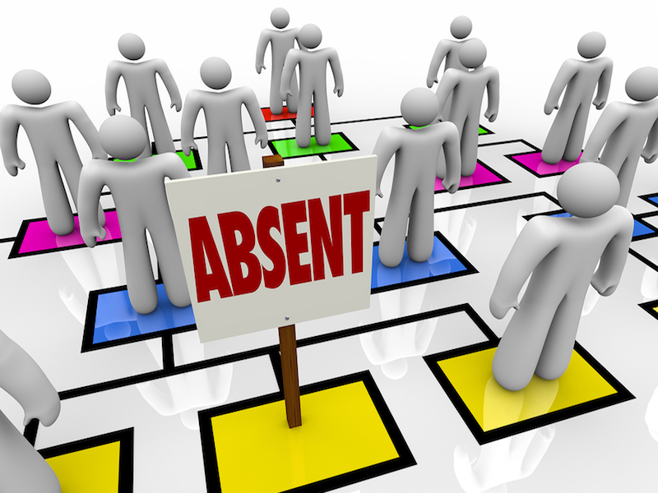

Slide 4

Workbook P. 51
Exercise I

Slide 5


Lesson Goals
Read and describe the events .
Determine happy and unhappy endings .
Identify the meaning of some new words .
Answer some questions .

Slide 6
A: Hey, look at my new cell phone .
B: Where'd you get it ?
A: I got it at the mall. It was free with my new plan .
B: So what stuff can it do ?
A: It has text messages, voice-mail, Internet and instant messenger too. I think you can even watch TV on it .
B: I think I may need to get one too. How long of a contract do you have to sign ?
A: Just a year, I think .
B: That's not too bad .

Slide 7
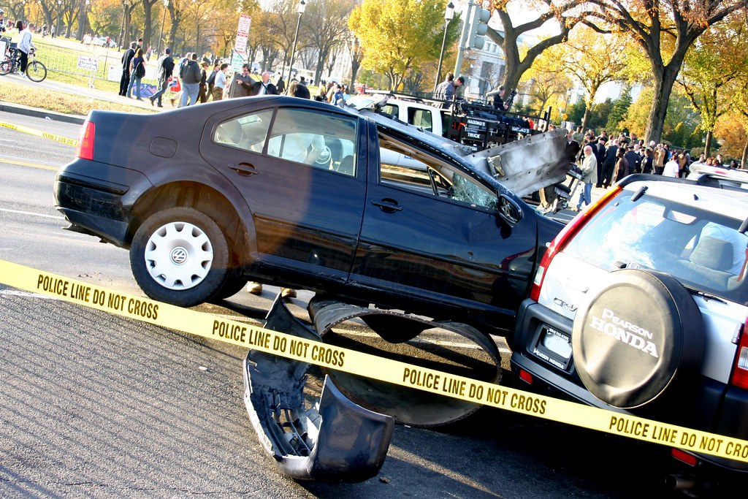
Warm Up
Have you ever seen a strange accident ?
Describe it ?

Slide 8
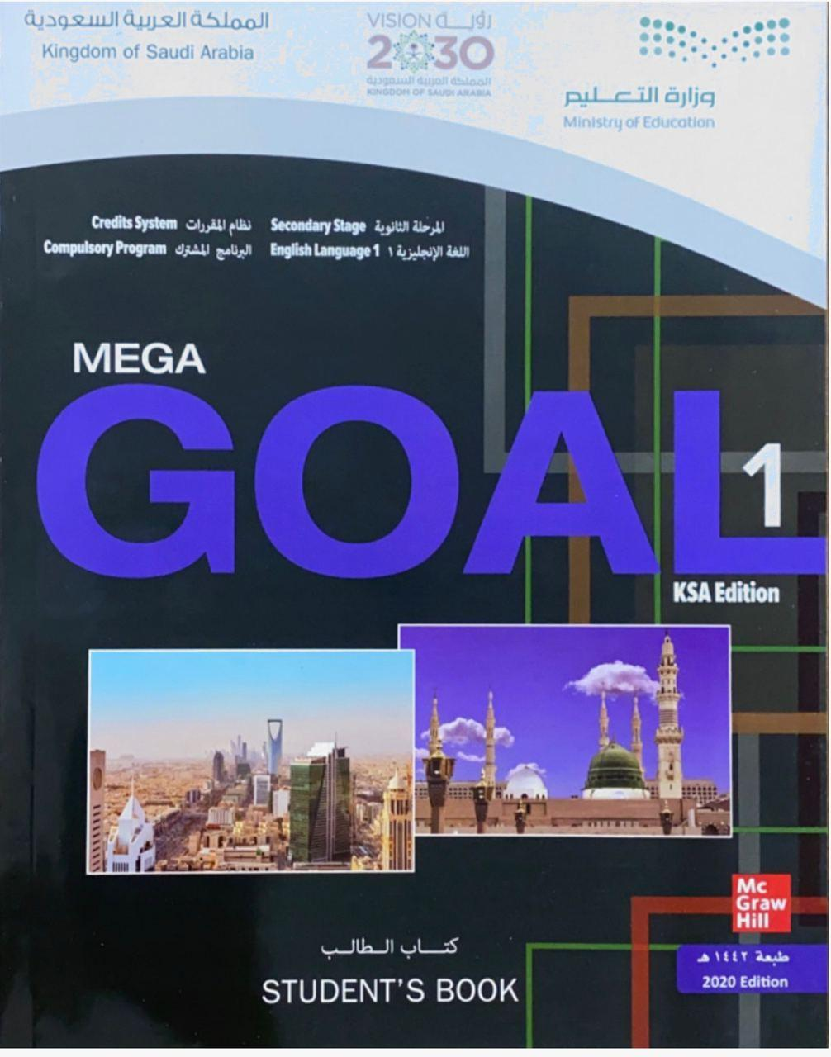

Open your Student’s book at page: 10

Slide 9
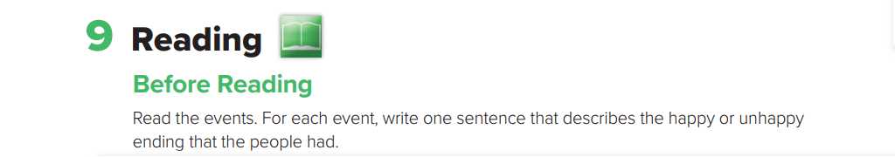
Before Reading

Slide 10
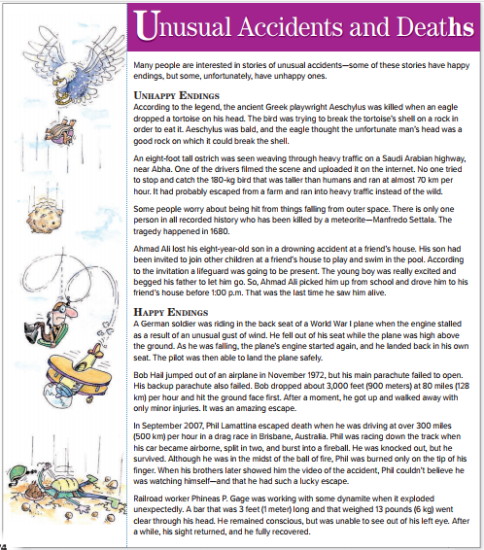


Read and Listen

Slide 11
What’s the title?
How many subheads ?
How many paragraphs?
How many photos ?

Slide 12
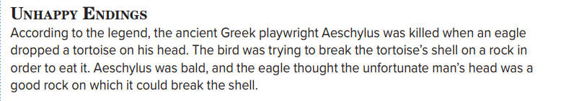
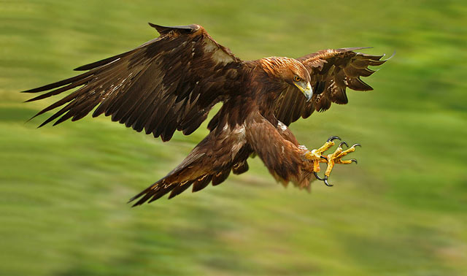

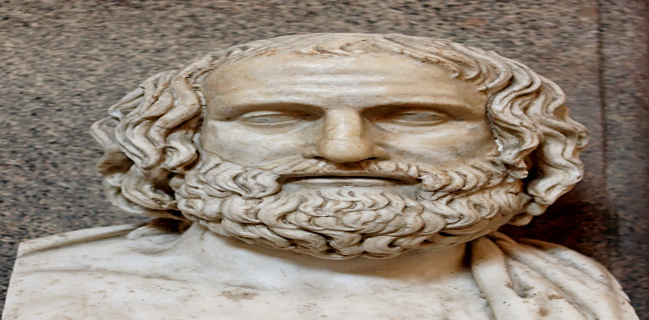
What was the name of the Greek playwright ?
How was Aeschylus killed ?
What was the eagle trying ?
What did the eagle think about the man’s head ?

Slide 13
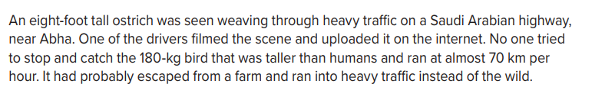

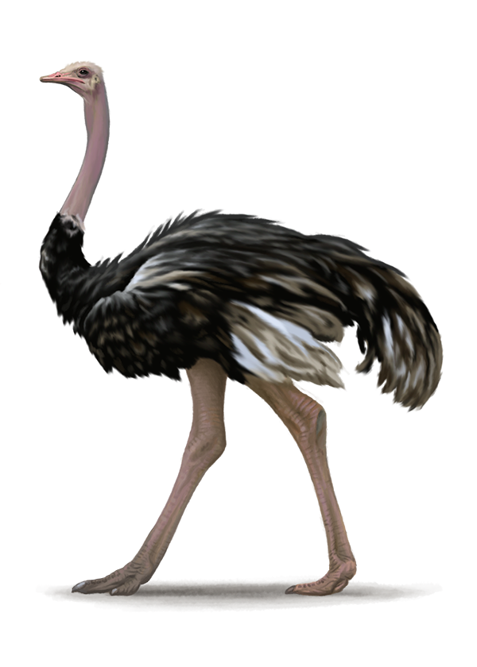
How tall was the ostrich ?
Where was the tall ostrich seen ?
How much does ostrich weigh ?
Was it taller than human ?

Slide 14
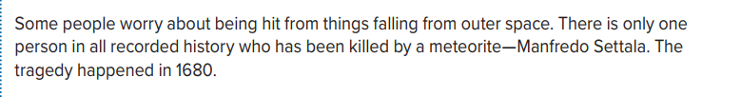

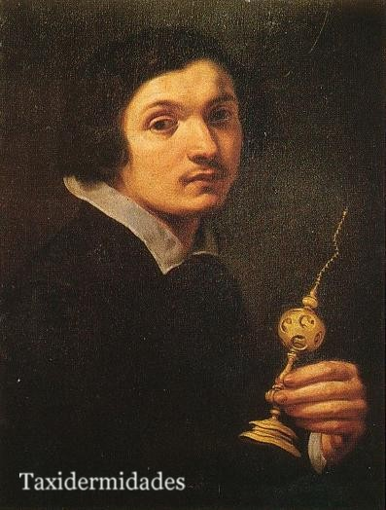
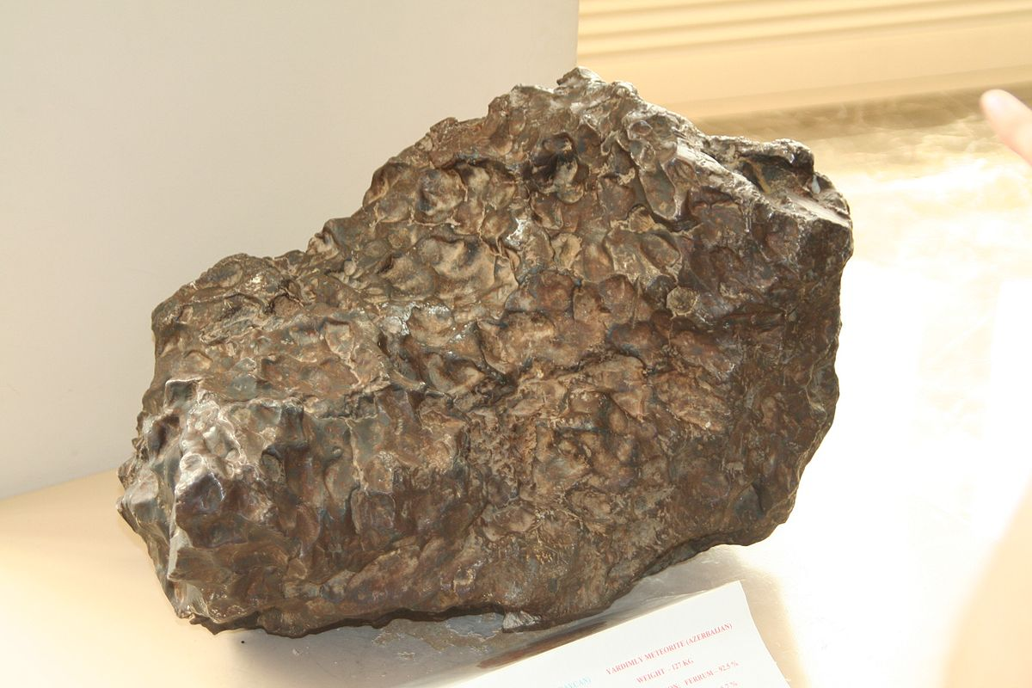
How many persons has been killed by a meteorite ?
Who was the only one person in all recorded history to be killed by a meteorite ?
When did the tragedy happen ?

Slide 15
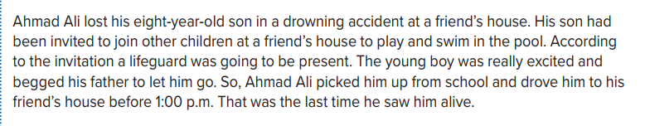

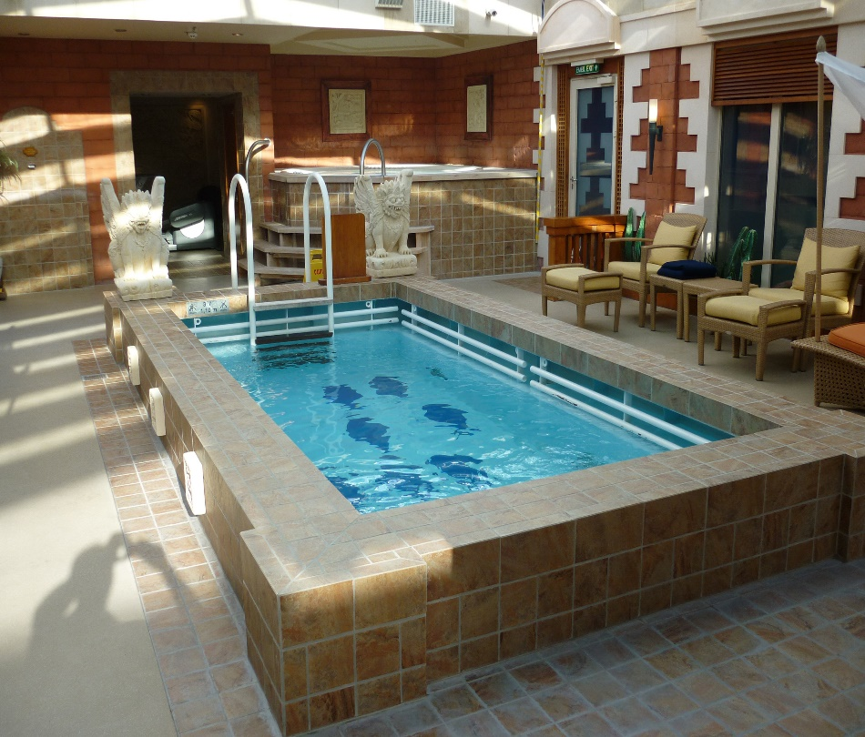
How old was Ahmad Ali’s son ?
How was Ahmad Ali’s son lost ?
Why has the son been invited to his friend’s house ?
What was the last time that Ahmad saw his son ?

Slide 16
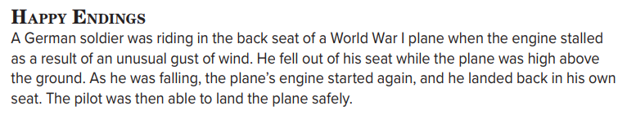

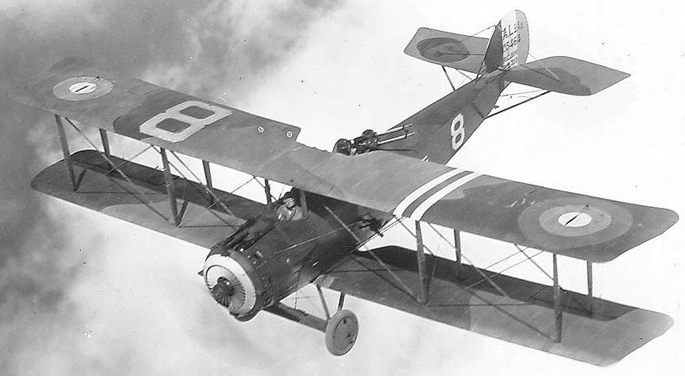
Who ?
Where ?
What happened ?

Slide 17
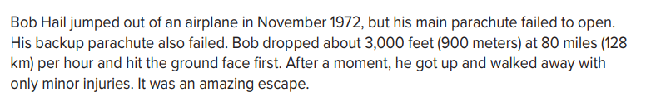
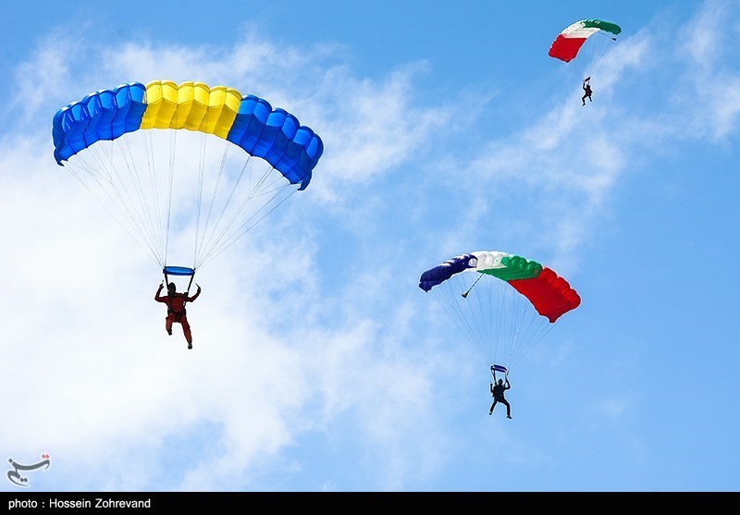
Who ?
What did he do ?
When ?
What happened to him?
How was Bob’s end?

Slide 18
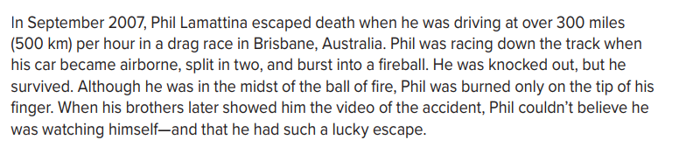

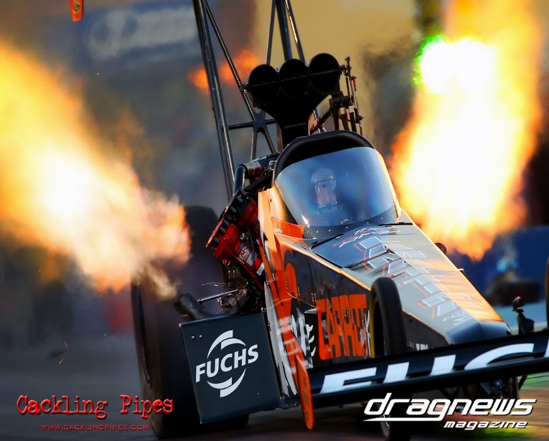
Who ?
When ?
Where ?
What happened to him?
Which part of his body was burned ?

Slide 19
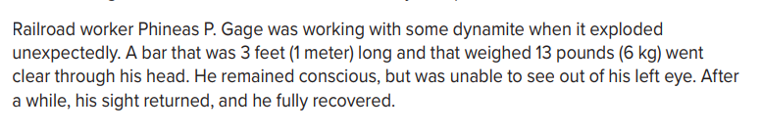
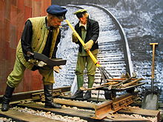
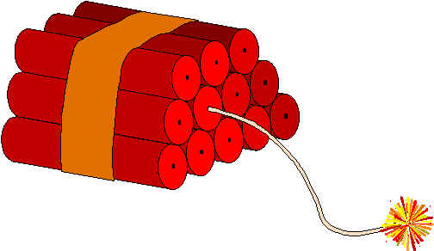
What was Phineas P. Gage’s job ?
What was the reason of the explosion ?
How long was that bar ?
How much did that bar weigh ?
What happened to him after the explosion ?

Slide 20
Open your Student’s book at page: 11

Slide 21
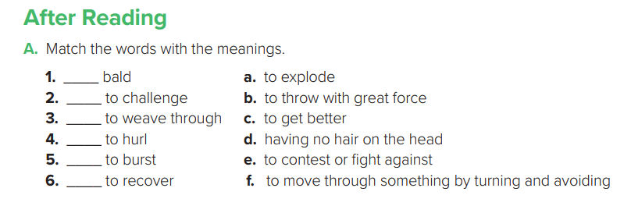
d
e
f
b
a
c

Slide 22
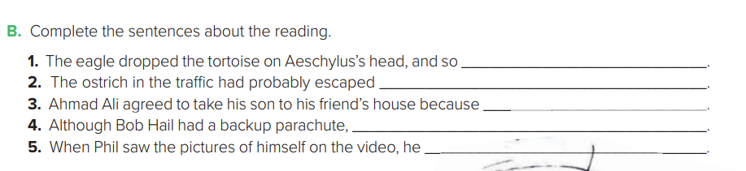
Aeschylus was killed
from a farm
many children were invited and a lifeguard was going to be present
it didn’t open
couldn’t believe he survived

Slide 23
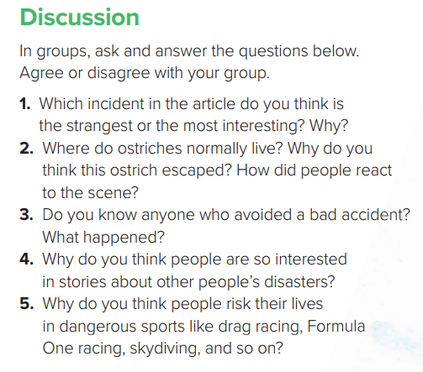

Slide 24


