Slide 1





Hope you all fine . .

Slide 2
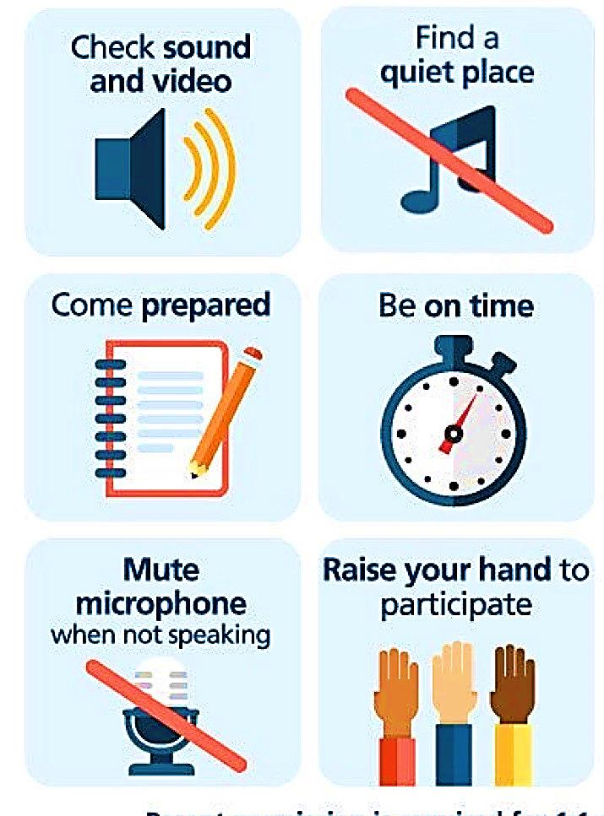
Online classroom rules!

Slide 3
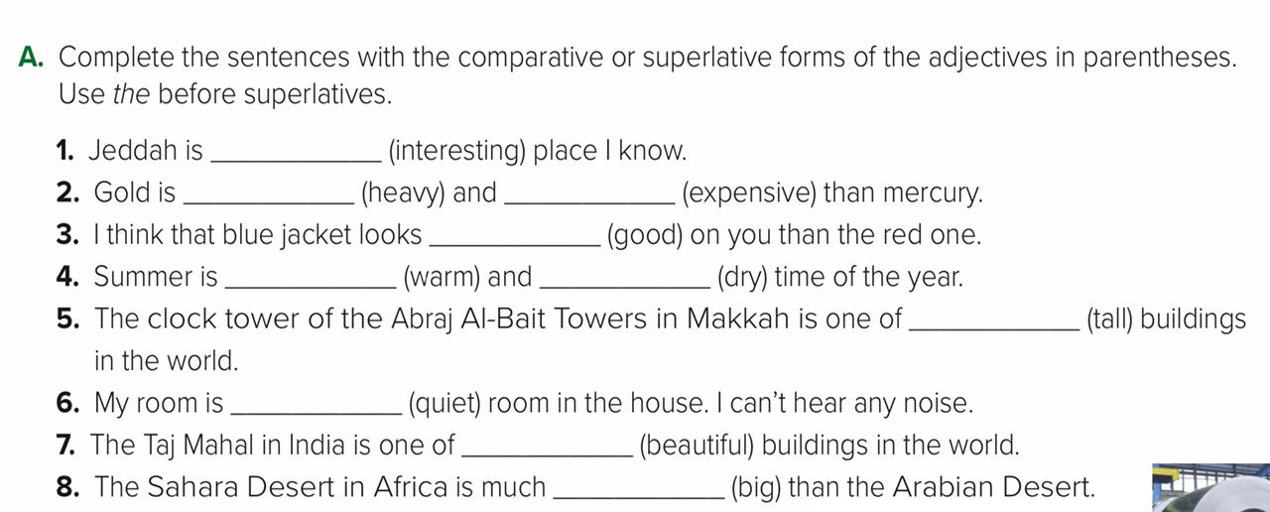
H.W answers
the most interesting
heavier
more expensive
better
the warmest
the driest
the tallest
the quietest
the most beautiful
bigger

Slide 4

U3. There’s no comparison
Listening and conversation
P21-22

Slide 5
Objectives
Improve
listening
skill
Use real talk in examples
1
2
3
4
Improve reading skill
Answer questions about the conversation

Slide 6
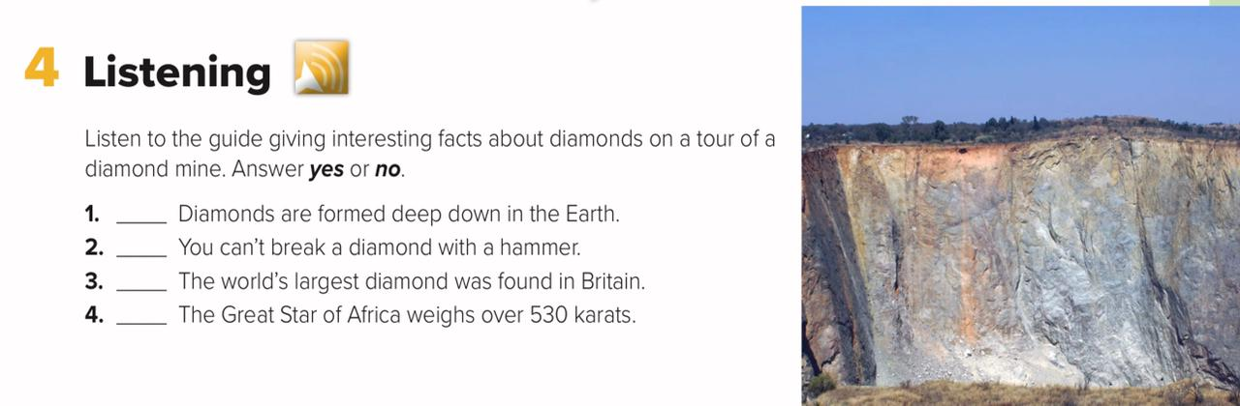

Slide 7
Yes
No
No
Yes

Slide 8

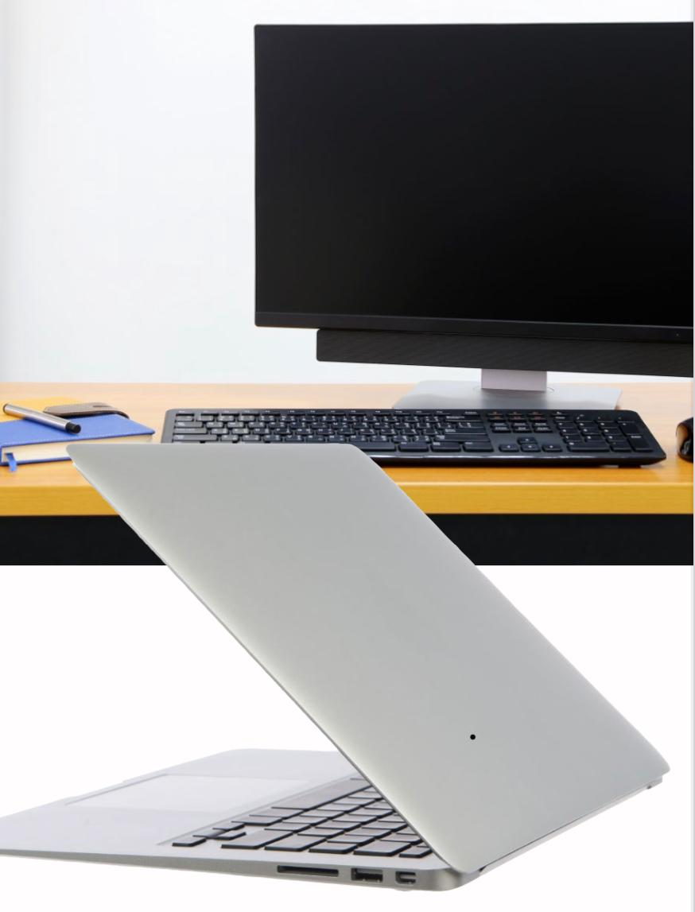

Warm up
What are these?
Why do people use them?
What comparisons can you make about desktop and laptop computers?

Slide 9
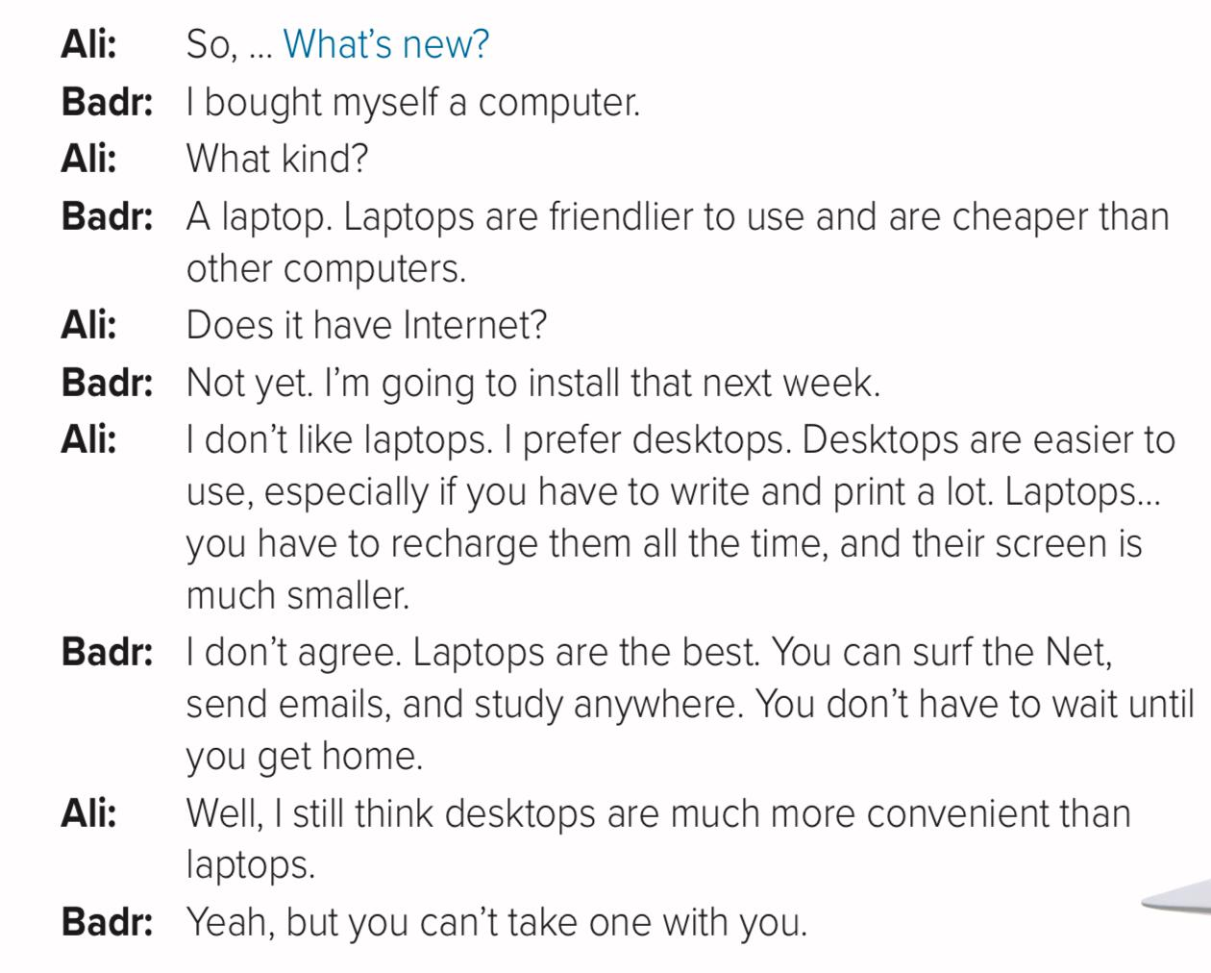

Slide 10


Slide 11
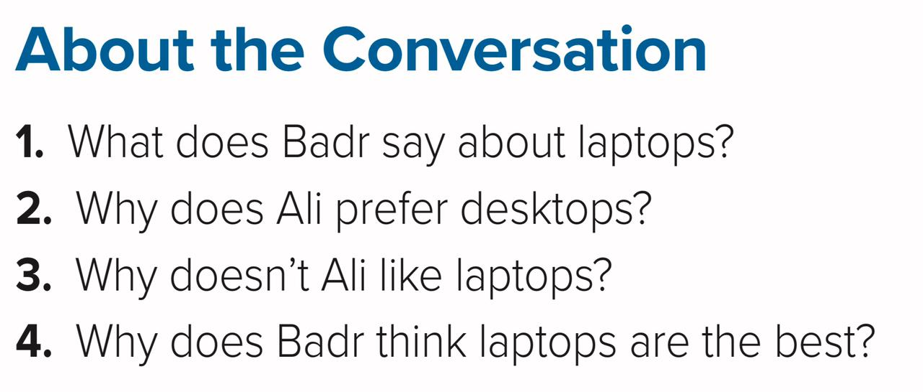

Slide 12
Badr says that laptops are friendlier to use and cheaper than other computers.
1
Ali prefers desktops because they are easier to use if you have to write and print a lot.
2
3
Ali doesn’t like laptops because you have to recharge them all the time, and their screen is smaller.
3
Badr thinks that laptops are the best because you can surf the Net, send emails, and study anywhere.

Slide 13

Dear Students,
Be selective on what you watch or use on laptop

Slide 14



