Slide 1
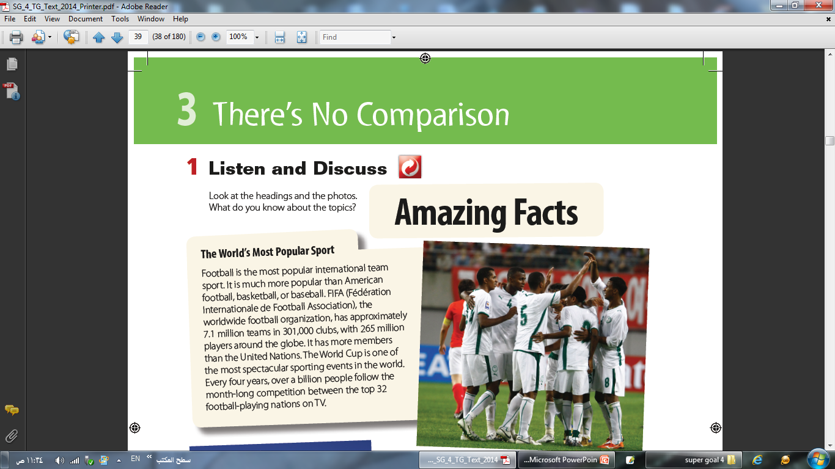
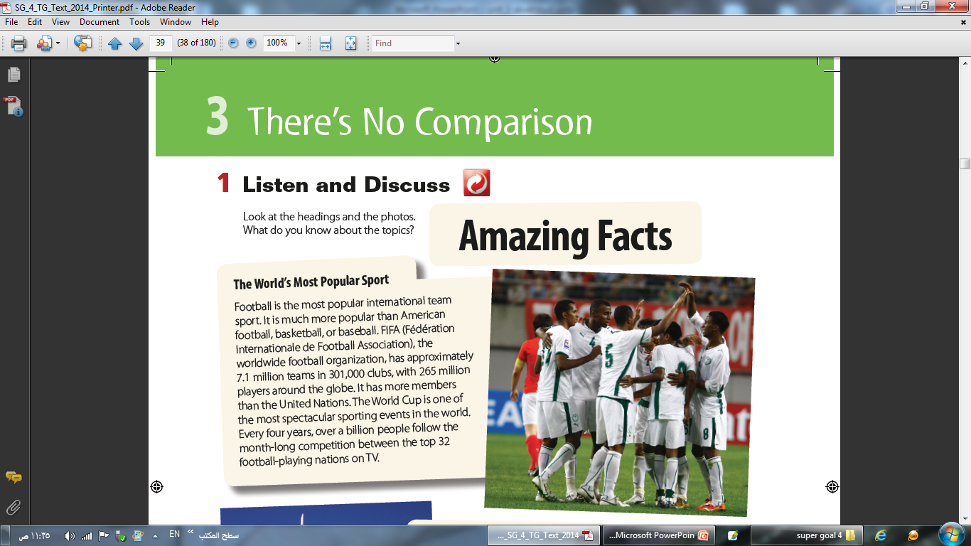

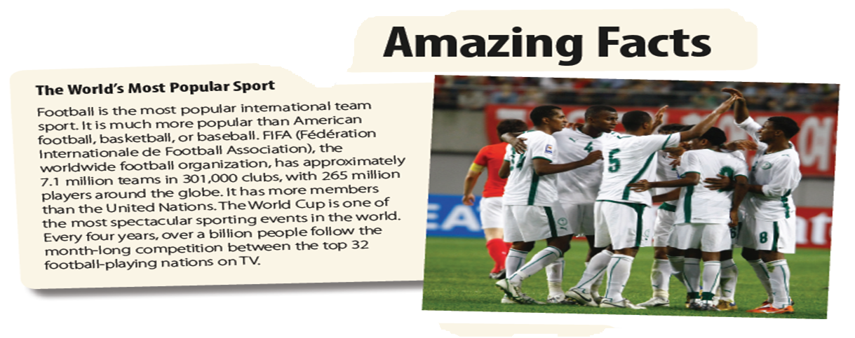

Slide 2
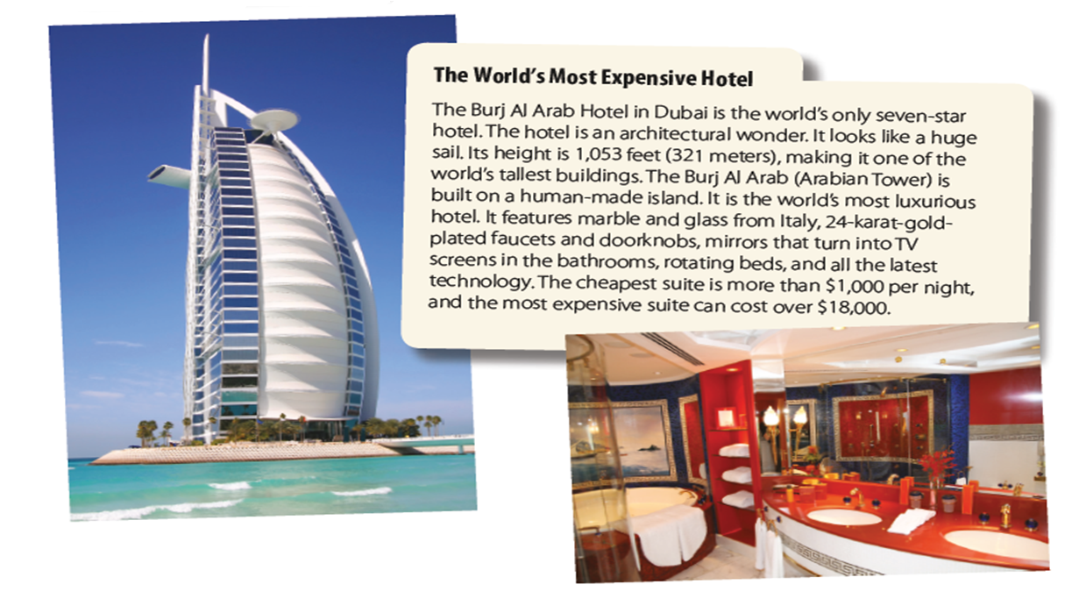

Slide 3
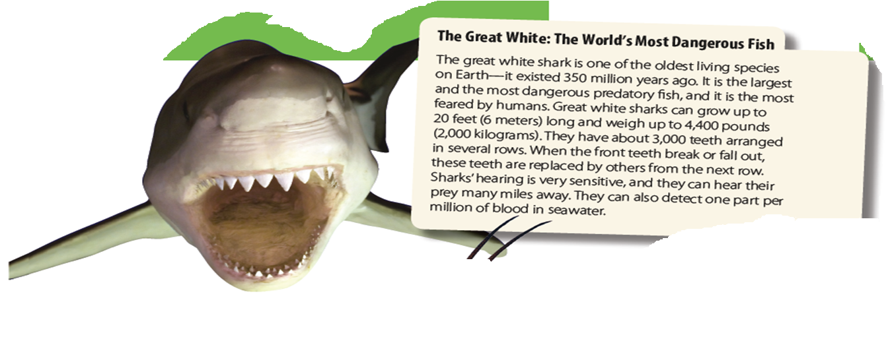
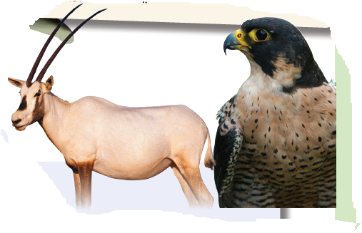
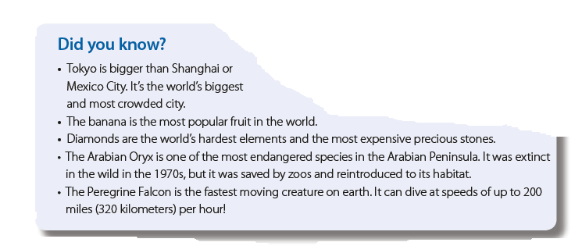

Slide 4
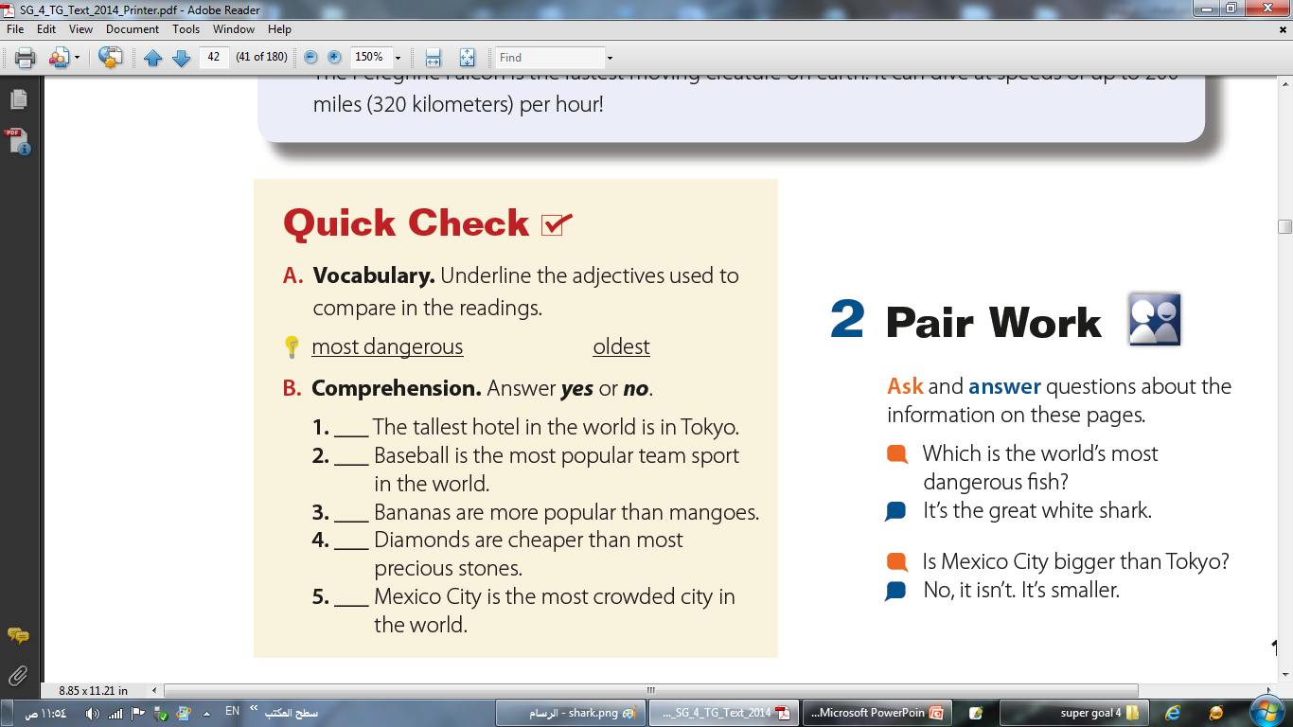
No
No
yes
No
No

Slide 5
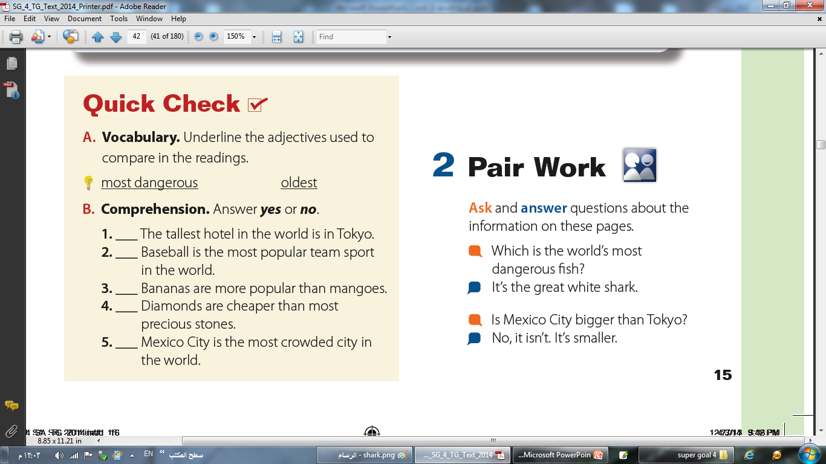

Slide 6
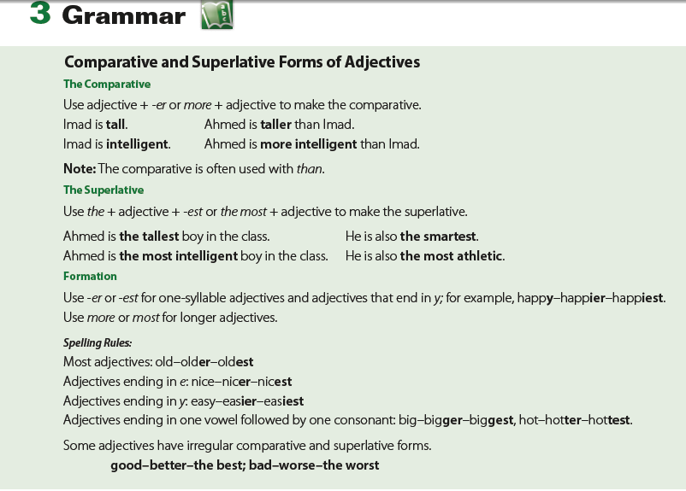

Slide 7
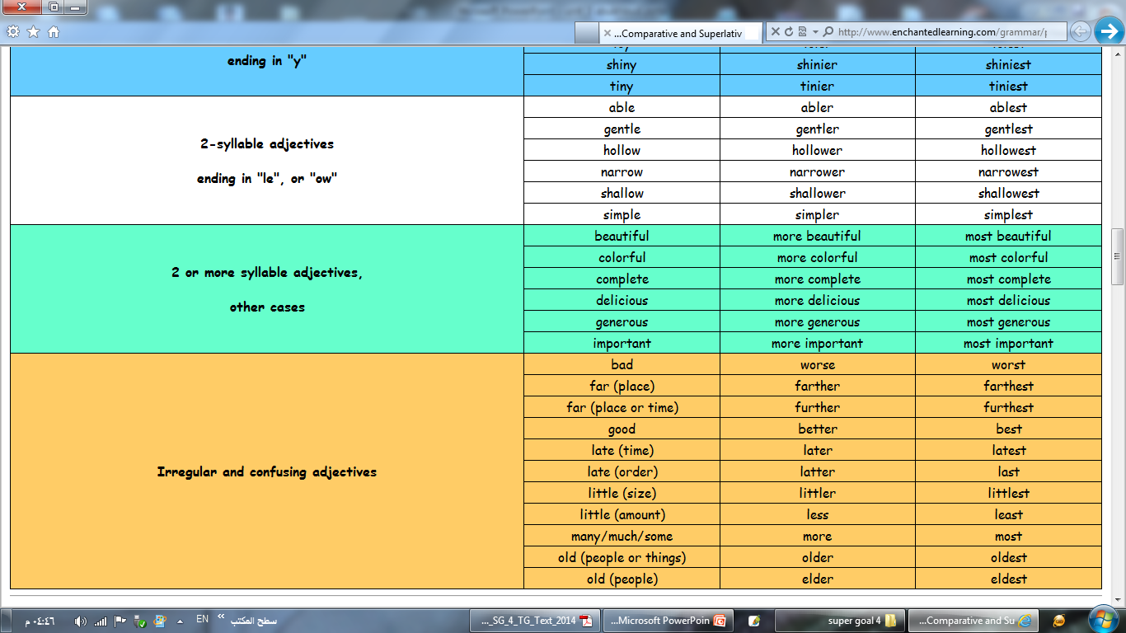
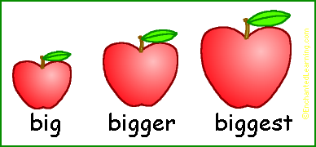
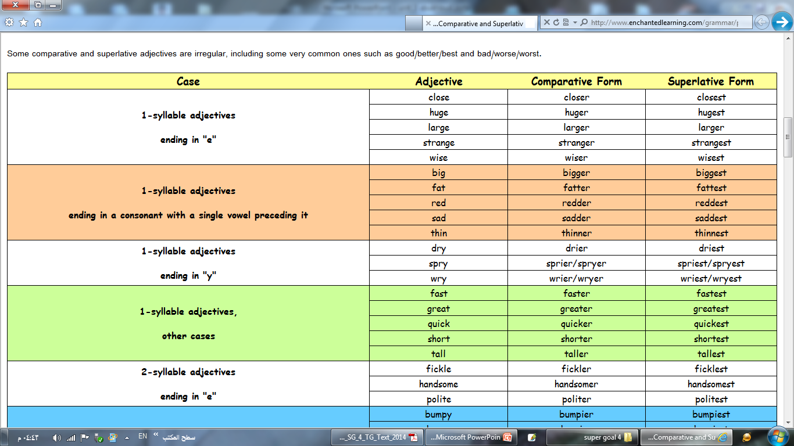
A comparative adjective is used to compare two things.
Use adjective + -er or more + adjective to make the comparative.
1
2
Imad is tall.
Ahmed is taller than Imad.
Imad is intelligent.
1
2
Ahmed is more intelligent than Imad.
Note:
The comparative is often used with than.
1: If a one syllable adjective ends in "e", the endings are "-r"
2: If a one syllable adjective ends in "y", change “y” to “i” and add “er”
3: If a one syllable adjective ends in a consonant (with a single vowel preceding it), then the consonant is doubled and the endings "-er"
4: The adjectives with two or more syllables, the comparative is formed by adding the word "more”

Slide 8
A superlative adjective is used when you compare three or more things.
Use the + adjective + -est or the most + adjective to make the superlative.
Ahmed is the tallest boy in the class.
He is also the smartest.
Ahmed is the most intelligent boy in the class.
He is also the most athletic.
1: If two syllables adjective ends in "e", the endings are "-st"
2: If two syllable adjective ends in "y", change “y” to “i” and add “est”
3: If two syllables adjective ends in a consonant (with a single vowel preceding it), then the consonant is doubled and the endings "-est"
4: The adjectives with two or more syllables, the comparative is formed by adding the word “the most ,“

Slide 9
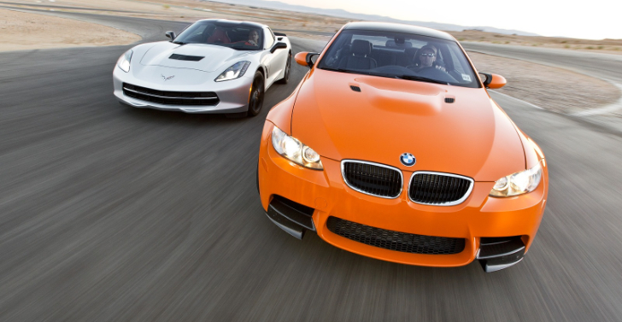
Some comparative and superlative adjectives are irregular such as:
My car is better than your car. ( good )
My car is the best car in the city. ( good )

Slide 10
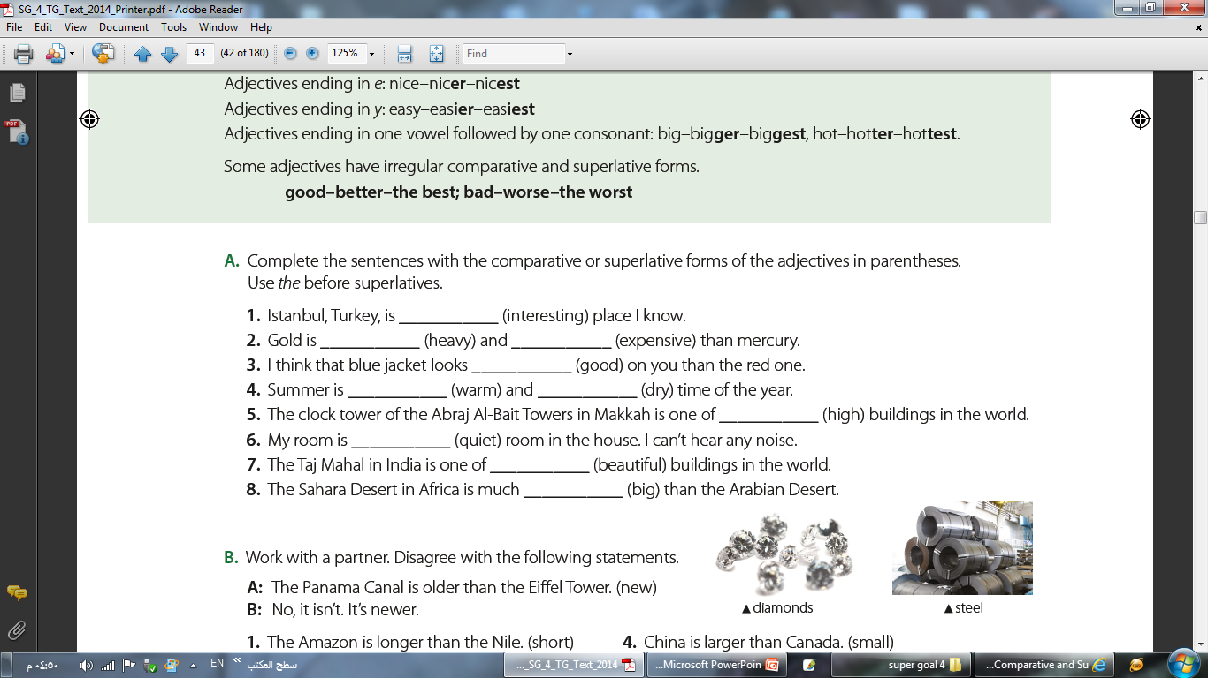
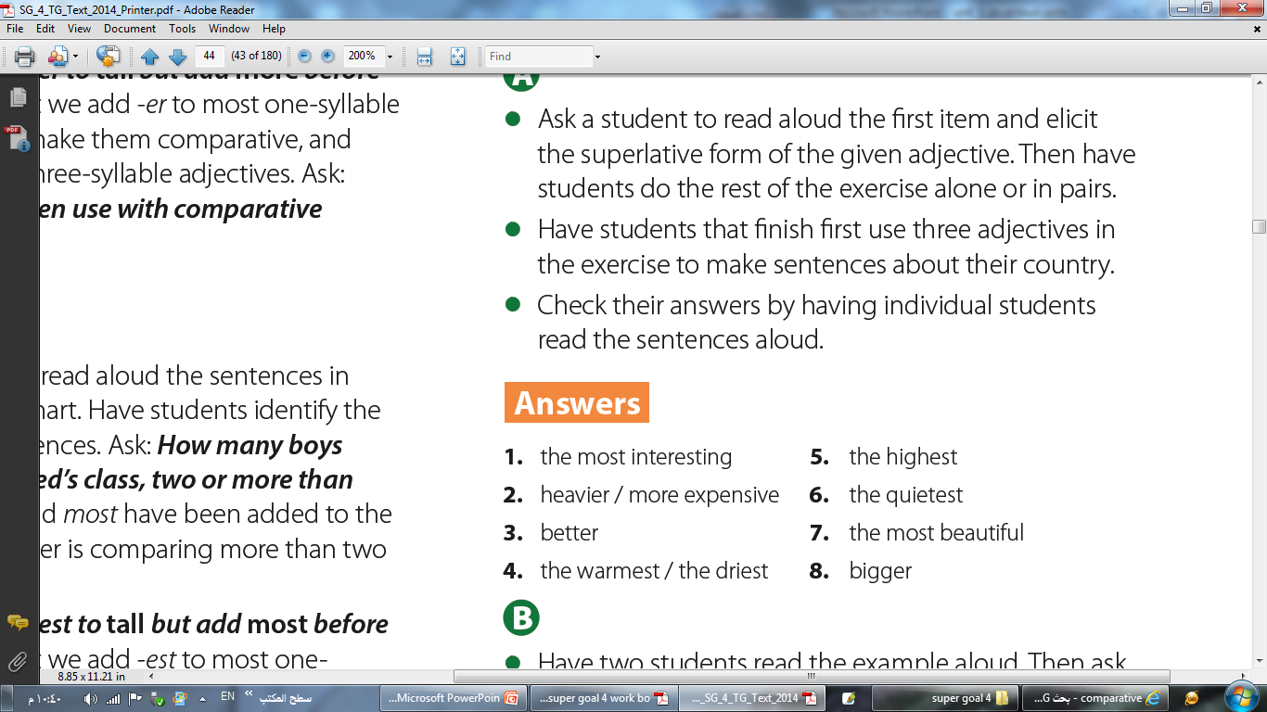
the most interesting

Slide 11
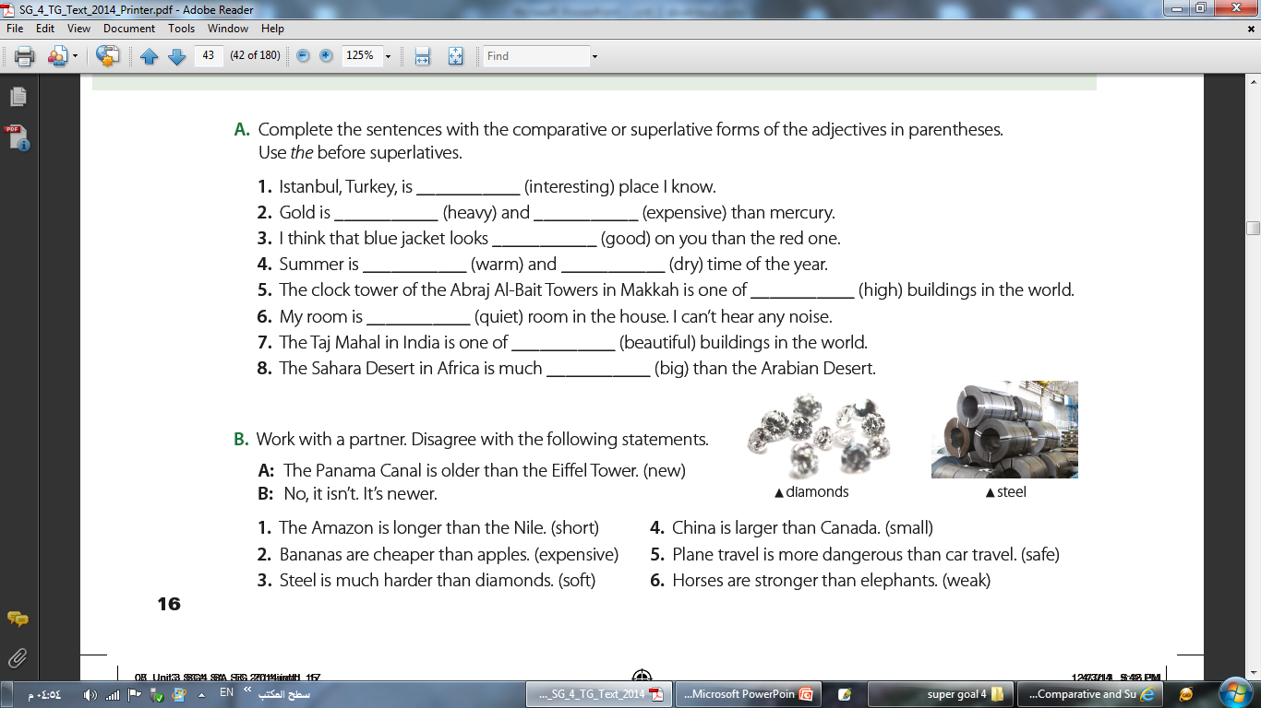
No, it isn’t.
It’s shorter.
No, they aren’t. They’re more expensive.
No, it isn’t. It’s softer.
No, it isn’t. It’s smaller.
No, it isn’t. It’s safer.
No, they aren’t. They’re weaker.

Slide 12
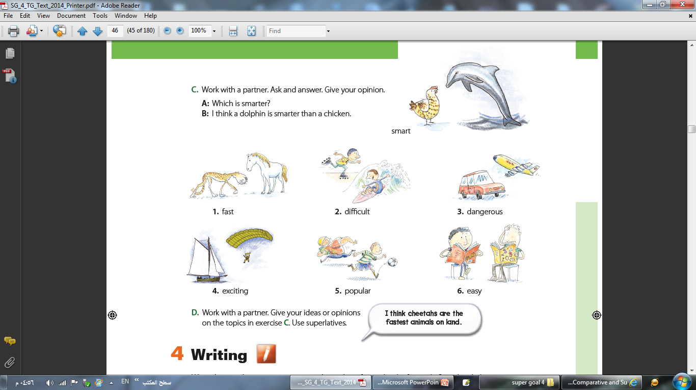
a horse
a cheetah
Which is faster?
I think a cheetah is faster than a horse.

Slide 13
a cheetah
a horse
rollerblading
surfing
Which is faster?
Which is more difficult?
I think a cheetah is faster than a horse.
I think surfing is more difficult than rollerblading.
driving
flying
diving
sailing
Which is more dangerous?
I think driving is more dangerous than flying.
Which is more exciting?
I think sky diving is more exciting than sailing.
rugby
football
English
math
Which is more popular?
Which is easier?
I think football is more popular than rugby.
I think English is easier than math.

Slide 14
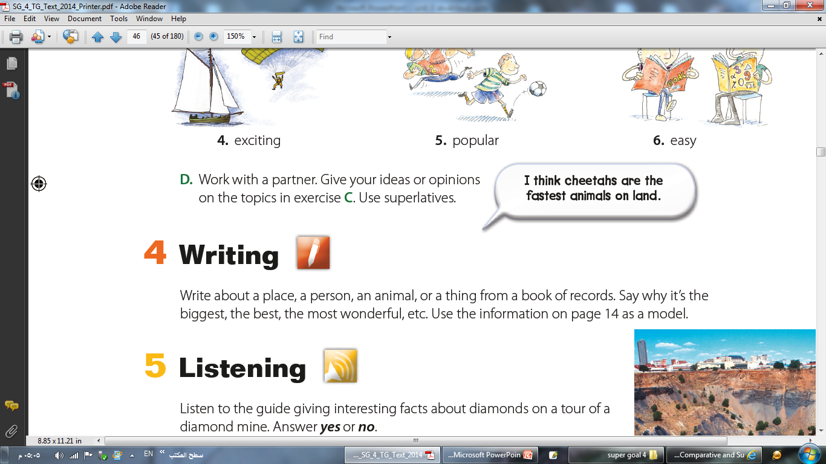

Slide 15
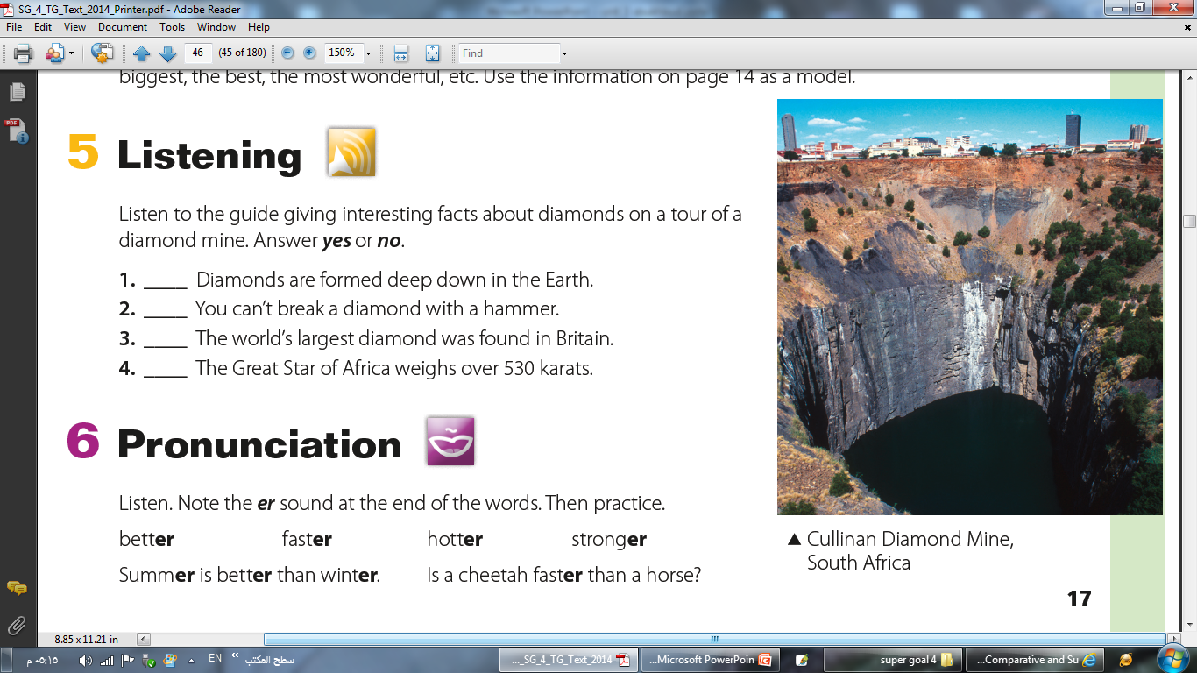
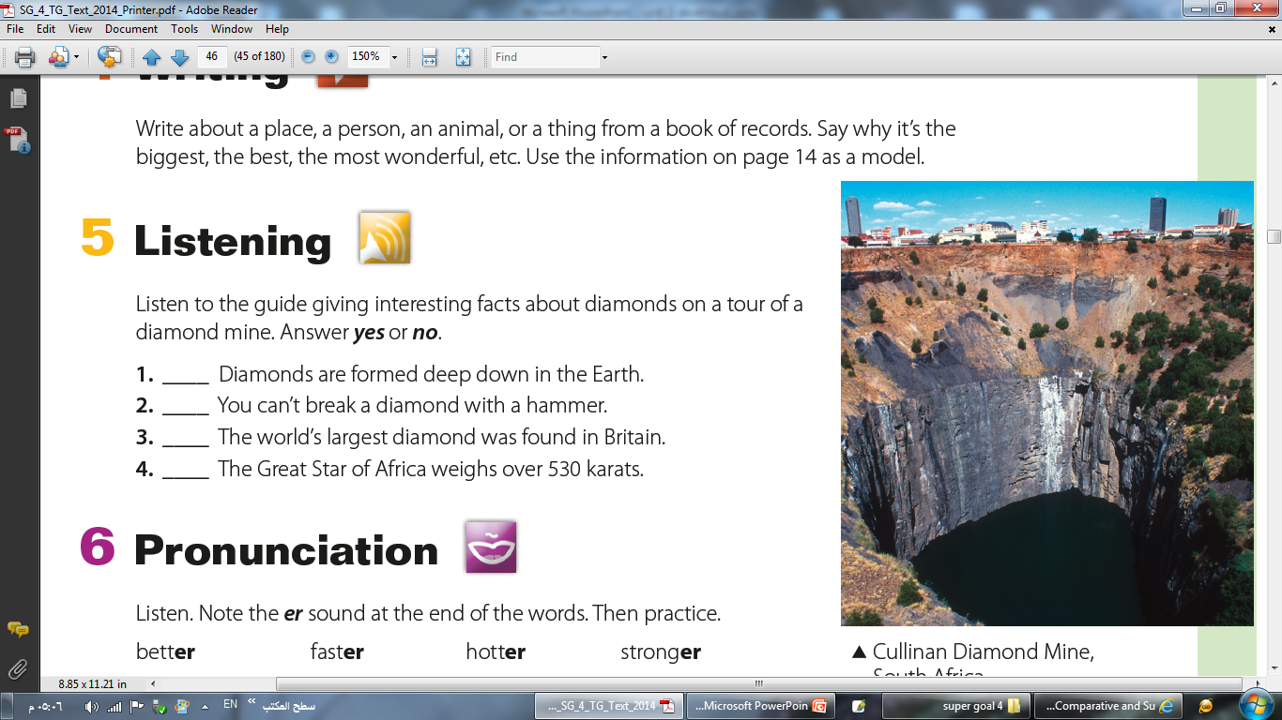
Yes
No
No
Yes

Slide 16
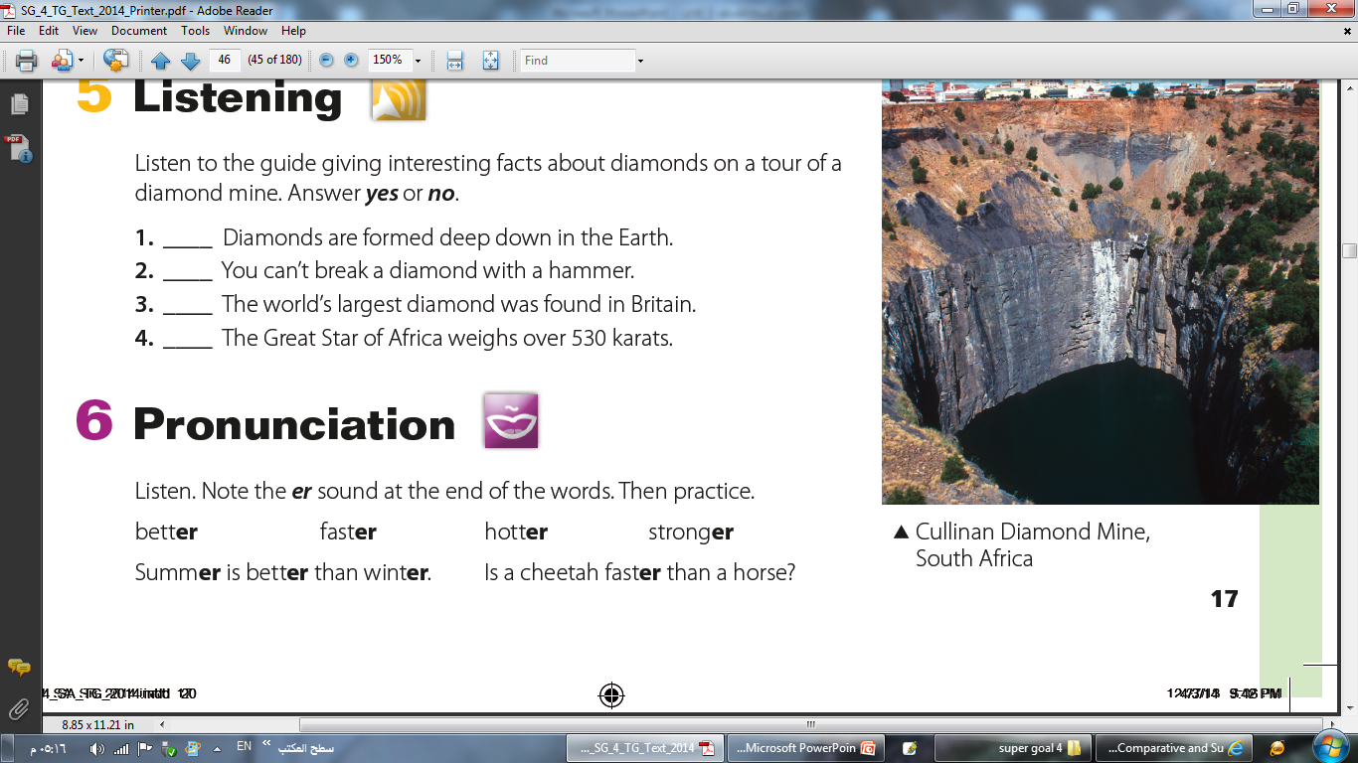

Slide 17
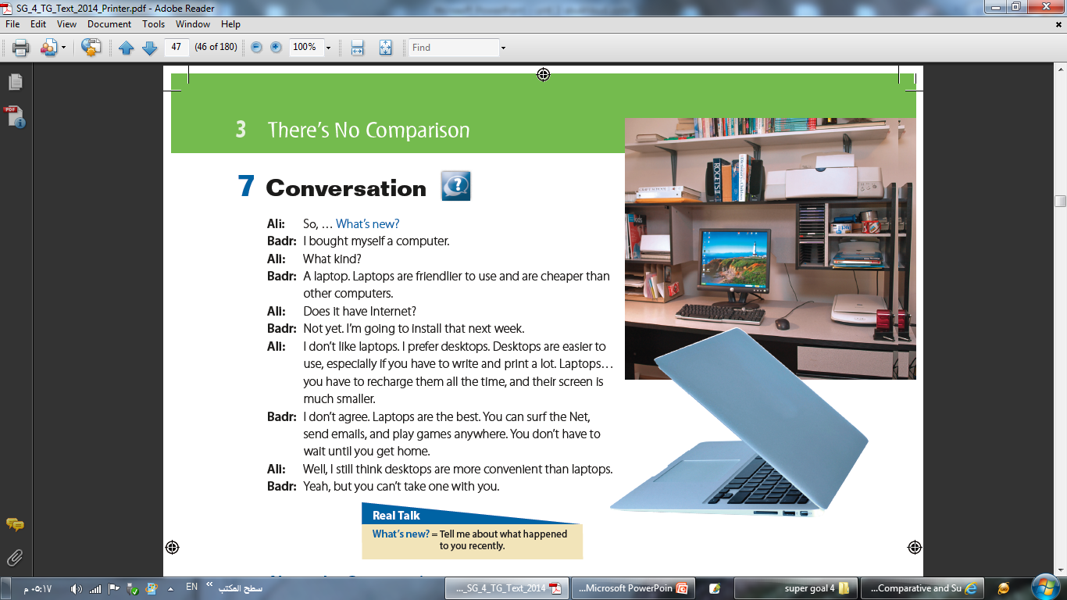
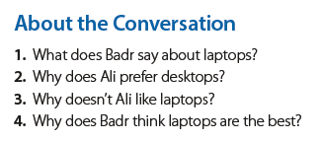
1: He says that laptops are friendlier to use and cheaper than other computers
2: Because they are easier to use if you have to write and print a lot.
3: Because you have to recharge them all the time, and their screen is smaller.
4: Because you can surf the Net, send emails, and play games anywhere.

Slide 18
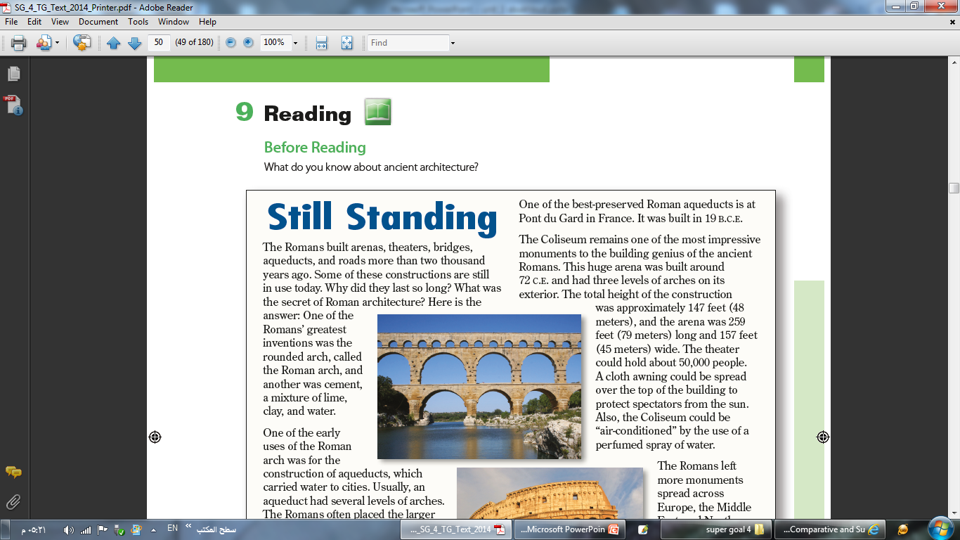
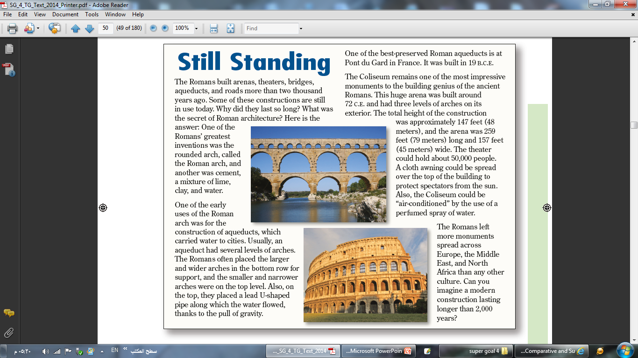

Slide 19
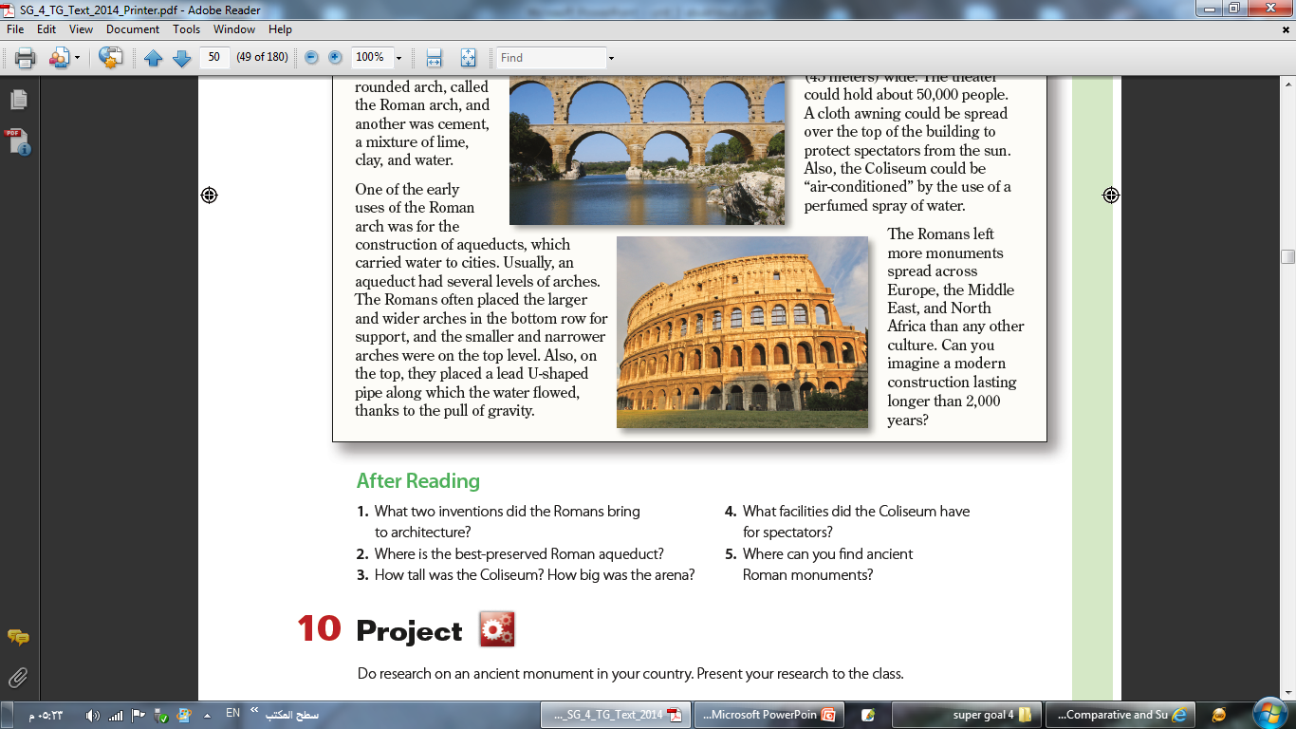
1. The Romans invented the rounded arch and cement
2. The best-preserved Roman aqueduct is the Pont du Gard in France.
3. The Coliseum was 48 meters tall. The arena was 79 meters long and 45 meters wide.
4. The Coliseum had an awning to protect spectators from the sun. The Coliseum was air-conditioned by the use of a perfumed spray of water.
5. You can find ancient Roman monuments across Europe, the Middle East, and North Africa.

Slide 20
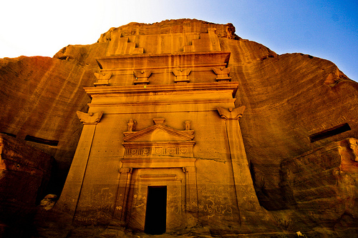
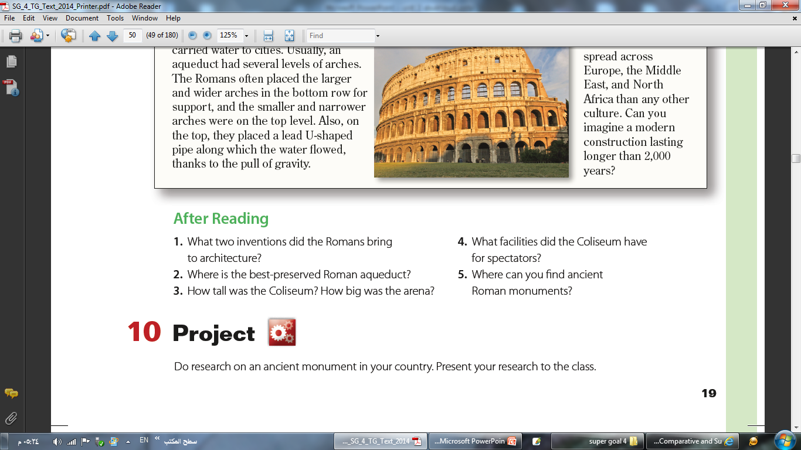

Slide 21
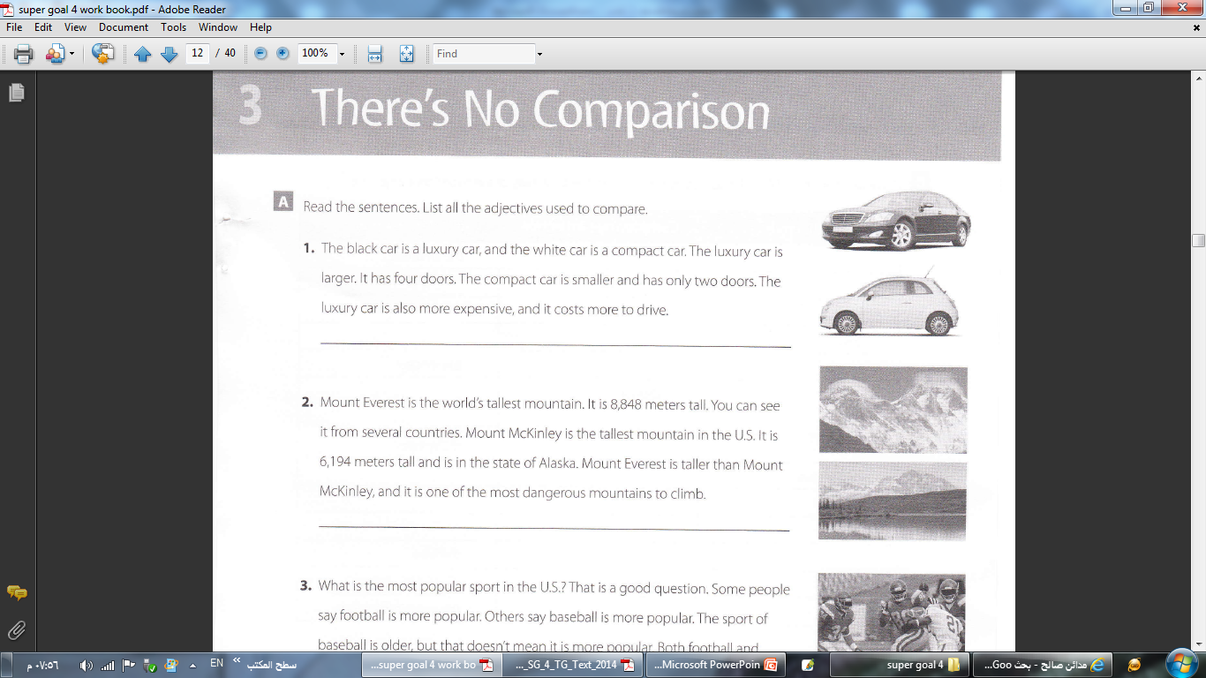
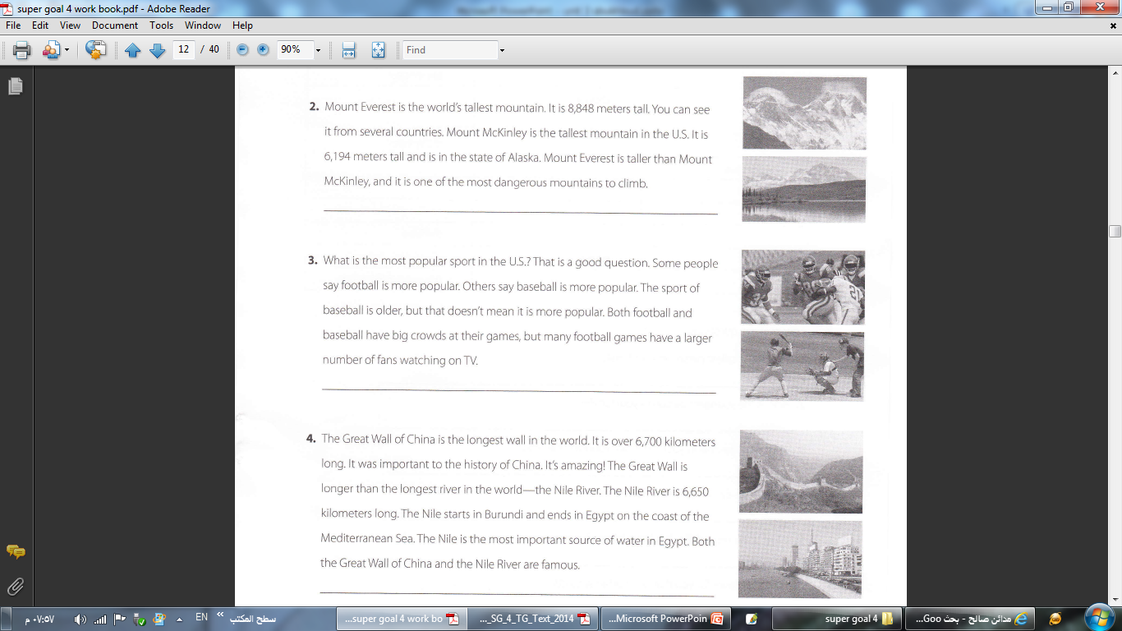
larger, smaller, more expensive
the…tallest, the tallest, taller, the most dangerous
the most popular, more popular, more popular, older, more popular, larger
the longest, longer, the longest, the most important

Slide 22
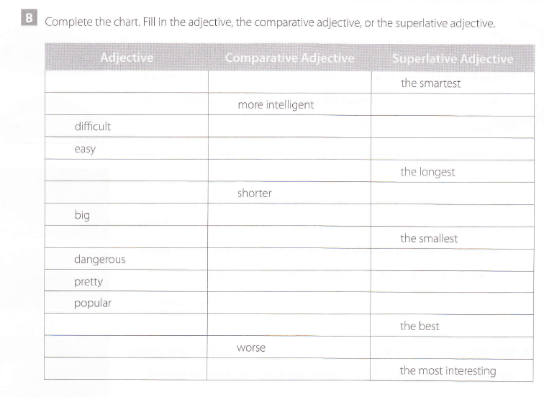
smart
smarter
intelligent
the most intelligent
more difficult
the most difficult
easier
the easiest
long
longer
short
the shortest
bigger
the biggest
small
smaller
more dangerous
the most dangerous
prettier
the prettiest
more popular
the most popular
good
better
bad
the worst
interesting
more interesting

Slide 23
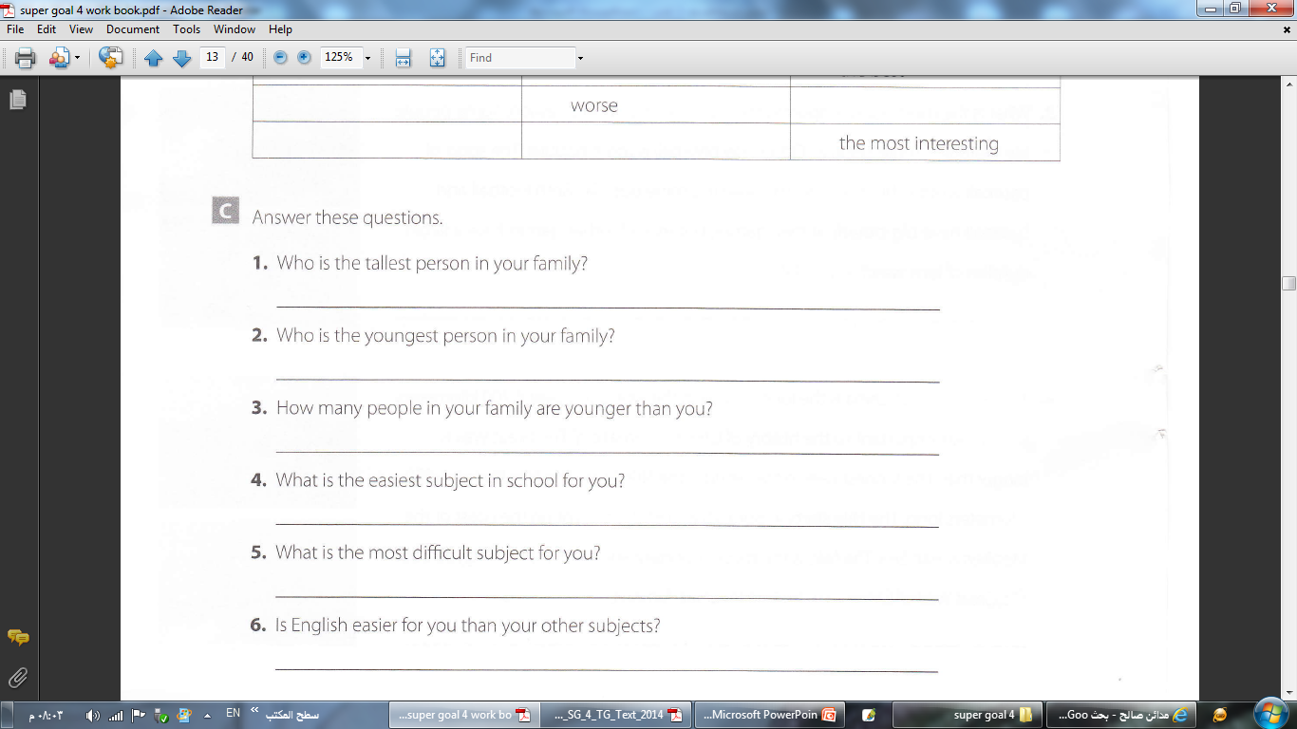
My father is the tallest person in my family.
I am the youngest person in my family.
No one in my family is younger than I am.
Arabic is the easiest subject in school for me.
Math is the most difficult subject for me.
Yes, English is easier for me than my other subjects.

Slide 24
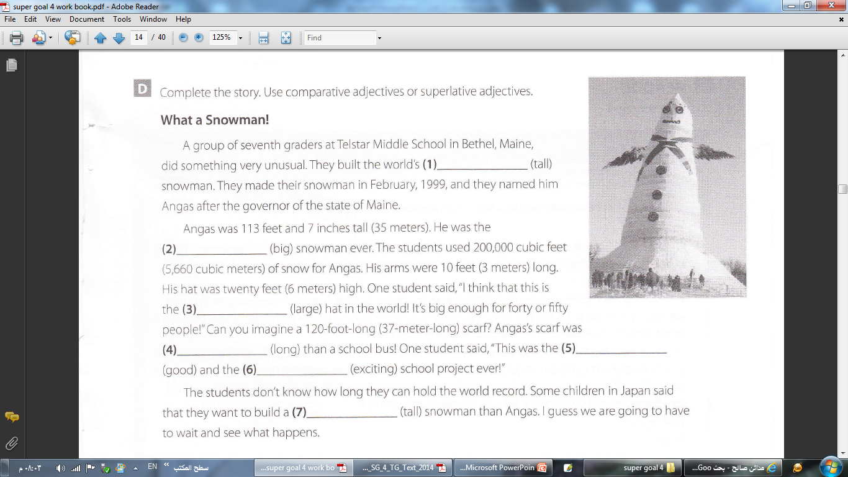

tallest
biggest
largest
longer
best
most exciting
taller
Yes
No
Yes
Yes
No

Slide 25
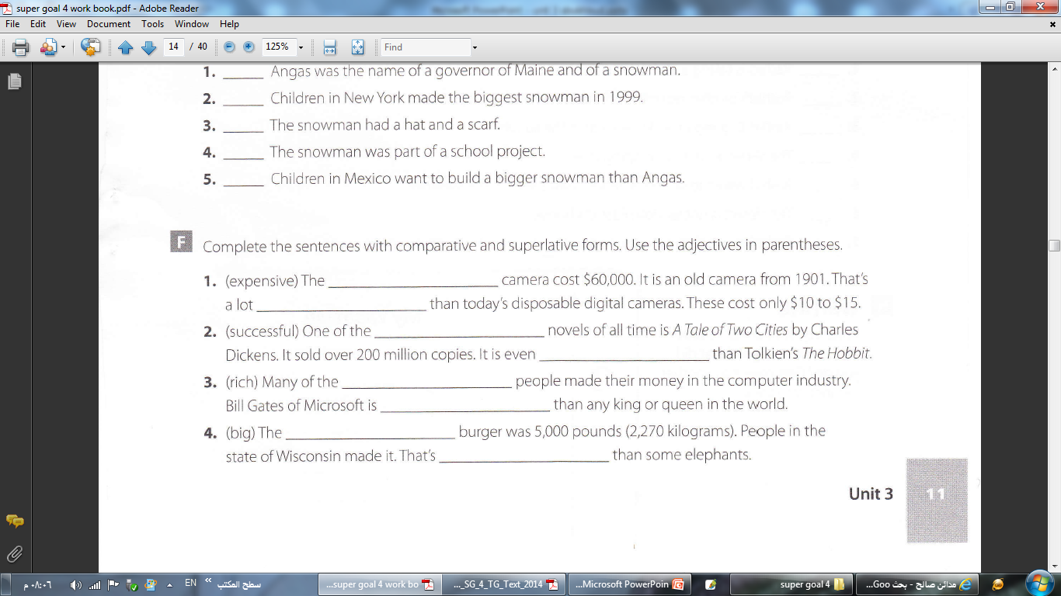
most expensive
more expensive
most successful
more successful
richest
richer
biggest
bigger

Slide 26
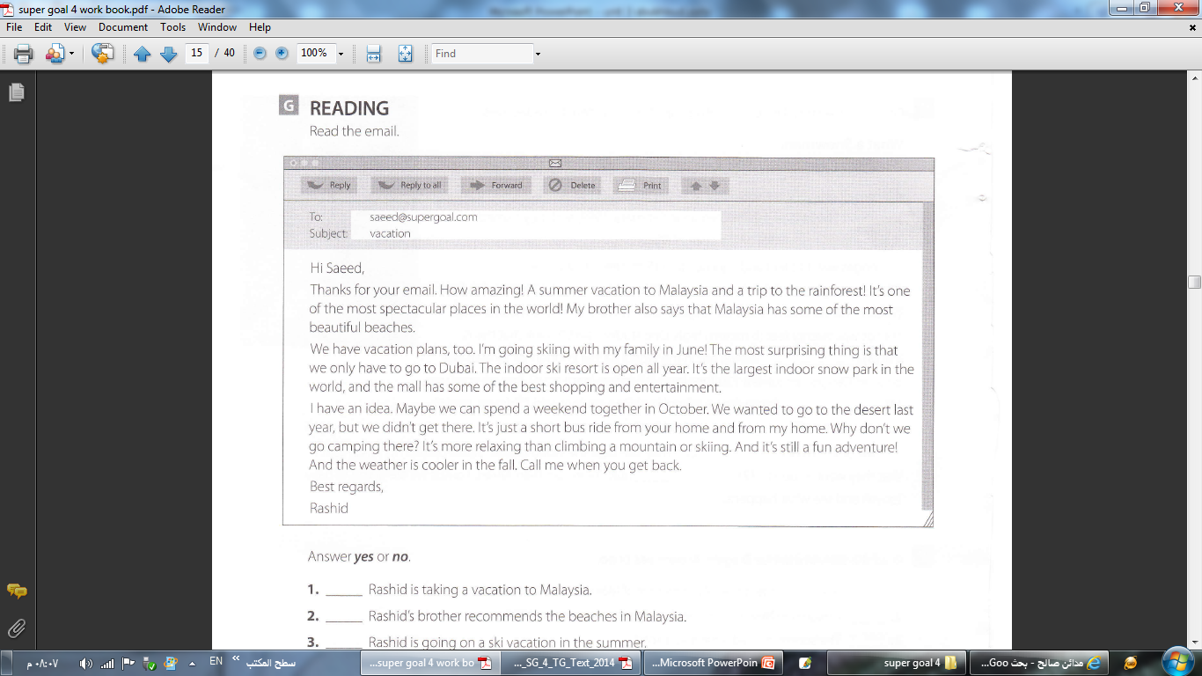
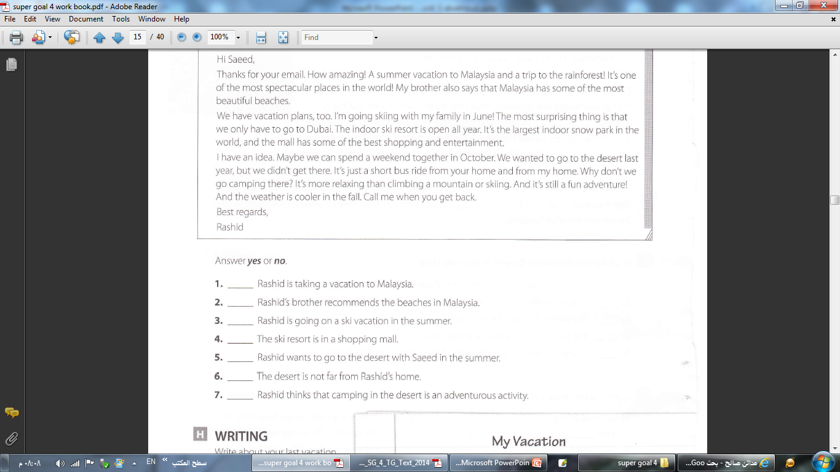
No
Yes
Yes
Yes
No
Yes
Yes

Slide 27
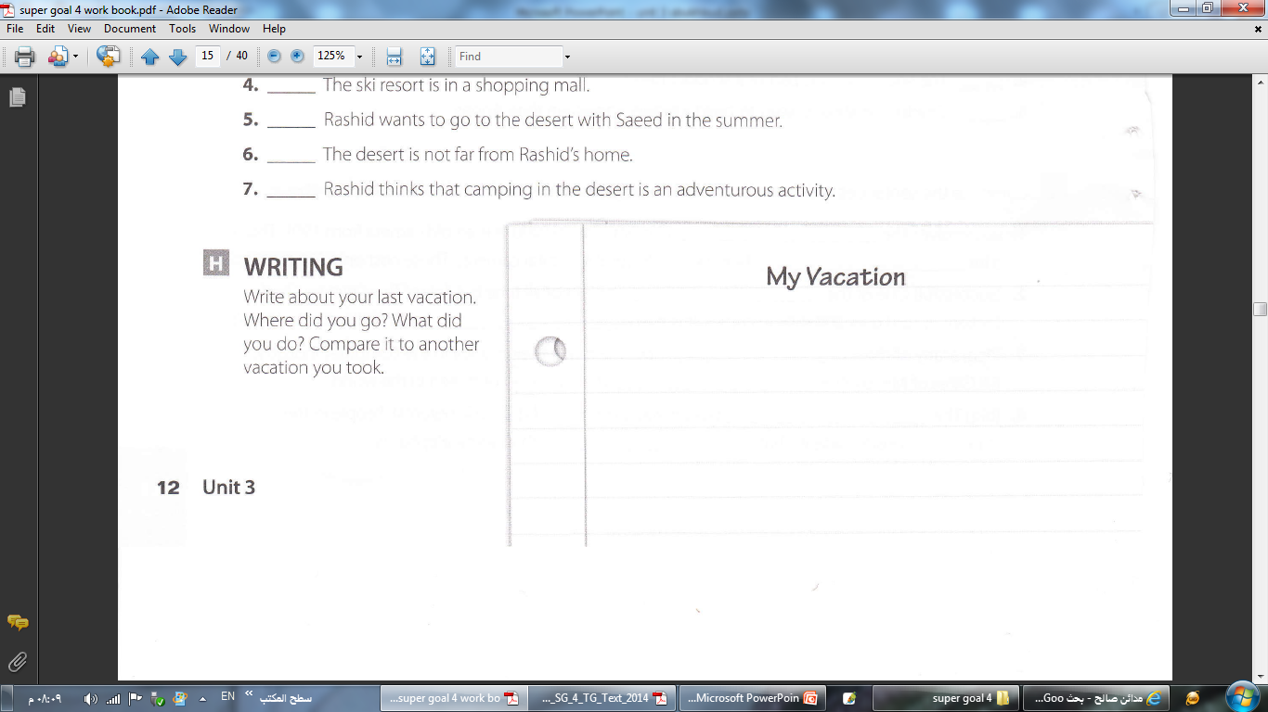
I went to Pike’s Peak in Colorado. It was great! We took a train to the top of the mountain. It is the tallest mountain in the state of Colorado. Before that, I went to the beach on vacation. It was fun, but I really like the mountains. For me, the mountains are nicer than the beach. Hiking is more fun than swimming, so my vacation to Pike’s Peak was better than my vacation to the beach.

