Slide 1
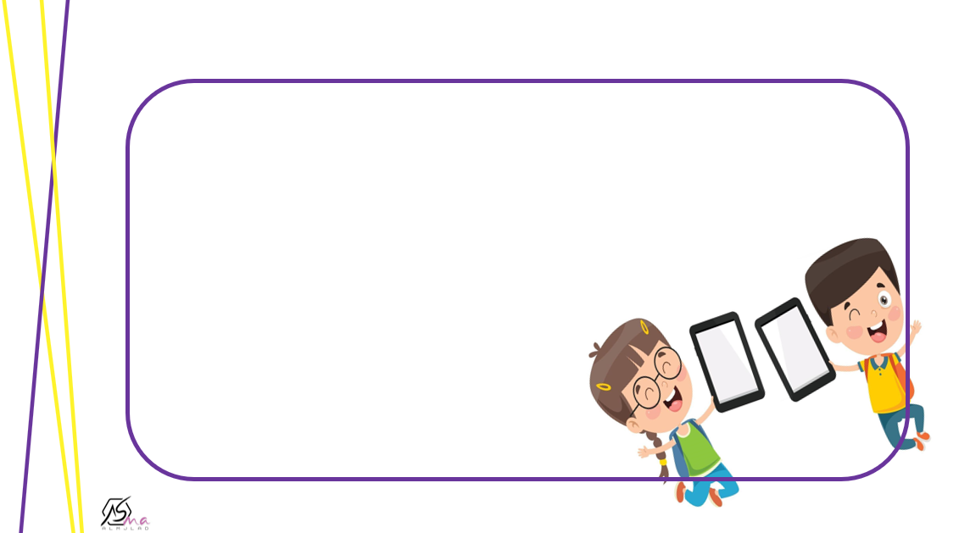

Homework
p.222

Slide 2
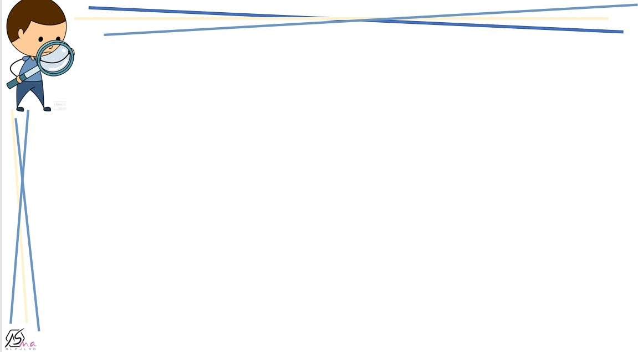
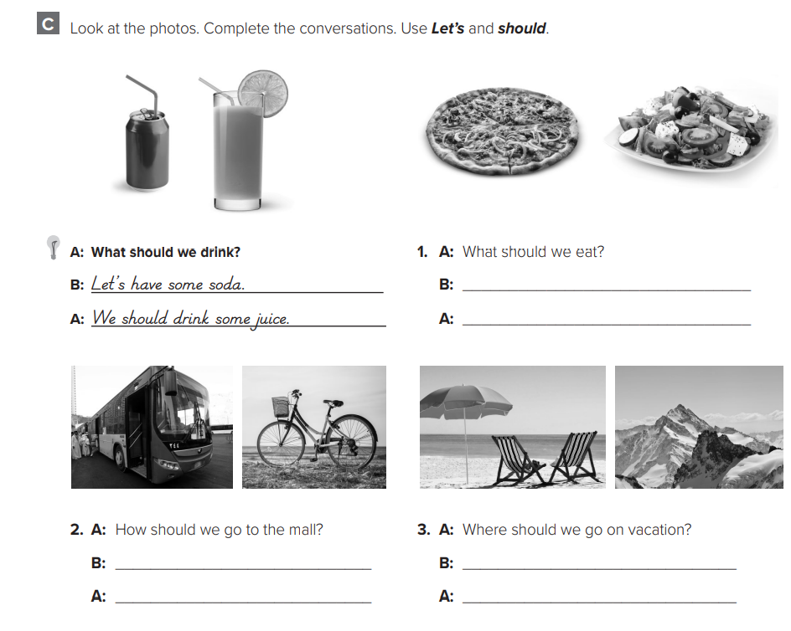
B: Let’s have some pizza.
A: We should eat some salad.
2. B: Let’s take the bus.
A: We should ride our bikes.
B: Let’s go to the beach.
A: We should go to the mountains.

Slide 3
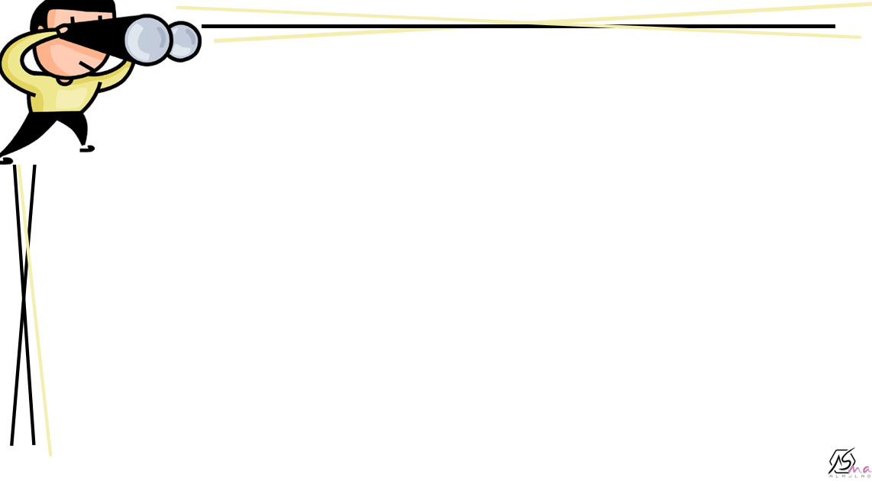
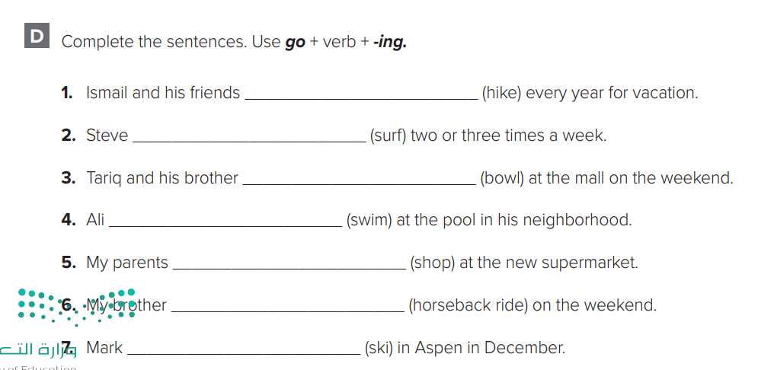
go hiking
goes surfing
go bowling
. goes swimming
go shopping
goes horseback riding
goes skiing

Slide 4
LET’S GO OUT ▪️CONVERSATION
Day: Tuesday
Date : 24/6/1444

Slide 5

GOALS
Listen to invitations and match excuses
Pronounce the reduction have to.
Listen to a conversation and practice
Role play a conversation.

Slide 6
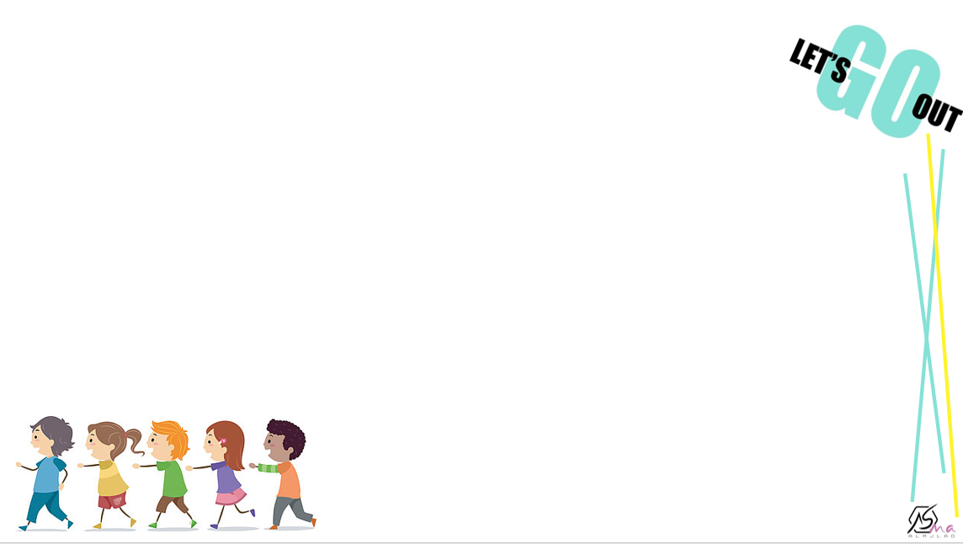

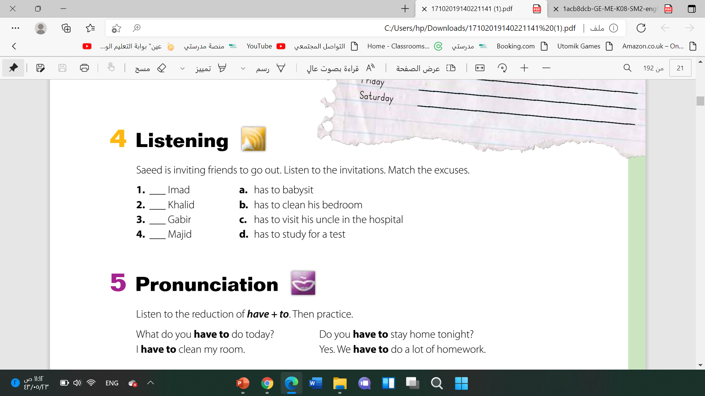


Saeed calls four friends. What are their names?
d
a
c
b
77

Slide 7
77

Slide 8
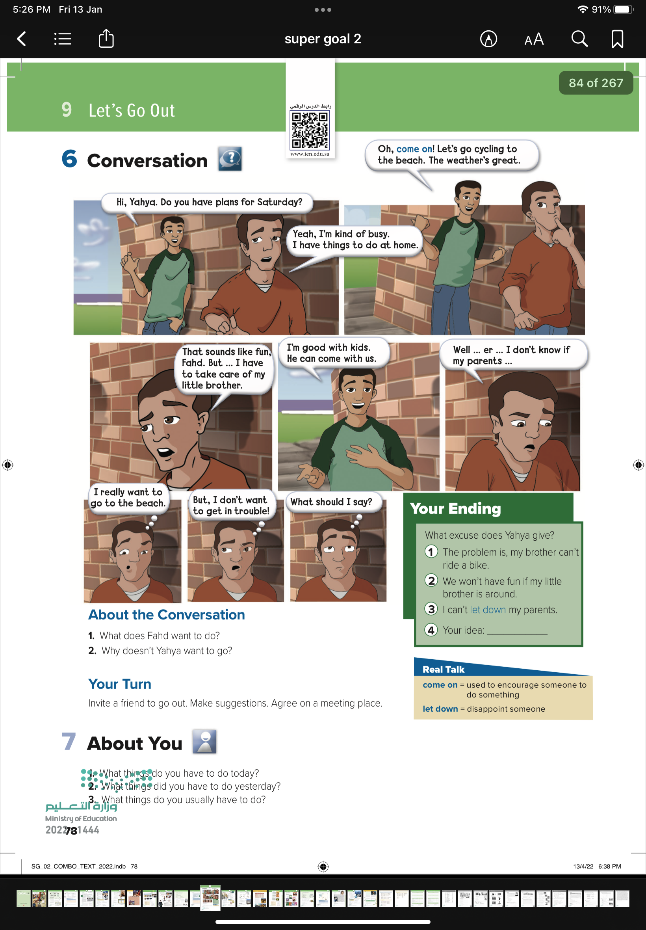
78

Slide 9
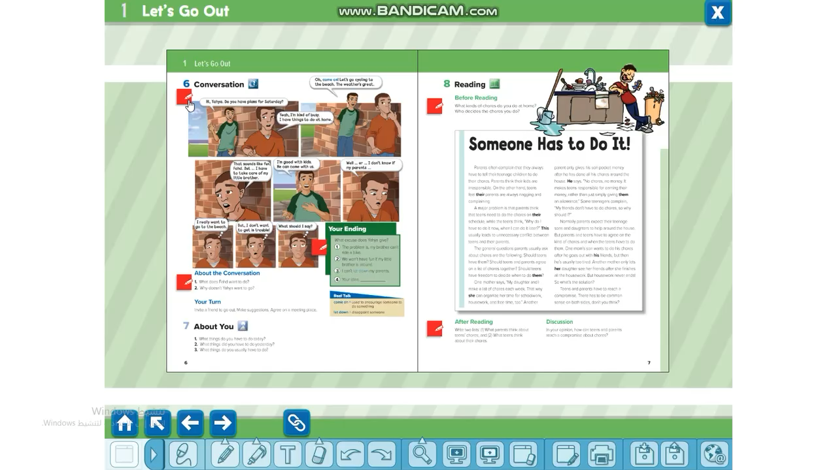

Slide 11
Fahad wants to go cycling to the beach.
Because he might get in trouble.

Slide 12
78

Slide 13
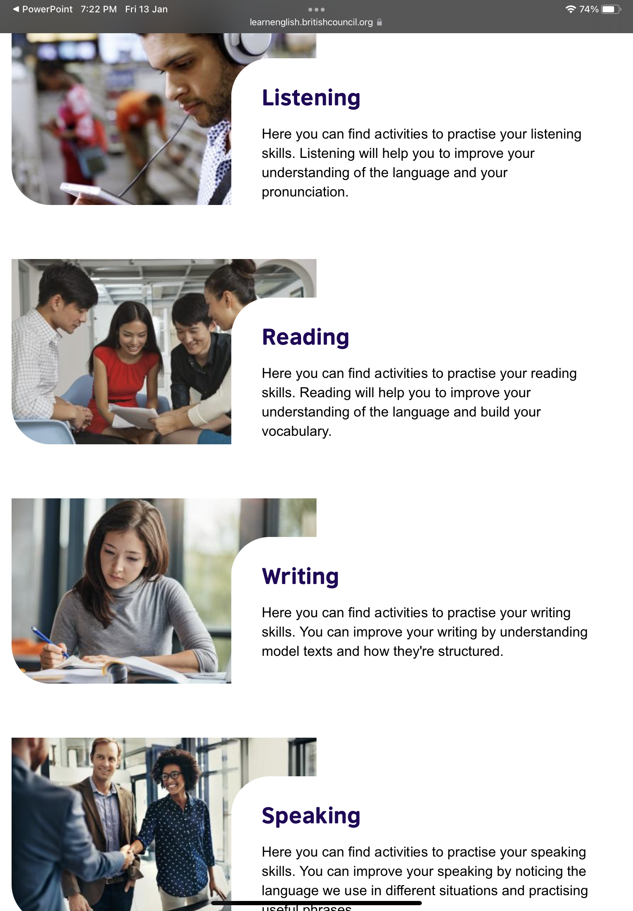
For improvement of any skill go to
https://learnenglish.britishcouncil.org/skills

Slide 14
Role play
High level thinking skill

Slide 15
1- What things do you have to do today?
2- What things did you have to do yesterday?
3- What things do you usually have to do ?

Slide 16


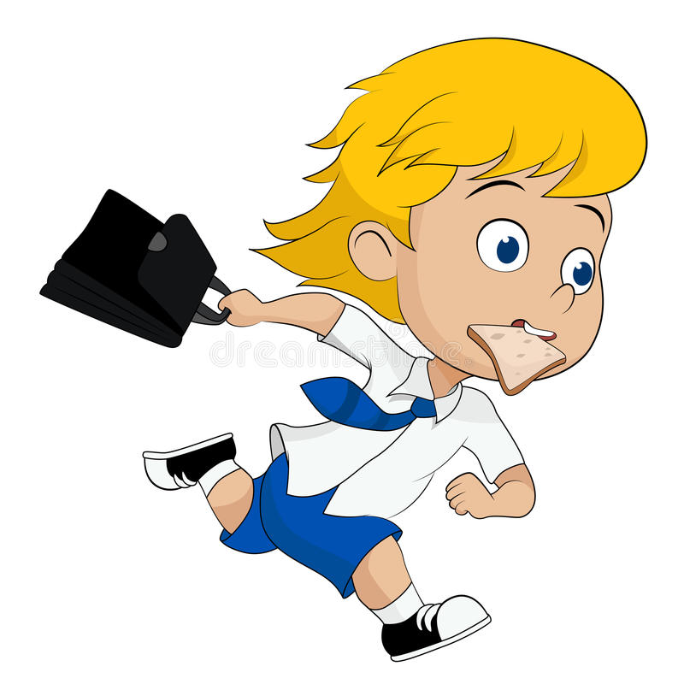
Project ( group work ) Find out from your classmates the most common excuses for ⬛️ being late to school
5 minutes

Slide 17

Homework
P.223
E-F

