Slide 1
What’s wrong
Reading p69
Tr:Manal Al shammari

Slide 2
Use should or shouldn’t
I have an earache. I……….(go) to the doctor.
Hameed has a fever .He……..(go) to school.
Let’s revise our previous unit
should
Shoudn’t

Slide 3
Online Class Rules
Be on Time
Prepare your book
Be Positive
Mute microphone

Slide 4

Why we are studing online?

Slide 5
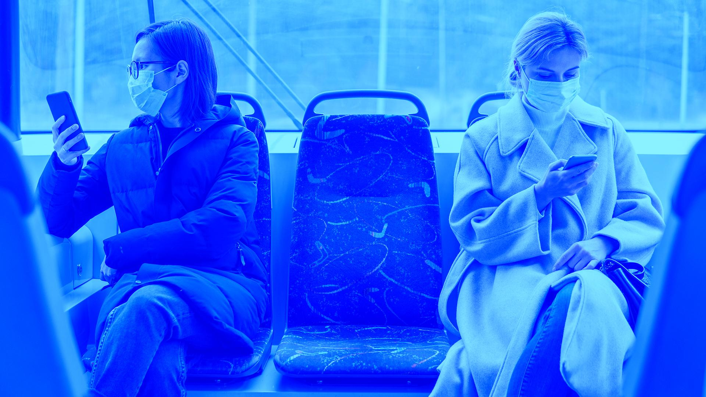
Why they are wearing a mask?

Slide 6
Objectives: at the end of the lesson you will be able to
Describe the way people get the illness
Match the main Idea with the Paragraph
01
02
03
04
Mention a verse about the benefit of being sick
Find out why vaccination against cold is impossible

Slide 7
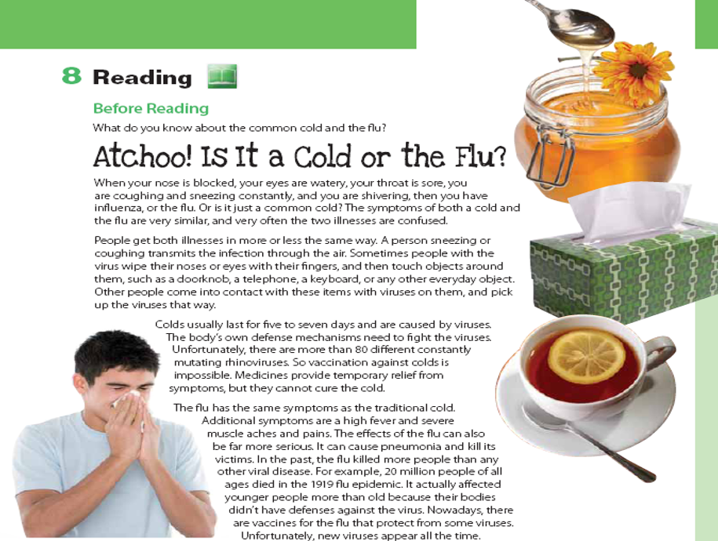
How many pictures do we have?
Can you read the title?
How many paragraphs?

Slide 8
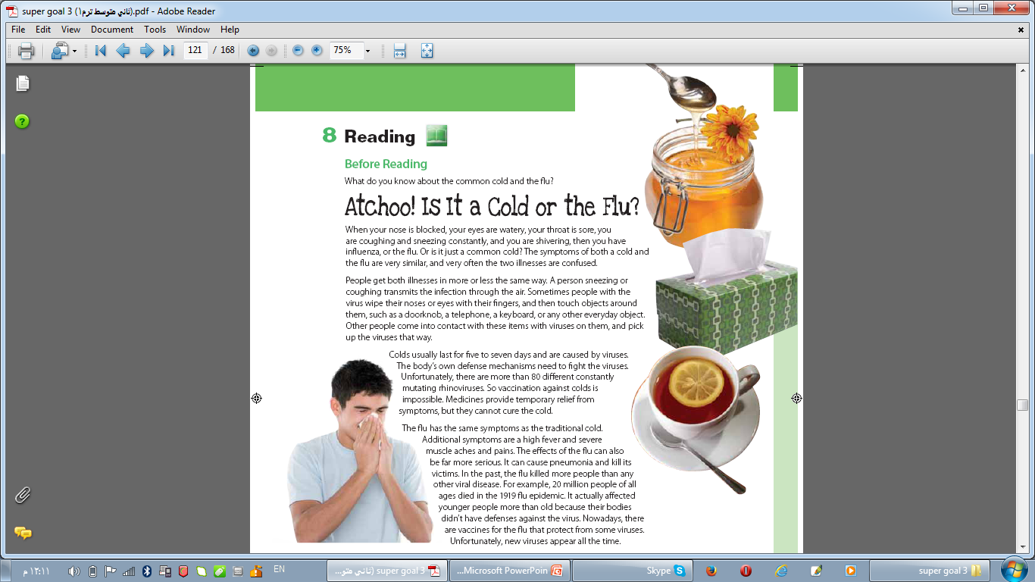

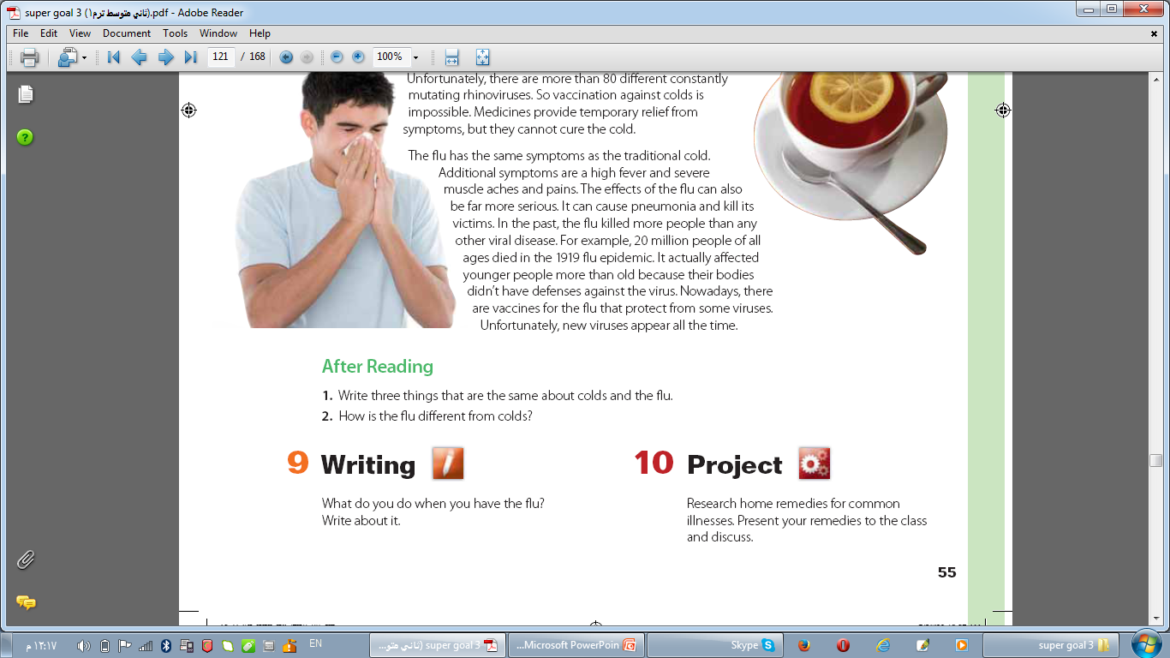
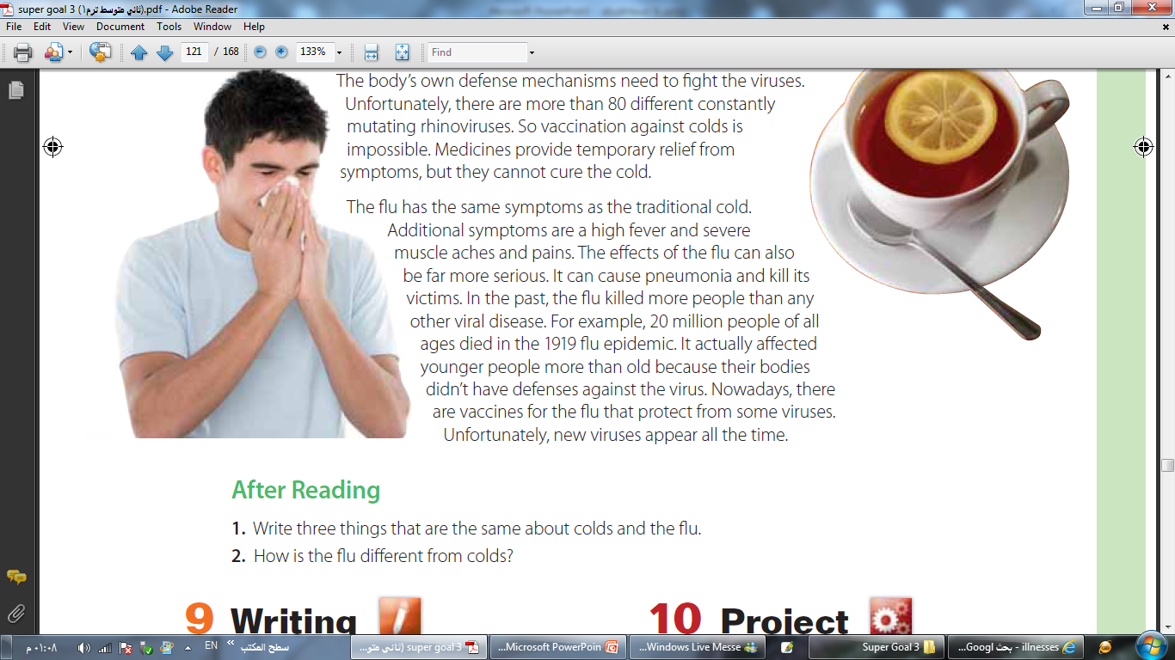

Slide 9
Venn Diagram
flu
cold
a high
fever and severe muscle aches and pains. The fl u can cause pneumonia and kill its victims. There are vaccines
your nose is blocked; your eyes are watery; your throat is sore; you are coughing and sneezing constantly; you are shivering
There aren’t vaccines

Slide 10
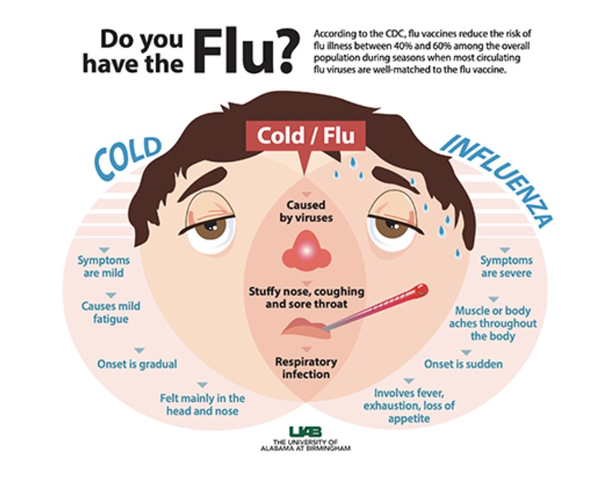

Slide 11

Role playing
You are the doctor now
Patient: doctor I have sneezing and coughing but no high fever. What’s wrong with me?
Doctor: you have cold .You should stay at home and take a rest.

Slide 12
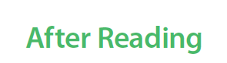
your nose is blocked; your eyes are watery; your throat is sore; you are coughing and sneezing constantly; you are shivering
When people have the fl u, they can have a high
fever and severe muscle aches and pains. The fl u can cause pneumonia and kill its victims. There are vaccines for the fl u but not for colds.

Slide 13
PROTECTING YOURSELF AND PREVENTING THE SPREAD OF THE DISEASE
Wash your hands with an alcohol-based sanitizer or with soap and water
Keep a distance of at least 1 meter between yourself and anyone who coughs or sneezes
Try your best not to touch your eyes, your nose and your mouth
Cover your mouth and your nose with your bent elbow or a tissue when coughing
Seek medical attention if you have difficulty breathing and a high fever
Follow the directions of your national or local health authorities

Slide 14

«لا يوردن ممرض على مصح»
النبي صلى الله عليه وسلم ذكر الطاعون فقال:
«فإذا وقع بأرض وأنتم بها فلا تخرجوا منها،
وإذا وقع بأرض ولستم بها فلا تهبطوا عليها» .
Please keep this slide for attribution.

Slide 15
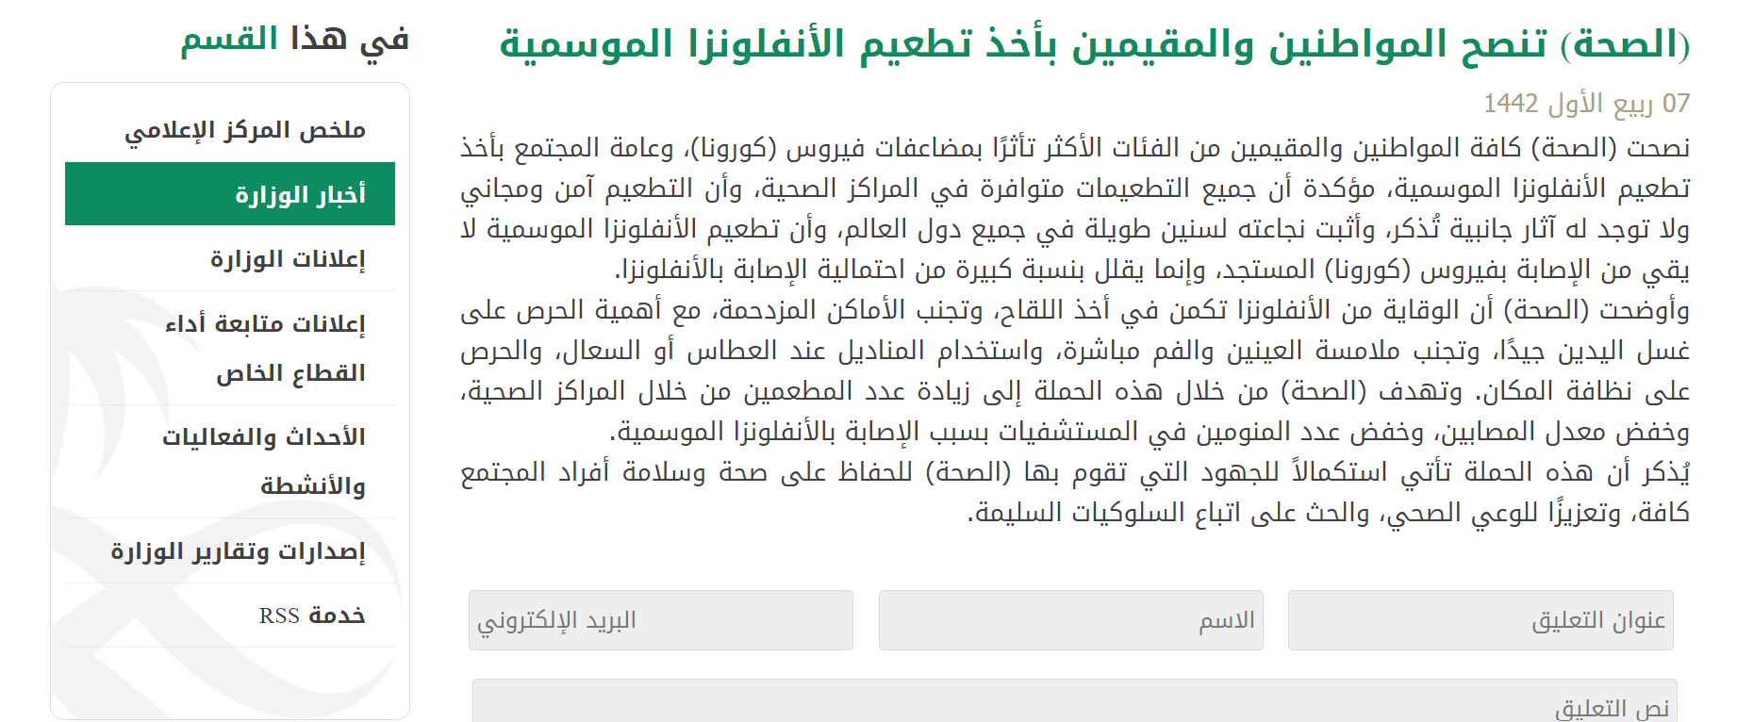

Slide 16
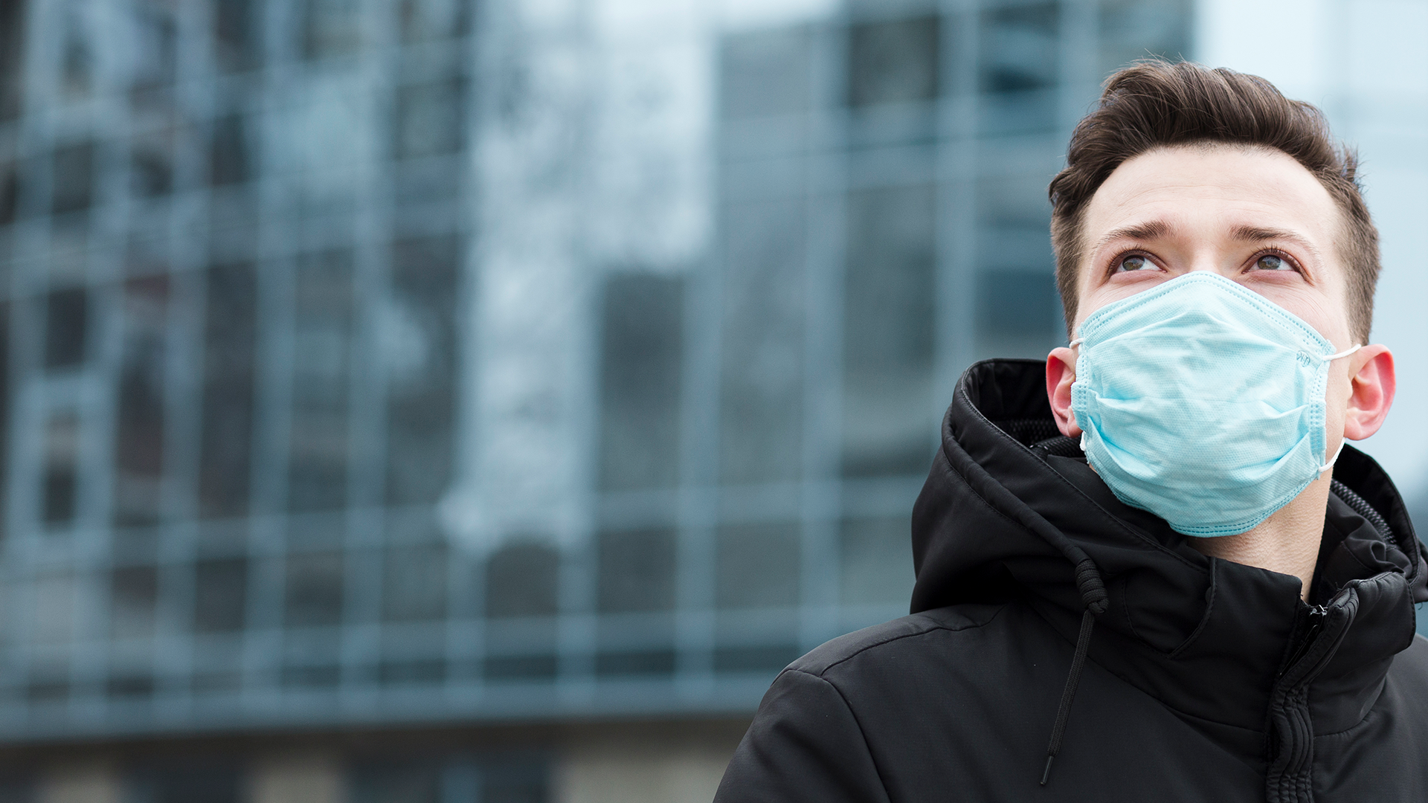
ABOUT 80% OF PEOPLE RECOVER FROM THIS DISEASE WITHOUT NEEDING SPECIAL TREATMENT

Slide 17
—Anne Frank
“I don’t think of all the misery, but of the beauty that still remains.”

Slide 19



Cold or flu
START

Slide 20

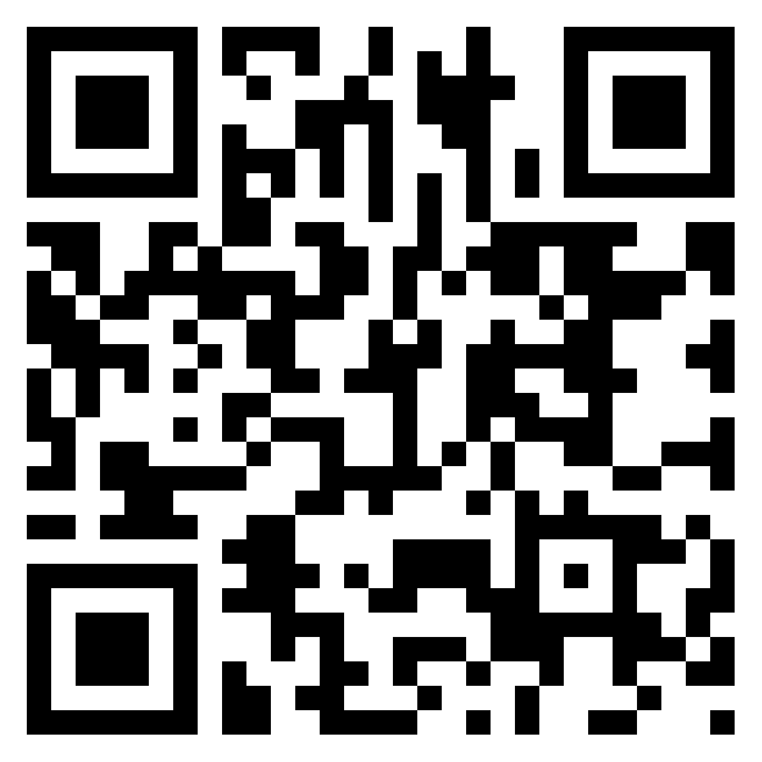
Share with us

Slide 21


Homework
In Madrasati Platform

Slide 22


Thanks my stars
Good bye

