Slide 1
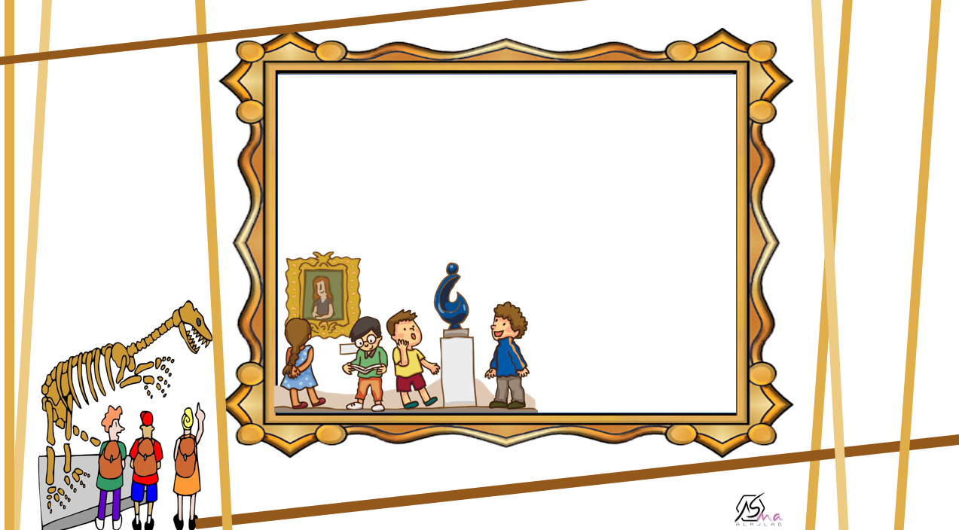
What Was It Like?
Conversation
About you

Slide 2
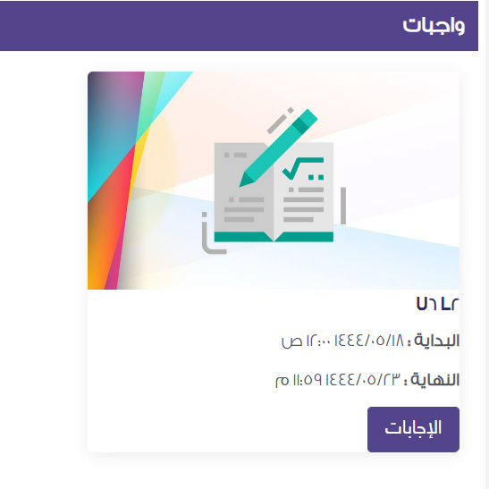

Slide 3

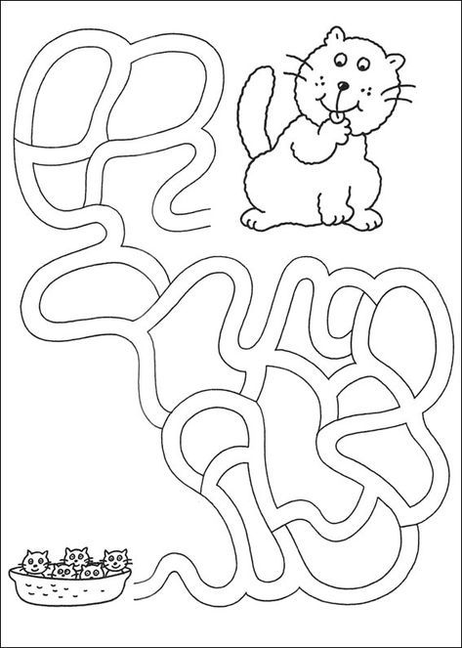
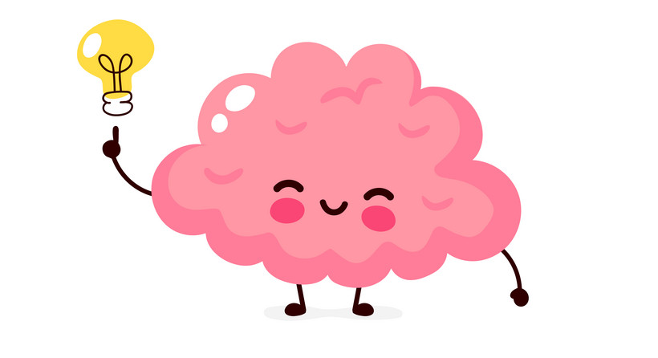


Slide 4
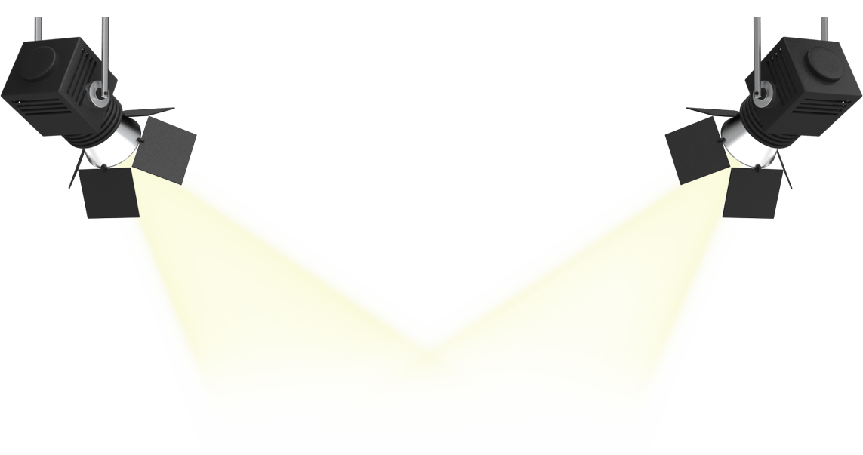

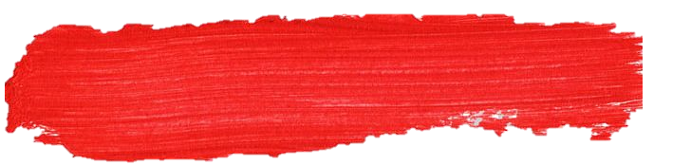
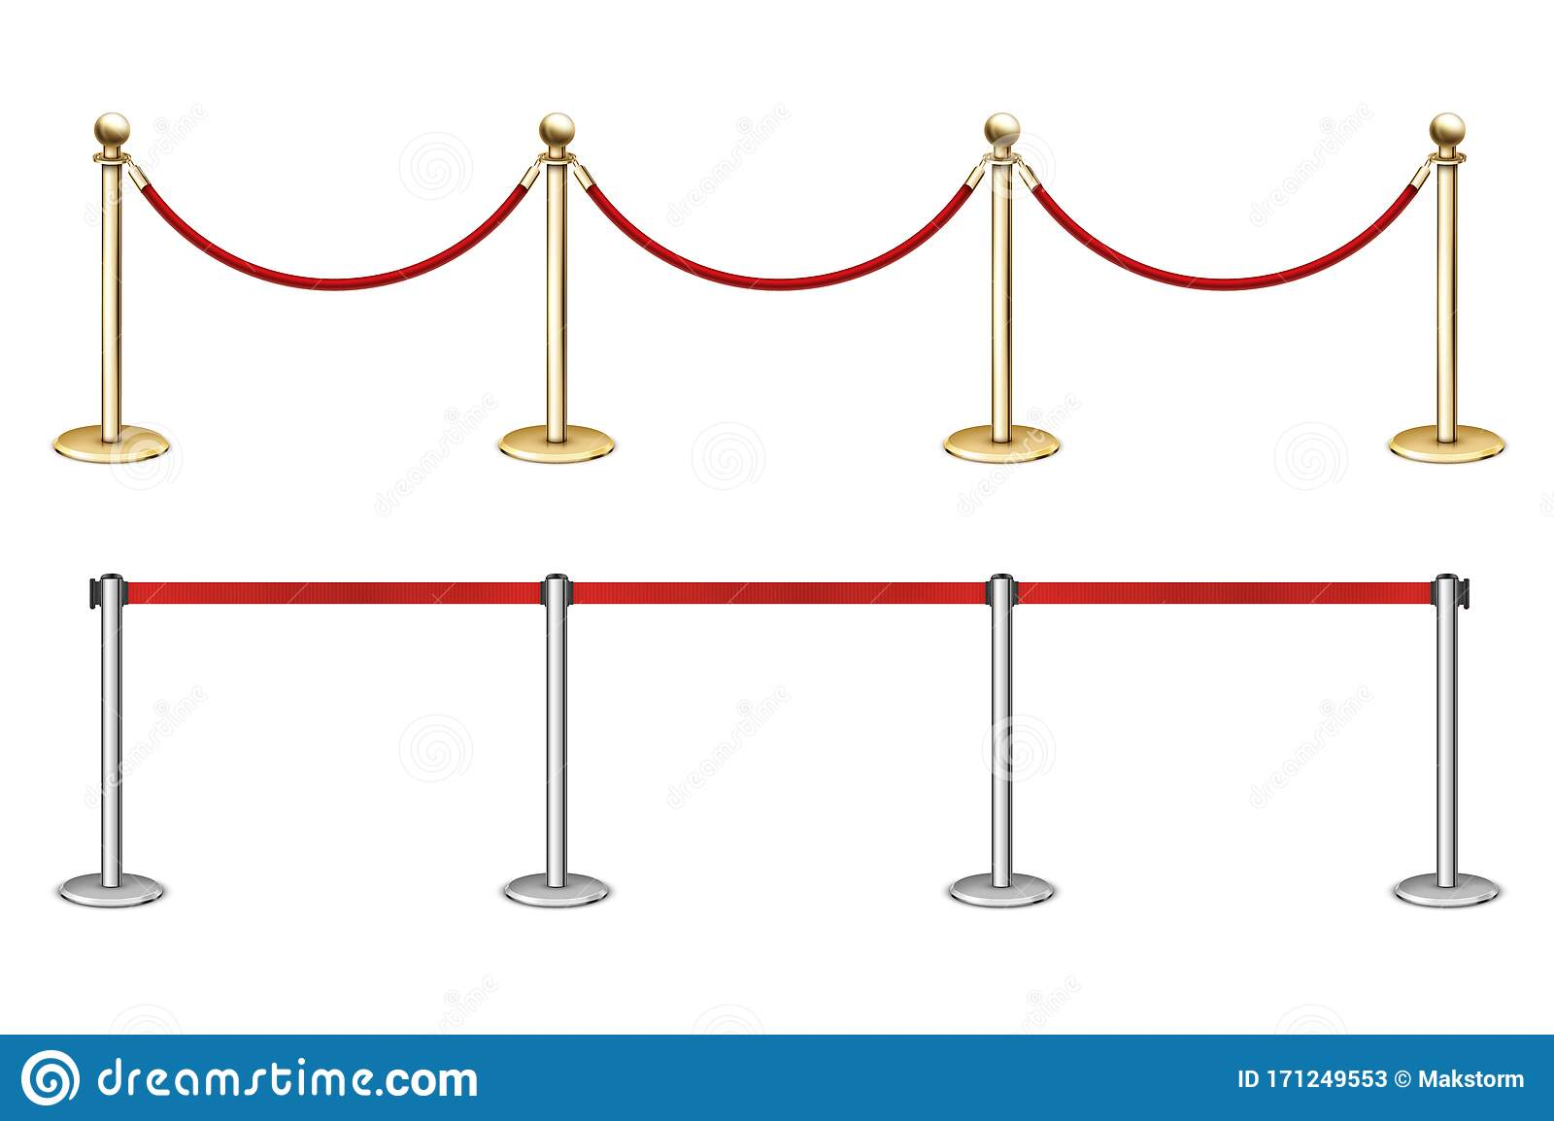
Answer questions about the conversation .
Objectives
Use the “real talk” phrases in a conversation .

Slide 5
What is your favorite food ?
What is your favorite restaurant ?
Introduction

Slide 6
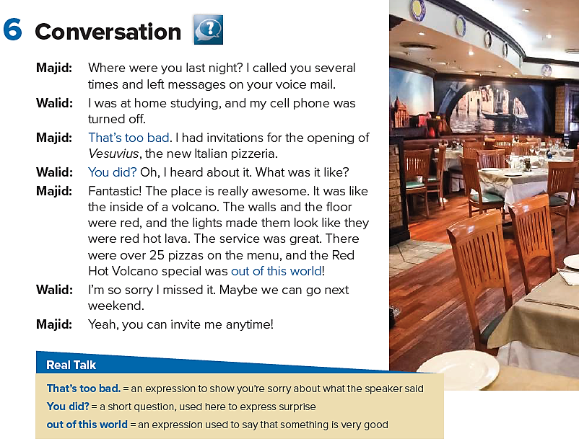

What are the two boys talking about ?
What is the kind of restaurant ?
What does it look like ?
How many pizzas are there on the menu ?

Slide 7
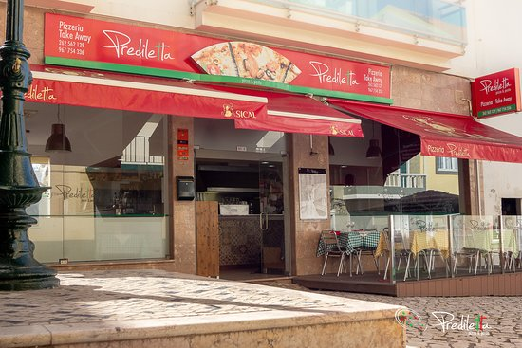
pizzeria

Slide 8
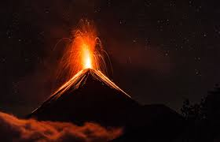
volcano

Slide 9
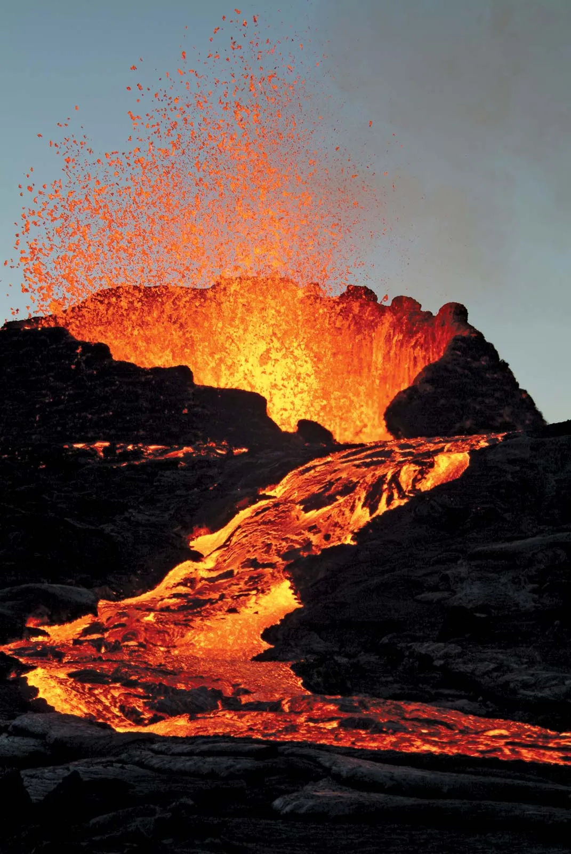
lava

Slide 10
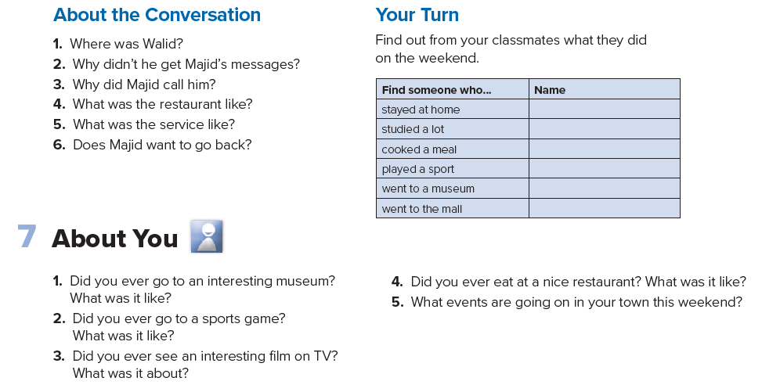
He was at home studying.
His cell phone was turned off.
He had invitations for the opening of the new pizzeria.
It was fantastic.
It was great.
Yes, he does.

Slide 12
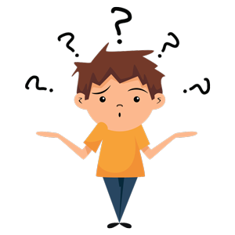


Slide 13
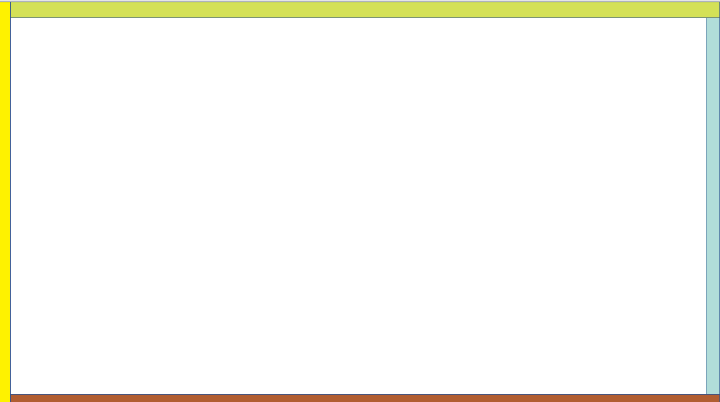

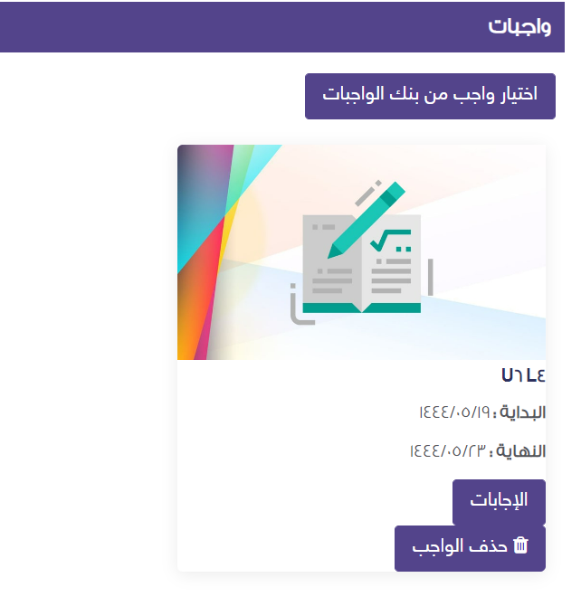
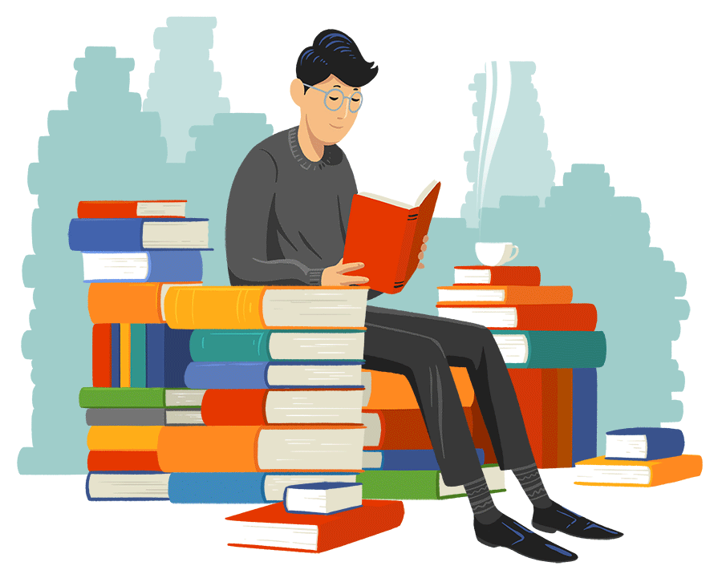
Home
Work
P . 211

Slide 15


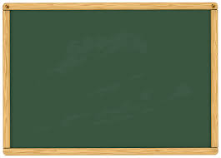
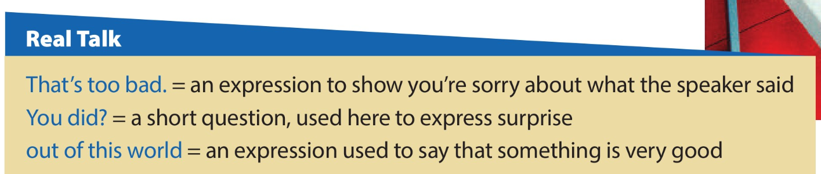
Page 52
1.Who says That’s too bad?
Majid
2.Why does he say it?
He’s sorry he couldn’t talk to Walid.
Say which ones they should respond to with That’s too bad.
1.There aren’t any more tickets for the game. (√)
Our restaurant didn’t get a good review. (√)
My dad bought a new car last week.
I was sick the entire weekend. (√)
I was a good football player in school.

Slide 17

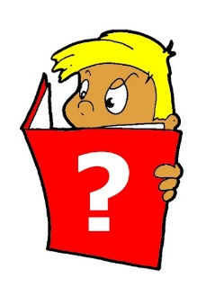

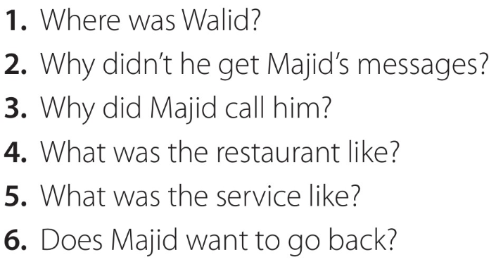
Page 52
Work with a partner, taking turns asking and answering the questions.
,nmn
He was at home studying.
His cell phone was turned off.
He had invitations for the opening of the new pizzeria.
It was fantastic.
It was great.
Yes, he does.

Slide 20
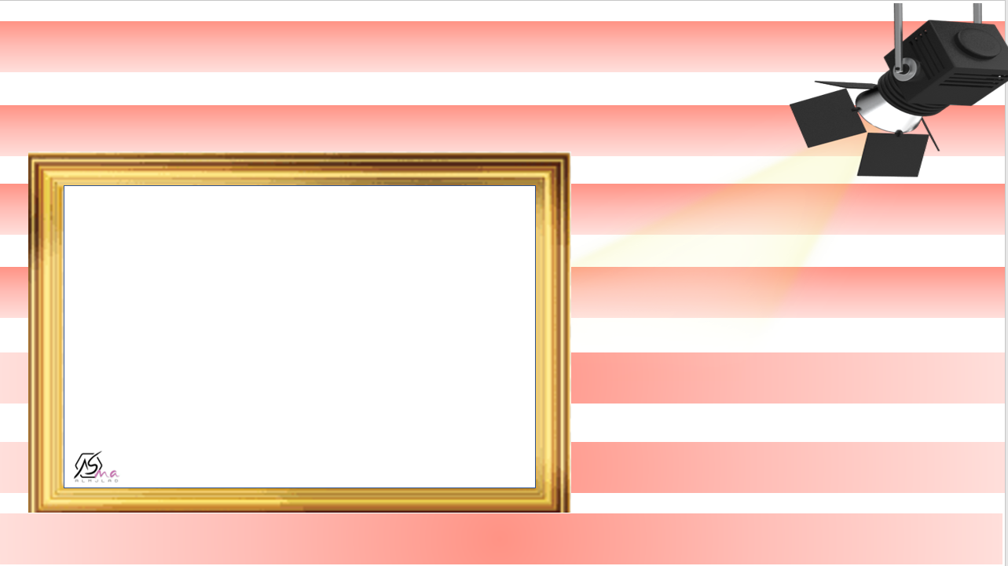



Slide 21



