Slide 1

U6
ثاني متوسط

Slide 2

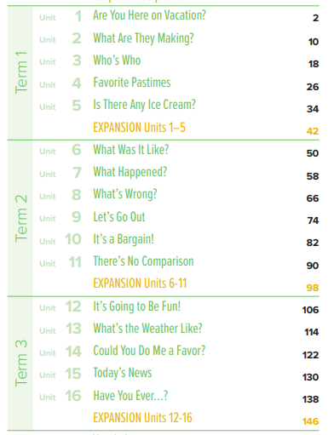

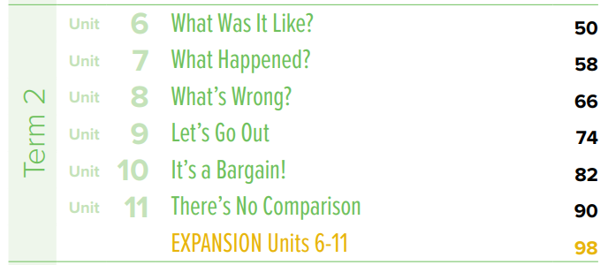
book contents
ثاني متوسط
T.Noureyah Alghamdi

Slide 3






SG2 U6
Page 50 & 51
♥
Match the museum to its description
Ask about a museum kind
Ask abut latest events

Slide 4

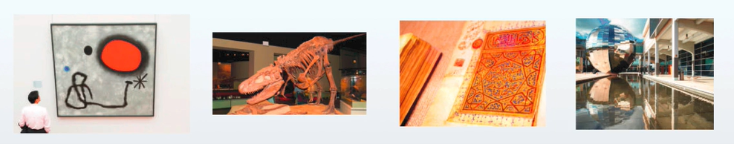
SG2 U6
Page 50 & 51

Slide 5
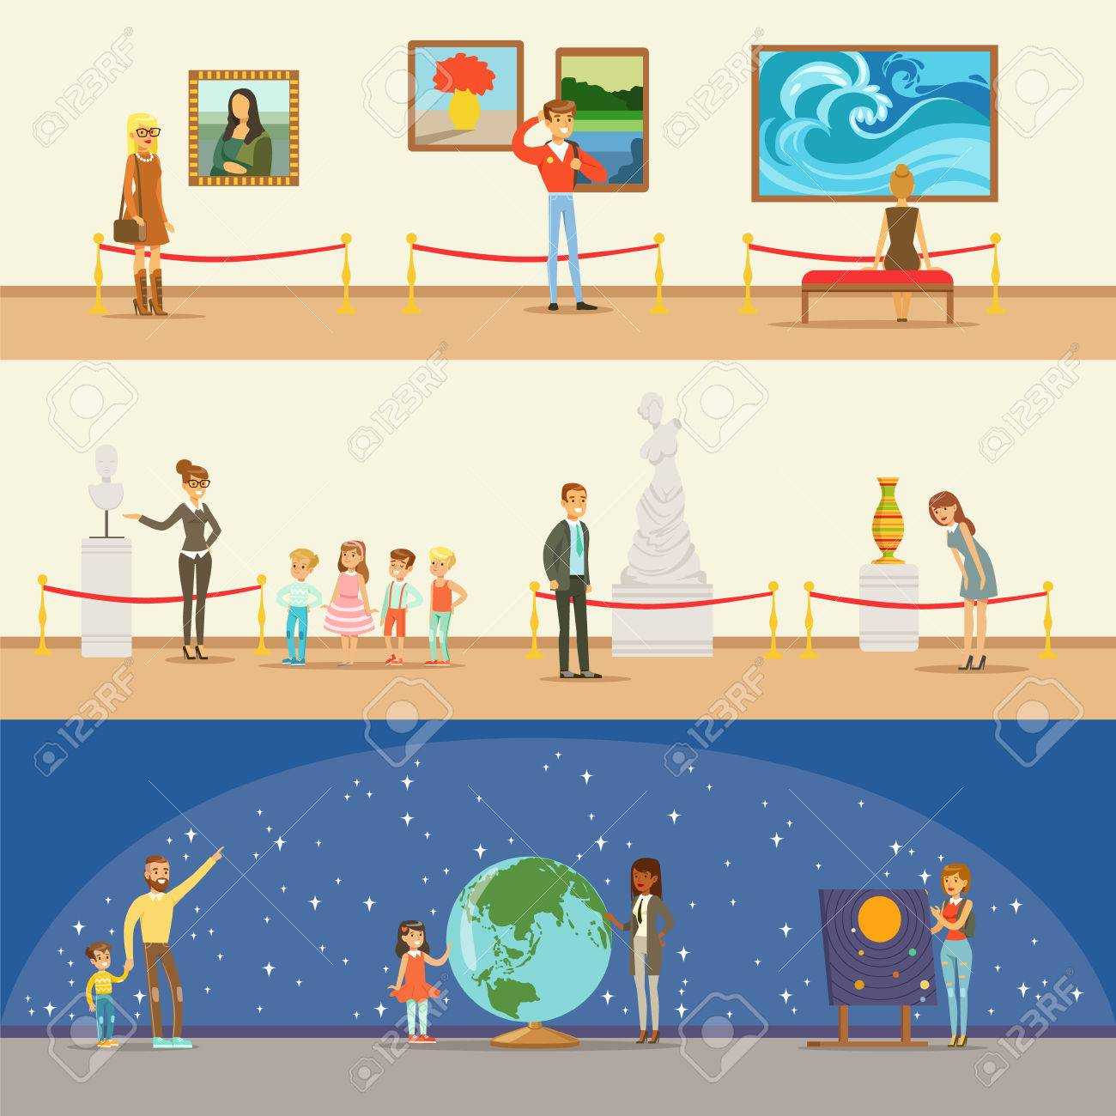

SG2 U6
Page 50 & 51
Museum exhibits

Slide 6
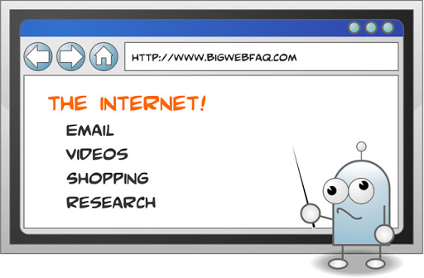


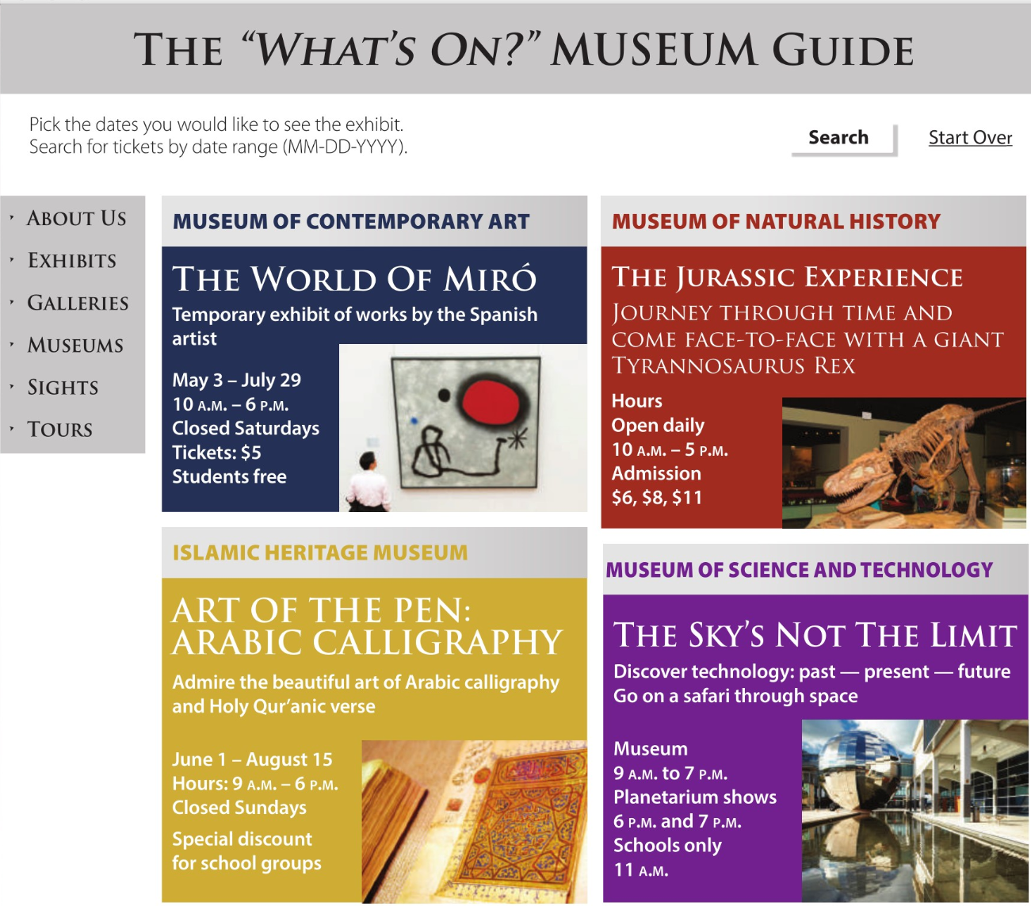
SG2 U6
Page 50
Before listening
Open your books to page 48 and look at the web page.
Answer the questions such as the following:
1.What is the subject of the web page?
museum exhibits
2.What’s the name of the web page?
The “What’s On?” Museum Guide
3.What does “What’s on?” mean?
What is happening?
4.What are the four types of museums?
contemporary art, natural history, Islamic heritage, science and technology
5.Where can you see dinosaurs?
Museum of Natural History
6.What country is the artist from?
Spain
7.Where can you see calligraphy?
Islamic Heritage Museum
8.Where can you learn about space?
Museum of Science and Technology
9.Which exhibits are temporary?
The World of Miró, Art of the Pen: Arabic Calligraphy

Slide 7
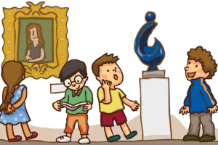
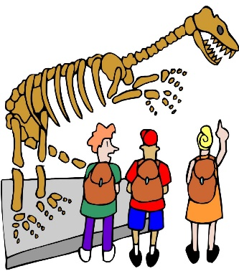
SG2 U6
Page 50
Museum exhibits
A museum is an institution that cares for (conserves) a collection of artifacts and other objects of artistic, cultural, historical, or scientific importance. Many public museums make these items available for public viewing through exhibits that .
A museum is a building in which we see objects of artistic, cultural, historical and scientific interest. These things are kept here for the public. It is a treasure house of great knowledge.
Four reasons to visit a museum
1. Museums make you feel good
a recent study finds that people are happier when they spend money on experiences rather than material purchases. Experiences are shown to create more happiness than material goods
2.Museums make you smarter
The primary role of museums is to engage and educate the community.
3. Museums inspire
Museums provide inspiration through personal connections with visitors. These kinds of personal memories created at museums do not expire.
4.Museums are a great way to spend time with friends and family.
Museums provide a great excuse to spend time with friends and family in a positive way. Personal connections can be made with museums and also with family members during visits.

Slide 8

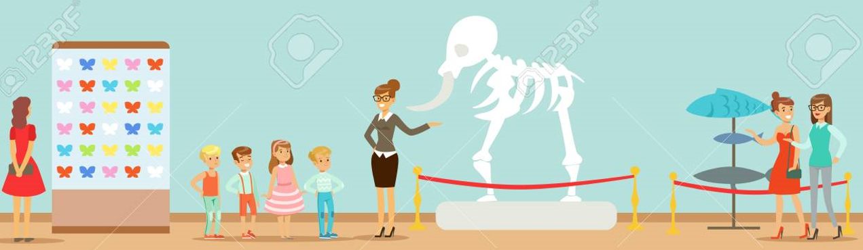
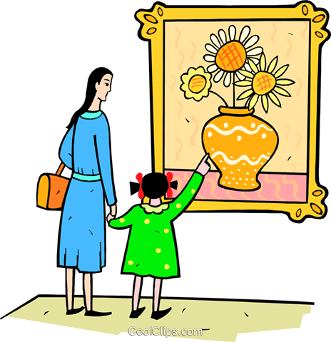
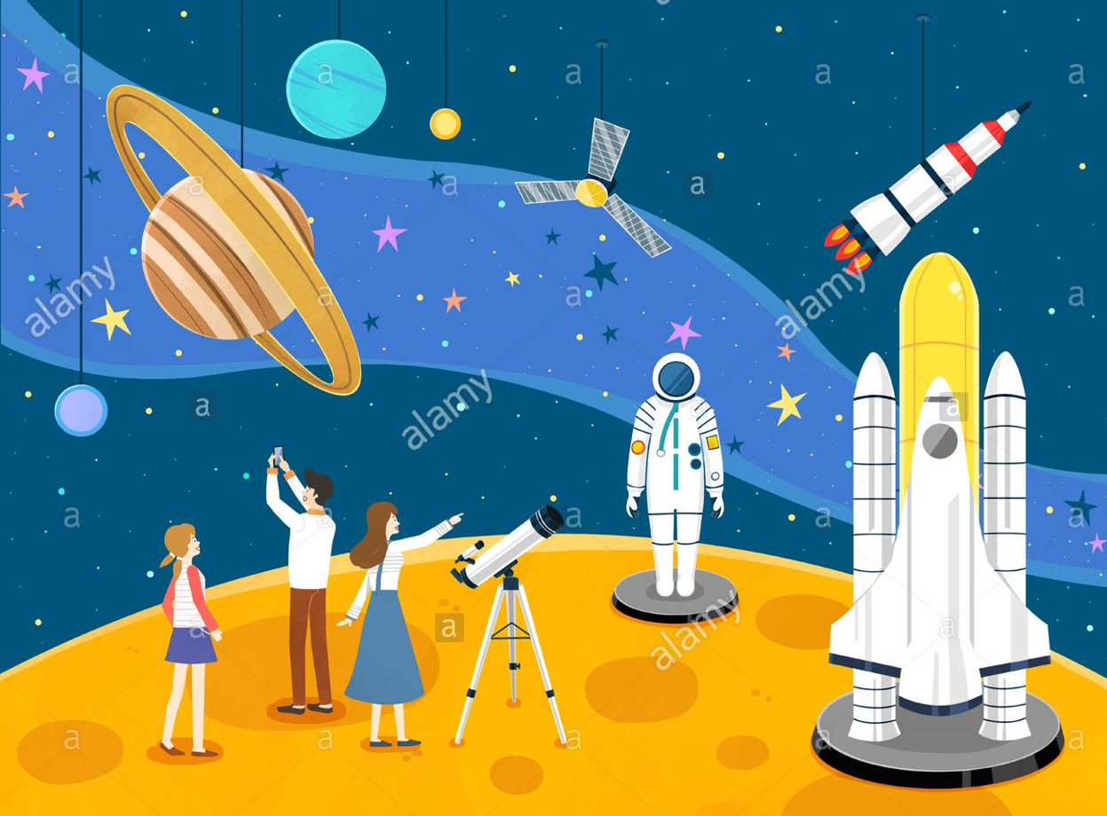
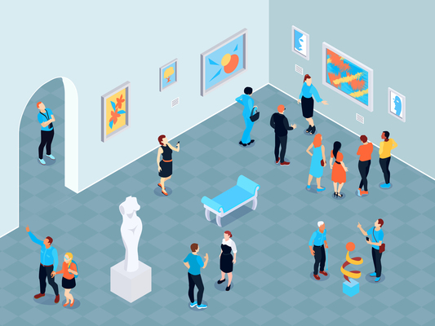

SG2 U6
Page 50
Which museum exhibits are interesting for you? Why
Which exhibits interest you? Why?
Technology Exhibitions
Healthcare Exhibitions
Food Exhibitions
Trade Exhibitions
Consumer Exhibitions

Slide 9






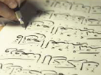
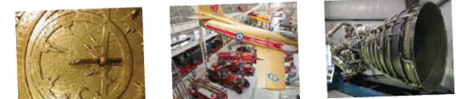

Unit:6
Wednesday 22\4\1444H
16th November 2022
Listen and Discuss What was It Like SG2 page 50 & 51
Anticipation guide
Listen and Discuss
Before Reading |  | Statement | After Reading
Agree | Disagree |  | Agree | Disagree
 |  | The Museum of Science and Technology has no information about prices.
 |  | We can see dinosaurs at Islamic Heritage Museum.
 |  | Robotics exhibit has old cars.
 |  | The artist is from Spain.
https://www.liveworksheets.com/tq3257708ir
T. Noureyah Alghamdi

Slide 10
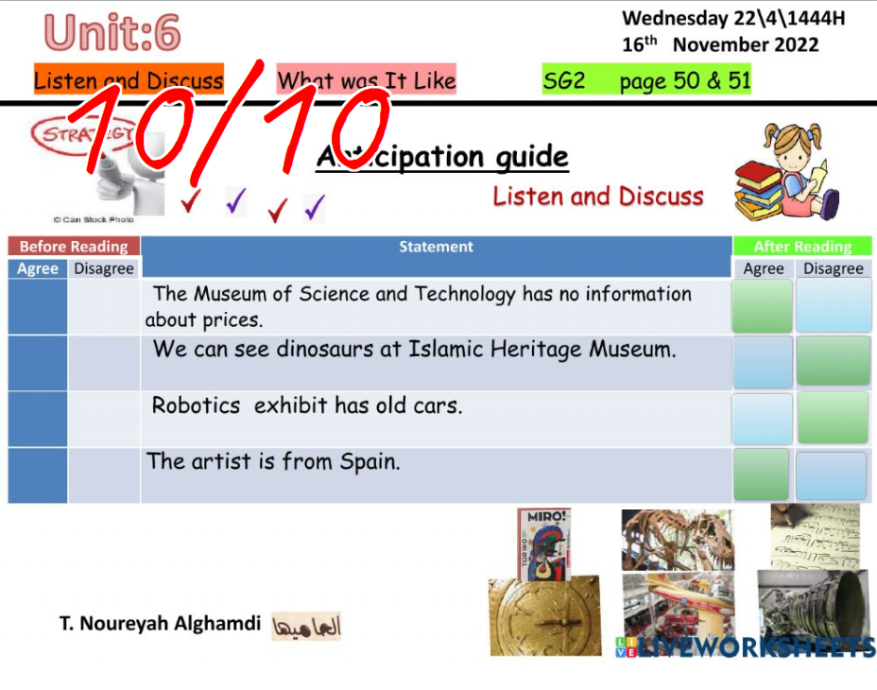
https://www.liveworksheets.com/tq3257708ir

Slide 11



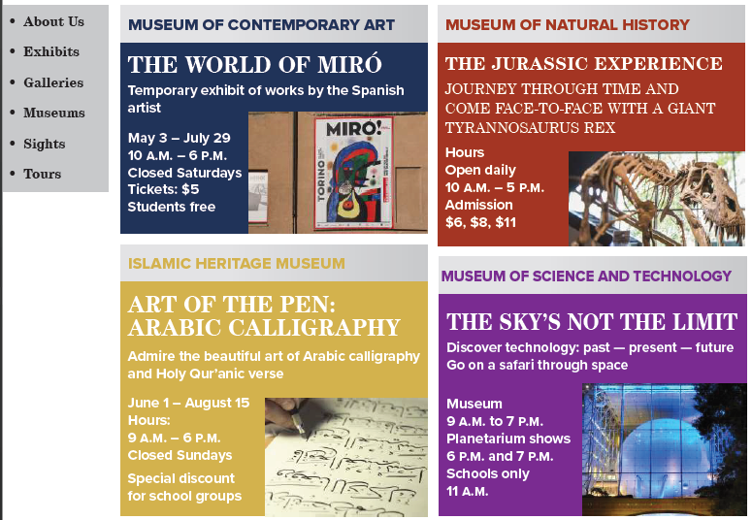

SG2 U6
Page 50
Repeat the
phrases chorally and individually.

Slide 12

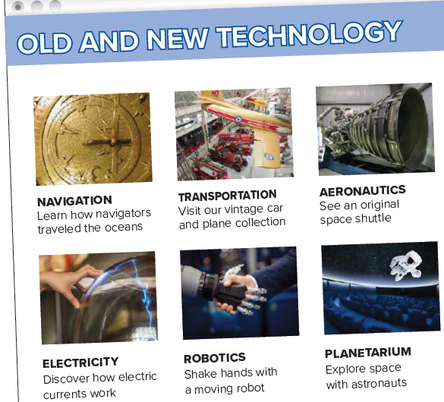
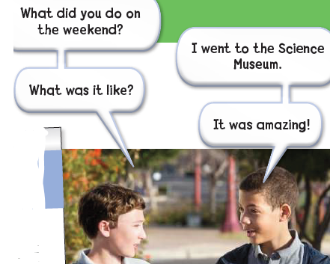
SG2 U6
Page 51

Slide 13


SG2 U6
Page 50
After listening
1.Which museum has no information about prices?
Museum of Science and Technology
Look at the web page on page 49.
Answer the questions the following:
1.What kind of technology exhibits can you see at the Science Museum?
navigation, transportation, aeronautics, electricity, robotics, planetarium
2.Which exhibit has old cars?
Transportation
3.Which exhibits interest you? Why?
4.What are the two people talking about?
5. What did Mike do? Did he like it?

Slide 14
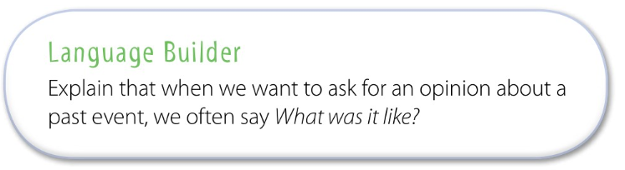
SG2 U6
Page 51

Slide 15

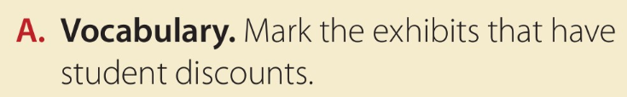

SG2 U6
Page 51
Locate where the information about admission prices is in each advertisement.
Then have them look for specific information about student prices.
The World of Miró, Art of the Pen: Arabic Calligraphy, and perhaps
the Natural History Museum

Slide 16

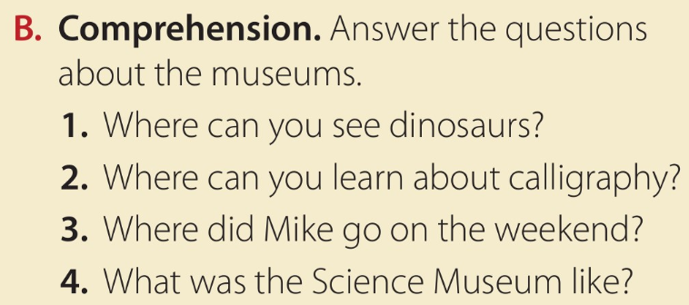
SG2 U6
Page 51
1.How many different museums are there?
four
2.What is the name of the boy in the conversation?
Mike
3.What are he and his friend talking about?
what Mike did on the weekend?
Work alone to answer the rest of the questions and check answers with a partner.
1.You can see dinosaurs at the Museum of Natural History.
2.You can learn about calligraphy at the Islamic Heritage Museum.
3.He went to the Science Museum.
4.It was amazing.

Slide 17
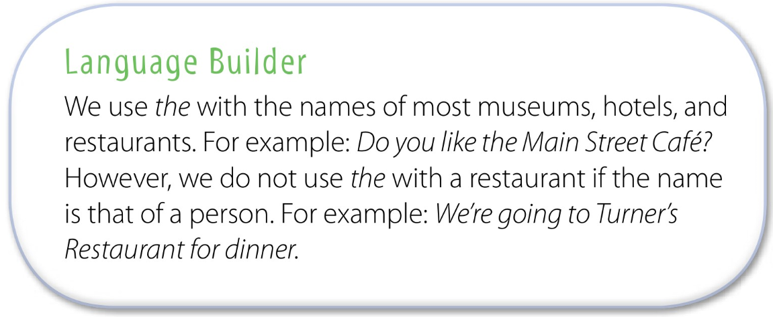
SG2 U6
Page 50

Slide 18


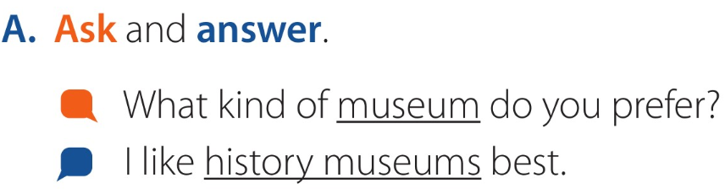
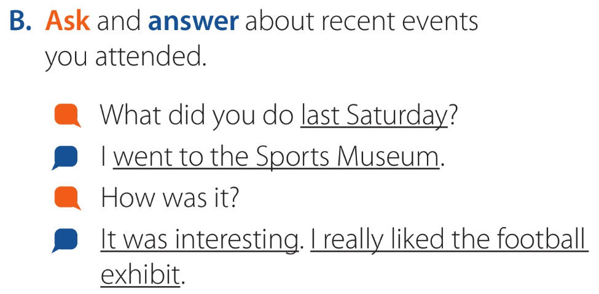
SG2 U6
Page 50
Take turns asking and answering the question

Slide 19
SG2 U6
Page 50
Making a substitution for the first question.
For example:
What did you do last Thursday?
☺What’s another way to say How was it?
What was it like?
Practice the conversation in pairs.

Slide 20


Slide 21



تجدون الرابط في اثراءات الدرس في الجدول
https://quizizz.com/join/quiz/5f9d93d3d34fc0001c7df0a3/start?studentShare=true

Slide 22








Assign page 209 for practice with the vocabulary of
the unit.
Exercise -A

Slide 23
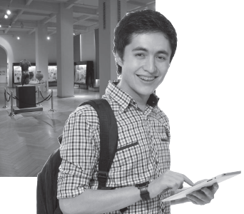
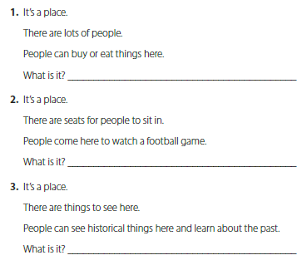
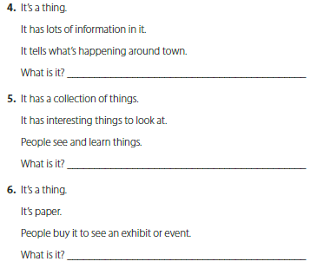
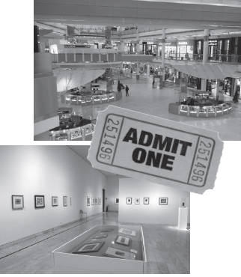
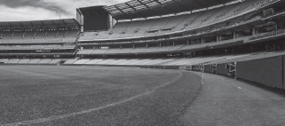
Page 209
It’s a mall.
It’s a guide
It’s a stadium.
It’s an exhibit.
It’s a museum
It’s a ticket

Slide 24


T.Noureyah Alghamdi
The end

Slide 25
