Slide 1
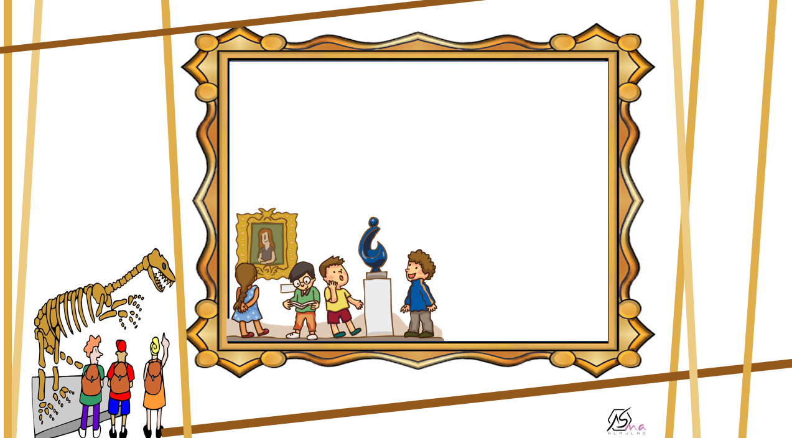
What Was It Like?
Listen and discuss

Slide 2

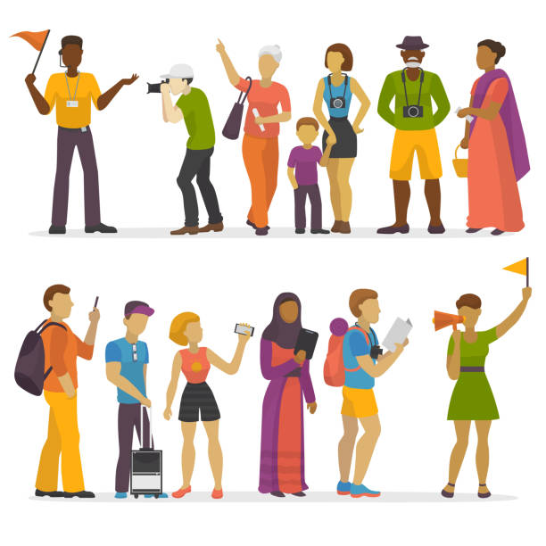
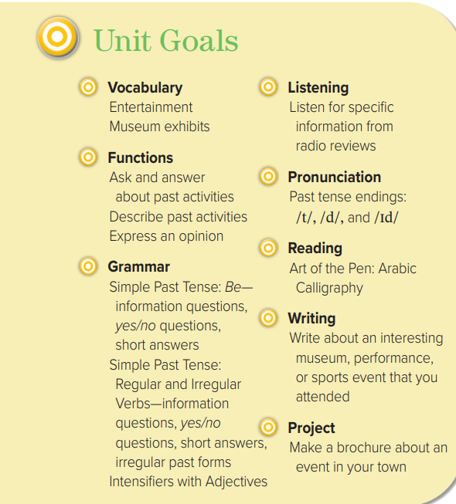
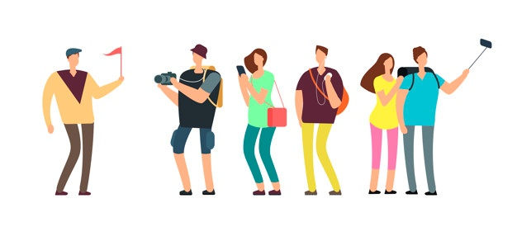

Slide 3
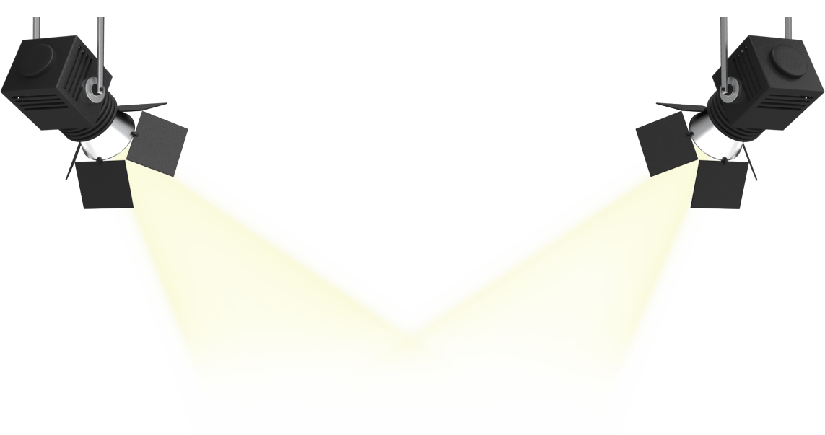


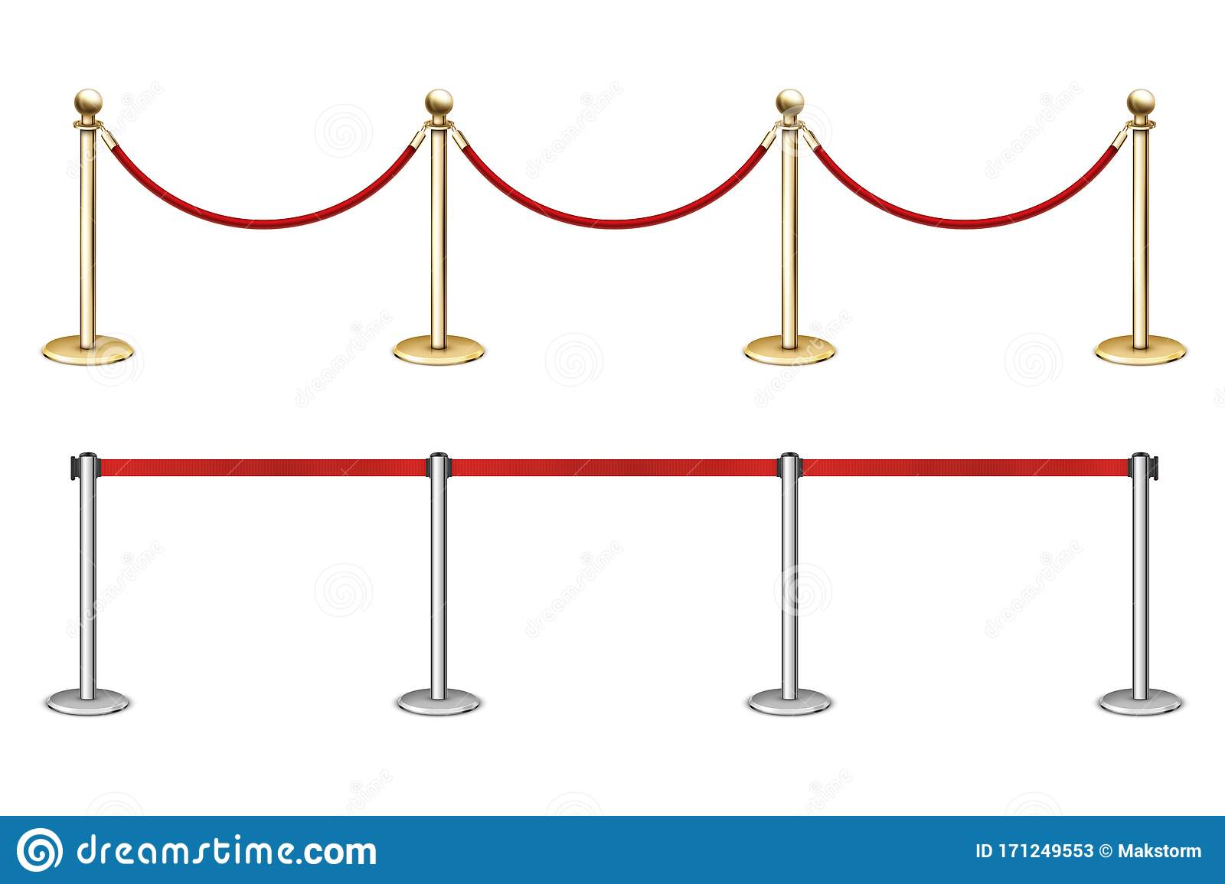
Match the museum to its description
Ask about a museum kind.
Objectives
Ask abut latest events

Slide 4
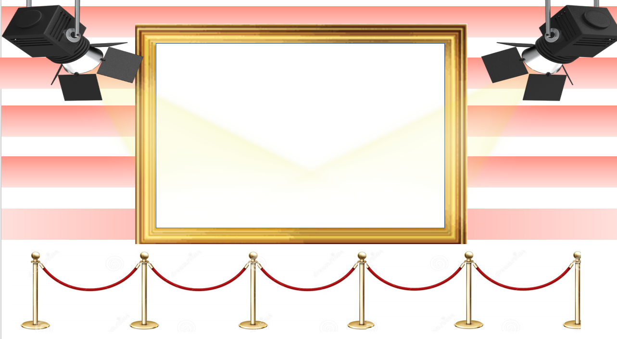
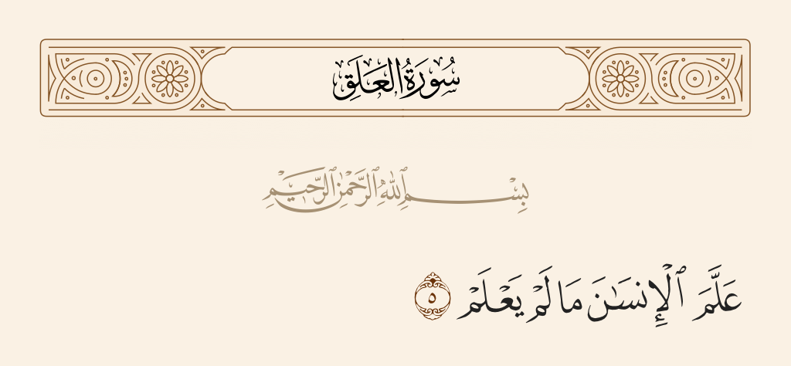

Slide 5

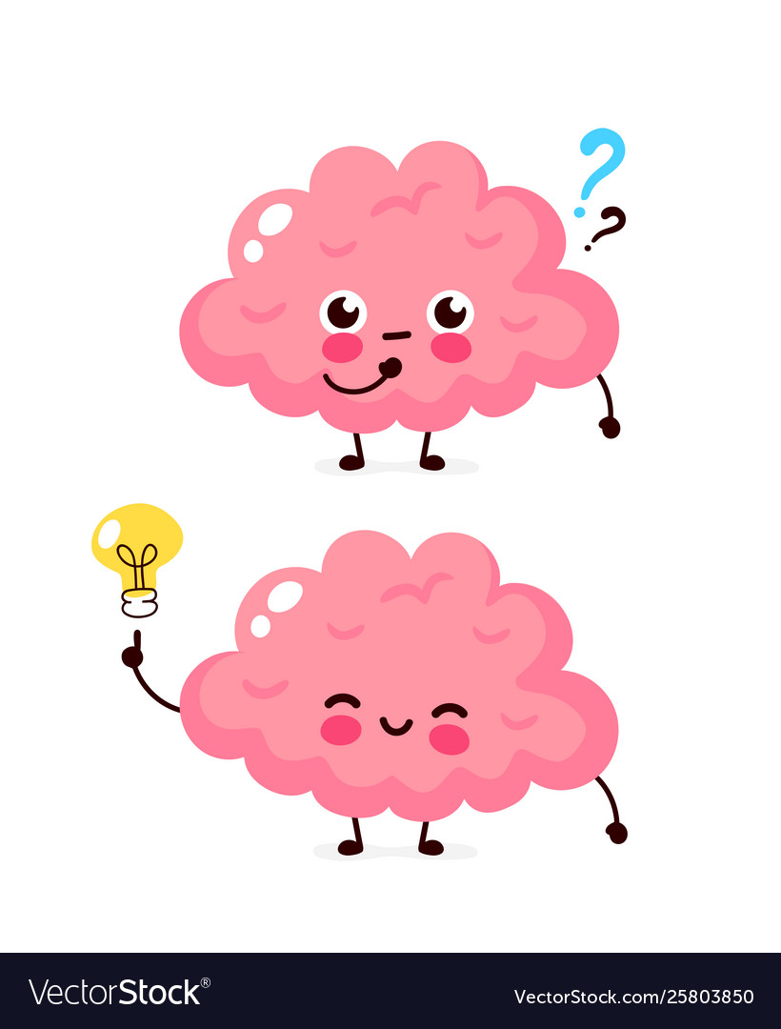


Slide 6
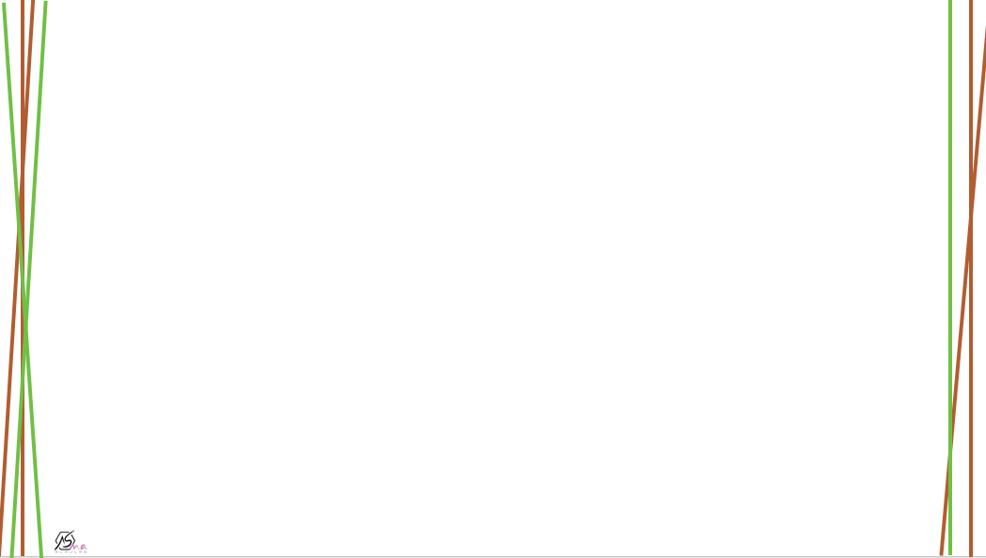

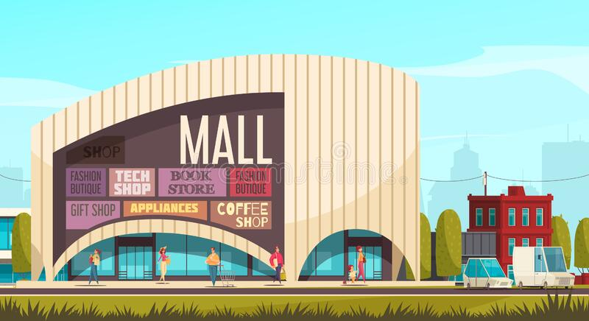
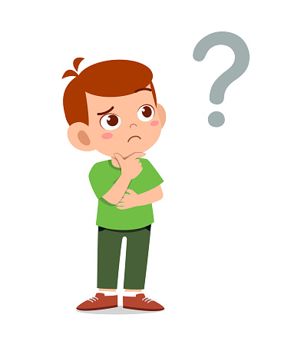
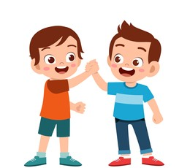
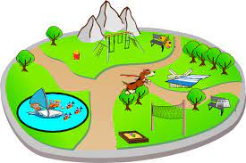
What did you do in your vacation ?
Did you go to the mall?
Did you visit a friend?
Were you at a park?

Slide 7
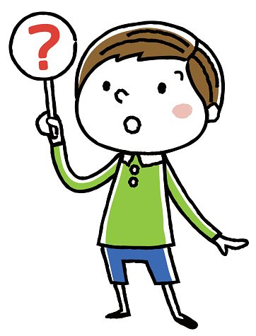
I played football
I went to the mall
I was at a park
We were at home

Slide 8

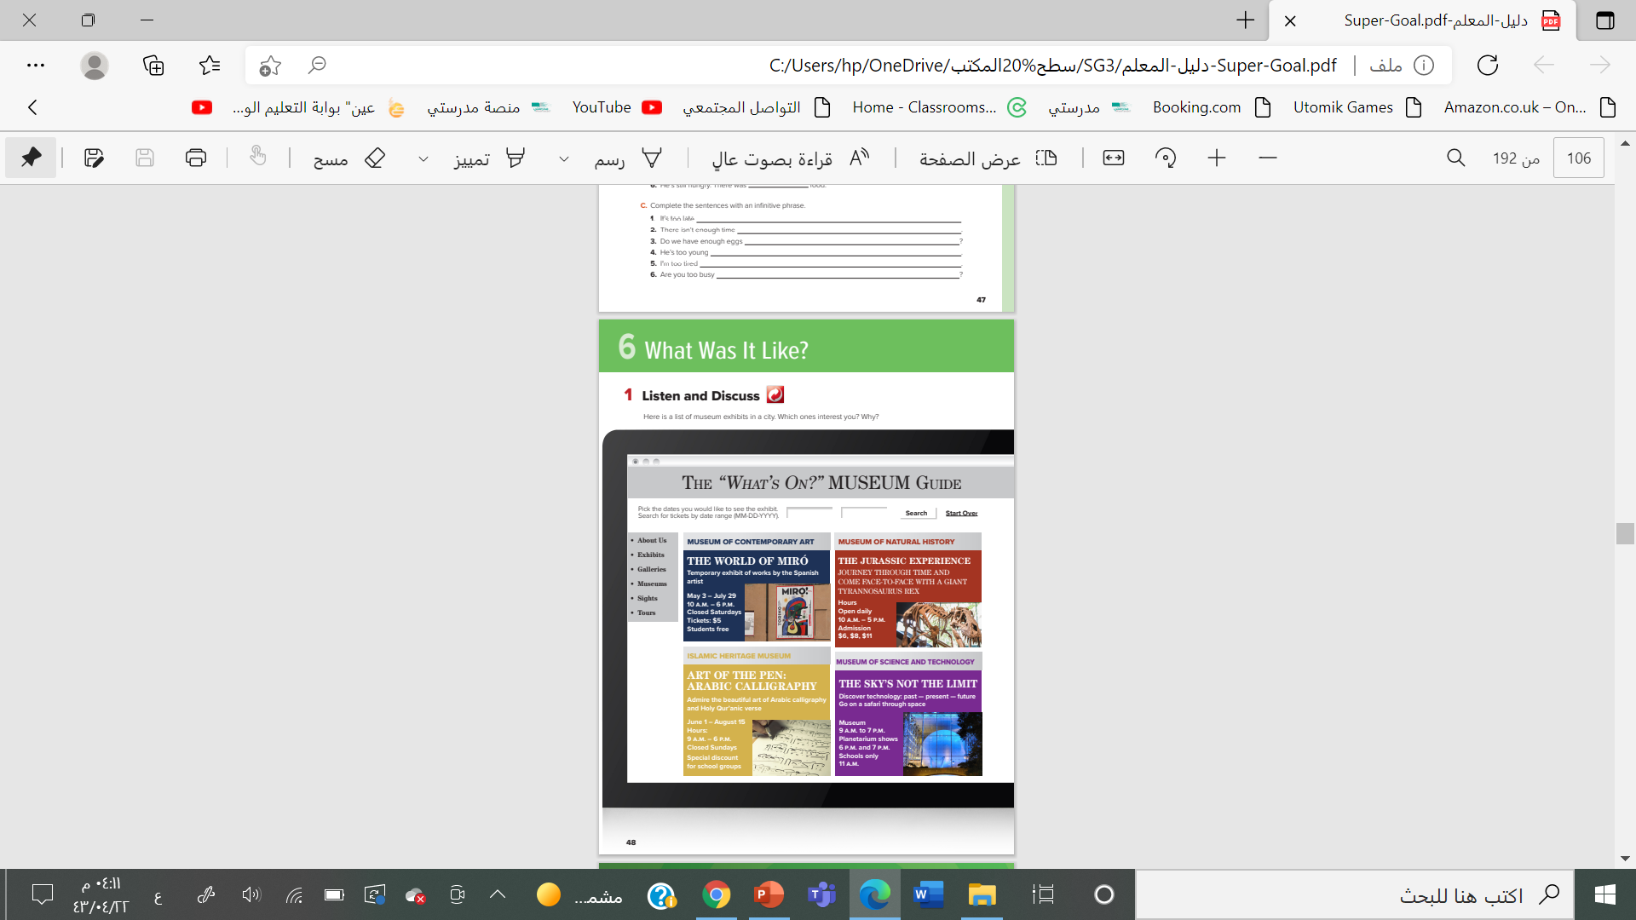
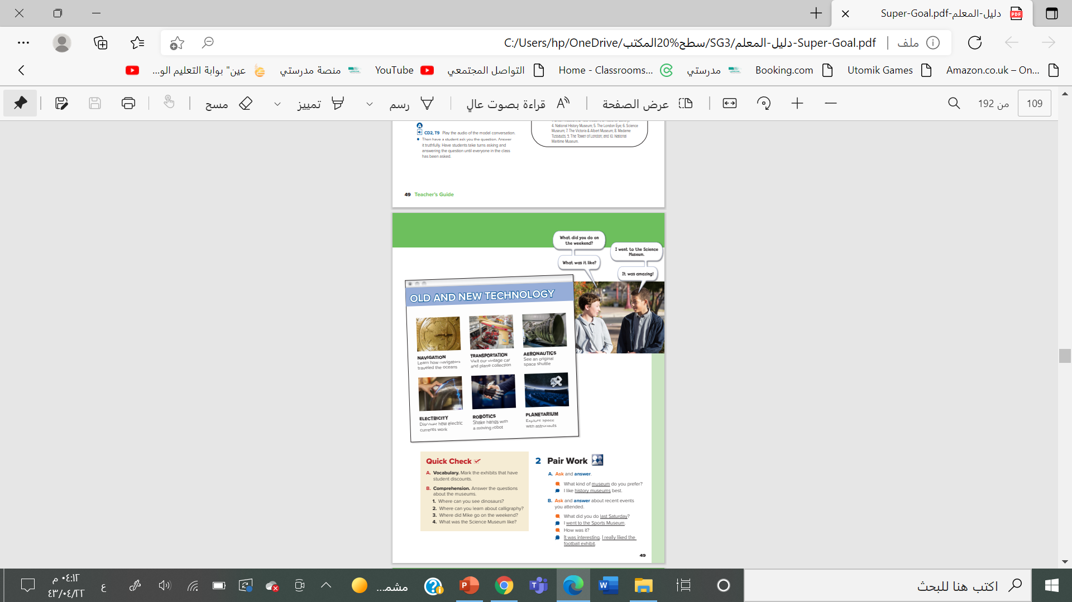


@ page 48+49

Slide 9
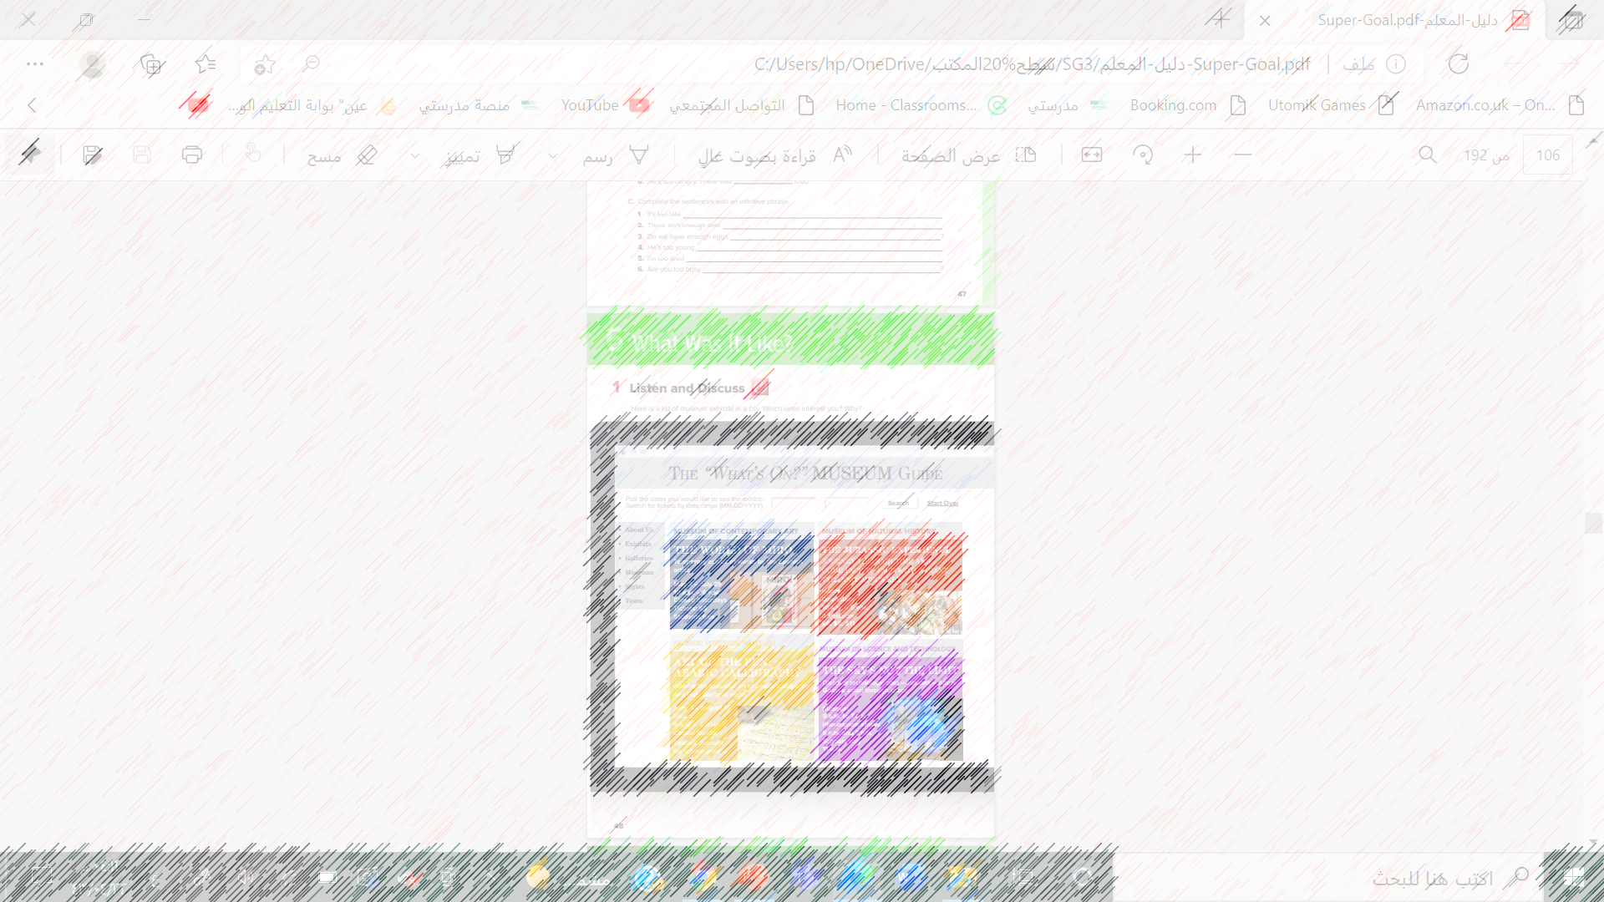
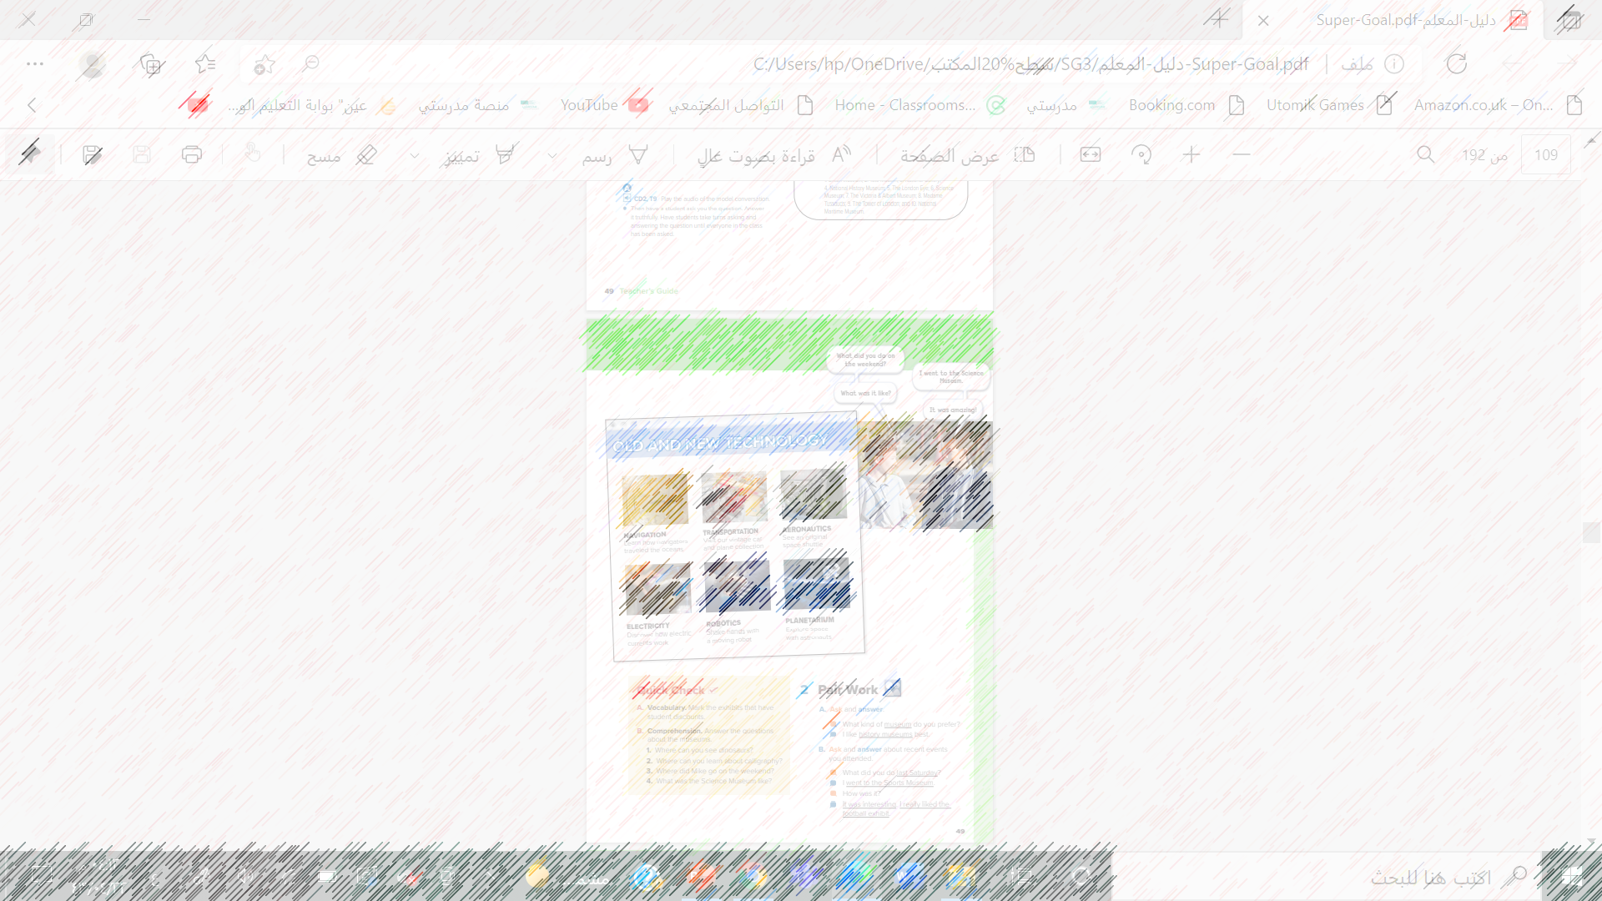
What is the subject of the web page?
What’s the name of the web page?
What does “What’s on?” mean?

Slide 10


Listen
Where can you see dinosaurs?
What country is the artist from?
Which exhibits are temporary?

Slide 11
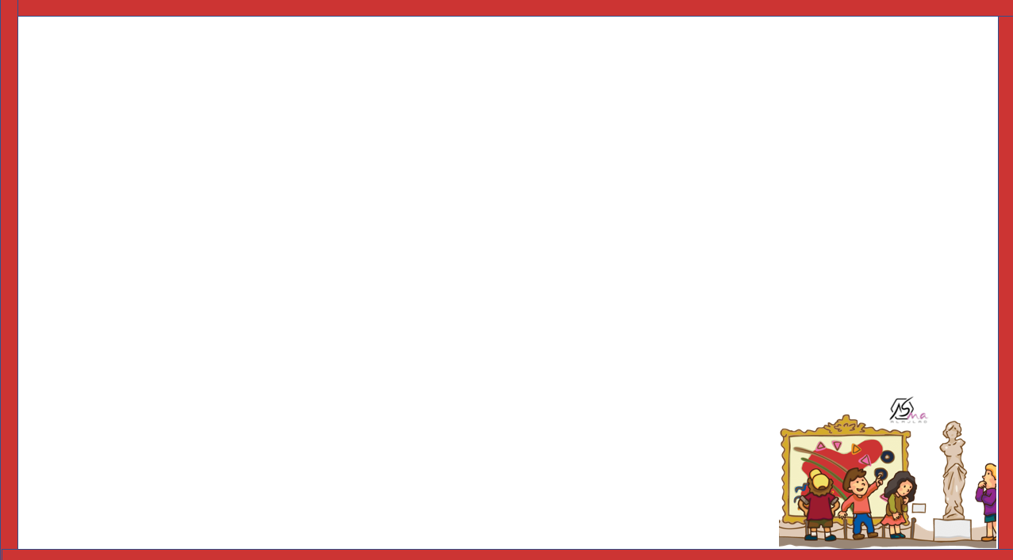
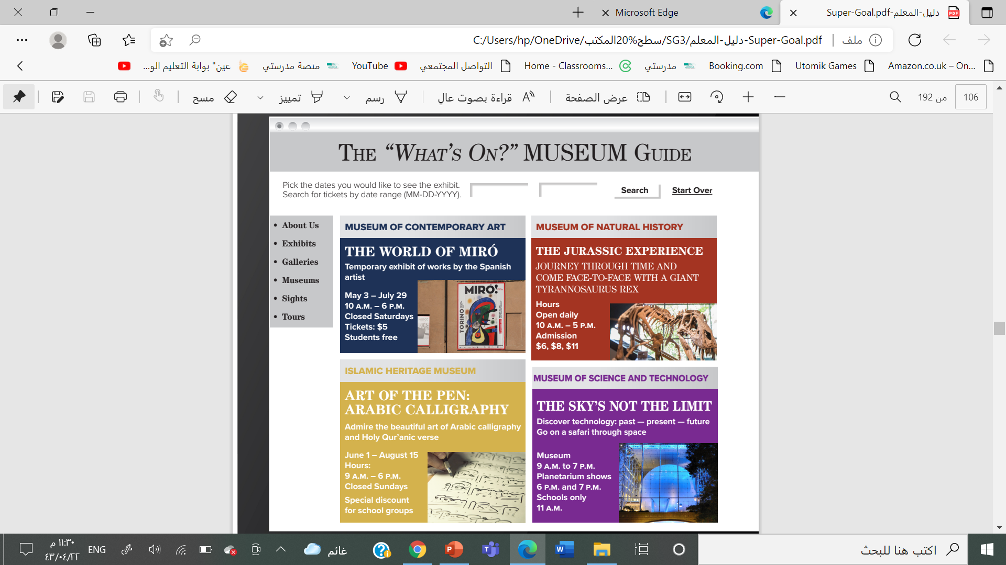

What are the four types of museums?
Where can you learn about space?

Slide 12
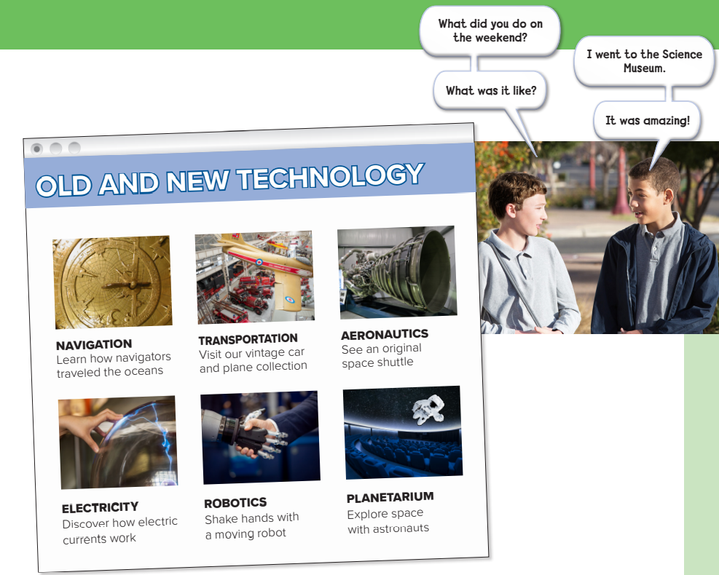

Listen

Slide 13
What are the two boys talking about?
Which museum has no information about prices?
What kind of technology exhibits can you see at the Science Museum?
Which exhibit has old cars?
Which exhibits interest you? Why?

Slide 14

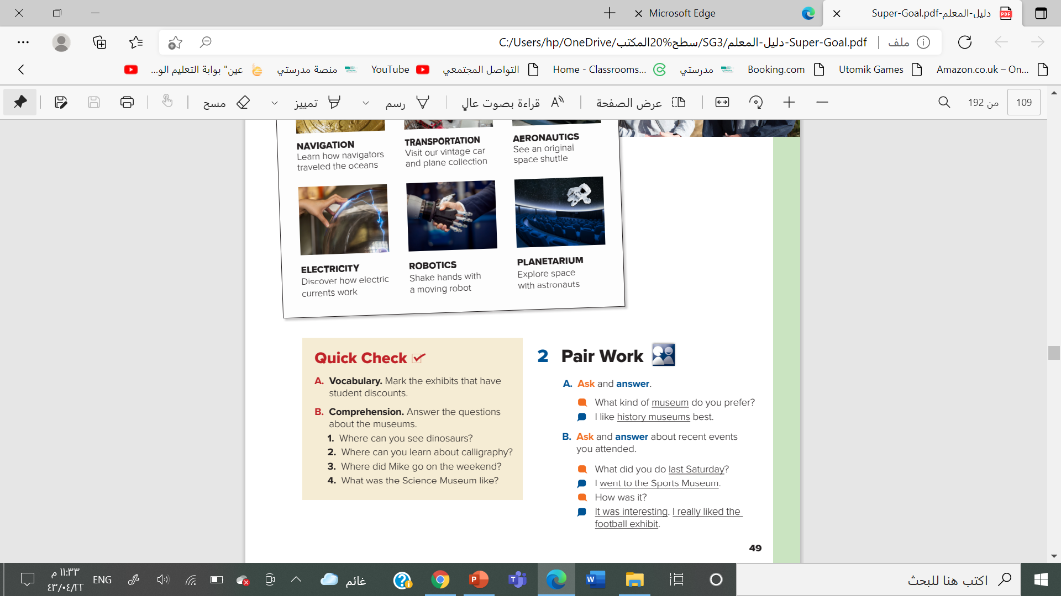
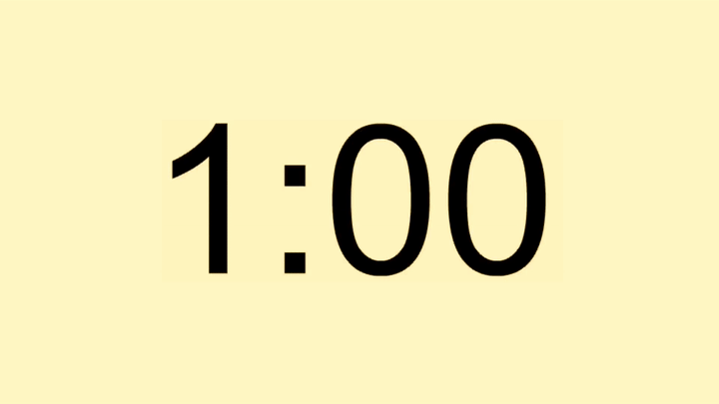
The World of Miró, Art of the Pen: Arabic Calligraphy, and perhaps the Natural History Museum
You can see dinosaurs at the Museum of Natural History
You can learn about calligraphy at the Islamic Heritage Museum.
He went to the Science Museum
. It was amazing

Slide 15
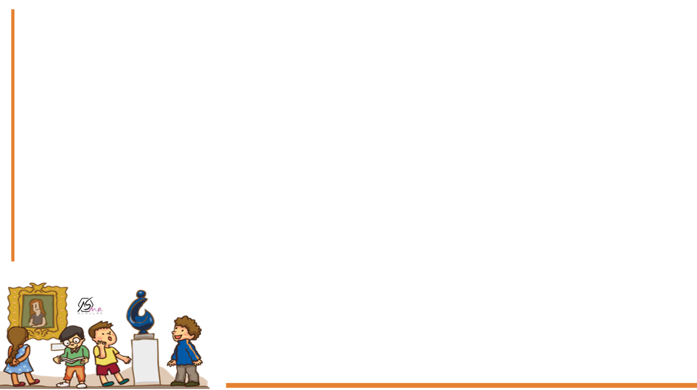
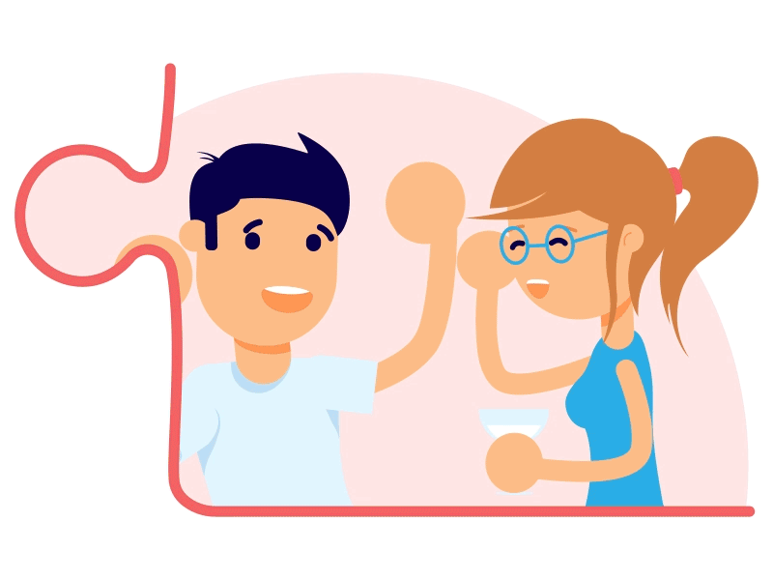
What did you do last Thursday?
What’s another way to say How was it?

Slide 16
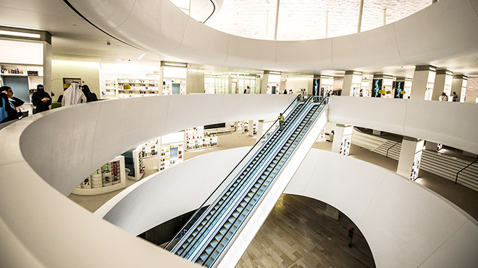

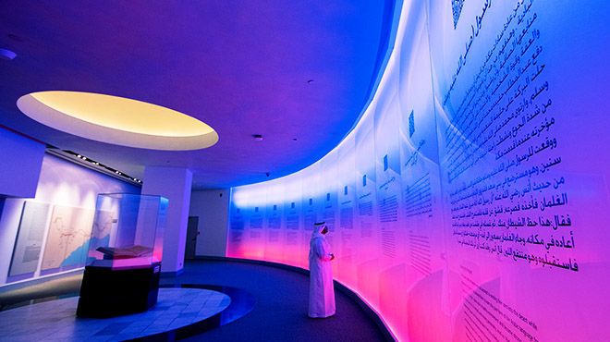

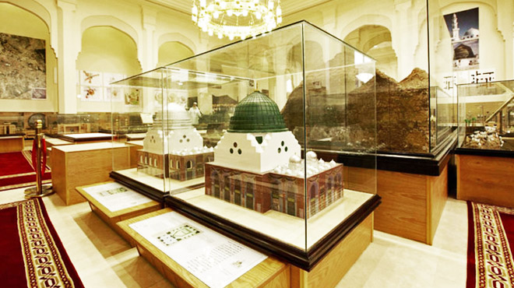
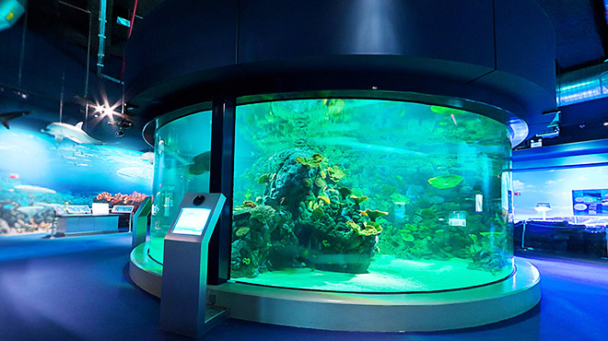
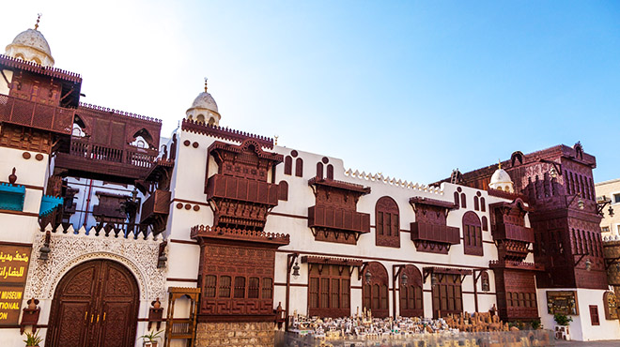
Name some museum in Saudi Arabia

Slide 17
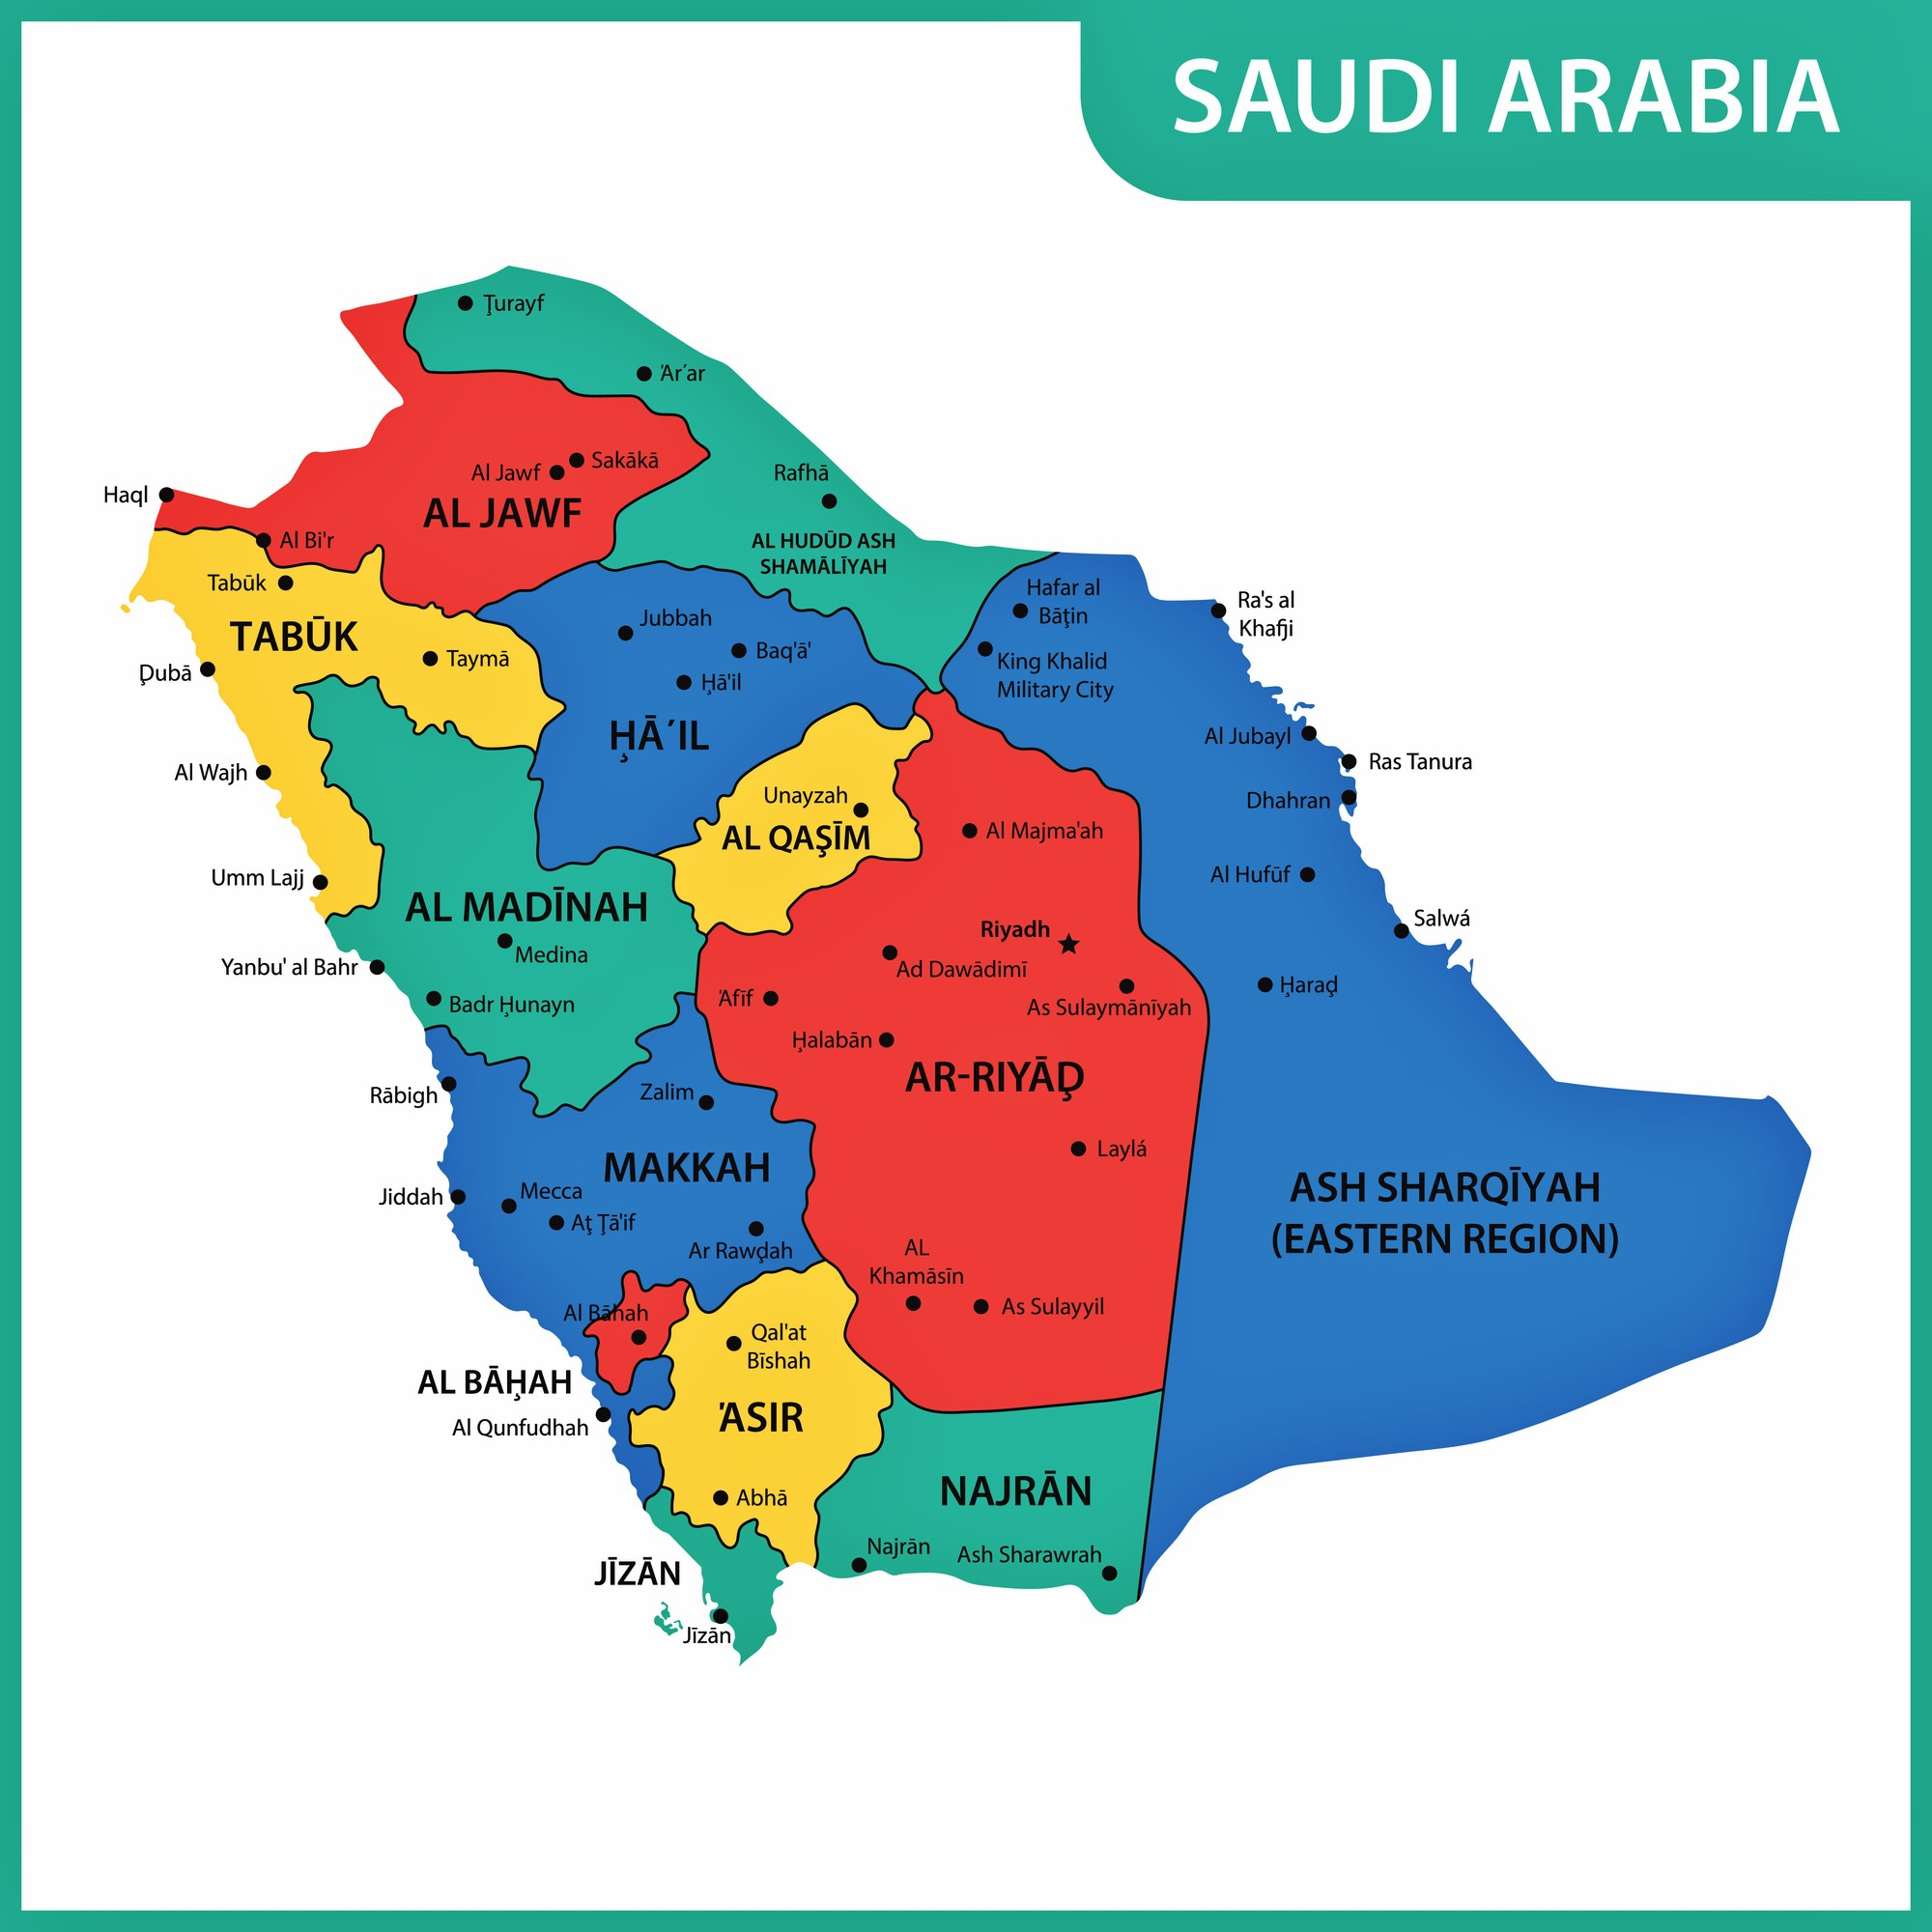
Name some museum in your city \ region

Slide 18
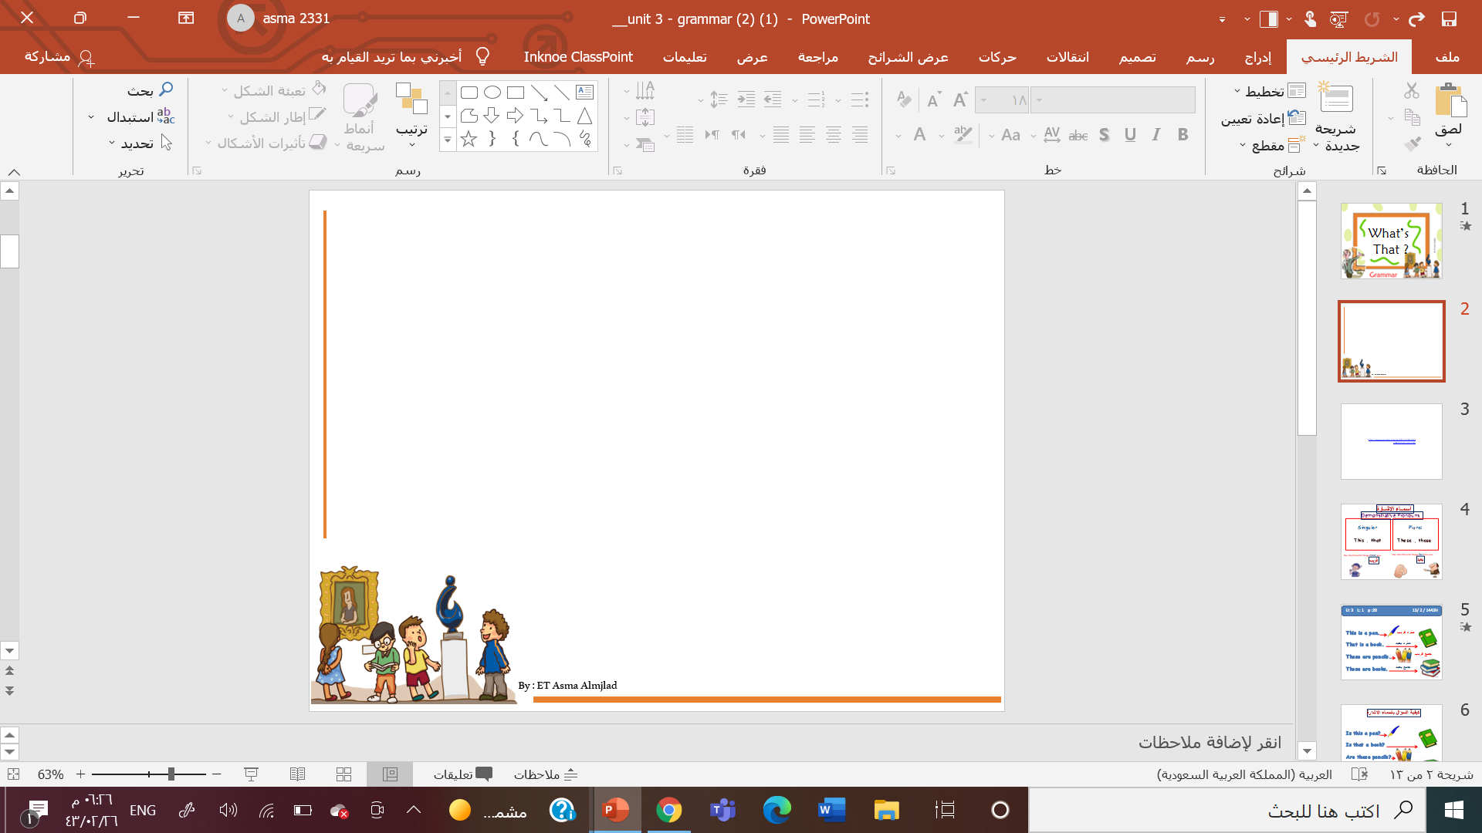
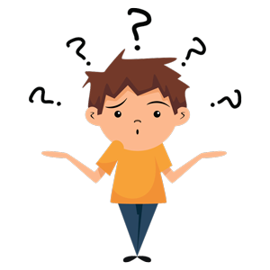


Slide 19
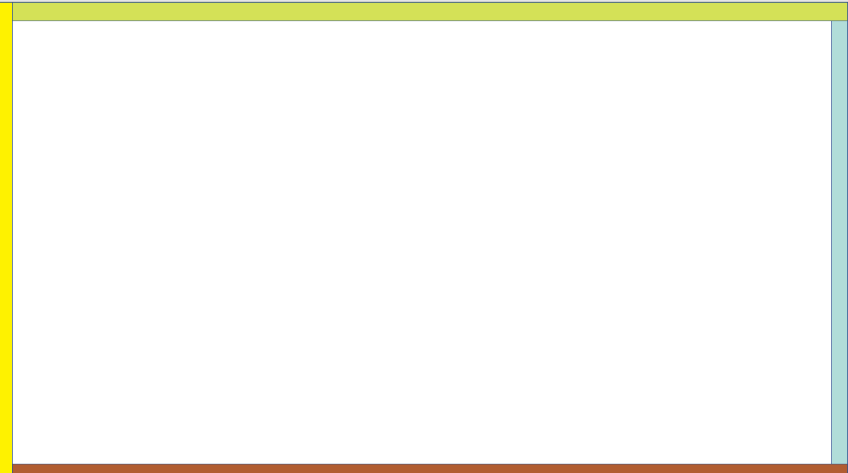


Work
book

Slide 20
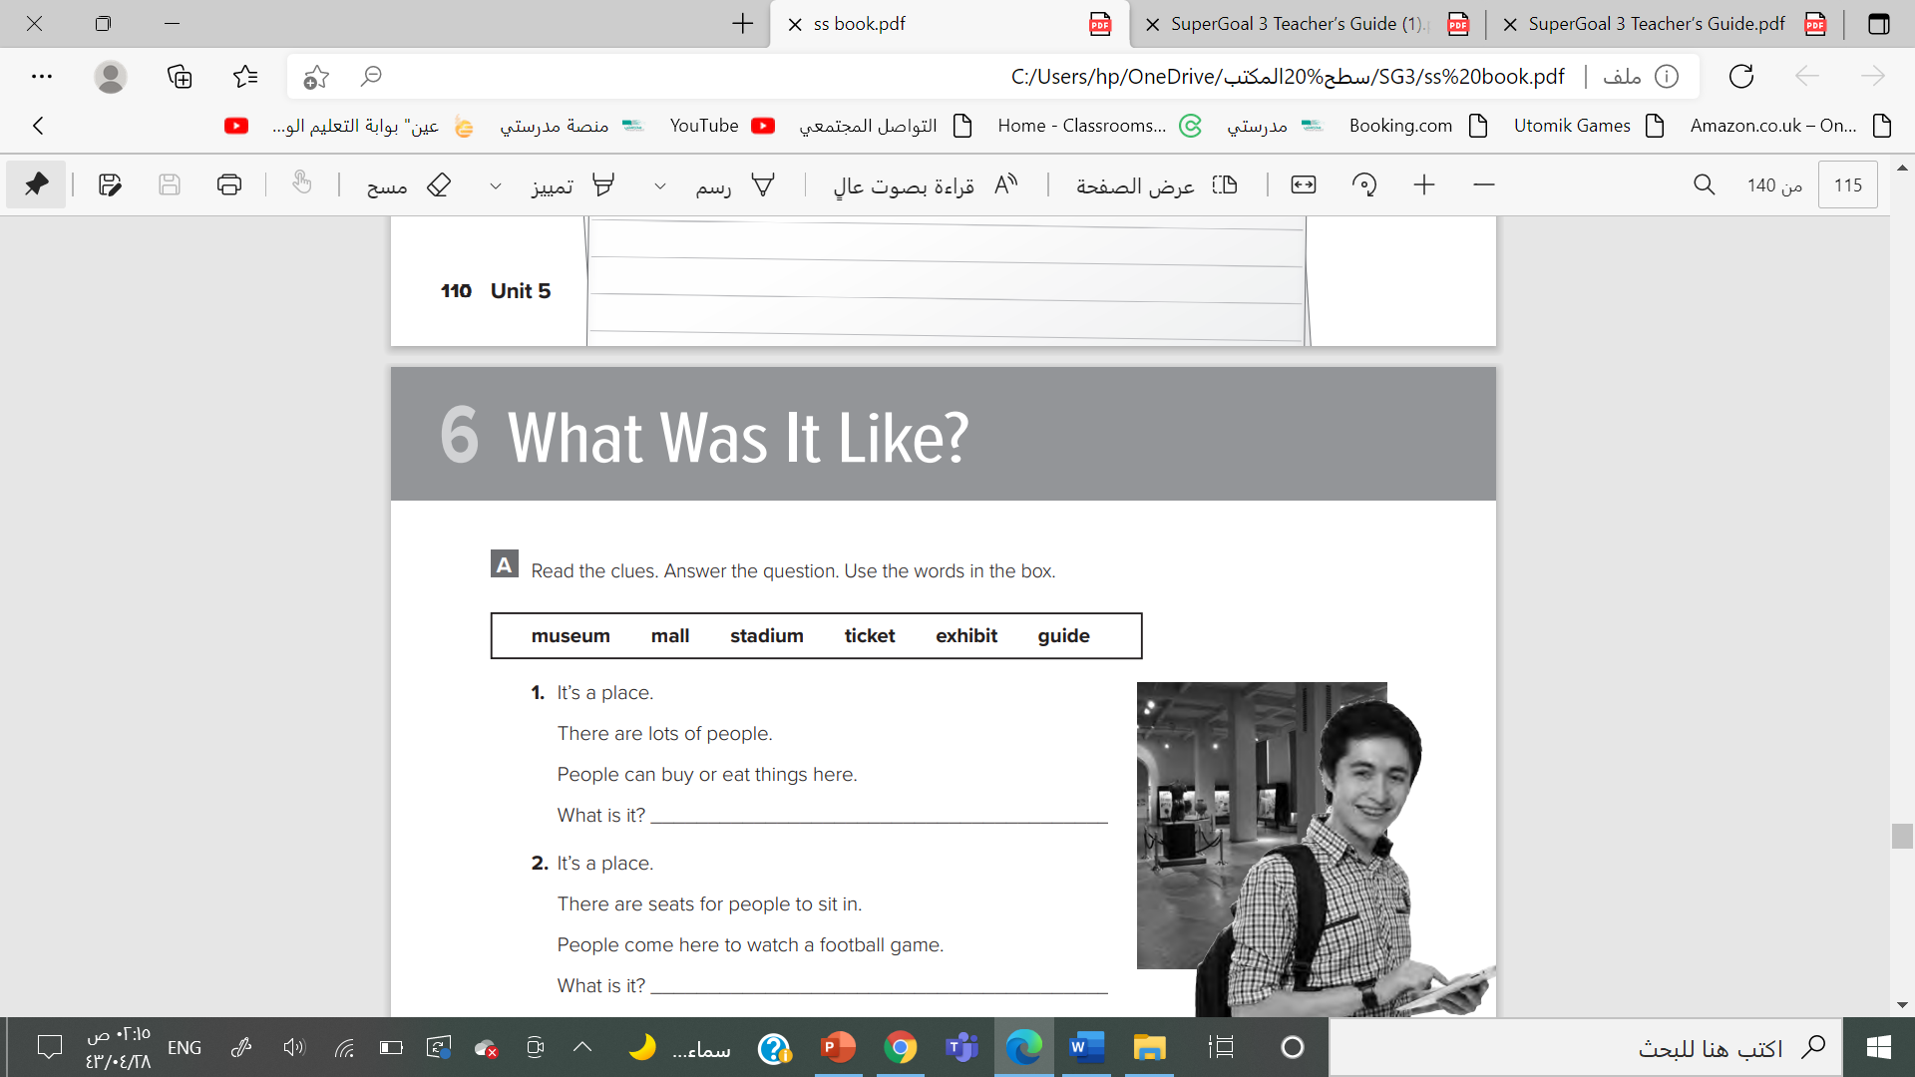

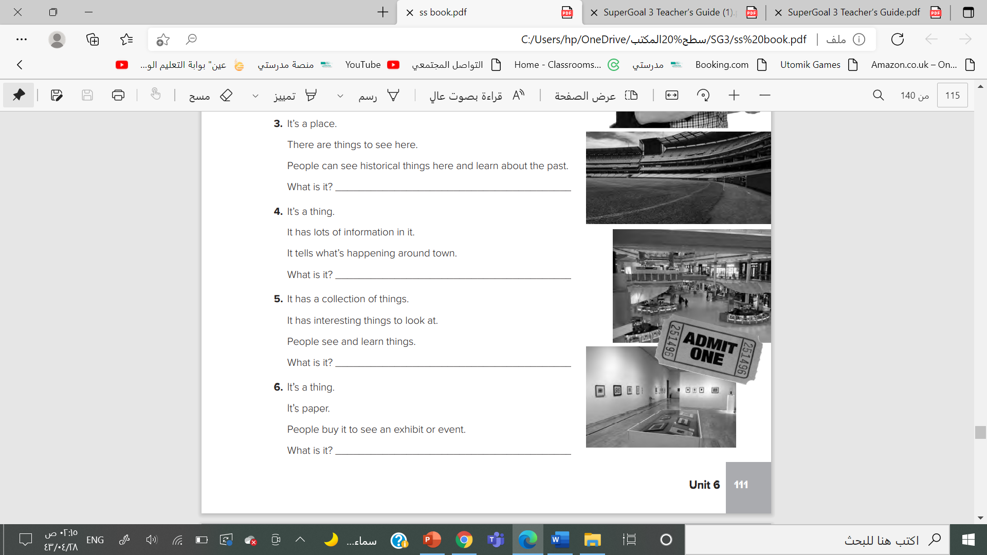
t’s a mall.
It’s a stadium.
It’s a museum.
It’s a guide

Slide 21
It’s an exhibit
It’s a ticket

Slide 22
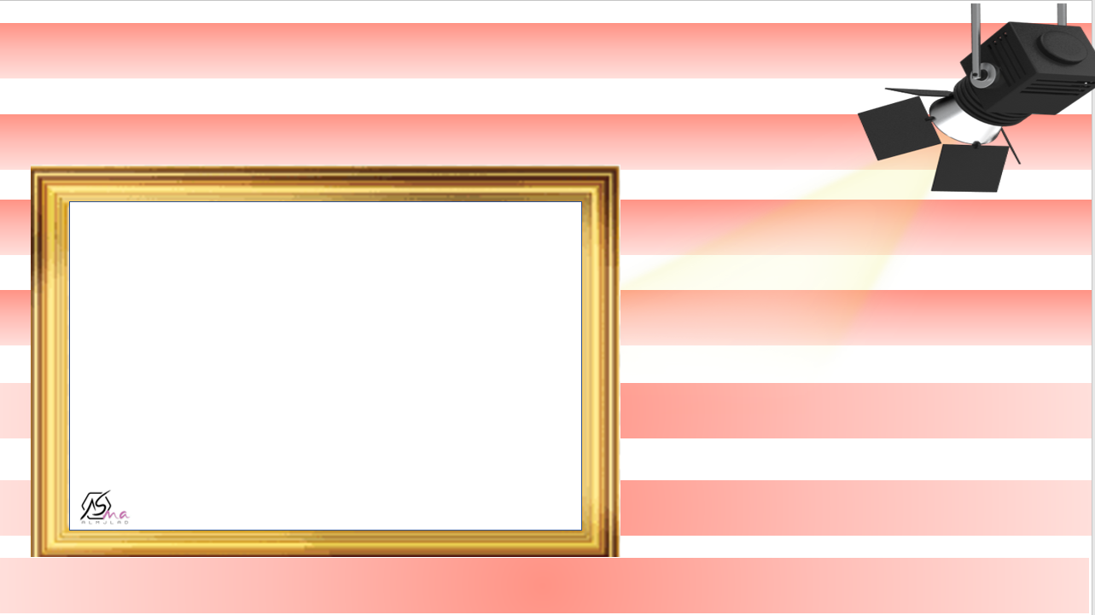



Slide 23



