Slide 1
Unit 6 Grammar

Slide 2

What day it was yesterday?
Yesterday
It was Wednesday.

Slide 3
What’s the difference?
Yesterday
Today
It was Wednesday
It is Thursday

Slide 4
Simple past
be
Did

Slide 5
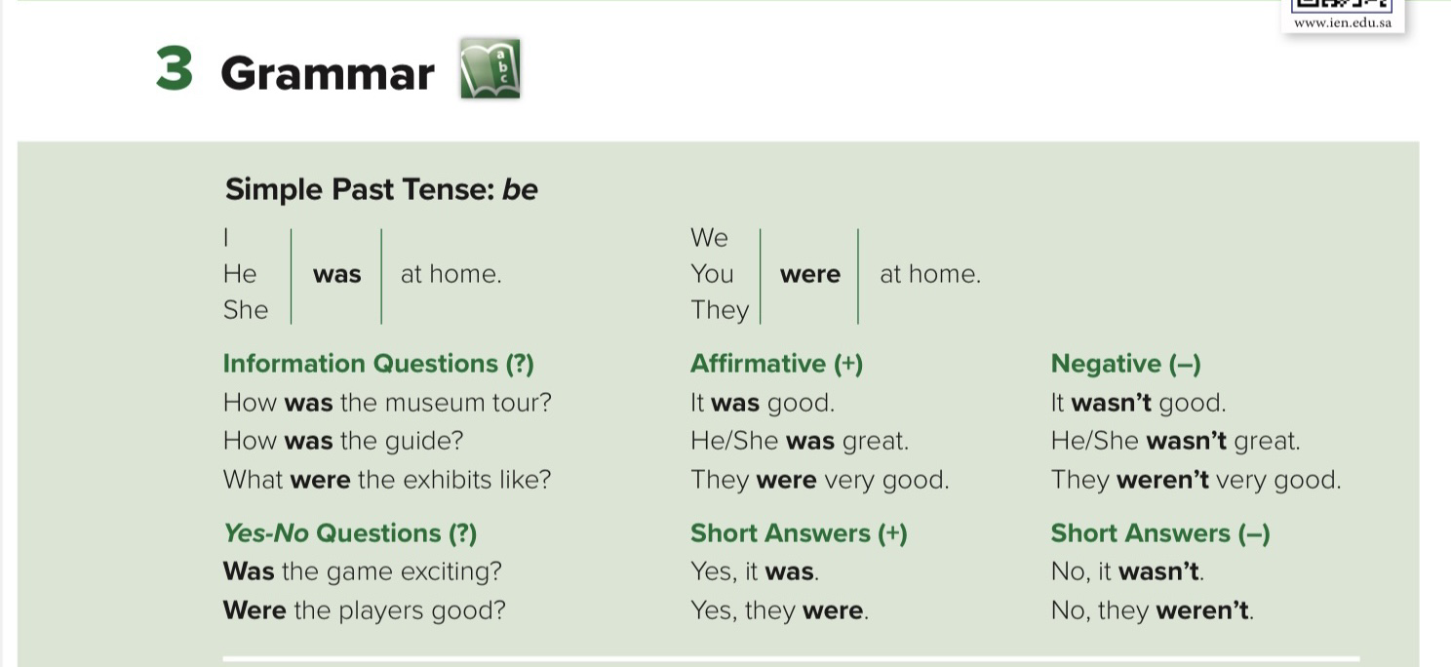
P . 50

Slide 6
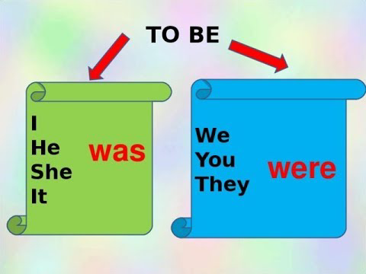

Slide 7
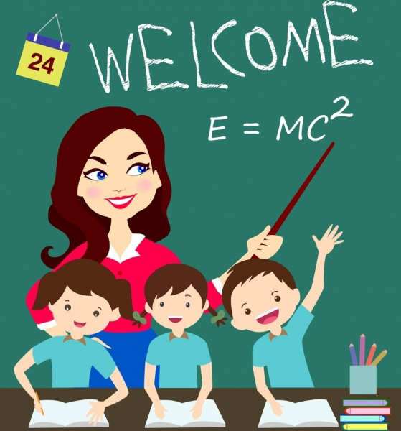
She is a teacher
She was a teacher
Change into the past simple

Slide 8
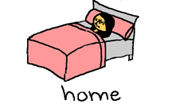
I am at home
I was at home
Change into the past simple

Slide 9
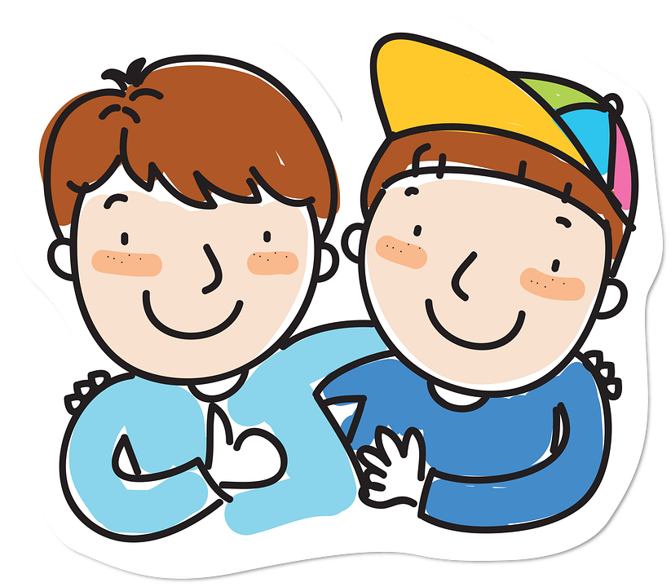
They are very good
They were very good
Change into the past simple

Slide 10
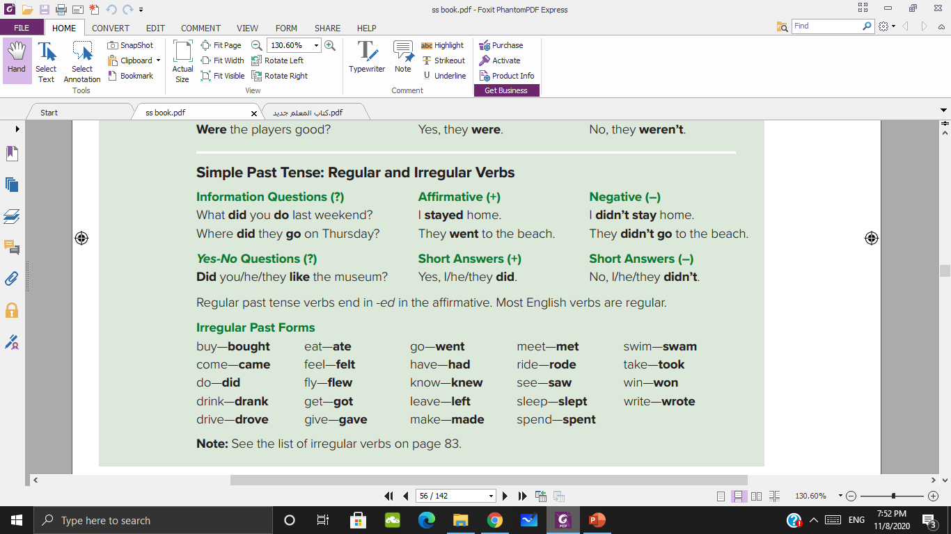

Slide 11
I watch TV
I watched TV

Slide 12
He plays football
He played football

Slide 13
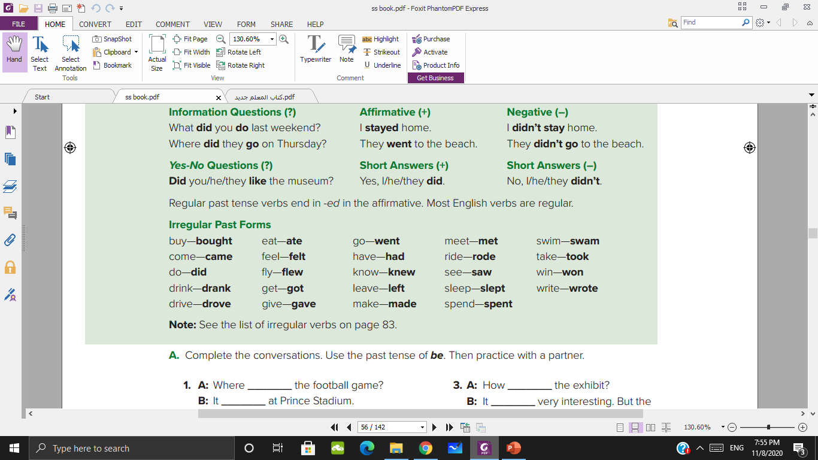

Slide 14
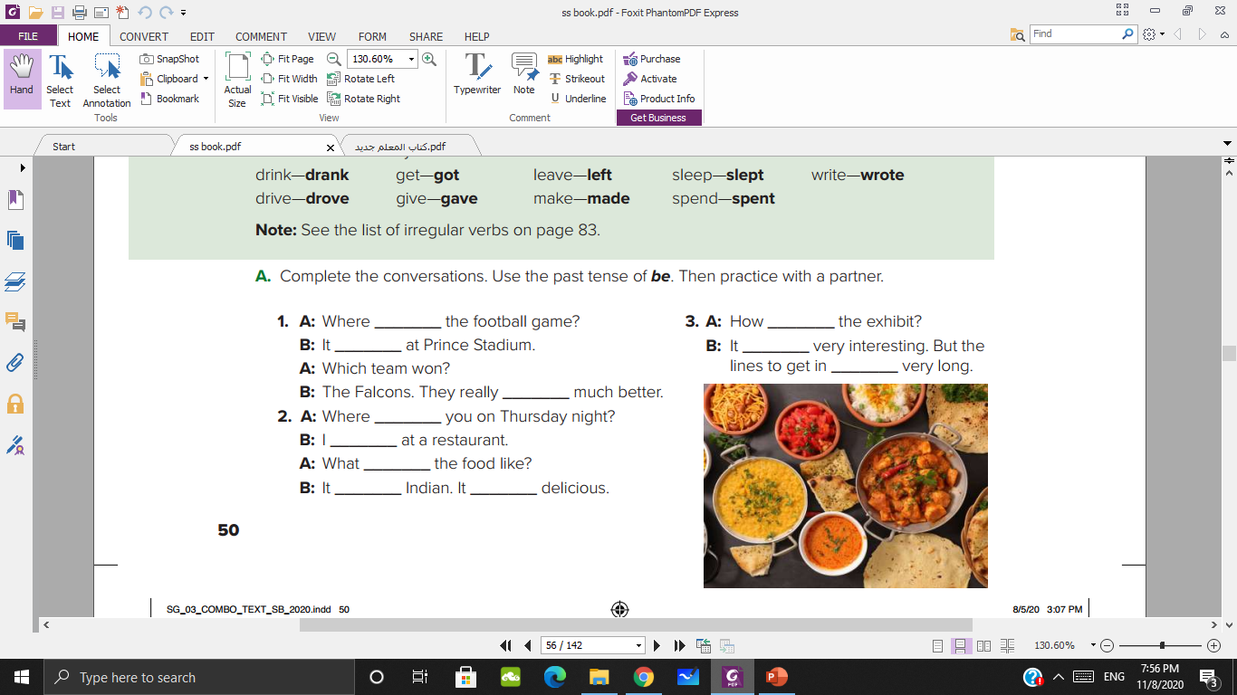
was
was
was
was
were
were
were
was
was
was
was

Slide 15
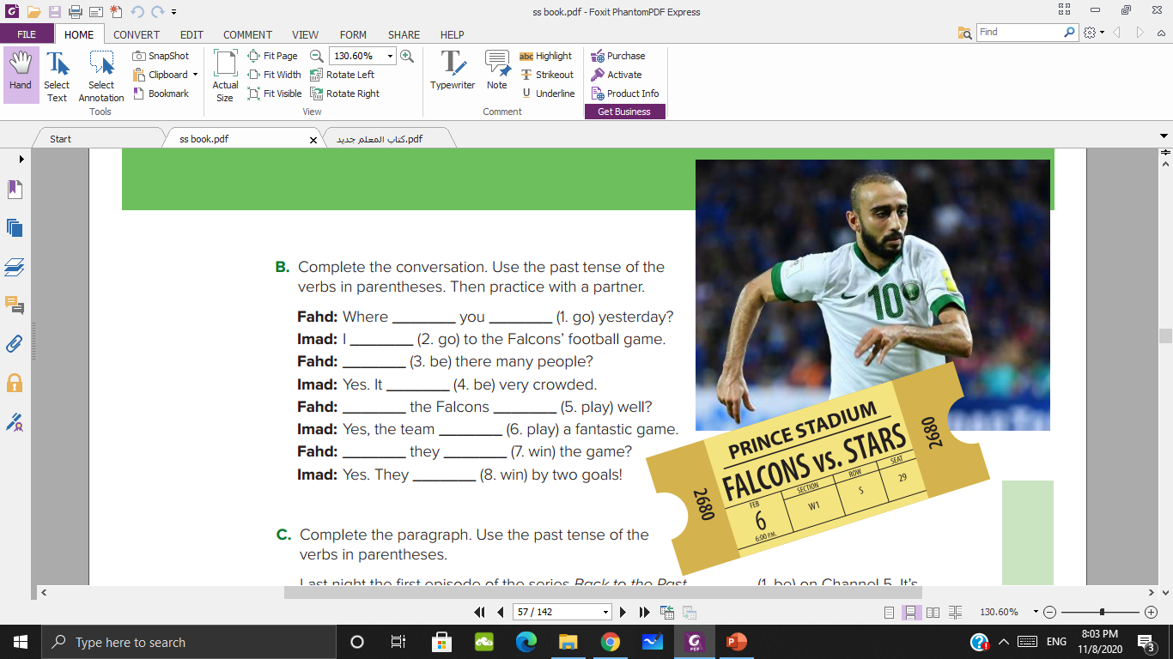
did
go
went
Were
was
Did
play
played
Did
win
won

Slide 16
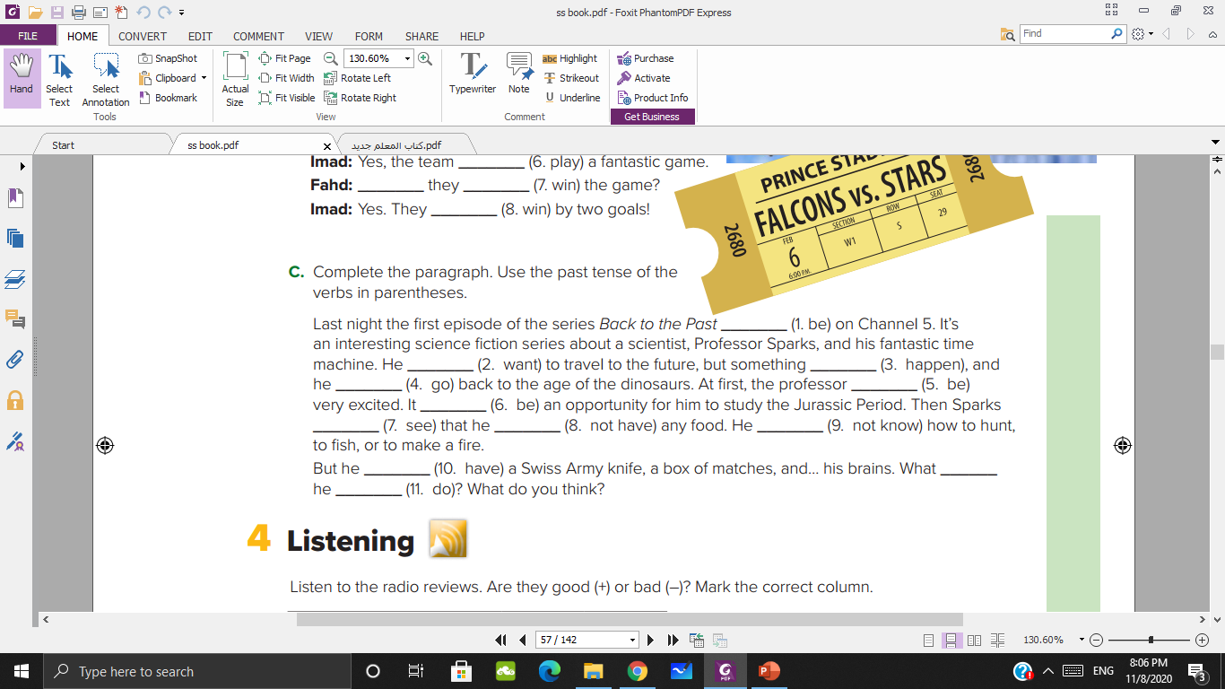
was
wanted
happened
went
was
was
saw
didn’t have
didn’t know
had
did
do

Slide 17
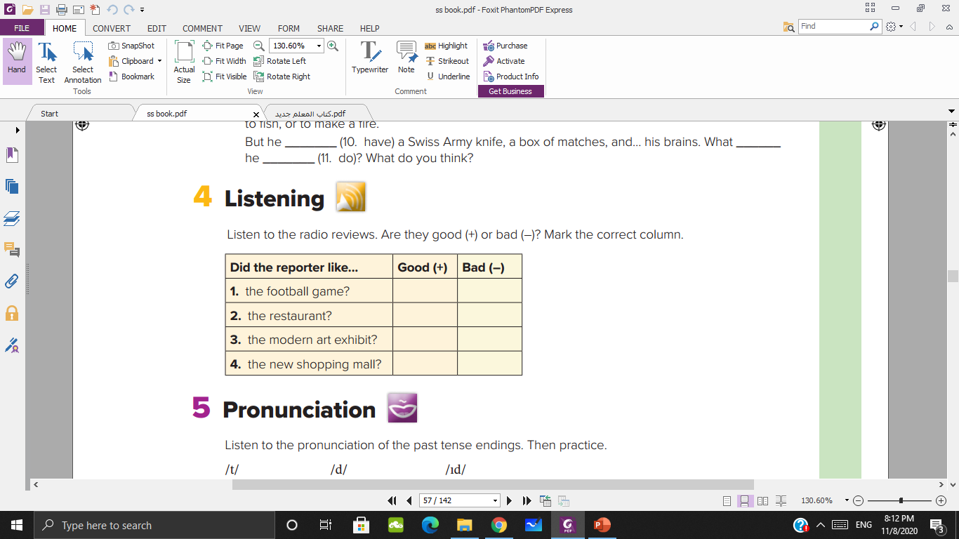

bad
bad
bad
good

Slide 18
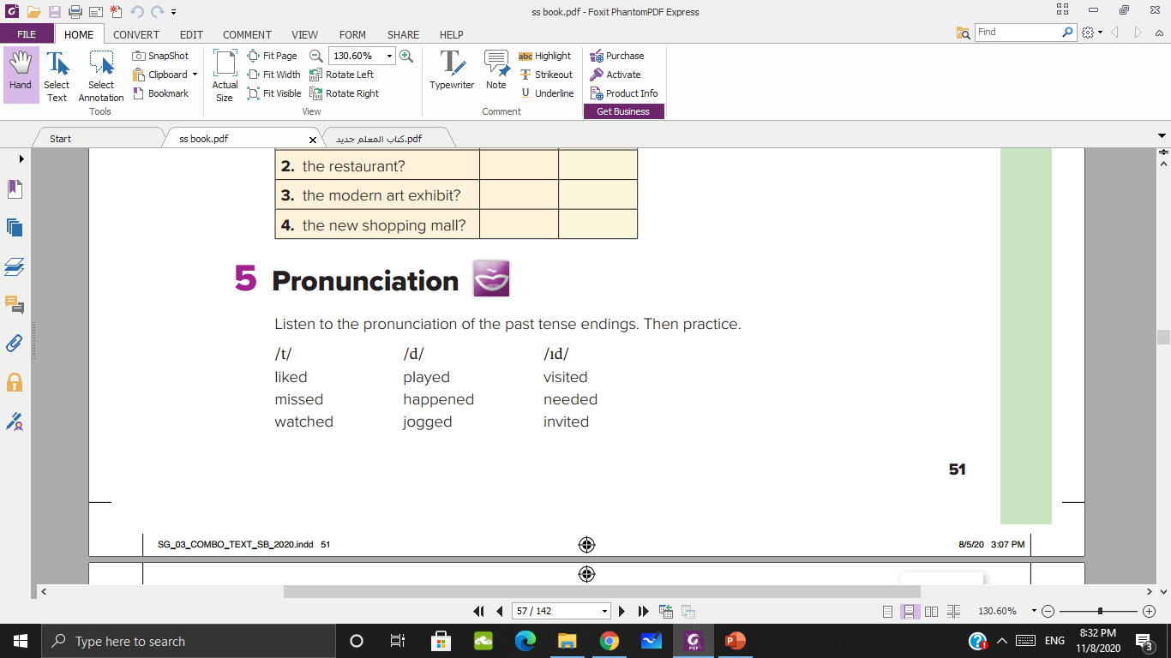

Slide 19
Homework p 112 ( C )

Slide 20
Thank you

