Slide 1

What time do you get up?
Grammar

Slide 2
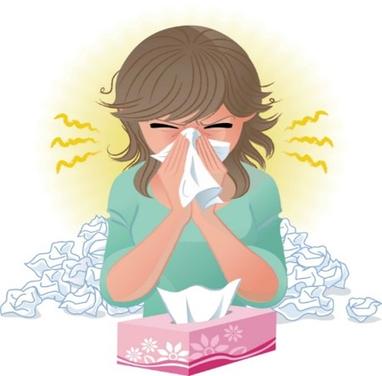
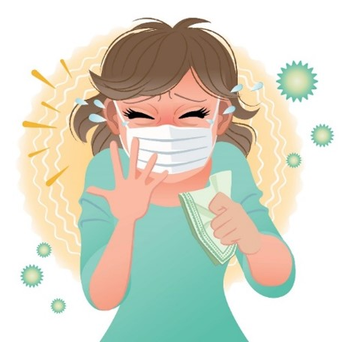
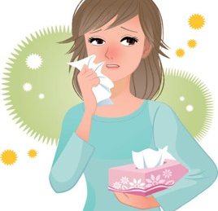
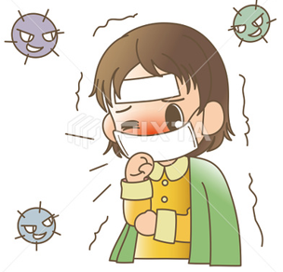

COVID 19
☺ Avoid gathering !
☺ wear a mask before going out
☺ Social distancing is not a choice, it is a must!
☺ Keep a distance of 2 meters to avoid accountability
☺ Wash hands constantly

Slide 3
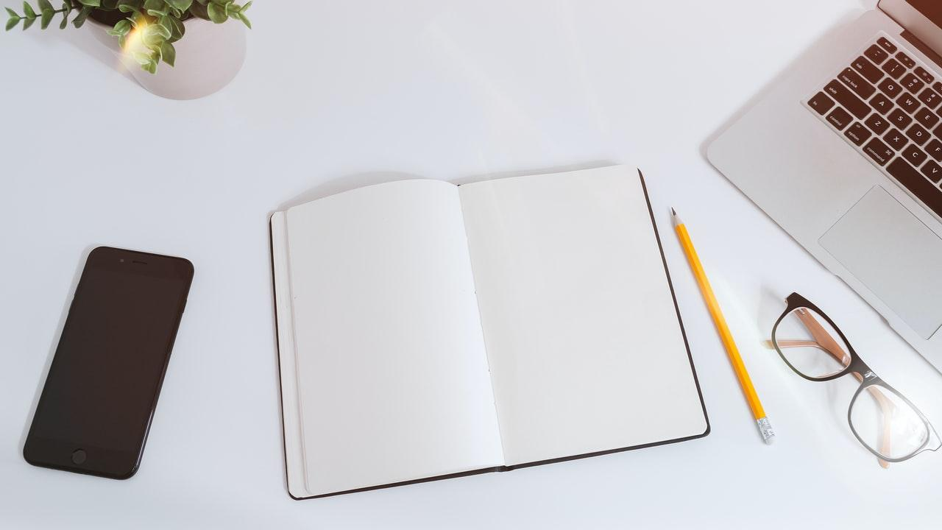
بسم الله الرحمن الرحيم
Day
Date

Slide 4
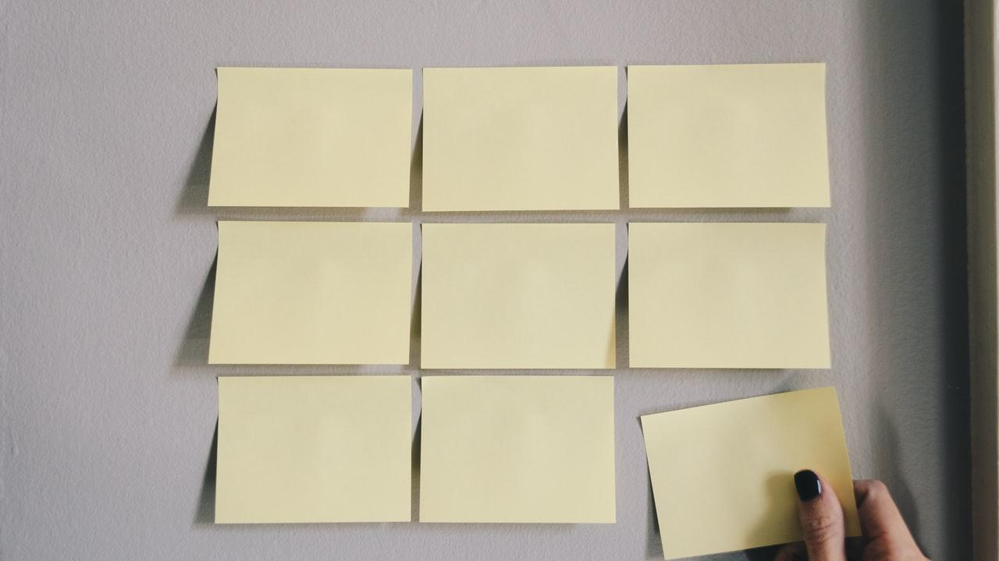
Learning Objectives
Use adverbs of frequency correctly
Use time expressions correctly
Use prepositions correctly
Answer questions after listening
Practice pronunciation correctly

Slide 5

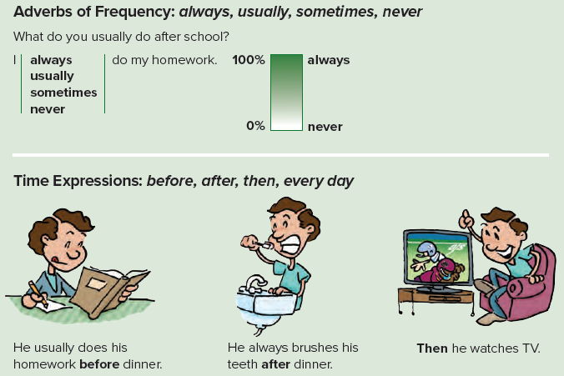

Slide 6
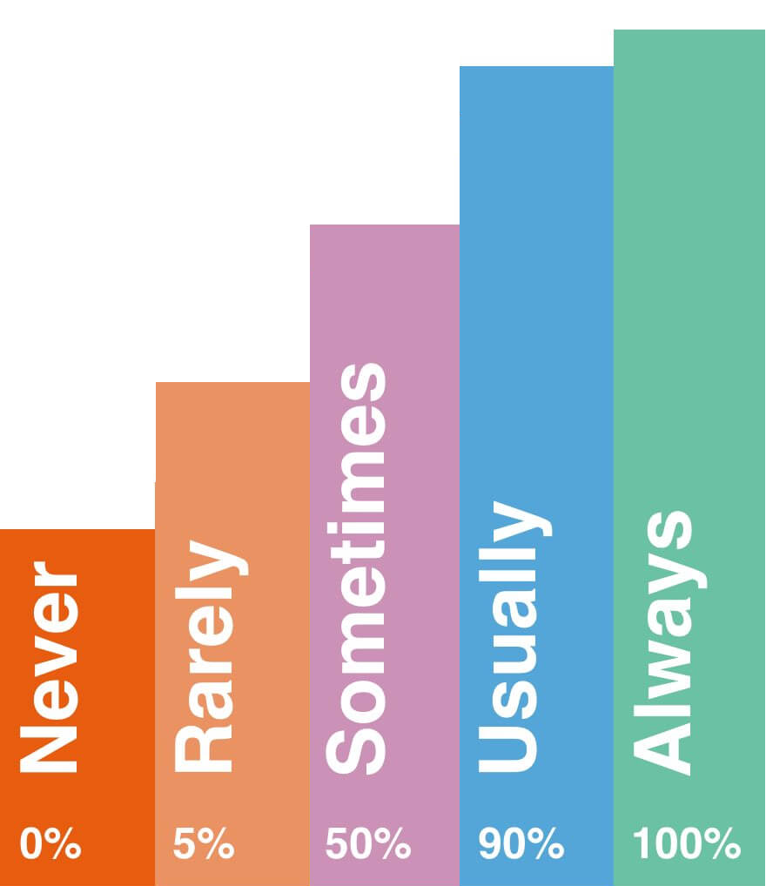
Adverbs of frequency

Slide 7
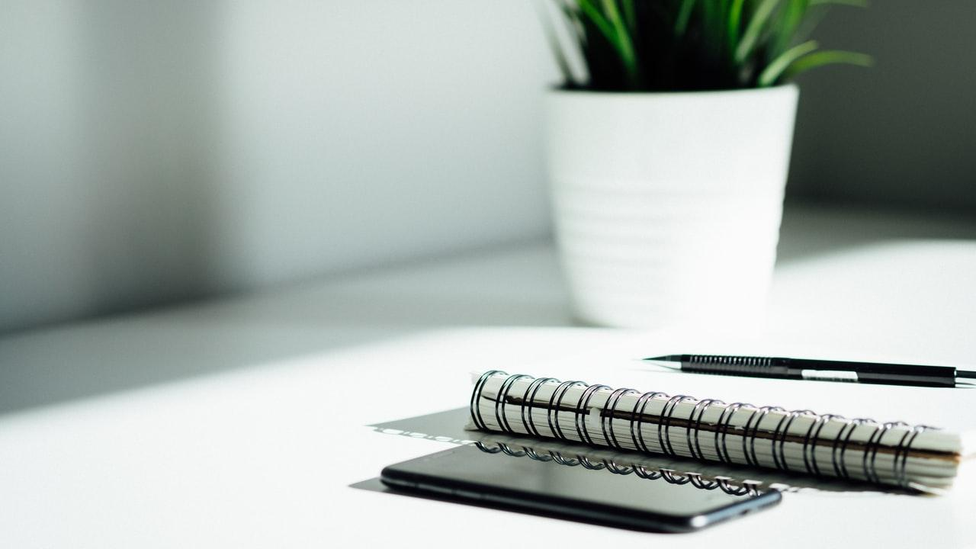

Practice

Slide 8
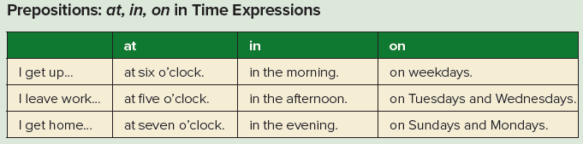

Slide 9
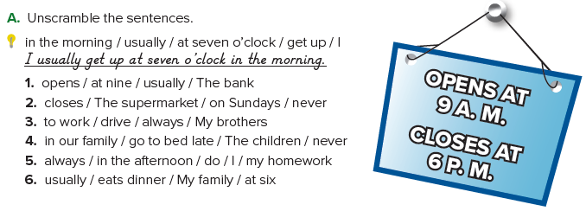
1. The bank usually opens at nine.
2. The supermarket never closes on Sundays.
3. My brothers always drive to work.
4. The children in our family never go to bed late.
5. I always do my homework in the afternoon.
6. My family usually eats dinner at six.

Slide 10
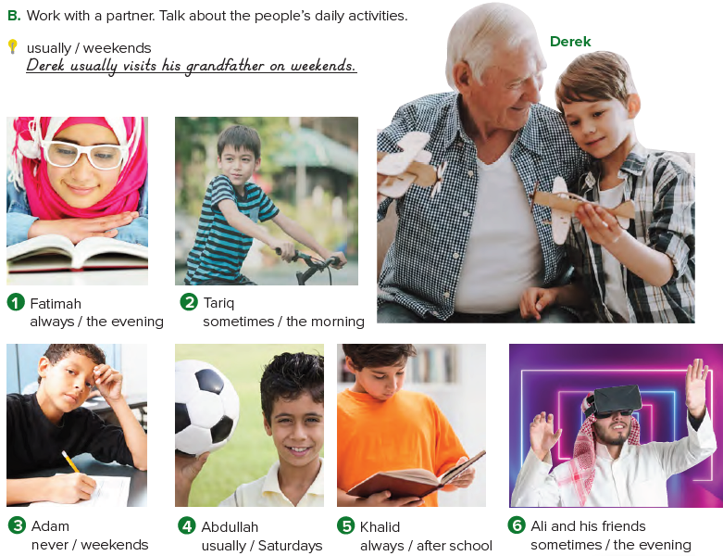
1. Fatimah always studies in the evening.
2. Tariq sometimes rides his bike in the morning.

Slide 11
3. Adam never goes to school on weekends.
4. Abdullah usually plays football on Saturdays.
5. Khalid always does his homework after school.
6. Ali and his friends sometimes play video games in the evening.

Slide 12
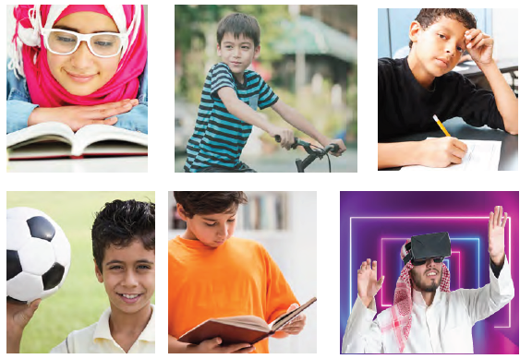

Slide 13

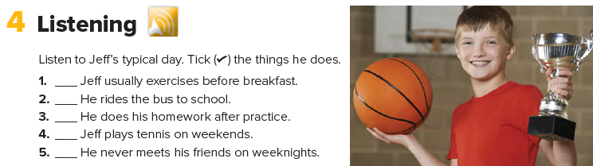


Slide 14
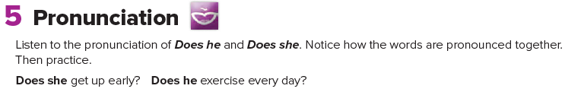

Slide 15
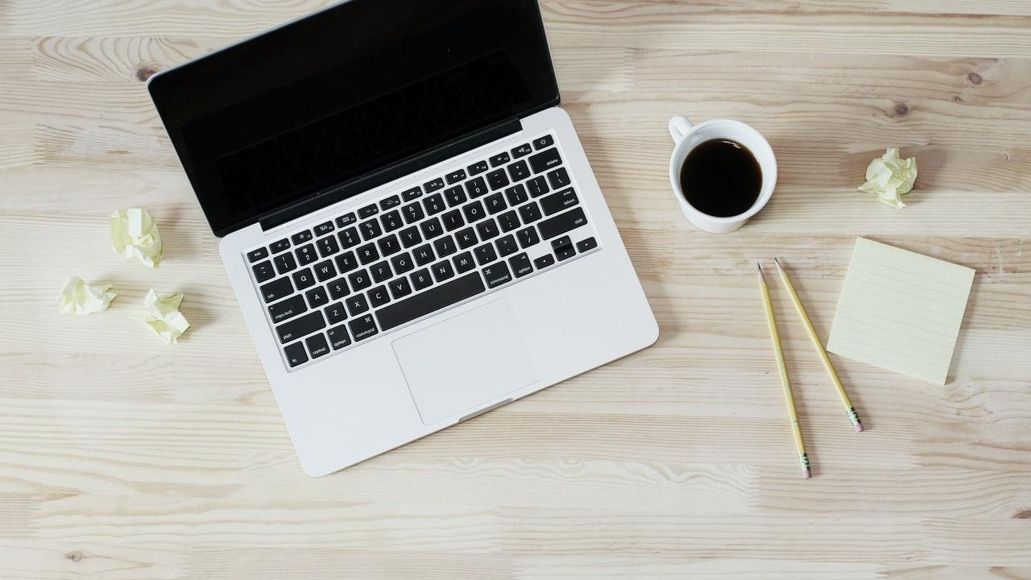
Home work
Page 98

Slide 16
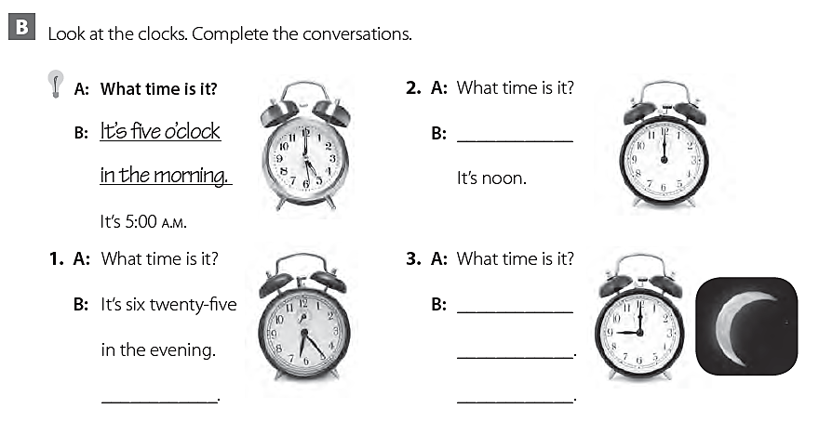
It’s twelve o’clock
It’s nine o’clock
at night
It’s 6:25 p.m.
It’s 9:00 P.M.

Slide 17
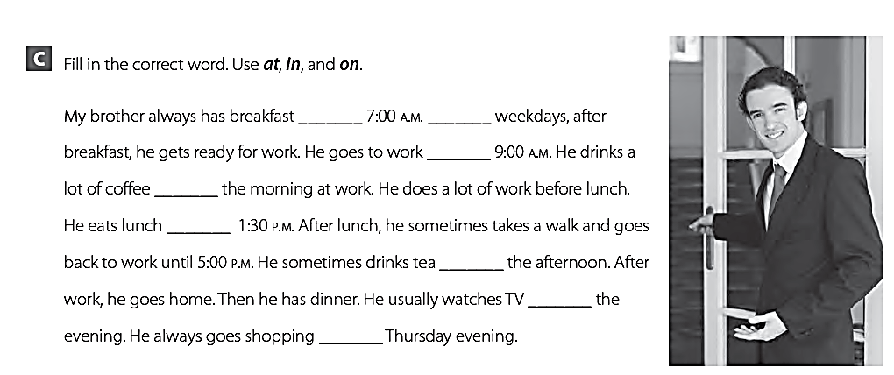
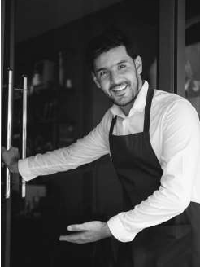
at
on
at
in
at
in
in
on

Slide 18
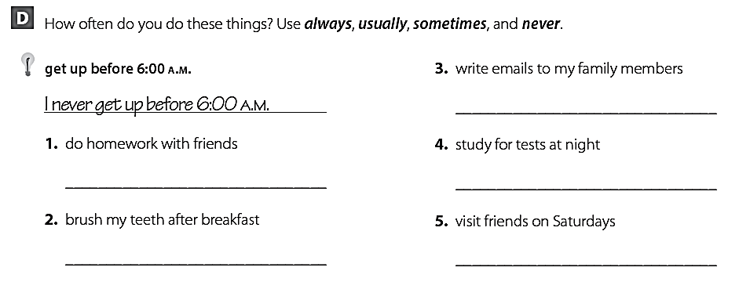
I sometimes write emails to my family
I never do homework with friends
I always study for tests at night
I always brush my teeth after breakfast
I usually visit friends on Thursdays

