Slide 1

What time do you get up?
Listen & Discuss

Slide 2
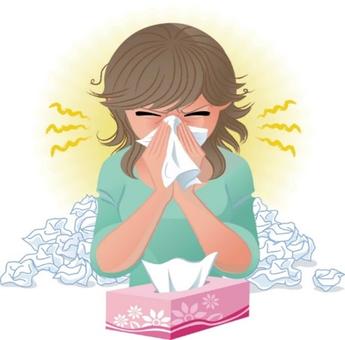
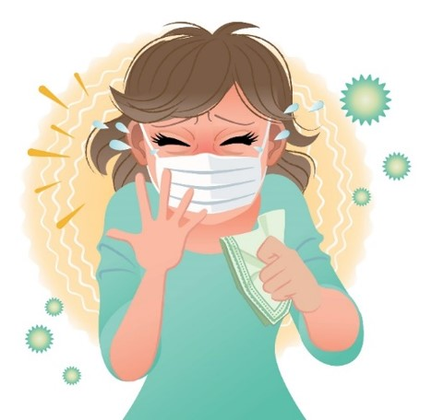
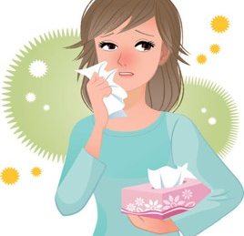
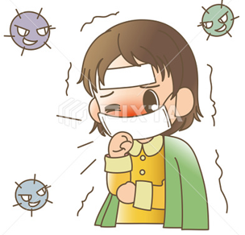

COVID 19
☺ Avoid gathering !
☺ wear a mask before going out
☺ Social distancing is not a choice, it is a must!
☺ Keep a distance of 2 meters to avoid accountability
☺ Wash hands constantly

Slide 3

بسم الله الرحمن الرحيم
Day
Date

Slide 4
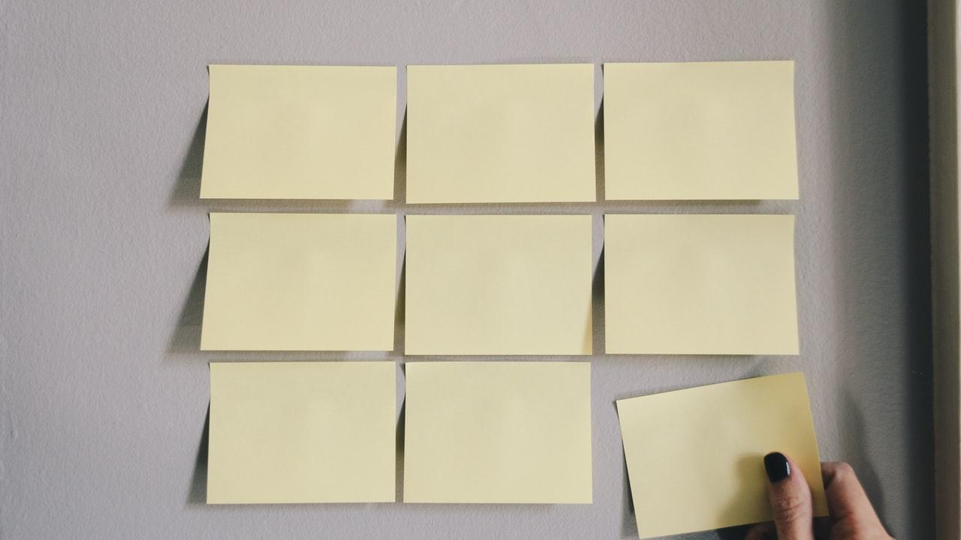
Learning Objectives
Describe daily activities correctly
Tell the time correctly
Name the part of the day correctly
Ask about daily activities
Answer questions about daily activities

Slide 5
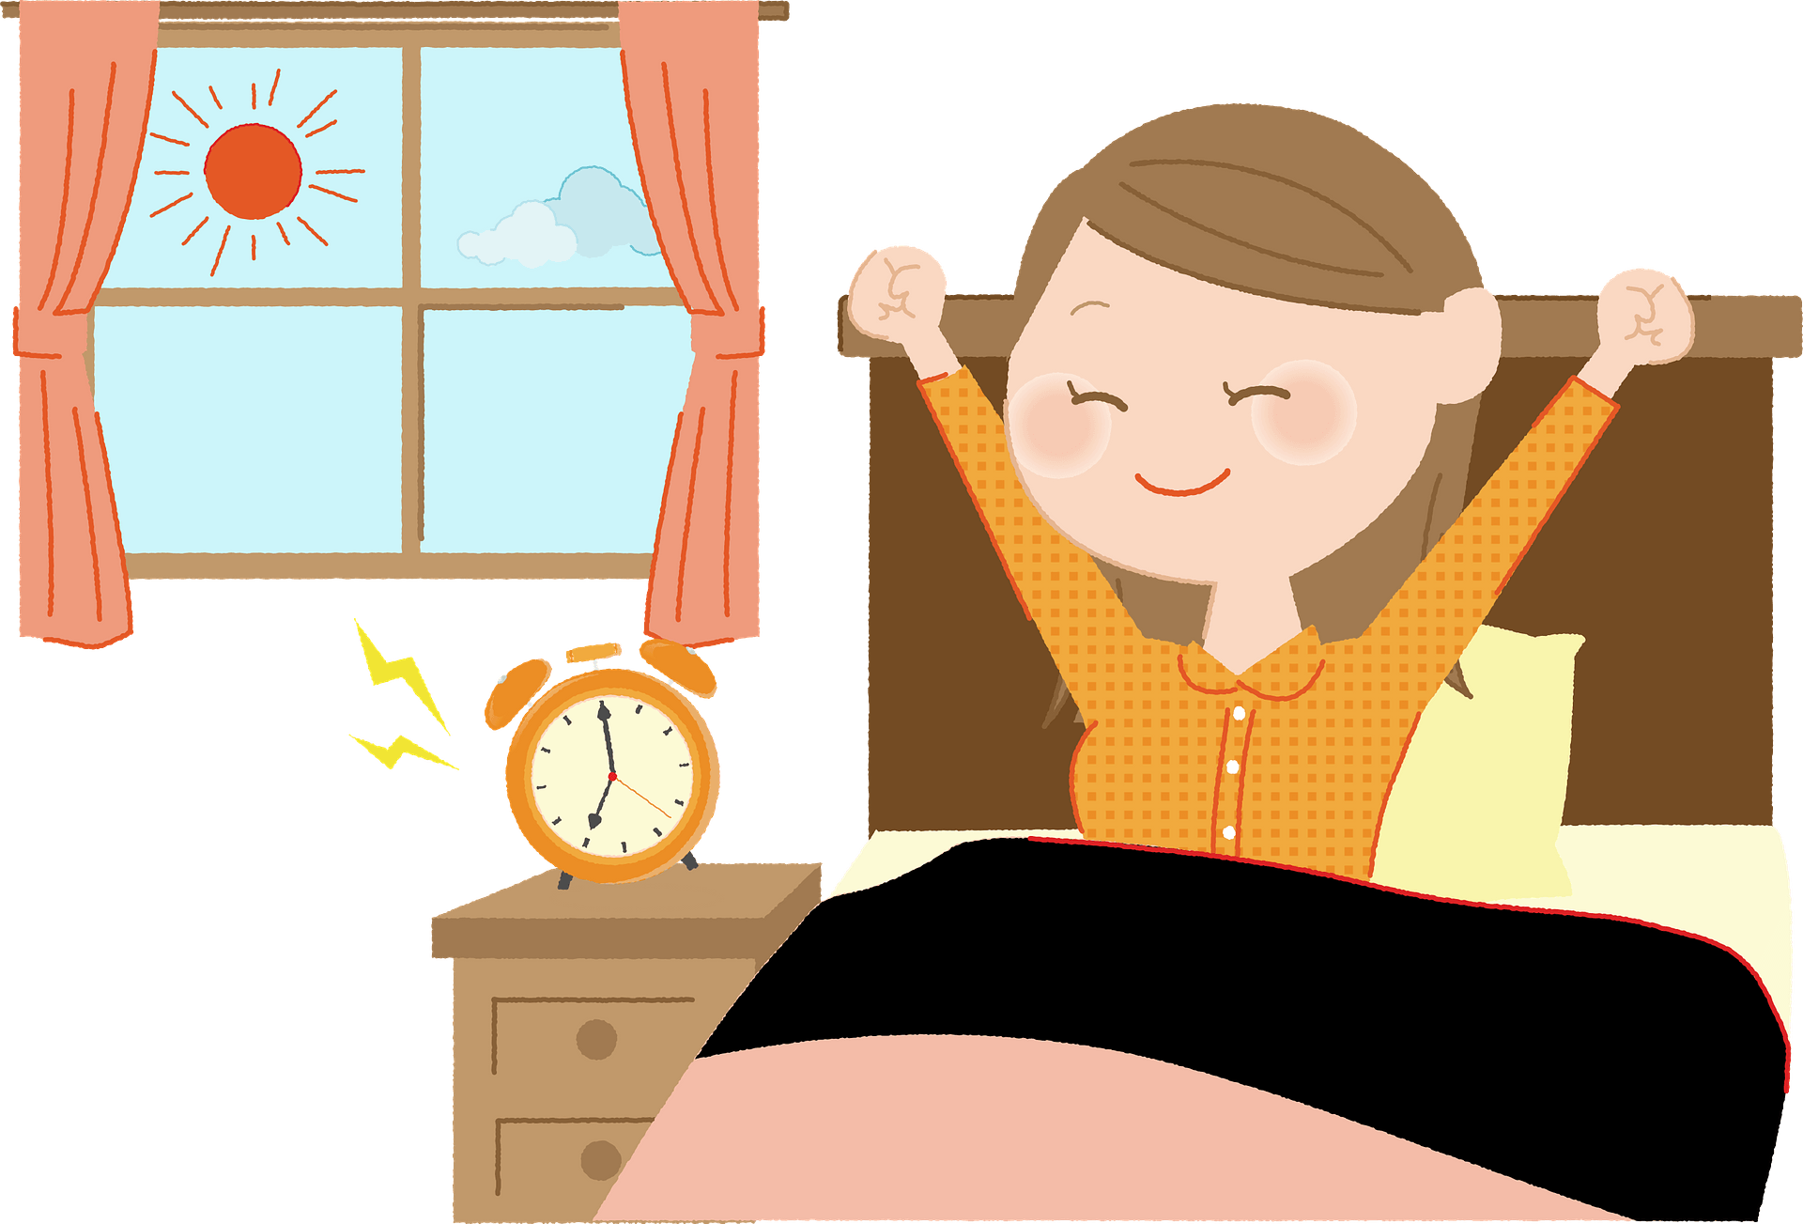
Warm Up
I get up at 5 a.m.

Slide 6
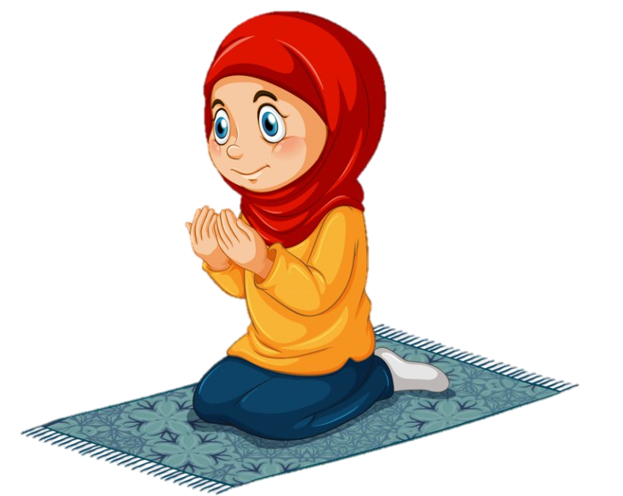
Warm Up
I pray Al Fajr prayer at 5:30 a.m.

Slide 7
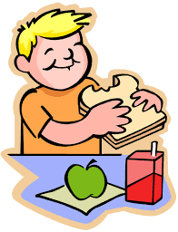
I eat breakfast at 6:30
Warm Up

Slide 8

I go to school at 7:15 a.m.
Warm Up

Slide 9
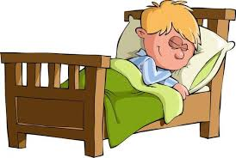
I go to bed at 8 p.m.
Warm Up

Slide 10
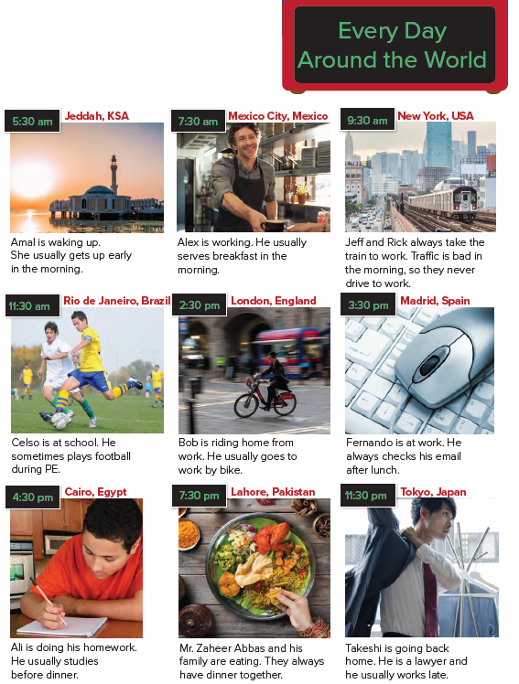

Which activities are the same or different in your country at these times?

Slide 11

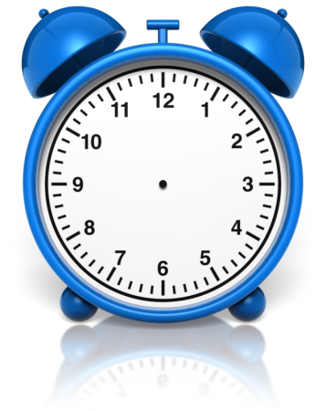

Slide 12


Slide 13

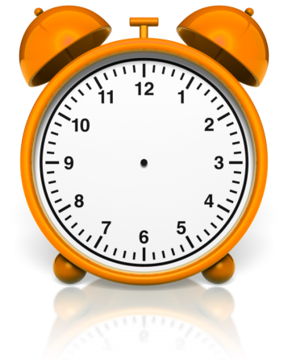

Slide 14

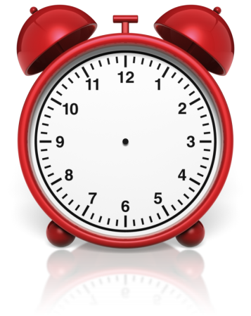

Slide 15



Slide 16

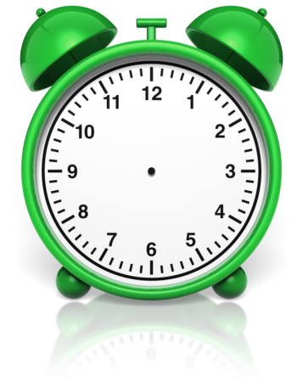

Slide 17
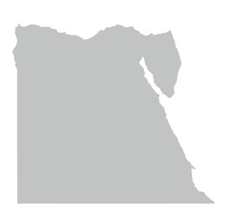

Slide 18


Slide 19


Slide 20

Practice

Slide 21
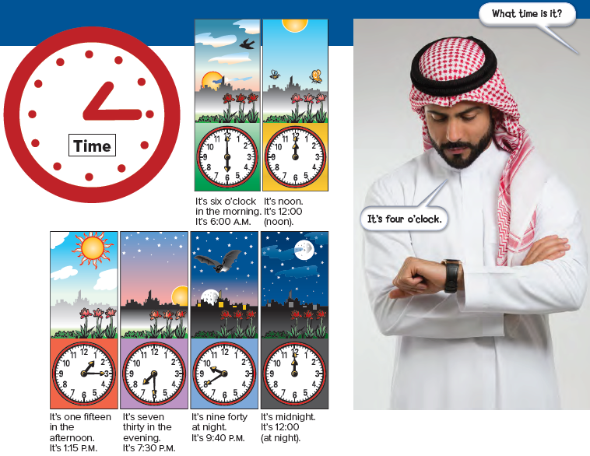

Slide 22
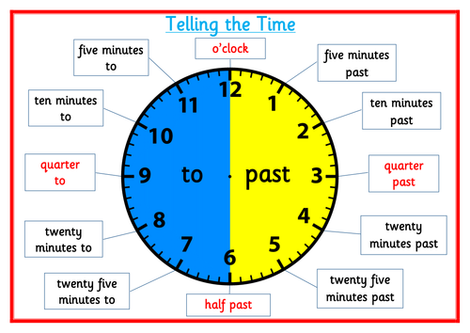

Slide 23


Practice

Slide 24
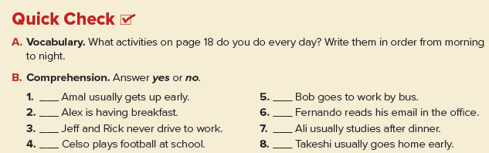
yes
no
yes
yes
no
yes
no
no

Slide 25
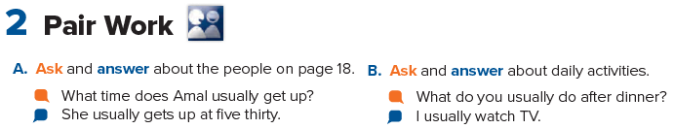

Slide 26

Home work
Page 97

Slide 27
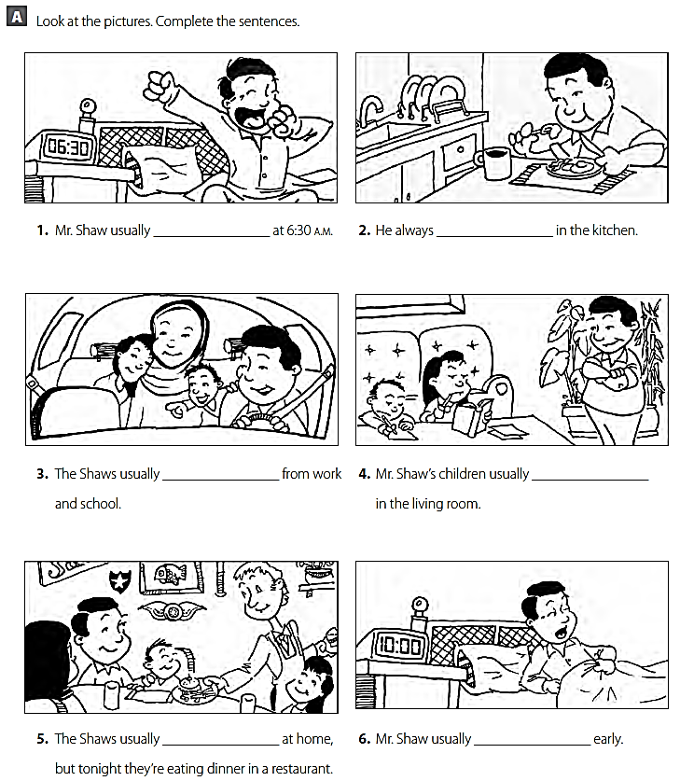
gets up
eats breakfast
drive home
study
eat dinner
goes to bed

