Slide 1

U2 What’s school like?
Reading p 15

Slide 2

Read “School Clubs” using predicting strategy.
Answer some question about the topic
This Photo by Unknown Author is licensed under CC BY-NC

Slide 3
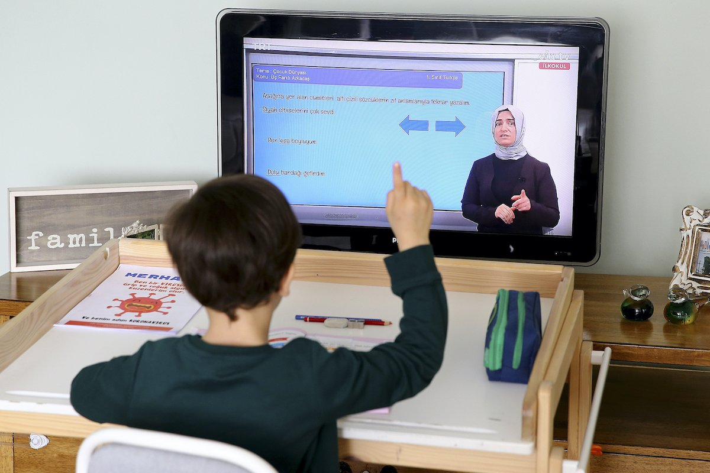
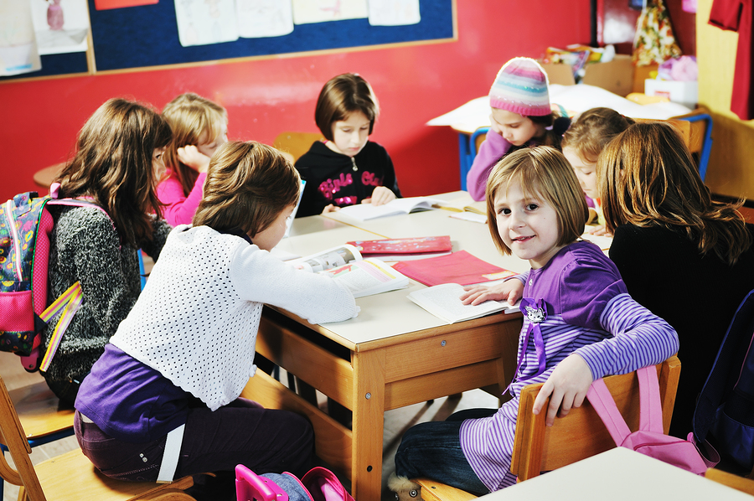
Have you missed learning in school?
Do you prefer online learning or face to face learning?

Slide 4


Slide 5
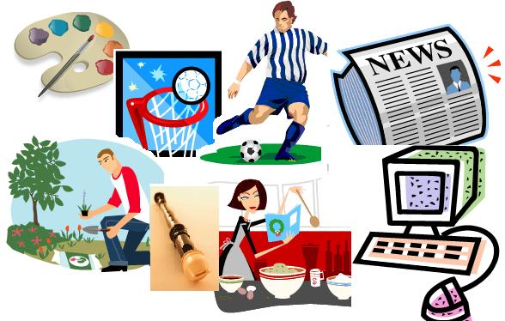
What club does your school have?

Slide 6
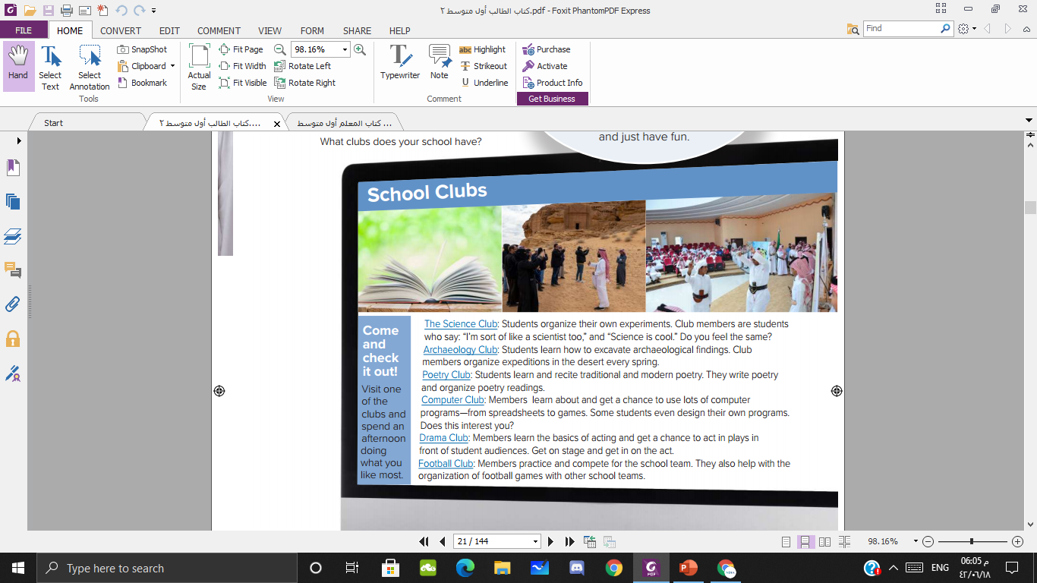
What clubs will you read about?

Slide 7
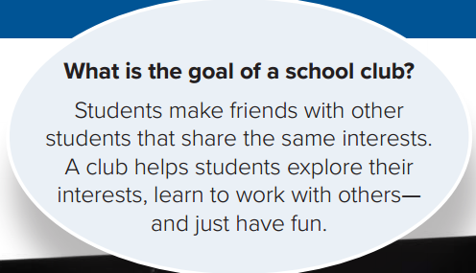
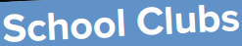
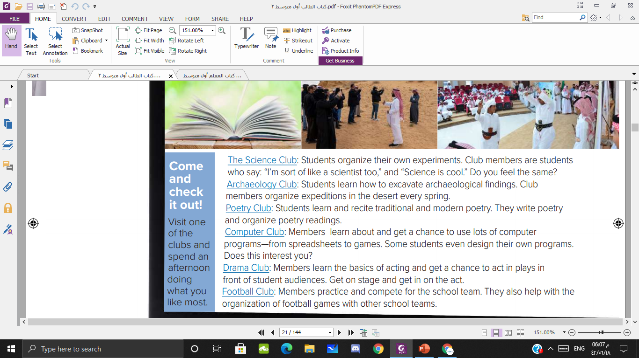


Slide 8
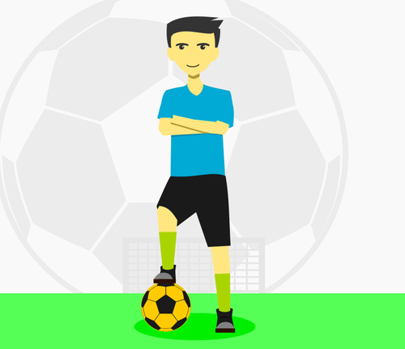
Football club

Slide 9

Drama club

Slide 10

Science club

Slide 11
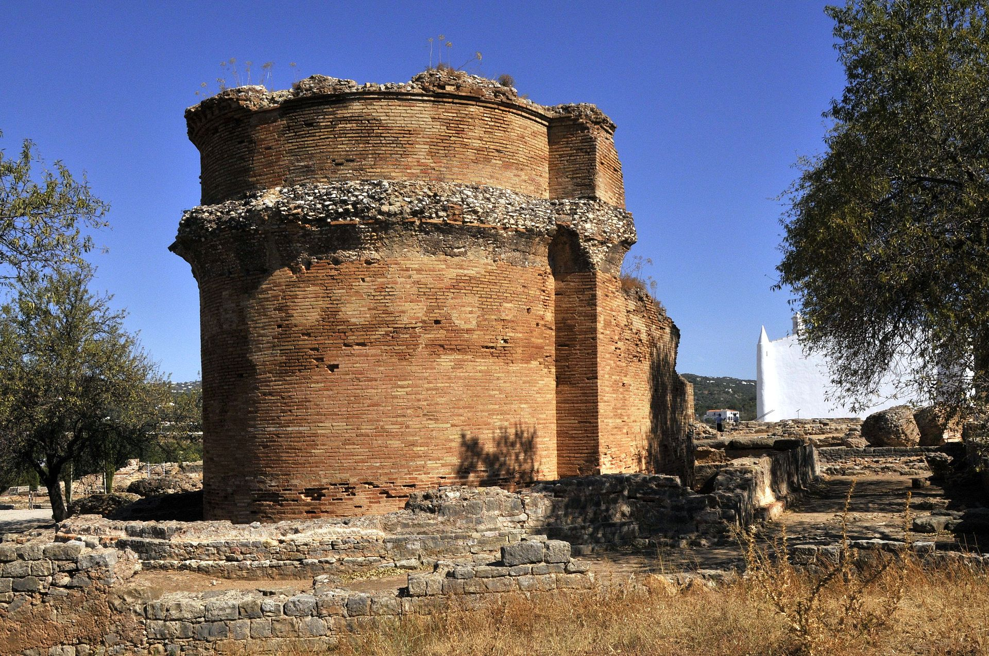
Archelogy club

Slide 12

Computer club

Slide 13

poetry club

Slide 14

https://www.cram.com/flashcards/games/jewel/school-clubs-11944425

Slide 15
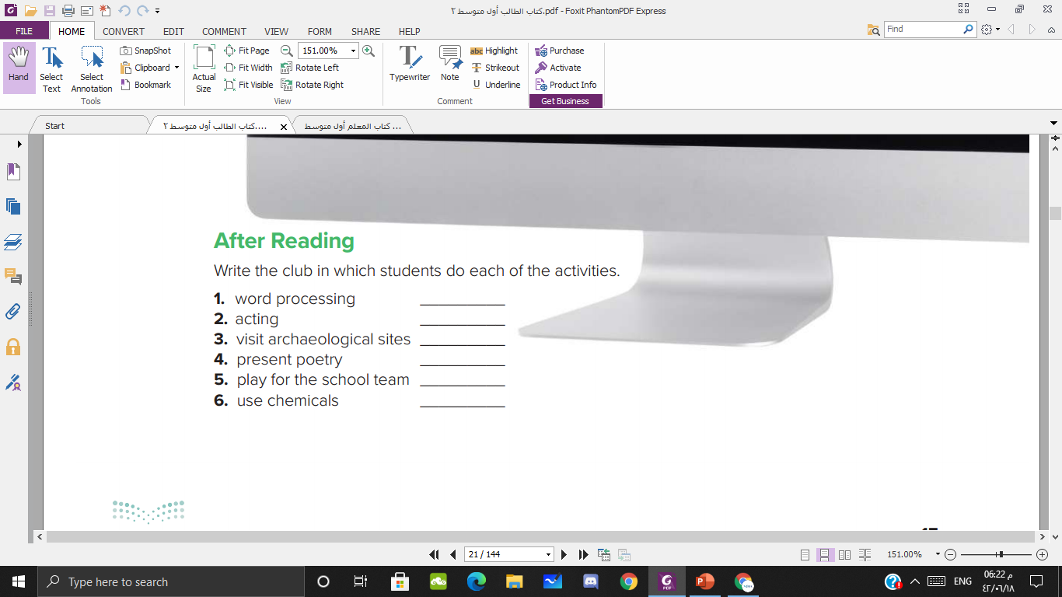
Computer club
Drama club
Archelogy club
Poetry club
Football club
Science club

Slide 16



