Slide 1

Unit 8
What are you doing?
Writing

Slide 2
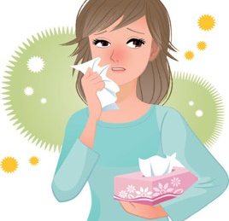
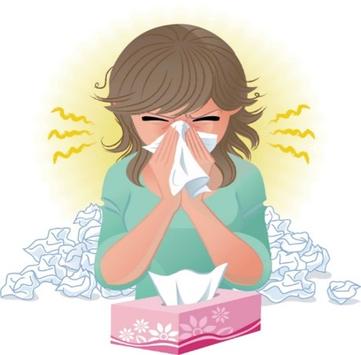
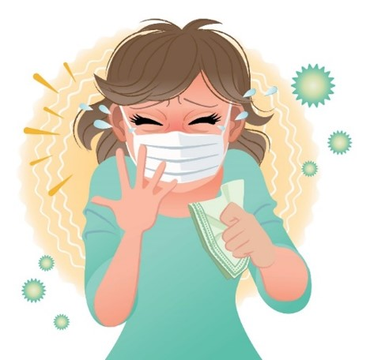
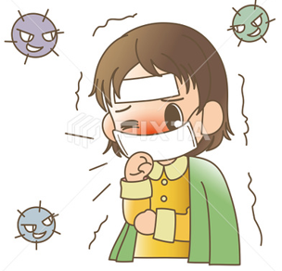

COVID 19
☺ Avoid gathering !
☺ wear a mask before going out
☺ Social distancing is not a choice, it is a must!
☺ Keep a distance of 2 meters to avoid accountability
☺ Wash hands constantly

Slide 3
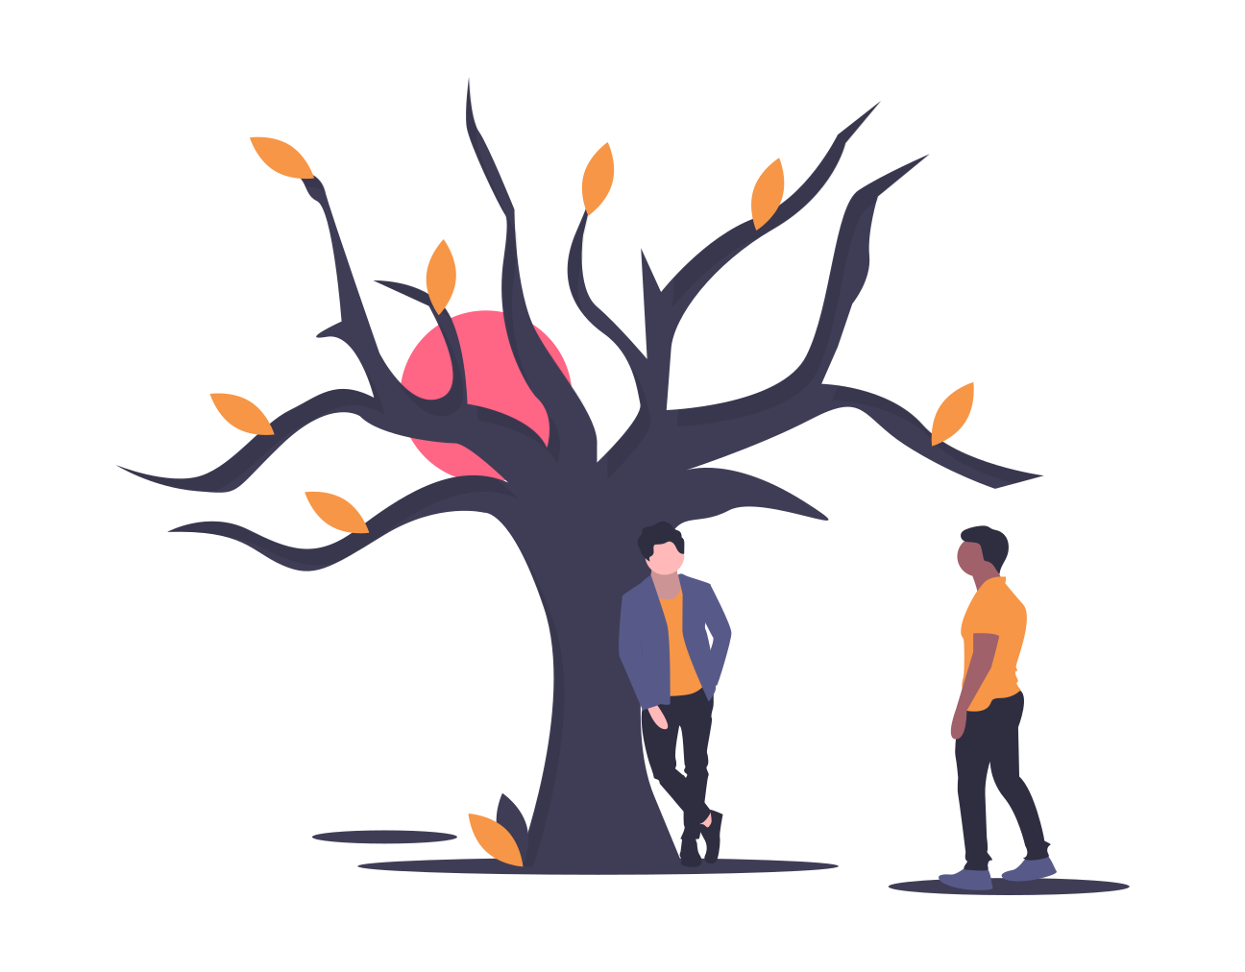
بسم الله الرحمن الرحيم
Day:
Date:

Slide 4
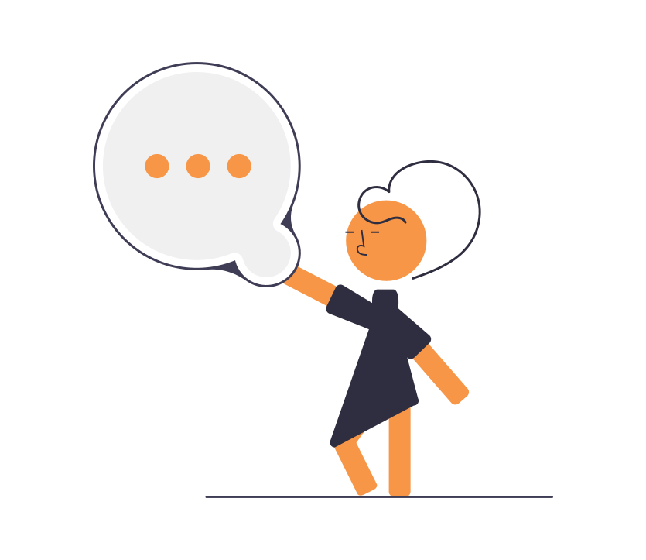
Learning Objectives
1. Use personal pronouns correctly.
2. Put words in the correct order to make sentences & questions
3. Write a paragraph about a family member.
4. Make a report about a popular place

Slide 5
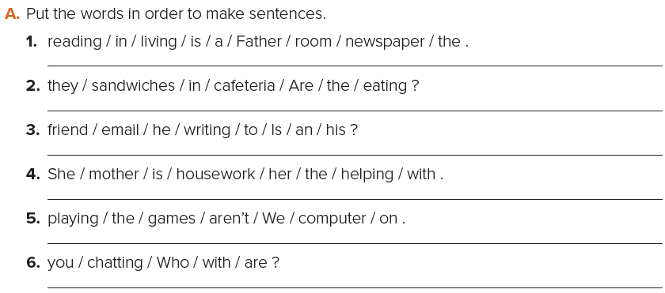
Father is reading the newspaper in the living room.
Are they eating sandwiches in the cafeteria?
Is he writing an email to his friend?
She is helping her mother with the housework.
We aren’t playing games on the computer.
Who are you chatting with?

Slide 6
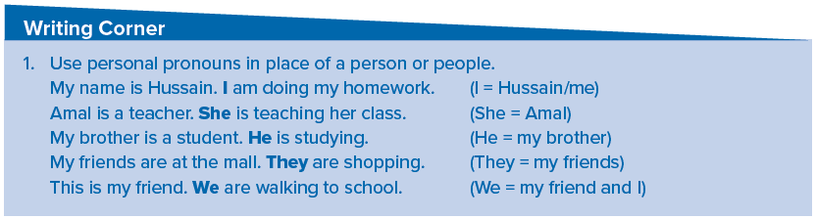


Slide 7
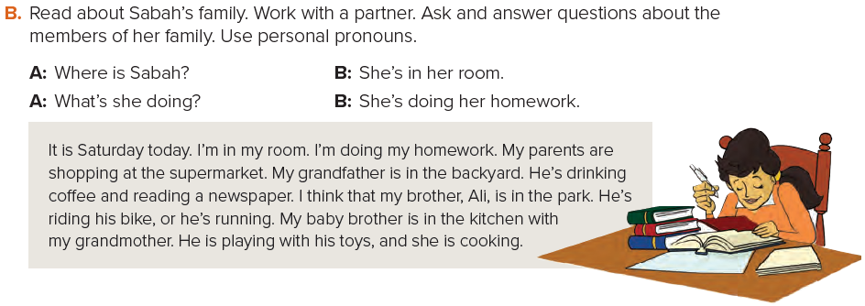
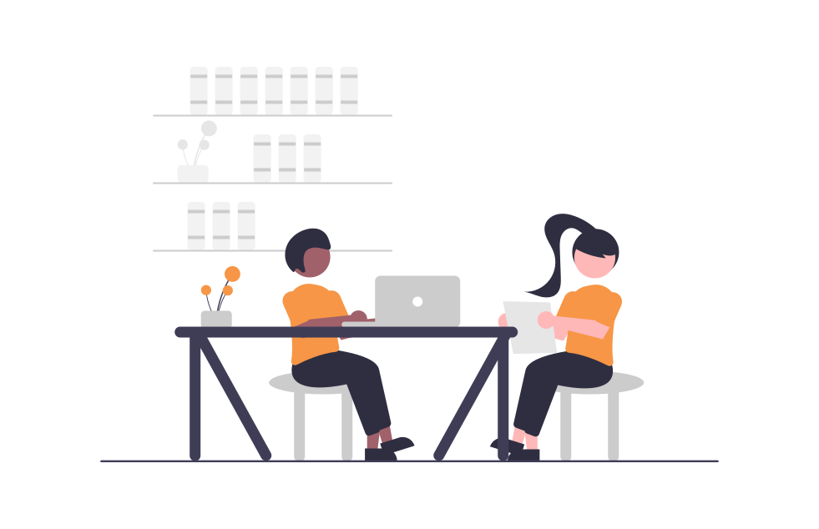
Answers
Sample answers :
A: Where are her parents? B: They’re at the supermarket.
A: What are they doing? B: They’re shopping.
A: Where is her grandmother? B: She’s in the kitchen.
A: What’s she doing? B: She’s cooking.

Slide 8
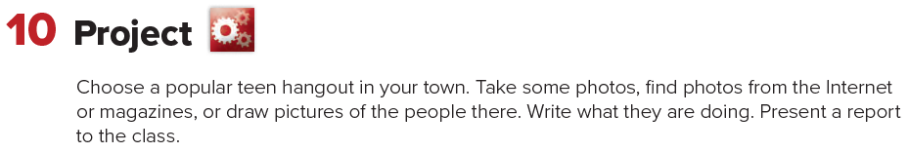


Slide 9
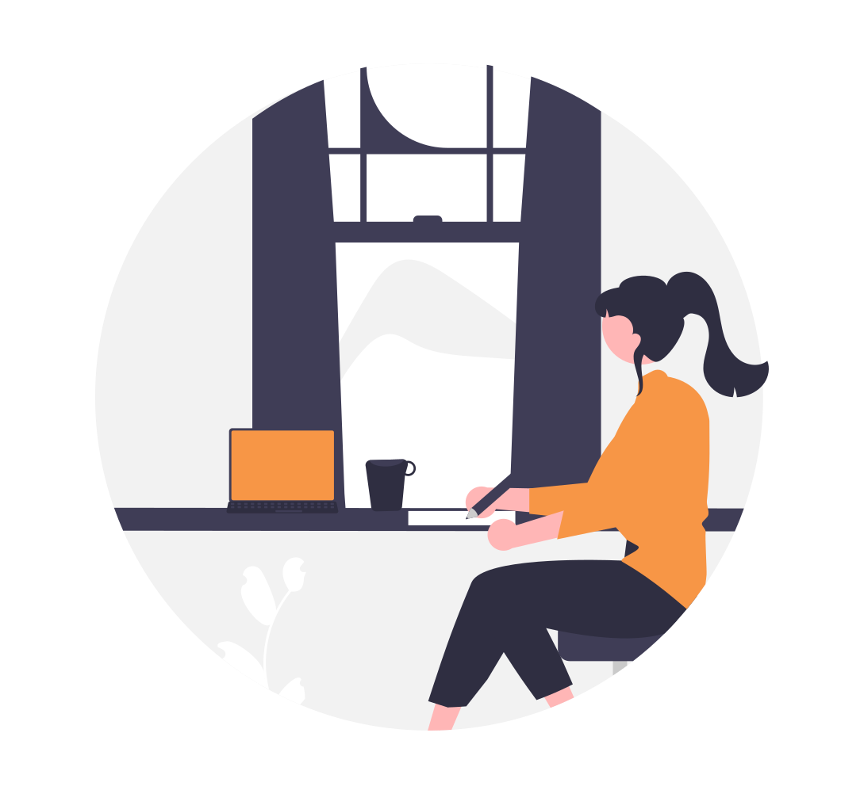
Homework
Page 122(E)

Slide 10
