Slide 1
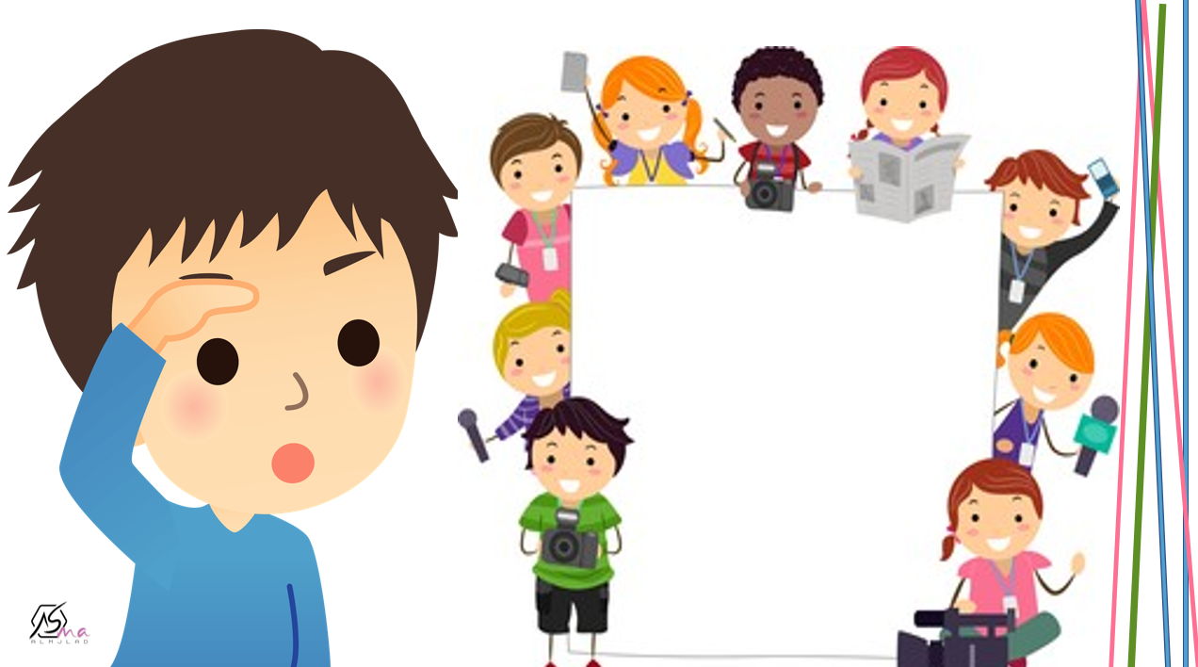

What are you doing ?
Listen and discuss
By : ET Asma Almjlad

Slide 2
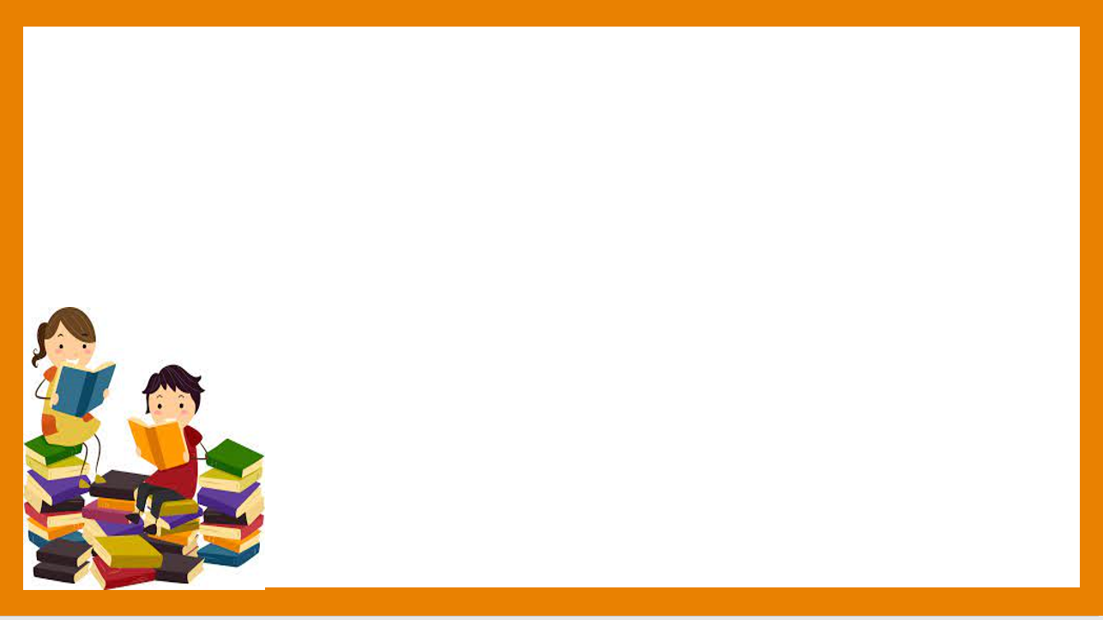
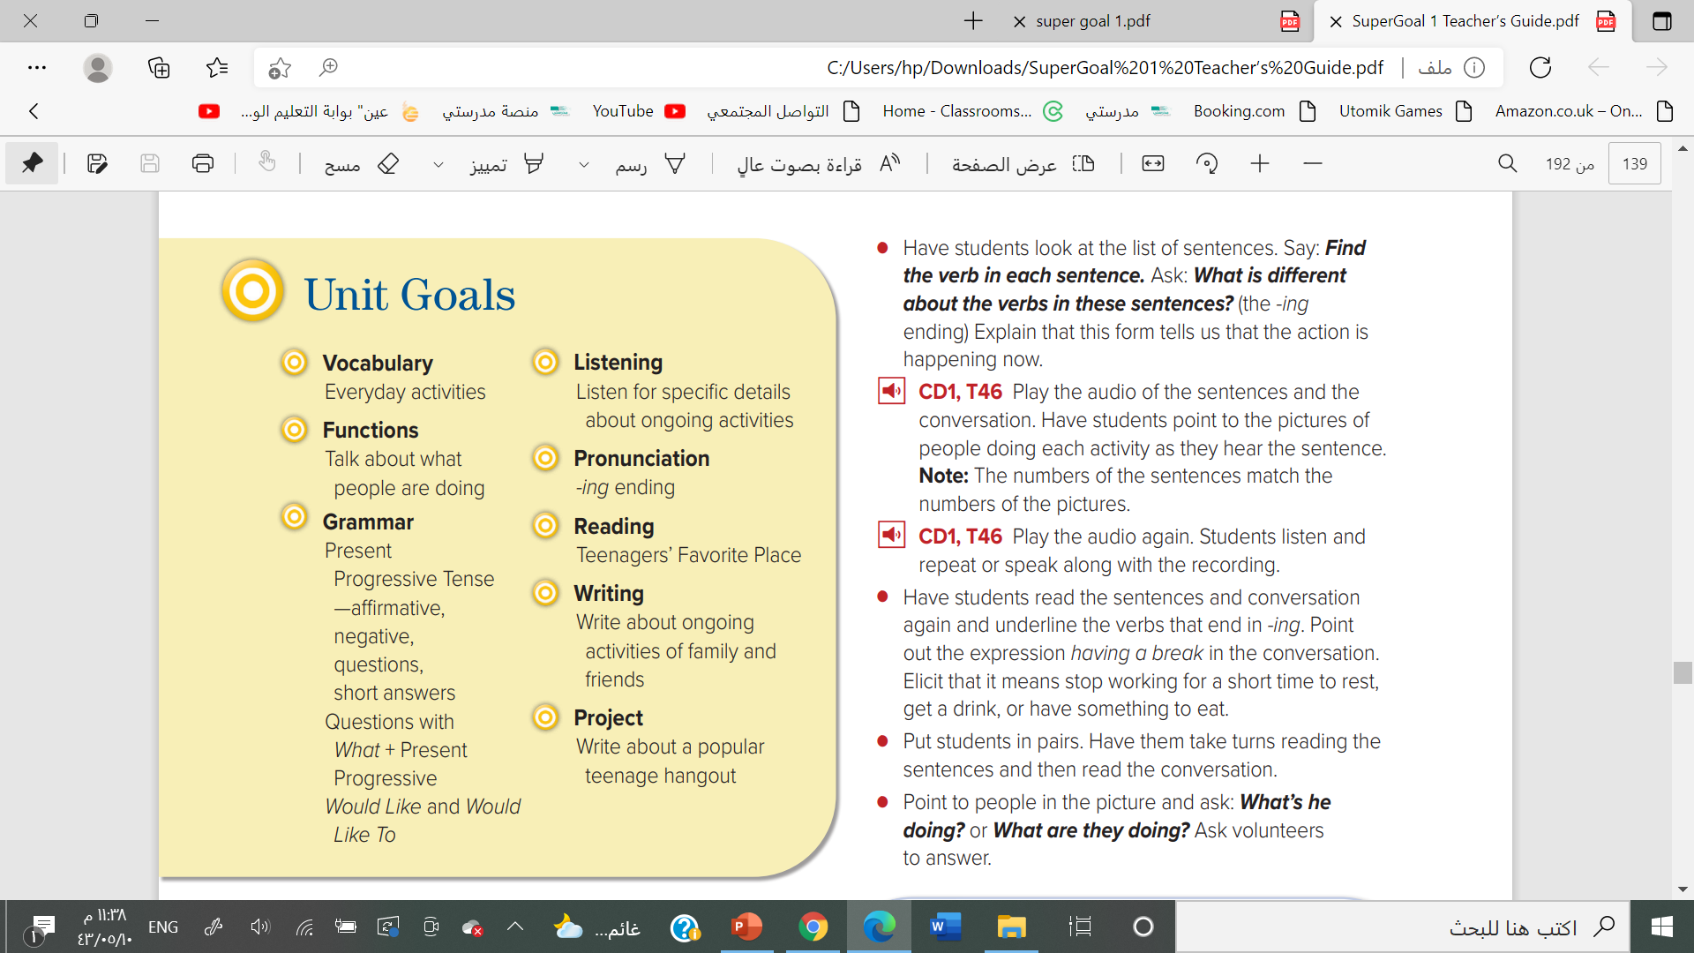


Slide 3
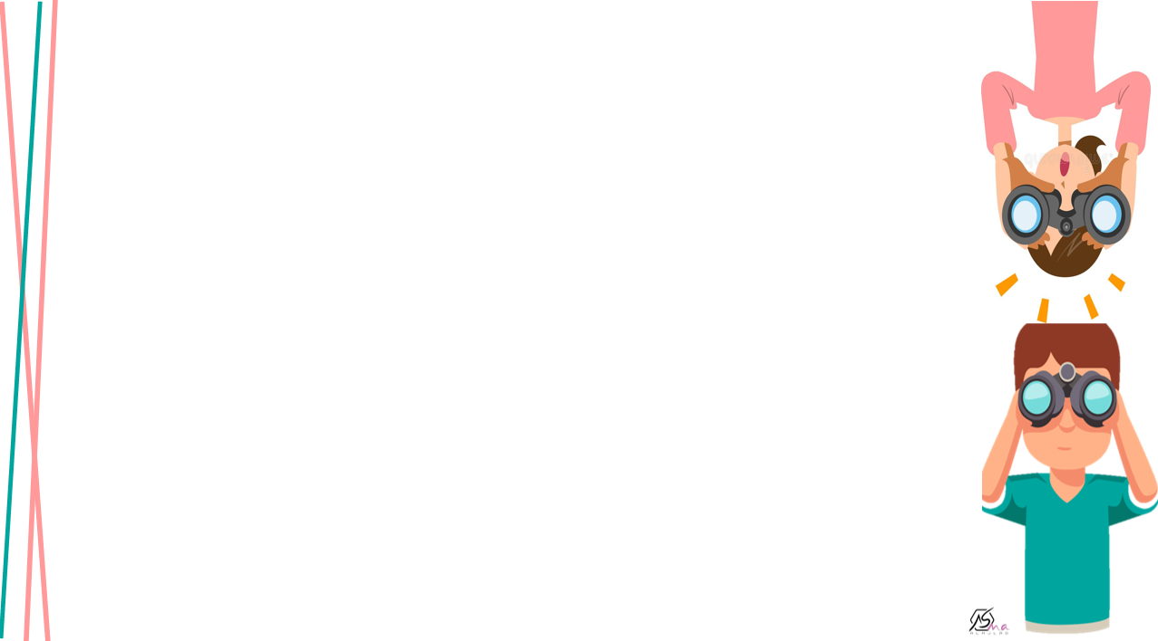

Describe activities which others are doing
Answer the question in the book

Slide 4
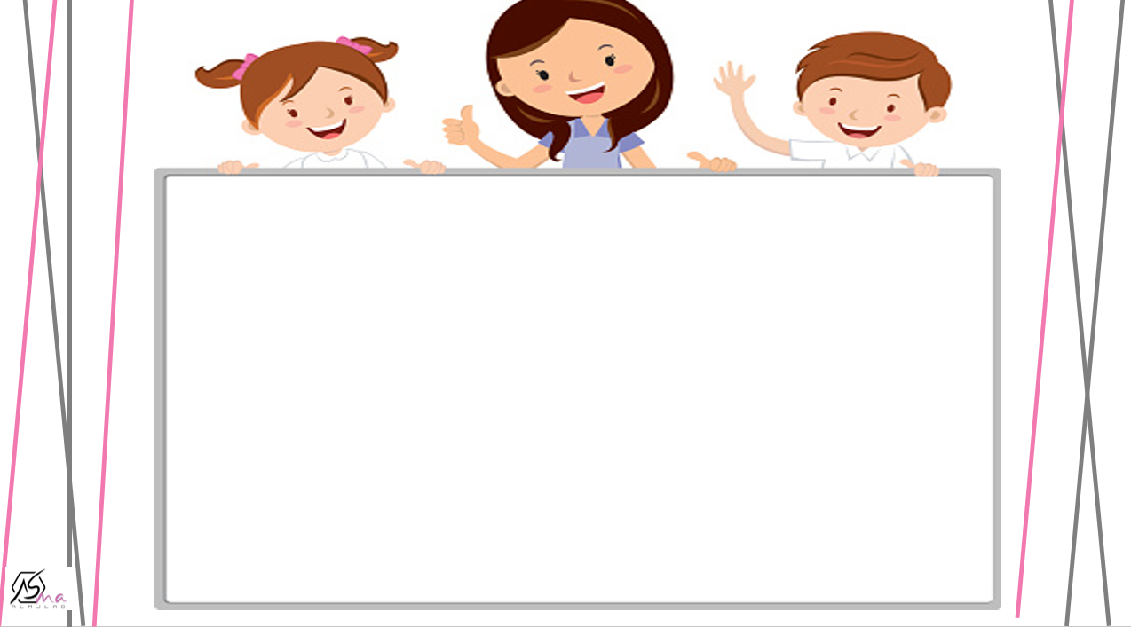


Slide 5
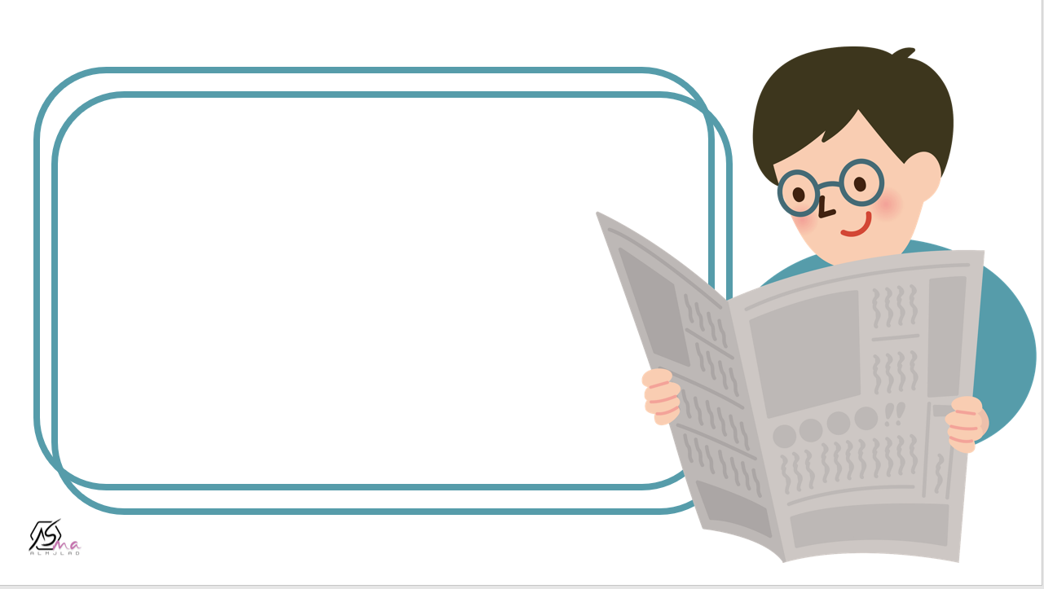




Slide 6



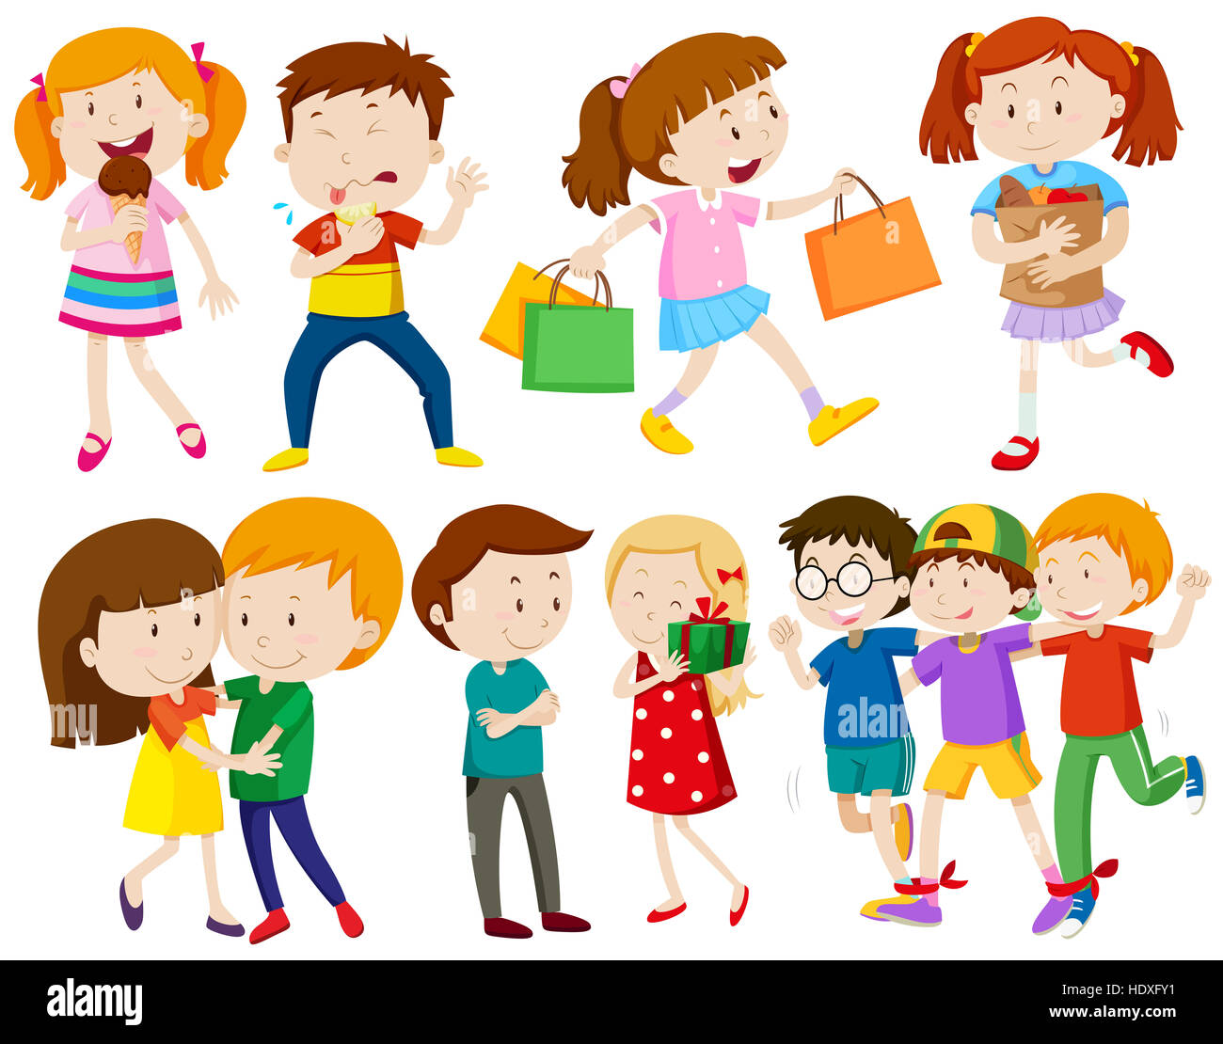

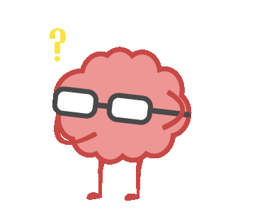

What are the people doing?

Slide 7
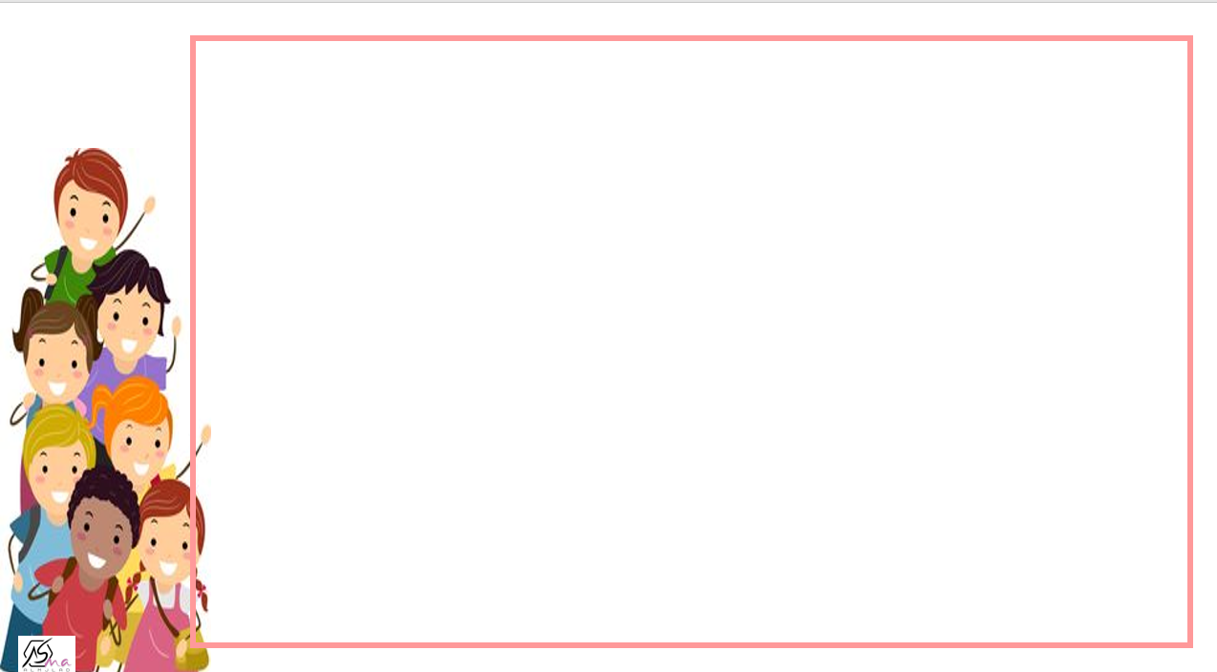




what is he doing ?

Slide 8
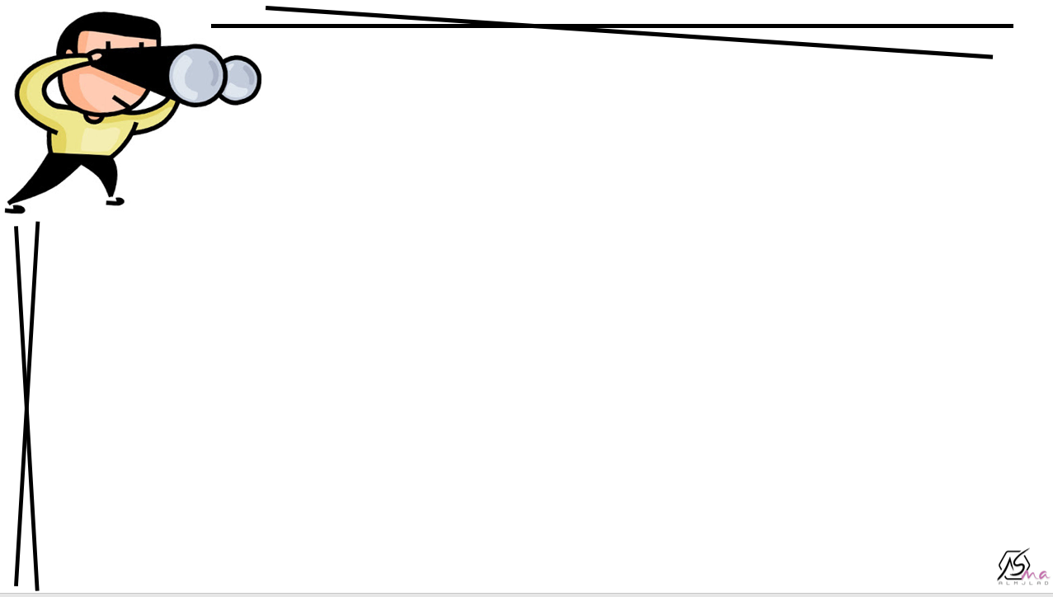
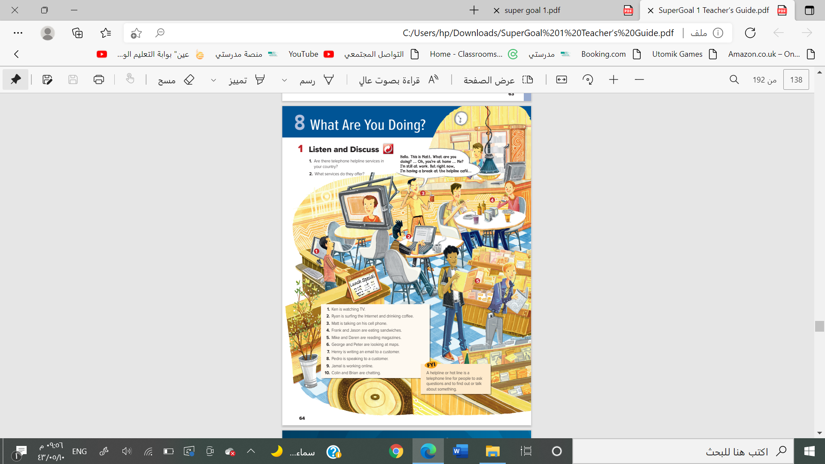
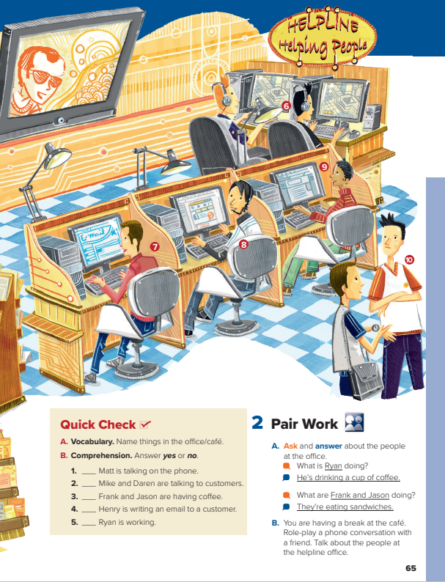

@page 64+65
What can you see in this picture ?
What they are doing ?

Slide 9




Are there telephone helpline services in your country?
What services do they offer?
Listen

Slide 10

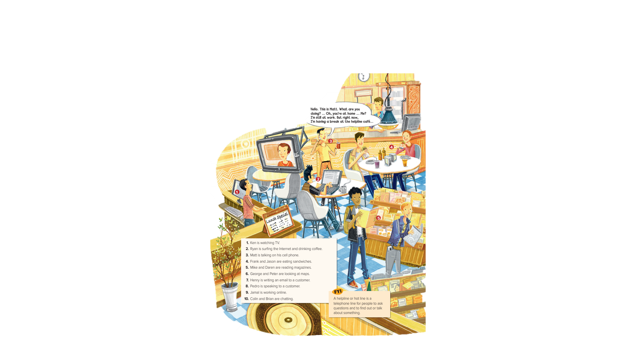

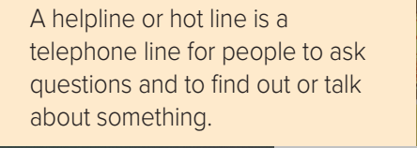
What are the names of telephone helpline services?
what are they offer ?

Slide 11
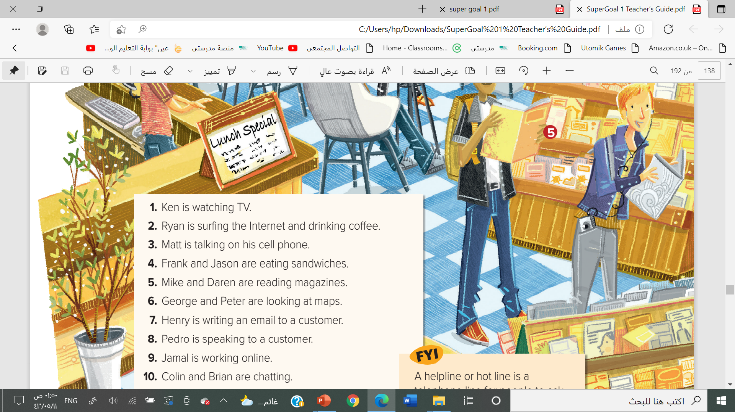
Find the verb in each sentence
What is different about the verbs in these sentences?

Slide 12
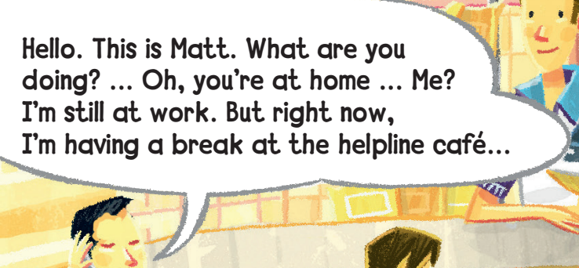

Slide 13
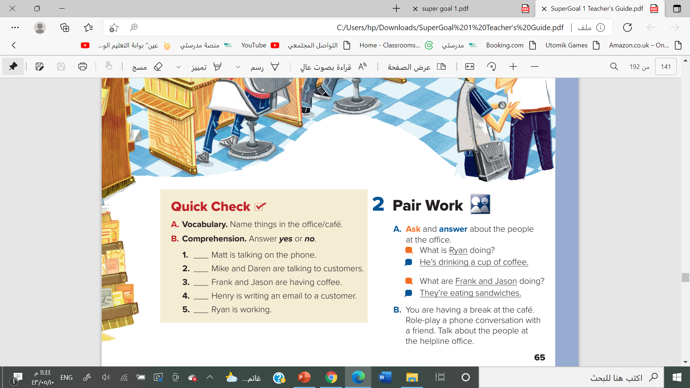


computers, food, drinks, lights/lamps
headphones, tables, chairs, a TV, magazines,
a plant, a headset, cell phone, etc.

Slide 14

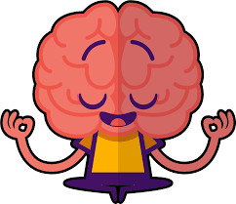
yes
no
no
yes
no

Slide 15



Slide 16


Slide 17


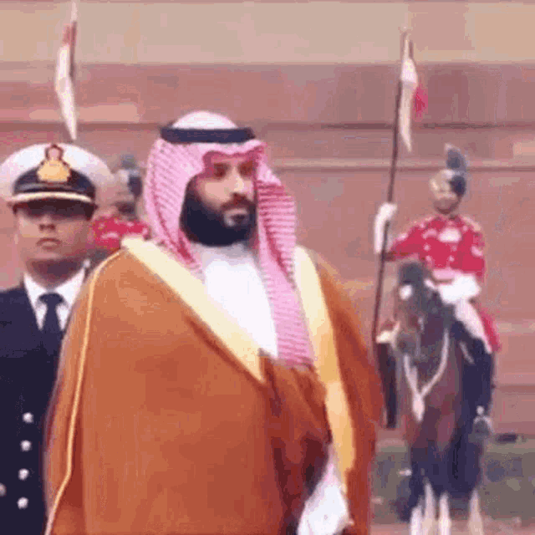
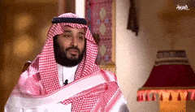

What is Crown prince Mohamad Bin Salman doing ?

Slide 18

What about you ?

Slide 19
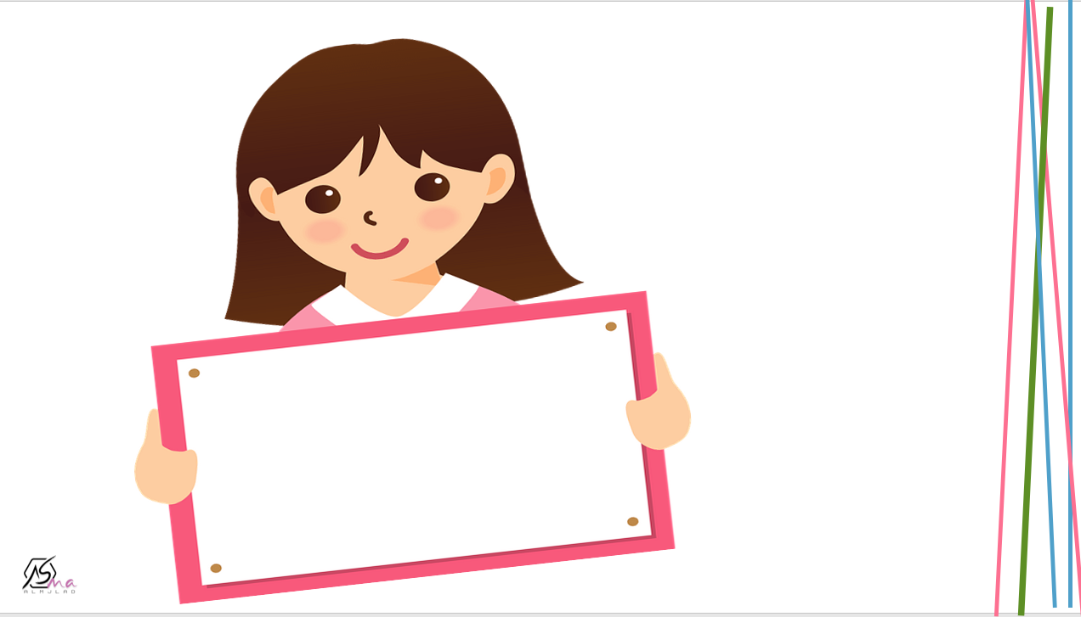

Work
book

Slide 20
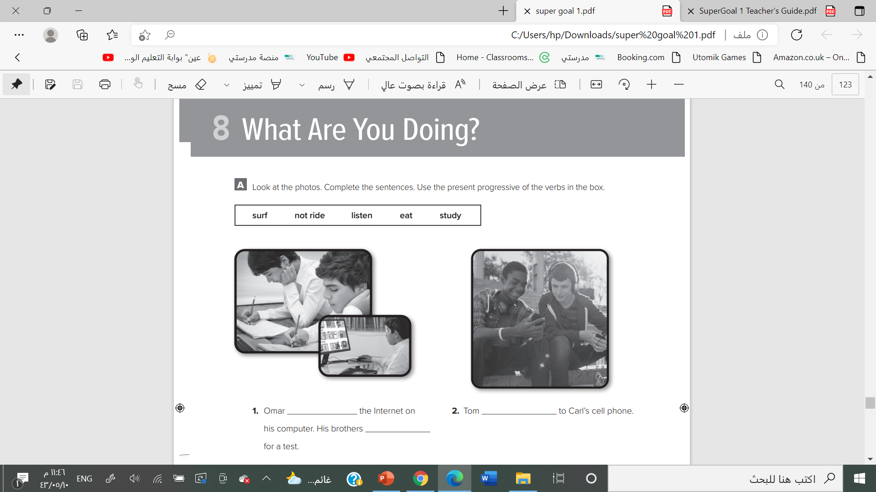

is surfing
is listening
are studying

Slide 21

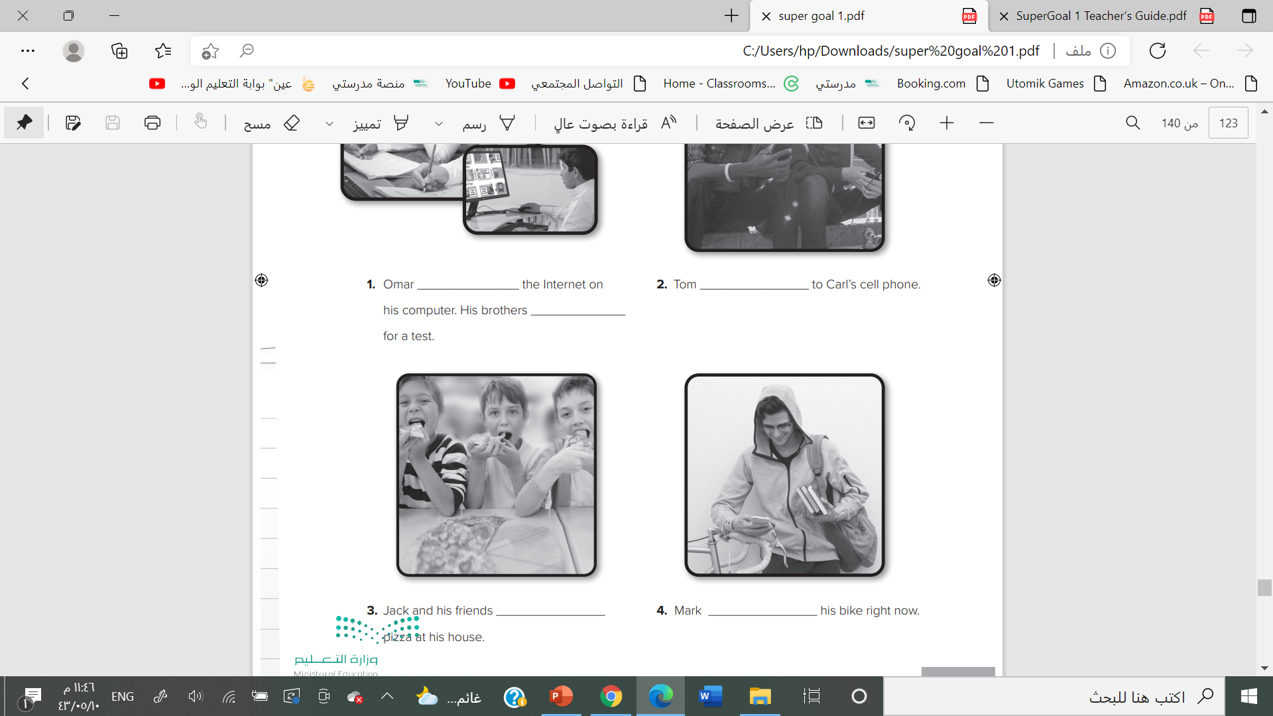
are eating
is n’t riding

Slide 22
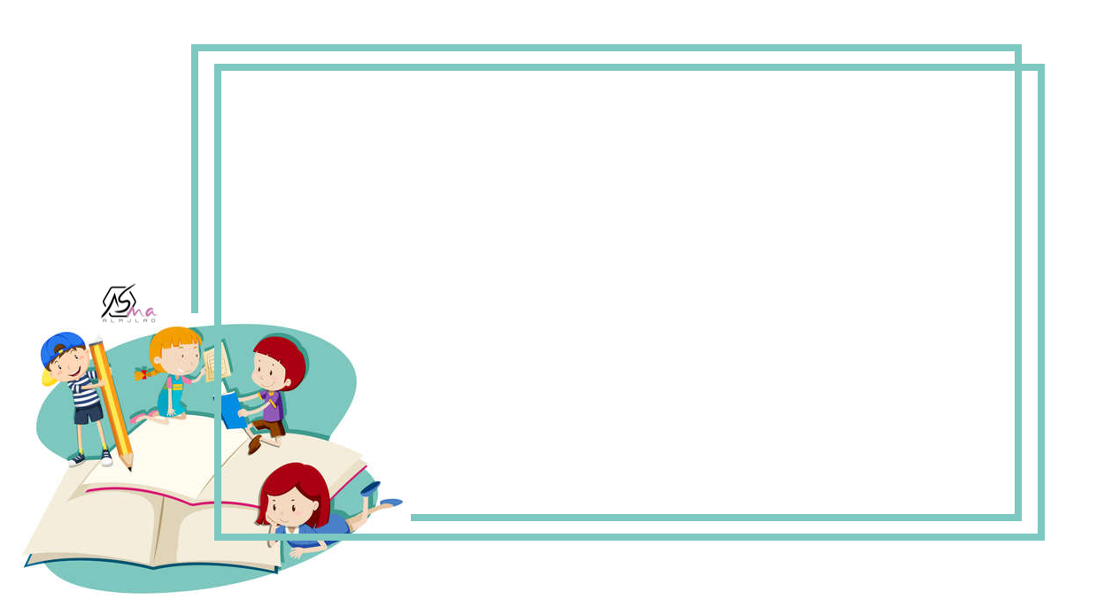



Slide 23
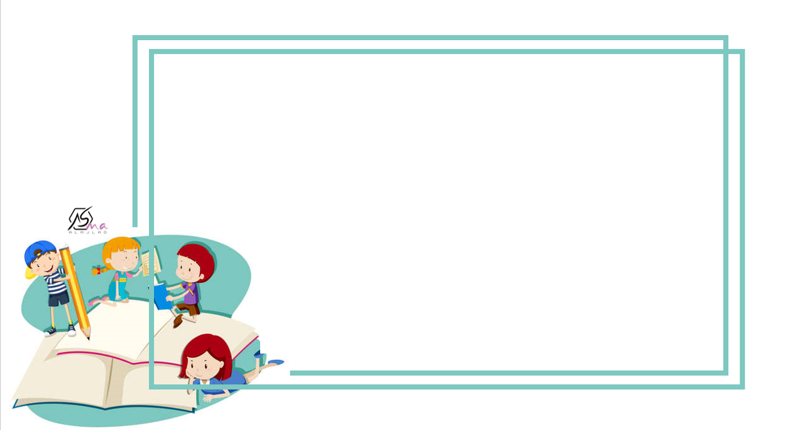


Slide 24


