Slide 1

Unit 8
What are you doing?
part 2

Slide 2
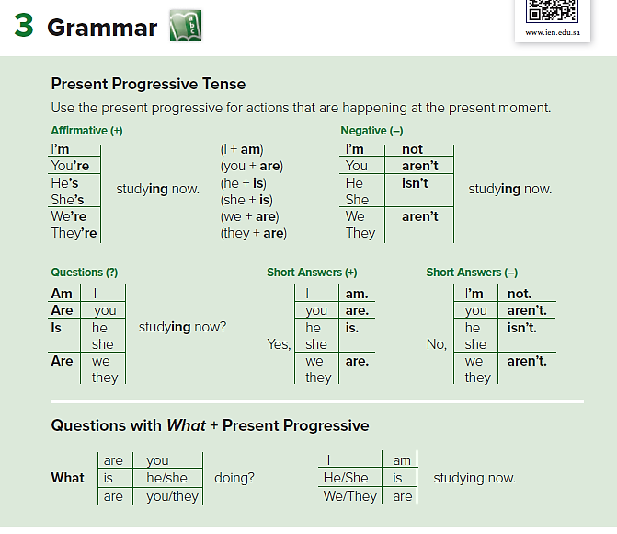

Slide 3
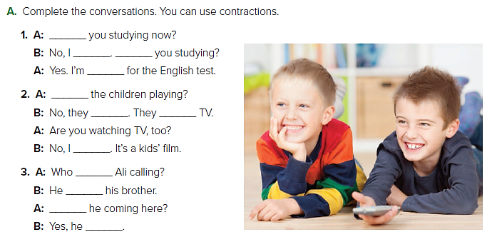
Are
’m not
studying
Are
aren’t
’m not
’s /is
’s calling
Is
is
Are
watching

Slide 4
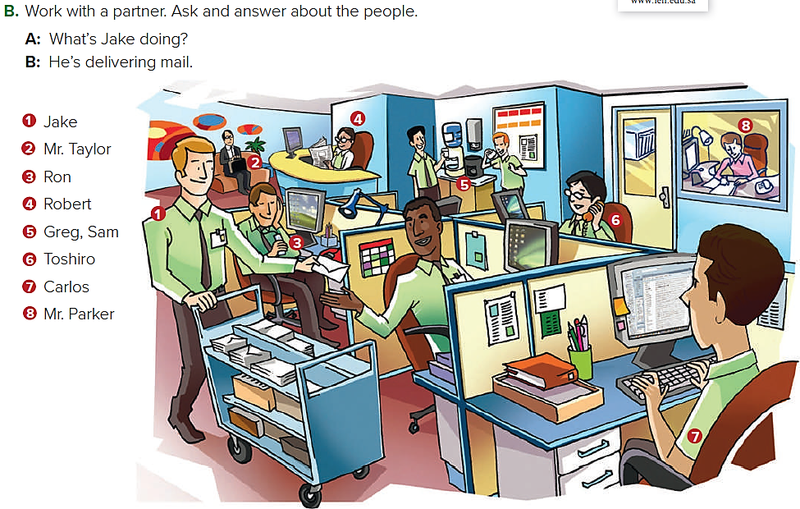
He’s waiting in the reception area.
He’s working in his office.
He’s reading the newspaper.
They’re drinking coffee.
He’s talking on the phone.
He’s listening to his cell phone.
He’s working online.

Slide 5
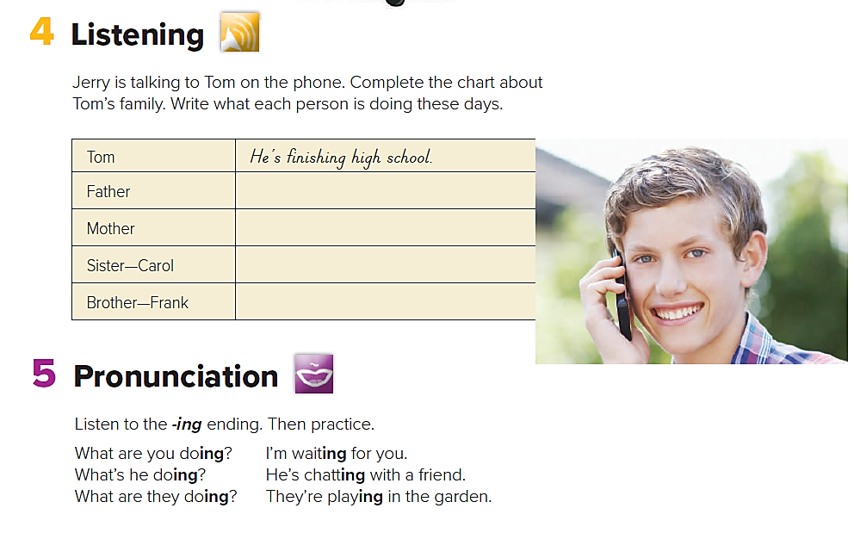

He’s working in a bank.
She’s watching Carol’s baby.
She’s working at a hospital.
He’s studying computers at college

Slide 6
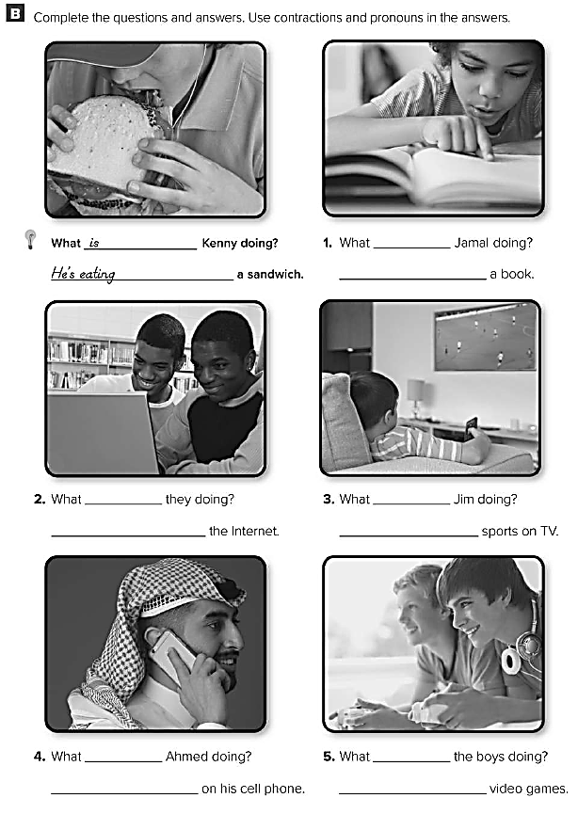
is
He’s reading
are
is
They’re surfing
He’s watching
is
are
He’s talking
They’re playing

