Slide 1

Unit 8
What are you doing?
part 3

Slide 2
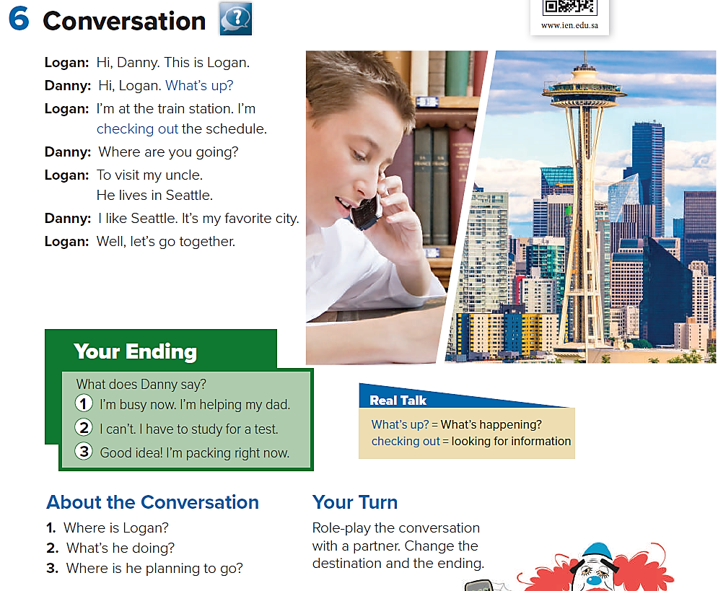

He’s at the train station.
He’s checking out the train schedule.
He’s planning to go to Seattle

Slide 3
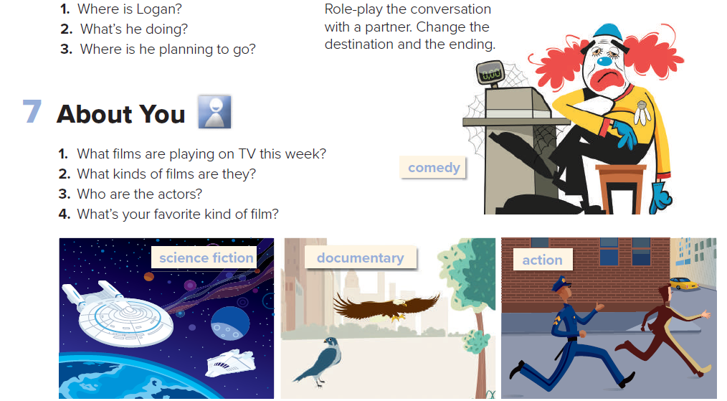

Slide 4
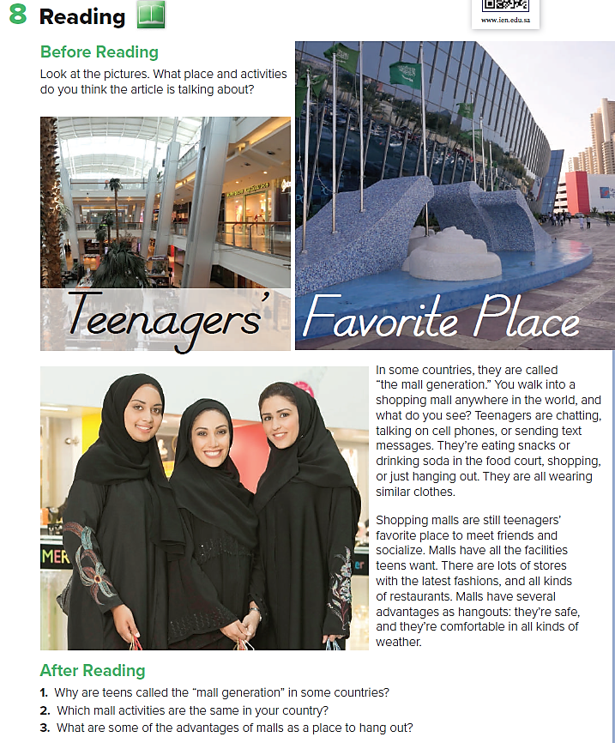
1-Because teenagers’ favorite place to meet friends and socialize is the mall.
3-Malls are safe, and they’re comfortable in all kinds of weather

Slide 5
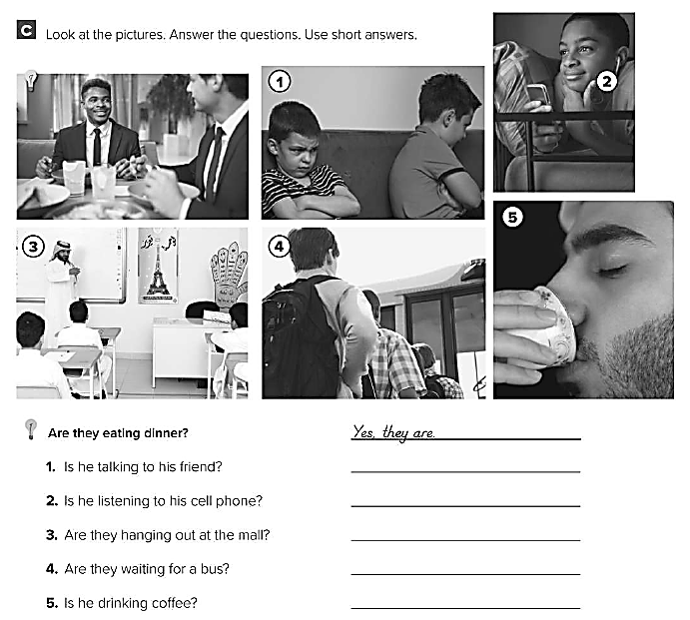
No , he isn’t
Yes , he is
No , they aren’t
Yes , they are
Yes , he is

Slide 6
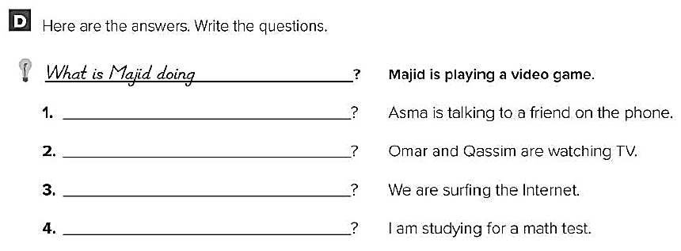
What is Asma doing ?
What are they doing ?
What are you doing ?
What are you doing ?

